Slide 1
Mechanics
EPHY108L (2-0-2-3)
Ayan khan
Department of physics

Slide 2
Special Theory of Relativity

Slide 3
Introduction
Annus Mirabilis Papers-1905
Photoelectric Effect
Brownian Motion
Special Relativity
Mass-Energy Equivalence
Einstein’s Postulates
The laws of physics are the same in all inertial frames of reference.
The speed of light in free space has the same value in all inertial frames of reference.
Origin of STR
Suggested video series: Special Relativity

Slide 4
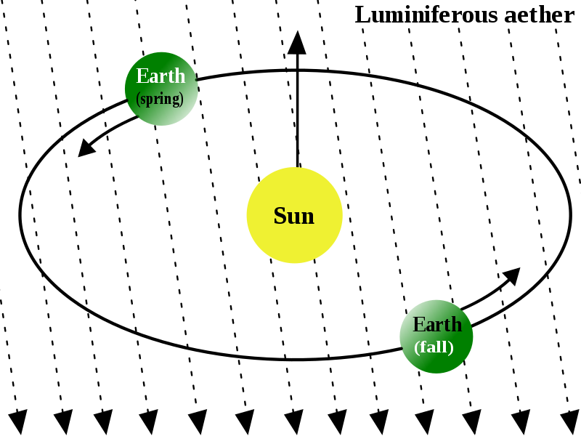
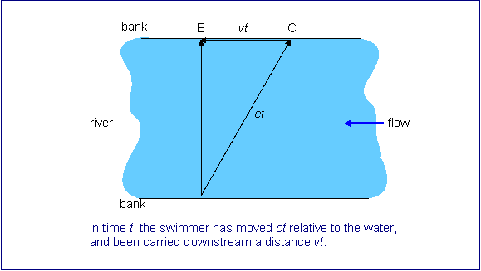
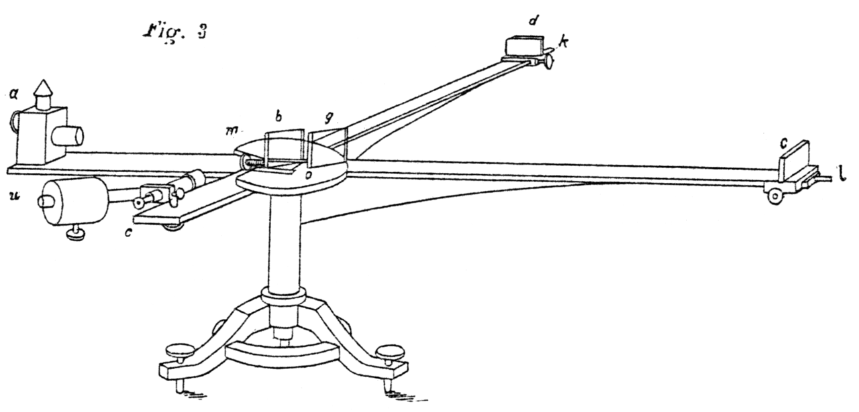
Michelson–Morley Experiment-I
The most famous failed experiment!
Experiment first performed in 1881 by Michelson and again in 1887
on improved apparatus by Michelson and Morley.
Luminiferous aether or ether was the postulated medium for
the propagation of light.
Michelson’s great idea was to construct an exactly similar race
for pulses of light, with the aether wind playing the part of the
river.

Slide 5
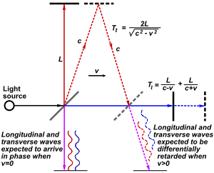
Michelson–Morley Experiment-II
The scheme was, a pulse of light is directed at an angle of 45 degrees at a half-silvered, half transparent mirror, so that half the pulse goes on through the glass, half is reflected.
These two half-pulses are the two swimmers.
They both go on to distant mirrors which reflect them back to the half-silvered mirror.
At this point, they are again half reflected and half transmitted, but a telescope is placed behind the half-silvered mirror as shown in the figure so that half of each half-pulse will arrive in this telescope.
Now, if there is an aether wind blowing, someone looking through the telescope should see the halves of the two half-pulses to arrive at slightly different times, since one would have gone more upstream and back, one more across stream in general.
Reference: http://galileoandeinstein.physics.virginia.edu/lectures/michelson.html

Slide 6
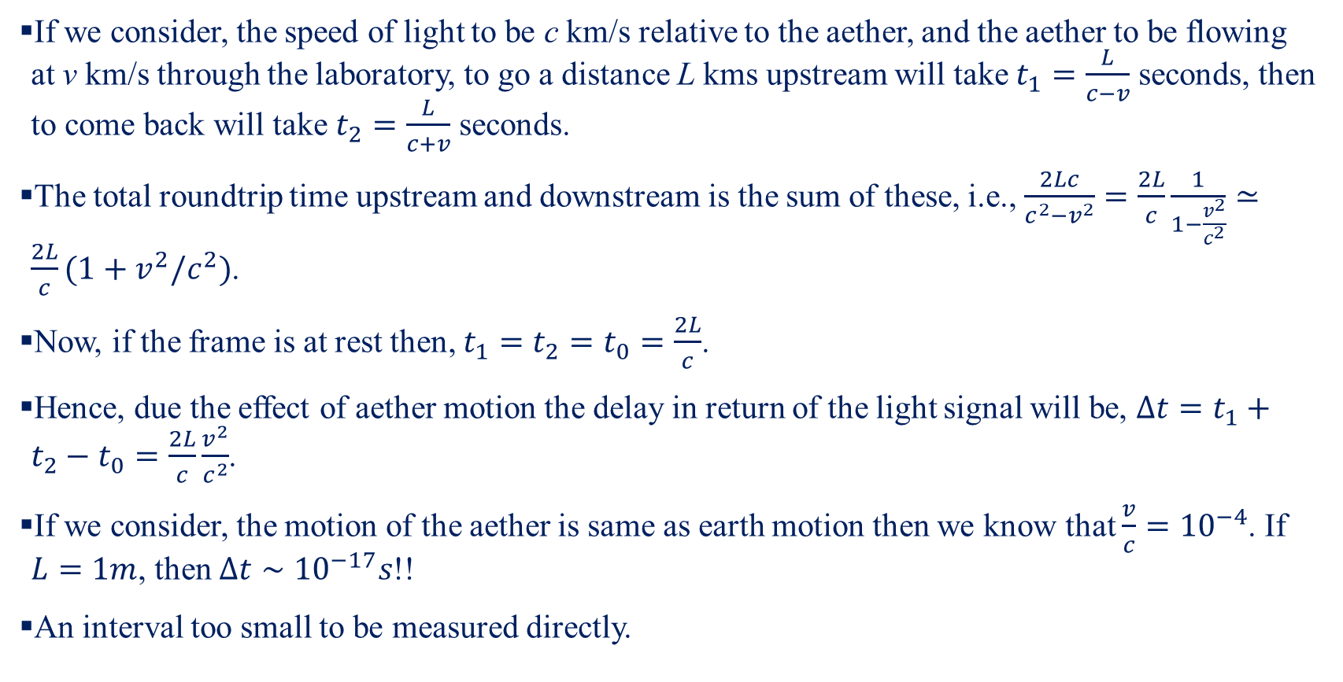
Michelson–Morley Experiment-III
If we consider, the speed of light to be c km/s relative to the aether, and the aether to be flowing at v km/s through the laboratory, to go a distance L kms upstream will take $t_{1}=\frac{L}{c−v}$ seconds, then to come back will take $t_{2}=\frac{L}{c+v}$ seconds.
The total roundtrip time upstream and downstream is the sum of these, i.e., $\frac{2Lc}{c^{2}−v^{2}}=\frac{2L}{c}\frac{1}{1−\frac{v^{2}}{c^{2}}}≃\frac{2L}{c}(1+v^{2}/c^{2})$.
Now, if the frame is at rest then, $t_{1}=t_{2}=t_{0}=\frac{2L}{c}$.
Hence, due the effect of aether motion the delay in return of the light signal will be, $Δt=t_{1}+t_{2}−t_{0}=\frac{2L}{c}\frac{v^{2}}{c^{2}}$.
If we consider, the motion of the aether is same as earth motion then we know that $\frac{v}{c}={10}^{−4}$. If $L=1m$, then $Δt∼{10}^{−17}s$!!
An interval too small to be measured directly.

Slide 7
Michelson–Morley Experiment-IV
To over come the issue of too small-time interval, Michelson used interference properties of the light waves.
Michelson sent in a steady beam of light of a single colour.
Now the light is split into two and reflected as previously described. One set of waves goes upstream and downstream, the other goes across stream and back.
Finally, they come together into the telescope and the eye.
If the one that took longer is half a wavelength behind, its troughs will be on top of the crests of the first wave, they will cancel, and nothing will be seen. If the delay is less than that, there will still be some dimming.
However, slight errors in the placement of the mirrors would have the same effect. To avoid that the apparatus is rotated. On turning it through 90 degrees, the upstream-downstream and the cross-stream waves change places.
Thus, if there is an aether wind, if you watch through the telescope while you rotate the turntable, you should expect to see variations in the brightness of the incoming light.

Slide 8
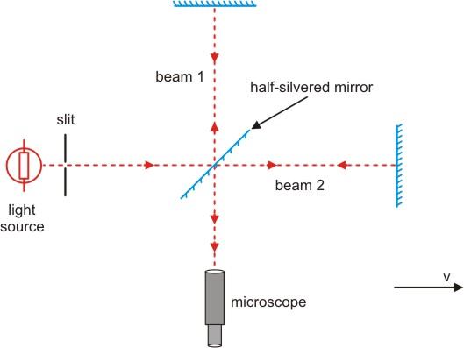


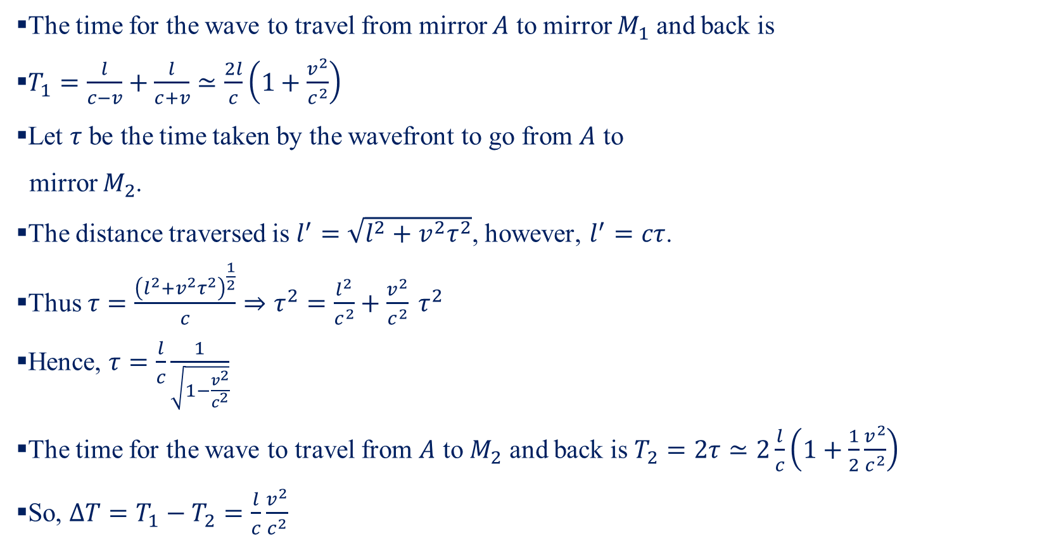



Michelson–Morley Experiment-V
The time for the wave to travel from mirror $A$ to mirror $M_{1}$ and back is
$T_{1}=\frac{l}{c−v}+\frac{l}{c+v}≃\frac{2l}{c}\left(1+\frac{v^{2}}{c^{2}}\right)$
Let $τ$ be the time taken by the wavefront to go from $A$ to
mirror $M_{2}$.
The distance traversed is $l^{′}=\sqrt{l^{2}+v^{2}τ^{2}}$, however, $l^{′}=cτ$.
Thus $τ=\frac{{\left(l^{2}+v^{2}τ^{2}\right)}^{\frac{1}{2}}}{c}⇒τ^{2}=\frac{l^{2}}{c^{2}}+\frac{v^{2}}{c^{2}} τ^{2}$
Hence, $τ=\frac{l}{c}\frac{1}{\sqrt{1−\frac{v^{2}}{c^{2}}}}$
The time for the wave to travel from $A$ to $M_{2}$ and back is $T_{2}=2τ≃2\frac{l}{c}\left(1+\frac{1}{2}\frac{v^{2}}{c^{2}}\right)$
So, $ΔT=T_{1}−T_{2}=\frac{l}{c}\frac{v^{2}}{c^{2}}$
$$M_{2}$$
$$l$$
$$l$$
$$M_{1}$$
$$A$$

Slide 9
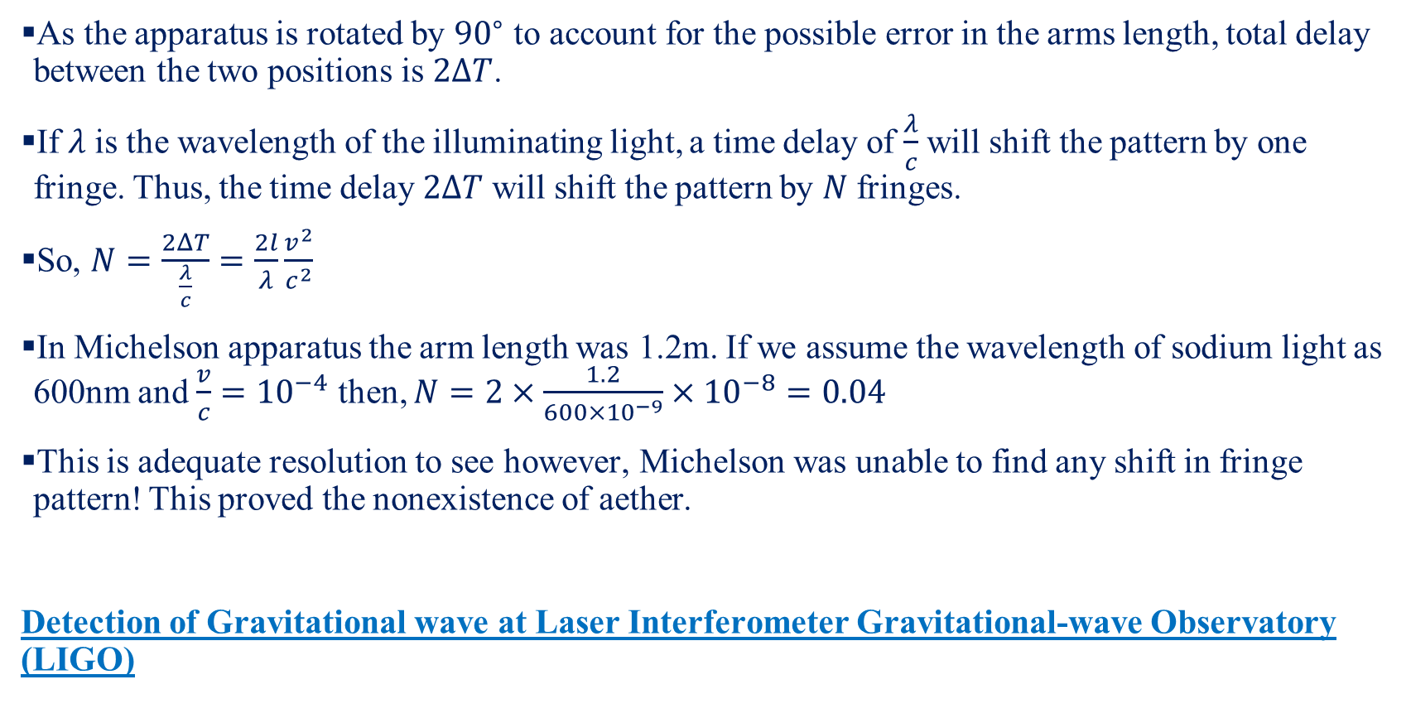
Michelson–Morley Experiment-VI
As the apparatus is rotated by ${90}^{∘}$ to account for the possible error in the arms length, total delay between the two positions is $2ΔT$.
If $λ$ is the wavelength of the illuminating light, a time delay of $\frac{λ}{c}$ will shift the pattern by one fringe. Thus, the time delay $2ΔT$ will shift the pattern by $N$ fringes.
So, $N=\frac{2ΔT}{\frac{λ}{c}}=\frac{2l}{λ}\frac{v^{2}}{c^{2}}$
In Michelson apparatus the arm length was 1.2m. If we assume the wavelength of sodium light as 600nm and $\frac{v}{c}={10}^{−4}$ then, $N=2×\frac{1.2}{600×{10}^{−9}}×{10}^{−8}=0.04$
This is adequate resolution to see however, Michelson was unable to find any shift in fringe pattern! This proved the nonexistence of aether.
Detection of Gravitational wave at Laser Interferometer Gravitational-wave Observatory (LIGO)

Slide 10
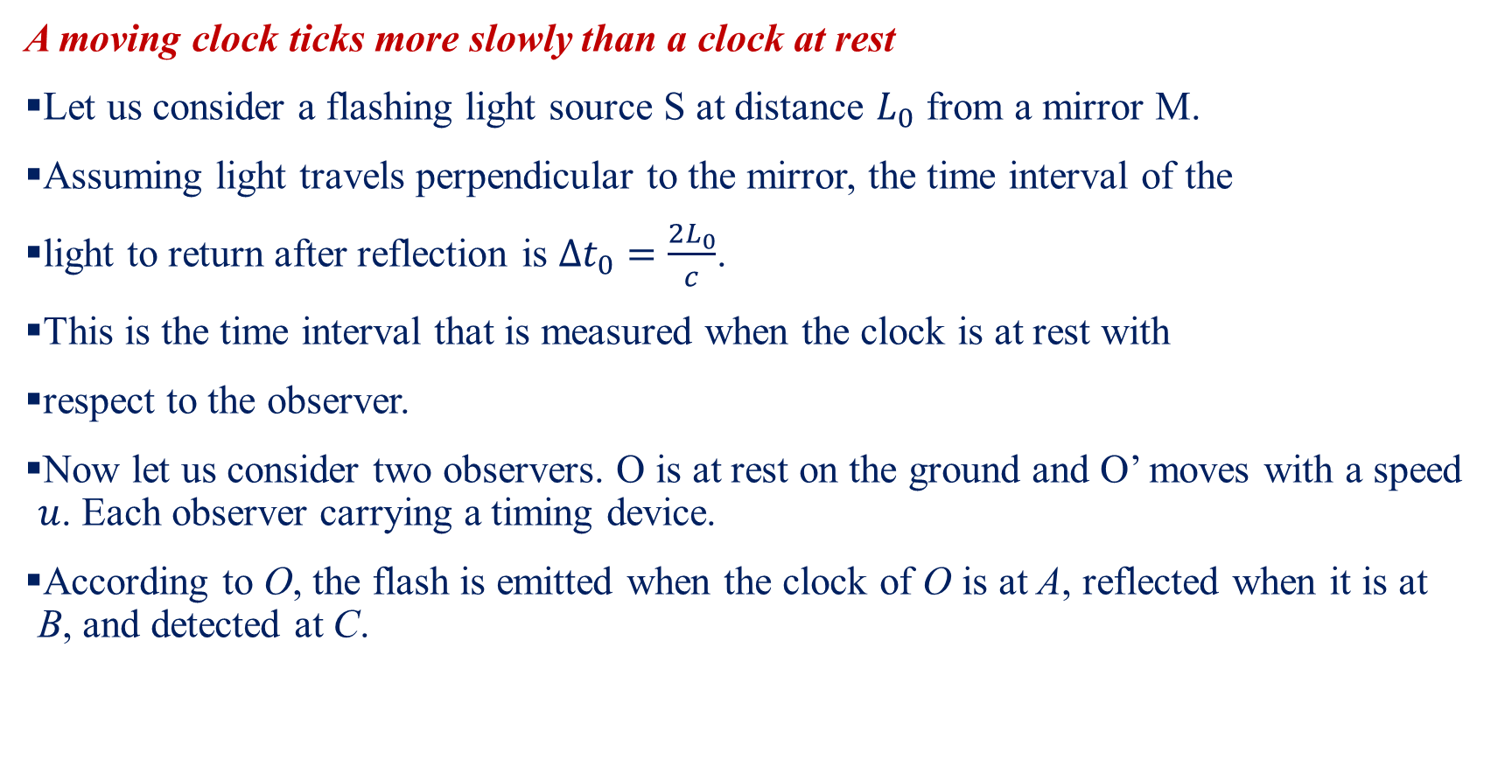
Time Dilation-I
A moving clock ticks more slowly than a clock at rest
Let us consider a flashing light source S at distance $L_{0}$ from a mirror M.
Assuming light travels perpendicular to the mirror, the time interval of the
light to return after reflection is $Δt_{0}=\frac{2L_{0}}{c}$.
This is the time interval that is measured when the clock is at rest with
respect to the observer.
Now let us consider two observers. O is at rest on the ground and O’ moves with a speed $u$. Each observer carrying a timing device.
According to O, the flash is emitted when the clock of O is at A, reflected when it is at B, and detected at C.
Image Source: Modern Physics, 3rd Edition, Kenneth Krane

Slide 11

Time Dilation-II
In this interval $Δt$, O observes the clock move forward a distance of $uΔt$ from the point at which the flash was emitted and O concludes the light beam travels a distance $2L$, where $L=\sqrt{L_{0}^{2}+{\left(\frac{uΔt}{2}\right)}^{2}}$
So $Δt=\frac{2L}{c}=\frac{2\sqrt{L_{0}^{2}+{\left(\frac{uΔt}{2}\right)}^{2}}}{c}⇒Δt=\frac{Δt_{0}}{\sqrt{1−\frac{u^{2}}{c^{2}}}}⇒Δt>Δt_{0}$
So, observer O measures a longer time interval than O’ measures.
Image Source: Modern Physics, 3rd Edition, Kenneth Krane

Slide 12
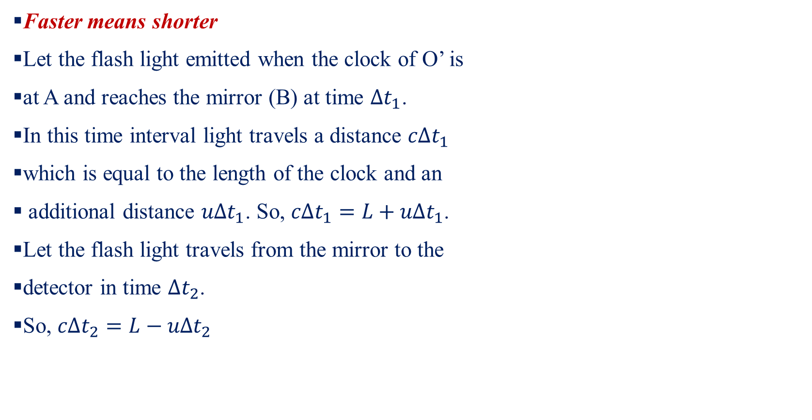
Length Contraction-I
Faster means shorter
Let the flash light emitted when the clock of O’ is
at A and reaches the mirror (B) at time $Δt_{1}$.
In this time interval light travels a distance $cΔt_{1}$
which is equal to the length of the clock and an
additional distance $uΔt_{1}$. So, $cΔt_{1}=L+uΔt_{1}$.
Let the flash light travels from the mirror to the
detector in time $Δt_{2}$.
So, $cΔt_{2}=L−uΔt_{2}$
Image Source: Modern Physics, 3rd Edition, Kenneth Krane

Slide 13

Length Contraction-II
So the total time interval, $Δt=Δt_{1}+Δt_{2}=\frac{L}{c−u}+\frac{L}{c+u}=\frac{2L}{c}\frac{1}{1−\frac{u^{2}}{c^{2}}}$
Now we know that $Δt=\frac{Δt_{0}}{\sqrt{1−\frac{u^{2}}{c^{2}}}}$.
So, $\frac{Δt_{0}}{\sqrt{1−\frac{u^{2}}{c^{2}}}}=\frac{2L}{c}\frac{1}{1−\frac{u^{2}}{c^{2}}}⇒\frac{2L_{0}}{c}\frac{1}{\sqrt{1−\frac{u^{2}}{c^{2}}}}=\frac{2L}{c}\frac{1}{1−\frac{u^{2}}{c^{2}}}⇒L=L_{0}\sqrt{1−\frac{u^{2}}{c^{2}}}⇒L<L_{0}$.

Slide 14
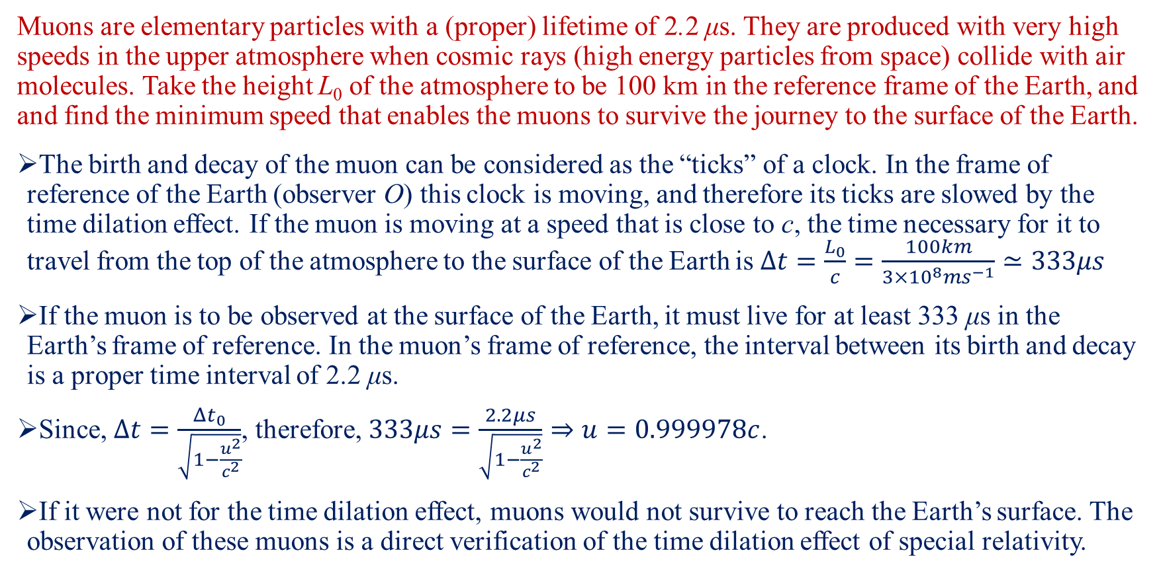
Example-I
Muons are elementary particles with a (proper) lifetime of 2.2 μs. They are produced with very high speeds in the upper atmosphere when cosmic rays (high energy particles from space) collide with air molecules. Take the height L₀ of the atmosphere to be 100 km in the reference frame of the Earth, and find the minimum speed that enables the muons to survive the journey to the surface of the Earth.
The birth and decay of the muon can be considered as the “ticks” of a clock. In the frame of reference of the Earth (observer O) this clock is moving, and therefore its ticks are slowed by the time dilation effect. If the muon is moving at a speed that is close to c, the time necessary for it to travel from the top of the atmosphere to the surface of the Earth is $Δt=\frac{L_{0}}{c}=\frac{100km}{3×{10}^{8}ms^{−1}}≃333μs$
If the muon is to be observed at the surface of the Earth, it must live for at least 333 μs in the Earth’s frame of reference. In the muon’s frame of reference, the interval between its birth and decay is a proper time interval of 2.2 μs.
Since, $Δt=\frac{Δt_{0}}{\sqrt{1−\frac{u^{2}}{c^{2}}}}$, therefore, $333μs=\frac{2.2μs}{\sqrt{1−\frac{u^{2}}{c^{2}}}}⇒u=0.999978c$.
If it were not for the time dilation effect, muons would not survive to reach the Earth’s surface. The observation of these muons is a direct verification of the time dilation effect of special relativity.

Slide 15
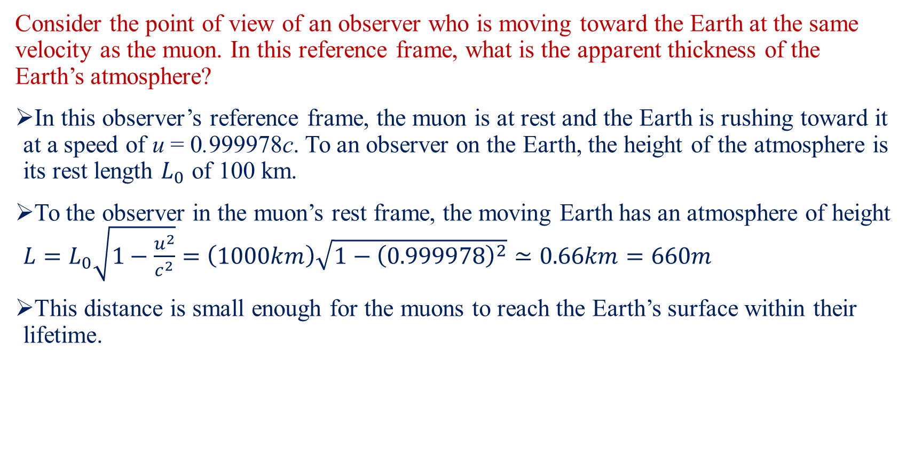
Example-II
Consider the point of view of an observer who is moving toward the Earth at the same velocity as the muon. In this reference frame, what is the apparent thickness of the Earth’s atmosphere?
In this observer’s reference frame, the muon is at rest and the Earth is rushing toward it at a speed of u = 0.999978c. To an observer on the Earth, the height of the atmosphere is its rest length $L_{0}$ of 100 km.
To the observer in the muon’s rest frame, the moving Earth has an atmosphere of height $L=L_{0}\sqrt{1−\frac{u^{2}}{c^{2}}}=\left(1000km\right)\sqrt{1−{\left(0.999978\right)}^{2}}≃0.66km=660m$
This distance is small enough for the muons to reach the Earth’s surface within their lifetime.

Slide 16
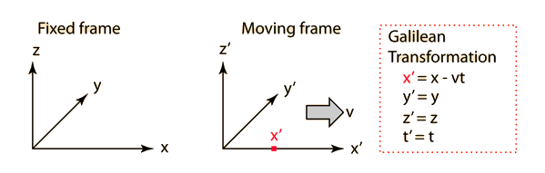
Galilean Transformation
The primed frame moves with velocity v in the x direction with respect to the fixed reference frame.
The reference frames coincide at t=t'=0.
The point x' is moving with the primed frame.
The Galilean transformation gives the coordinates of the point as measured from the fixed frame in terms of its location in the moving reference frame.
The Galilean transformation is the common sense relationship which agrees with our everyday experience. It has embedded within it the presumption that the passage of time is the same for every observer.
Reference: http://hyperphysics.phy-astr.gsu.edu/hbase/Relativ/ltrans.html#c1

Slide 17
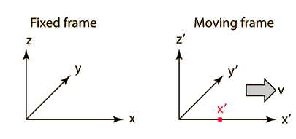
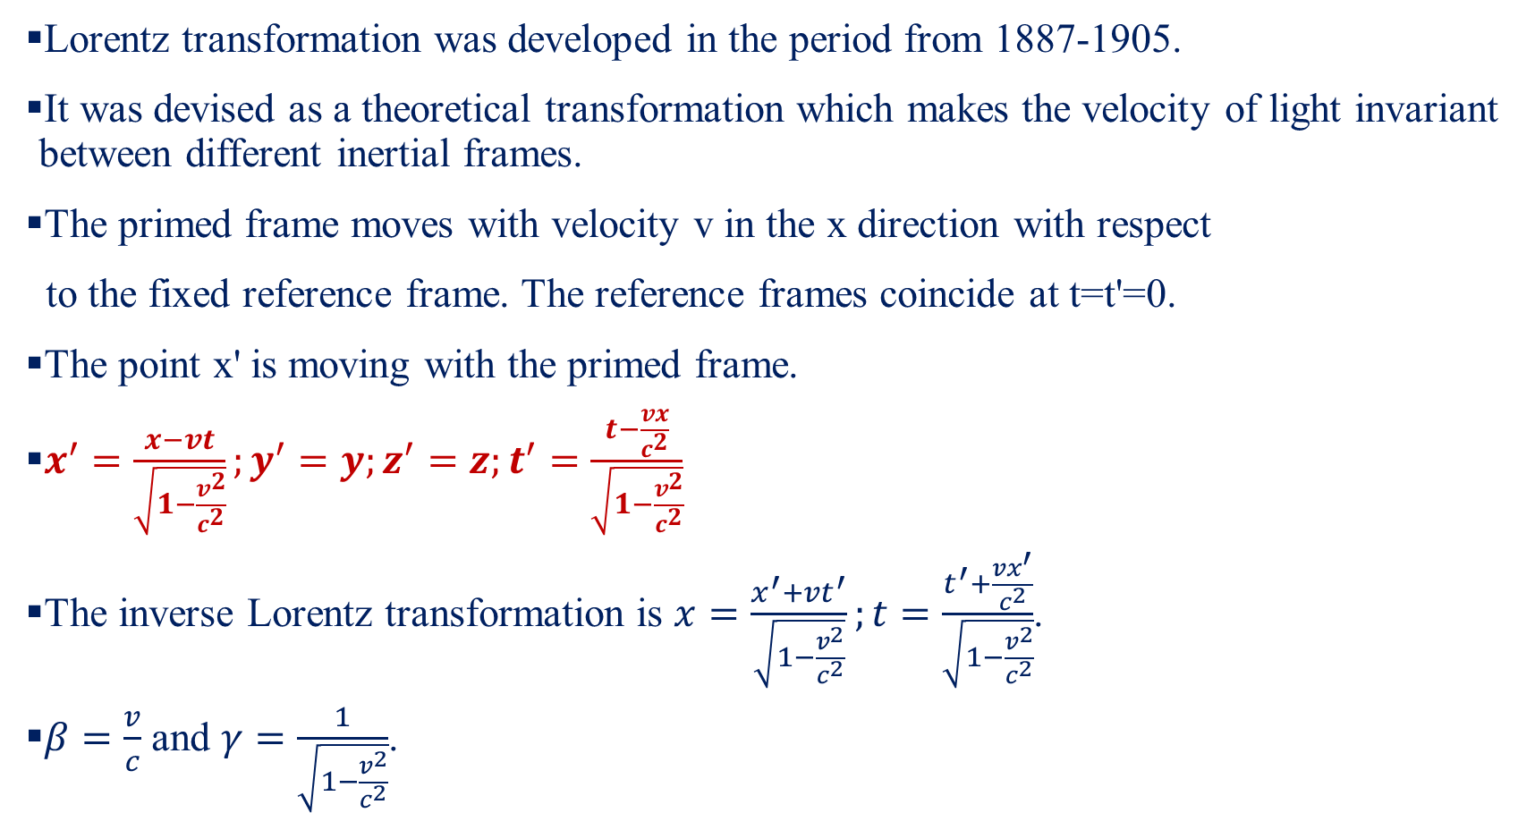
Lorentz Transformation-I
Lorentz transformation was developed in the period from 1887-1905.
It was devised as a theoretical transformation which makes the velocity of light invariant between different inertial frames.
The primed frame moves with velocity v in the x direction with respect
to the fixed reference frame. The reference frames coincide at t=t'=0.
The point x' is moving with the primed frame.
$x^{′}=\frac{x−vt}{\sqrt{1−\frac{v^{2}}{c^{2}}}};y^{′}=y;z^{′}=z;t^{′}=\frac{t−\frac{vx}{c^{2}}}{\sqrt{1−\frac{v^{2}}{c^{2}}}}$
The inverse Lorentz transformation is $x=\frac{x^{′}+vt^{′}}{\sqrt{1−\frac{v^{2}}{c^{2}}}};t=\frac{t^{′}+\frac{vx^{′}}{c^{2}}}{\sqrt{1−\frac{v^{2}}{c^{2}}}}$.
$β=\frac{v}{c}$ and $γ=\frac{1}{\sqrt{1−\frac{v^{2}}{c^{2}}}}$.
Reference: http://hyperphysics.phy-astr.gsu.edu/hbase/Relativ/ltrans.html#c1

Slide 18
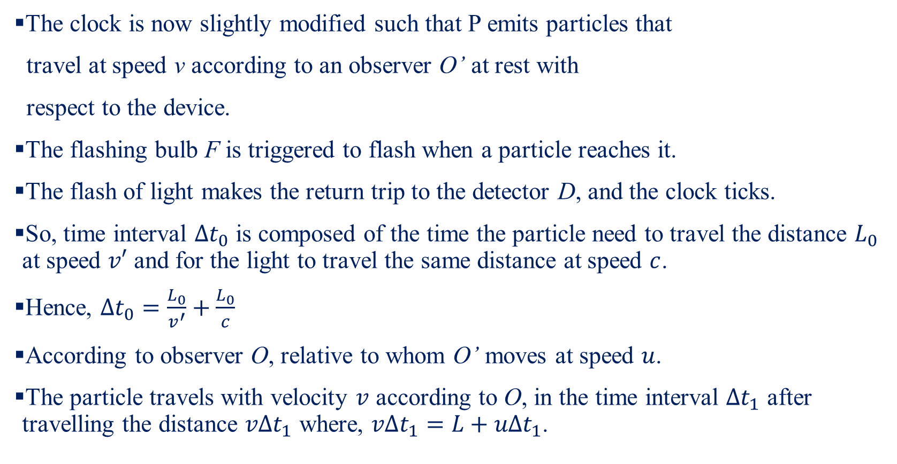
Relativistic Velocity Addition-I
The clock is now slightly modified such that P emits particles that
travel at speed v according to an observer O’ at rest with
respect to the device.
The flashing bulb F is triggered to flash when a particle reaches it.
The flash of light makes the return trip to the detector D, and the clock ticks.
So, time interval $Δt_{0}$ is composed of the time the particle need to travel the distance $L_{0}$ at speed $v′$ and for the light to travel the same distance at speed $c$.
Hence, $Δt_{0}=\frac{L_{0}}{v^{′}}+\frac{L_{0}}{c}$
According to observer O, relative to whom O’ moves at speed $u$.
The particle travels with velocity $v$ according to O, in the time interval $Δt_{1}$ after travelling the distance $vΔt_{1}$ where, $vΔt_{1}=L+uΔt_{1}$.
Image Source: Modern Physics, 3rd Edition, Kenneth Krane

Slide 19
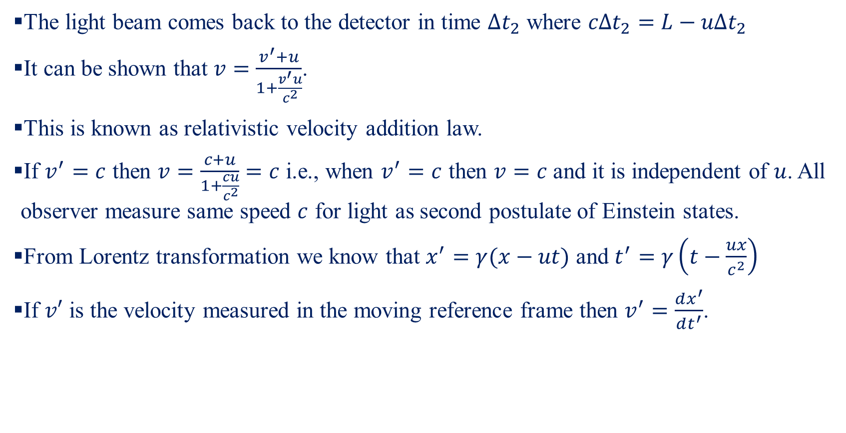
Relativistic Velocity Addition-II
The light beam comes back to the detector in time $Δt_{2}$ where $cΔt_{2}=L−uΔt_{2}$
It can be shown that $v=\frac{v^{′}+u}{1+\frac{v^{′}u}{c^{2}}}$.
This is known as relativistic velocity addition law.
If $v^{′}=c$ then $v=\frac{c+u}{1+\frac{cu}{c^{2}}}=c$ i.e., when $v^{′}=c$ then $v=c$ and it is independent of $u$. All observer measure same speed $c$ for light as second postulate of Einstein states.
From Lorentz transformation we know that $x^{′}=γ(x−ut)$ and $t^{′}=γ\left(t−\frac{ux}{c^{2}}\right)$
If $v′$ is the velocity measured in the moving reference frame then $v^{′}=\frac{dx^{′}}{dt^{′}}$.

Slide 20
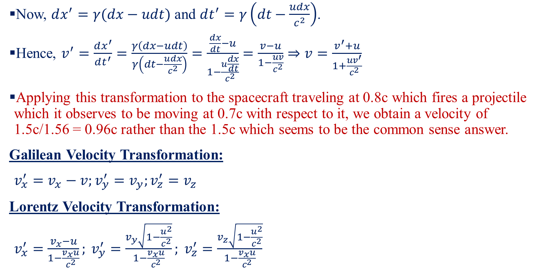
Relativistic Velocity Addition-III
Now, $dx^{′}=γ(dx−udt)$ and $dt^{′}=γ\left(dt−\frac{udx}{c^{2}}\right)$.
Hence, $v^{′}=\frac{dx^{′}}{dt^{′}}=\frac{γ\left(dx−udt\right)}{γ\left(dt−\frac{udx}{c^{2}}\right)}=\frac{\frac{dx}{dt}−u}{1−\frac{u\frac{dx}{dt}}{c^{2}}}=\frac{v−u}{1−\frac{uv}{c^{2}}}⇒v=\frac{v^{′}+u}{1+\frac{uv^{′}}{c^{2}}}$
Applying this transformation to the spacecraft traveling at 0.8c which fires a projectile which it observes to be moving at 0.7c with respect to it, we obtain a velocity of 1.5c/1.56 = 0.96c rather than the 1.5c which seems to be the common sense answer.
Galilean Velocity Transformation:
$v_{x}^{′}=v_{x}−v;v_{y}^{′}=v_{y};v_{z}^{′}=v_{z}$
Lorentz Velocity Transformation:
$v_{x}^{′}=\frac{v_{x}−u}{1−\frac{v_{x}u}{c^{2}}}; v_{y}^{′}=\frac{v_{y}\sqrt{1−\frac{u^{2}}{c^{2}}}}{1−\frac{v_{x}u}{c^{2}}}; v_{z}^{′}=\frac{v_{z}\sqrt{1−\frac{u^{2}}{c^{2}}}}{1−\frac{v_{x}u}{c^{2}}}$

Slide 21
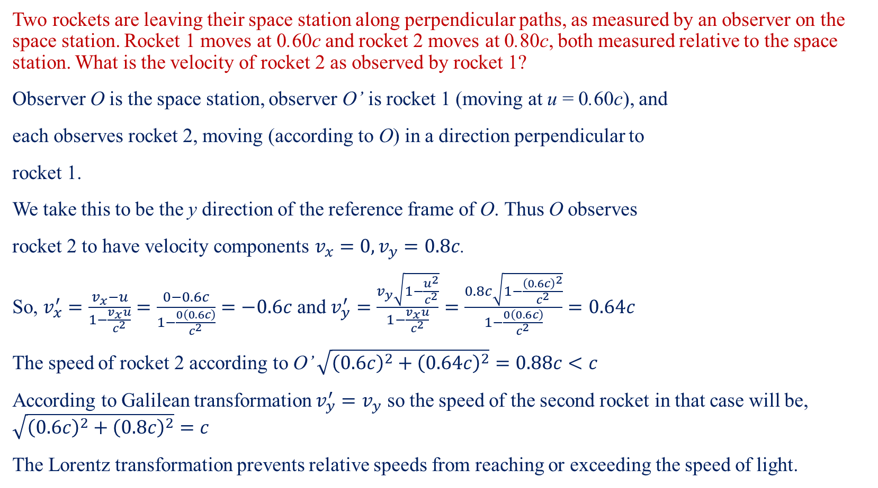
Example-III
Two rockets are leaving their space station along perpendicular paths, as measured by an observer on the space station. Rocket 1 moves at 0.60c and rocket 2 moves at 0.80c, both measured relative to the space station. What is the velocity of rocket 2 as observed by rocket 1?
Observer O is the space station, observer O’ is rocket 1 (moving at u = 0.60c), and
each observes rocket 2, moving (according to O) in a direction perpendicular to
rocket 1.
We take this to be the y direction of the reference frame of O. Thus O observes
rocket 2 to have velocity components $v_{x}=0, v_{y}=0.8c$.
So, $v_{x}^{′}=\frac{v_{x}−u}{1−\frac{v_{x}u}{c^{2}}}=\frac{0−0.6c}{1−\frac{0\left(0.6c\right)}{c^{2}}}=−0.6c$ and $v_{y}^{′}=\frac{v_{y}\sqrt{1−\frac{u^{2}}{c^{2}}}}{1−\frac{v_{x}u}{c^{2}}}=\frac{0.8c\sqrt{1−\frac{{\left(0.6c\right)}^{2}}{c^{2}}}}{1−\frac{0\left(0.6c\right)}{c^{2}}}=0.64c$
The speed of rocket 2 according to O’ $\sqrt{{\left(0.6c\right)}^{2}+{\left(0.64c\right)}^{2}}=0.88c<c$
According to Galilean transformation $v_{y}^{′}=v_{y}$ so the speed of the second rocket in that case will be, $\sqrt{{\left(0.6c\right)}^{2}+{\left(0.8c\right)}^{2}}=c$
The Lorentz transformation prevents relative speeds from reaching or exceeding the speed of light.

Slide 22

Relativistic Momentum-I
In Fig(a) the momentum is conserved but if the frame is moving with velocity u=0.55c (say) then $p_{i}=m_{1}v_{1i}+m_{2}v_{2i}=2m×0.55c+m\left(−0.34c\right)=0.76mc$ (by applying velocity transformation) and $p_{f}=m_{1}v_{1f}+m_{2}v_{2f}=2m×0.069c+m×0.703c=0.841mc$.
So, $p_{i}≠p_{f}$, thus momentum is not conserved.
To conserve the momentum, we need to redefine the momentum as $\vec{p}=\frac{m\vec{v}}{\sqrt{1−\frac{v^{2}}{c^{2}}}}=γm\vec{v}$.
Image Source: Modern Physics, 3rd Edition, Kenneth Krane

Slide 23

Relativistic Momentum-II
One can regard the increase in an object’s momentum over the classical value as being due to an increase in the object’s mass. Then $m_{0}=m$ is the rest mass of the object and $m=m(v)$ is the relativistic mass.
Image Source: Concept of Modern Physics, Arthur Beiser

Slide 24
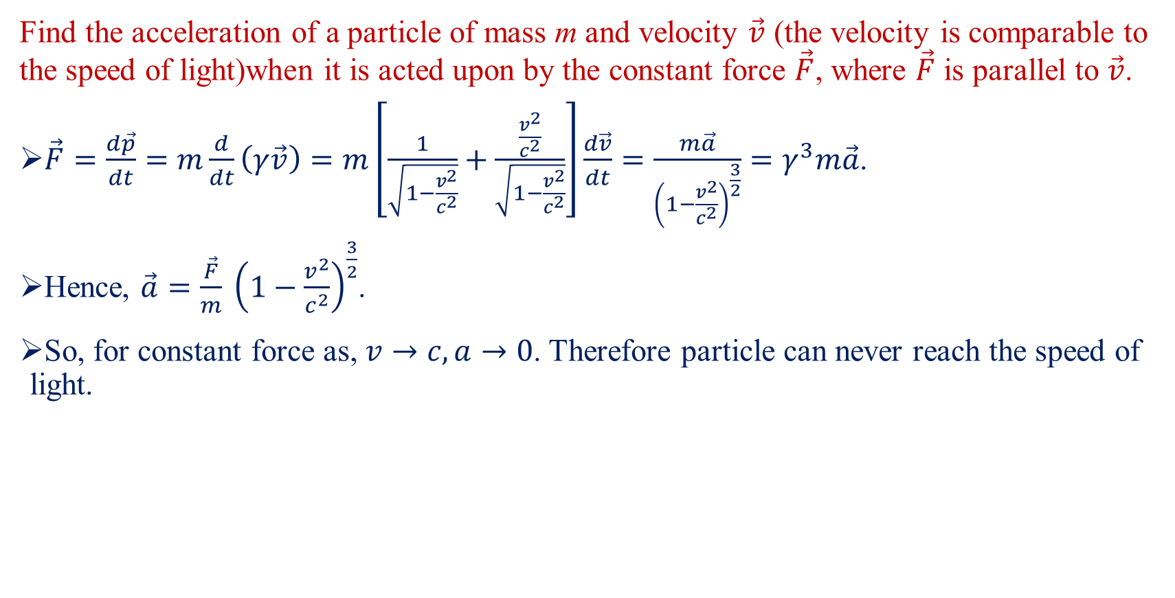
Example-IV
Find the acceleration of a particle of mass m and velocity $\vec{v}$ (the velocity is comparable to the speed of light)when it is acted upon by the constant force $\vec{F}$, where $\vec{F}$ is parallel to $\vec{v}$.
$\vec{F}=\frac{d\vec{p}}{dt}=m\frac{d}{dt}\left(γ\vec{v}\right)=m\left[\frac{1}{\sqrt{1−\frac{v^{2}}{c^{2}}}}+\frac{\frac{v^{2}}{c^{2}}}{\sqrt{1−\frac{v^{2}}{c^{2}}}}\right]\frac{d\vec{v}}{dt}=\frac{m\vec{a}}{{\left(1−\frac{v^{2}}{c^{2}}\right)}^{\frac{3}{2}}}=γ^{3}m\vec{a}$.
Hence, $\vec{a}=\frac{\vec{F}}{m} {\left(1−\frac{v^{2}}{c^{2}}\right)}^{\frac{3}{2}}$.
So, for constant force as, $v→c, a→0$. Therefore particle can never reach the speed of light.

Slide 25
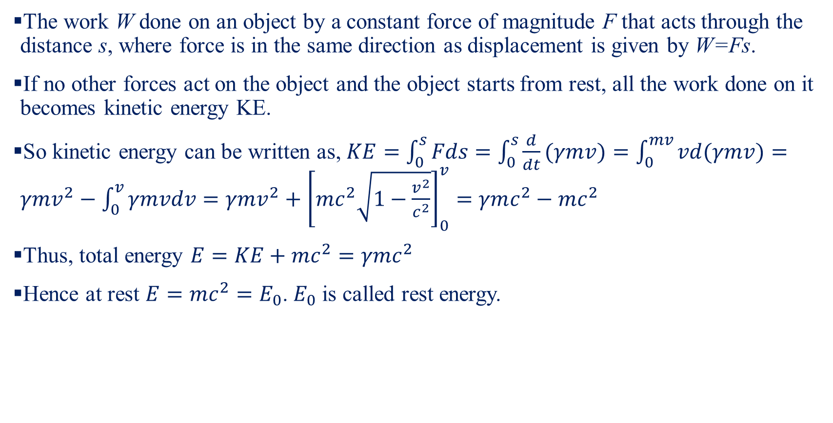
Mass Energy Equivalence
The work W done on an object by a constant force of magnitude F that acts through the distance s, where force is in the same direction as displacement is given by W=Fs.
If no other forces act on the object and the object starts from rest, all the work done on it becomes kinetic energy KE.
So kinetic energy can be written as, $KE=\int_{0}^{s}{Fds}=\int_{0}^{s}{\frac{d}{dt}(γmv)}=\int_{0}^{mv}{vd(γmv)}=γmv^{2}−\int_{0}^{v}{γmvdv}=γmv^{2}+{\left[mc^{2}\sqrt{1−\frac{v^{2}}{c^{2}}}\right]}_{0}^{v}=γmc^{2}−mc^{2}$
Thus, total energy $E=KE+mc^{2}=γmc^{2}$
Hence at rest $E=mc^{2}=E_{0}$. $E_{0}$ is called rest energy.

Slide 26

Example-V
A stationary body explodes into two fragments each of mass 1.0 kg that move apart at speeds of 0.6c relative to the original body. Find the mass of the original body.
The rest energy of the original body must equal the sum of the total energies of the fragments. Hence, $E_{0}=mc^{2}=γm_{1}c^{2}+γm_{2}c^{2}=2γc^{2}⇒m=2γ=\frac{2}{\sqrt{1−0.36}}=2.5kg$.

