Slide 1
Mechanics
EPHY108L (2-0-2-3)
Ayan khan
Department of physics

Slide 2
Kinematics

Slide 3
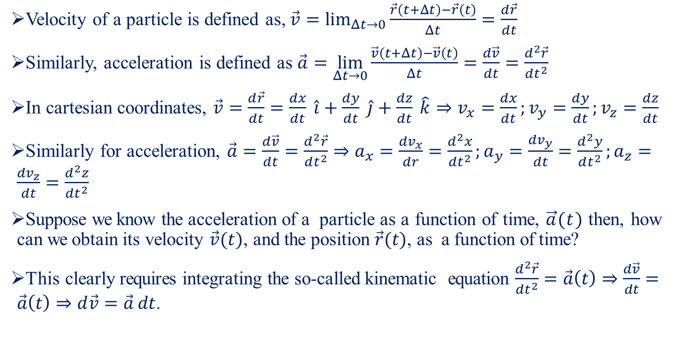
Velocity and Acceleration-I
Velocity of a particle is defined as, $\vec{v}=\lim_{Δt→0}{\frac{\vec{r}\left(t+Δt\right)−\vec{r}\left(t\right)}{Δt}}=\frac{d\vec{r}}{dt}$
Similarly, acceleration is defined as $\vec{a}=\lim_{Δt→0}{\frac{\vec{v}\left(t+Δt\right)−\vec{v}\left(t\right)}{Δt}}=\frac{d\vec{v}}{dt}=\frac{d^{2}\vec{r}}{dt^{2}}$
In cartesian coordinates, $\vec{v}=\frac{d\vec{r}}{dt}=\frac{dx}{dt} \hat{i}+\frac{dy}{dt} \hat{j}+\frac{dz}{dt} \hat{k}⇒v_{x}=\frac{dx}{dt};v_{y}=\frac{dy}{dt};v_{z}=\frac{dz}{dt}$
Similarly for acceleration, $\vec{a}=\frac{d\vec{v}}{dt}=\frac{d^{2}\vec{r}}{dt^{2}}⇒a_{x}=\frac{dv_{x}}{dr}=\frac{d^{2}x}{dt^{2}};a_{y}=\frac{dv_{y}}{dt}=\frac{d^{2}y}{dt^{2}};a_{z}=\frac{dv_{z}}{dt}=\frac{d^{2}z}{dt^{2}}$
Suppose we know the acceleration of a particle as a function of time, $\vec{a}(t)$ then, how can we obtain its velocity $\vec{v}(t)$, and the position $\vec{r}(t)$, as a function of time?
This clearly requires integrating the so-called kinematic equation $\frac{d^{2}\vec{r}}{dt^{2}}=\vec{a}\left(t\right)⇒\frac{d\vec{v}}{dt}=\vec{a}\left(t\right)⇒d\vec{v}=\vec{a} dt$.

Slide 4
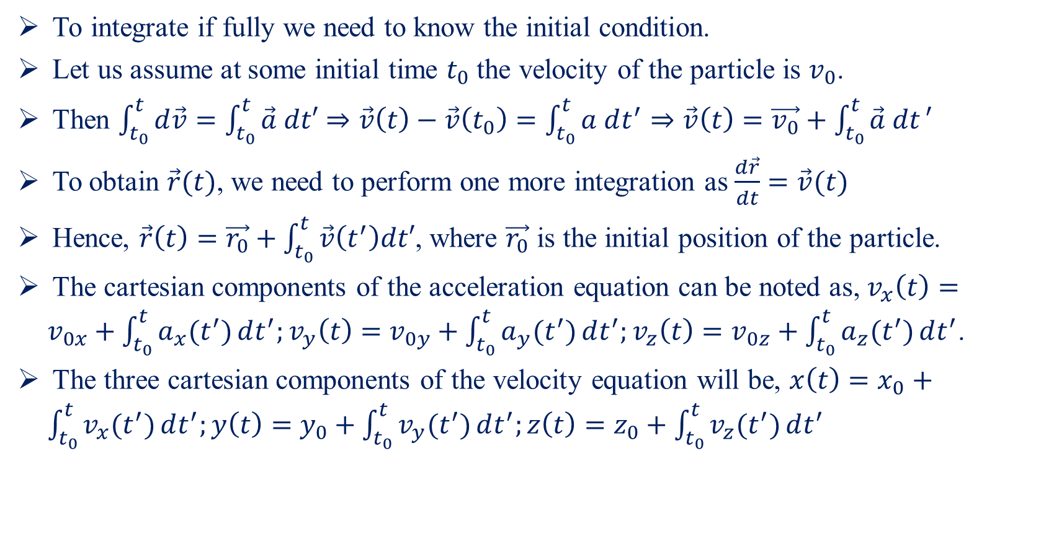
Velocity and Acceleration-II
To integrate if fully we need to know the initial condition.
Let us assume at some initial time $t_{0}$ the velocity of the particle is $v_{0}$.
Then $\int_{t_{0}}^{t}{d\vec{v}}=\int_{t_{0}}^{t}{\vec{a} dt′}⇒\vec{v}\left(t\right)−\vec{v}\left(t_{0}\right)=\int_{t_{0}}^{t}{a dt^{′}}⇒\vec{v}\left(t\right)=\vec{v_{0}}+\int_{t_{0}}^{t}{\vec{a} dt}′$
To obtain $\vec{r}(t)$, we need to perform one more integration as $\frac{d\vec{r}}{dt}=\vec{v}(t)$
Hence, $\vec{r}\left(t\right)=\vec{r_{0}}+\int_{t_{0}}^{t}{\vec{v}\left(t^{′}\right)dt′}$, where $\vec{r_{0}}$ is the initial position of the particle.
The cartesian components of the acceleration equation can be noted as, $v_{x}\left(t\right)=v_{0x}+\int_{t_{0}}^{t}{a_{x}(t^{′})}dt^{′};v_{y}\left(t\right)=v_{0y}+\int_{t_{0}}^{t}{a_{y}(t^{′})}dt^{′};v_{z}\left(t\right)=v_{0z}+\int_{t_{0}}^{t}{a_{z}(t^{′})}dt^{′}$.
The three cartesian components of the velocity equation will be, $x\left(t\right)=x_{0}+\int_{t_{0}}^{t}{v_{x}(t^{′})}dt^{′};y\left(t\right)=y_{0}+\int_{t_{0}}^{t}{v_{y}(t^{′})}dt^{′};z\left(t\right)=z_{0}+\int_{t_{0}}^{t}{v_{z}(t^{′})}dt^{′}$

Slide 5
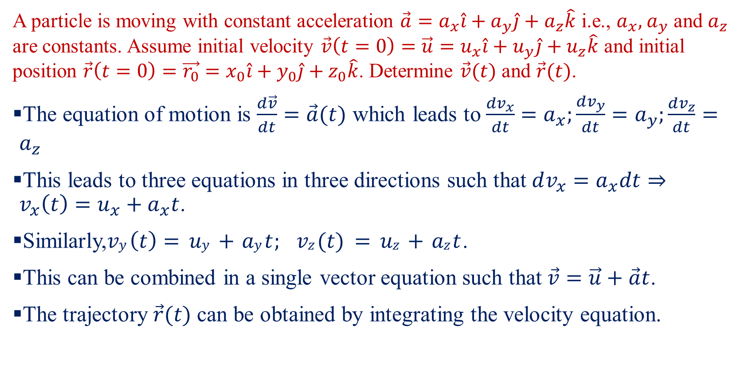
Velocity and Acceleration-III
A particle is moving with constant acceleration $\vec{a}=a_{x}\hat{i}+a_{y}\hat{j}+a_{z}\hat{k}$ i.e., $a_{x},$ $a_{y}$ and $a_{z}$ are constants. Assume initial velocity $\vec{v}\left(t=0\right)=\vec{u}=u_{x}\hat{i}+u_{y}\hat{j}+u_{z}\hat{k}$ and initial position $\vec{r}\left(t=0\right)=\vec{r_{0}}=x_{0}\hat{i}+y_{0}\hat{j}+z_{0}\hat{k}$. Determine $\vec{v}(t)$ and $\vec{r}(t)$.
The equation of motion is $\frac{d\vec{v}}{dt}=\vec{a}(t)$ which leads to $\frac{dv_{x}}{dt}=a_{x};\frac{dv_{y}}{dt}=a_{y};\frac{dv_{z}}{dt}=a_{z}$
This leads to three equations in three directions such that $dv_{x}=a_{x}dt⇒v_{x}\left(t\right)=u_{x}+a_{x}t$.
Similarly,$vy \left(t\right)= uy + ay t; vz (t) = uz + az t$.
This can be combined in a single vector equation such that $\vec{v}=\vec{u}+\vec{a}t$.
The trajectory $\vec{r}(t)$ can be obtained by integrating the velocity equation.

Slide 6
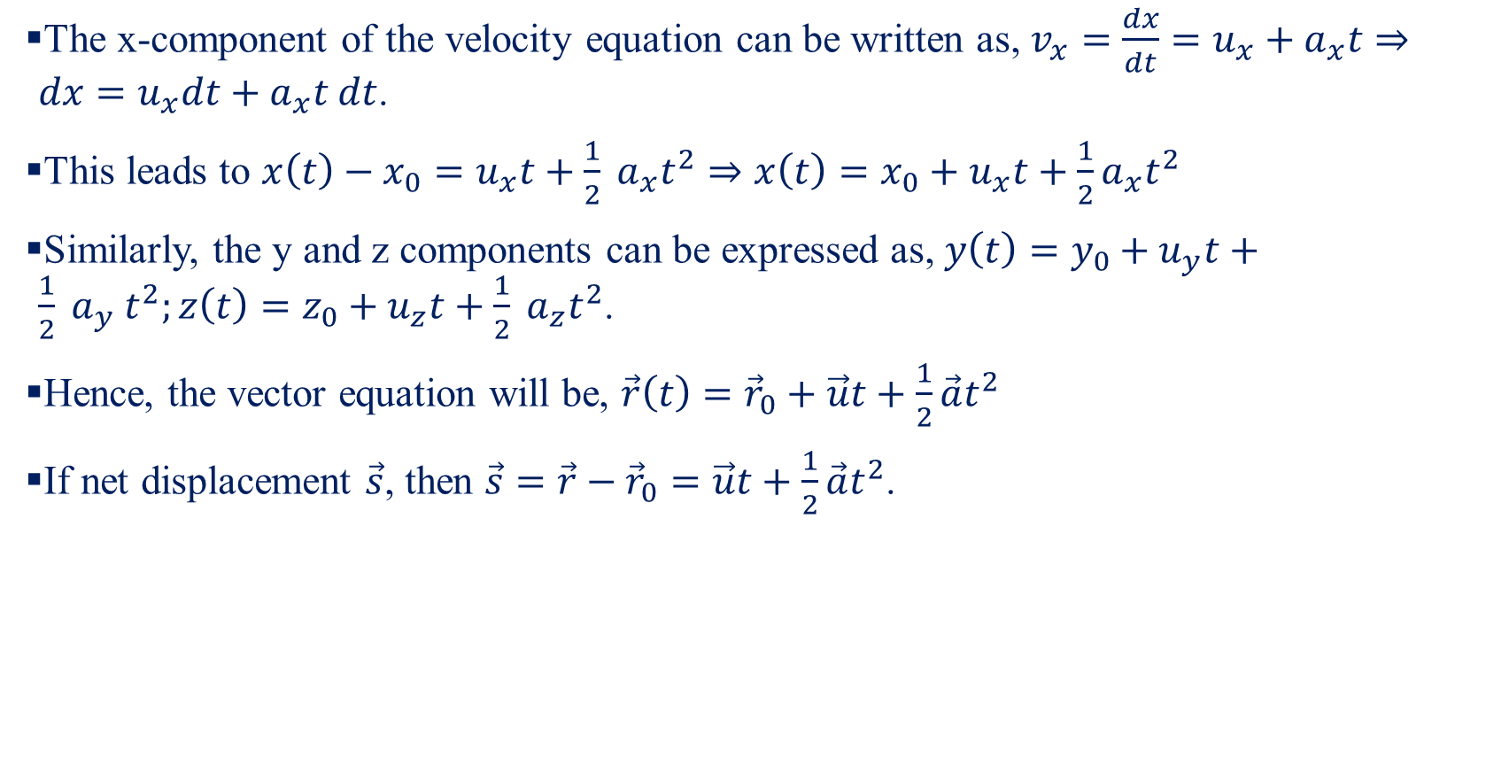
Velocity and Acceleration-IV
The x-component of the velocity equation can be written as, $v_{x}=\frac{dx}{dt}=u_{x}+a_{x}t⇒dx=u_{x}dt+a_{x}t dt$.
This leads to $x\left(t\right)−x_{0}=u_{x}t+\frac{1}{2} a_{x}t^{2}⇒x\left(t\right)=x_{0}+u_{x}t+\frac{1}{2}a_{x}t^{2}$
Similarly, the y and z components can be expressed as, $y\left(t\right)=y_{0}+u_{y}t+\frac{1}{2} a_{y} t^{2};z\left(t\right)=z_{0}+u_{z}t+\frac{1}{2} a_{z}t^{2}$.
Hence, the vector equation will be, $\vec{r}\left(t\right)={\vec{r}}_{0}+\vec{u}t+\frac{1}{2}\vec{a}t^{2}$
If net displacement $\vec{s}$, then $\vec{s}=\vec{r}−{\vec{r}}_{0}=\vec{u}t+\frac{1}{2}\vec{a}t^{2}$.

Slide 7
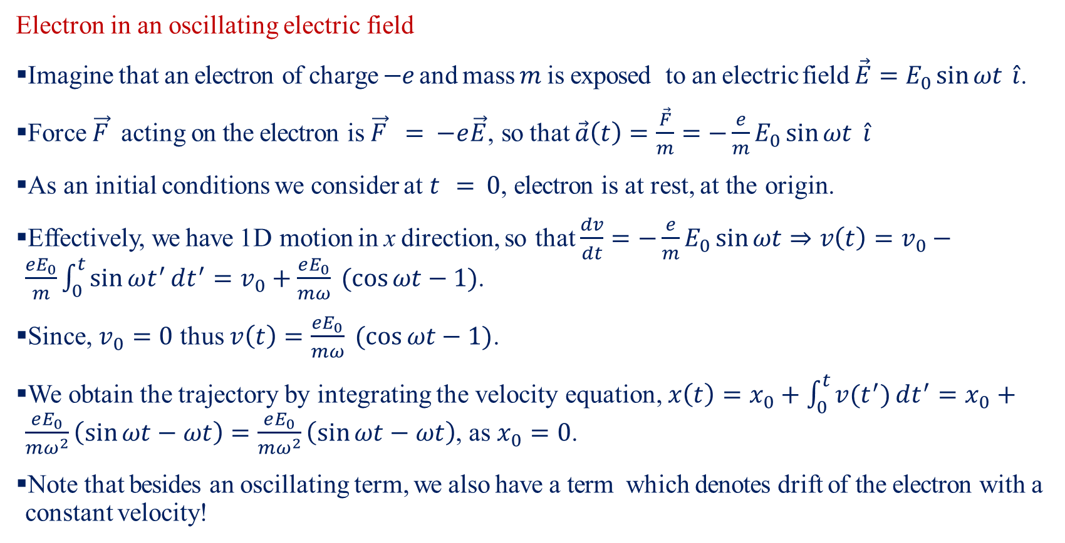
Velocity and Acceleration-V
Electron in an oscillating electric field
Imagine that an electron of charge $−e$ and mass $m$ is exposed to an electric field $\vec{E}=E_{0}\sin{ωt} \hat{i}$.
Force $\vec{F}$ acting on the electron is $\vec{F} = −e\vec{E}$, so that $\vec{a}\left(t\right)=\frac{\vec{F}}{m}=−\frac{e}{m}E_{0}\sin{ωt} \hat{i}$
As an initial conditions we consider at $t = 0$, electron is at rest, at the origin.
Effectively, we have 1D motion in x direction, so that $\frac{dv}{dt}=−\frac{e}{m}E_{0}\sin{ωt}⇒v\left(t\right)=v_{0}−\frac{eE_{0}}{m}\int_{0}^{t}{\sin{ωt^{′}}dt^{′}}=v_{0}+\frac{eE_{0}}{mω} (\cos{ωt}−1)$.
Since, $v_{0}=0$ thus $v\left(t\right)=\frac{eE_{0}}{mω} (\cos{ωt}−1)$.
We obtain the trajectory by integrating the velocity equation, $x\left(t\right)=x_{0}+\int_{0}^{t}{v(t^{′})}dt^{′}=x_{0}+\frac{eE_{0}}{mω^{2}}\left(\sin{ωt}−ωt\right)=\frac{eE_{0}}{mω^{2}}\left(\sin{ωt}−ωt\right)$, as $x_{0}=0$.
Note that besides an oscillating term, we also have a term which denotes drift of the electron with a constant velocity!

Slide 8
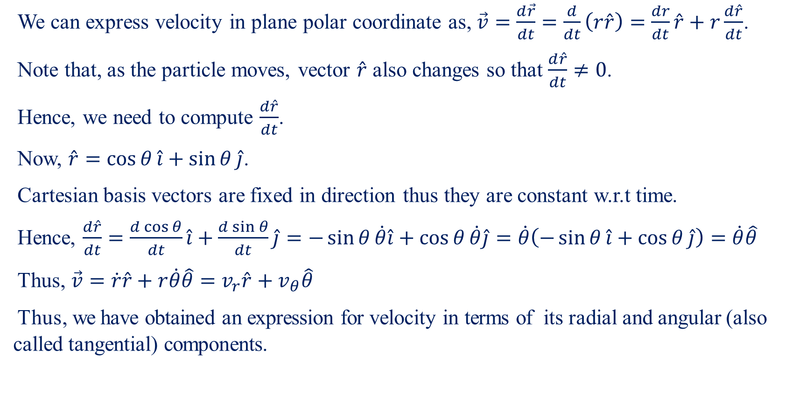
Kinematics in Plane Polar Coordinate-I
We can express velocity in plane polar coordinate as, $\vec{v}=\frac{d\vec{r}}{dt}=\frac{d}{dt}\left(r\hat{r}\right)=\frac{dr}{dt}\hat{r}+r\frac{d\hat{r}}{dt}$.
Note that, as the particle moves, vector $\hat{r}$ also changes so that $\frac{d\hat{r}}{dt}≠0$.
Hence, we need to compute $\frac{d\hat{r}}{dt}$.
Now, $\hat{r}=\cos{θ}\hat{i}+\sin{θ}\hat{j}$.
Cartesian basis vectors are fixed in direction thus they are constant w.r.t time.
Hence, $\frac{d\hat{r}}{dt}=\frac{d\cos{θ}}{dt}\hat{i}+\frac{d\sin{θ}}{dt}\hat{j}=−\sin{θ}\dot{θ}\hat{i}+\cos{θ}\dot{θ}\hat{j}=\dot{θ}\left(−\sin{θ}\hat{i}+\cos{θ}\hat{j}\right)=\dot{θ}\hat{θ}$
Thus, $\vec{v}=\dot{r}\hat{r}+r\dot{θ}\hat{θ}=v_{r}\hat{r}+v_{θ}\hat{θ}$
Thus, we have obtained an expression for velocity in terms of its radial and angular (also called tangential) components.

Slide 9
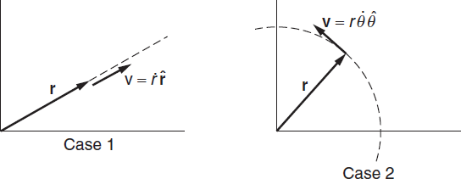

Kinematics in Plane Polar Coordinate-II
What is the physical significance of $v_{r}$ and $v_{θ}$ ?
Case 1: This case corresponds to motion along the radial direction, with $θ$ held fixed ($θ˙ = 0$), so that $\vec{v}=\dot{r}\hat{r}$
Case 2: Here there is no radial motion ($r˙ = 0$), so velocity will be along the arc of a circle with $\vec{v}=r\dot{θ}\hat{θ}$.

Slide 10
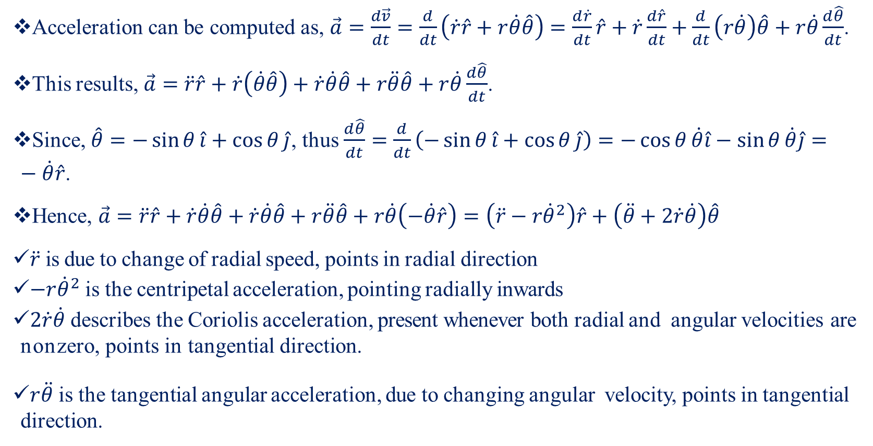
Kinematics in Plane Polar Coordinate-III
Acceleration can be computed as, $\vec{a}=\frac{d\vec{v}}{dt}=\frac{d}{dt}\left(\dot{r}\hat{r}+r\dot{θ}\hat{θ}\right)=\frac{d\dot{r}}{dt}\hat{r}+\dot{r}\frac{d\hat{r}}{dt}+\frac{d}{dt}\left(r\dot{θ}\right)\hat{θ}+r\dot{θ}\frac{d\hat{θ}}{dt}$.
This results, $\vec{a}=\ddot{r}\hat{r}+\dot{r}\left(\dot{θ}\hat{θ}\right)+\dot{r}\dot{θ}\hat{θ}+r\ddot{θ}\hat{θ}+r\dot{θ}\frac{d\hat{θ}}{dt}$.
Since, $\hat{θ}=−\sin{θ}\hat{i}+\cos{θ}\hat{j}$, thus $\frac{d\hat{θ}}{dt}=\frac{d}{dt}\left(−\sin{θ}\hat{i}+\cos{θ}\hat{j}\right)=−\cos{θ}\dot{θ}\hat{i}−\sin{θ}\dot{θ}\hat{j}=−\dot{θ}\hat{r}$.
Hence, $\vec{a}=\ddot{r}\hat{r}+\dot{r}\dot{θ}\hat{θ}+\dot{r}\dot{θ}\hat{θ}+r\ddot{θ}\hat{θ}+r\dot{θ}\left(−\dot{θ}\hat{r}\right)=\left(\ddot{r}−r{\dot{θ}}^{2}\right)\hat{r}+\left(\ddot{θ}+2\dot{r}\dot{θ}\right)\hat{θ}$
$\ddot{r}$ is due to change of radial speed, points in radial direction
$−r{\dot{θ}}^{2}$ is the centripetal acceleration, pointing radially inwards
$2\dot{r}\dot{θ}$ describes the Coriolis acceleration, present whenever both radial and angular velocities are nonzero, points in tangential direction.
$r\ddot{θ}$ is the tangential angular acceleration, due to changing angular velocity, points in tangential direction.

Slide 11
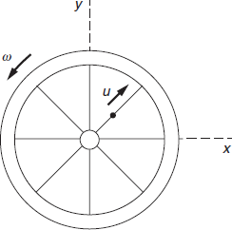
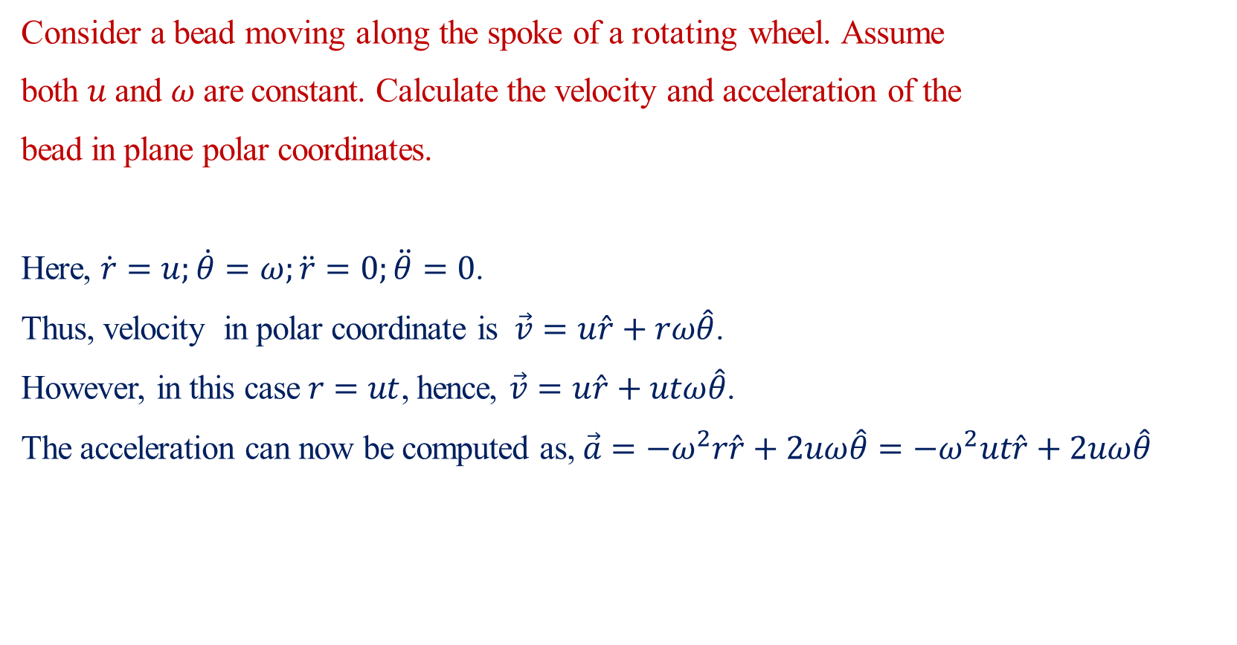
Kinematics in Plane Polar Coordinate-IV
Consider a bead moving along the spoke of a rotating wheel. Assume
both $u$ and $ω$ are constant. Calculate the velocity and acceleration of the
bead in plane polar coordinates.
Here, $\dot{r}=u;\dot{θ}=ω;\ddot{r}=0;\ddot{θ}=0$.
Thus, velocity in polar coordinate is $\vec{v}=u\hat{r}+rω\hat{θ}$.
However, in this case $r=ut$, hence, $\vec{v}=u\hat{r}+utω\hat{θ}$.
The acceleration can now be computed as, $\vec{a}=−ω^{2}r\hat{r}+2uω\hat{θ}=−ω^{2}ut\hat{r}+2uω\hat{θ}$

