Slide 1
Mechanics
EPHY108L (2-0-2-3)
Ayan khan
Department of physics

Slide 2
Work Energy Theorem

Slide 3
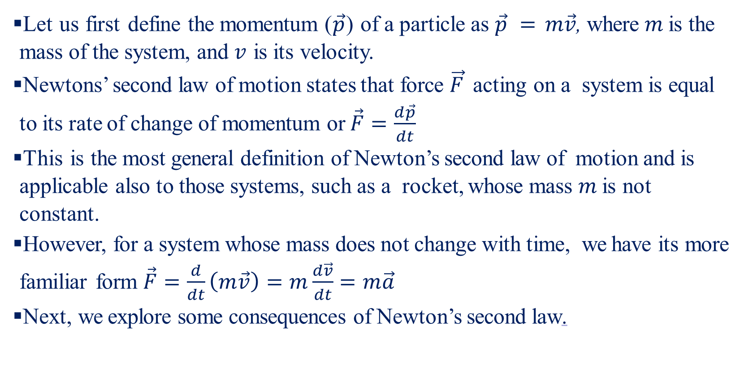
Newton’s Law of Motion
Let us first define the momentum ($\vec{p}$) of a particle as $\vec{p} = m\vec{v}$, where $m$ is the mass of the system, and $v$ is its velocity.
Newtons’ second law of motion states that force $\vec{F}$ acting on a system is equal to its rate of change of momentum or $\vec{F}=\frac{d\vec{p}}{dt}$
This is the most general definition of Newton’s second law of motion and is applicable also to those systems, such as a rocket, whose mass $m$ is not constant.
However, for a system whose mass does not change with time, we have its more familiar form $\vec{F}=\frac{d}{dt}\left(m\vec{v}\right)=m\frac{d\vec{v}}{dt}=m\vec{a}$
Next, we explore some consequences of Newton’s second law.

Slide 4
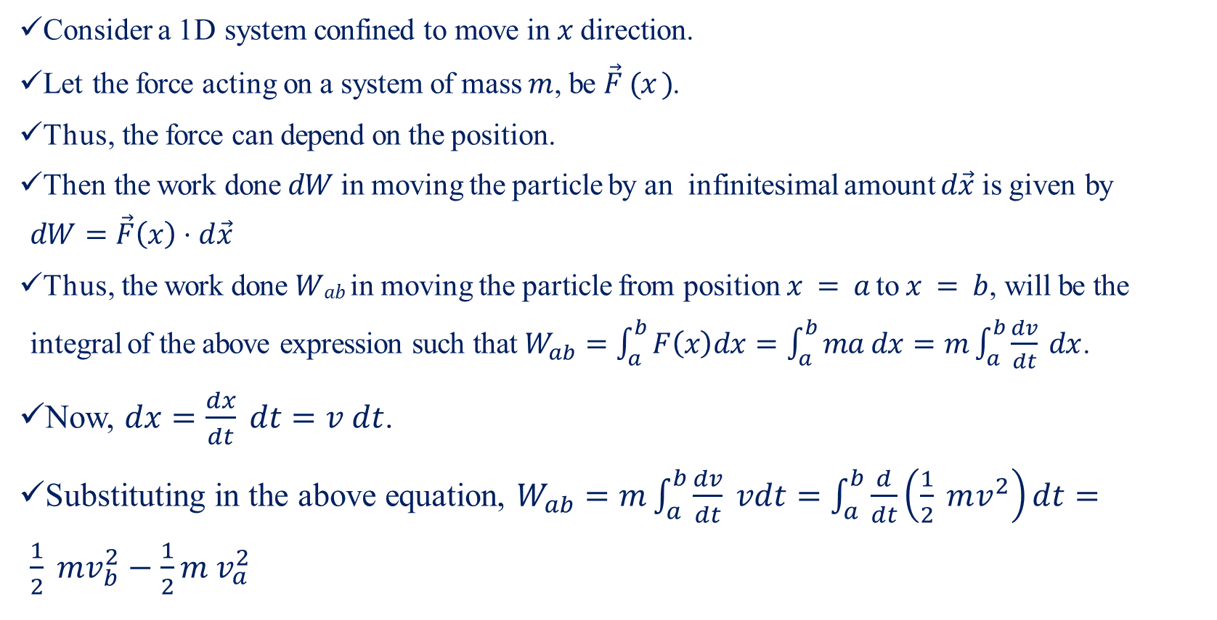
Work and Energy-I
Consider a 1D system confined to move in $x$ direction.
Let the force acting on a system of mass $m$, be $\vec{F} (x )$.
Thus, the force can depend on the position.
Then the work done $dW$in moving the particle by an infinitesimal amount $d\vec{x}$ is given by $dW=\vec{F}\left(x\right)⋅d\vec{x}$
Thus, the work done $Wab$ in moving the particle from position $x = a$ to $x = b$, will be the integral of the above expression such that $W_{ab}=\int_{a}^{b}{F\left(x\right)dx}=\int_{a}^{b}{ma dx}=m\int_{a}^{b}{\frac{dv}{dt}} dx$.
Now, $dx=\frac{dx}{dt} dt=v dt$.
Substituting in the above equation, $W_{ab}=m\int_{a}^{b}{\frac{dv}{dt} vdt}=\int_{a}^{b}{\frac{d}{dt}}\left(\frac{1}{2} mv^{2}\right)dt=\frac{1}{2} mv_{b}^{2}−\frac{1}{2}m v_{a}^{2}$

Slide 5
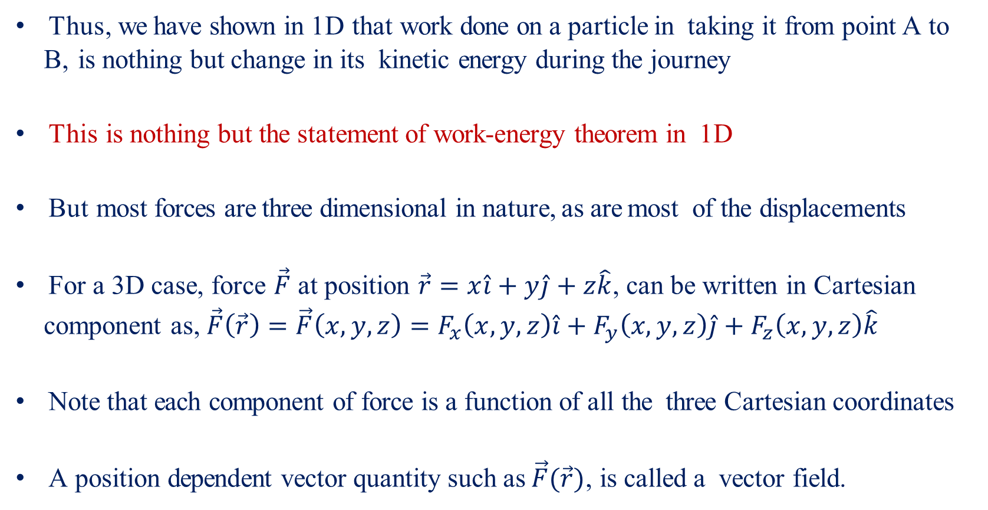
Work and Energy-II
Thus, we have shown in 1D that work done on a particle in taking it from point A to B, is nothing but change in its kinetic energy during the journey
This is nothing but the statement of work-energy theorem in 1D
But most forces are three dimensional in nature, as are most of the displacements
For a 3D case, force $\vec{F}$ at position $\vec{r}=x\hat{i}+y\hat{j}+z\hat{k}$, can be written in Cartesian component as, $\vec{F}\left(\vec{r}\right)=\vec{F}\left(x,y,z\right)=F_{x}\left(x,y,z\right)\hat{i}+F_{y}\left(x,y,z\right)\hat{j}+F_{z}\left(x,y,z\right)\hat{k}$
Note that each component of force is a function of all the three Cartesian coordinates
A position dependent vector quantity such as $\vec{F}(\vec{r})$, is called a vector field.

Slide 6
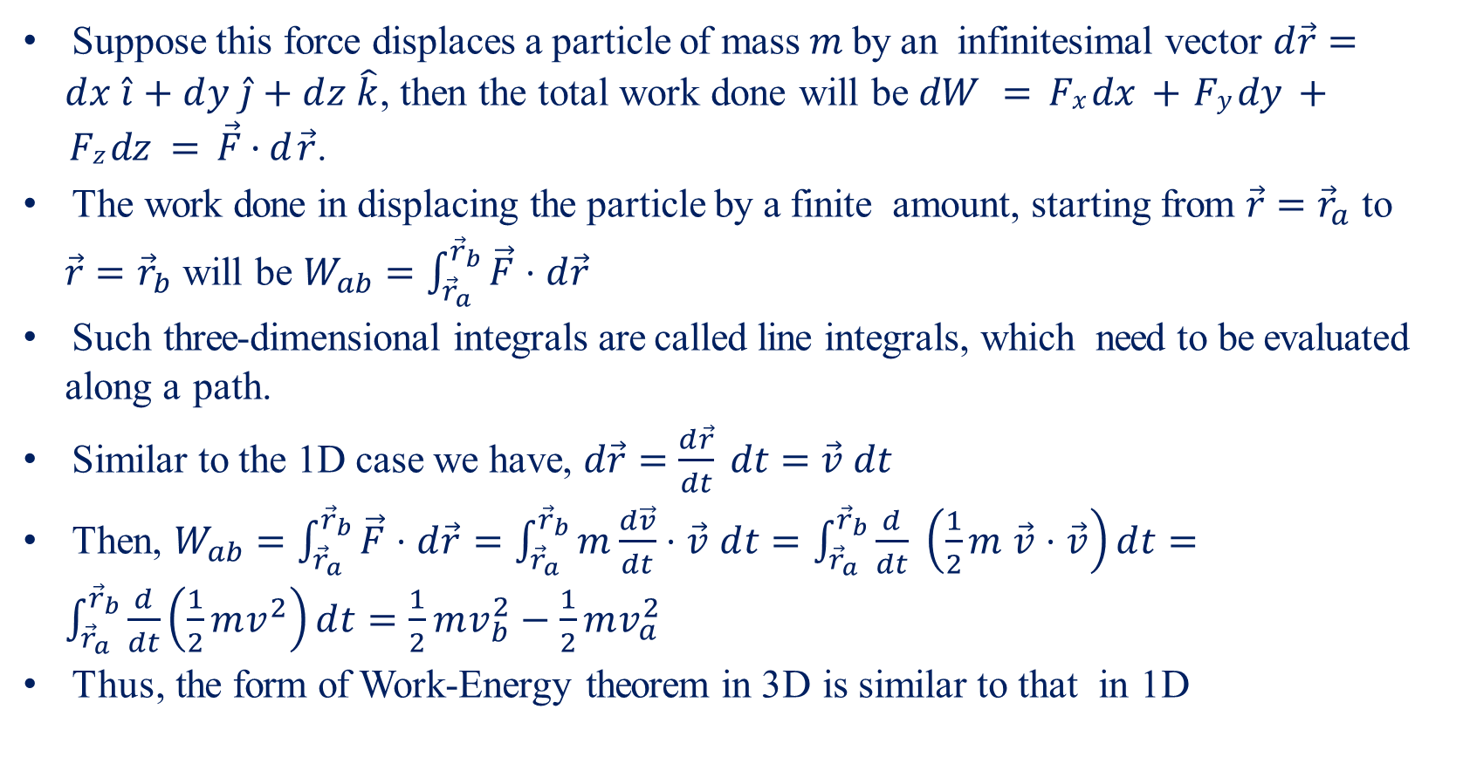
Work and Energy-III
Suppose this force displaces a particle of mass $m$ by an infinitesimal vector $d\vec{r}=dx \hat{i}+dy \hat{j}+dz \hat{k}$, then the total work done will be $dW = Fx dx + Fy dy + Fz dz = \vec{F}·d \vec{r}$.
The work done in displacing the particle by a finite amount, starting from $\vec{r}={\vec{r}}_{a}$ to $\vec{r}={\vec{r}}_{b}$ will be $W_{ab}=\int_{{\vec{r}}_{a}}^{{\vec{r}}_{b}}{\vec{F}⋅d\vec{r}}$
Such three-dimensional integrals are called line integrals, which need to be evaluated along a path.
Similar to the 1D case we have, $d\vec{r}=\frac{d\vec{r}}{dt} dt=\vec{v} dt$
Then, $W_{ab}=\int_{{\vec{r}}_{a}}^{{\vec{r}}_{b}}{\vec{F}⋅d\vec{r}}=\int_{{\vec{r}}_{a}}^{{\vec{r}}_{b}}{m\frac{d\vec{v}}{dt}⋅\vec{v} dt}=\int_{{\vec{r}}_{a}}^{{\vec{r}}_{b}}{\frac{d}{dt} \left(\frac{1}{2}m \vec{v}⋅\vec{v}\right)dt}=\int_{{\vec{r}}_{a}}^{{\vec{r}}_{b}}{\frac{d}{dt}\left(\frac{1}{2}mv^{2}\right)}dt=\frac{1}{2}mv_{b}^{2}−\frac{1}{2}mv_{a}^{2}$
Thus, the form of Work-Energy theorem in 3D is similar to that in 1D

Slide 7
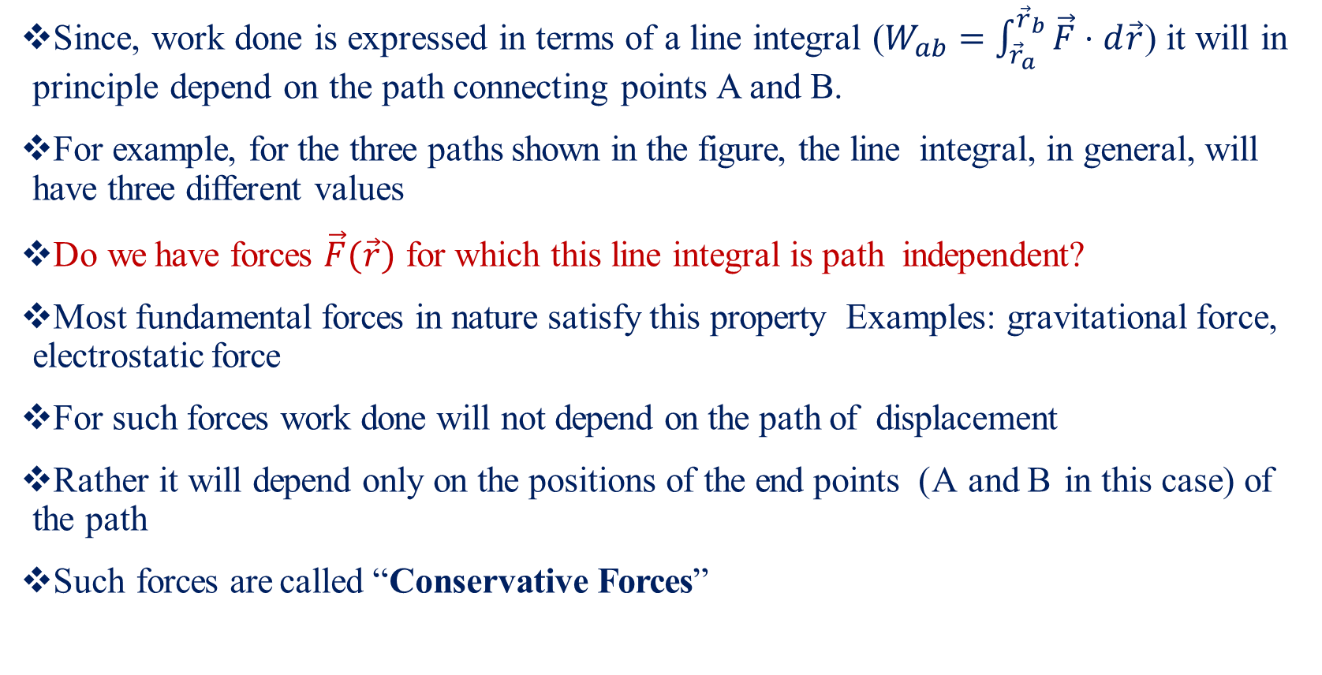
Conservative Forces
Since, work done is expressed in terms of a line integral ($W_{ab}=\int_{{\vec{r}}_{a}}^{{\vec{r}}_{b}}{\vec{F}⋅d\vec{r}}$) it will in principle depend on the path connecting points A and B.
For example, for the three paths shown in the figure, the line integral, in general, will have three different values
Do we have forces $\vec{F}(\vec{r})$ for which this line integral is path independent?
Most fundamental forces in nature satisfy this property Examples: gravitational force, electrostatic force
For such forces work done will not depend on the path of displacement
Rather it will depend only on the positions of the end points (A and B in this case) of the path
Such forces are called “Conservative Forces”
B
1
3
2
A

Slide 8
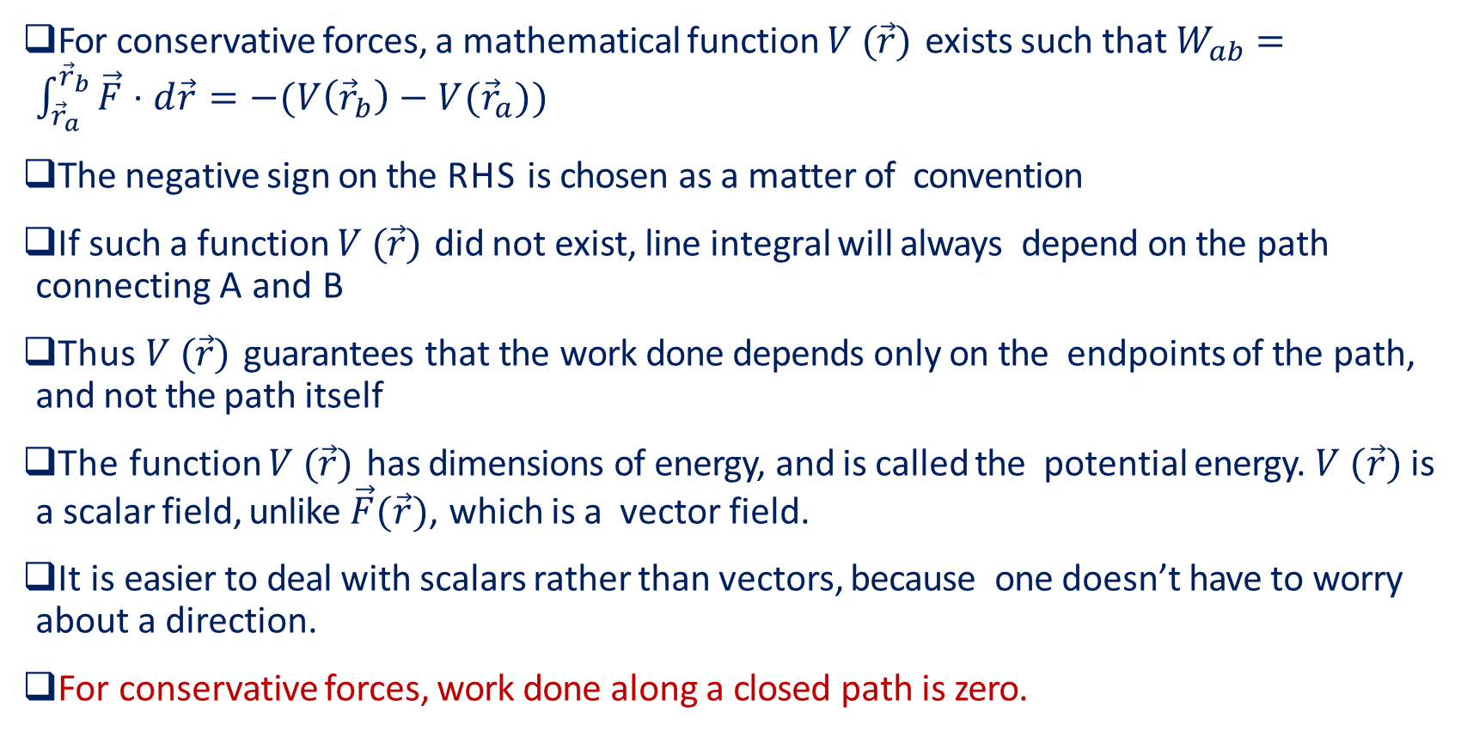
Potential Energy-I
For conservative forces, a mathematical function $V (\vec{r})$ exists such that $W_{ab}=\int_{{\vec{r}}_{a}}^{{\vec{r}}_{b}}{\vec{F}⋅d\vec{r}}=−(V\left({\vec{r}}_{b}\right)−V({\vec{r}}_{a}))$
The negative sign on the RHS is chosen as a matter of convention
If such a function $V (\vec{r})$ did not exist, line integral will always depend on the path connecting A and B
Thus $V (\vec{r})$ guarantees that the work done depends only on the endpoints of the path, and not the path itself
The function $V (\vec{r})$ has dimensions of energy, and is called the potential energy. $V (\vec{r})$ is a scalar field, unlike $\vec{F}(\vec{r})$, which is a vector field.
It is easier to deal with scalars rather than vectors, because one doesn’t have to worry about a direction.
For conservative forces, work done along a closed path is zero.

Slide 9
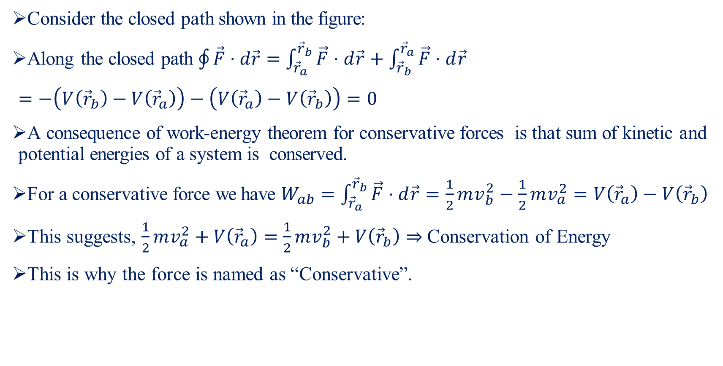
Potential Energy-II
B
Consider the closed path shown in the figure:
Along the closed path $\oint{\vec{F}⋅d\vec{r}}=\int_{{\vec{r}}_{a}}^{{\vec{r}}_{b}}{\vec{F}⋅d\vec{r}}+\int_{{\vec{r}}_{b}}^{{\vec{r}}_{a}}{\vec{F}⋅d\vec{r}}$
$=−\left(V\left({\vec{r}}_{b}\right)−V\left({\vec{r}}_{a}\right)\right)−\left(V\left({\vec{r}}_{a}\right)−V\left({\vec{r}}_{b}\right)\right)=0$
A consequence of work-energy theorem for conservative forces is that sum of kinetic and potential energies of a system is conserved.
For a conservative force we have $W_{ab}=\int_{{\vec{r}}_{a}}^{{\vec{r}}_{b}}{\vec{F}⋅d\vec{r}}=\frac{1}{2}mv_{b}^{2}−\frac{1}{2}mv_{a}^{2}=V\left({\vec{r}}_{a}\right)−V\left({\vec{r}}_{b}\right)$
This suggests, $\frac{1}{2}mv_{a}^{2}+V\left({\vec{r}}_{a}\right)=\frac{1}{2}mv_{b}^{2}+V\left({\vec{r}}_{b}\right)⇒$ Conservation of Energy
This is why the force is named as “Conservative”.
1
2
A

Slide 10
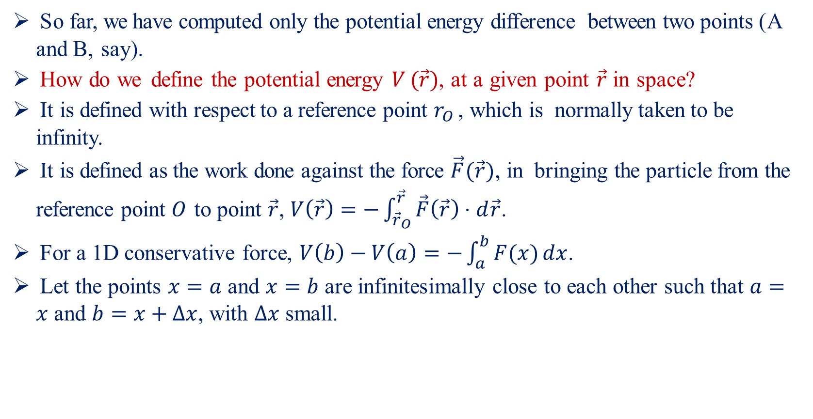
Potential Energy-III
So far, we have computed only the potential energy difference between two points (A and B, say).
How do we define the potential energy $V (\vec{r})$, at a given point $\vec{r}$ in space?
It is defined with respect to a reference point $r_{O}$ , which is normally taken to be infinity.
It is defined as the work done against the force $\vec{F}(\vec{r})$, in bringing the particle from the reference point $O$ to point $\vec{r}$, $V\left(\vec{r}\right)=−\int_{{\vec{r}}_{O}}^{\vec{r}}{\vec{F}\left(\vec{r}\right)⋅d\vec{r}}$.
For a 1D conservative force, $V\left(b\right)−V\left(a\right)=−\int_{a}^{b}{F(x)}dx$.
Let the points $x=a$ and $x=b$ are infinitesimally close to each other such that $a=x$ and $b=x+Δx$, with $Δx$ small.

Slide 11
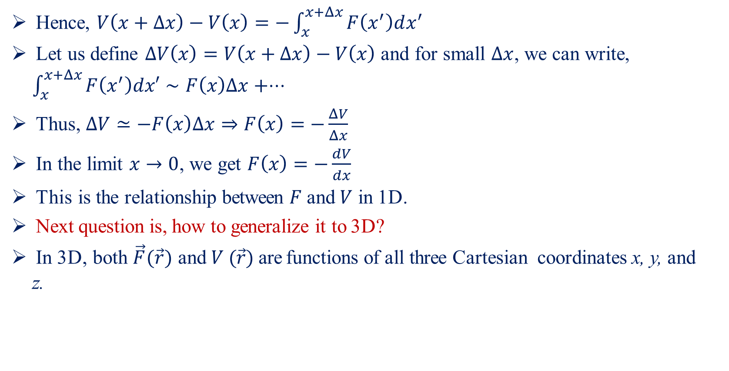
Potential Energy-IV
Hence, $V\left(x+Δx\right)−V\left(x\right)=−\int_{x}^{x+Δx}{F\left(x^{′}\right)dx^{′}}$
Let us define $ΔV\left(x\right)=V\left(x+Δx\right)−V\left(x\right)$ and for small $Δx$, we can write, $\int_{x}^{x+Δx}{F\left(x^{′}\right)dx′}∼F\left(x\right)Δx+⋅⋅⋅$
Thus, $ΔV≃−F\left(x\right)Δx⇒F\left(x\right)=−\frac{ΔV}{Δx}$
In the limit $x→0$, we get $F\left(x\right)=−\frac{dV}{dx}$
This is the relationship between $F$ and $V$ in 1D.
Next question is, how to generalize it to 3D?
In 3D, both $\vec{F}(\vec{r})$ and $V (\vec{r})$ are functions of all three Cartesian coordinates x, y, and z.

Slide 12
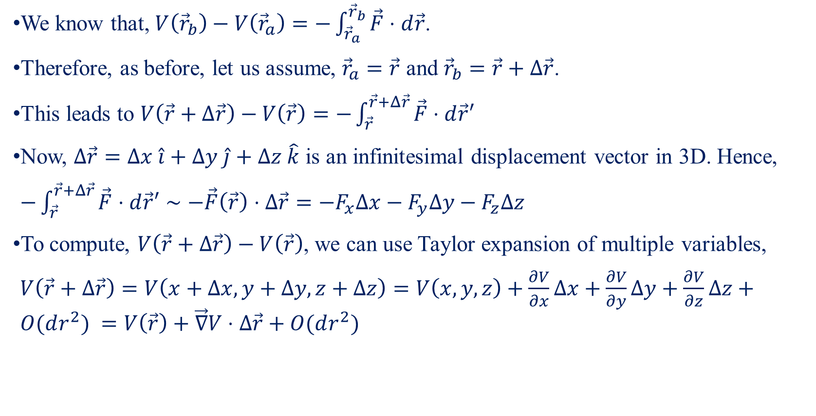
Potential Energy-V
We know that, $V\left({\vec{r}}_{b}\right)−V\left({\vec{r}}_{a}\right)=−\int_{{\vec{r}}_{a}}^{{\vec{r}}_{b}}{\vec{F}⋅d\vec{r}}$.
Therefore, as before, let us assume, ${\vec{r}}_{a}=\vec{r}$ and ${\vec{r}}_{b}=\vec{r}+Δ\vec{r}$.
This leads to $V\left(\vec{r}+Δ\vec{r}\right)−V\left(\vec{r}\right)=−\int_{\vec{r}}^{\vec{r}+Δ\vec{r}}{\vec{F}⋅d\vec{r}′}$
Now, $Δ\vec{r}=Δx \hat{i}+Δy \hat{j}+Δz \hat{k}$ is an infinitesimal displacement vector in 3D. Hence,
$−\int_{\vec{r}}^{\vec{r}+Δ\vec{r}}{\vec{F}⋅d\vec{r}′}∼−\vec{F}\left(\vec{r}\right)⋅Δ\vec{r}=−F_{x}Δx−F_{y}Δy−F_{z}Δz$
To compute, $V\left(\vec{r}+Δ\vec{r}\right)−V\left(\vec{r}\right)$, we can use Taylor expansion of multiple variables,
$V\left(\vec{r}+Δ\vec{r}\right)=V\left(x+Δx, y+Δy,z+Δz\right)=V\left(x,y,z\right)+\frac{∂V}{∂x}Δx+\frac{∂V}{∂y}Δy+\frac{∂V}{∂z}Δz+O(dr^{2}) =V\left(\vec{r}\right)+\vec{∇}V⋅Δ\vec{r}+O(dr^{2})$

Slide 13
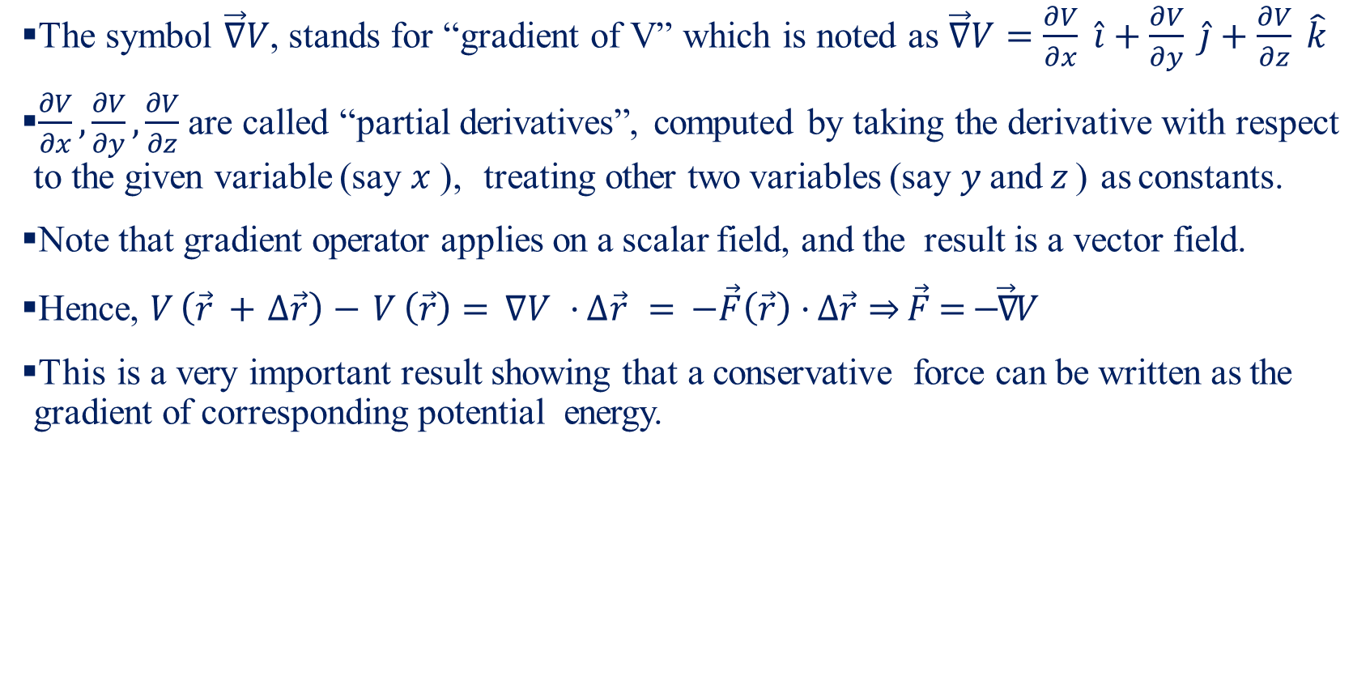
Potential Energy-VI
The symbol $\vec{∇}V$, stands for “gradient of V” which is noted as $\vec{∇}V=\frac{∂V}{∂x} \hat{i}+\frac{∂V}{∂y} \hat{j}+\frac{∂V}{∂z} \hat{k}$
$\frac{∂V}{∂x},\frac{∂V}{∂y},\frac{∂V}{∂z}$ are called “partial derivatives”, computed by taking the derivative with respect to the given variable (say $x$ ), treating other two variables (say $y$ and $z$ ) as constants.
Note that gradient operator applies on a scalar field, and the result is a vector field.
Hence, $V \left(\vec{r} + ∆\vec{r}\right)− V \left(\vec{r}\right)= ∇V · ∆\vec{r} = −\vec{F}\left(\vec{r}\right)· ∆\vec{r}⇒\vec{F}=−\vec{∇}V$
This is a very important result showing that a conservative force can be written as the gradient of corresponding potential energy.

