Slide 1
Mechanics
EPHY108L (2-0-2-3)
Ayan khan
Department of physics

Slide 2
Gradient, Divergence and Curl

Slide 3

Gradient-I
Let $f (x, y, z ) = r 2 = x 2 + y 2 + z 2$, then determine $\vec{∇}f$.
$\vec{∇}f = 2(x \hat{i} + y \hat{j} + z \hat{k}) = 2\vec{r}$
No Video Upload

Slide 4
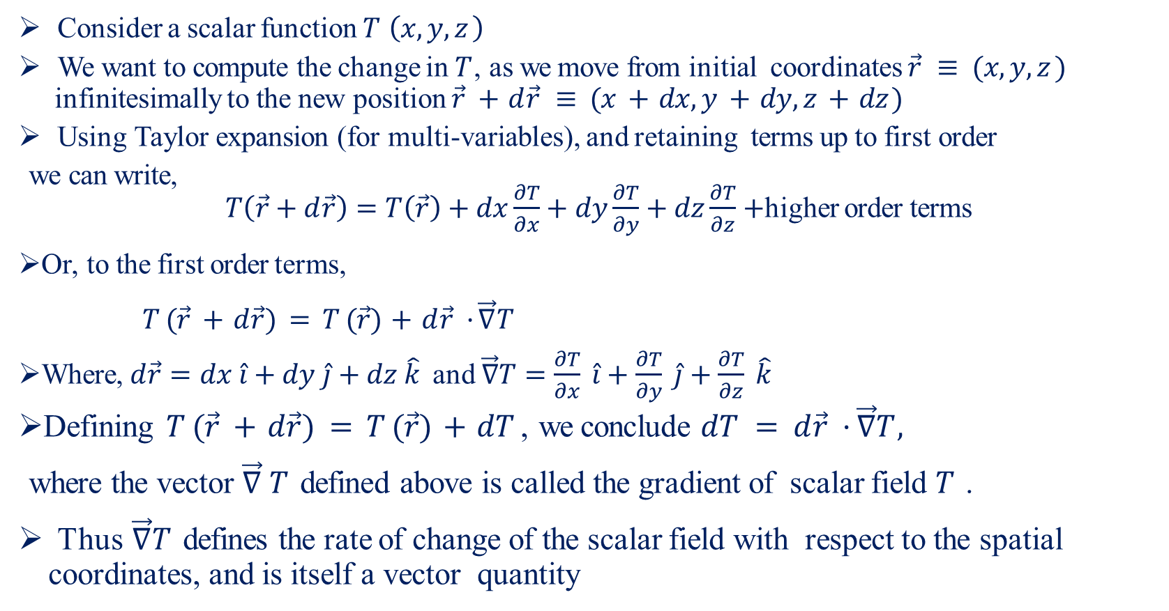
Gradient-II
Consider a scalar function $T \left(x, y, z \right)$
We want to compute the change in $T$, as we move from initial coordinates $\vec{r} ≡ (x, y, z )$ infinitesimally to the new position $\vec{r} + d\vec{r} ≡ (x + dx, y + dy, z + dz )$
Using Taylor expansion (for multi-variables), and retaining terms up to first order
we can write,
$T\left(\vec{r}+d\vec{r}\right)=T\left(\vec{r}\right)+dx\frac{∂T}{∂x}+dy\frac{∂T}{∂y}+dz\frac{∂T}{∂z}+$higher order terms
Or, to the first order terms,
$T (\vec{r} + d\vec{r}) = T (\vec{r}) + d\vec{r} · \vec{∇}T$
Where, $d\vec{r}=dx \hat{i}+dy \hat{j}+dz \hat{k}$ and $\vec{∇}T=\frac{∂T}{∂x} \hat{i}+\frac{∂T}{∂y} \hat{j}+\frac{∂T}{∂z} \hat{k}$
Defining $T (\vec{r} + d\vec{r}) = T (\vec{r}) + dT$ , we conclude $dT = d\vec{r} · \vec{∇}T,$
where the vector $\vec{∇} T$ defined above is called the gradient of scalar field $T$ .
Thus $\vec{∇}T$ defines the rate of change of the scalar field with respect to the spatial coordinates, and is itself a vector quantity

Slide 5
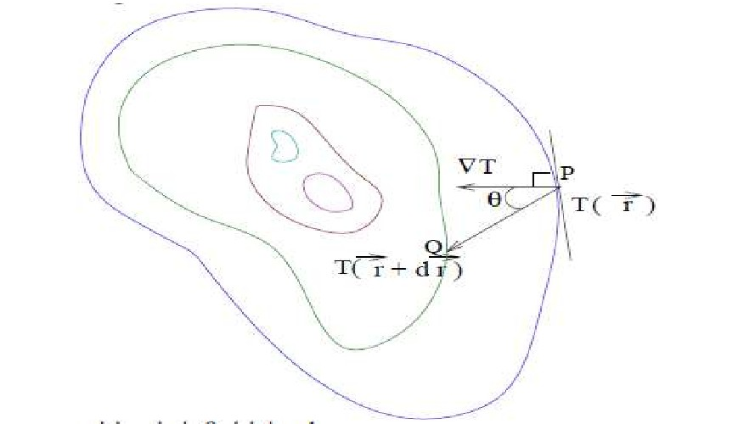
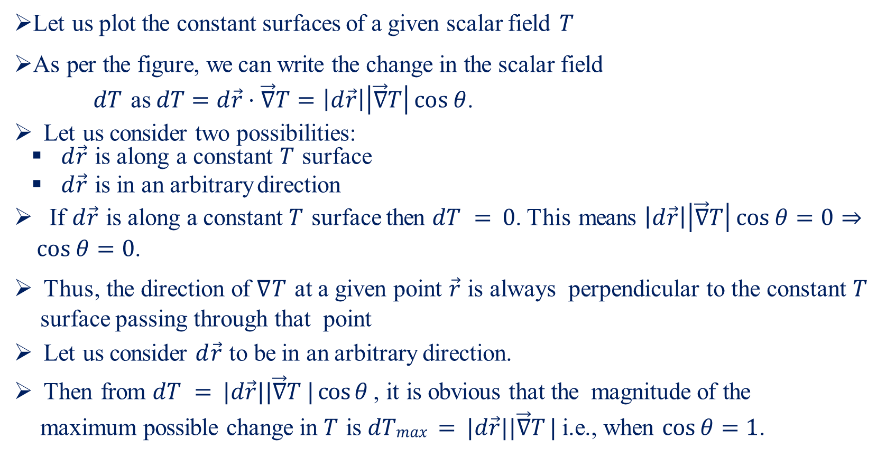
Gradient-III
Let us plot the constant surfaces of a given scalar field $T$
As per the figure, we can write the change in the scalar field
$dT$ as $dT=d\vec{r}⋅\vec{∇}T=\left|d\vec{r}\right|\left|\vec{∇}T\right|\cos{θ}$.
Let us consider two possibilities:
$d\vec{r}$ is along a constant $T$ surface
$d\vec{r}$ is in an arbitrary direction
If $d\vec{r}$ is along a constant $T$ surface then $dT = 0$. This means $\left|d\vec{r}\right|\left|\vec{∇}T\right|\cos{θ}=0⇒\cos{θ}=0$.
Thus, the direction of $∇T$ at a given point $\vec{r}$ is always perpendicular to the constant $T$ surface passing through that point
Let us consider $d\vec{r}$ to be in an arbitrary direction.
Then from $dT = |d\vec{r}||\vec{∇}T | cos⁡θ$ , it is obvious that the magnitude of the maximum possible change in $T$ is $dTmax = |d\vec{r}||\vec{∇}T |$ i.e., when $\cos{θ}=1$.

Slide 6
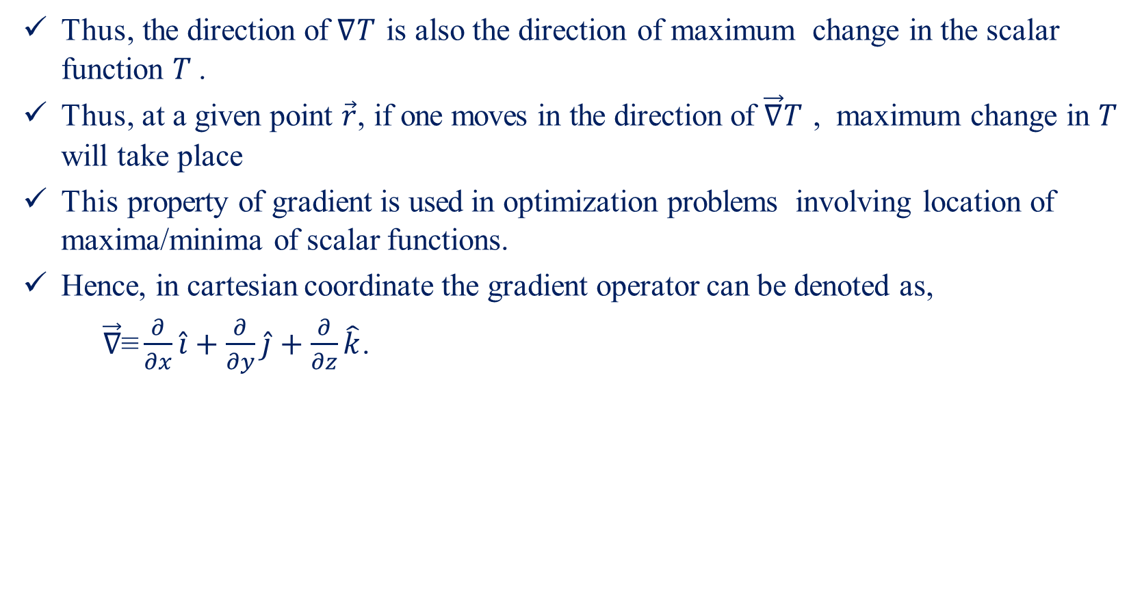
Gradient-IV
Thus, the direction of $∇T$ is also the direction of maximum change in the scalar function $T$ .
Thus, at a given point $\vec{r}$, if one moves in the direction of $\vec{∇}T$ , maximum change in $T$ will take place
This property of gradient is used in optimization problems involving location of maxima/minima of scalar functions.
Hence, in cartesian coordinate the gradient operator can be denoted as,
$\vec{∇}\text{≡}\frac{∂}{∂x}\hat{i}+\frac{∂}{∂y}\hat{j}+\frac{∂}{∂z}\hat{k}$.

Slide 7
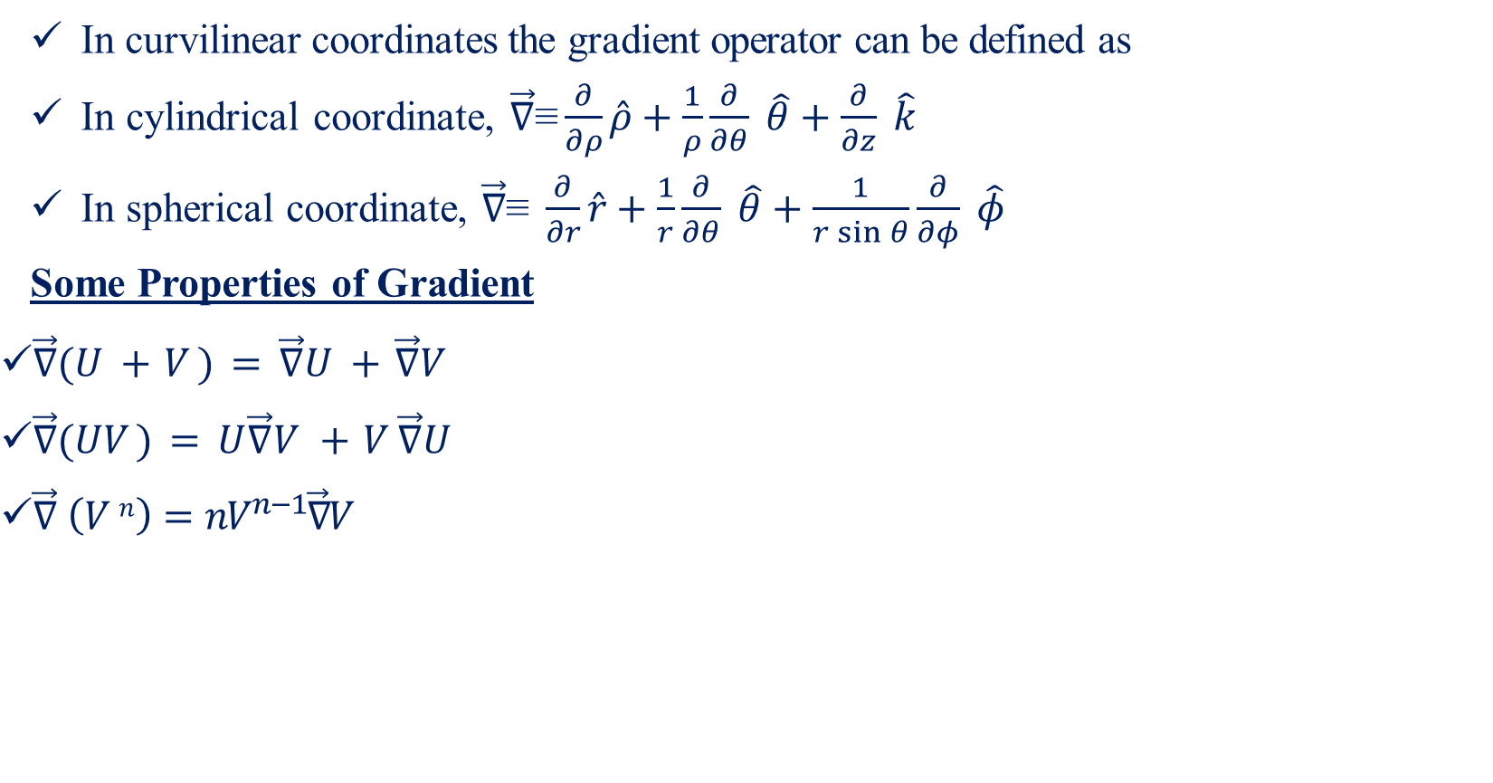
Gradient-V
In curvilinear coordinates the gradient operator can be defined as
In cylindrical coordinate, $\vec{∇}\text{≡}\frac{∂}{∂ρ}\hat{ρ}+\frac{1}{ρ}\frac{∂}{∂θ} \hat{θ}+\frac{∂}{∂z} \hat{k}$
In spherical coordinate, $\vec{∇}\text{≡} \frac{∂}{∂r}\hat{r}+\frac{1}{r}\frac{∂}{∂θ} \hat{θ}+\frac{1}{r\sin{θ}}\frac{∂}{∂φ} \hat{φ}$
Some Properties of Gradient
$\vec{∇}(U + V ) = \vec{∇}U + \vec{∇}V$
$\vec{∇}(UV ) = U\vec{∇}V + V \vec{∇}U$
$\vec{∇} \left(V n\right)=nV^{n−1}\vec{∇}V$

Slide 8
Divergence
No Video Upload

Slide 9
Curl-I
No Video Upload

Slide 10
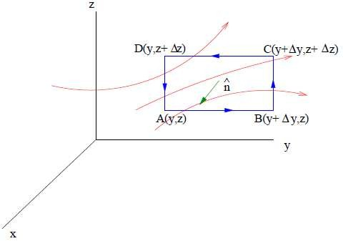
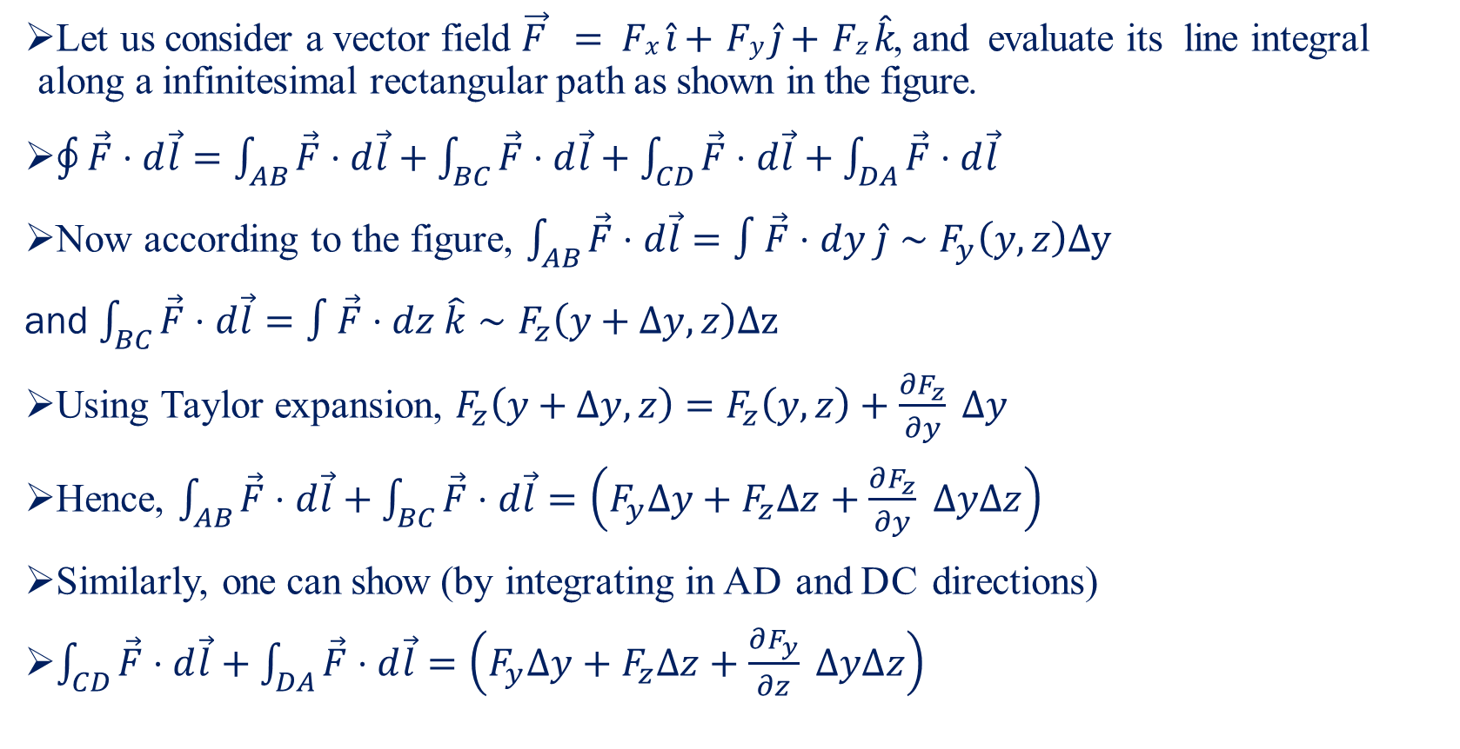
Curl-II
Let us consider a vector field $\vec{F} = Fx \hat{i}+ Fy \hat{j}+ Fz \hat{k}$, and evaluate its line integral along a infinitesimal rectangular path as shown in the figure.
$\oint{\vec{F}⋅d\vec{l}}=\int_{AB}{\vec{F}⋅d\vec{l}}+\int_{BC}{\vec{F}⋅d\vec{l}}+\int_{CD}{\vec{F}⋅d\vec{l}}+\int_{DA}{\vec{F}⋅d\vec{l}}$
Now according to the figure, $\int_{AB}{\vec{F}⋅d\vec{l}}=∫\vec{F}⋅dy \hat{j}∼F_{y}\left(y,z\right)Δy$
and $\int_{BC}{\vec{F}⋅d\vec{l}}=∫\vec{F}⋅dz \hat{k}∼F_{z}\left(y+Δy,z\right)Δz$
Using Taylor expansion, $F_{z}\left(y+Δy,z\right)=F_{z}\left(y,z\right)+\frac{∂F_{z}}{∂y} Δy$
Hence, $\int_{AB}{\vec{F}⋅d\vec{l}}+\int_{BC}{\vec{F}⋅d\vec{l}}=\left(F_{y}Δy+F_{z}Δz+\frac{∂F_{z}}{∂y} ΔyΔz\right)$
Similarly, one can show (by integrating in AD and DC directions)
$\int_{CD}{\vec{F}⋅d\vec{l}}+\int_{DA}{\vec{F}⋅d\vec{l}}=\left(F_{y}Δy+F_{z}Δz+\frac{∂F_{y}}{∂z} ΔyΔz\right)$

Slide 11
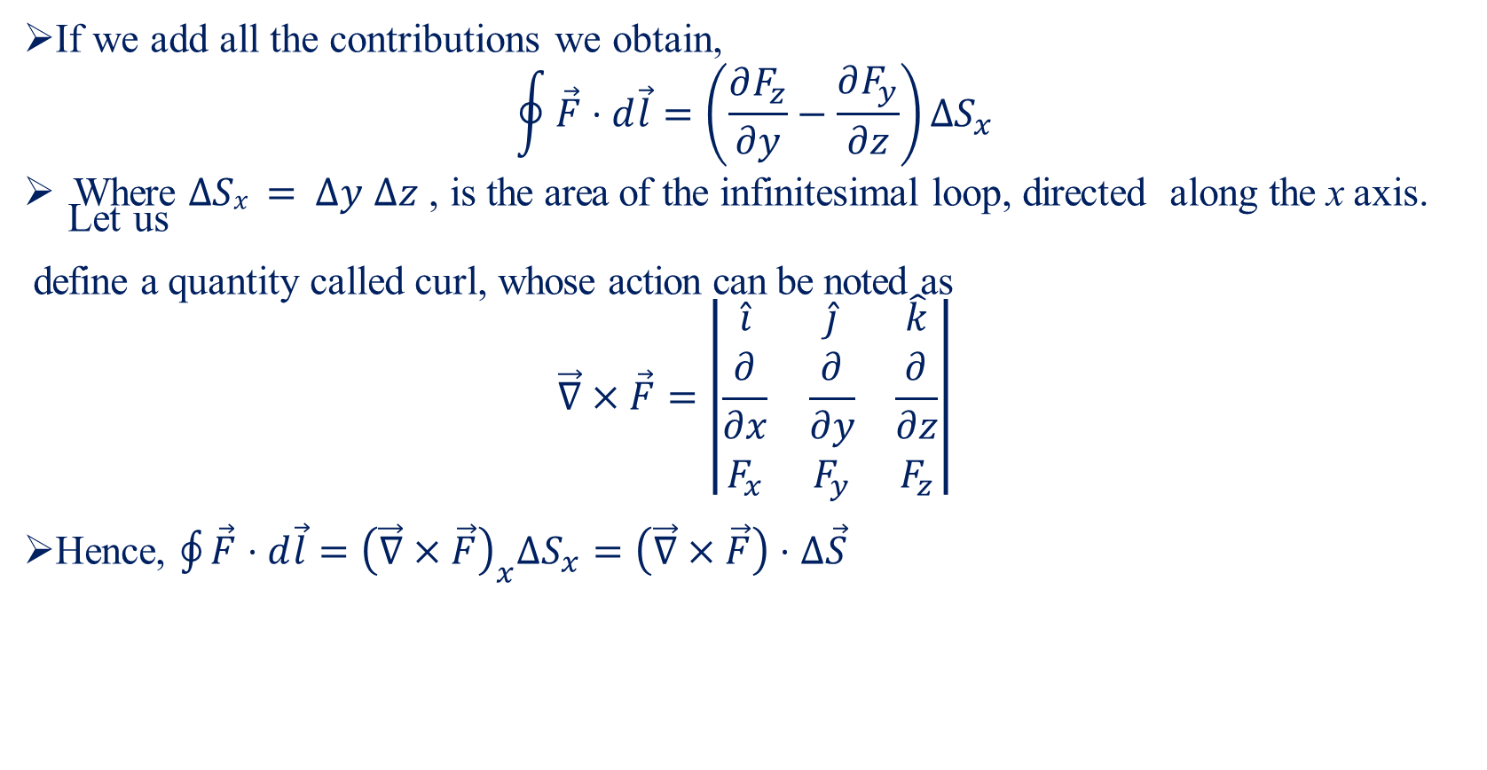
Curl-III
If we add all the contributions we obtain,
$$\oint{\vec{F}⋅d\vec{l}}=\left(\frac{∂F_{z}}{∂y}−\frac{∂F_{y}}{∂z}\right)ΔS_{x}$$
Where $∆Sx = ∆y ∆z$ , is the area of the infinitesimal loop, directed along the x axis. Let us
define a quantity called curl, whose action can be noted as
$$\vec{∇}×\vec{F}=\left|\begin{matrix}\hat{i} & \hat{j} & \hat{k} \\ \frac{∂}{∂x} & \frac{∂}{∂y} & \frac{∂}{∂z} \\ F_{x} & F_{y} & F_{z}\end{matrix}\right|$$
Hence, $\oint{\vec{F}⋅d\vec{l}}={\left(\vec{∇}×\vec{F}\right)}_{x}ΔS_{x}=\left(\vec{∇}×\vec{F}\right)⋅Δ\vec{S}$

Slide 12
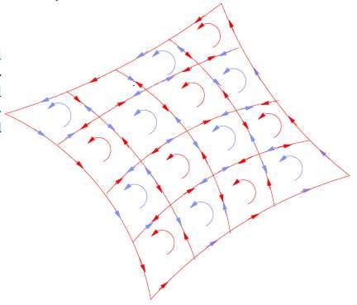
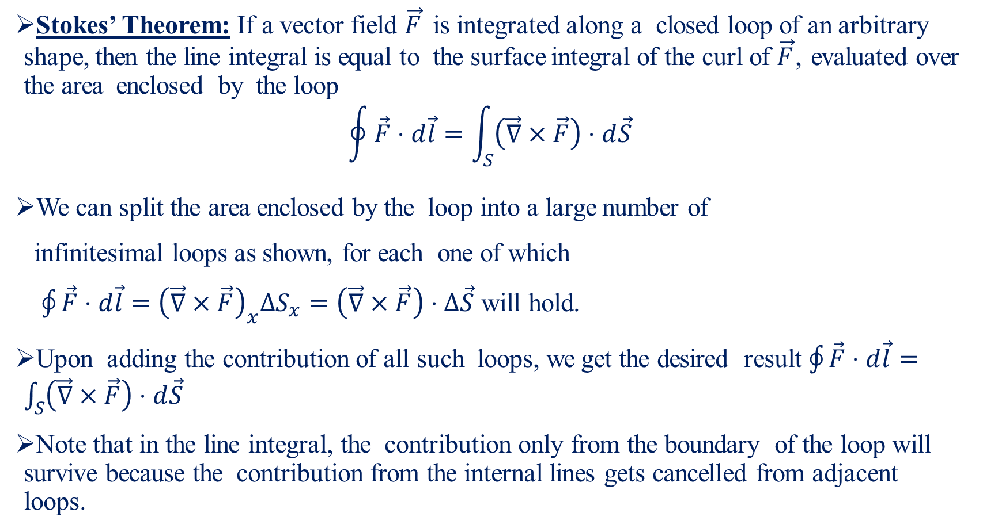
Curl-IV
Stokes’ Theorem: If a vector field $\vec{F}$ is integrated along a closed loop of an arbitrary shape, then the line integral is equal to the surface integral of the curl of $\vec{F}$, evaluated over the area enclosed by the loop
$$\oint{\vec{F}⋅d\vec{l}}=\int_{S}{\left(\vec{∇}×\vec{F}\right)⋅d\vec{S}}$$
We can split the area enclosed by the loop into a large number of
infinitesimal loops as shown, for each one of which
$\oint{\vec{F}⋅d\vec{l}}={\left(\vec{∇}×\vec{F}\right)}_{x}ΔS_{x}=\left(\vec{∇}×\vec{F}\right)⋅Δ\vec{S}$ will hold.
Upon adding the contribution of all such loops, we get the desired result $\oint{\vec{F}⋅d\vec{l}}=\int_{S}{\left(\vec{∇}×\vec{F}\right)⋅d\vec{S}}$
Note that in the line integral, the contribution only from the boundary of the loop will survive because the contribution from the internal lines gets cancelled from adjacent loops.

Slide 13
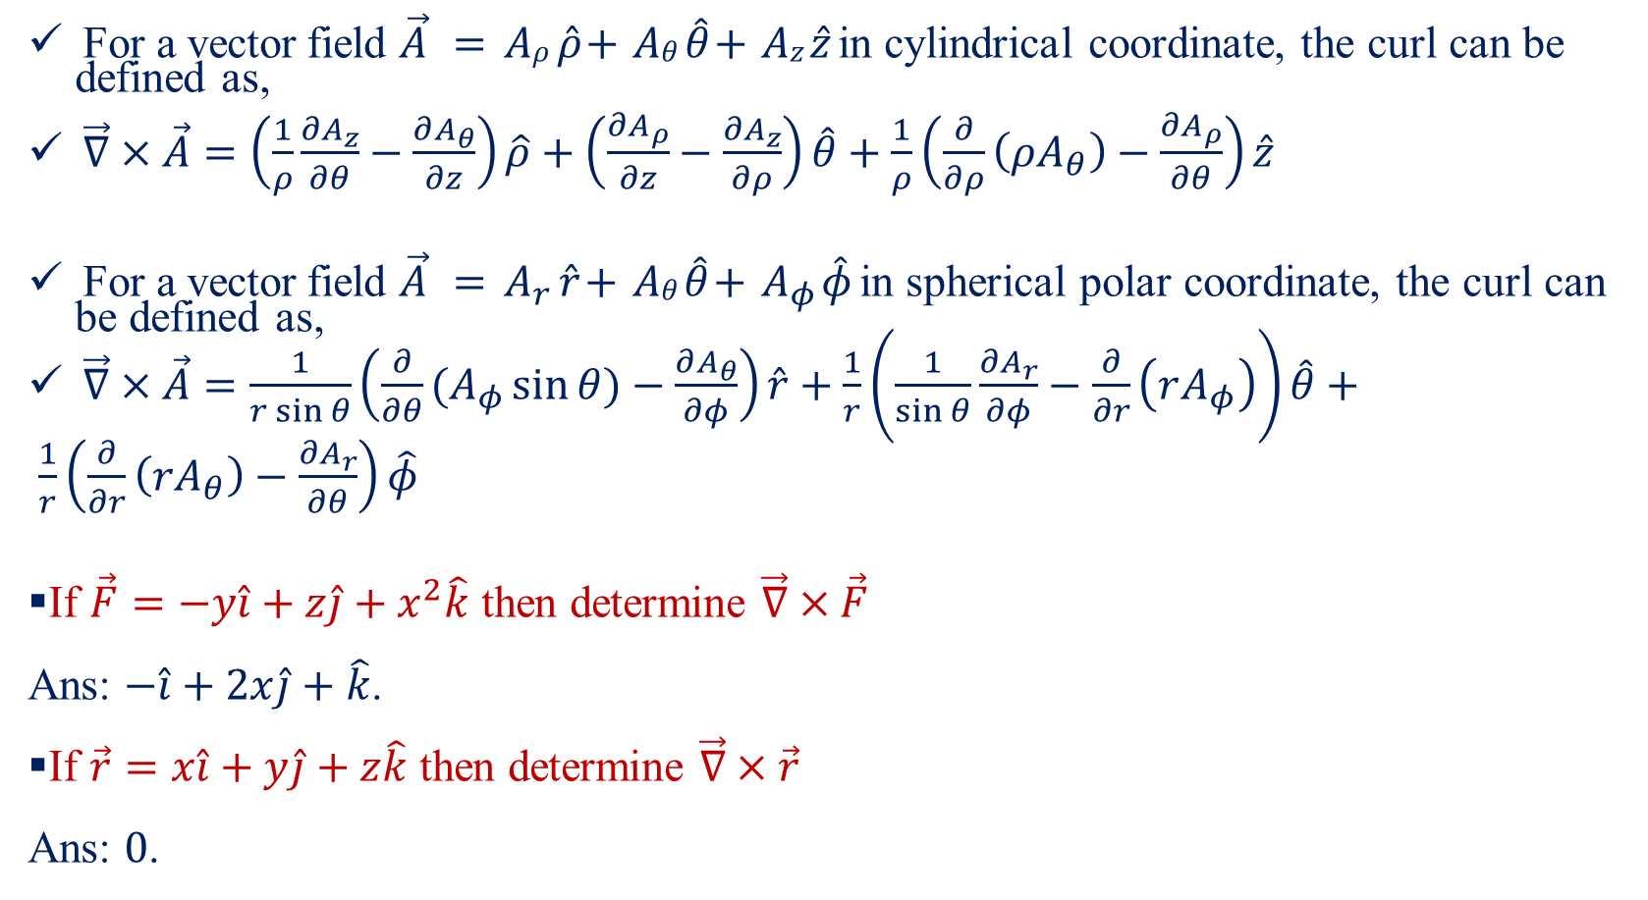
Curl-V
For a vector field $\vec{A} = Aρ \hat{ρ}+ Aθ \hat{θ}+ Az \hat{z}$ in cylindrical coordinate, the curl can be defined as,
$\vec{∇}×\vec{A}=\left(\frac{1}{ρ}\frac{∂A_{z}}{∂θ}−\frac{∂A_{θ}}{∂z}\right)\hat{ρ}+\left(\frac{∂A_{ρ}}{∂z}−\frac{∂A_{z}}{∂ρ}\right)\hat{θ}+\frac{1}{ρ}\left(\frac{∂}{∂ρ}\left(ρA_{θ}\right)−\frac{∂A_{ρ}}{∂θ}\right)\hat{z}$
For a vector field $\vec{A} = A_{r} \hat{r}+ Aθ \hat{θ}+ A_{φ} \hat{φ}$ in spherical polar coordinate, the curl can be defined as,
$\vec{∇}×\vec{A}=\frac{1}{r\sin{θ}}\left(\frac{∂}{∂θ}(A_{φ}\sin{θ)}−\frac{∂A_{θ}}{∂φ}\right)\hat{r}+\frac{1}{r}\left(\frac{1}{\sin{θ}}\frac{∂A_{r}}{∂φ}−\frac{∂}{∂r}\left(rA_{φ}\right)\right)\hat{θ}+$
$\frac{1}{r}\left(\frac{∂}{∂r}\left(rA_{θ}\right)−\frac{∂A_{r}}{∂θ}\right)\hat{φ}$
If $\vec{F}=−y\hat{i}+z\hat{j}+x^{2}\hat{k}$ then determine $\vec{∇}×\vec{F}$
Ans: $−\hat{i}+2x\hat{j}+\hat{k}$.
If $\vec{r}=x\hat{i}+y\hat{j}+z\hat{k}$ then determine $\vec{∇}×\vec{r}$
Ans: $0$.

Slide 14
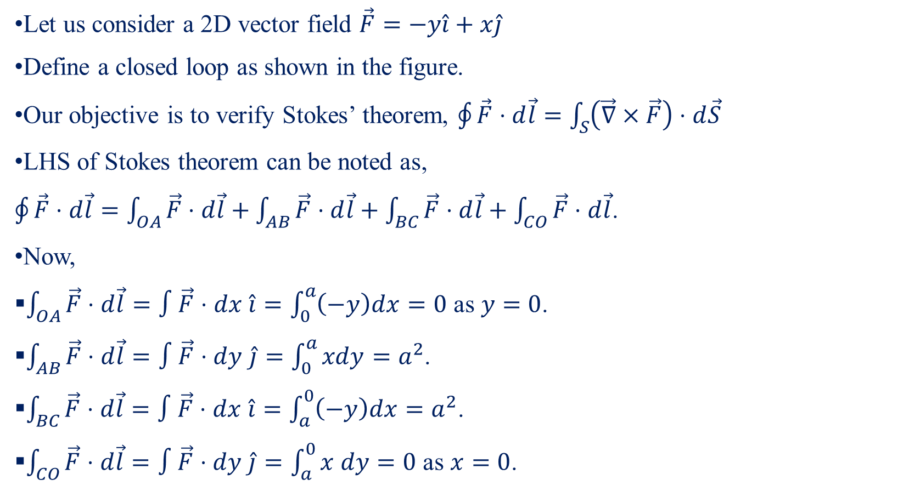
Curl-VI
Y
Let us consider a 2D vector field $\vec{F}=−y\hat{i}+x\hat{j}$
Define a closed loop as shown in the figure.
Our objective is to verify Stokes’ theorem, $\oint{\vec{F}⋅d\vec{l}}=\int_{S}{\left(\vec{∇}×\vec{F}\right)⋅d\vec{S}}$
LHS of Stokes theorem can be noted as,
$\oint{\vec{F}⋅d\vec{l}}=\int_{OA}{\vec{F}⋅d\vec{l}}+\int_{AB}{\vec{F}⋅d\vec{l}}+\int_{BC}{\vec{F}⋅d\vec{l}}+\int_{CO}{\vec{F}⋅d\vec{l}}$.
Now,
$\int_{OA}{\vec{F}⋅d\vec{l}}=∫\vec{F}⋅dx \hat{i}=\int_{0}^{a}{\left(−y\right)dx}=0$ as $y=0$.
$\int_{AB}{\vec{F}⋅d\vec{l}}=∫\vec{F}⋅dy \hat{j}=\int_{0}^{a}{xdy}=a^{2}$.
$\int_{BC}{\vec{F}⋅d\vec{l}}=∫\vec{F}⋅dx \hat{i}=\int_{a}^{0}{\left(−y\right)dx}=a^{2}$.
$\int_{CO}{\vec{F}⋅d\vec{l}}=∫\vec{F}⋅dy \hat{j}=\int_{a}^{0}{x dy}=0$ as $x=0$.
C
B (a,a)
X
O
A

Slide 15
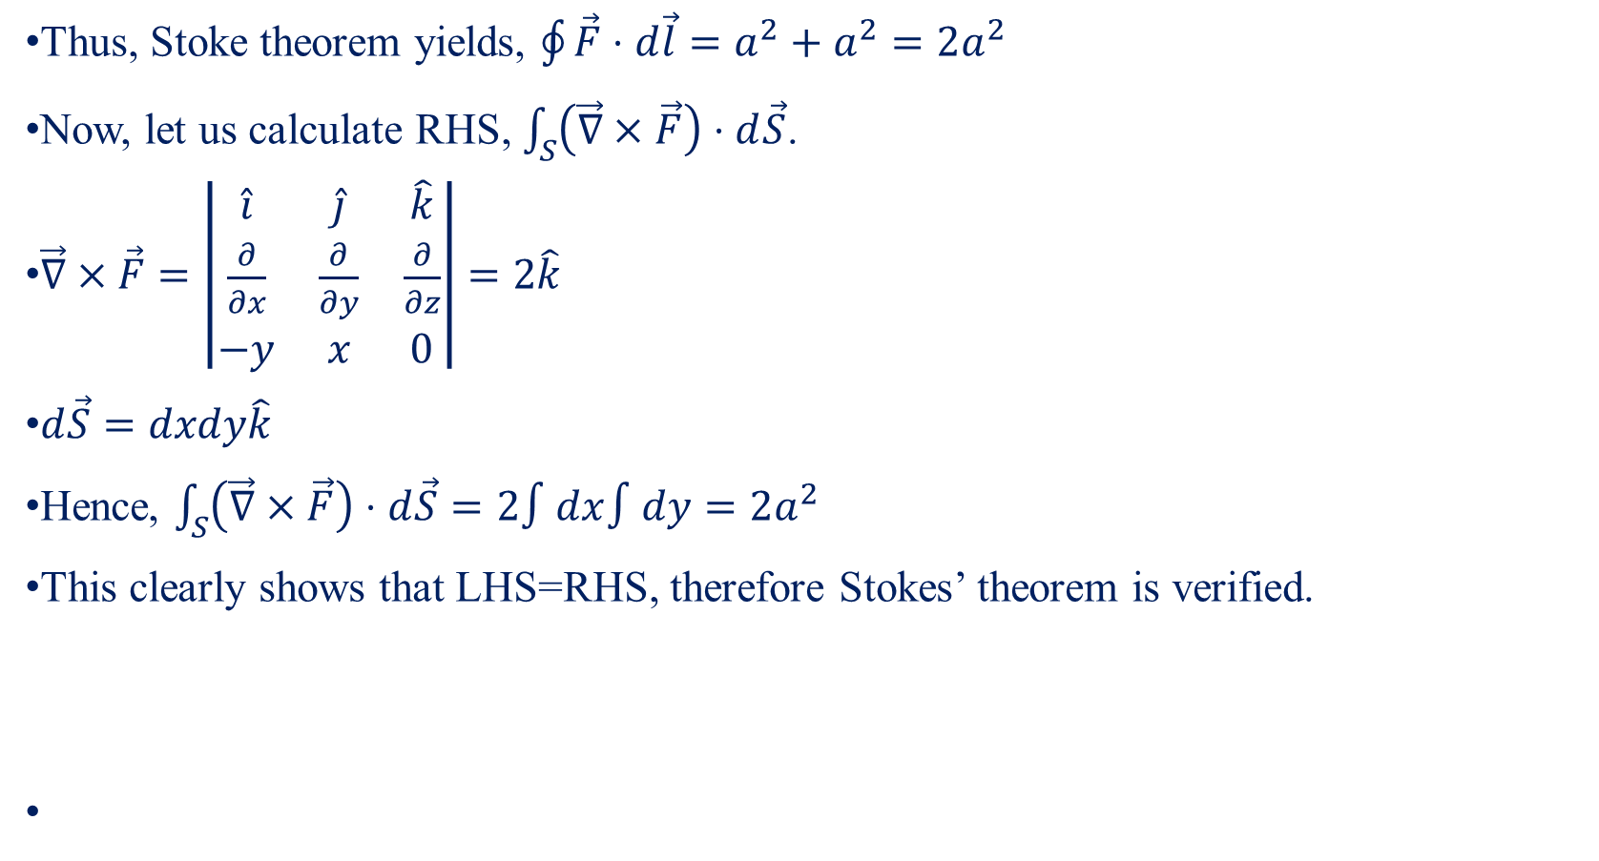
Curl-VII
Thus, Stoke theorem yields, $\oint{\vec{F}⋅d\vec{l}}=a^{2}+a^{2}=2a^{2}$
Now, let us calculate RHS, $\int_{S}{\left(\vec{∇}×\vec{F}\right)⋅d\vec{S}}$.
$\vec{∇}×\vec{F}=\left|\begin{matrix}\hat{i} & \hat{j} & \hat{k} \\ \frac{∂}{∂x} & \frac{∂}{∂y} & \frac{∂}{∂z} \\ −y & x & 0\end{matrix}\right|=2\hat{k}$
$d\vec{S}=dxdy\hat{k}$
Hence, $\int_{S}{\left(\vec{∇}×\vec{F}\right)⋅d\vec{S}}=2∫dx∫dy=2a^{2}$
This clearly shows that LHS=RHS, therefore Stokes’ theorem is verified.

Slide 16
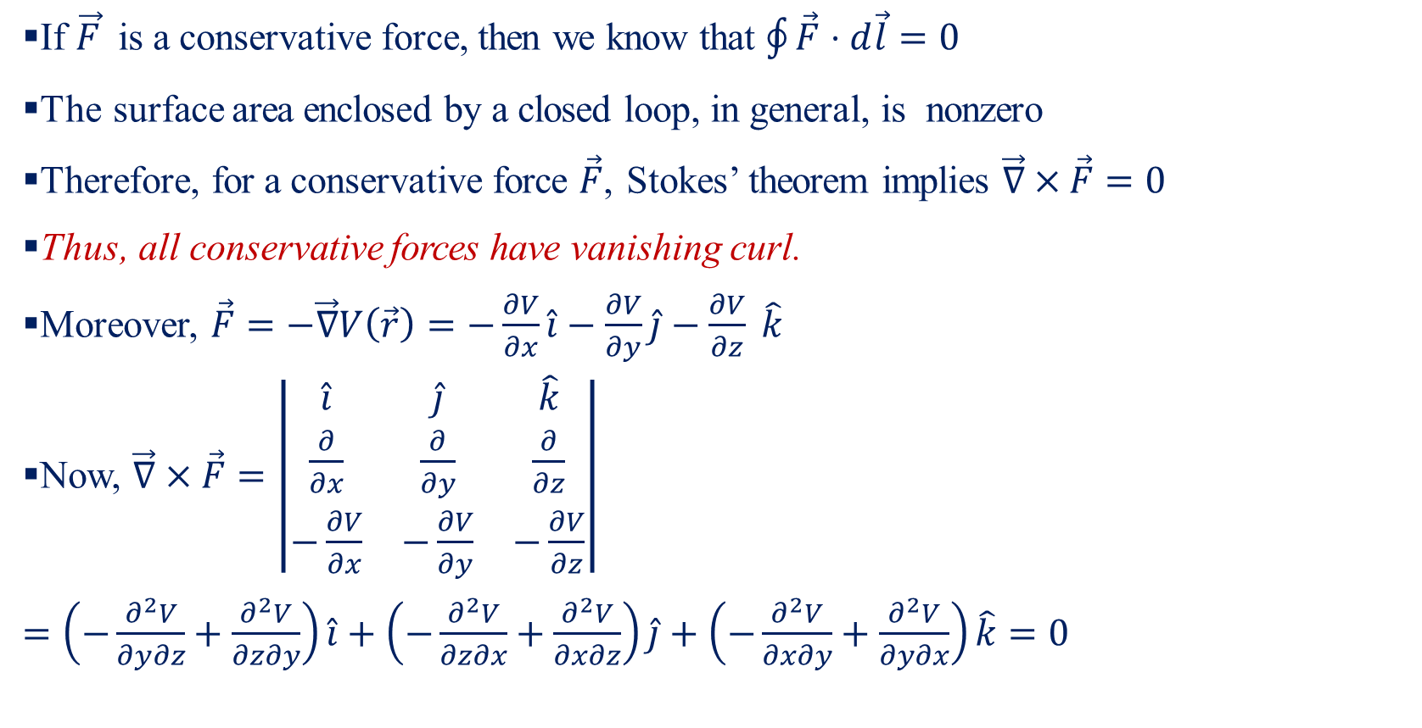
Curl and Conservative Force-I
If $\vec{F}$ is a conservative force, then we know that $\oint{\vec{F}⋅d\vec{l}}=0$
The surface area enclosed by a closed loop, in general, is nonzero
Therefore, for a conservative force $\vec{F}$, Stokes’ theorem implies $\vec{∇}×\vec{F}=0$
Thus, all conservative forces have vanishing curl.
Moreover, $\vec{F}=−\vec{∇}V\left(\vec{r}\right)=−\frac{∂V}{∂x}\hat{i}−\frac{∂V}{∂y}\hat{j}−\frac{∂V}{∂z} \hat{k}$
Now, $\vec{∇}×\vec{F}=\left|\begin{matrix}\hat{i} & \hat{j} & \hat{k} \\ \frac{∂}{∂x} & \frac{∂}{∂y} & \frac{∂}{∂z} \\ −\frac{∂V}{∂x} & −\frac{∂V}{∂y} & −\frac{∂V}{∂z}\end{matrix}\right|$
$=\left(−\frac{∂^{2}V}{∂y∂z}+\frac{∂^{2}V}{∂z∂y}\right)\hat{i}+\left(−\frac{∂^{2}V}{∂z∂x}+\frac{∂^{2}V}{∂x∂z}\right)\hat{j}+\left(−\frac{∂^{2}V}{∂x∂y}+\frac{∂^{2}V}{∂y∂x}\right)\hat{k}=0$

Slide 17
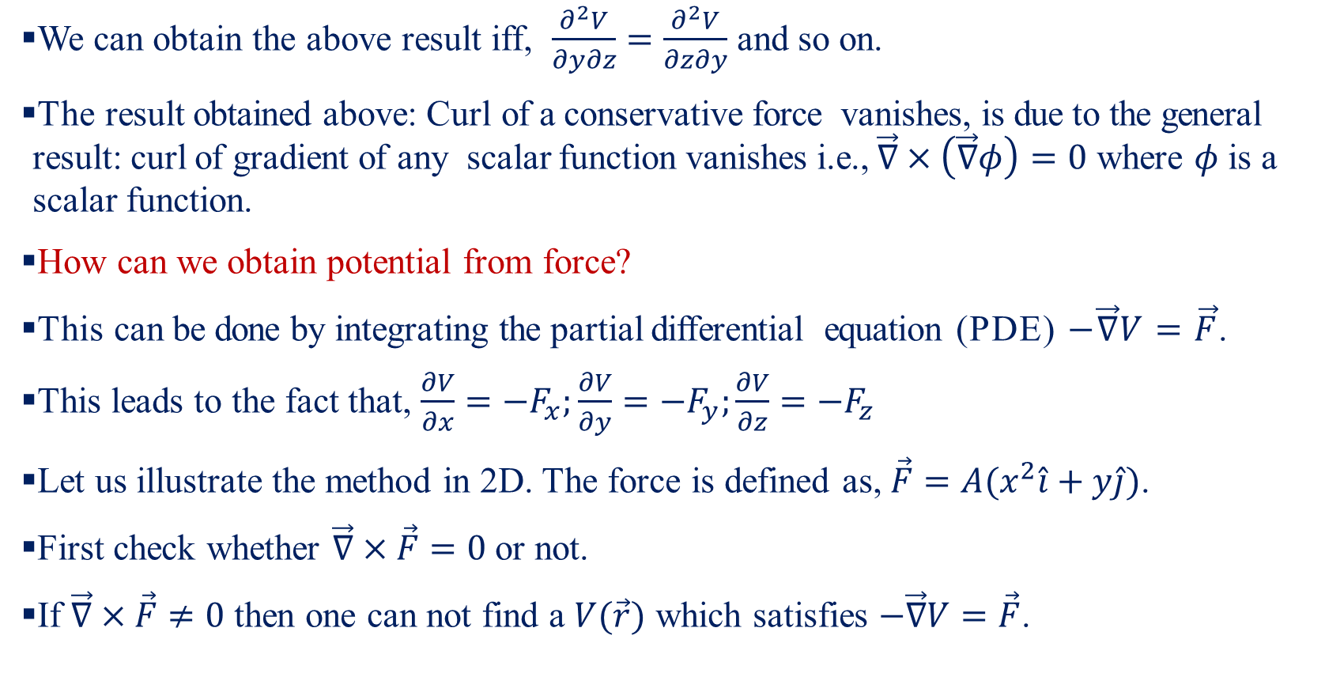
Curl and Conservative Force-II
We can obtain the above result iff, $\frac{∂^{2}V}{∂y∂z}=\frac{∂^{2}V}{∂z∂y}$ and so on.
The result obtained above: Curl of a conservative force vanishes, is due to the general result: curl of gradient of any scalar function vanishes i.e., $\vec{∇}×\left(\vec{∇}φ\right)=0$ where $φ$ is a scalar function.
How can we obtain potential from force?
This can be done by integrating the partial differential equation (PDE) $−\vec{∇}V=\vec{F}$.
This leads to the fact that, $\frac{∂V}{∂x}=−F_{x};\frac{∂V}{∂y}=−F_{y};\frac{∂V}{∂z}=−F_{z}$
Let us illustrate the method in 2D. The force is defined as, $\vec{F}=A(x^{2}\hat{i}+y\hat{j})$.
First check whether $\vec{∇}×\vec{F}=0$ or not.
If $\vec{∇}×\vec{F}≠0$ then one can not find a $V(\vec{r})$ which satisfies $−\vec{∇}V=\vec{F}$.

Slide 18
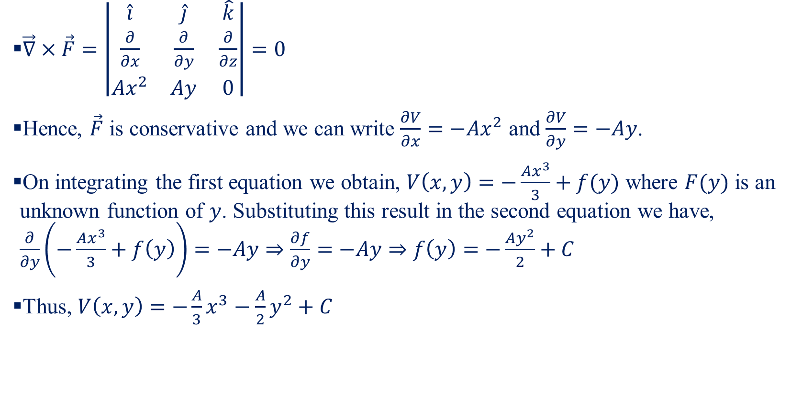
Curl and Conservative Force-III
$\vec{∇}×\vec{F}=\left|\begin{matrix}\hat{i} & \hat{j} & \hat{k} \\ \frac{∂}{∂x} & \frac{∂}{∂y} & \frac{∂}{∂z} \\ Ax^{2} & Ay & 0\end{matrix}\right|=0$
Hence, $\vec{F}$ is conservative and we can write $\frac{∂V}{∂x}=−Ax^{2}$ and $\frac{∂V}{∂y}=−Ay$.
On integrating the first equation we obtain, $V\left(x,y\right)=−\frac{Ax^{3}}{3}+f(y)$ where $F(y)$ is an unknown function of $y$. Substituting this result in the second equation we have, $\frac{∂}{∂y}\left(−\frac{Ax^{3}}{3}+f\left(y\right)\right)=−Ay⇒\frac{∂f}{∂y}=−Ay⇒f\left(y\right)=−\frac{Ay^{2}}{2}+C$
Thus, $V\left(x,y\right)=−\frac{A}{3}x^{3}−\frac{A}{2}y^{2}+C$

