Slide 1
Insights into Lending Risks
Optimizing Loan Approvals Through Identification Risky Applicant
Amaan Shaikh
Senior Analyst at Tiger Analytics

Slide 2
Table of content
Background
Business Problem
Dataset Overview
Objectives
Data Cleaning & Preprocessing
Key Insights
Numerical Variables (Part-1)
Numerical Variables (Part-2)
Categorical Variables (Part-1)
Categorical Variables (Part-2)
Categorical Variables (Part-3)
Categorical Variables (Part-4)
Indirect Impact Factors
Recommendations
Challenges & Assumptions
Conclusion
GitHub Repository
Visualizations Overview (Archive)

Slide 3
Background
Company:
Challenge:
Focus:
Largest online loan marketplace facilitating personal and business loans.
High financial losses due to loan defaults.
Analyze historical loan data (2007–2011) to identify default risky applicants.

Slide 4
Business Problem
Problem:
Solution:
Financial losses caused by loan defaults.
Need for identifying risky loan applicants during the approval process.

Slide 5
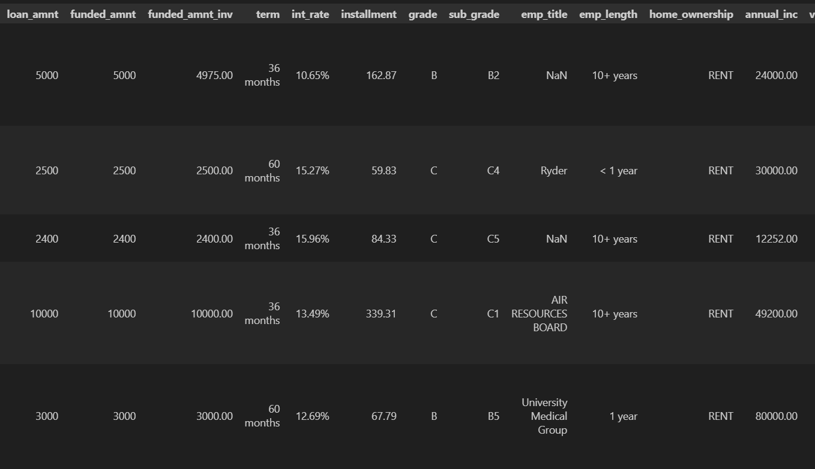
Dataset Overview
loan.csv: Historical loan data (2007–2011).
Data_Directory.xlsx: Variable descriptions.
Key Features: Loan amount, interest rate, annual income, credit history, etc.

Slide 6
Objectives
Conduct exploratory data analysis (EDA) to:
Identify strong indicators of loan default.
Highlight potential risky applicants.
Provide actionable recommendations.

Slide 7
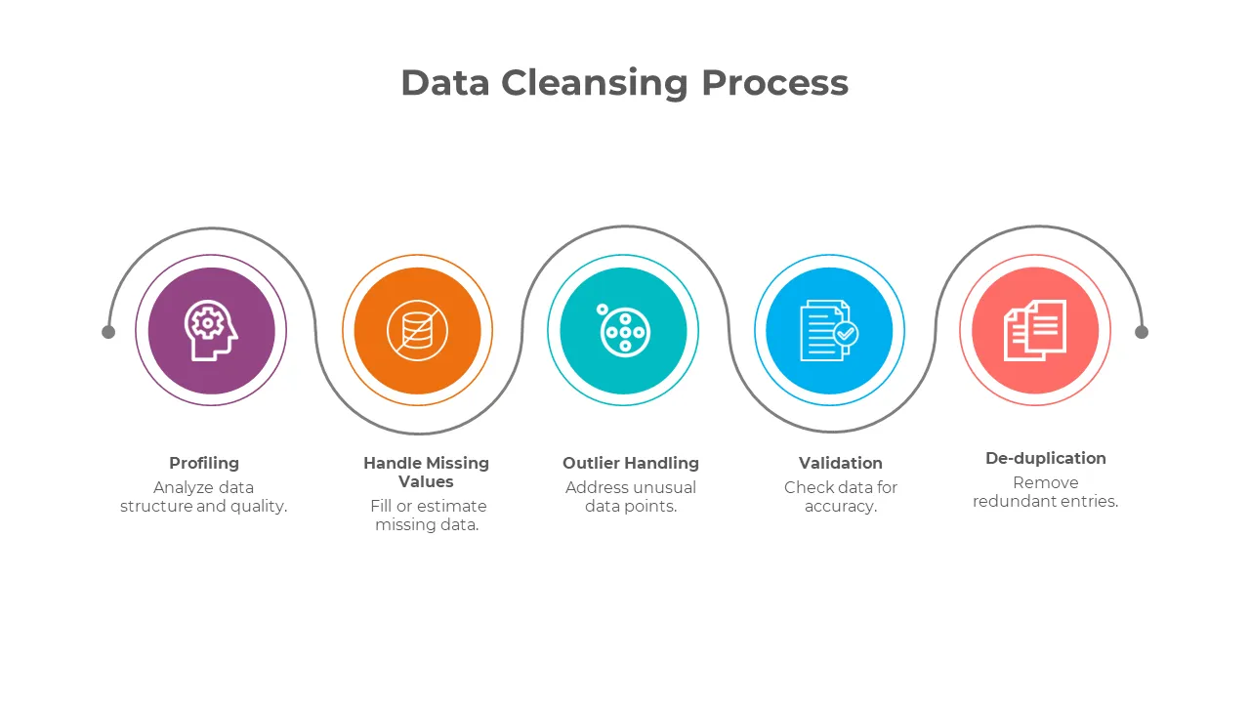
Data Cleaning & Preprocessing
Handled missing values and outliers.
Applied log transformations to reduce skewness.
Engineered features: credit_history_length, time_since_last_payment, etc.

Slide 8
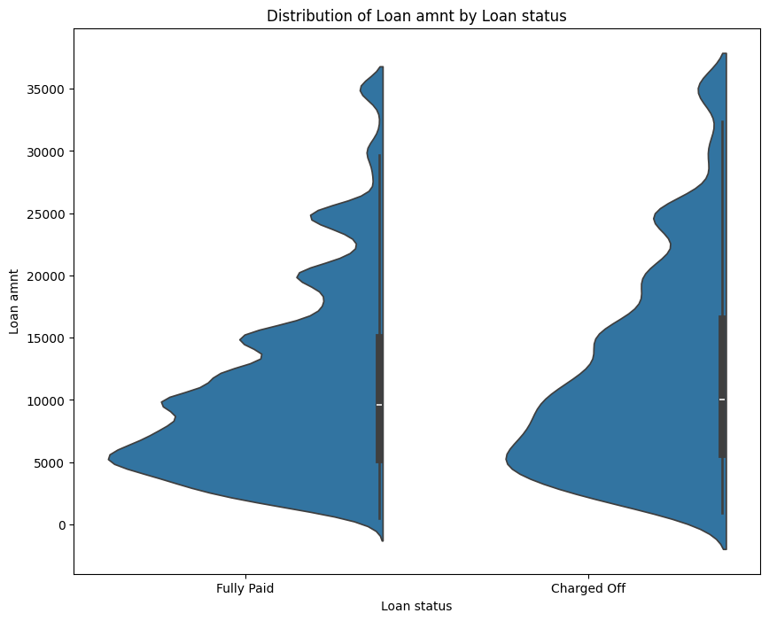
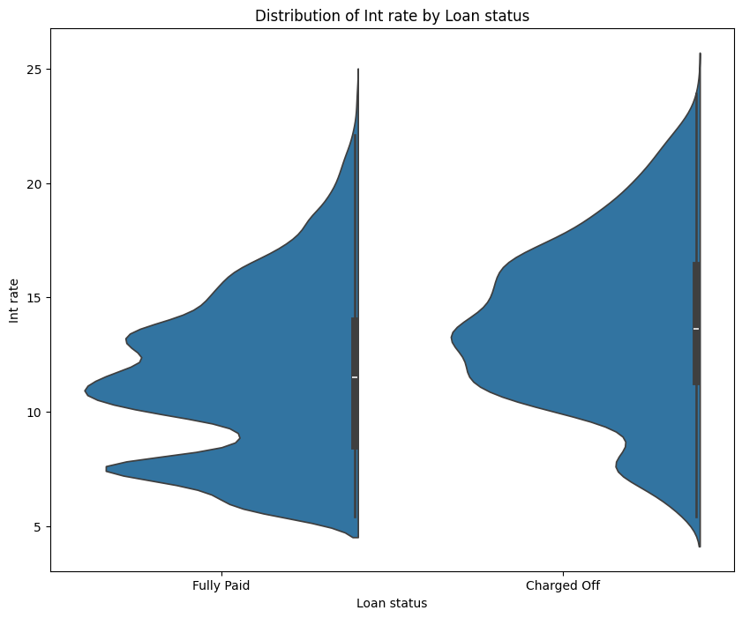
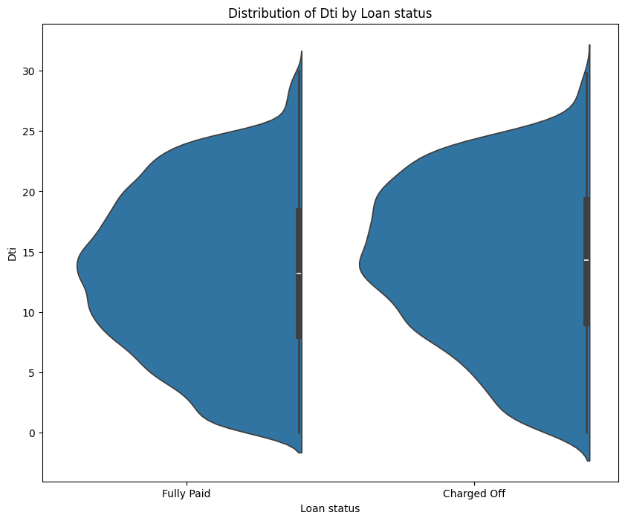
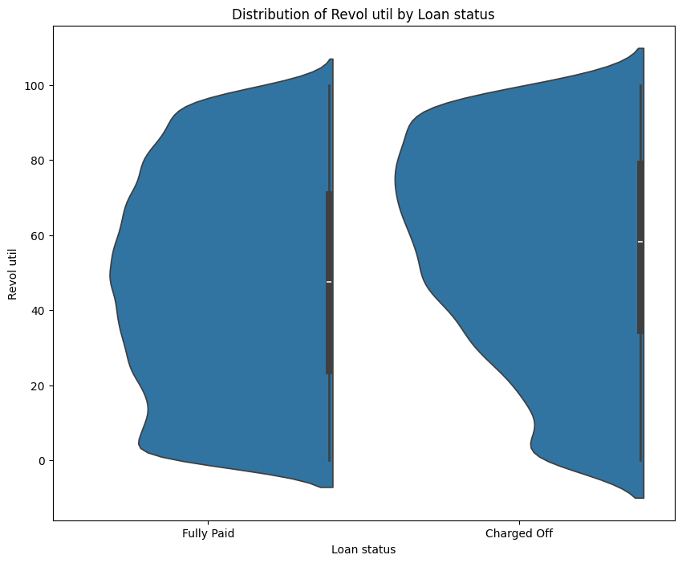
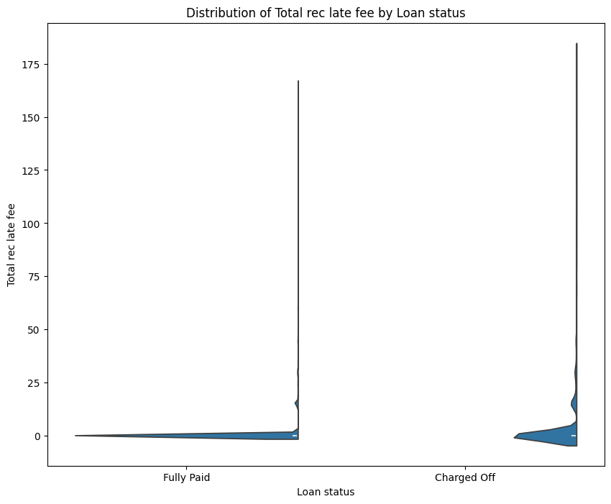
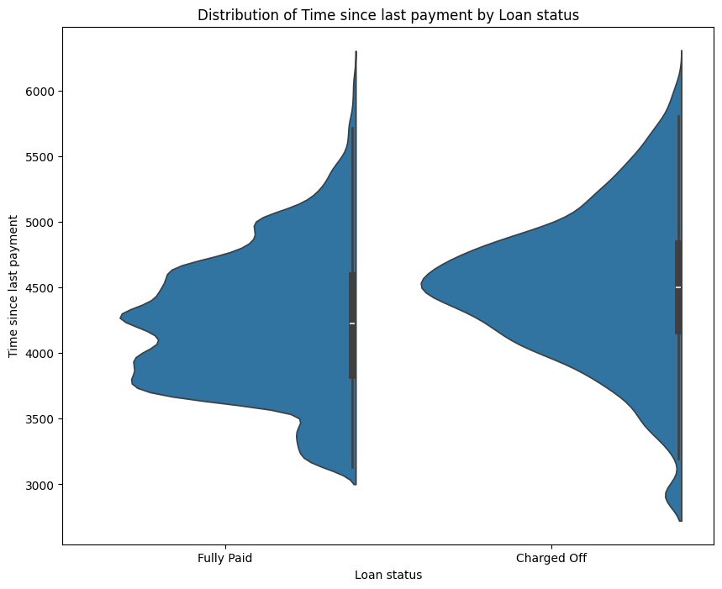
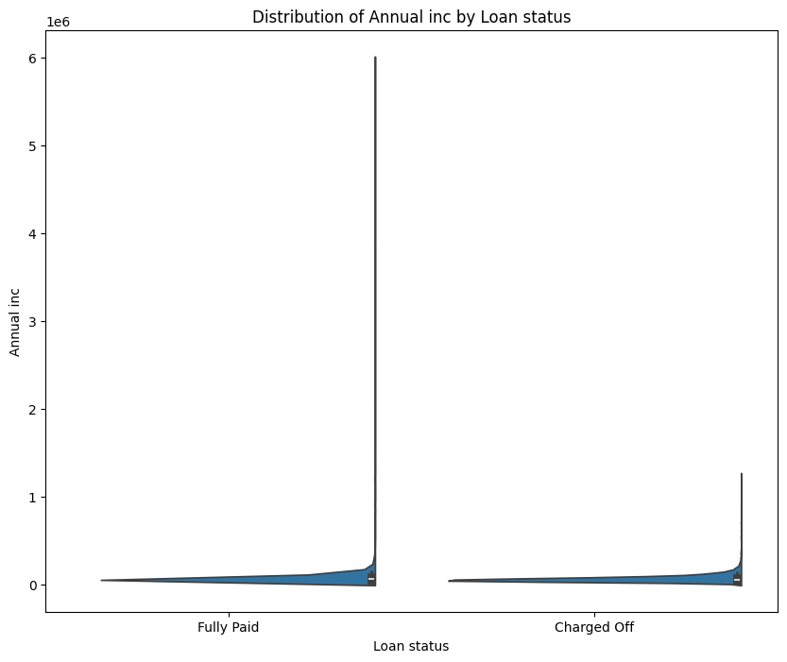
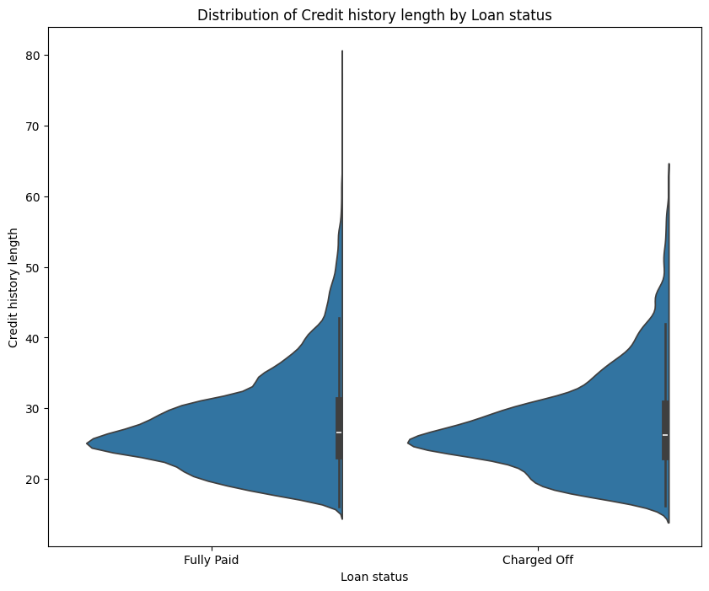
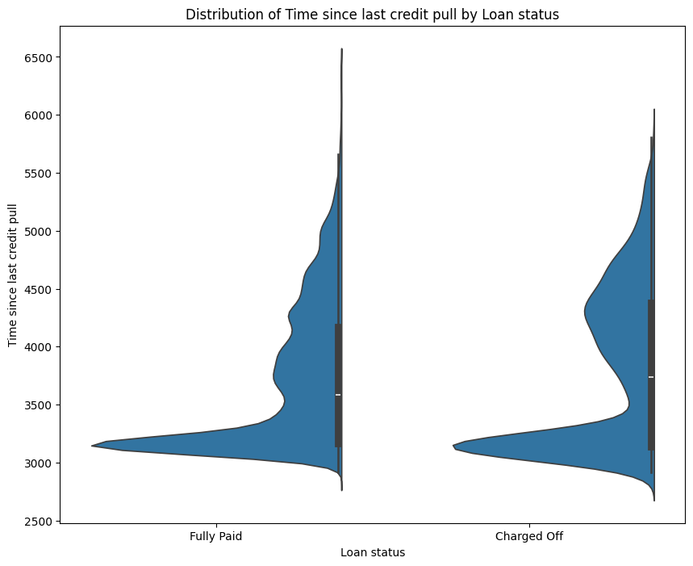
Key Insights –
Numerical Variables (Part-1)
Risky Applicant Indicators:
🔼 High loan amounts[Loan amnt]
🔼 High interest rates [int rate].
🔼 High debt-to-income ratio[dti]
🔼 High revolving utilization rate[Revol util].
🔼 High count of late fee received to date[Total rec late fee]
🔼 High day count since last payment[Time since last payment]
🔽 Low annual income [Annual inc]
🔽 Low short credit history [Credit history length]
🔽 Less day count since last credit pull [Time Since last credit pull]

Slide 9
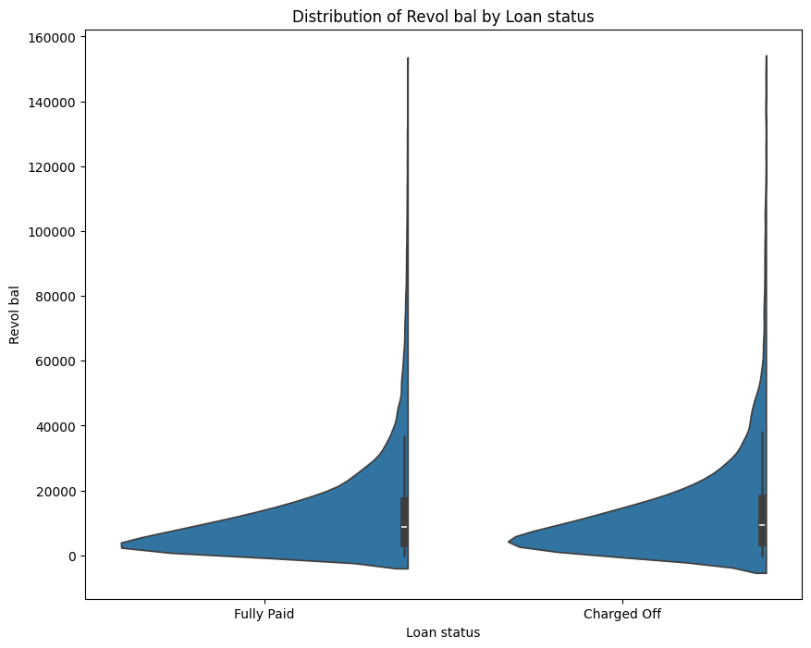
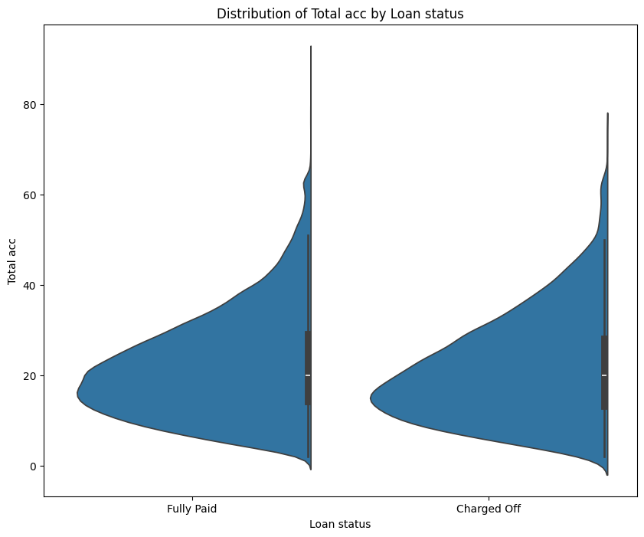
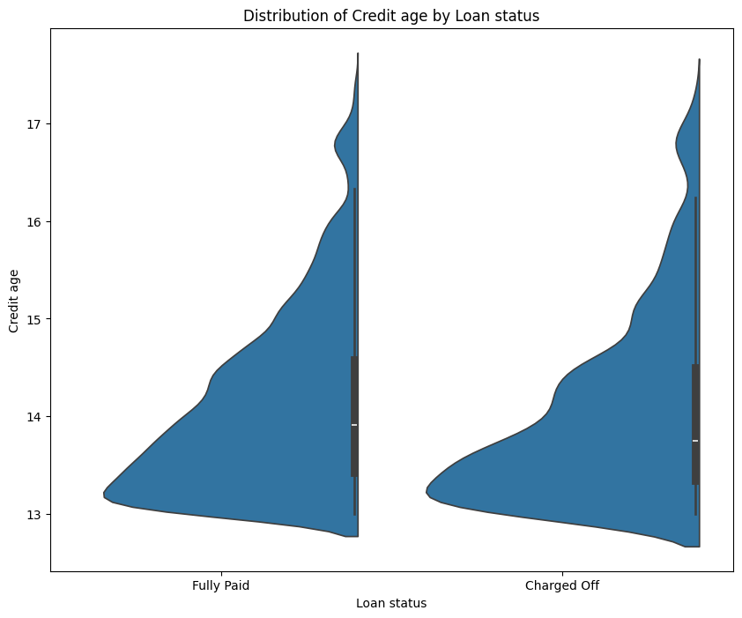
Key Insights –
Numerical Variables (Part-2)
Factors with Minimal or No Impact visible on charts:
Total credit revolving balance [Revol bal]
Total number of credit lines currently in borrower’s credit file[Total acc]
Total number of years borrower’s credit history present [Credit age]

Slide 10
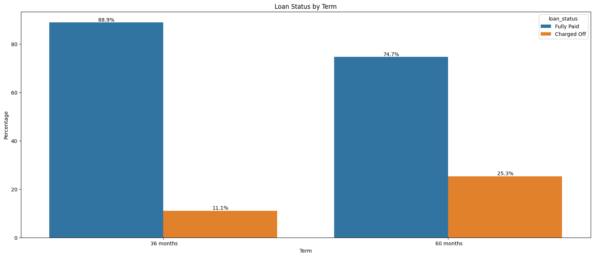
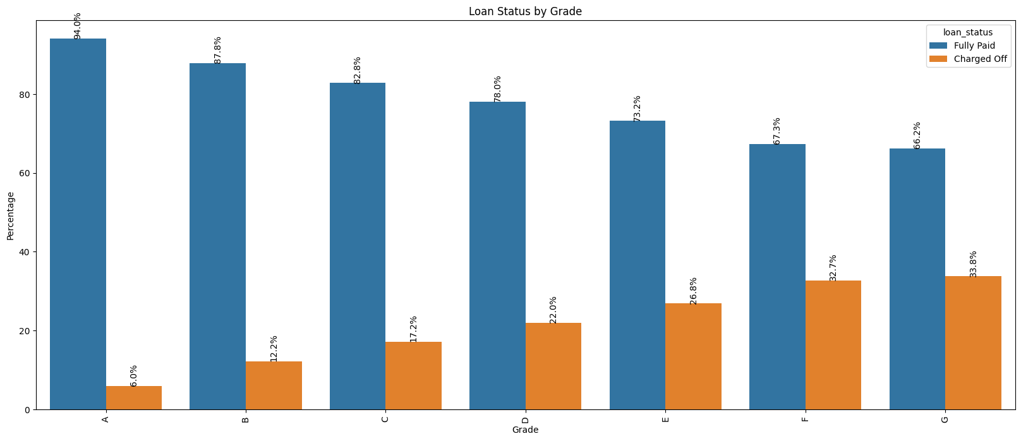
Key Insights –
Categorical Variables (Part-1)
Risky Indicators:
Loans with a 60-month term have a significantly higher default percentage. [Term]
As grade value increasing, default percentages increase, indicating a strong correlation with risk. [Grade]

Slide 11
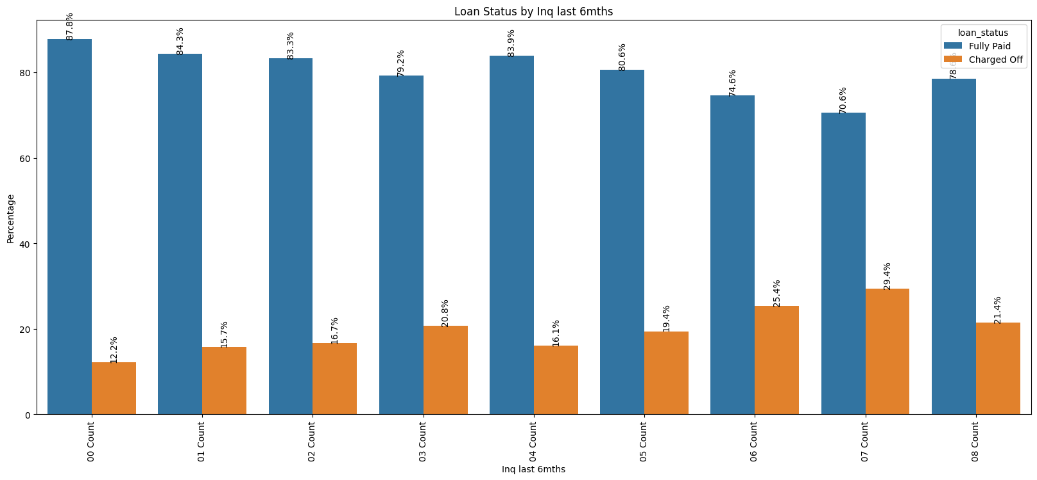
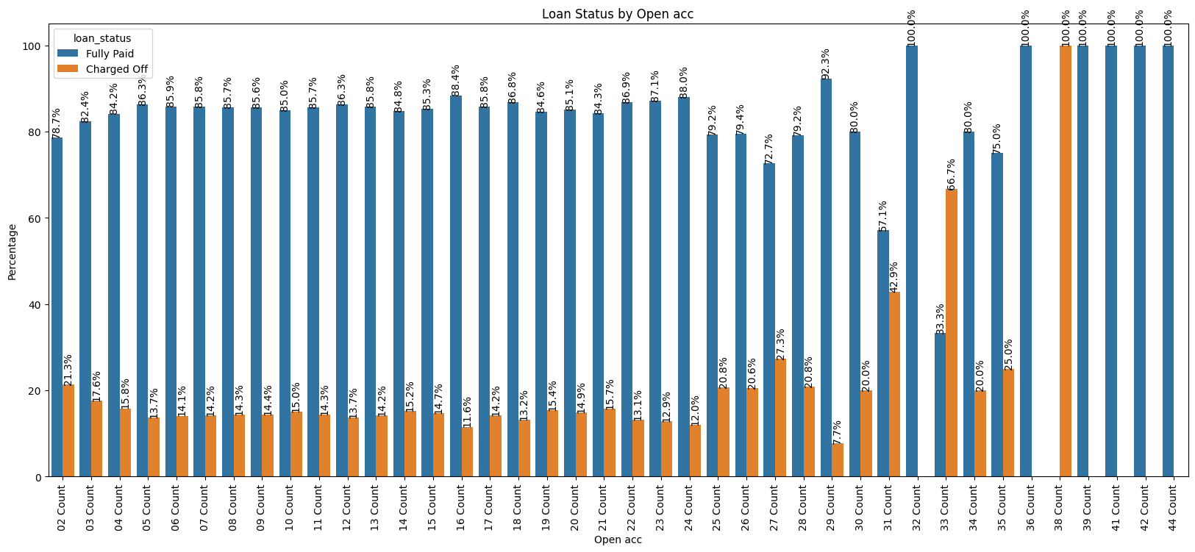
Key Insights –
Categorical Variables (Part-2)
Risky Indicators:
Higher inquiries in the last 6 months correlate with increased default percentages. [Inq last 6mths]
Higher number of open accounts is associated with increased default risk. [Open acc]

Slide 12
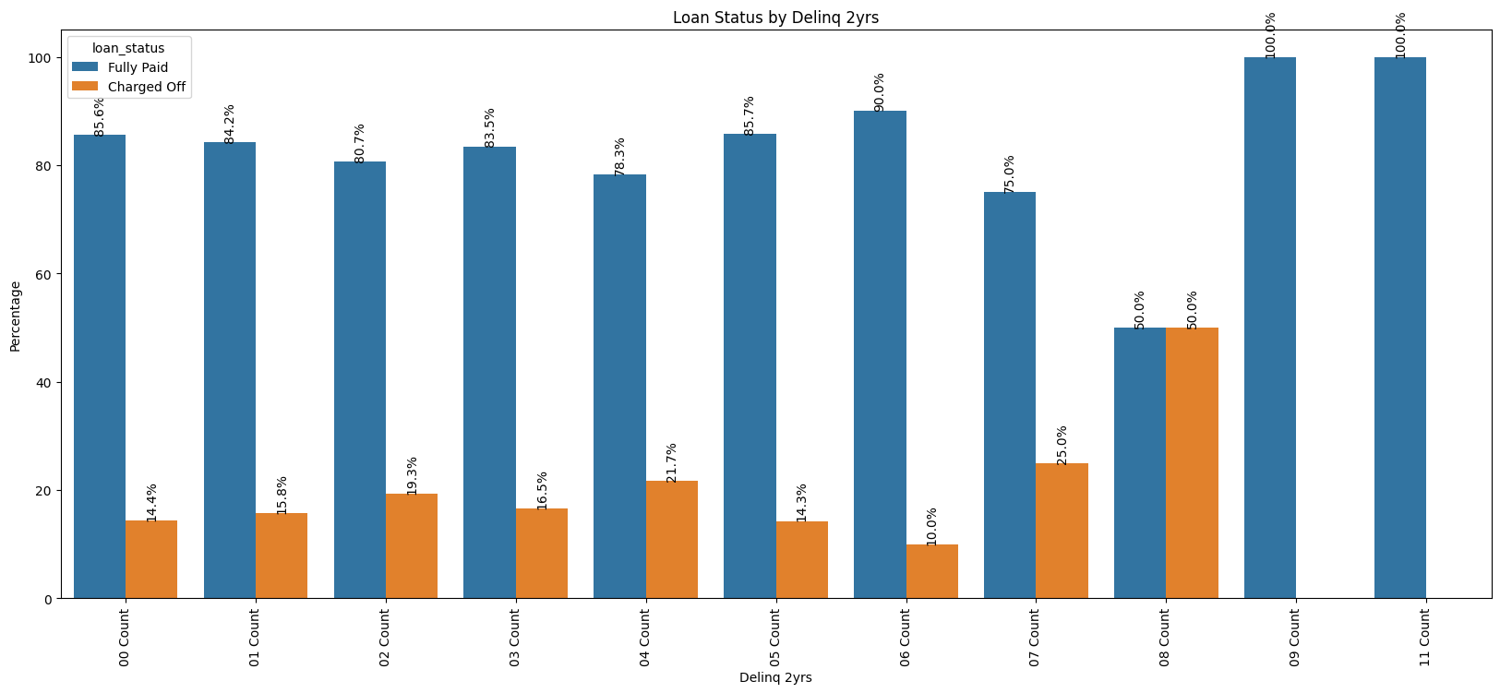
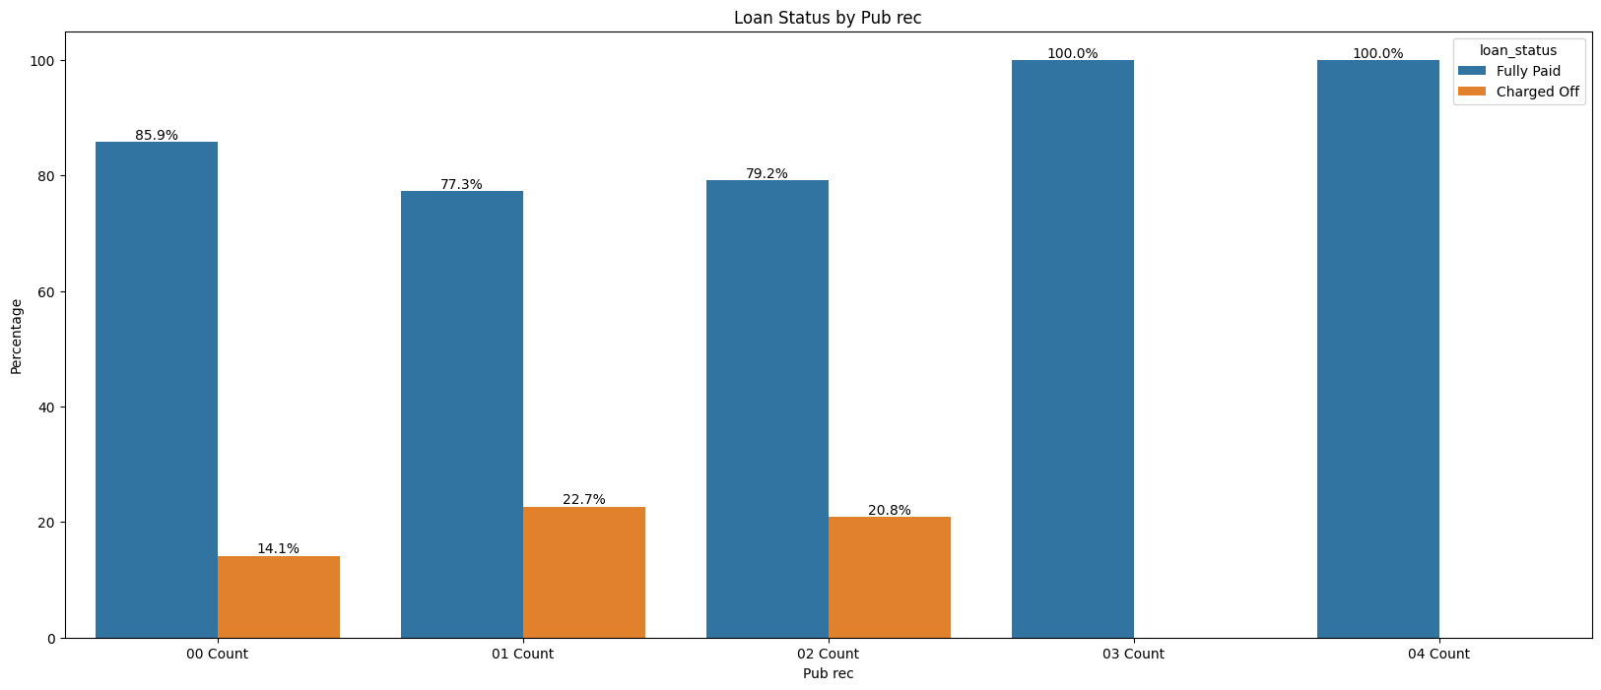
Key Insights –
Categorical Variables (Part-3)
Factors with Minimal Impact visible on charts:
Generally insignificant, but higher 30+days past due incidences of delinquency counts may indicate potential risk. [Delinq 2yrs]
Public records have minimal impact on loan status. [Pub rec]

Slide 13
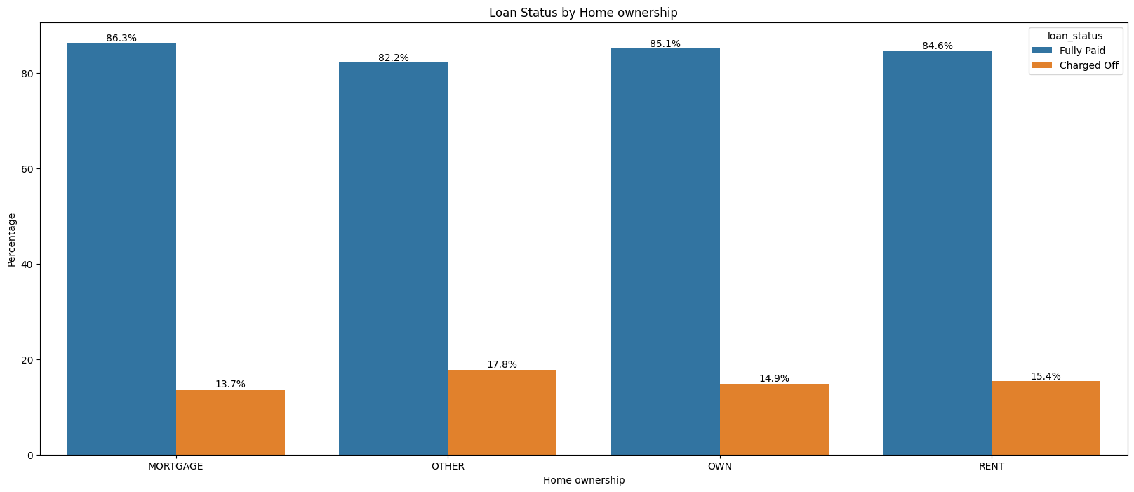
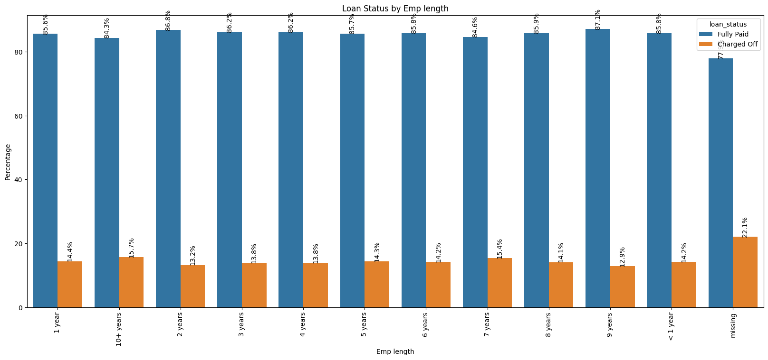
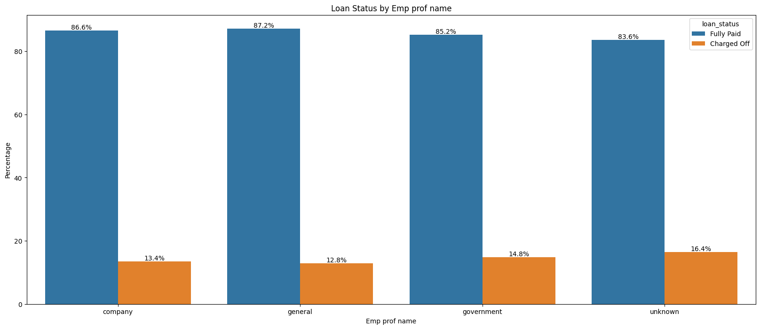
Key Insights –
Categorical Variables (Part-4)
Factors with No Impact visible on charts:
No significant impact of Employment length, though missing data shows a slight increase in default percentage. Also, missing data has highest default percentage. [Emp length]
No notable differences in default percentages based on home ownership.
Profession names show no strong relationship with default risk. [Emp prof name]

Slide 14
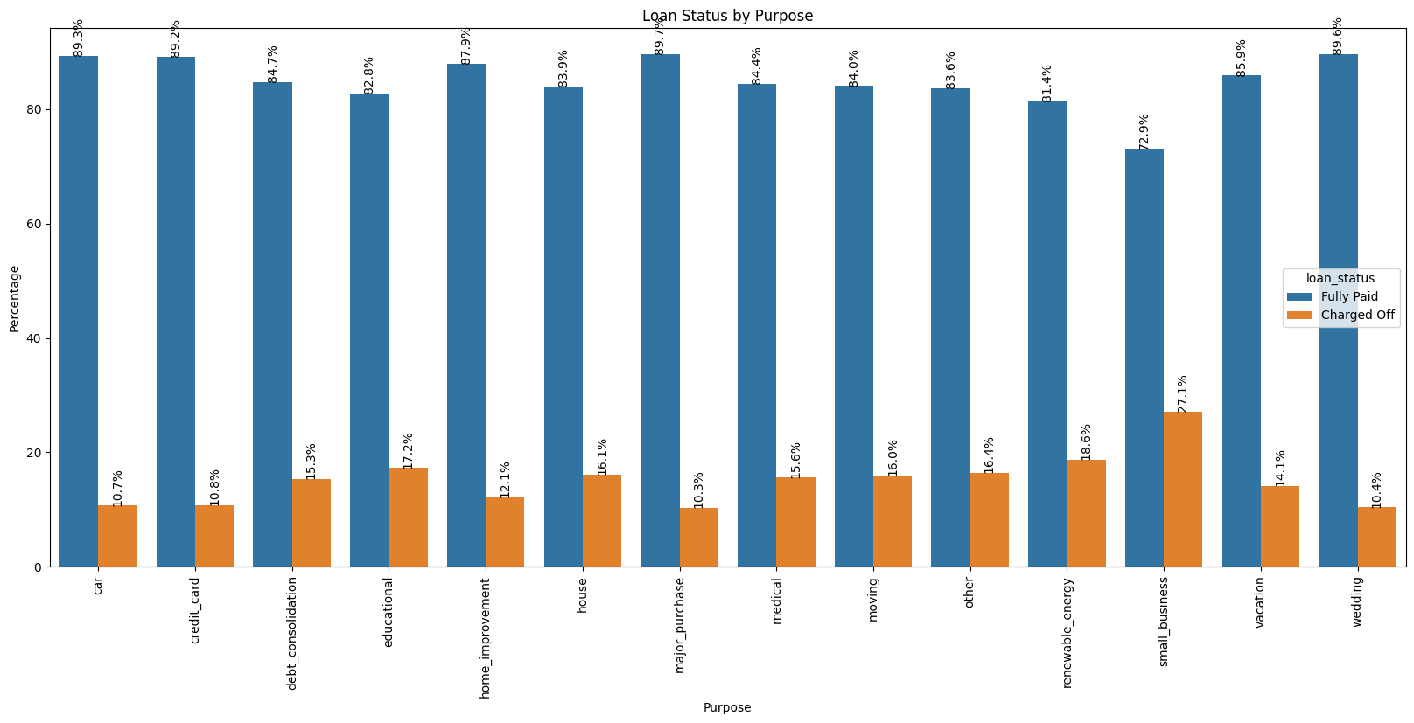
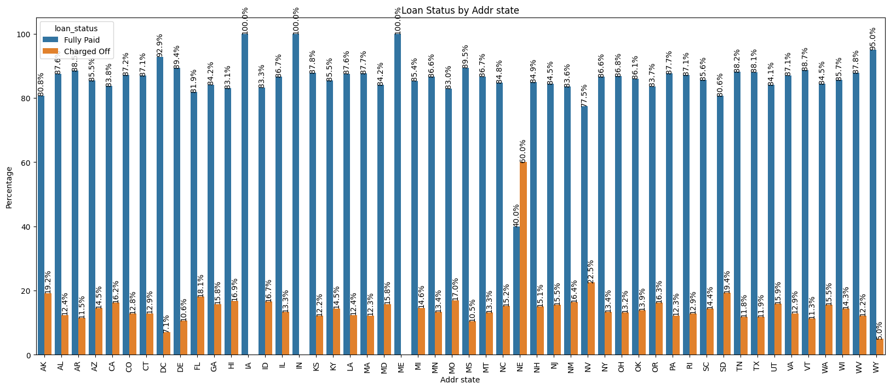
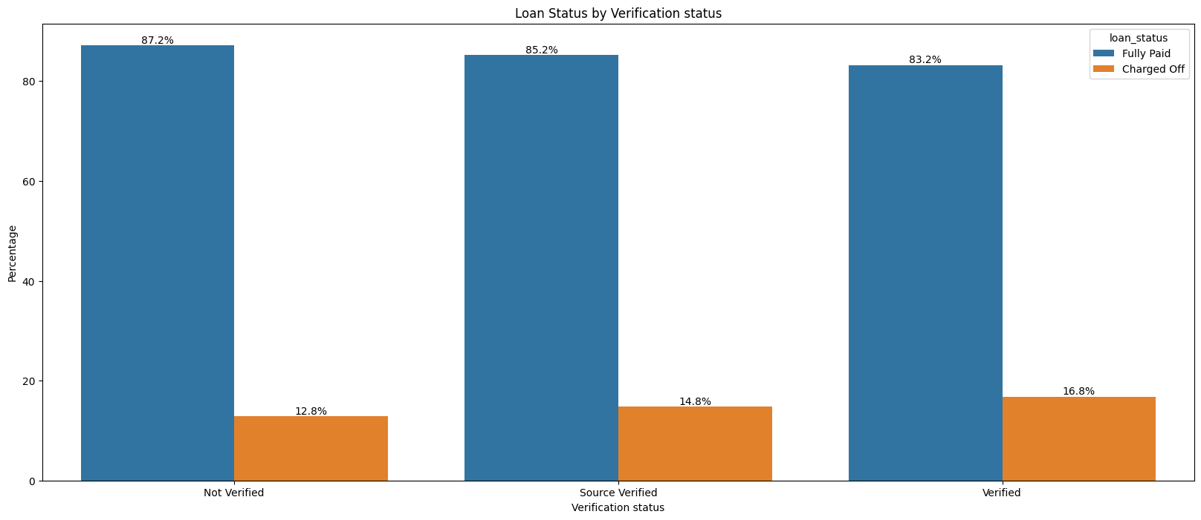
Indirect Impact Factors
Factors with No Direct Impact but Possible Indications:
Loans with a 60-month term have significantly higher default percentages, indicating a potential need to assess risk more rigorously for longer-term loans.
Verified applicants show a higher default percentage, suggesting potential flaws in the verification process.
Loans for small businesses have the highest default rates, indicating a need for stricter background checks for certain purposes.
Nebraska (NE) shows a 60% default rate, suggesting validation processes vary by state and may require improvement.

Slide 15
Recommendations
Revise credit approval policies for:
High loan amounts or interest rates or DTI ratio.
Higher number of open accounts or inquiries
Short credit history
Longer-term loans
Strengthen verification processes.
Implement stricter checks for:
Small business loans.
High-risk states like Nebraska.
Precise data gathering such as Employee length (Employment experience year)

Slide 16
Challenges & Assumptions
🍕Challenges:
Skewed numerical variables persist post-transformation.
High granularity in categorical variables (e.g., addr_state, purpose).
Balancing outliers vs noise.
Interpreting categorical variables effectively.
💡Assumptions:
loan_status reliably represents borrower risk.
Economic conditions during the dataset period are stable.
Data accurately represents past trends.
Missing data is random and unbiased.
Retained outliers to capture risk-related anomalies.

Slide 17
Conclusion
Identified key drivers of loan default.
Provided actionable insights to minimize credit risk.
Enhanced decision-making for loan approvals.

Slide 18
GitHub Repository
Link: insights-into-lending-risks
Reference: https://github.com/amaan2398/insights-into-lending-risks

Slide 19
Thank You

Slide 20
Visualizations Overview

Slide 21
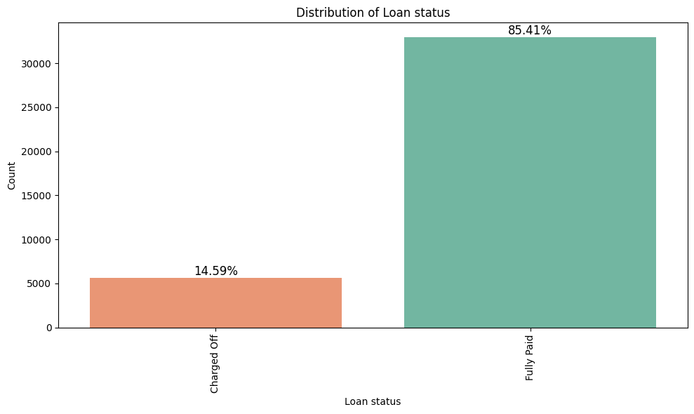
Loan Status

Slide 22
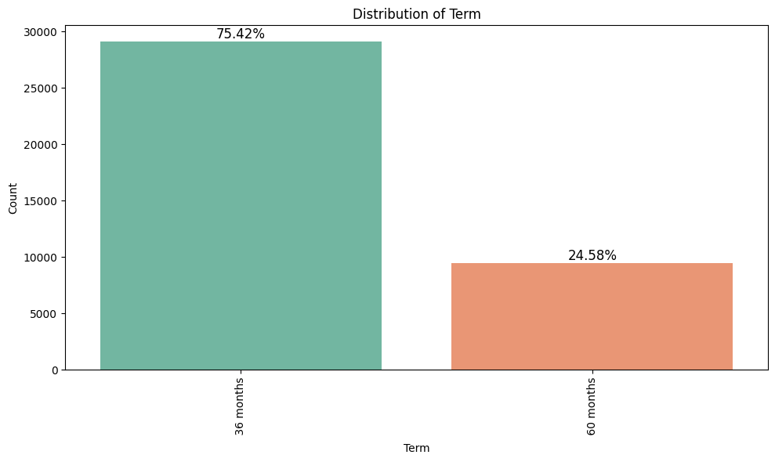
Term

Slide 23
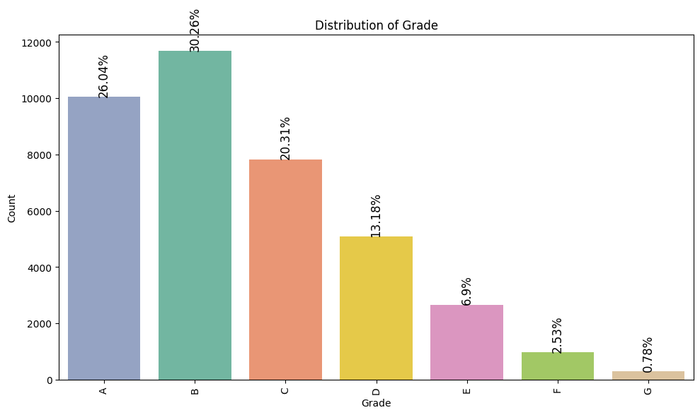
Grade

Slide 24
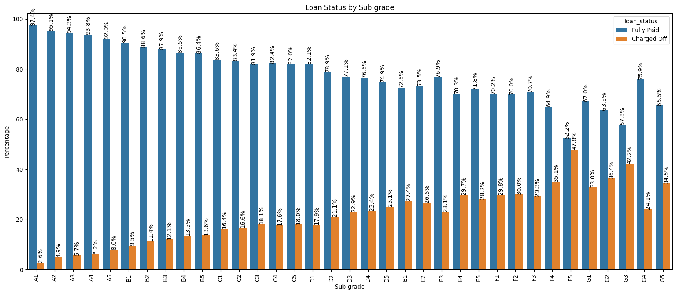
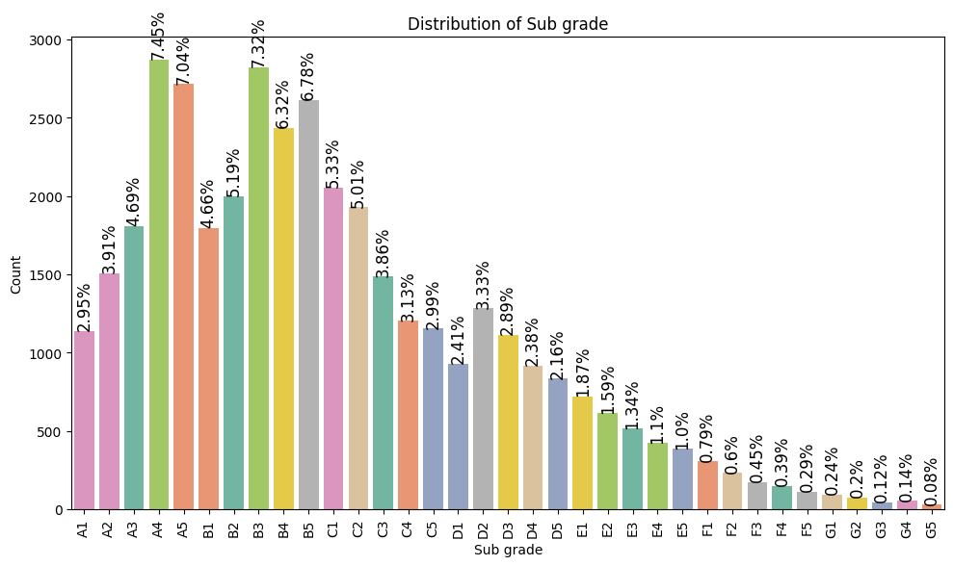
Sub Grade

Slide 25
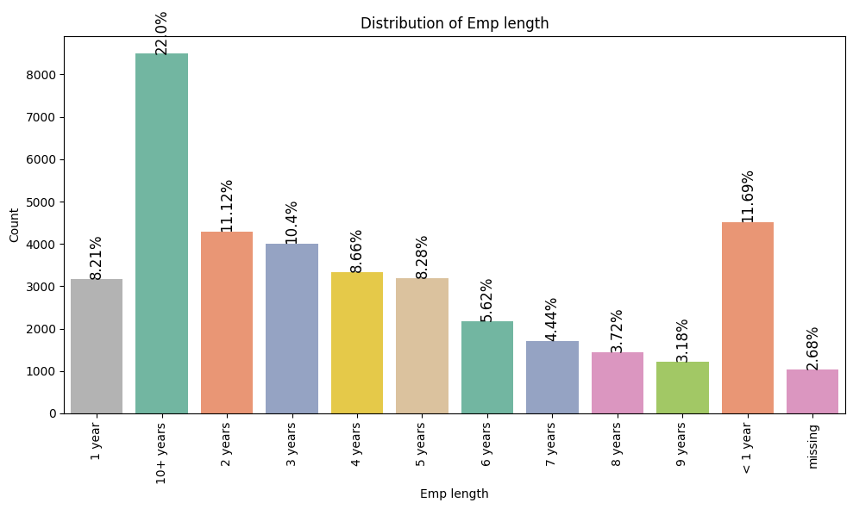
Employee Length

Slide 26
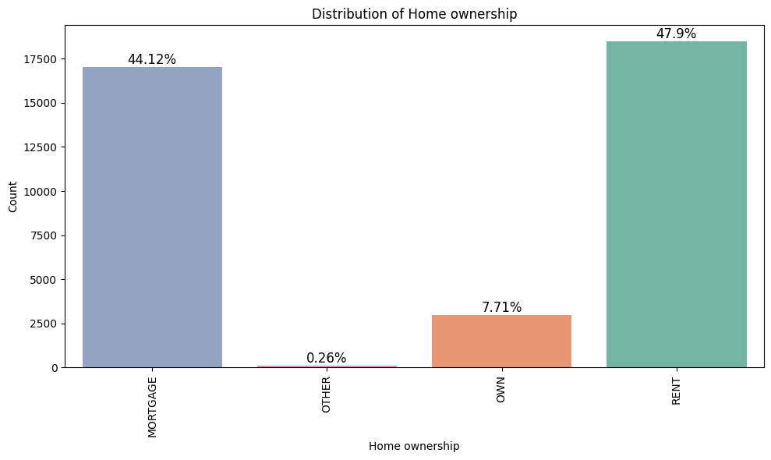
Home Ownership

Slide 27
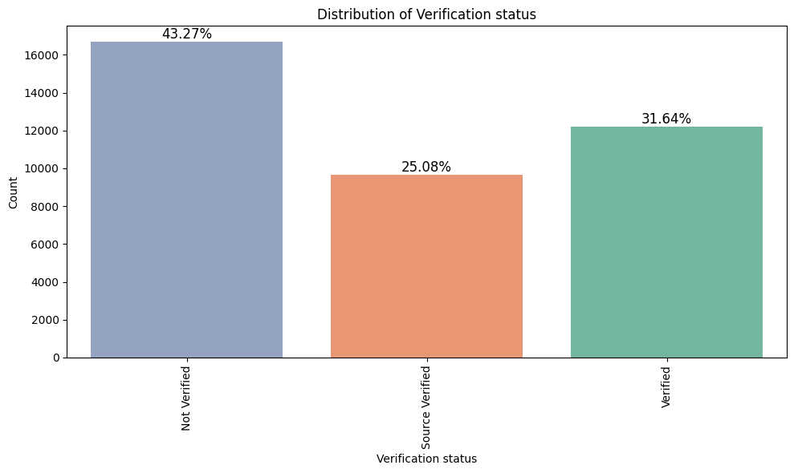
Verification Status

Slide 28
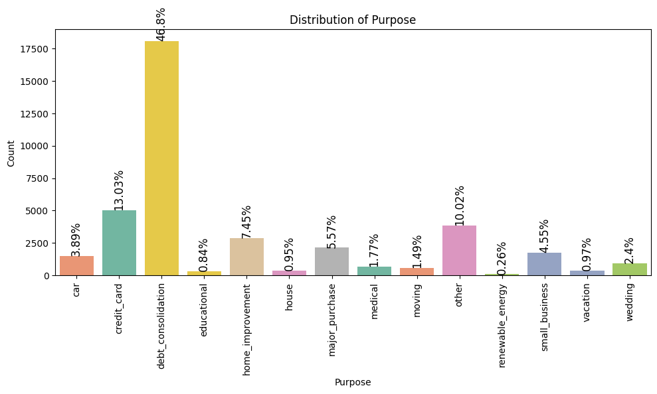
Purpose

Slide 29
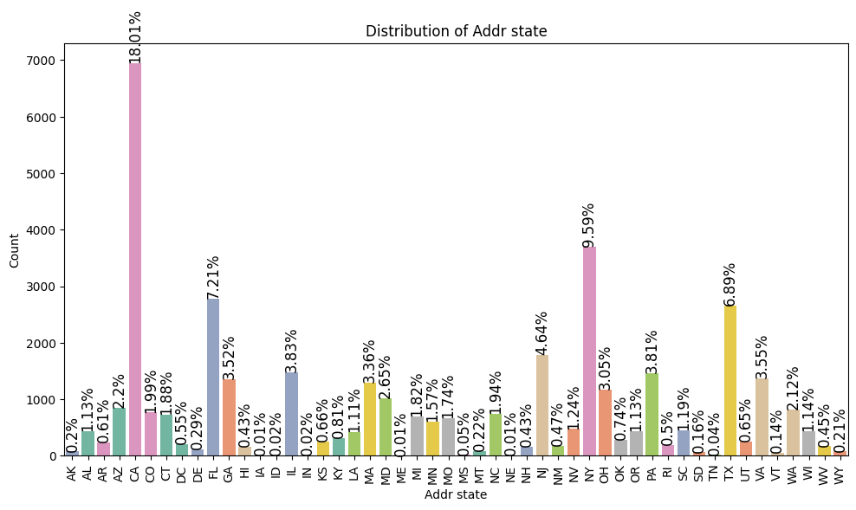
Address State

Slide 30
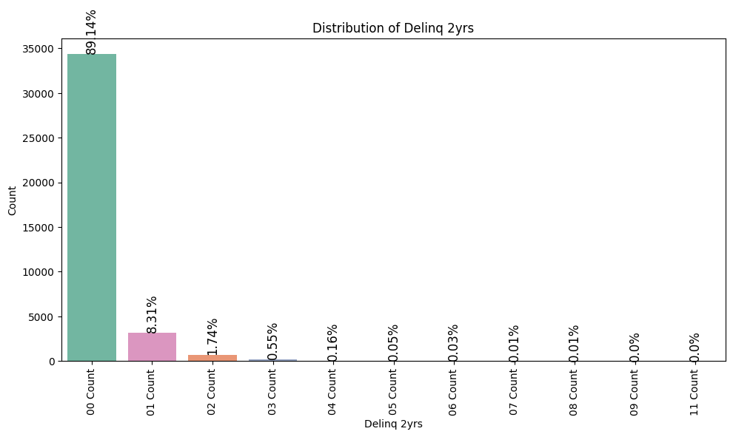
Delinquency

Slide 31
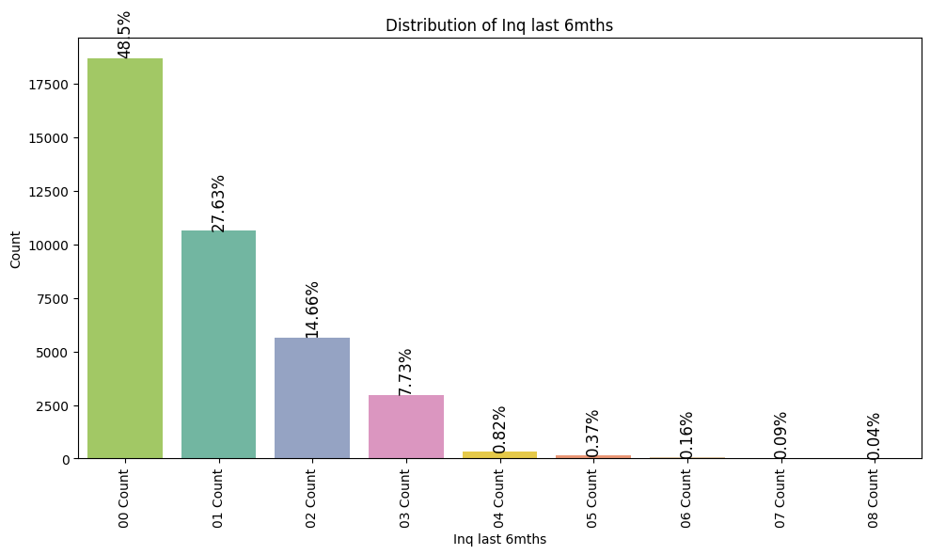
Inquiry Last 6 months

Slide 32
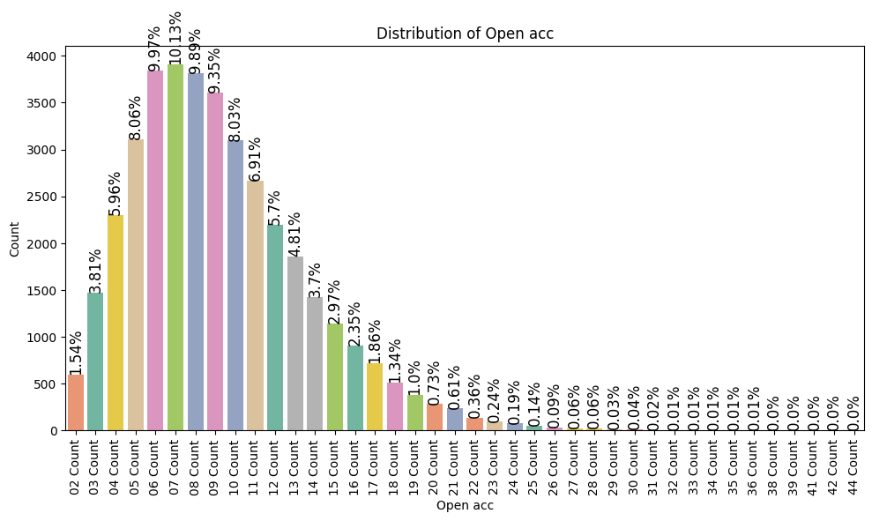
Open Account

Slide 33
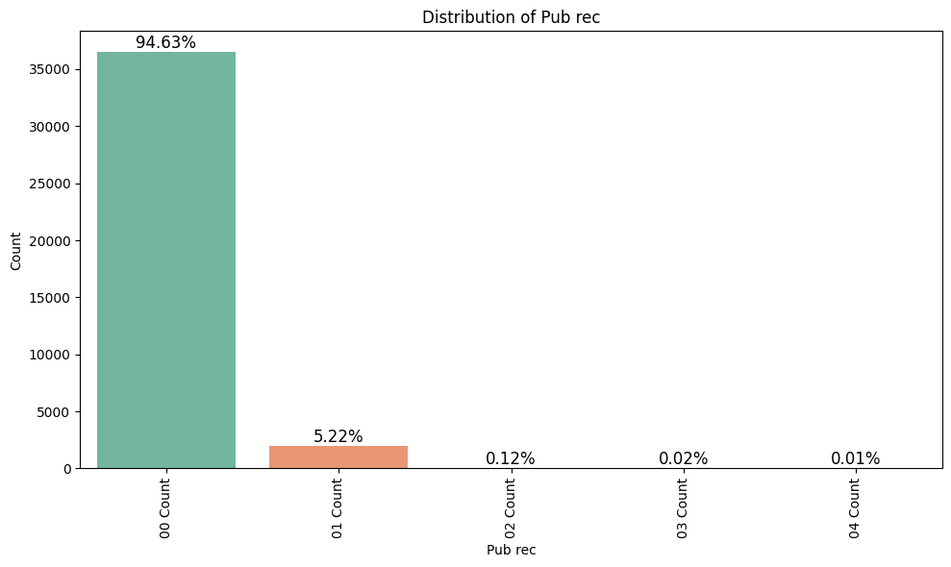
Number of derogatory
public records

Slide 34
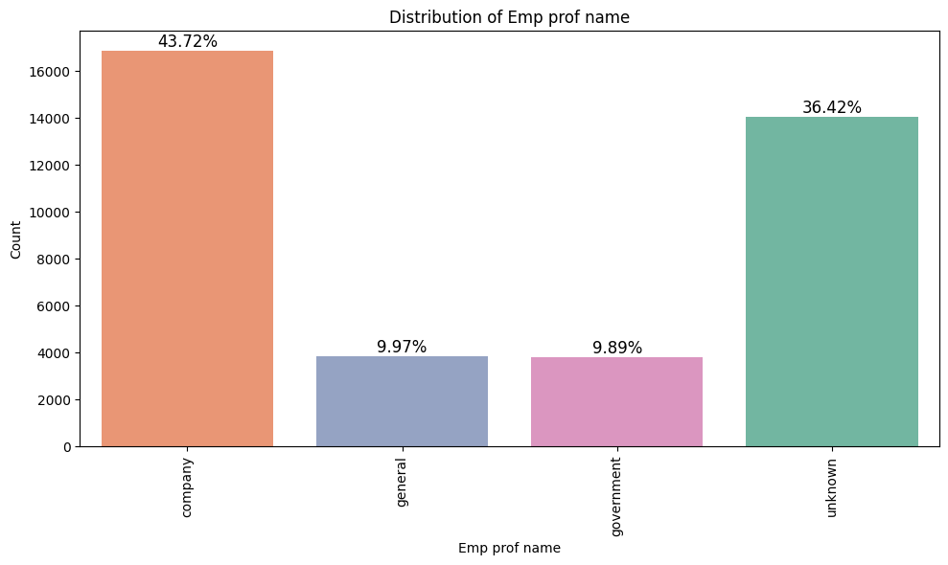
Employee profession

Slide 35
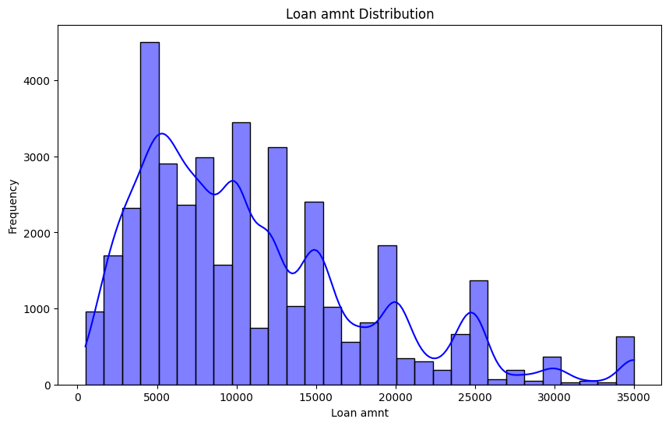
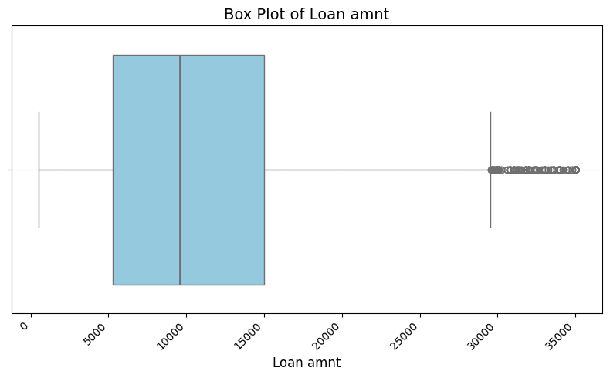
Loan Amount

Slide 36
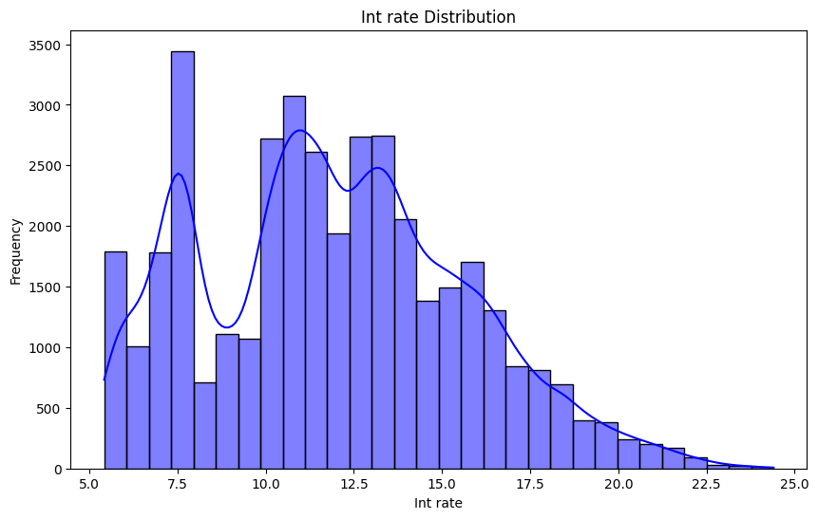
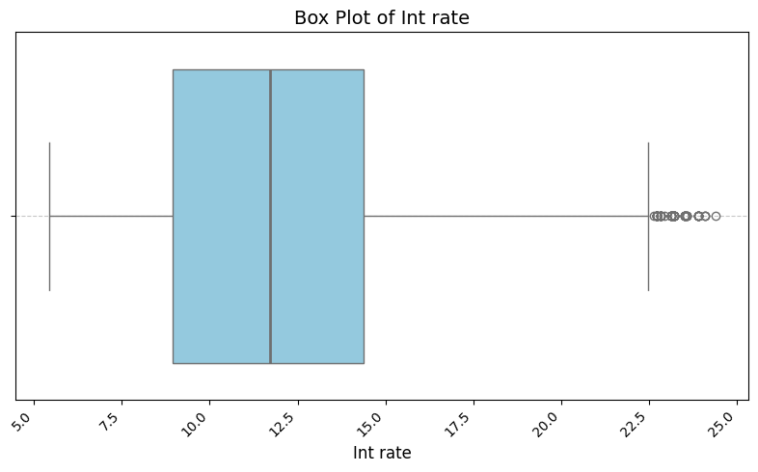
Interest rate

Slide 37
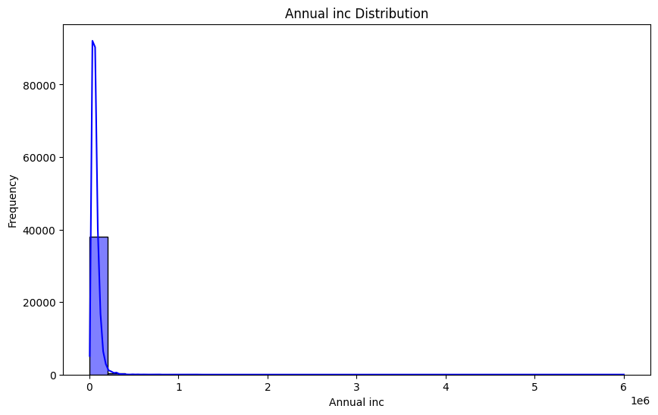
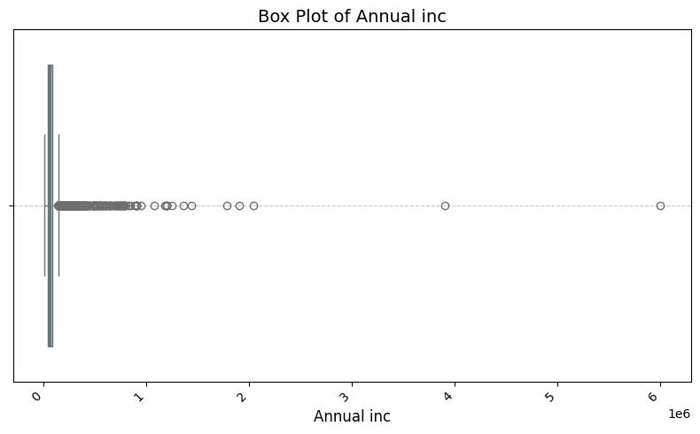
Annual Income

Slide 38
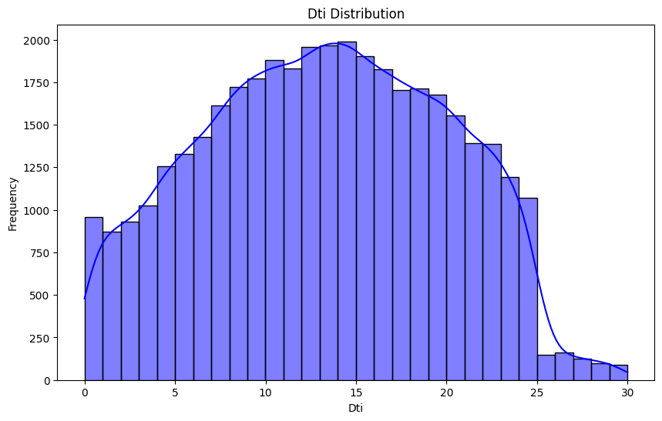
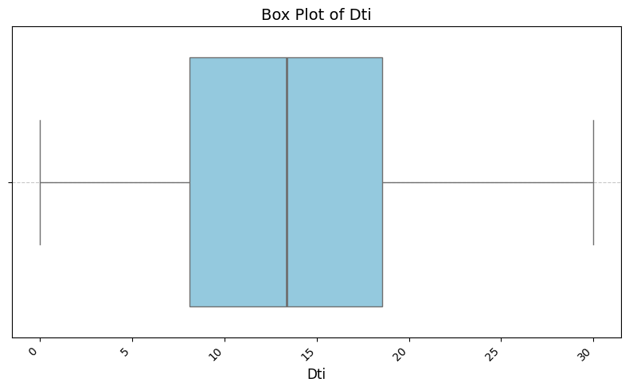
Debt to income ratio

Slide 39
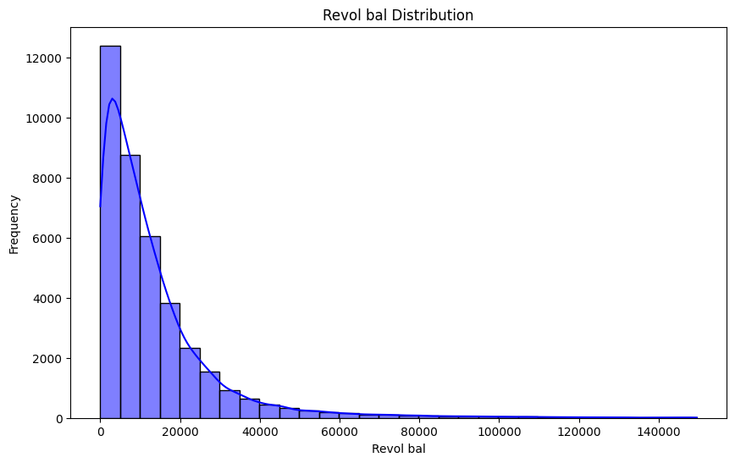

Revolving balance

Slide 40


Revolving line
utilization rate

Slide 41


Total account

Slide 42


Total recovery late fee

Slide 43

Credit Age

Slide 44


Credit History Length

Slide 45


Time since last payment

Slide 46


Time since last credit pull

