Slide 1
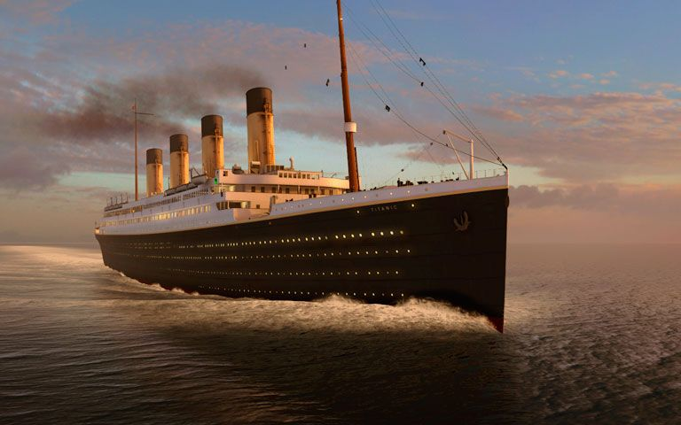
R.M.S. Titanic Case Study

Slide 2
Problem Statement
The sinking of the RMS Titanic is one of the most infamous shipwrecks in history. On April 15, 1912, during her maiden voyage, the Titanic sank after colliding with an iceberg, killing 1502 out of 2224 passengers and crew. This sensational tragedy shocked the international community and led to better safety regulations for ships.
One of the reasons that the shipwreck led to such loss of life was that there were not enough lifeboats for the passengers and crew. Although there was some element of luck involved in surviving the sinking, some groups of people were more likely to survive than others, such as women, children, and the upper-class.
In this, we ask you to complete the analysis of what sorts of people were likely to survive. In particular, we ask you to apply the tools of machine learning to predict which passengers survived the tragedy.

Slide 3
Data Dictionary
VARIABLE | DEFINITION | KEY
Survived | Survival | 0 : No, 1 : Yes
Pclass | Ticket class | 1 : 1st, 2 : 2nd, 3 : 3rd
Sex | Sex | -
Age | Age in years | -
SibSp | Number of siblings/spouses aboard | -
Parch | Number of parents/children aboard | -
Ticket | Ticket number | -
Fare | Passenger fare | -
Cabin | Cabin number | -
Embarked | Port of embarkation | C : Cherbourg, Q : Queenstown, S : Southampton

Slide 4
Problem description
As we have to predict whether the passengers survived or did not survive, it is a Binary Classification problem.
The variable ‘Survived’ is the target variable/label and rest are predictor variables/features.
We can apply the following machine learning algorithms to solve this problem:
Logistic Regression
Decision Tree Classifier
Random Forest Classifier
K Nearest Neighbors
Naïve Bayes Classifier
We will check the following algorithm performance metrics:
Accuracy
Precision
Recall
F1 Score
AUC - ROC curve

Slide 5
Data description
TOTAL NUMBER OF PASSENGERS | 891
TYPE OF VARIABLE | COUNT
Numeric | 5
Categorical | 5
Text | 1
Boolean | 1
VARIABLE | MISSING VALUES | % of MISSING VALUES
Cabin | 687 | 77.10 %
Age | 177 | 19.87 %
Embarked | 2 | 0.22 %

Slide 6
Data description
VARIABLE DROPPED | REASON
PassengerId | It has all unique values, which does not have any effect on the outcome
Name | Extracted titles from the names and dropped it as it has all unique values
Ticket | It has 76.4% unique values which does not have much effect on the outcome
Cabin | It has 77.10% missing values, and imputing such a huge number might give inaccurate predictions
VARIABLE NAME | MISSING VALUES IMPUTATION METHOD
Age | Imputed the missing values with random numbers between maximum standard deviation and minimum standard deviation of Age from the Mean Age
Embarked | As there were only 2 missing values, we used Mode of the values for imputation

Slide 7
Exploratory Data Analysis

Slide 8
Pclass wise passenger survival ratio

Slide 9
Sex wise passenger survival ratio

Slide 10
Embarked wise passenger survival ratio

Slide 11
Title wise passenger survival ratio

Slide 12
Age wise passenger survival ratio

Slide 13
Siblings & Spouses wise passenger survival ratio

Slide 14
Parents and children wise passenger survival ratio

Slide 15
Fare wise passenger survival ratio

Slide 16
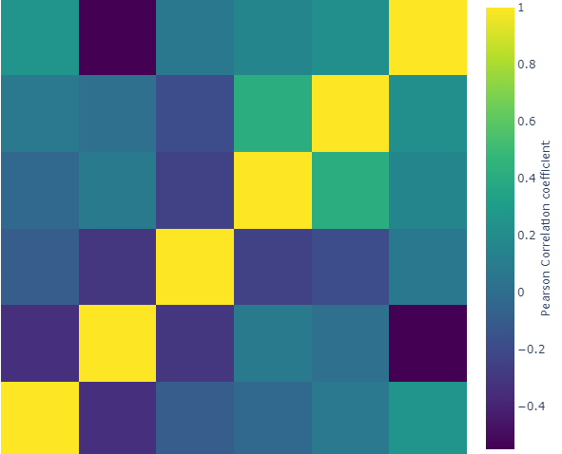
Correlation between numeric variables
Fare
Parch
SibSp
Age
Pclass
Survived
Survived Pclass Age SibSp Parch Fare

Slide 17
Machine learning model selection
Accuracy scores of all models by cross validation method ( cv=4 )
Hence Logistic Regression selected
Model name | Accuracy score | Standard Deviation
Logistic Regression | 0.828680 | 0.024066
K Nearest Neighbors | 0.824522 | 0.025227
Random Forest | 0.810469 | 0.021572
Naïve Bayes | 0.802018 | 0.013767
Decision Tree | 0.775348 | 0.018196

Slide 18
Performance Metrics
Before model tuning (via GridSearch)
After model tuning
Metric name | Accuracy | Precision | Recall | F1 Score | ROC AUC
Metric Score | 0.799 | 0.785 | 0.699 | 0.739 | 0.783
Metric name | Accuracy | Precision | Recall | F1 Score | ROC AUC
Metric Score | 0.804 | 0.797 | 0.699 | 0.745 | 0.788

Slide 19
Conclusion
We started with the data exploration where we got to know the variables of the dataset, checked about missing data and found out which features are important. We used visualizations to understand the data better. During feature engineering and data pre-processing, we imputed missing values, converted features into numeric ones, grouped values into categories and created a few new features. Afterwards we started training 5 different machine learning models via cross validation, picked one with the best accuracy score (Logistic Regression) and tuned the parameters to increase the performance metric scores. Lastly, we looked at the confusion matrix and computed the performance metric scores and feature importance.

Slide 20
THANK YOU

