Slide 1
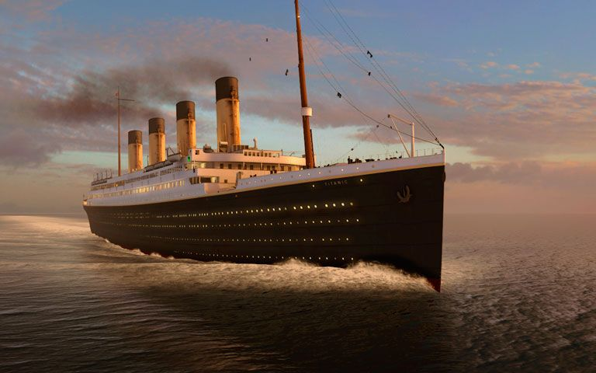
R.M.S. Titanic Case Study

Slide 2
Problem Statement
The sinking of the RMS Titanic is one of the most infamous shipwrecks in history. On April 15, 1912, during her maiden voyage, the Titanic sank after colliding with an iceberg, killing 1502 out of 2224 passengers and crew. This sensational tragedy shocked the international community and led to better safety regulations for ships.
One of the reasons that the shipwreck led to such loss of life was that there were not enough lifeboats for the passengers and crew. Although there was some element of luck involved in surviving the sinking, some groups of people were more likely to survive than others, such as women, children, and the upper-class.
In this, we ask you to complete the analysis of what sorts of people were likely to survive. In particular, we ask you to apply the tools of machine learning to predict which passengers survived the tragedy.

Slide 3
Data Dictionary
VARIABLE | DEFINITION | KEY
Survived | Survival | 0 : No, 1 : Yes
Pclass | Ticket class | 1 : 1st, 2 : 2nd, 3 : 3rd
Sex | Sex | -
Age | Age in years | -
SibSp | Number of siblings/spouses aboard | -
Parch | Number of parents/children aboard | -
Ticket | Ticket number | -
Fare | Passenger fare | -
Cabin | Cabin number | -
Embarked | Port of embarkation | C : Cherbourg, Q : Queenstown, S : Southampton

Slide 4
Problem description
As we have to predict whether the passengers survived or did not survive, it is a Binary Classification problem.
The variable ‘Survived’ is the target variable/label and rest are predictor variables/features.
We can apply the following machine learning algorithms to solve this problem:
Logistic Regression
Decision Tree Classifier
Random Forest Classifier
K Nearest Neighbors
Naïve Bayes Classifier
We will check the following algorithm performance metrics:
Accuracy
Precision
Recall
F1 Score
AUC - ROC curve

Slide 5
Data description
TOTAL NUMBER OF PASSENGERS | 891
TYPE OF VARIABLE | COUNT
Numeric | 5
Categorical | 5
Text | 1
Boolean | 1
VARIABLE | MISSING VALUES | % of MISSING VALUES
Cabin | 687 | 77.10 %
Age | 177 | 19.87 %
Embarked | 2 | 0.22 %

Slide 6
Data description
VARIABLE DROPPED | REASON
PassengerId | It has all unique values, which does not have any effect on the outcome
Name | Extracted titles from the names and dropped it as it has all unique values
Ticket | It has 76.4% unique values which does not have much effect on the outcome
Cabin | It has 77.10% missing values, and imputing such a huge number might give inaccurate predictions
VARIABLE NAME | MISSING VALUES IMPUTATION METHOD
Age | Imputed the missing values with random numbers between maximum standard deviation and minimum standard deviation of Age from the Mean Age
Embarked | As there were only 2 missing values, we used Mode of the values for imputation

Slide 7
Exploratory Data Analysis

Slide 8
Pclass wise passenger survival ratio

Slide 9
Sex wise passenger survival ratio

Slide 10
Embarked wise passenger survival ratio

Slide 11
Title wise passenger survival ratio

Slide 12
Correlation

Slide 13
Model selection
Accuracy scores of all models
Best model
Performance metrics before tuning
Tuning hyperparameters
Performance metrics after tuning

Slide 14
Conclusion
Start to end process in short

Slide 15
THANK YOU

