Slide 1
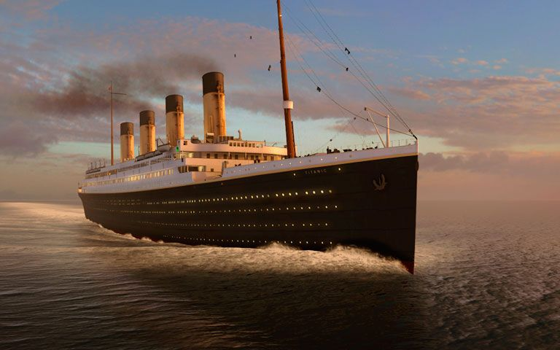
R.M.S. Titanic Case Study

Slide 2
Problem Statement
The sinking of the RMS Titanic is one of the most infamous shipwrecks in history. On April 15, 1912, during her maiden voyage, the Titanic sank after colliding with an iceberg, killing 1502 out of 2224 passengers and crew. This sensational tragedy shocked the international community and led to better safety regulations for ships.
One of the reasons that the shipwreck led to such loss of life was that there were not enough lifeboats for the passengers and crew. Although there was some element of luck involved in surviving the sinking, some groups of people were more likely to survive than others, such as women, children, and the upper-class.
In this, we ask you to complete the analysis of what sorts of people were likely to survive. In particular, we ask you to apply the tools of machine learning to predict which passengers survived the tragedy.

Slide 3
Data Dictionary
VARIABLE | DEFINITION | KEY
Survived | Survival | 0 : No, 1 : Yes
Pclass | Ticket class | 1 : 1st, 2 : 2nd, 3 : 3rd
Sex | Sex | -
Age | Age in years | -
SibSp | Number of siblings/spouses aboard | -
Parch | Number of parents/children aboard | -
Ticket | Ticket number | -
Fare | Passenger fare | -
Cabin | Cabin number | -
Embarked | Port of embarkation | C : Cherbourg, Q : Queenstown, S : Southampton

Slide 4
TYPE of problem
As we have to predict whether the passengers survived or did not survive, it is a Binary Classification problem.
The variable ‘Survived’ is the target variable/label and rest are predictor variables/features.
We can apply the following machine learning algorithms to solve this problem:
Logistic Regression
Decision Tree Classifier
Random Forest Classifier
K Nearest Neighbors
Naïve Bayes Classifier
We will check the following algorithm performance metrics:
Accuracy
Precision
Recall
F1 Score
AUC - ROC curve

Slide 5
EDA
Missing Values
Types of features
Plots of all types
Correlation of features
Which imputations are needed
Which features can be dropped
Which imputation methods used
Standard scaling
Data preprocessing

Slide 7
Model selection
Accuracy scores of all models
Best model
Performance metrics before tuning
Tuning hyperparameters
Performance metrics after tuning

Slide 8
Conclusion
Start to end process in short

Slide 9
THANK YOU

