Slide 1
Customer Analytics

Slide 2
Problem Statement
An International E-Commerce company(Electronic goods) wants to use some of the most advanced machine learning techniques to analyze their customers with respect to their services and some important customer success matrix. They also have future expansion plans to India.
They have some specific key insights to be found out from their existing customer database.
Since the company also wants to start their operations in India, they want you to do a Sentiment analysis (Positive or Negative) of their competitors such as:
Amazon India
Flipkart
Snapdeal
Perform the below steps:
Extract twitter data for each of the competitors (Min tweets per competitors -3000)
Remove stop words and Perform positive and negative tweet analysis.
Create a word-cloud
Analyse for which products what are the sentiments.

Slide 3
Tweets extracted

Slide 4
Selection Explanation

Slide 5
Sentiment Analysis of amazonIN Tweets

Slide 6
Sentiment Analysis of Flipkart Tweets

Slide 7
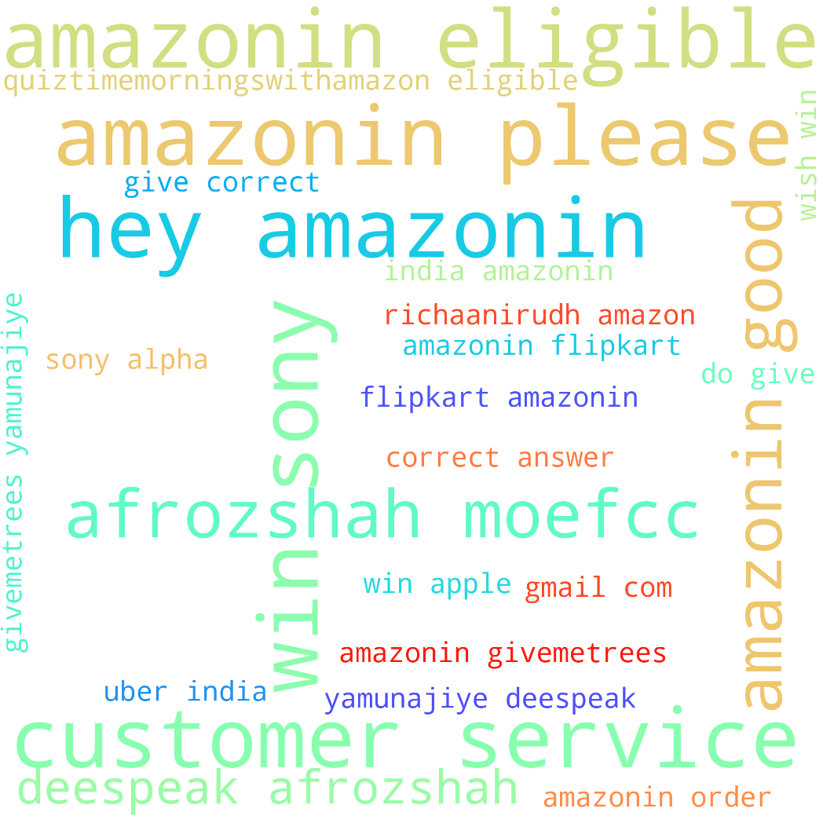
Word Cloud amazonIN Tweets

Slide 8
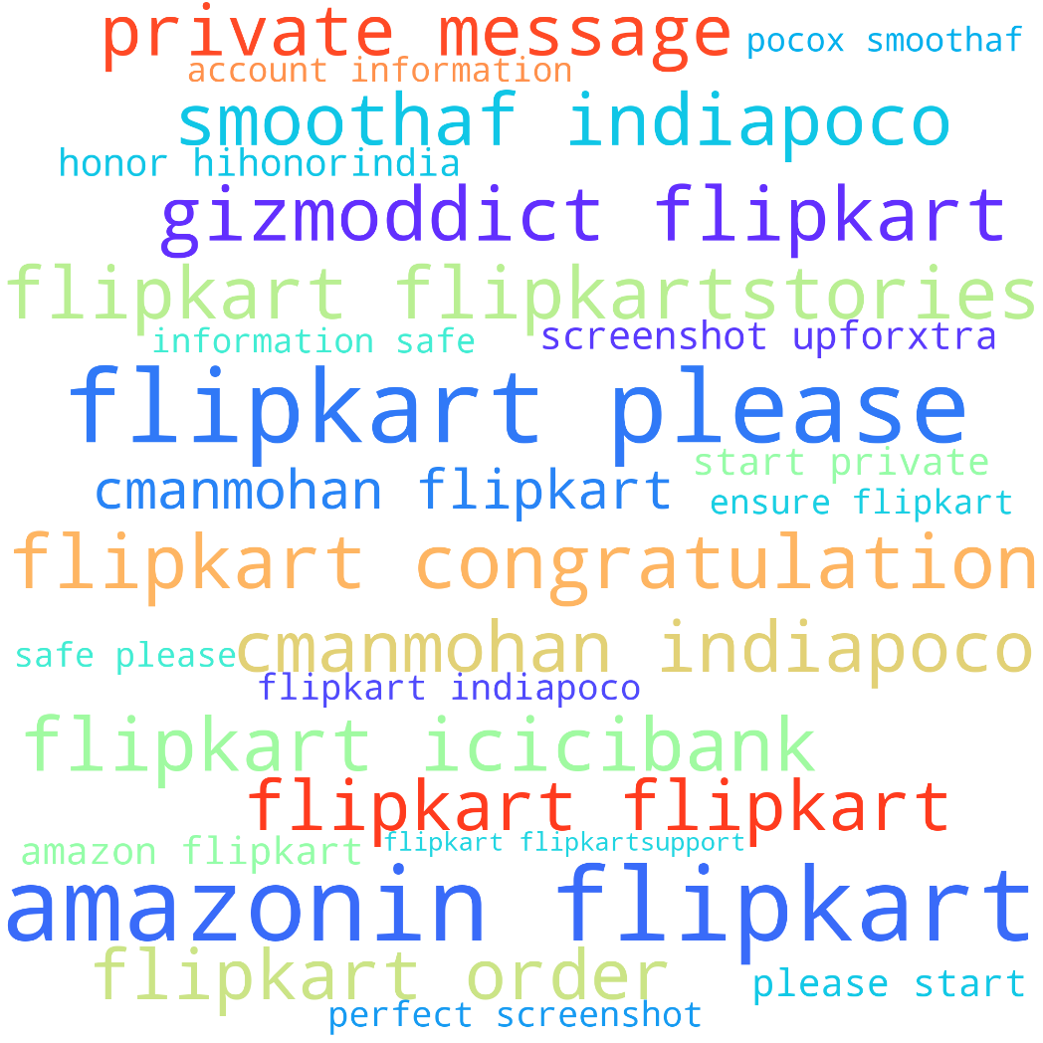
Word Cloud Flipkart Tweets

Slide 9
Product selected for Analysis

Slide 10
Sentiment Analysis of amazonIN headphones Tweets

Slide 11
Sentiment Analysis of amazonIN Laptops Tweets

Slide 12
Sentiment Analysis of amazonIN Cameras Tweets

Slide 13
Sentiment Analysis of amazonIN Speakers Tweets

Slide 14
Sentiment Analysis of amazonIN Mobiles Tweets

Slide 15
Sentiment Analysis of Flipkart headphones Tweets

Slide 16
Sentiment Analysis of Flipkart Laptops Tweets

Slide 17
Sentiment Analysis of Flipkart Cameras Tweets

Slide 18
Sentiment Analysis of Flipkart Speakers Tweets

Slide 19
Sentiment Analysis of Flipkart Mobiles Tweets

Slide 20
Top 3 Products with Positive Sentiments

Slide 21
Top 3 Products with Negative Sentiments

Slide 22
Conclusion

