Slide 1


VISVESVARAYA TECHNOLOGICAL UNIVERSITY
BHEEMANNA KHANDRE INSTITUTE OF TECHNOLOGY
DEPARTMENT OF ELECTONICS & COMMUNICATION ENGINEERING
BHALKI-585 328
INTERNSHIP REVIEW
ON
CLOUD AND NETWORK INTERNSHIP
AT
ROOMAN TECHNOLOGY PVT LTD
SUBMITTED BY
Amaan Ali – (3RB22EC048)
Under the Guidance of
Internal Guide
Prof : Channabasamma .M
Department of ECE
External Guide
Karthik Rao Designation: Program Manager

Slide 2

z
COMPANY PROFILE
Rooman Technologies Pvt Ltd
is a reputed training and internship organization established in 1999 that provides skill development, technical training, and internship programs in various technology domains.
Industry: Skill Development & Technical Training
Head Office: Bangalore, India
Website: https://rooman.net/
Specializations:
• Cloud Computing
• Networking
• Cyber Security
• DevOps
• Linux Administration

Slide 3
Internship Overview
Role: Cloud and Network Intern
Duration: 4 Months
Mode: Internship Training
Focused Areas:
• Cloud Computing
• Networking
• Linux Administration
• Automation
Quick Summary
A beginner-friendly internship focused on Cloud Computing and Networking with practical hands-on projects and industry tools.

Slide 4
Internship Description
Learn Cloud Computing and Networking concepts and technologies
Gain practical knowledge of server management and network configuration
Work with industry tools and cloud platforms through hands-on tasks
Build confidence to solve real-world IT infrastructure challenges

Slide 5
Technologies and Skills Using
Linux Operating System
AWS S3
Git &
SSH
Networking Devices
DNS Configuration

Slide 6
Key Responsibilities
Learn cloud infrastructure and network configuration
Work with servers, networking tools, and cloud platforms
Gain hands-on experience in system management and troubleshooting
Improve technical skills using industry best practices
Understand modern Cloud Computing and Networking technologies
Web Development Internship Presentation | 6

Slide 7
Learning Outcomes
Outcome
Understand Cloud Computing and Networking concepts
Improve troubleshooting and problem-solving skills
Learn server management and network configuration
Gain hands-on experience with practical implementation
Become more job-ready for entry-level IT and networking roles
Practical knowledge
+
Mini projects
+
Portfolio
=
Career readiness
Web Development Internship Presentation | 7

Slide 8
PROJECT INTRODUCTION
The internship includes project-based learning to solve real-world problems.
Configure and manage cloud and networking tasks
Apply cloud and network concepts in practical activities
Perform troubleshooting, testing, and system monitoring
Learn how real-time IT infrastructure projects are managed and implemented
Project Areas
Cloud setup
Network configuration
Server management
System troubleshooting

Slide 9
Static Website Hosting Using AWS S3
Project Description
The project is a cloud-based static website hosting implementation developed using Amazon AWS S3, HTML, and CSS.
The project was designed to understand cloud deployment, serverless website hosting, and cloud storage management.
The project focused on:
Static website hosting using AWS S3
Cloud storage configuration
Public access and bucket policy management
Website deployment and testing
Basic cloud security and access control concepts

Slide 10
PROJECT FEATURES
Features of the Application
  AWS S3 bucket creation
  Static website hosting
  Website file upload
  Public access configuration
  Bucket policy management
  Website testing through S3 endpoint
  Cloud storage management
  Basic security and access control

Slide 11
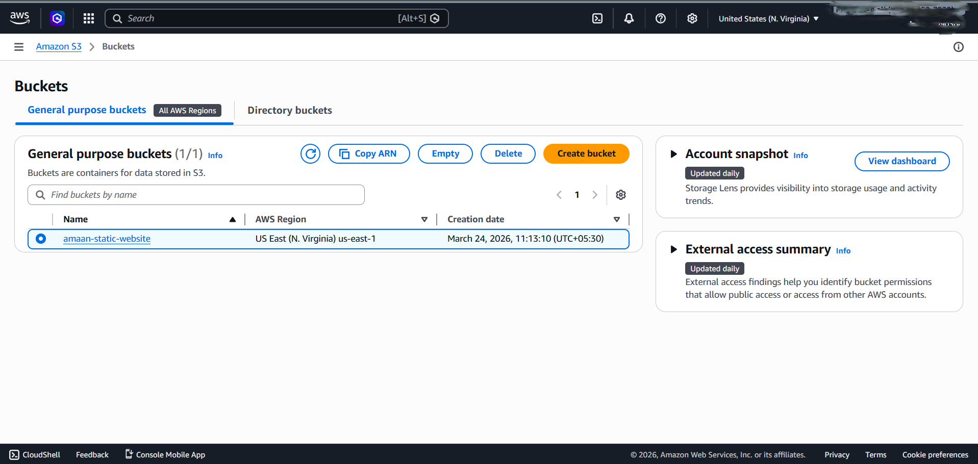
Work Done
lementation
Project Implementation - 01

Slide 12
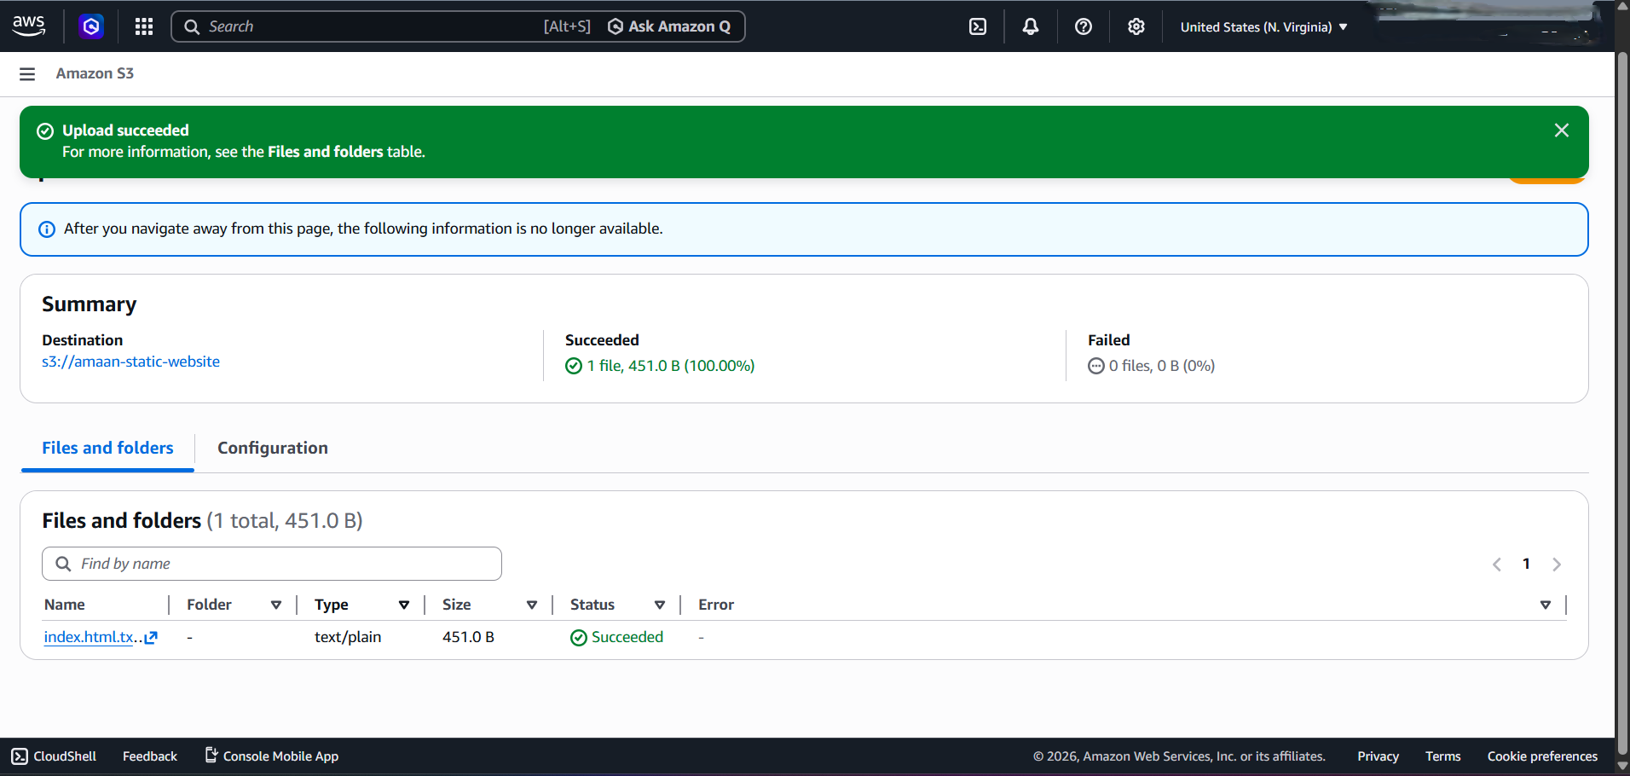
Project Implementation - 02

Slide 13
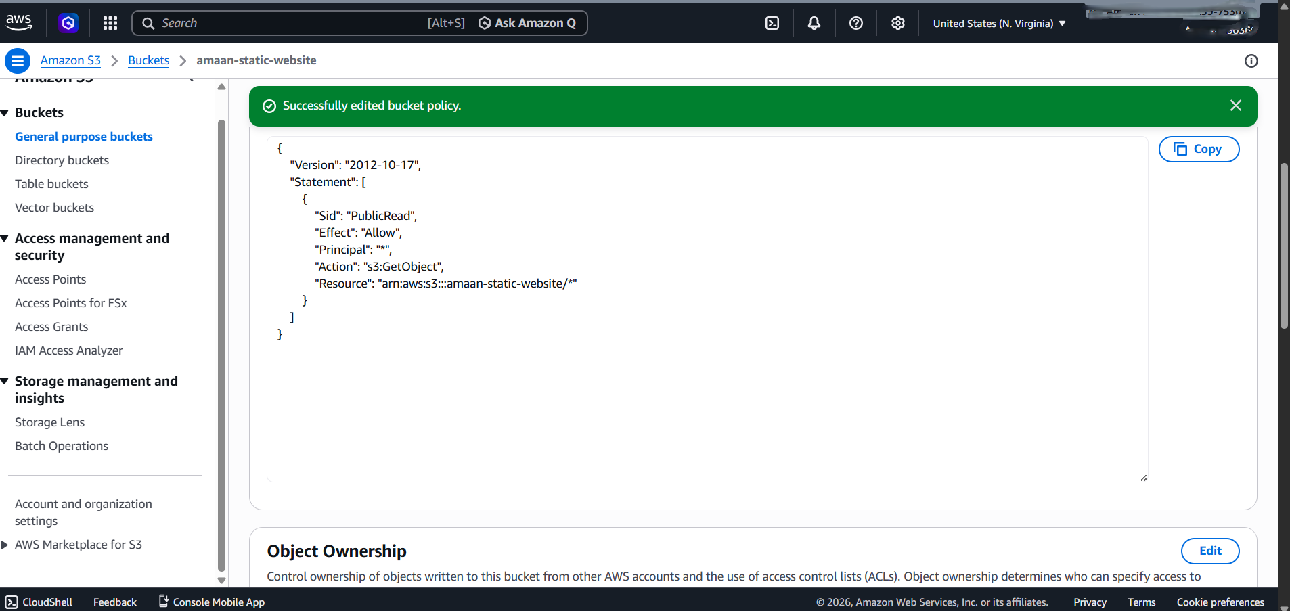
Project Implementation - 03

Slide 14
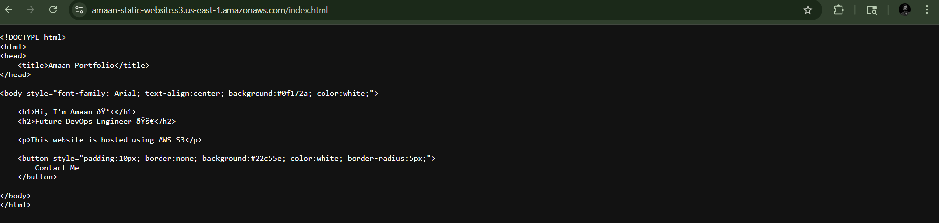
Project Implementation - 04
Outcome of the Program
Successfully hosted website using AWS S3
Learned cloud deployment concepts
Gained hands-on AWS experience
Improved website hosting skills

Slide 15
Overall Summary
This internship focuses on Cloud Computing, Networking, AWS services, and practical technical skills for entry-level IT roles.

Slide 16
Thank You

