Slide 1
Smart Campus Facility Reservation System with AI-Assisted Recommendations
FINAL YEAR PROJECT | PROGRESS MEETING
Amaan Rashid | TP073098 | Computer Engineering | APU4F2605CE
Supervisor: Dr Mukil Alagirisamy Second Marker: Syed Mohd Bahrin
Notes:
Good morning. A short update: what is built and working, what is built and being tested, and the plan to finish. I can show everything live after the slides. [20 seconds]

Slide 2
Half the system is built and verified
1
WHERE THE PROJECT STANDS
50%
DONE
DONE
DONE
Booking engine and rule model
No double booking (in the database)
Student, manager and admin dashboards
of the planned modules done and verified
DONE
DONE
DONE
AI recommender (LinUCB)
Grounded chatbot
Smart door and room automation (Wokwi)
Done and verified (6)
TESTING
TESTING
IN PROGRESS
End of booking: reminder, extend, overstay
3D digital twin and energy dashboard
Remote control of the room
Built, in testing (2)
In progress (1)
PLANNED
PLANNED
PLANNED
Planned (3)
All booking rules and privacy in the database
Evaluation and user study
No-show prediction model
Counted by module from the Phase 1 plan plus the smart-room extension. "Done" means built and checked by automated tests or a live run.
Notes:
Twelve modules in total. Six are done and verified: the booking engine and its rule model, the no-double-booking guarantee in the database, the three dashboards, the AI recommender, the grounded chatbot, and the smart door with room automation in Wokwi. Two more are built and being tested: the end-of-booking features and the 3D twin with energy figures. Remote control of the room is in progress. Three are planned: moving every booking rule into the database, the evaluation and user study, and the no-show model. So half is done and verified, and two thirds is built. [80 seconds]

Slide 3
One web app, one database, one smart room
2
SYSTEM ARCHITECTURE
Web app (Next.js on Vercel)
Supabase (PostgreSQL)
Booking, approvals, admin console
AI recommender + grounded chatbot
3D digital twin, energy dashboard
No-overlap constraint, row-level security
pg_cron: release no-shows, reminders
Activity log written by triggers
Users
Student
Facility manager
Administrator
Browser or phone
Room API
ESP32 room device (Wokwi)
unlock, status, event, extend
Device key checked on every call
Door codes derived, never stored
Keypad, OLED, servo lock
Presence sensor + noise
Lights and air-con outputs
Double booking is blocked by the database itself. The other booking rules are checked by the app today and move into the database next.
Notes:
Three parts. Users reach one Next.js web app on Vercel. The app and the room API both use Supabase. The no-double-booking rule is enforced by PostgreSQL itself, so it holds even for two requests at the same instant. The other booking rules, like opening hours and length, are checked by the app today; moving them into the database is the first item of the next phase. The ESP32 in Wokwi only talks to the room API, with its own device key. [70 seconds]

Slide 4




Suggestions that learn, answers that come from real data
3
AI RECOMMENDER AND CHATBOT
Grounded chatbot
Answers only from database rows
Free times, rules, a specific time, follow-ups
Only your own bookings
"My bookings" is filtered to the signed-in student
Offers alternatives
If busy, asks the recommender for other rooms or days
Every free slot is scored on time closeness, capacity fit and off-peak use, with a reason shown.
LinUCB re-ranks for each student; cascade feedback learns from what was taken and what was skipped.
Regret 5.8% against 14.3% for fixed scoring.
Works offline
Uses an AI provider when a key is set, rule-based otherwise
Notes:
The AI part has two pieces. When a time is taken, the recommender offers ranked alternatives, each with a reason. A LinUCB bandit learns each student's preferences from what they accept. In a simulation with four kinds of students it raised acceptance from 71.1 to 79.6 percent; real acceptance will be measured in the user study. The chatbot only phrases answers from rows the database returns, shows a student only their own bookings, and suggests alternatives when a room is busy. [80 seconds]

Slide 5
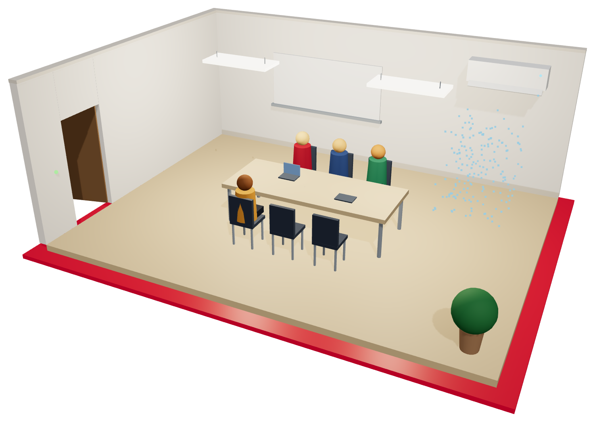




The booking now controls a room, and you can see it
4
SMART LIBRARY ROOM AND 3D TWIN
Get code
6 digits from a secret, never stored
Unlock
keypad opens the lock and checks in
Room runs
presence drives lights and air-con
No-show
not checked in: slot freed automatically
y[n] = 0.1 · x[n] + 0.9 · y[n−1]
Low-pass filter (τ ≈ 1.9 s) with hysteresis 0.35 / 0.08 stops lights flickering on a noisy sensor
3D twin, rendered from the room's state: lights, air-con, door, lock, people and booking status. In testing: live updates from Wokwi every 5 s, the energy dashboard, and the end-of-booking reminder, extend and overstay alert.
Notes:
This is the engineering extension. One library room is simulated on an ESP32 in Wokwi. The student's six-digit door code is derived from the booking id with HMAC, so codes are never stored. Typing it opens the servo lock and checks the student in; if nobody checks in, the slot is freed automatically. A noisy presence signal is cleaned by a low-pass filter with hysteresis, and drives the lights and air-con. On the right is the 3D twin of the room. It is built; live updates from Wokwi, the energy figures and the end-of-booking features are being tested now. [90 seconds]

Slide 6


Tested in code, grounded in literature
5
EVIDENCE SO FAR
Literature for the new features
Recommender
Li et al. (2010) LinUCB; Kveton et al. (2015) cascading bandits
106
PostgreSQL 17
automated tests: time, recommender, bandit, chatbot, door logic, energy, twin
migrations run on a real database, with permission checks
Smart room
Naylor et al. (2018) occupant-centric control; Labeodan et al. (2015)
Digital twin
Lu et al. (2020) Cambridge campus twin; Ghansah & Lu (2023)
Smart campus
Cavus et al. (2022) IoT systematic review
4 methods
Live run
compared in a simulation on the same students
door code to unlock and check-in confirmed working in Wokwi
No-shows
Topuz et al. (2024) no-show-aware scheduling
Notes:
The evidence so far: 106 automated tests; the database migrations run on a real PostgreSQL 17 with permission checks; a simulation comparing four ranking methods; and a live Wokwi run where the door code unlocked the room and checked the booking in. The new features are grounded in eight papers, from LinUCB to campus digital twins. [55 seconds]

Slide 7
What is not finished yet, and how each gets closed
6
PENDING GAPS
Gap | Why it matters | How it gets closed
Booking rules in the app only | Opening hours, length, advance window and cancel notice are checked by the app, not the database | Database trigger that rejects any booking breaking the rules
Bookings readable by all users | Any signed-in user could read every booking through the API | Students see only their own rows; others get a free/busy view
Direct booking edits | A student could change their own end time without the extension rules | Changes only through checked database functions
New firmware not yet run | Countdown, keypad extend and overstay code has not been compiled | Build in VS Code, then run the end-of-booking test steps
Live twin and energy untested | 3D twin and energy chart not yet seen with live Wokwi data | End-to-end run with Wokwi; seeded week for the chart
Formal evaluation pending | Concurrent booking, speed and chatbot accuracy tests not yet run | Scripts for DS1, DS4 and a fixed question set
Demo housekeeping | Device key was shared during development; test data in the database | Re-key the device; remove the seed before the user study
The first three are the hardening step: they make the Phase 1 promise of rules held in the database fully true.
Notes:
To be open about where things stand, these are the gaps. The first three are about the database: today only the no-overlap rule is enforced there, all signed-in users can read all bookings through the API, and students can edit their own booking rows. All three are fixed in the hardening step with a trigger, a tighter read policy and checked functions. Then the firmware and the live twin need an end-to-end run, the formal evaluation scripts need writing, and the demo device gets a new key. [80 seconds]

Slide 8





Operate the room from the app, in under a second
7
IN PROGRESS: REMOTE CONTROL OVER MQTT
Admin taps
API checks
Publish
ESP32 acts
Confirms
Unlock / lights / air-con / message, next to the 3D twin
Admin or that room's manager only; command saved and logged
MQTT over TLS to rooms/<device>/cmd, signed and expiring
Subscribed in Wokwi; verifies the signature, applies safety rules
Reports back; room log and 3D twin update
Why MQTT
Security
Safety and fallback
Push: the device gets commands at once, no polling
Light protocol made for IoT devices
A simulated ESP32 has no public address, so it subscribes outwards to a broker
TLS broker login; topic per device
Each command signed with the device key (HMAC), with an expiry and a one-time id, so a copied message cannot be replayed
Every command logged with who sent it
Overrides expire (e.g. 30 min), then the room returns to automatic
Lights are never cut while people are inside without a warning
If the broker is down, the device picks commands up over HTTP
Turns the 3D twin from a viewer into a two-way digital twin: the model shows the room and also operates it.
Notes:
Remote control is in progress. An admin taps a button next to the 3D twin, for example unlock or lights off. The API checks that the person is an admin or that room's manager, logs the command, and publishes it over MQTT with TLS to that device's topic. The ESP32 in Wokwi is subscribed, so it receives it within a second. It checks an HMAC signature with an expiry, so a copied message cannot be replayed, applies its safety rules, acts, and reports back so the log and the twin update. Overrides expire, and if the broker is down the device falls back to HTTP. This makes the twin two-way. [90 seconds]

Slide 9
From working system to measured results
8
PLAN TO FINISH
1
NEXT, FIRST
2
IN PROGRESS
3
NEXT
4
NEXT
Hardening
Remote control
Evaluation
Extensions and report
All booking rules enforced in the database
Students see only their own bookings
Booking changes only through checked functions
MQTT push to the ESP32, HTTP fallback
Unlock, lights, air-con, door message
Signed, expiring, logged commands
Two bookings at the same instant: only one succeeds
Recommender under 1 s; chatbot question set
User study: acceptance, no-shows, SUS above 68
No-show prediction model
Batch allocation for busy periods
Phase 2 report and final demo
Hardening comes first, so the user study runs on the final, secure system with the test data removed.
Notes:
Four steps to finish. First, and before anything else, hardening: every booking rule enforced inside the database, students able to see only their own bookings, and booking changes only through checked functions. Second, remote control, which I have started: operate the room from its 3D view, so the twin works both ways. Third, the evaluation against the Phase 1 targets, including the user study and the SUS score. Fourth, the no-show model, batch allocation, and the report. [75 seconds]

Slide 10
Questions, then a live demo
THANK YOU
Booking with suggestions, chatbot, manager and admin views, Wokwi smart room and 3D twin
Notes:
Thank you. Happy to take questions, then I will show it running. [10 seconds]

