Slide 1
PROJECT PHASE 1 | MID-POINT ORAL PRESENTATION | EE016-3-3-PP1
Smart Campus Facility Reservation System
with AI-Assisted Recommendations
Amaan Rashid | TP073098 | Computer Engineering | APU4F2605CE
Supervisor: Dr Mukil Alagirisamy Second Marker: Syed Mohd Bahrin
Notes:
Good morning. My project is a smart campus facility reservation system with AI-assisted recommendations. In the next fifteen minutes: the problem, the literature, the concept design, what is already implemented, and the Phase 2 plan. [20 seconds]

Slide 2
1
Contents
1
Problem statement
2
Aim and objectives
Booking is digitised. Allocation is not
Five objectives, eight UN-SDGs
3
Literature review
4
Concept design
Eleven papers and the gap they leave
Architecture, database, rule model
5
Implementation to date
6
Phase 2
Working system, approximately 30 percent
Evaluation, not implementation
Notes:
Six parts. Most of the time goes on the research gap and the design, because that is where the engineering contribution sits. [25 seconds]

Slide 3
2
PROBLEM STATEMENT
Research problem
Booking systems record who booked. They do not manage the space.
Booking is already online everywhere. One library product alone runs at 7,500 institutions in 106 countries. The problem is what the software still does not do.
Scope of the rules
Rules cover one kind of space only, so a university runs several systems and never sees the whole picture
Failed requests
A refused booking ends there, so students hold extra slots they do not need as insurance
Where the rules live
Booking rules are published as text and applied by staff, not enforced by the software
Data integrity
Two bookings made in the same instant can both succeed, because the check sits in the application, not the database
Allocation is therefore settled by staff intervention (Sunway University, 2026), and the university holds no reliable record of how its own space is used.
Notes:
Start here, because the obvious objection is that this is already solved. It is not. Booking is online; managing the space is not. Walk the four rows, then land the last line. Say the Sunway detail out loud rather than reading it: their booking page sets a minimum group size of three for a pod that seats ten, and to prove you turned up for a booking made online at midnight, a member of staff has to see your face at a counter within fifteen minutes. That is not a criticism of Sunway. It is what happens when the booking is digital and the managing is not. [70 seconds]

Slide 4
3
AIM AND OBJECTIVES
Aim and objectives
AIM
One booking system for every kind of campus space: staff set the rules without a developer, the database refuses to double-book, a refused request returns ranked alternatives, and availability questions are answered in plain English.
01
Design a rule model where a facility type holds the rules and its rooms follow, with one room able to override one value
02
Build the no-clash rule into the database itself, so it holds no matter what the app does
03
Construct an engine that answers a refused booking with ranked alternatives, and adapts to each student
04
Develop an assistant that cannot fabricate or leak data, by construction rather than by instruction
05
Evaluate against fixed targets: zero clashes, acceptance rate, answer accuracy, no-show rate, usability above 68
Notes:
One aim, five objectives. Each one names a mechanism, not a feature, because a booking website with settings is something you can already buy. One and two are the guarantees, three and four are the intelligence, five proves it works. [60 seconds]

Slide 5
4
JUSTIFICATION
Justification
Operational
Technical
Social
Every rule the software applies is one staff no longer enforce by hand, and every unused booking it surfaces is space the university can reclaim
Recommendation and conversational support are proven in other domains. No reviewed campus booking system has integrated either
Allocation that follows no visible rule cannot be shown to be fair. A rule applied uniformly can be, and utilisation data replaces impression with evidence
Eight UN Sustainable Development Goals — two for each of the first four objectives
11
12
9
10
7
3
4
8
Sustainable
cities
Responsible
use
Industry and
infrastructure
Reduced
inequality
Clean
energy
Health and
wellbeing
Quality
education
Decent
work
Each goal is a mechanism, not a label. Goal 7: matching group size to room size means fewer big rooms lit and cooled for two people. Full mapping in the report.
Notes:
Three reasons, then the goals. The one to stress is fairness: it is not decoration, it is why the rule engine has to treat everyone the same and why the activity log can only be added to, never edited. On the goals, do not read all eight — pick goal 7 and give the energy example. [55 seconds]

Slide 6
5
LITERATURE REVIEW
Literature reviewed
PAPER
PUBLISHED IN
CONTRIBUTION TO THIS PROJECT
CAMPUS BOOKING SYSTEMS
Venkatesh et al. (2026)
IJERT
Baseline workflow: request, approve, record
Antony et al. (2026)
IJOEST
Names AI availability prediction as work not done
Artes et al. (2024)
ACM MSIE
Rigorous method, never implemented
Hwang, Jung & Lee (2022)
JPSP
Conflict prevention belongs in the data layer
Lalitha et al. (2022)
IEEE ICCST
One facility type, one fixed rule set
RECOMMENDATION
Roy & Dutta (2022)
J. Big Data
Cold start and sparsity: scoring over training
Valencia-Arias et al. (2024)
ISWA
Context-awareness and explainability
CONVERSATIONAL ASSISTANTS IN HIGHER EDUCATION
Okonkwo & Ade-Ibijola (2021)
Computers & Ed: AI
Administrative queries as the use case; error as the risk
Rahim et al. (2022)
Sustainability
302 Malaysian students: trust governs adoption
Essel et al. (2022)
IJETHE
68 students, measured gain: the Phase 2 template
Dempere et al. (2023)
Front. Educ.
Accuracy and privacy risk: grounds a narrow scope
All eleven published between 2021 and 2026, and all eleven verified against Crossref or the publisher's own record.
Notes:
Do not read this table. Say: eleven papers in three groups, and the right-hand column is the contribution each made to the design. Then land two. Antony, because the authors themselves list AI availability prediction as work not done, which is evidence from inside the literature that the gap is real. And Roy and Dutta, because that paper decides the main technical choice. [55 seconds]

Slide 7
6
LITERATURE REVIEW
Findings from the literature
Campus booking systems
Recommendation
Conversational assistants
All five digitise the paperwork and stop there
Rules are fixed in code, so a policy change is a software change
Commercial products (LibCal, Skedda, MIDAS) are configurable, but within one facility segment
Roy and Dutta: the standard method depends on history, and this system launches with none
Hence rule-based scoring with weights that adapt per student
Valencia-Arias: every suggestion should carry its reason
Okonkwo: administrative queries are the strongest use case; incorrect answers the principal risk
Rahim, 302 Malaysian students: trust governs adoption
Dempere: hence an assistant restricted to phrasing retrieved rows
None of the four assistant papers identifies facility or resource management as an application area.
Notes:
Three columns, one point each. Left: every reviewed system digitised the paperwork and stopped. Middle: Roy and Dutta justifies the main technical decision, since there is no booking history to train on. Right: the principal risk is a confident wrong answer, which is why the assistant only phrases rows the database returned. Then the closing line. [65 seconds]

Slide 8
7
LITERATURE REVIEW
The research gap
1
2
3
Policy stops at the segment boundary
Alternatives are never ranked
No conversational access for students
Configurable rules exist commercially, but only within one segment. The library buys one product, the sports centre another. Nothing spans them.
The papers offer nothing when a request fails. The one product that does reads a substitution list maintained by hand.
Library assistants follow fixed scripts. Conversational booking exists as a staff add-on on one shared account.
ADDRESSED BY
ADDRESSED BY
ADDRESSED BY
Rooms, courts and halls under one rule model
Ranked on time, capacity fit and load, and adapted per student
In-product, per student, scoped to their own data
Assessed against the products universities buy today, not only against the papers.
Notes:
This slide is the hinge of the talk. Three gaps, three answers. Slow down: everything after this delivers against them. [60 seconds]

Slide 9
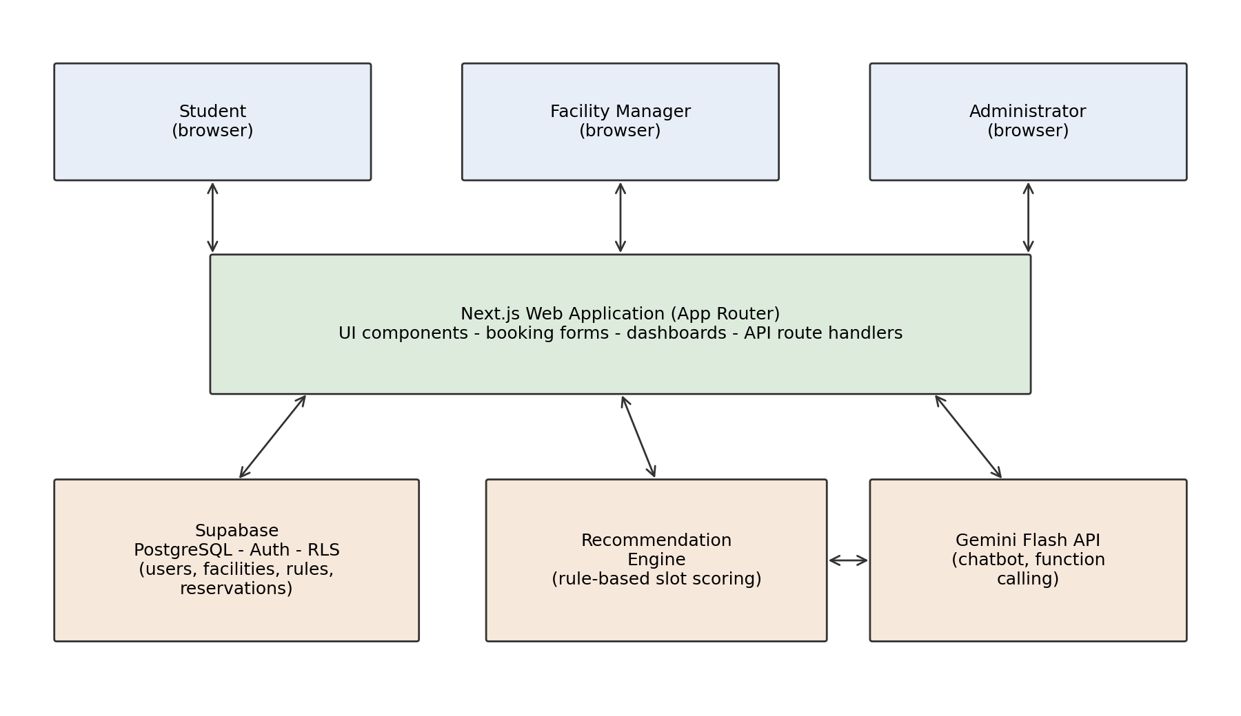
8
CONCEPT DESIGN
System architecture
Design decisions
One codebase serves all three dashboards and the API
PostgreSQL, since MySQL cannot enforce the no-overlap rule
The model sits behind a wrapper and can be replaced
Runs entirely on free tiers
Figure 3.1 of the report
Notes:
Three browser dashboards, one application, one database. Two decisions worth defending: PostgreSQL rather than MySQL, because the guarantee on the next slide needs a feature MySQL does not have; and the model behind a wrapper, because a model this project depended on was retired midway through the phase. [55 seconds]

Slide 10
9
METHODOLOGY
Development approach and evaluation
Incremental build order
Three levels of testing
1
Database, access control, authentication
Unit and integration
Rules, slot generation, scoring, ranking. 15 automated tests passing
2
Facility configuration and rule engine
3
Booking, with overlaps blocked by the database
System
Two overlapping bookings submitted at the same instant; exactly one must succeed
4
Recommendation engine with adaptive weights
5
Assistant grounded in live data
User acceptance
Task time against the current process, acceptance rate, answer accuracy, usability above 68
6
Analytics, notifications, attendance
Each increment stands alone, so dropping a later one never leaves a broken system.
Notes:
The build order is deliberate: the database and the no-overlap rule come first, because everything else rests on them. On testing, note the middle row: the guarantee is tested by issuing real simultaneous requests, not by reading the code. [55 seconds]

Slide 11
10
CONCEPT DESIGN
Rule model: policy held as data
The principal contribution. Booking policy is stored as configuration and changed through a form, not written into the program.
FACILITY CATEGORY
FACILITIES
RULE OVERRIDE
Badminton, Discussion Room
Court 1, Court 2, Room A
Optional, per facility
Holds the venue and all six rules: opening and
closing time, minimum and maximum duration,
advance window, cancellation notice
Store only what differs — name, capacity, status.
Everything else is inherited from the category
A single value may be overridden on one facility.
Anything left blank still follows the category
▶
▶
Implication
An administrator can add an entirely new category — a swimming pool, a recording studio — with its own rules and no code change. The software is therefore not written for one campus: any institution deploys the same build and configures its own policy.
Notes:
If you remember one design slide, make it this one. Policy is data, not code. Change a rule on the category and every facility under it follows; override one facility and only that one changes. This is what makes it portable between institutions, and it is the commercial argument as well. [70 seconds]

Slide 12
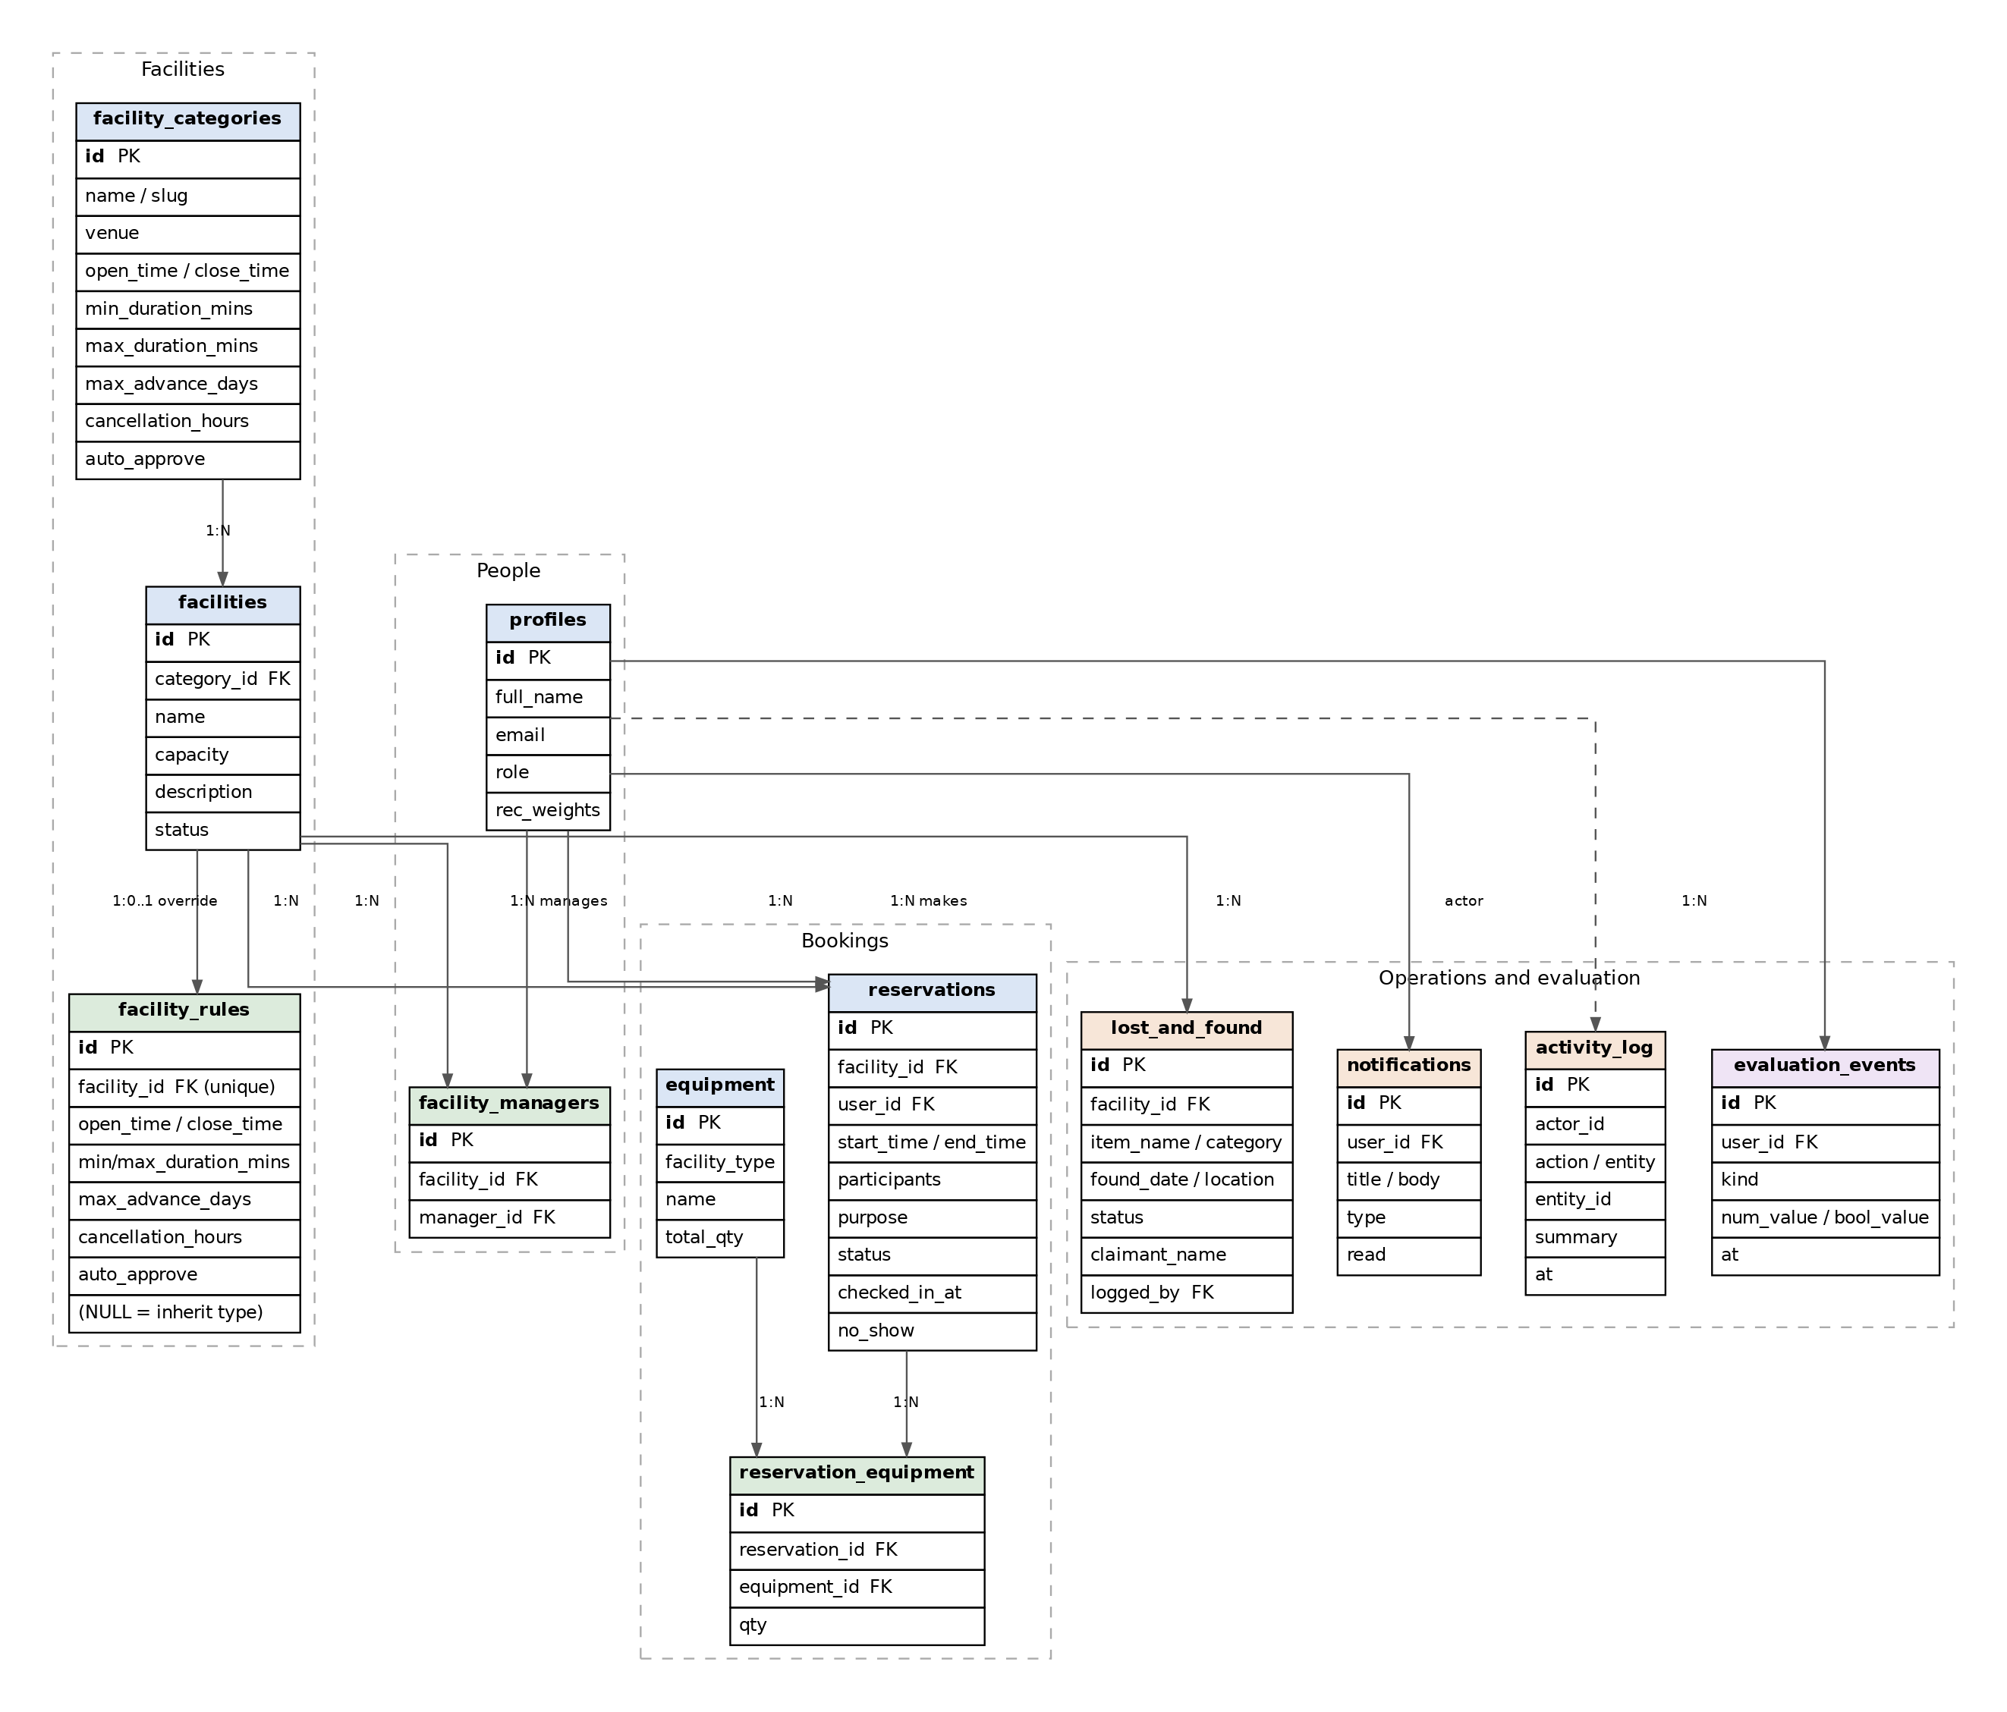
11
CONCEPT DESIGN
Database design and the conflict guarantee
Enforced by the database, not the application
A single constraint states that two time ranges on the same facility may never overlap. If two requests arrive in the same instant, PostgreSQL rejects one itself.
EXCLUDE USING gist (
facility_id WITH =,
tstzrange(start, end) WITH &&
)
Access control, also in the database
A manager acts only on facilities assigned to them
A student modifies only their own bookings
Self-registration creates a student account only
Holds even if the API is called directly
Figure 3.3 — twelve tables in four groups
Notes:
Two guarantees sit in the database rather than in application code. The first means there is no race to lose; most reviewed systems check in application code, which can lose it. The second means a manager cannot read another manager's facilities even by bypassing the interface. [65 seconds]

Slide 13
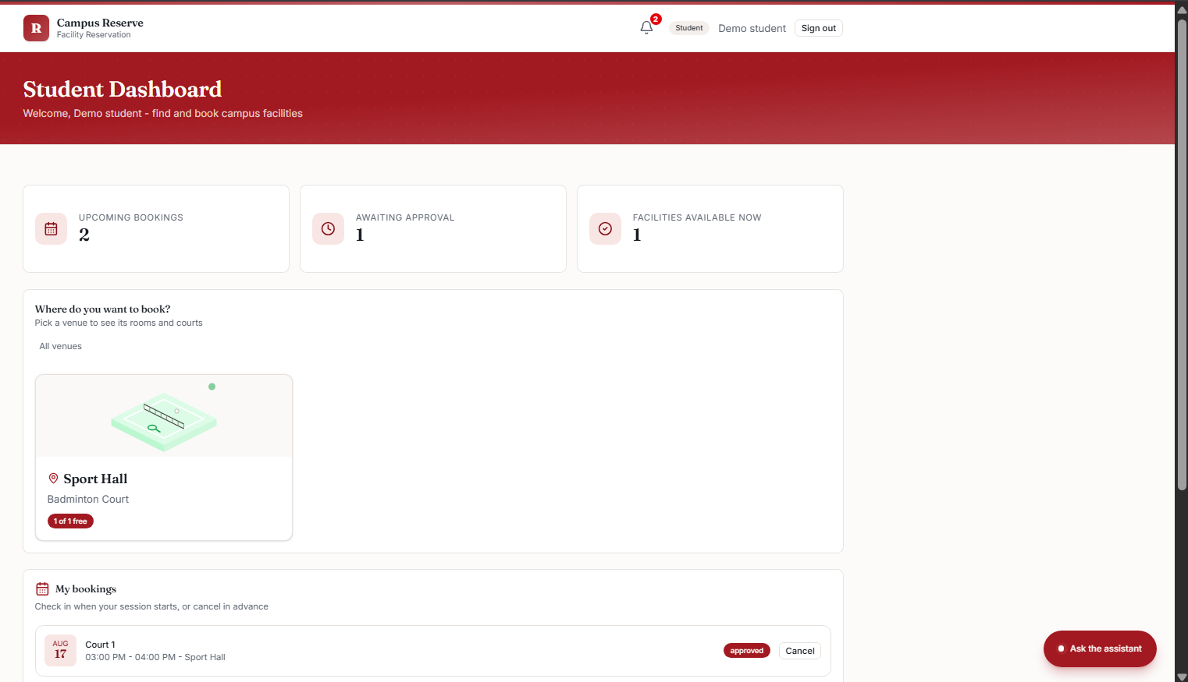
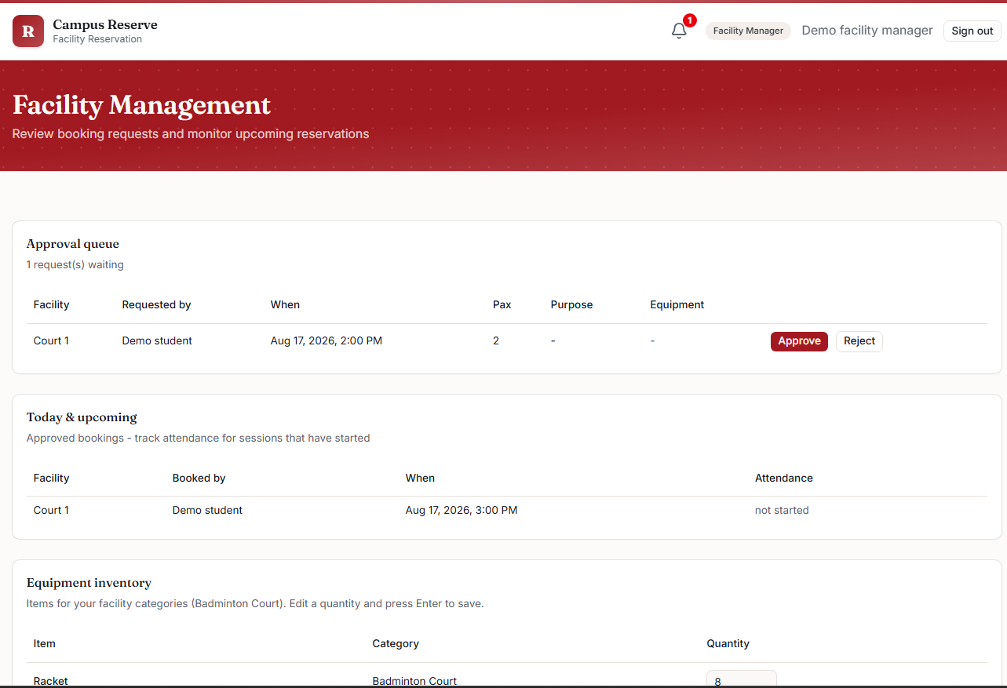
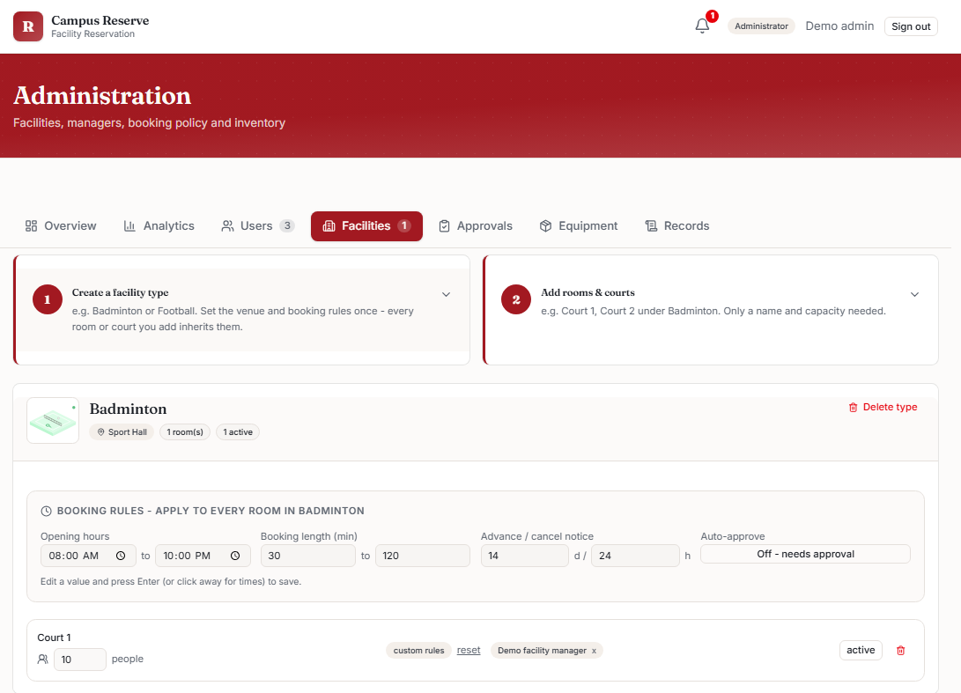
12
IMPLEMENTATION
Implementation: three role interfaces
Running against a live database. Every rule shown on screen is read from the schema, not written into the page.
Student
Facility manager
Administrator
Venue, then facility with a live in-use badge, then a time validated against that facility's own rules
Approval queue, attendance and no-show marking, scoped to assigned facilities
A category with its rules, and the facilities inheriting them underneath
The administrator view is the one to note. Rules sit on the category; the facilities beneath inherit them. Adding a swimming pool with different rules is a form, not a code change — objective 1, in operation.
Notes:
Three roles, one codebase, one database. Do not walk through each screen. Point at the third and make one claim: the administrator sets rules on a category and every facility under it follows. Offer the live demonstration here if the panel looks interested. [40 seconds]

Slide 14
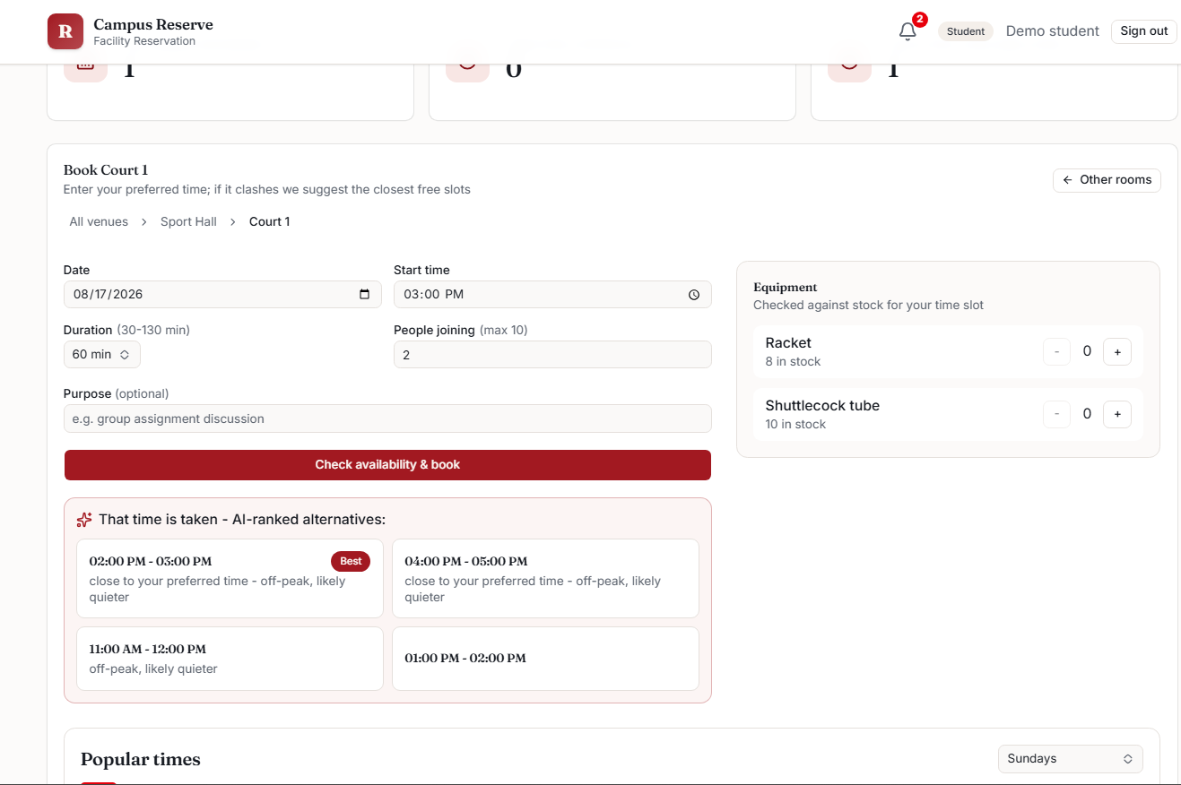
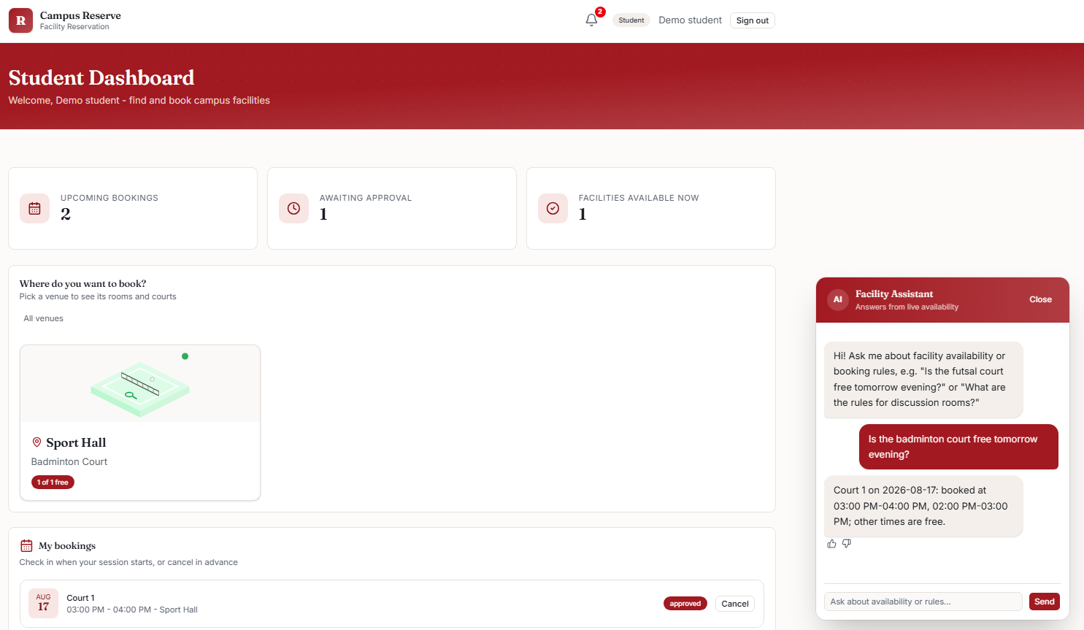
13
IMPLEMENTATION
AI components in operation
15:00 requested and unavailable. Ranked alternatives returned, each with its reason.
Answered from rows read under that student's own authorisation.
Ranking rule
Grounding
score = time proximity + capacity fit + off-peak load
The model never reaches the database. It calls a typed function, the server executes it under that student's own authorisation, and the model phrases only the rows returned. Anything outside its four question types is referred to staff.
14:00 → 0.85 13:00 → 0.65
Both are adjacent to the request. 13:00 ranks lower because it falls inside a peak period. Weights adapt as the student accepts or ignores.
Notes:
The strongest evidence in the deck, so slow down. Left: three o'clock was requested and unavailable, and instead of a refusal the system returned ranked alternatives with reasons. Read the two scores and land the point that one o'clock ranks lower because it sits in a peak period. Right: say the sentence out loud — the model never reaches the database; it phrases rows the server retrieved under that student's own authorisation. [55 seconds]

Slide 15
14
PROFESSIONAL PRACTICES
Professional engineering practices
Data protection
BEM code of conduct
Malaysian PDPA 2010: collection limited to what a booking requires, bounded retention, and access decided in the database
Circular 001 §2.1.7: no opinion unfounded on fact. Applied to software, the assistant is not permitted to guess
Public health and safety
Accessibility and inclusion
Occupancy limits encode a fire and crowd-density rule. The same field imposes a health capacity cap with no code change
WCAG 2.1 AA, plain interface language for an international cohort, and the counter process retained so nobody is excluded
Whole-life cost and net zero
Continuing development
Hosted, so no hardware to power, cool or dispose of. Paper eliminated, journeys reduced, empty rooms no longer conditioned
Access control, exclusion constraints and function-calling APIs learned from primary sources and verified by testing
Notes:
Six areas. The one worth dwelling on is the second: the engineering code states that no opinion may be expressed unfounded on fact. Applied to software, the assistant is not permitted to guess; it composes answers only from rows it retrieved. A professional obligation expressed as an architecture. [55 seconds]

Slide 16
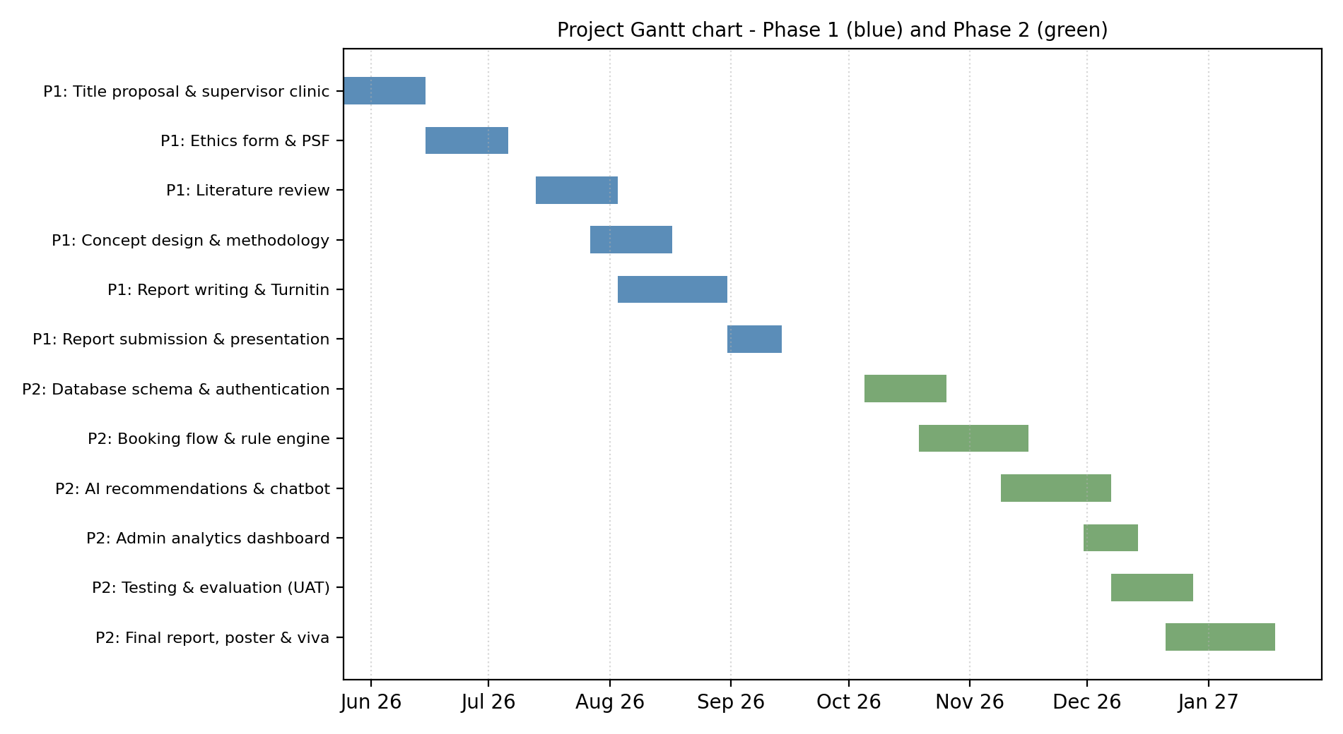
15
MANAGEMENT AND FINANCE
Project management, finance and marketability
RM 0
recurring cost — the whole
stack runs on free tiers
Route to market
Because policy is configuration rather than code, the same platform serves another institution without modification.
A per-institution subscription, with near-zero marginal cost for a small deployment.
Corporate room-booking products exist, but campus needs — student roles, mixed facility types, approval hierarchies — are underserved. Private colleges first: shorter procurement.
Figure 3.9 — Phase 1 and Phase 2
Notes:
Phase 1 runs from the title proposal to today; Phase 2 runs to the viva. Supervisor meetings fortnightly, recorded in log sheets. The recurring cost is genuinely zero, which is also the commercial argument: marginal cost per institution is near nothing. [45 seconds]

Slide 17
16
CONCLUSION
Current status and Phase 2
Completed in Phase 1
Not yet claimed
Eleven papers reviewed and verified; research gap established
Recommendation quality is untested with real students until ethics clears
Concept design complete: architecture, twelve tables, derived rules
Peak periods are fixed in code, not yet learned from booking history
Working prototype: booking, rule engine, recommender, assistant, analytics
The cross-facility claim is proven in the schema, demonstrated on seven facilities
15 automated tests passing on the recommendation engine
Phase 2: evaluation, not implementation
Sep
Oct–Nov
Nov–Dec
Dec–Jan
Jan
Ethics approval
Harden and instrument
User acceptance testing
Analyse and write up
Final report, poster, viva
Gates everything below
Seed data, edge cases, logging
All five targets measured
Measured values, not estimates
Hardbound submission
Notes:
Everything on the left is finished, and a booking with an AI suggestion can be demonstrated in about thirty seconds if that is useful. The right column is deliberate: three things not yet claimed, stated before anyone asks. The strip along the bottom is Phase 2 — because the build happened during Phase 1, Phase 2 is evaluation. Ethics approval gates everything, which is why the build was front-loaded. [65 seconds]

Slide 18
17
REFERENCES
References
Antony, A., Maria Thomas, L., K Suresh, M., Sony, M., & Saritha R, R. (2026). EDUNEXUS: College facility booking platform. IJOEST, 10(1), 36–38.
Artes, A. L., Lorzano, E. R., Tayam, J. R., & Intal, G. L. (2024). Cardinal Reserve: A proposed online room reservation system for a HEI. MSIE 2024, 108–118.
Dempere, J., Modugu, K., Hesham, A., & Ramasamy, L. K. (2023). The impact of ChatGPT on higher education. Frontiers in Education, 8, 1206936.
Essel, H. B., Vlachopoulos, D., Tachie-Menson, A., Johnson, E. E., & Baah, P. K. (2022). The impact of a virtual teaching assistant (chatbot) on students' learning. IJETHE, 19, 57.
Hwang, K., Jung, I. H., & Lee, J. M. (2022). Design and implementation of database for shared facility reservation system in school. JPSP, 6(8), 7033–7041.
Lalitha, V., Magesh, K., Selvanarayanan, A., & Keertheshwaran, G. (2022). Online college event-hall booking reservation system. ICCST 2022, 972–975.
Okonkwo, C. W., & Ade-Ibijola, A. (2021). Chatbots applications in education: A systematic review. Computers and Education: AI, 2, 100033.
Rahim, N. I. M., Iahad, N. A., Yusof, A. F., & Al-Sharafi, M. A. (2022). AI-chatbots adoption model for higher-education institutions. Sustainability, 14(19), 12726.
Roy, D., & Dutta, M. (2022). A systematic review and research perspective on recommender systems. Journal of Big Data, 9, 59.
Valencia-Arias, A., et al. (2024). Artificial intelligence and recommender systems in e-commerce. Intelligent Systems with Applications, 24, 200435.
Venkatesh, S., Pradeep, P., Balamurugan, M., Guhan, S., & Niyasaju. (2026). Design and implementation of a web-based campus facility reservation system. IJERT, 15(3).
All eleven verified against Crossref or the publisher's own article page.
Notes:
I will not read these. All eleven were verified against Crossref or the publisher directly. [10 seconds]

Slide 19
Thank you
Questions
The system is running if a live demonstration would be useful — a booking with an AI suggestion takes about thirty seconds.
Amaan Rashid | Smart Campus Facility Reservation System with AI-Assisted Recommendations
Notes:
Offer the demo — it is the strongest evidence you have and most panels take it. If you do not know an answer: 'I have not investigated that yet, but my instinct is X, and I would verify it by Y.' Never bluff.

