Slide 1





ADMIN GUIDE
Connecting a smart room
Turn any existing room into a smart room with a Wokwi simulation or a real ESP32: five steps, about six minutes, no SQL and no redeploy.
1
2
3
4
5
Open Smart room
Choose room + device
Copy ID + key
Paste into sketch
Check it's live
~1 min
in the web app
~5 min
on the device
0
SQL scripts or redeploys
Notes:
This guide shows how an administrator adds a new smart room. Everything on the web side is in the admin console; the only device work is pasting two lines into the firmware.

Slide 2
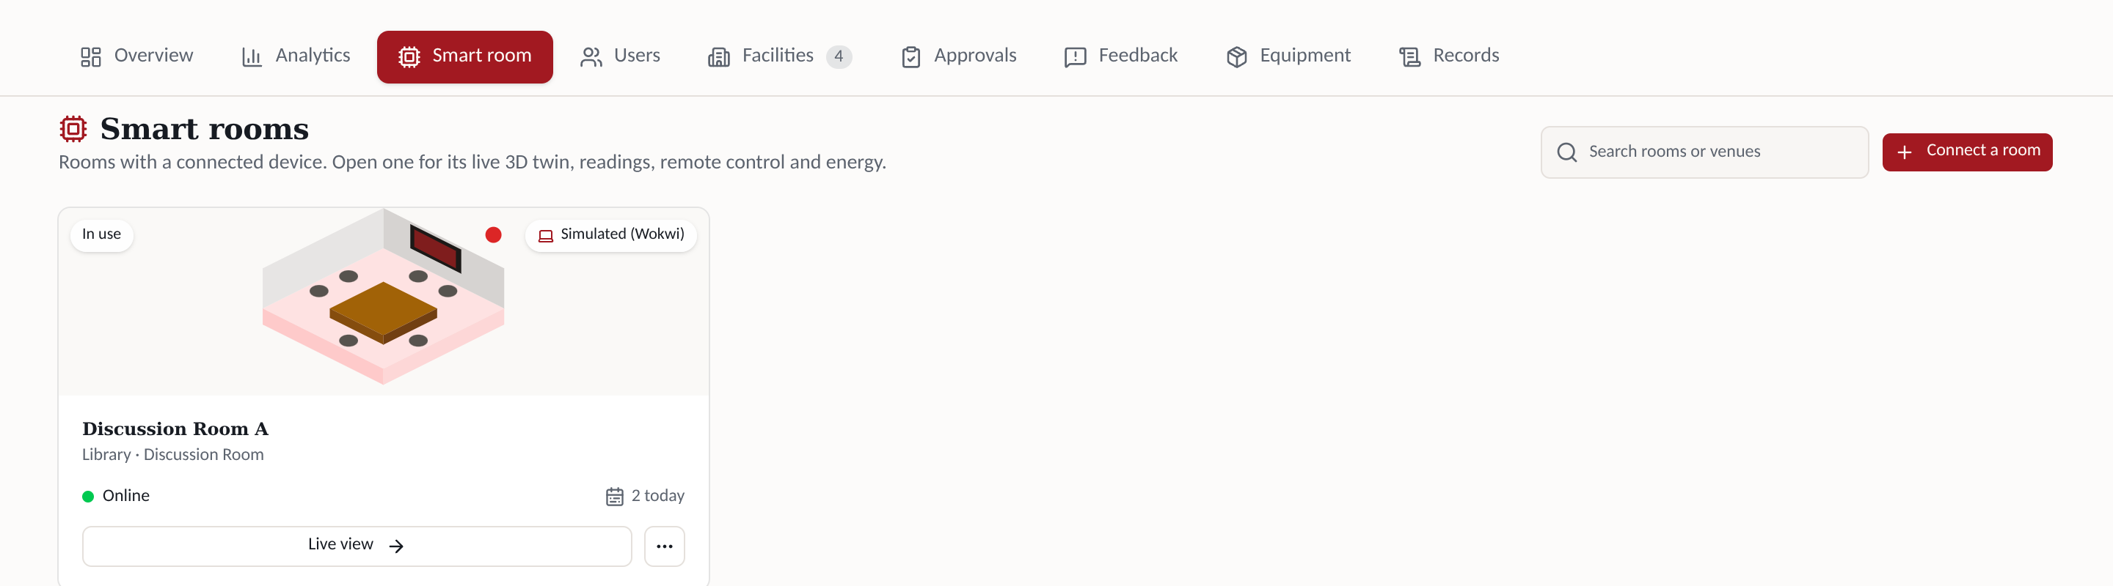
STEP 1 OF 5 · WEB APP
Open Admin → Smart room
1
2
3
4
1
Smart room tab
2
Connect a room
3
Device type
4
Live status
Admin console, third tab.
Opens the setup window (next step).
Badge shows Simulated (Wokwi) or Physical (ESP32).
Online = device reported in the last 30 s.
Notes:
The Smart room tab lists only rooms that already have a device. Each card shows the device type and whether it is online. The Connect a room button starts the setup.

Slide 3
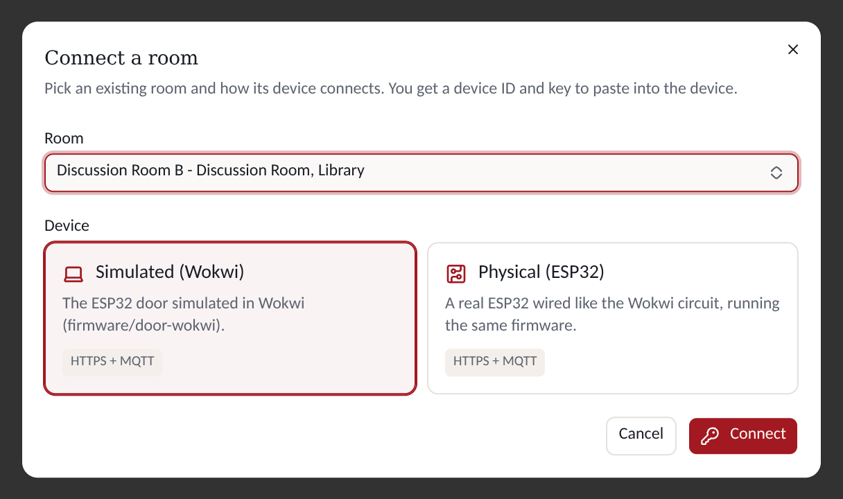
STEP 2 OF 5 · WEB APP
Choose the room and the device
1
Room
1
Any existing room that has no device yet. Rooms are created in the Facilities tab.
2
Device
2
Simulated (Wokwi) or Physical (ESP32). Same firmware; both talk HTTPS + MQTT.
3
3
Connect
The browser makes a random 32-character key and saves only its SHA-256 hash.
Only admins can write device records (row-level security on room_devices).
Notes:
Pick the room and say whether the device is simulated in Wokwi or a physical ESP32. The label only affects how it is shown; both run the same firmware and use HTTPS for status and MQTT for commands. On Connect, the key is generated in the browser and only its hash reaches the database.

Slide 4
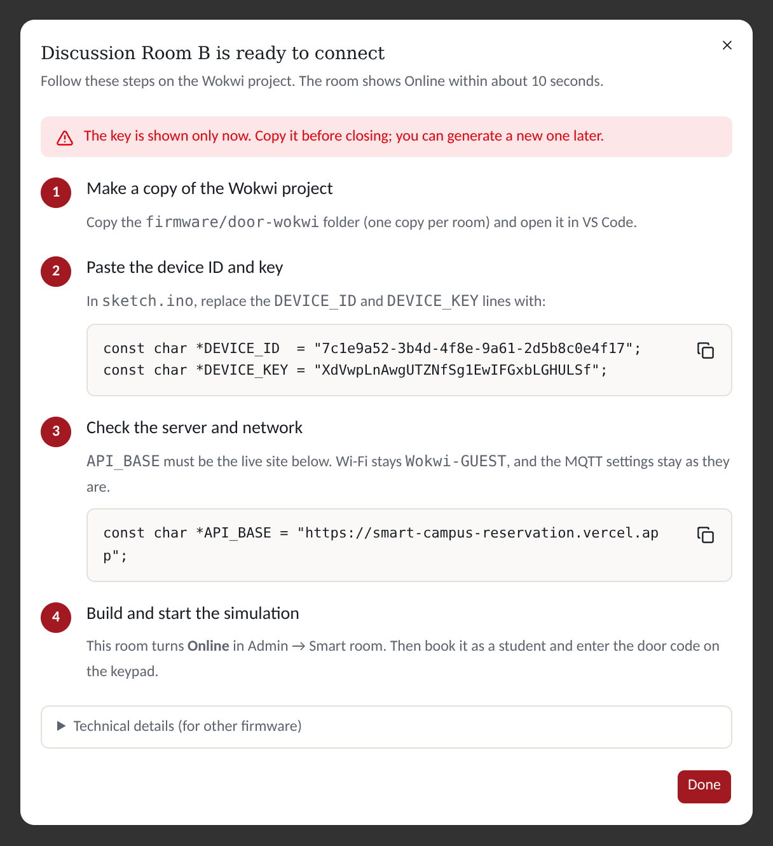
STEP 3 OF 5 · WEB APP
Copy the device ID and key
1
1
Shown once
Only the hash is stored, so copy it now. Lost it? Generate a new key later.
2
Two lines for sketch.ino
2
DEVICE_ID and DEVICE_KEY, ready to paste. The copy button copies both.
3
Live server address
3
API_BASE is always the deployed site, never localhost, so Wokwi can reach it.
4
Technical details
4
Status URL and MQTT topic, for anyone writing their own firmware.
Notes:
The result window walks through the device steps. The key is shown only once because the database keeps just its SHA-256. The two sketch lines and the server address each have a copy button.

Slide 5
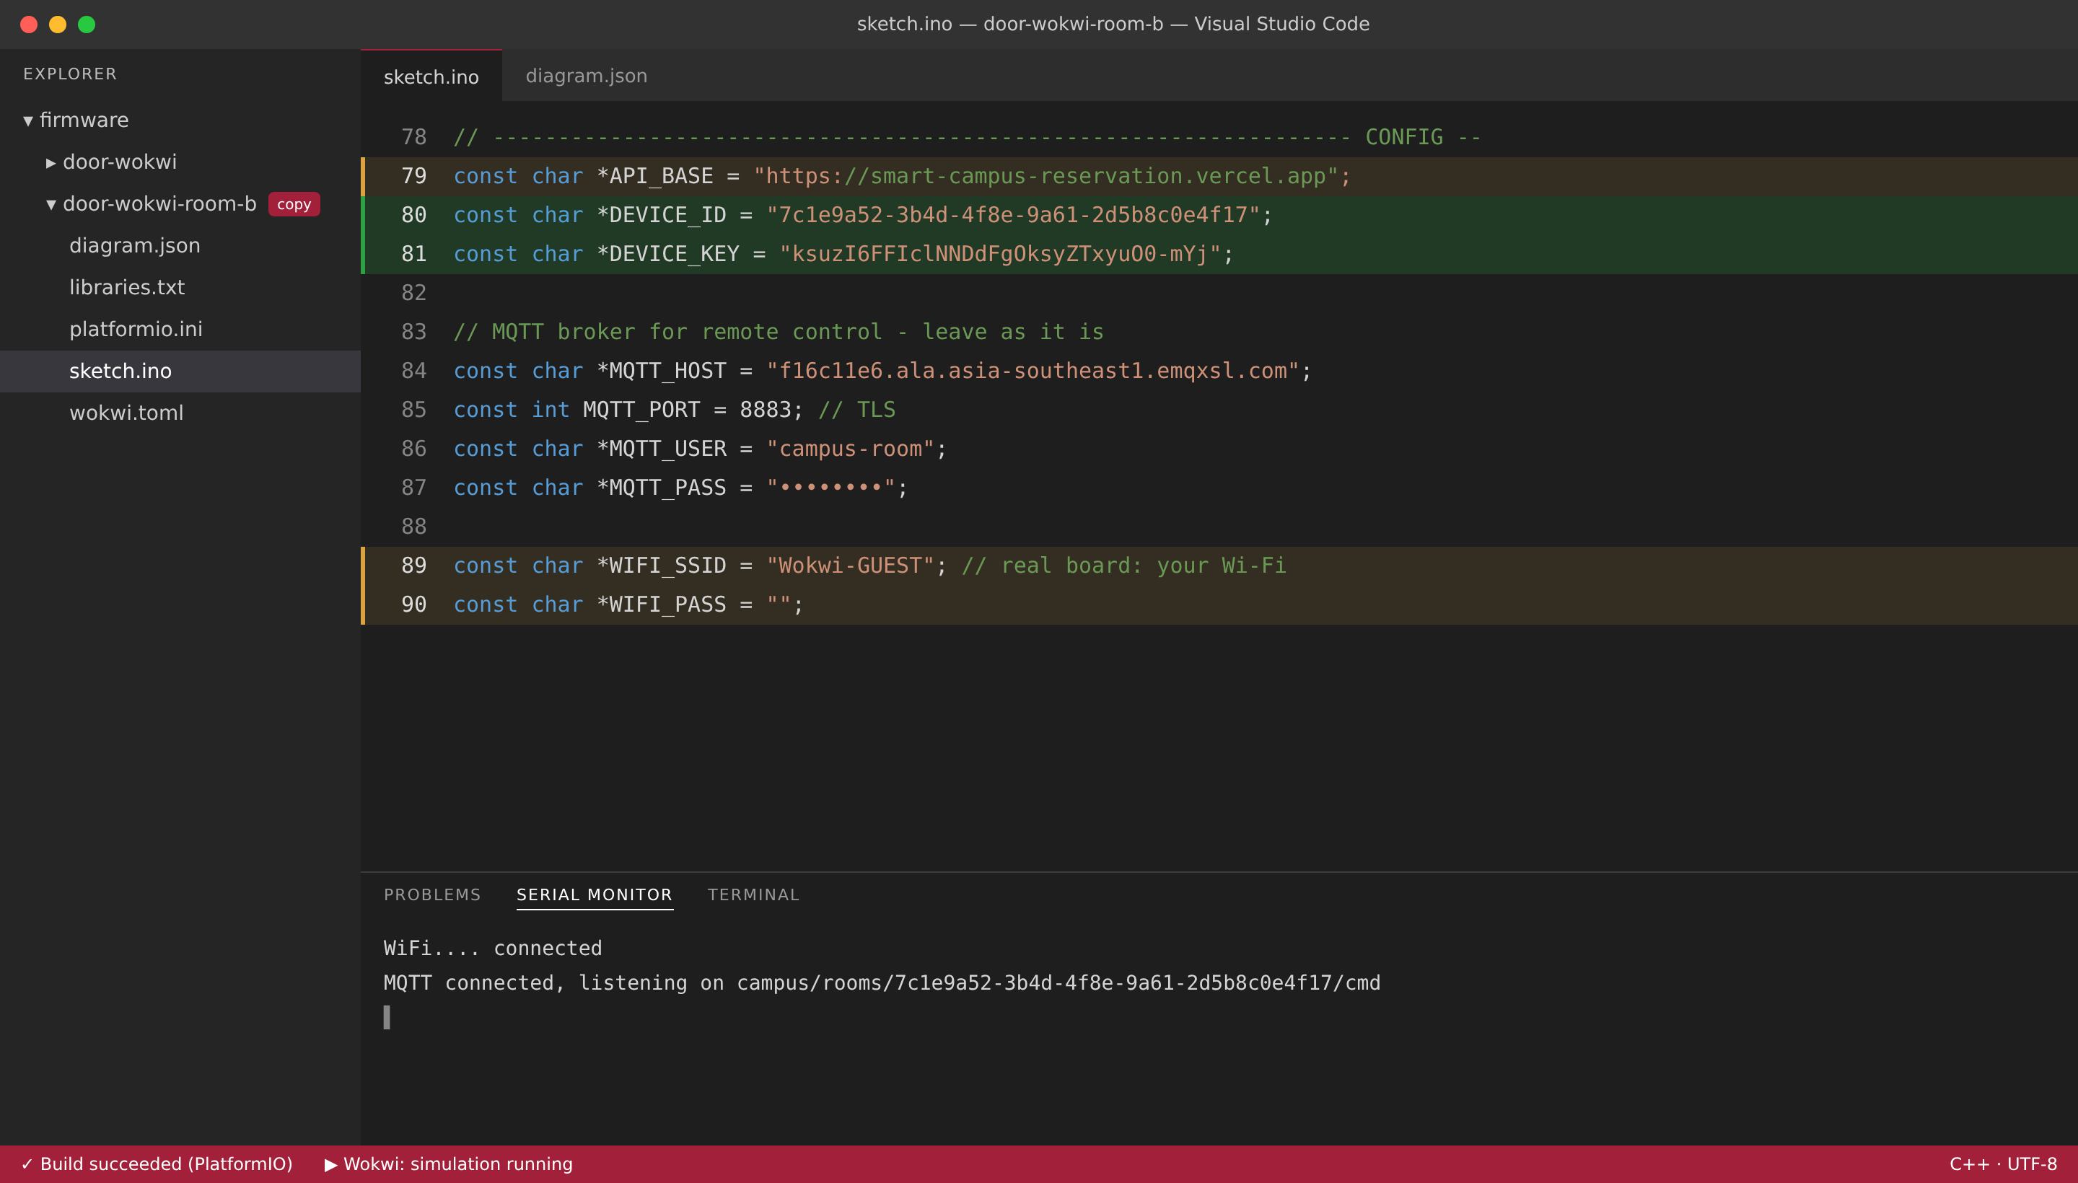
STEP 4 OF 5 · DEVICE
Paste into the firmware and run it
1
1
Copy the project
Duplicate firmware/door-wokwi, one copy per room.
2
2
Paste lines 80–81
Replace DEVICE_ID and DEVICE_KEY (green).
3
3
Check the amber lines
API_BASE = live site. Real ESP32: set WIFI_SSID / WIFI_PASS.
4
Watch the Serial Monitor
"MQTT connected, listening on campus/rooms/…/cmd"
4
5
Build and start
5
PlatformIO build, then start the Wokwi simulation (or flash the board).
Illustration of the VS Code + Wokwi workspace. The serial lines are the firmware's real messages; MQTT settings stay unchanged.
Notes:
On the device side you copy the firmware folder, paste the two lines, and check that API_BASE points at the live site. For a physical board you also set the Wi-Fi. After building, the serial monitor shows Wi-Fi and MQTT connecting.

Slide 6
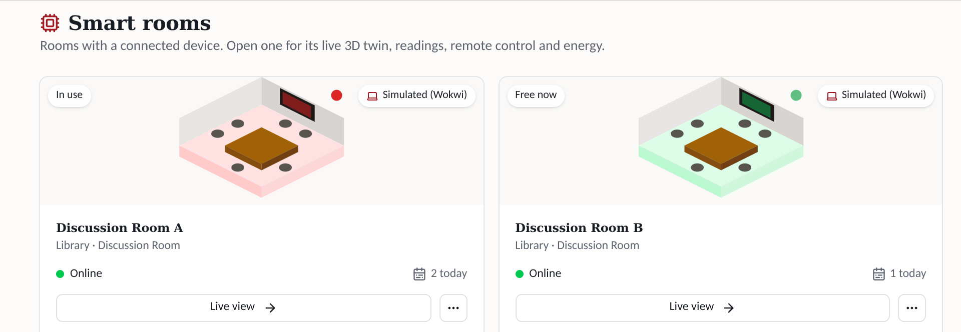
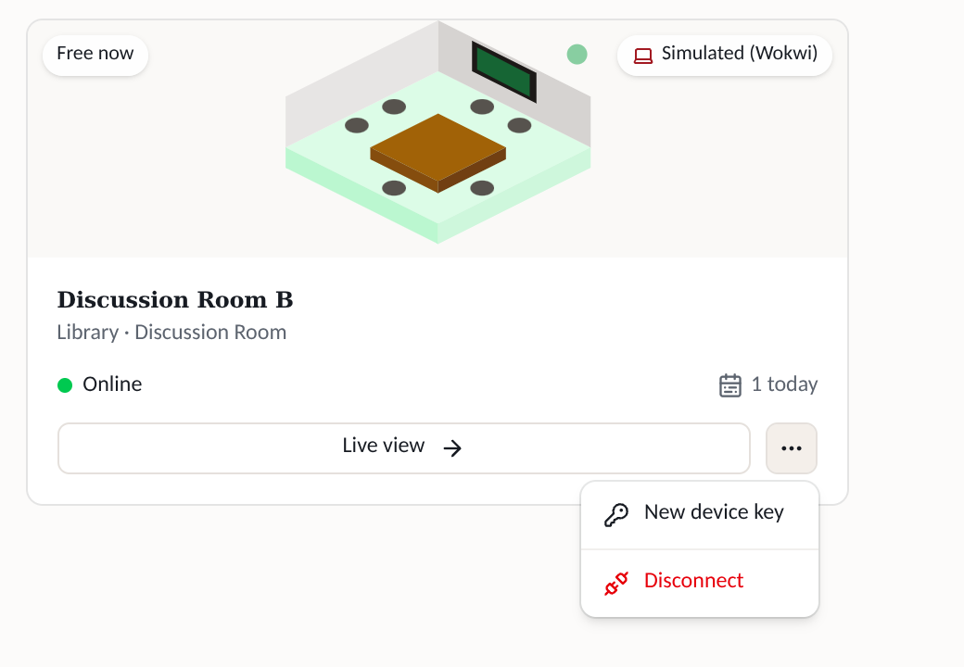
STEP 5 OF 5 · CHECK
Confirm it's live, and fix it if not
1
2
1 New room shows Online within ~10 s. Book it as a student and try the door code.
2 ⋯ menu: new key, or disconnect (history kept).
What you see | Likely cause | Fix
Card says "Never connected" | Device can't reach the site | Check API_BASE and Wi-Fi; read the Serial Monitor
OLED: "Device not registered" | ID or key pasted wrong, or an old key | Paste again, or ⋯ → New device key
OLED: "Server unreachable" | Wrong URL or site down | Open the live site; check API_BASE
Serial: "MQTT connect failed" | Broker settings | Commands still arrive via the 5 s status poll
Notes:
Within about ten seconds the new room shows Online. If not, the table maps what you see to the usual cause. Remote commands fall back to the five-second status poll if MQTT is down.

Slide 7



BEHIND THE SCENES
What happens after you click Connect
Admin browser
Campus Reserve
(Vercel + Supabase)
MQTT broker
(EMQX, TLS)
Device
(Wokwi / ESP32)
Connect: save SHA-256(key) only
HTTPS GET /api/room/status every 5 s (x-device-key)
booking, lock state, display text, pending commands
POST /api/room/event: door, presence, lights, AC
Remote command
publish, HMAC-signed
check signature + 60 s expiry
Notes:
The browser saves only the key's hash. The device proves itself on every request with the key, which the server hashes and compares. Status and events go over HTTPS; remote commands go through the MQTT broker, signed with a key derived from the device key, and expire after 60 seconds. If MQTT is unavailable the same commands are picked up by the status poll.

