Slide 1

TITLE OF THE PROJECT :LLM-driven Financial Chatbot for Real-Time Stock Market Analysis.
TEAM MEMBERS NAME & USN Amaan Siddiqui-1DB23CS012 Achuta Rao M -1DB23CS004 Shreejal Dash - 1DB23CS201 Kishan Kumar - 1DB23CS103
Under the Guidance of : Mrs. Anjali Vyas Assistant Professor Dept. Of CSE

Slide 2
Abstract
With over 130 million registered retail investor accounts in India, a large number of first-time investors lack the analytical tools and expertise required to interpret complex market signals, leading to poor decisions and financial losses.
FinSight AI is a web-based, AI-powered conversational assistant that analyzes real-time stock market data, news sentiment, and financial documents to generate actionable investment insights.
The system integrates live NSE/BSE market data, Gemini 1.5 Flash LLM, and a Retrieval-Augmented Generation (RAG) framework powered by ChromaDB to deliver stock signals, SIP recommendations, IPO assessments, and a paper trading simulation.
The goal is to democratize financial analysis for retail investors who lack access to professional advisory services all through a simple conversational interface.

Slide 3
INTRODUCTION
India's retail investor base has grown rapidly due to digital trading platforms, yet most new investors lack structured analytical support.
Traditional tools provide raw price data but fail to combine market data, news sentiment, and AI-driven context into unified, understandable insights.
Recent advances in LLMs (Large Language Models) enable systems that interpret unstructured financial text alongside structured price data.
FinSight AI proposes a full-stack conversational assistant built on a Decoupled Three-Tier Multi-Agent RAG Architecture:
• Presentation Layer — React.js chatbot interface
• Application Layer — FastAPI backend with Agentic Orchestrator
• Intelligence Layer — Gemini 1.5 Flash + ChromaDB RAG
The system generates buy/hold/sell signals, SIP fund picks, IPO
assessments, sentiment analysis, and paper trading simulation all via natural language interaction.

Slide 4
PROBLEM STATEMENT
Retail investors in India often incur financial losses due to the absence of intelligent tools that interpret market data and sentiment in real time. Most existing trading platforms provide raw financial information but lack systems that combine market data, news sentiment, and AI-driven insights to support informed investment decisions.

Slide 5
OBJECTIVES
To Develop FinSight AI — an intelligent conversational investment assistant providing real-time financial insights using LLM, RAG, and multi-agent architecture.
→ Integrate real-time stock data from NSE and BSE via yfinance and nsepython for live price, OHLC, and NIFTY 50 analysis.
→ Build an AI signal engine that generates Buy/Hold/Sell recommendations using RSI and 50/200-day moving average crossover via pandas-ta.
→ Design a weighted multi-source sentiment pipeline combining Economic Times RSS (40%), Moneycontrol RSS (40%), and Reddit r/IndiaInvestments (20%) for market mood analysis.
→ Implement a RAG pipeline using ChromaDB and Gemini embeddings over DRHP prospectuses, SEBI circulars, and RBI documents for grounded, fact-based responses.
→ Build a paper trading simulation module with ₹1,00,000 virtual capital for risk-free strategy testing backed by Supabase.

Slide 6
LITERATURE SURVEY
SI Number | Authors & Year | Title | Methodology | Limitations
1) | Luckianto et al. (2026) | MARAG-Fin: Intelligent Multi-Agent RAG-LLM. | Multi-agent RAG with NeuralProphet for index forecasting. | High latency in real-time agent coordination.
2) | Das et al. (2025) | Order-Aware multimodal fusion for financial advisory | Transformer-based fusion of video and financial text. | Focuses on summary quality, not price prediction.
3) | Liagkouras et al. (2025) | Hybrid LSTM with Sentiment Analysis System. | Fuses LSTM with news sentiment for directional prediction. | Limited to regulatory news; lacks social media signals.
4) | Jadhav et al. (2025) | LLMs in Equity Markets: Applications & Insights. | Review of LLM techniques for portfolio and risk research. | Highlights LLM "black box" interpretability issues.
5) | Srivatsan N. (2025) | Using LLMs to Predict Stock Price: A Hybrid Model. | Zero-shot sentiment + LSTM + XGBoost hybrid. | Accuracy depends entirely on high social media volume.
6

Slide 7
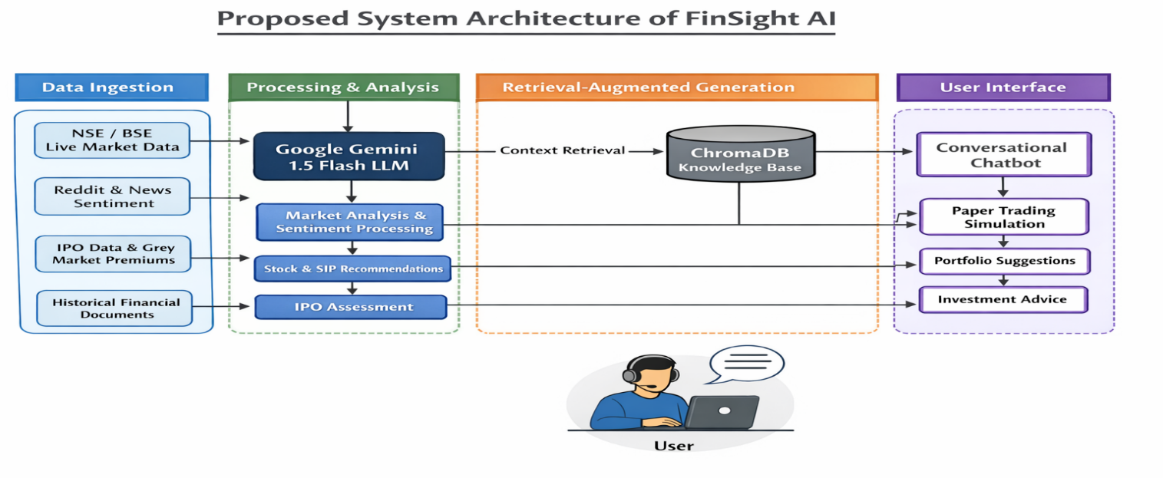
System Design and Architecture

Slide 8
INITIAL FINDINGS
Development Status: Phase 1 (Core Pipeline)
Orchestrator Logic: The orchestrator.py module is fully functional, utilizing a 5-step asynchronous pipeline (Intent to Response) with validated routing for 9 specific financial intent types.
Context Engineering: The context_assembler.py is implemented, featuring a 7-section structured prompt and RAG integration with cosine-distance relevance scoring to ensure high-fidelity responses.
System Integrity: All I/O operations are strictly non-blocking (asyncio), and every generated insight is now hardcoded with a mandatory SEBI disclaimer for regulatory compliance.
Validated Decisions: Market data is prioritized over RAG context for real-time accuracy, while Reddit sentiment is weighted at 20% to mitigate social media noise.
Current Focus
The project is transitioning from core orchestration to Service Integration, with active development starting on the Gemini 1.5 Flash inference engine and real-time market data scrapers.

Slide 9
Technical Implementation
As of Review 2, the core backend infrastructure of FinSight AI is fully operational. The FastAPI application server is production-ready with all six API routers registered, SQLite database initialized, and a 30-minute APScheduler refresh cycle actively running.
The paper trading engine is 95% complete, supporting real buy/sell execution with balance validation, P&L calculation, average price computation on repeated purchases, and full transaction history all backed by a live SQLite database seeded with ₹1,00,000 virtue.
The context assembler, which bridges the agentic orchestrator and Gemini 1.5 Flash, is 80% complete with a 7-section structured prompt builder handling live market data, technical signals, sentiment scores, RAG knowledge chunks, IPO data, and portfolio context.
The orchestrator itself implements a 5-step agentic pipeline with dual-mode support for both batch and real-time streaming responses, with all tool calls executing concurrently via asyncio.

Slide 10
Overall Progress
Layer | Component | Status | Done
Backend core | main.py | ✅ Real | 100%
Backend core | trading_engine.py | ✅ Real | 95%
Backend core | context_assembler.py | ✅ Real | 80%
Backend core | orchestrator.py | ✅ Real | 85%
Config | requirements.txt | ✅ Real | 100%
Config | .env | ❌ Keys missing | 20%
Services | gemini.py | ❓ Unknown | ?
Services | market_data.py | ❓ Unknown | ?
Services | sentiment.py | ❓ Unknown | ?
Services | signals_engine.py | ❓ Unknown | ?
Services | ipo_tracker.py | ❓ Unknown | ?
Services | rag.py | ❓ Unknown | ?
Data | ChromaDB corpus | ❌ Empty | 0%
Frontend | React UI | ⚠️ Streaming bug | 60%
Routers | All 6 routers | ❓ Unknown | ?

Slide 11
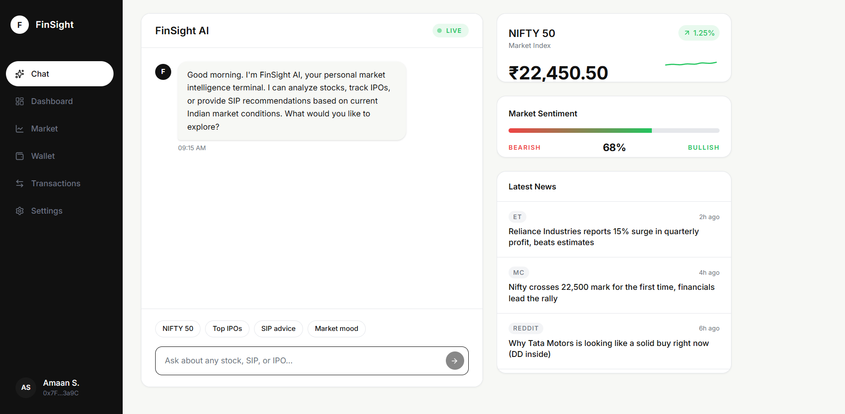
Snapshots

Slide 12
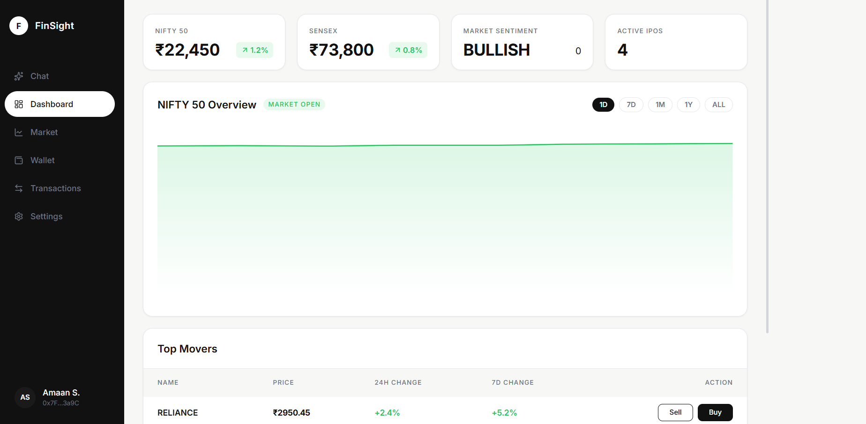
Snapshots

Slide 13
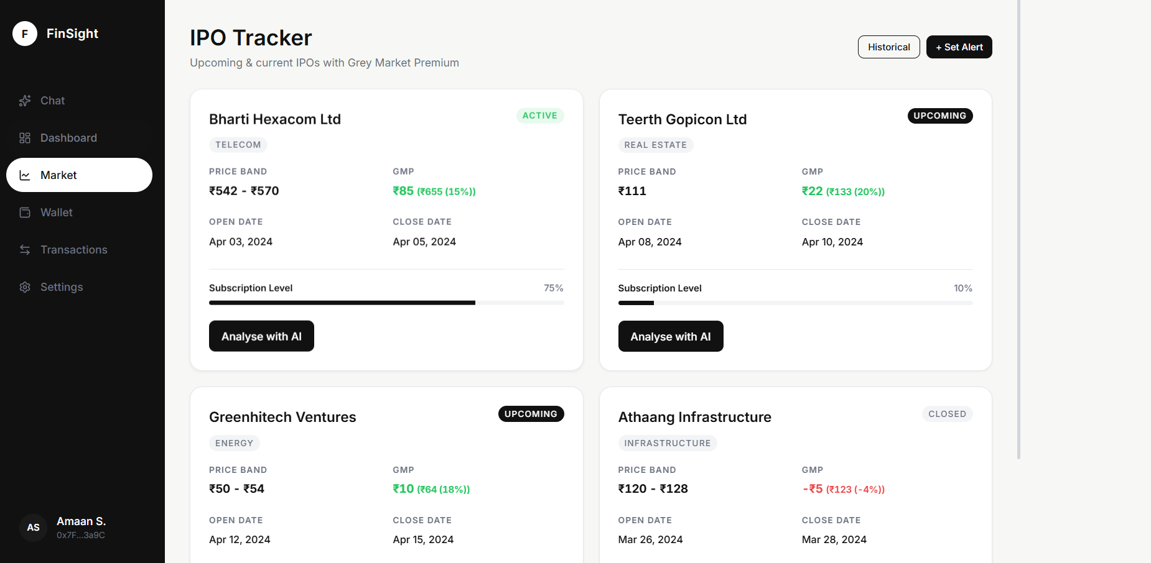
Snapshots

Slide 14
Conclusion
FinSight AI presents a web-based AI financial assistant that simplifies stock market analysis for retail investors through a conversational interface.
The system successfully integrates real-time market data, sentiment analysis, and LLM-based reasoning to generate meaningful investment insights such as buy/sell signals, SIP recommendations, and IPO evaluations.
The inclusion of a RAG framework ensures more reliable and context-aware responses, addressing limitations of traditional AI models.
The paper trading module enables users to test strategies without financial risk, improving practical understanding of market behavior.
Overall, the project aims to bridge the gap between complex financial data and user-friendly decision support, making investment analysis more accessible.

Slide 15
REFERENCES
[1] M. Luckianto and A. A. S. Gunawan, "MARAG-Fin: An Intelligent Multi agent RAG-LLM Architecture Integrating Financial News Sentiment and Time Series Data for Data-driven Trading Decision-making," Int. J. Intell. Eng. Syst., vol. 19, no. 1, pp. 738-748, 2026.
[2] S. Das, S. Ghosh, A. Tiwari, R. E. Z. M. Lynghoi, S. Saha, Z. Murad, and A. Maurya, "Presenting an Order-Aware Multimodal Fusion Framework for Financial Advisory Summarization With an Exclusive Video Dataset," IEEE Access, vol. 13, pp. 48364-48381, 2025
[3] K. Liagkouras and K. Metaxiotis, "A Hybrid Long Short-Term Memory with a Sentiment Analysis System for Stock Market Forecasting," Electronics, vol. 14, no. 2753, pp. 1-18, 2025
[4] A. Jadhav and V. Mirza, "Large Language Models in equity markets: applications, techniques, and insights," Front. Artif. Intell., vol. 8, no. 1608365, pp. 1-15, Aug. 2025
[5] N. Srivatsan, "Using Large Language Models to Predict Stock Price: A Hybrid Model Combining Social Media Sentiment and Market Data," Natl. High Sch. J. Sci., pp. 1-12, Aug. 2025.

