Slide 1
DBMS COURSE PROJECT · FINAL PRESENTATION
Design and Implementation of a Database Management System for
Hostel Accommodation and Student Services Management System
GROUP MEMBERS
Mohammed Amaan Khan · 25WU0101075
Arslan Alam · 25WU0101016
Jaswant Reddy · 25WU0101056
Occupied bed
Free bed
Open service request

Slide 2
The problem with hostel registers
Today
This project
Beds allotted twice, or to a student who already has a room
Complaint slips lost; nobody knows who fixed what, or when
Rent receipts on paper; defaulters listed by hand every month
No quick way to find a free bed in a girls' or boys' hostel
Rooms, residents, requests and rent in one MySQL database
Allotment rules checked by the database: capacity, gender, one room each
Every service request tracked from Open to Resolved with a full history
Rent dues and free beds are one query away
Intended users
Students
raise requests and pay rent
Wardens
allot rooms and track dues
Service staff
resolve requests step by step
Hostel Accommodation and Student Services Management System
2

Slide 3
Project objectives
1
Normalized schema
Store hostels, rooms, students, staff and departments in 3NF.
10
2
Room allotment
Allot and vacate rooms, keep every stay as history.
tables in Third Normal Form
3
Service workflow
Track requests through Open, Assigned, In Progress, Resolved.
2 stored procedures
4 triggers
3 views
9 report queries
4
Rent tracking
Record monthly rent and list residents with dues.
5
Data integrity
Enforce rules with constraints, triggers and procedures.
Hostel Accommodation and Student Services Management System
3

Slide 4
ER design: ten entities
Department
Student
Staff
Service_Type
Hostel
dept_id | dept_code | dept_name
student_id | roll_no | gender | dept
staff_id | name | designation
type_name | target_days
hostel_id | name | Boys/Girls | warden
Room
Allocation
Service_Request
Request_Update
Fee_Payment
room_no | capacity | monthly_rent
student | room | check_in | status
description | status | resolved_on
new_status | staff | remarks | time
fee_month | amount | mode
Master data
Hostel and allotment
Service workflow
Fee payment
Hostel Accommodation and Student Services Management System
4

Slide 5
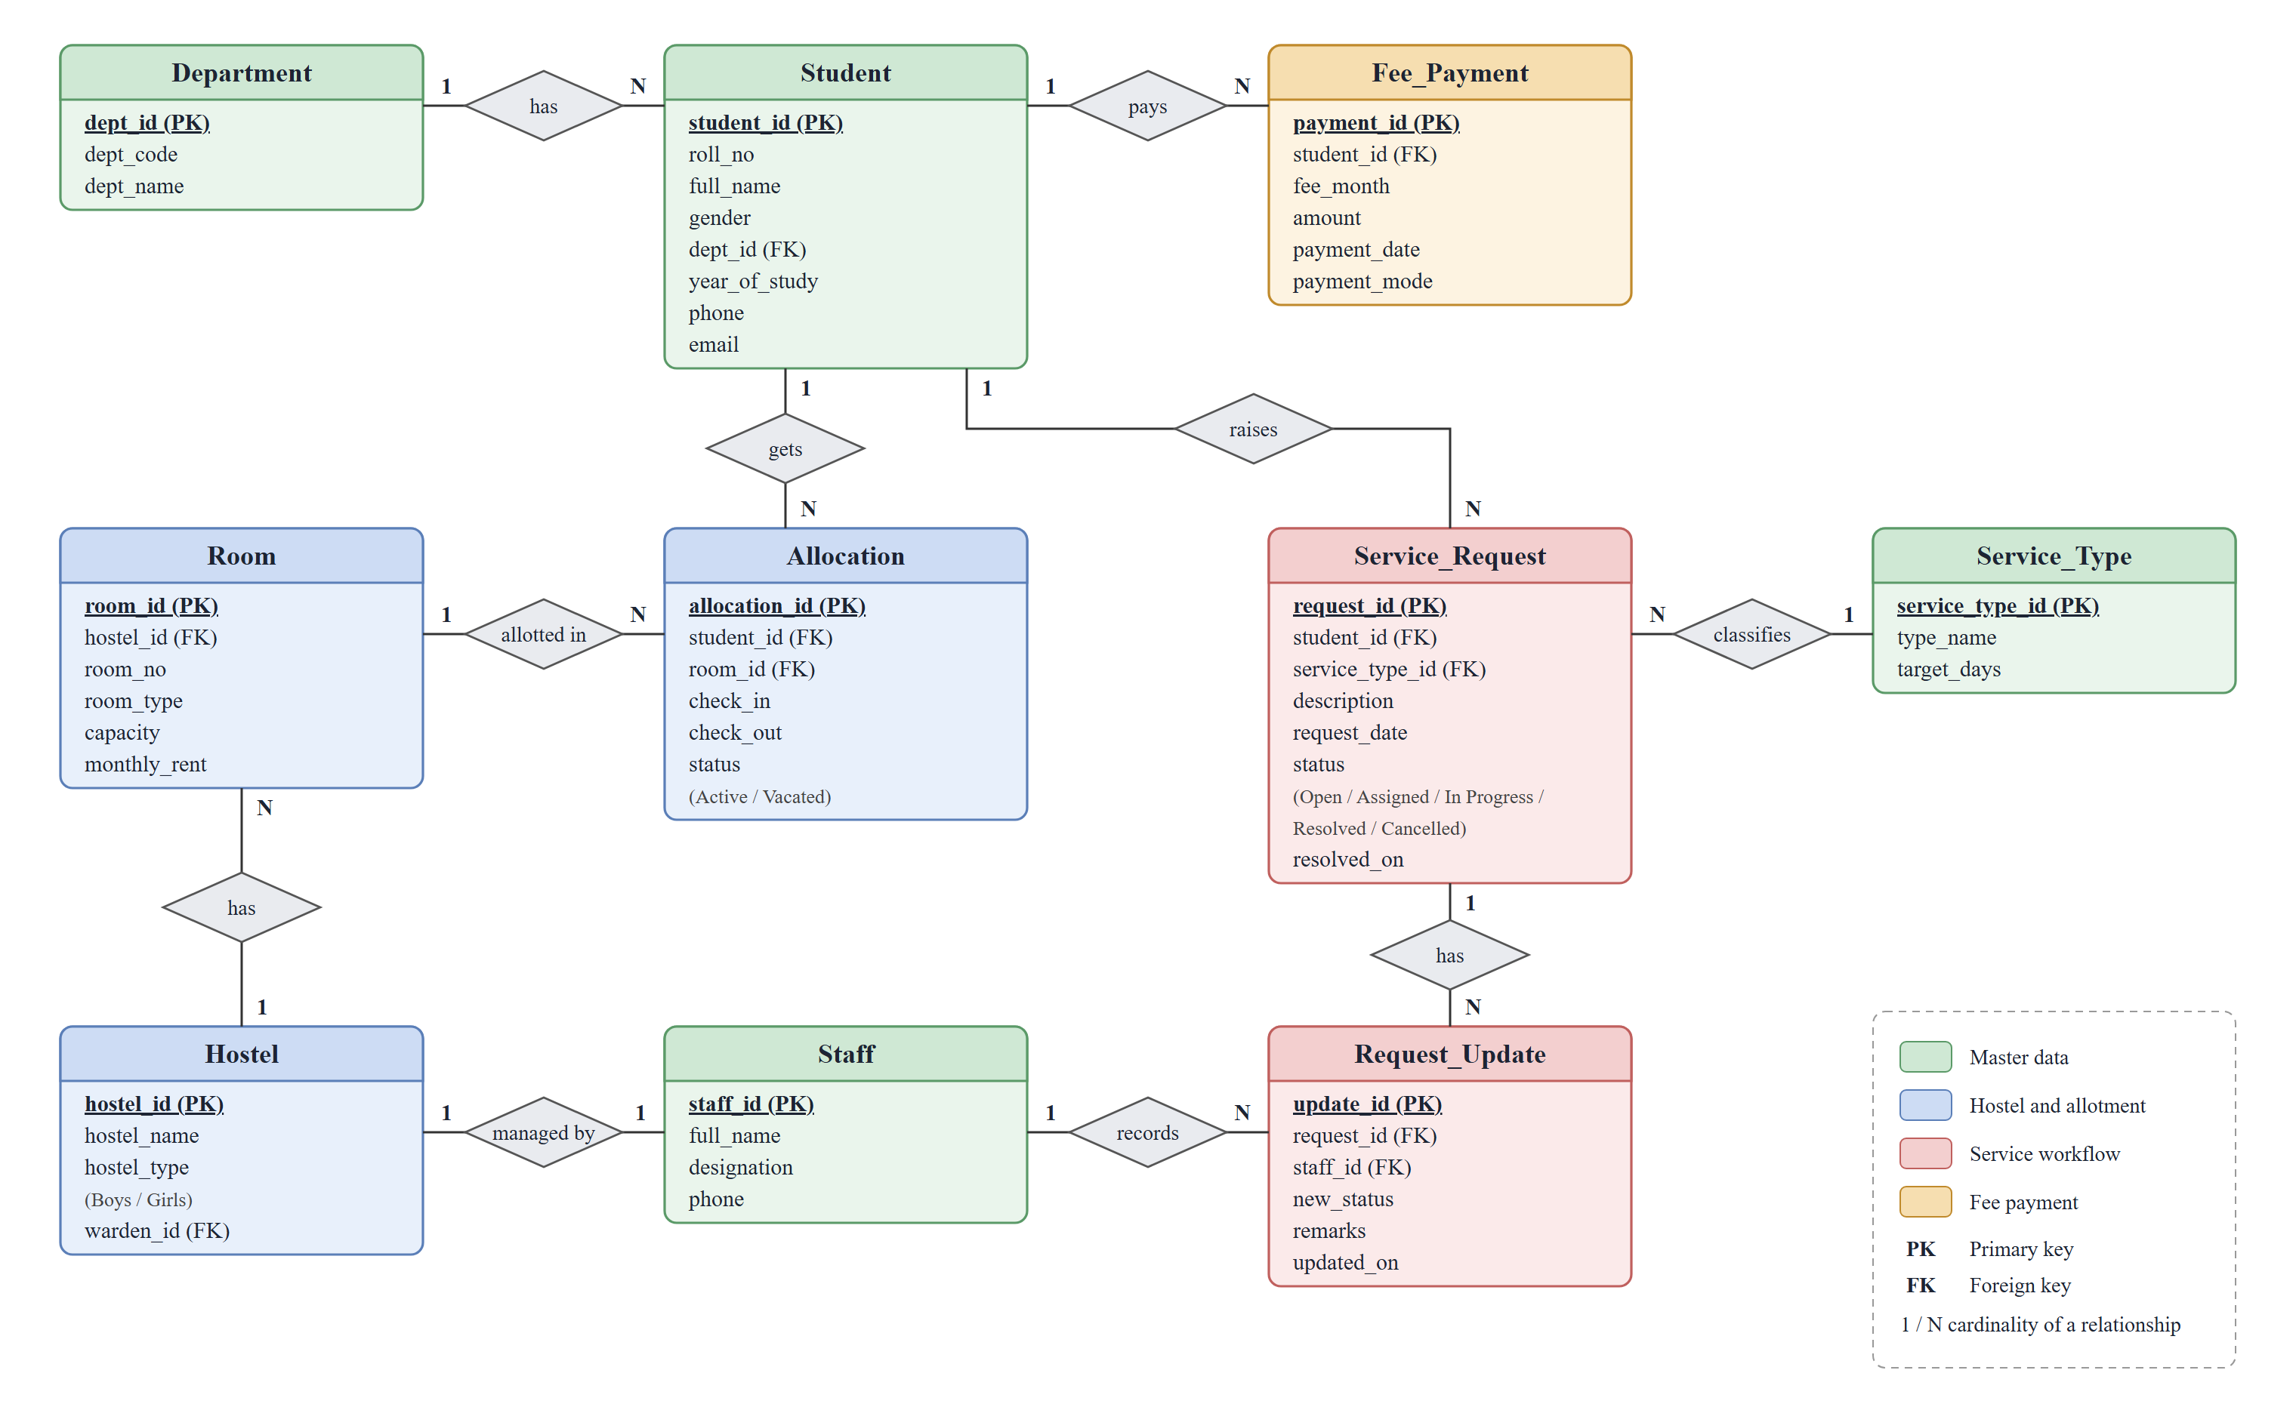
Relationships and cardinality
1 = one, N = many. Allocation resolves the M:N relationship between Student and Room and keeps the dates of each stay.
Hostel Accommodation and Student Services Management System
5

Slide 6
Normalization up to 3NF
1NF
All values are atomic and every table has a primary key. Each payment and each request step is its own row.
Example: rent
room_id → monthly_rent
Rent is stored once in Room. Allocation keeps only room_id, so a rent change is a single UPDATE and every resident sees it.
No update, insertion or deletion anomaly.
2NF
No partial dependencies. Composite candidate keys such as (hostel_id, room_no) determine the whole row.
3NF
No transitive dependencies. Hostel names, rent and service type targets each live in one table only.
Hostel Accommodation and Student Services Management System
6

Slide 7
Service request workflow
1
2
3
4
Student raises
Staff assigns
Staff works
Staff closes
sp_raise_request checks residency and duplicates.
Staff of the matching trade take it.
Work has started; remarks are saved.
Trigger stamps resolved_on.
Status: Open
Status: Assigned
Status: In Progress
Status: Resolved
Enforced by the database
trg_update_before_insert allows only the next step, and nothing after Resolved or Cancelled.
trg_update_after_insert copies the status to the request. Every step is a row in request_update: staff, remarks, time.
Room allotment has its own trigger: no full room, no hostel of the other gender, one active room per student.
Hostel Accommodation and Student Services Management System
7

Slide 8
Database features
1
Constraints
PK, FK, UNIQUE (hostel_id, room_no), (student_id, fee_month); CHECK capacity 1 to 3, year 1 to 4, check_out >= check_in.
2
Indexes
allocation(room_id, status), allocation(student_id, status), service_request(status), fee_payment(fee_month).
3
Views
v_room_occupancy, v_open_requests and v_fee_summary.
4
Procedures
sp_allocate_room allots a bed; sp_raise_request accepts only residents and one open request per type.
5
Triggers
Allotment rules, the request step order and status update, and rent equal to the room's rent.
6
Queries
Nine report queries (Q1 to Q9): free beds, open requests, request history, dues, collection per hostel.
Hostel Accommodation and Student Services Management System
8

Slide 9
Live demo: database and queries
1
Create
2
Insert
Run hostel_management_system.sql: tables, keys, checks, indexes, views, procedures, triggers.
Sample data loaded: at least five records in every table, allotments made through the procedure.
3
Query
4
Trigger
Run Q1 to Q9: joins across four tables, GROUP BY, HAVING, NOT EXISTS, views.
Try to allot a full room or skip a request step and show MySQL refusing it.
Hostel Accommodation and Student Services Management System
9

Slide 10
Expected results with the sample data
OCCUPANCY FORMULA
Free beds = capacity − Active allocations of the room (view v_room_occupancy)
7 / 15
5
2
beds taken after the script (47%)
residents with October rent due (Q6)
requests resolved, 3 still Open
Divya Menon is refused Aryabhata Block (boys) and G101 (full), then allotted M301: occupancy becomes 8 of 15.
Request #7 goes Open, Assigned, In Progress, Resolved; the trigger fills in resolved_on.
Rohan Das pays Rs. 4,000: refused by the trigger. He pays Rs. 4,500: accepted, and he drops off the dues list.
Hostel Accommodation and Student Services Management System
10

Slide 11
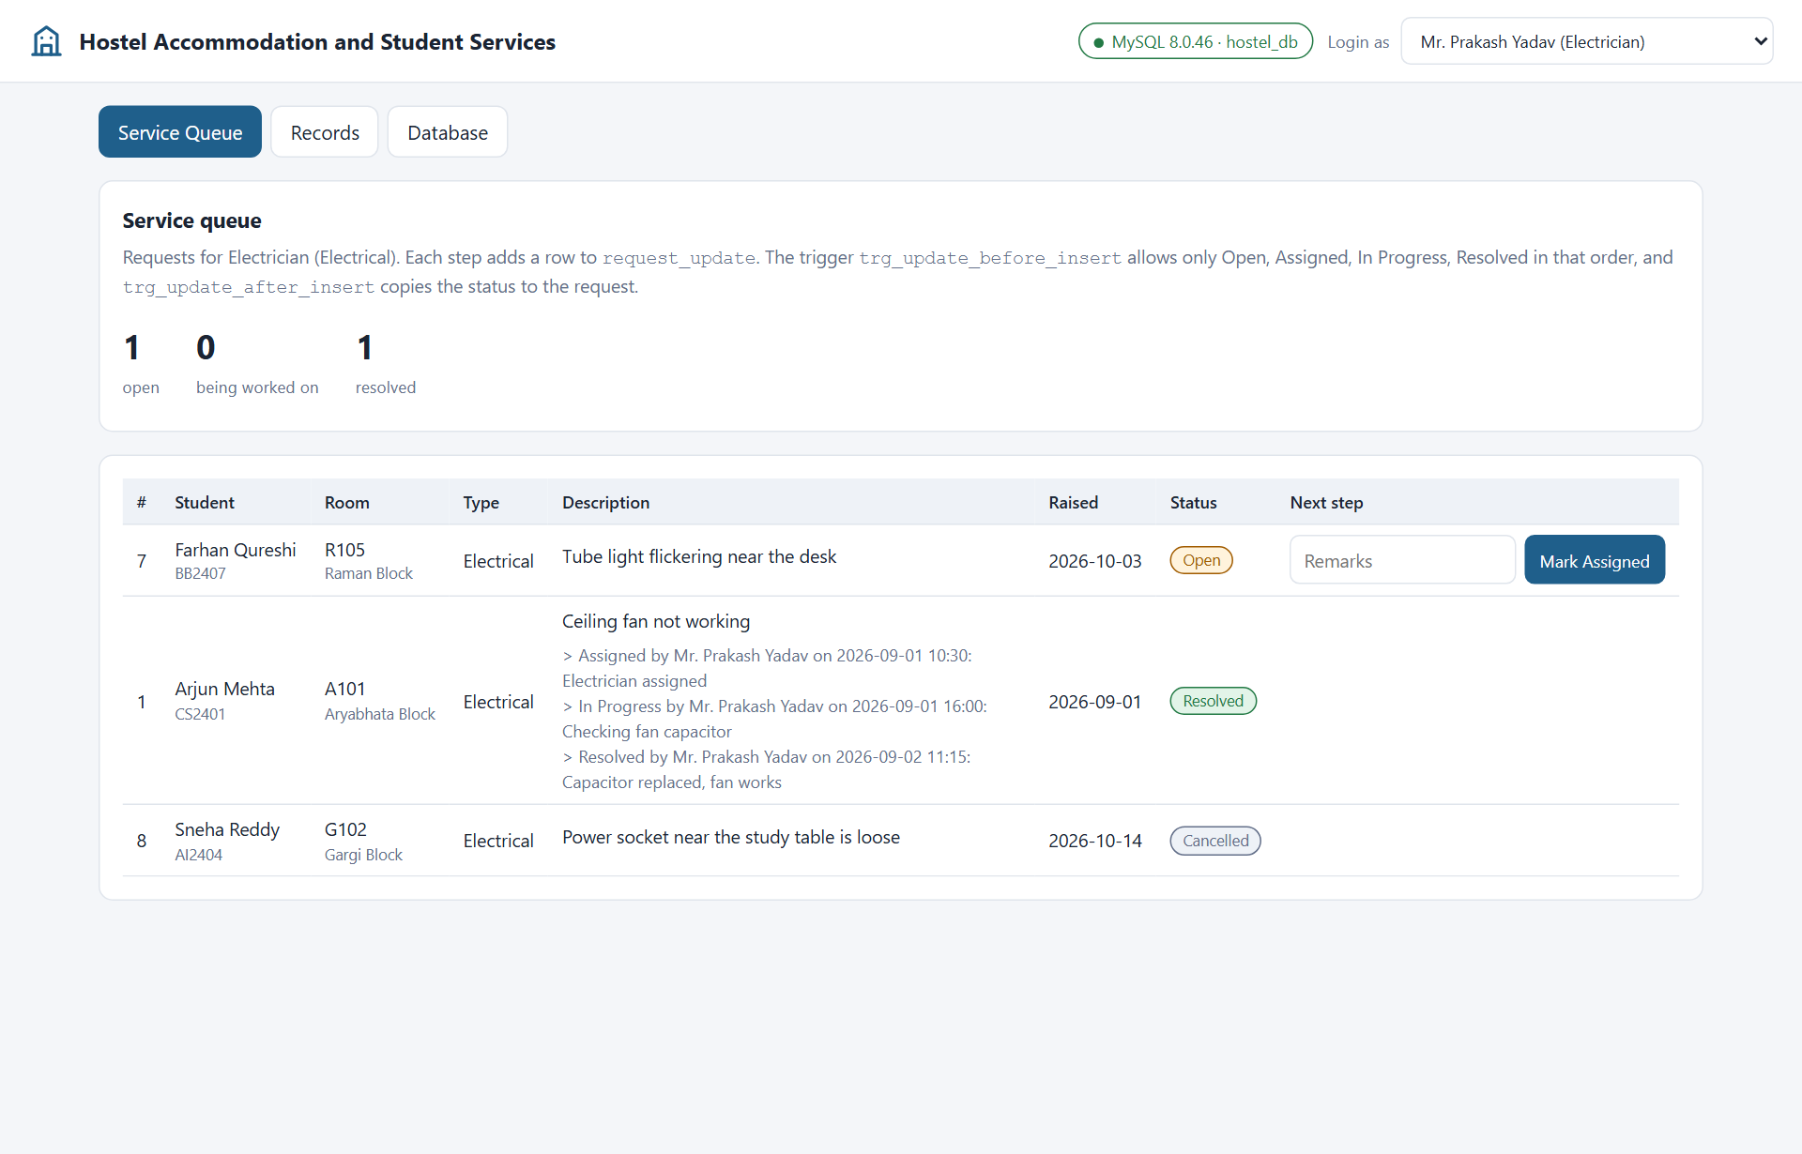
User interface demo
Node.js + Express + mysql2, connected to MySQL
Insert
Raise a request, allot a room, pay rent, or add a row in Records; then show the new row in MySQL.
Delete
Cancel a request or delete a row in Records; a hostel still in use is refused by the foreign key.
View
Occupancy, dues and the Database tab, matched with SELECT in MySQL.
Every page shows the SQL statement sent to MySQL.
Hostel Accommodation and Student Services Management System
11

Slide 12
Conclusion and future scope
CONCLUSION
POSSIBLE EXTENSIONS
Hostel rooms, allotment, service requests and rent now live in one normalized database. The rules are enforced by MySQL itself, so they hold however the data is entered.
Password login with role-based access
Email or SMS alerts on request status and dues
Online rent payment with late fees
Mess menu, mess bill and visitor log
Thank you
Questions?

