Slide 1
Personalized Deep Learning Model for Closed-Loop 40 Hz Entrainment to Optimize Theta-Gamma Coupling in Alzheimer’s Disease
Amaar Chughtai
Project Summary
This project develops a closed-loop deep learning system for personalized 40 Hz auditory entrainment therapy in Alzheimer's disease. Current protocols deliver stimulation on fixed schedules, ignoring individual neural responses and within-session habituation. Using EEG from 35 elderly subjects (OpenNeuro ds005048), I trained a causal Temporal Convolutional Network to forecast phase-amplitude coupling (PAC) 5 seconds ahead (test R² = 0.606 ± 0.032, 5 seeds) from 12 PAC and stimulation-context features that generalize across subjects unlike the full 73-feature set. The predictive controller directed stimulation to 82.6% of low-coupling windows versus 51.7% for reactive control (p < 0.001, g = 4.47). Overall PAC alignment rose from 64.5% to 72.1% (g = 1.31), reaching 91% of the oracle’s targeting gap. All 35 subjects benefited in silico. These results demonstrate that PAC forecasting enables personalized 40 Hz therapy that outperforms fixed and reactive protocols, advancing treatment for Alzheimer's disease.

Slide 2
Introduction
Research Question
Can deep learning models trained on EEG-derived features forecast theta–gamma phase-amplitude coupling (PAC) dynamics 5-10 seconds into the future, and does integrating such forecasts into a closed-loop controller produce measurable improvements in personalized 40 Hz entrainment therapy for Alzheimer’s disease?
Hypothesis
A causal Temporal Convolutional Network can forecast PAC (phase-amplitude coupling) at horizons beyond 3 seconds where simpler baselines fail, and integrating these forecasts into a closed-loop controller will outperform reactive threshold control.
Project Origin
I became interested in computational approaches to Alzheimer’s therapy after reading about the landmark Iaccarino et al. (2016) Nature study showing that 40 Hz sensory stimulation reduced amyloid-beta plaques in AD mouse models by up to 50%. Looking into human clinical translation, I noticed a gap of how all existing protocols deliver stimulation on rigid fixed schedules that ignore individual neural responses, causing habituation and fatigue. Approximately 30% of patients are non-responders (Fortunato et al., 2023), and habituation degrades entrainment within sessions, yet fixed protocols cannot detect or adapt to these dynamics.
This observation led to my central question investigating how a machine learning could predict when a patient’s brain will lose entrainment, enabling proactive intervention. I began this project in early 2026 using the publicly available OpenNeuro ds005048 EEG dataset. The project concept originated from my independent literature review and was not assigned as part of any class or institutional program.

Slide 3
Continuation
None. This is not a continuation of any previous science fair project.
Work by Others
Key prior work relevant to this project:
Iaccarino et al. (2016, Nature): Foundational study discovering 40 Hz optogenetic and sensory stimulation reduced amyloid-beta by ~50% in AD mouse models through microglial activation.
Murdock et al. (2024, Nature): Identified glymphatic clearance as a key mechanism; multisensory 40 Hz stimulation reduced neocortical plaque volume by 37% in 5XFAD mice.
Chan et al. (2025, Alzheimer’s & Dementia): Open-label extension study showing sustained EEG entrainment and reduced brain atrophy in mild AD patients with 40 Hz multisensory stimulation, first human evidence of target engagement at this scale.
Fortunato et al. (2023, Frontiers in Neuroscience): Found ~30% non-responder rate in 40 Hz entrainment studies, motivating personalized/adaptive approach.
Lahijanian et al. (2024, Scientific Reports): Created the OpenNeuro ds005048 dataset (35 elderly subjects, 40 Hz auditory entrainment), using theta-gamma PAC as the primary coupling measure, and showed enhanced default mode network connectivity.
Lawhern et al. (2018, J Neural Engineering): Developed EEGNet, a compact CNN for brain-computer interfaces, which I adapted as the static PAC estimator.
Tort et al. (2010, J Neurophysiology): Introduced the Modulation Index for calculating phase-amplitude coupling, used as the entrainment biomarker throughout this work.
Jiao (2025, Frontiers in Digital Health): Advocated for AI-driven biofeedback for personalized digital therapeutics in gamma entrainment.

Slide 4
Methods
Dataset
OpenNeuro ds005048 (Lahijanian et al., 2024)
35 elderly subjects: Alzheimer’s disease (n = 17), MCI (n = 6), healthy controls (n = 10), unspecified (n = 2)
7 frontal EEG channels (Fp1, Fp2, F7, F3, Fz, F4, F8), sampled at 250 Hz
Protocol: 40 Hz auditory stimulation (40 s ON / 20 s OFF cycles)
Preprocessing
Bandpass filter: 0.5–80 Hz (4th-order Butterworth, zero-phase)
Notch filter: 50 Hz (Q = 30) for power-line removal
Artifact rejection: ±100 µV threshold (applied before CAR)
Common average reference (after artifact rejection)
Windowing: 2-second windows (500 samples), 1-second hop
Subject-Level Data Splits (No Within-Subject Leakage)
Training: 24 subjects (11,736 windows)
Validation: 5 subjects (2,725 windows)
Test: 6 subjects (2,822 windows), never seen during training or hyperparameter selection
Phase-Amplitude Coupling (PAC) Computation
Modulation Index (Tort et al., 2010): measures coordination between theta phase (4-8 Hz) and gamma amplitude (38-42 Hz)
KL divergence from uniform distribution over 18 phase bins (20°)
Computed at epoch level (20–40s); assigned to all constituent 2-second windows within each epoch
Range: 6e-6 to 7e-4 (dimensionless MI units); mean approx. 4.4e-5

Slide 5
Feature Engineering: PAC + Stimulation Context (12 Features)
A feature ablation study revealed that 61 spectral features encode subject-specific EEG characteristics (likely reflecting individual anatomy and recording conditions) that do not generalize across subjects. Dropping all spectral features and using only 12 PAC-derived and stimulation context features raised test R² from −0.025 (73 features) to 0.558 (12 features, single seed). The 5-seed mean is R² = 0.606 ± 0.032, a 5× improvement over the prior TCN best of 0.121.
Feature Subset | # Features | Test R²
All (spectral + PAC + stim) | 73 | −0.025
PAC only | 7 | 0.344
PAC + Stim context (final) | 12 | 0.558*
Spectral only | 61 | −0.420
*Single-seed ablation result. 5-seed mean: R² = 0.606 ± 0.032 (see Results, Table 3).
The 12 PAC+Stim features: PAC current value, causal moving averages (2, 4, 8, 16 windows), first-order and 4-step differences, stim state (binary), time since switch, stim fraction over 20s, cycle phase (sin + cos encoding). All strictly causal. Z-score normalized on training set only.
EEGNet (Static PAC Estimator)
Input: (batch, 1, 7, 500). 7 channels, 2s at 250 Hz
Block 1: temporal convolution (8 filters, 256 ms kernel) + depthwise spatial convolution across 7 channels
Block 2: separable convolution (16 filters); fully connected regression head outputting scalar PAC prediction
1,457 parameters; MSE loss; Adam optimizer; test R² = 0.287 (data-imposed ceiling; best epoch 53)
MultiscaleCausalTCN (Temporal Forecaster)
Input: (batch, 20, 12) — 20-step lookback (20 seconds) × 12 PAC+Stim features
4 causal depthwise-separable conv blocks with dilations [1, 2, 4, 8]; effective receptive field = 31 time steps
GroupNorm + SiLU activation; attention pooling; dual-head output (future PAC + delta-PAC)
22,914 parameters (h = 64); Huber loss; AdamW; early stopping (patience = 20 epochs)
5-second prediction horizon; test R² = 0.606 (7ch, 5-seed mean 0.606 ± 0.032, range 0.558-0.647); 4ch test R² = 0.430 (h = 32, 5,154 params)

Slide 6
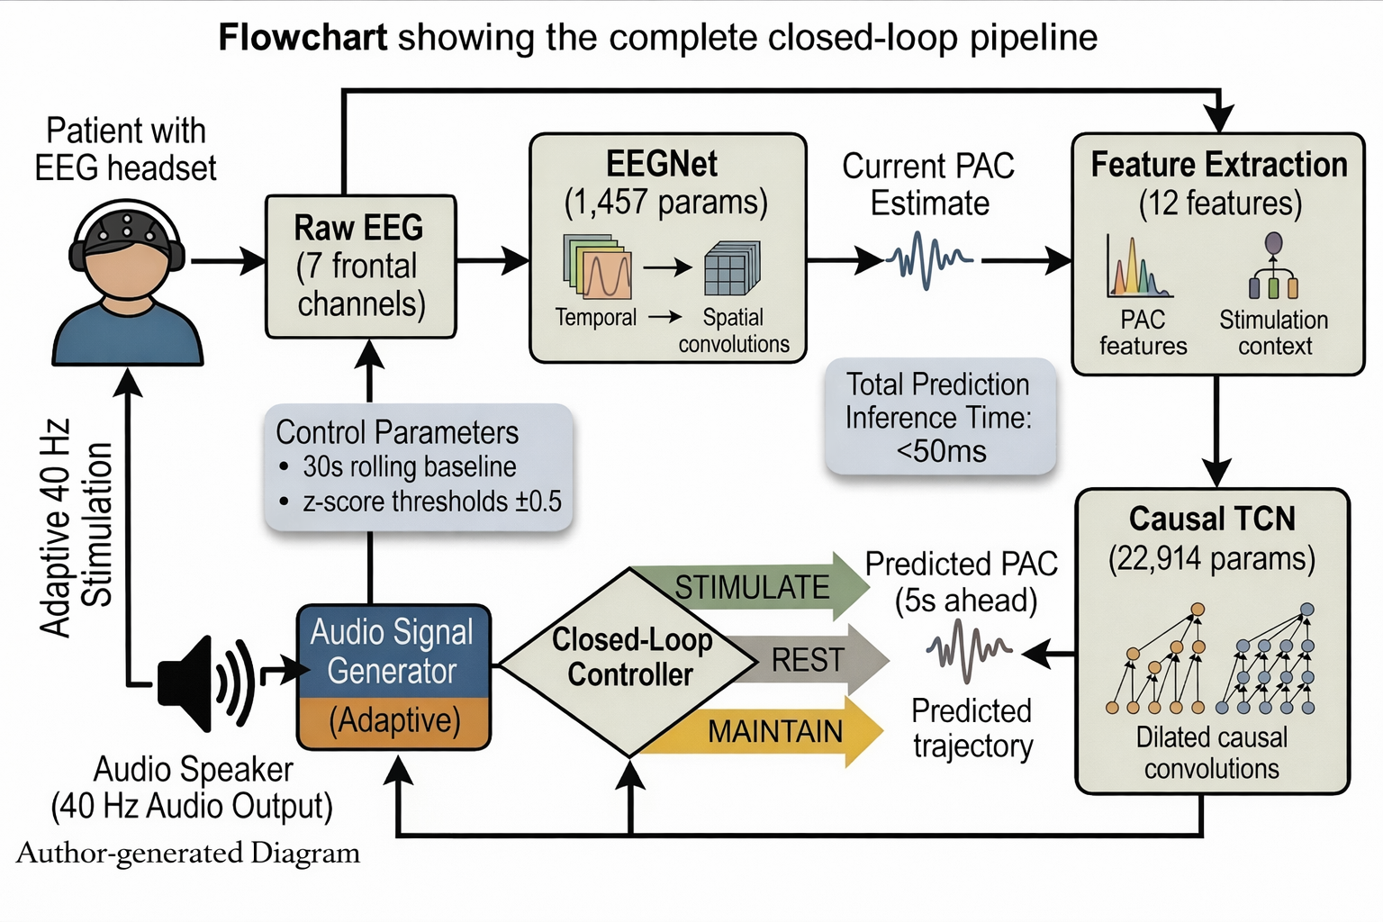
Closed-Loop Controller Design
Personalization: 30-second rolling baseline per subject; z-score = (PAC − μ) / σ
Decision: z < −0.5 → STIMULATE; z > +0.5 → REST; else MAINTAIN current state
5-second hysteresis to prevent rapid state oscillation
Variants compared: Fixed Schedule (40 s ON / 20 s OFF), Reactive Threshold, TCN Predictive, Hybrid, PI Controller, Alignment Oracle (perfect hindsight upper bound)
Validation Protocol
Offline counterfactual replay on all 35 subjects’ recorded EEG from OpenNeuro dataset
Ground-truth PAC labels used as TCN input to isolate the forecaster’s contribution from EEGNet error
Validation metrics: Alignment = mean of Low-PAC Stim Rate and High-PAC Rest Rate; PAC Targeting Gap (mean PAC during rest minus mean PAC during stimulation)
Statistics: Wilcoxon signed-rank (paired, N = 35); Hedges’ g with 95% BCa bootstrap confidence intervals (10,000 iterations)
Figure 1. System architecture of the closed-loop 40 Hz entrainment system. Raw EEG from 7 frontal channels flows through signal processing, EEGNet PAC estimation, 12-feature PAC+Stim engineering, causal TCN forecasting (5 s horizon), and an adaptive controller that drives personalized 40 Hz auditory stimulation. Dashed arrow indicates closed-loop feedback. (Diagram created by the author.)

Slide 7
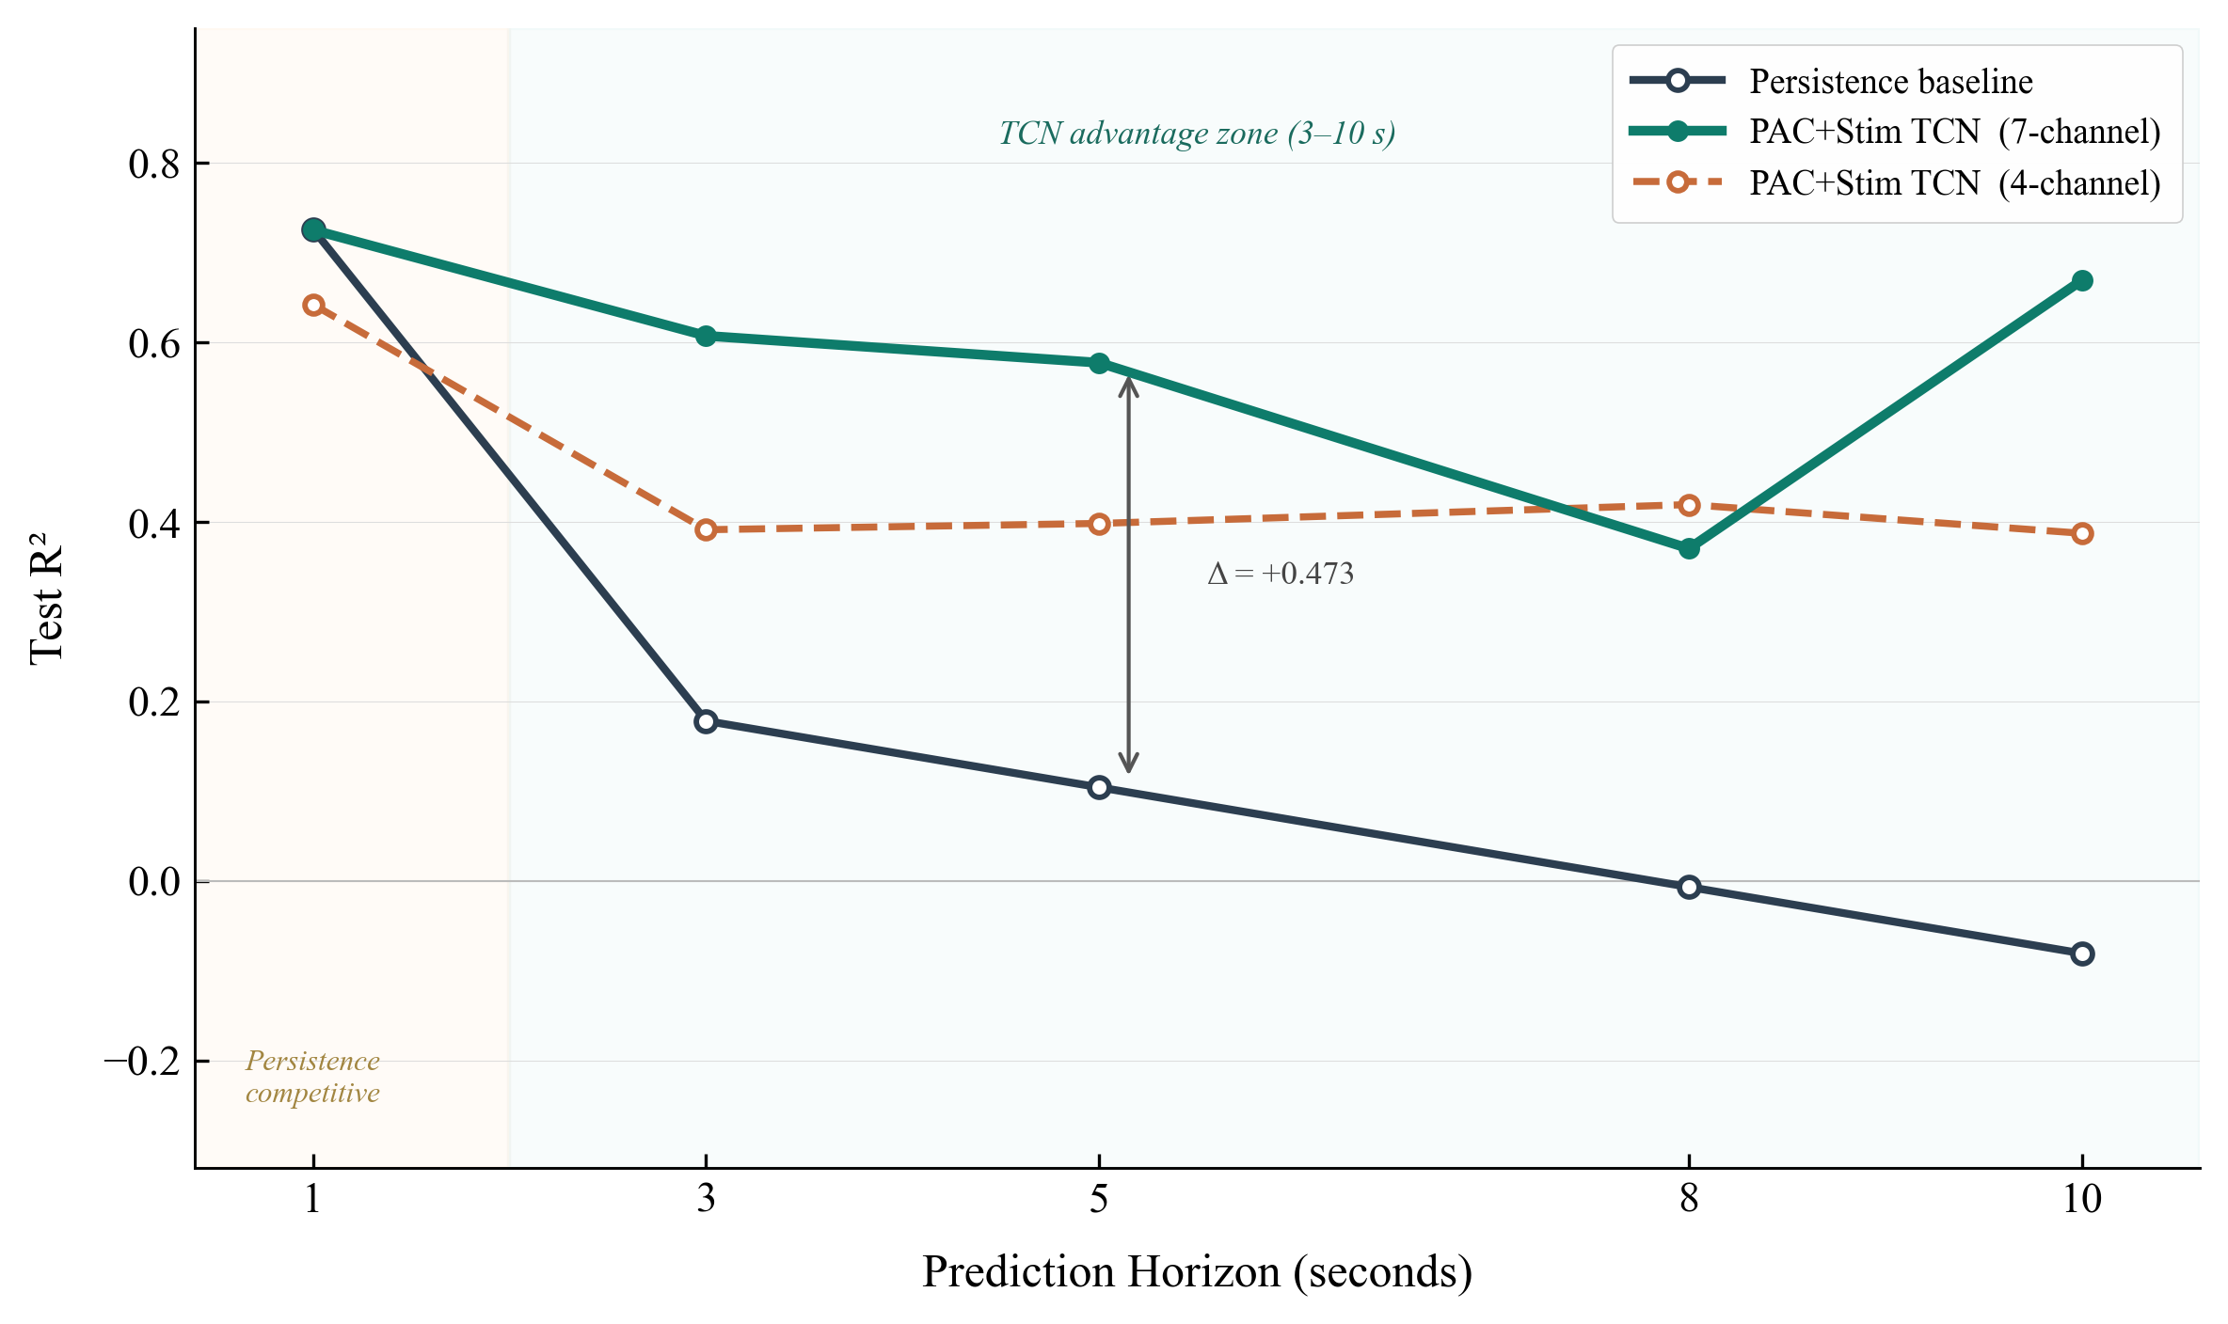
Results
Architecture Search: R² = 0.287 Static PAC Prediction Ceiling
Eight neural network architectures (1,457 to 1.1 M parameters) were tested for static PAC prediction from 2-second EEG snapshots. All converged to R² ≈ 0.287, suggesting a data-imposed ceiling showing that epoch-level PAC cannot be recovered from instantaneous windows. This finding redirected the project toward temporal forecasting. The bottleneck was the features available.
Horizon Sweep: PAC+Stim TCN vs. Baselines
TCN models trained on 12 PAC+Stim features at horizons 1-10 s (PAC+Stim features only). An inflection point emerges at ≈3 s where persistence collapses but the TCN maintains strong R²:
Horizon | Persistence R² | TCN R² (7ch) | TCN R² (4ch) | TCN Margin
1 s | 0.726 | 0.725 | 0.642 | −0.001
3 s | 0.178 | 0.607 | 0.391 | +0.429
5 s | 0.104 | 0.577 | 0.398 | +0.473
8 s | −0.007 | 0.370 | 0.419 | +0.377
10 s | −0.081 | 0.669 | 0.387 | +0.750
Table 1. PAC+Stim TCN horizon sweep (single seed). At 1 s, persistence is competitive. At 3-10 s, persistence collapses while the TCN (7ch) maintains R² = 0.37-0.67. This value is actionable for proactive neuromodulation. Multi-seed 5-seed mean at horizon 5: R² = 0.606 ± 0.032, range 0.558-0.647.

Slide 8
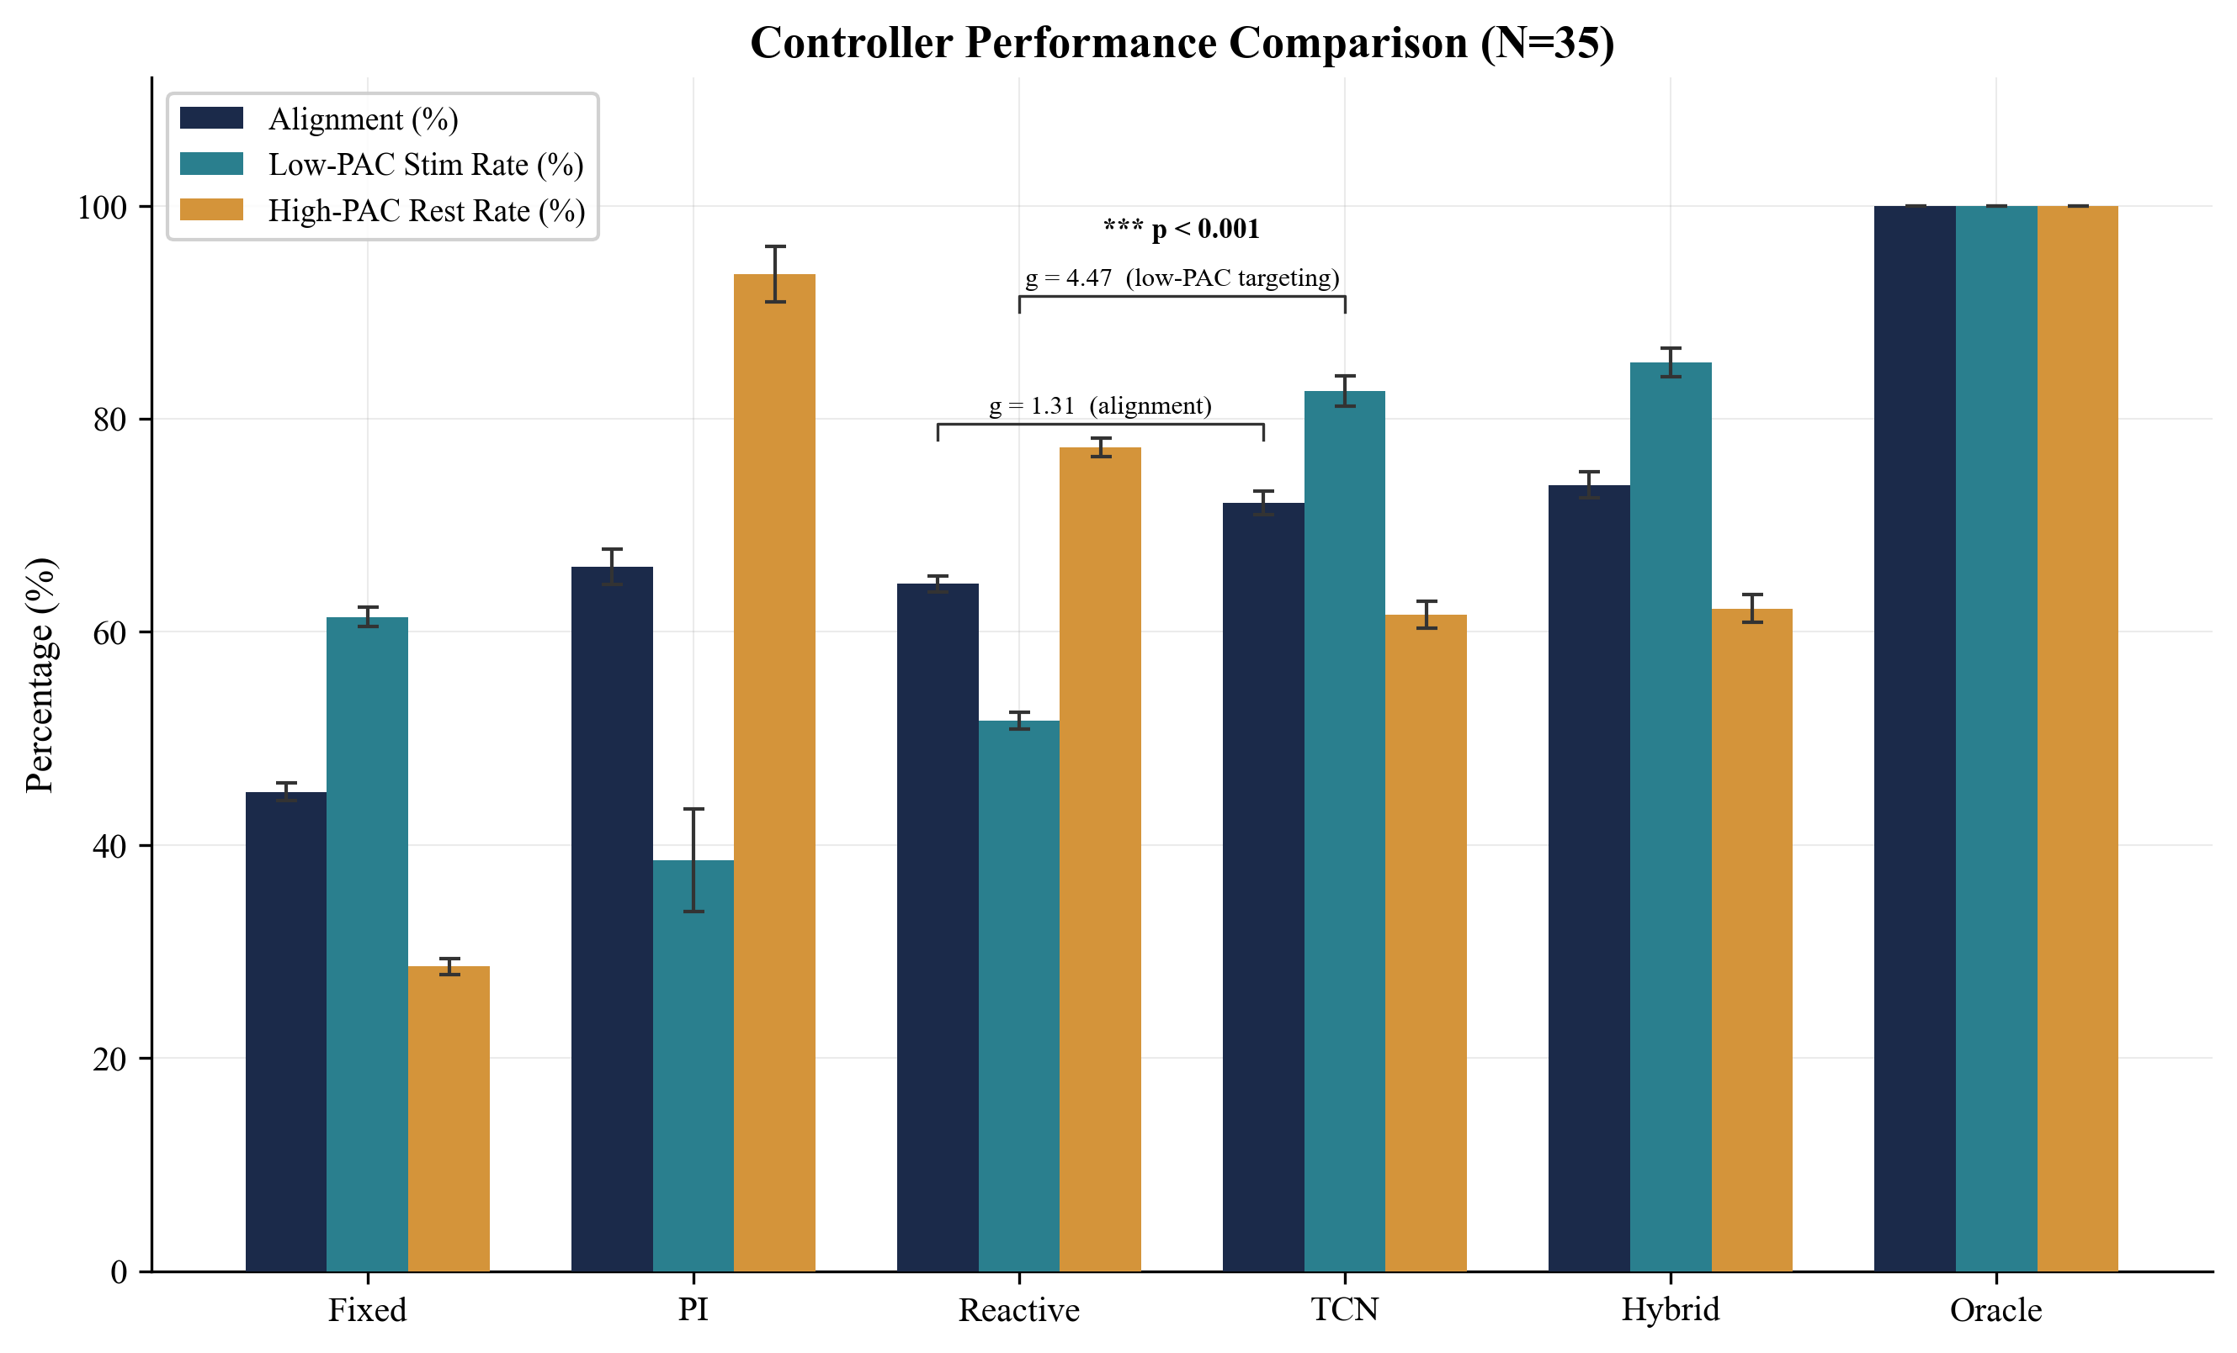
Controller Comparison (N = 35 Subjects, Real EEG)
Controller | Alignment | Low-PAC Stim | High-PAC Rest | Stim % | PAC Gap
Fixed Schedule | 45.0% | 61.4% | 28.6% | 66.6% | −6.6
Reactive Threshold | 64.5% | 51.7% | 77.3% | 36.7% | +21.1
TCN Predictive | 72.1% | 82.6% | 61.6% | 59.7% | +30.5
Alignment Oracle | 100% | 100% | 100% | 48.3% | +33.3
Table 2. Controller comparison on 35 subjects’ real EEG recordings. PAC Gap in dimensionless Modulation Index units (x10^-6 MI units). The TCN Predictive controller reaches 91% of the theoretical oracle bound.

Slide 9
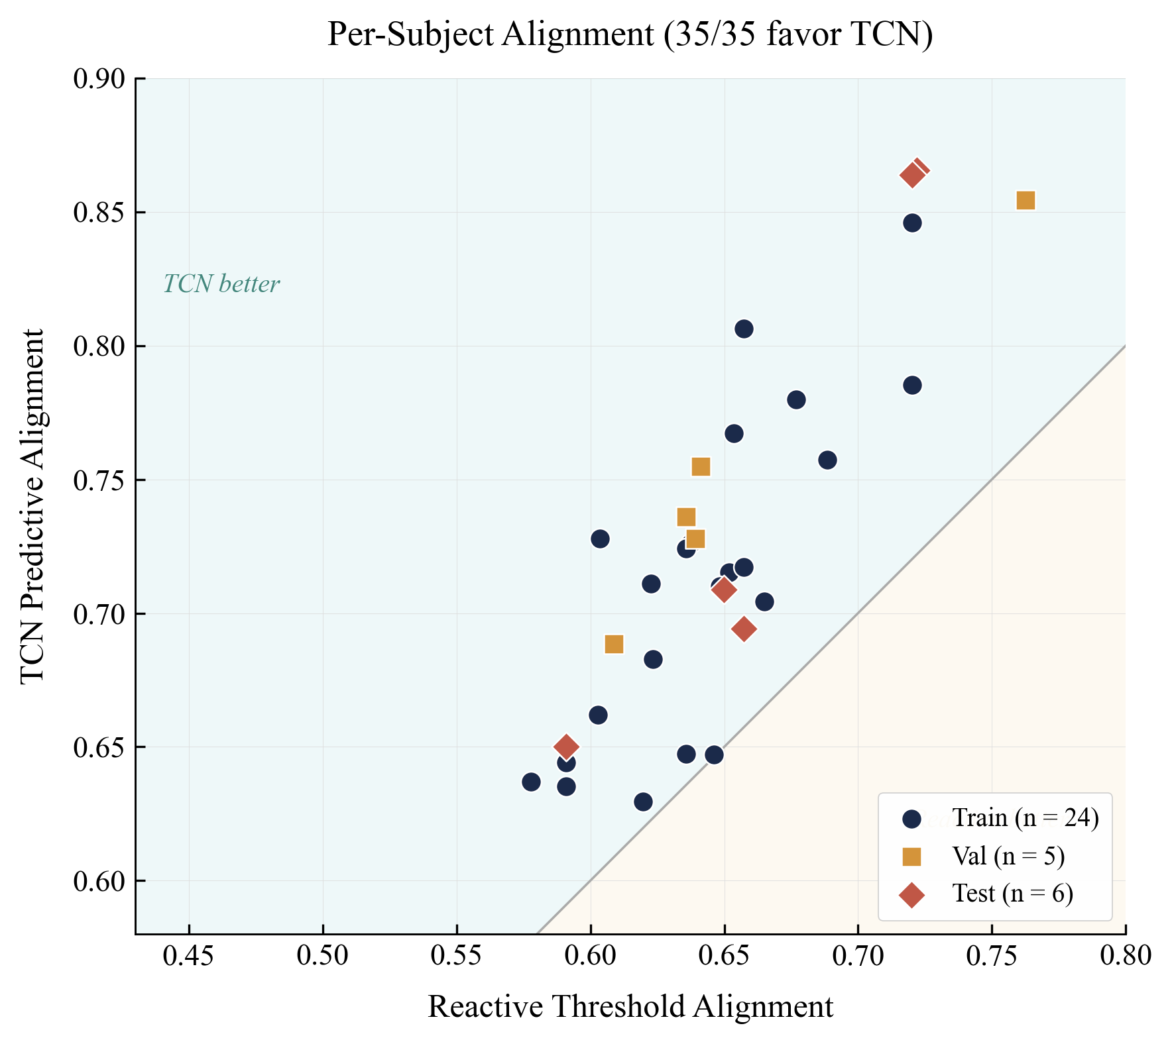
Multi-Seed Robustness (7ch, horizon = 5 s)
Validated across 5 random seeds (h = 64 TCN, PAC+Stim features):
Seed | Val R² | Test R²
42 | 0.804 | 0.558
123 | 0.822 | 0.620
456 | 0.799 | 0.597
789 | 0.831 | 0.608
2024 | 0.846 | 0.647
Mean ± Std | 0.820 ± 0.019 | 0.606 ± 0.032
Statistical Significance (TCN vs. Reactive Threshold)
Alignment: 72.1% vs. 64.5%, Hedges’ g = +1.31 [95% CI: 0.75, 1.87], p < 0.001 (large effect)
Low-PAC Stim Rate: 82.6% vs. 51.7%; Hedges’ g = +4.47 [95% CI: 3.33, 5.62], p < 0.001 (very large effect)
PAC Targeting Gap: 30.5 vs. 21.1 (x10^-6 MI); Hedges’ g = +1.57 [95% CI: 0.98, 2.17], p < 0.001 (large effect)
Per patient benefit: 35/35 subjects showed higher alignment with TCN control (binomial p < 0.001); advantage consistent across train (24), validation (5), and held-out test (6) splits.
Threshold: TCN outperforms reactive at all z-score thresholds from 0.2 to 1.0; stable performance plateau at ≥ 0.3.

Slide 10
Discussion
Interpretation of Results
Feature selection: 8 static model families all converged to R² ≈ 0.287 on 73 features; switching to 12 PAC+Stim features raised test R² to 0.606. A post-hoc comparison of 10 temporal architectures confirmed that all Tier 1 architectures converge to R² ≈ 0.61-0.65 on the same 12 features, while none exceeds R² = 0.28 on 73 features.
The ≈3-second inflection point reflects PAC autocorrelation timescale: below 3s, persistence suffices; above 3s, state transitions require temporal context that only the TCN captures from the 20-step PAC trajectory.
Spectral features encode subject-specific EEG characteristics (likely individual anatomy and recording conditions) that don’t generalize: val-test R² gap shrinks from 0.358 (73 feat) to 0.246 (12 feat) when spectral features are removed.
Comparison to Prior Work
Analogous to closed-loop DBS for Parkinson’s disease (Rosin et al., 2011): adaptive stimulation concentrates therapy on periods of need.
Extends beyond spindle detection (Portiloop, Lacroix et al., 2022) to multi-step forecasting (necessary when intervention requires lead time).
First system targeting PAC dynamics specifically for 40 Hz gamma entrainment optimization at 5-10 s horizons.
Limitations and Possible Errors
Offline counterfactual replay. The current system measures the quality of decisions the model makes. Live validation with real-time EEG streaming with clinics should be done and is in-progress.
Single-site dataset (Tehran memory clinic): may increase model variability; multi-site replication needed.
7 frontal channels only: Relevant theta-gamma coupling in parietal and temporal regions is not captured by this montage.

Slide 11
Conclusions
Key Findings
The predictive controller achieves 72.1% alignment, 82.6% low-PAC targeting, and 91% of the theoretical oracle bound (all p < 0.001 vs. reactive; Hedges’ g = 1.31–4.47).
The TCN maintains R² = 0.37–0.67 at 3–10 s horizons where persistence collapses to negative R², defining the operationally actionable regime for proactive neuromodulation.
All 35 subjects benefited, including 6 held-out test subjects never seen during training.
Features: replacing 73 spectral features with 12 PAC+Stim features raised temporal test R² from −0.025 to 0.606 (5-seed mean; 4ch: 0.430). Feature selection mattered more than any architectural change.
Eight architectures (1,457 to 1.1 M parameters) all converge to R² = 0.287 for static PAC prediction, a data-imposed ceiling proving the bottleneck is the feature representation, not the model architecture.
Context
These results show that temporal PAC forecasting can drive proactive closed-loop control that outperforms both fixed-schedule and reactive protocols. No prior system has attempted PAC-specific temporal prediction for personalized gamma entrainment control.
Productization and Clinical Roadmap
Complete system under $250 per patient: consumer EEG headset (Muse 2, ~$200) paired with standard headphones, running the adaptive controller through the web application. No clinical hardware required.
Caregiver dashboard: deployed on Hugging Face Spaces; remote PAC monitoring, session tracking, and memory assessment so families can follow a patient's progress from anywhere.
Pilot in progress: currently have initiated outreach to regional memory care facilities (Mission Villa, Valley Medical) to demo the application and collect real-world EEG data during 15-minute supervised sessions. Collected data feeds back to improve the TCN model.
Future plan: conduct observational pilot with IRB approval to collect real-world EEG during supervised 15-minute sessions, followed by a feasibility study (N = 5-10) comparing adaptive vs. fixed stimulation to demonstrate improved entrainment maintenance in actual patients.

Slide 12
Scope of Work
New Work by Author
Independently identified the research gap (fixed-schedule limitation in 40 Hz entrainment) through literature review.
Designed and implemented the computational pipeline including EEG preprocessing, PAC computation, architecture search across 8 neural network families, feature ablation study (73 vs. 12 PAC+Stim features), and MultiscaleCausalTCN design.
Discovered the R² = 0.287 data ceiling through experimentation, the ~3-second prediction horizon inflection point, and the improved feature selection (12 PAC+Stim features raising R² from −0.025 to 0.606)
Designed the closed-loop controller with personalization module, hysteresis logic, and multi-strategy comparison framework including alignment oracle upper bound.
Conducted all statistical analyses: Wilcoxon signed-rank tests, Hedges’ g effect sizes with 95% bootstrap CIs, binomial sign tests, threshold sensitivity sweeps.
Validated the complete system on 35 real patient EEG recordings through offline counterfactual replay.
Professional, Institutional, and Academic Resources and Support
Data: OpenNeuro ds005048, publicly available EEG dataset
Computing: Personal M4 Apple Silicon MacBook & personal RTX 3080 GPU; no institutional computing resources were used.
Software: open-source libraries (PyTorch, MNE-Python, SciPy, NumPy, Matplotlib)
My AP Statistics teacher was briefly consulted when carrying out the statistical analyses of the ML models.
No institutional lab, university mentor, summer research program, or specialized equipment was used.

Slide 13
References / Supplemental Information
References
[1] Iaccarino HG et al. Gamma frequency entrainment attenuates amyloid load. Nature 540, 230–235, 2016.
[2] Murdock MH et al. Multisensory gamma stimulation promotes glymphatic clearance. Nature 627, 149–156, 2024.
[3] Chan D et al. Gamma sensory stimulation in mild Alzheimer's dementia: open-label extension. Alzheimer's & Dementia 21(10), e70792, 2025.
[4] Fortunato C et al. Gamma entrainment for cognitive improvement in neurodegeneration. Front Neurosci 17, 2023.
[5] Lahijanian B et al. Auditory gamma entrainment enhances DMN connectivity in dementia. Sci Rep 14, 2024.
[6] Lawhern VJ et al. EEGNet: compact CNN for EEG-based BCIs. J Neural Eng 15, 056013, 2018.
[7] Tort ABL et al. Measuring phase-amplitude coupling. J Neurophysiology 104, 1195–1210, 2010.
[8] Jiao D. Advancing personalized digital therapeutics: integrating music therapy, brainwave entrainment, and AI-driven biofeedback. Front Digital Health 7, 1552396, 2025.
[9] Rosin B et al. Closed-loop DBS for Parkinson’s disease. Neuron 72, 370–384, 2011.
[10] Lacroix A et al. Portiloop: real-time causal sleep spindle detection. PLOS ONE 17, e0269421, 2022.
Supplemental Information
Dataset: https://openneuro.org/datasets/ds005048

