Slide 1
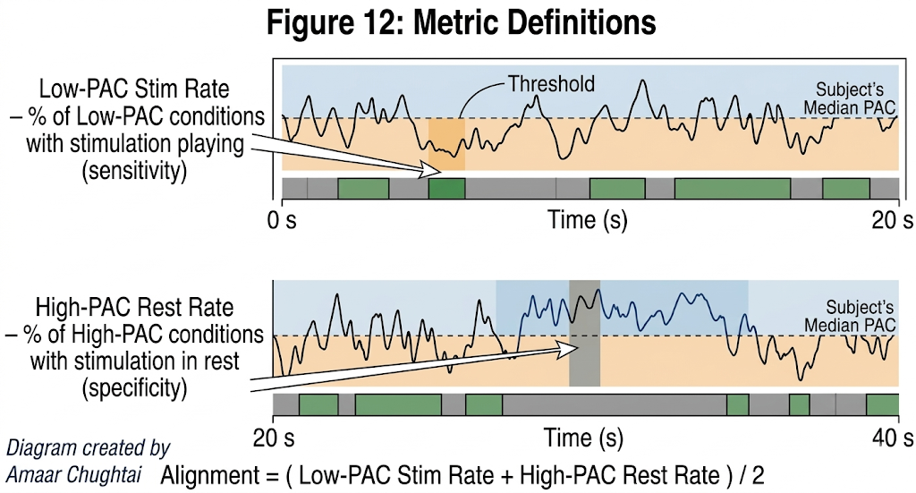
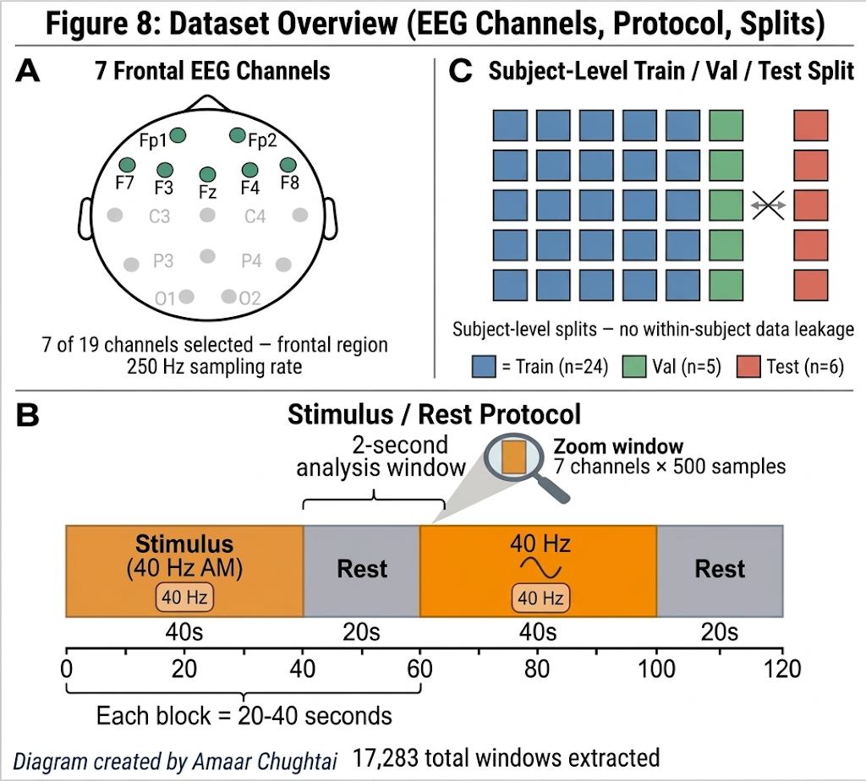
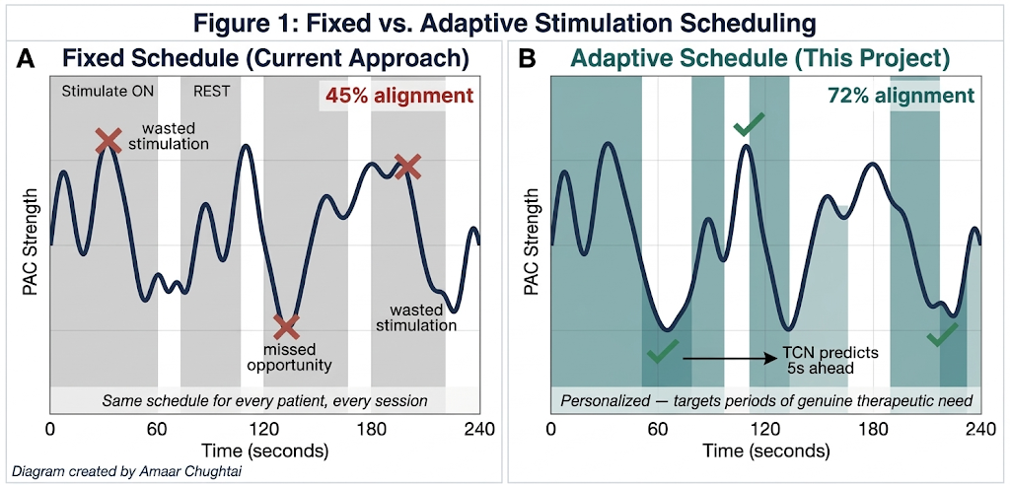
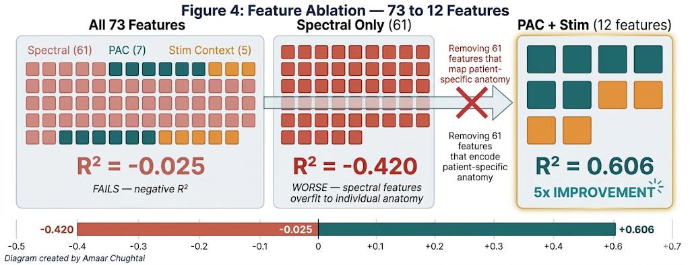
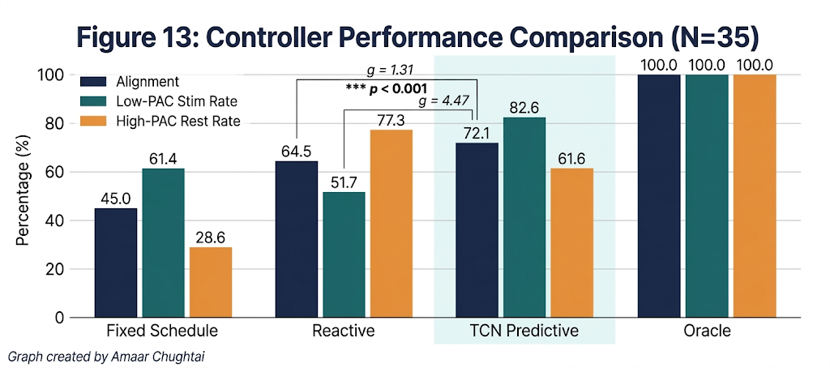
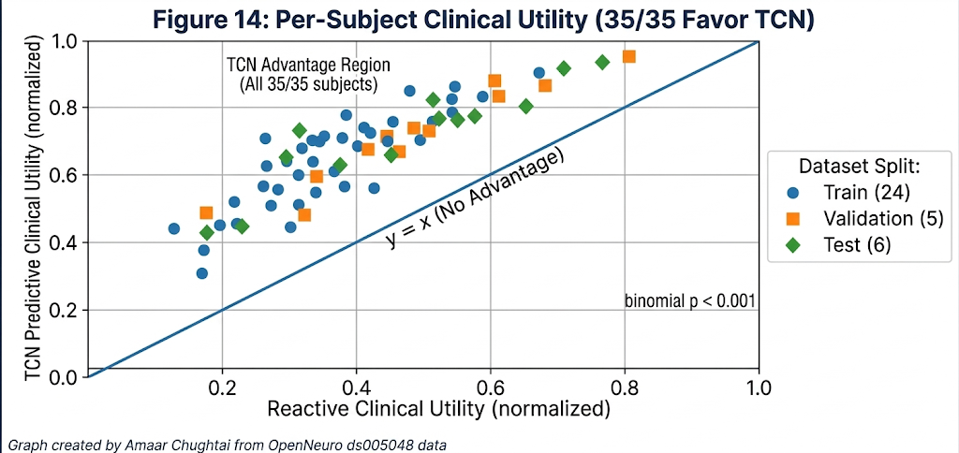
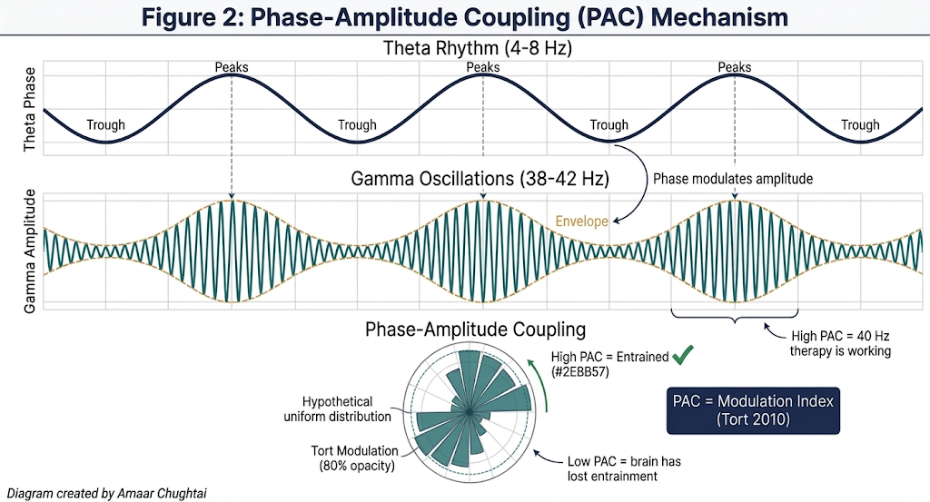
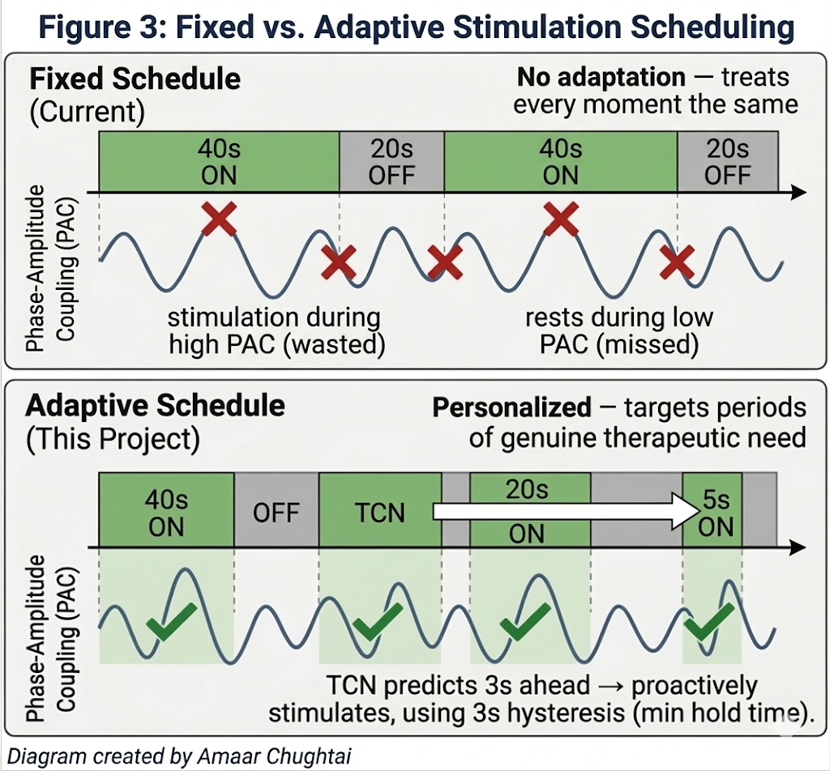
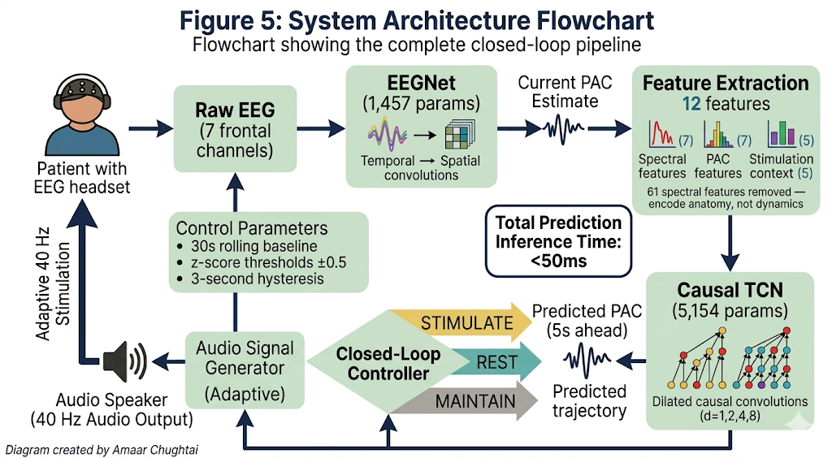
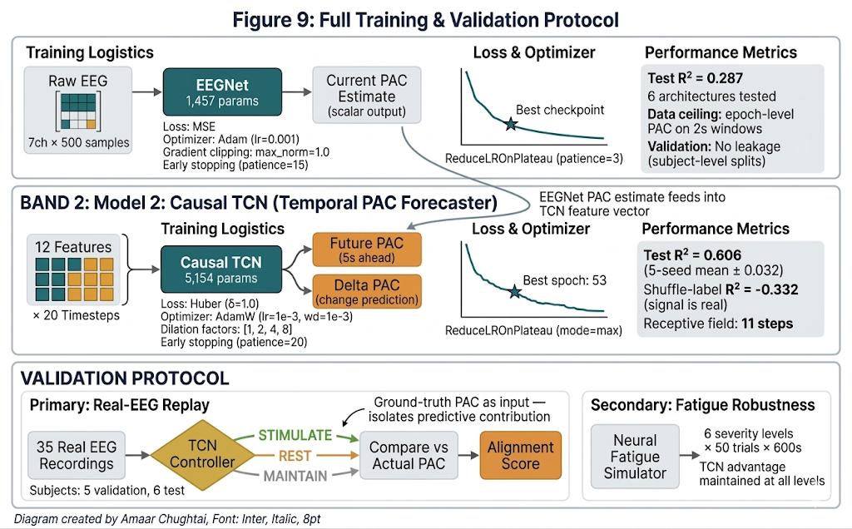
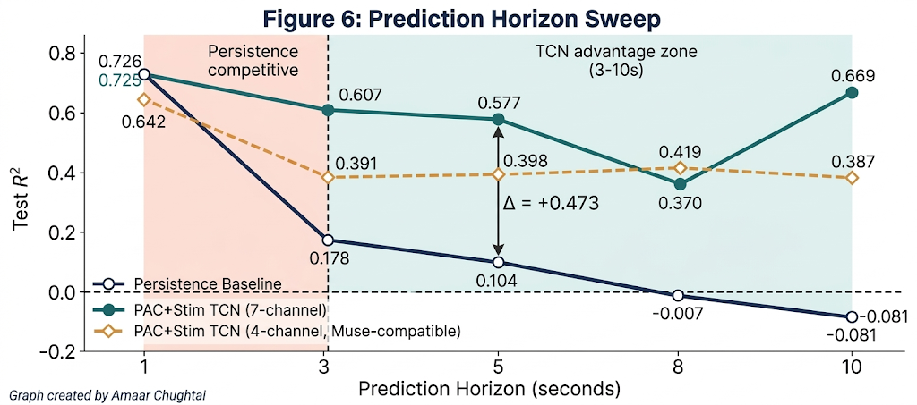
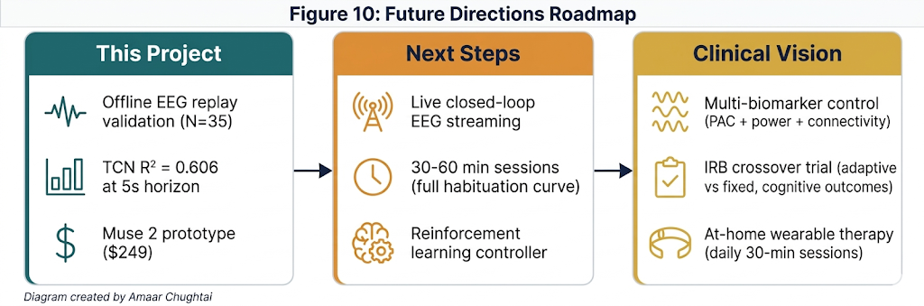
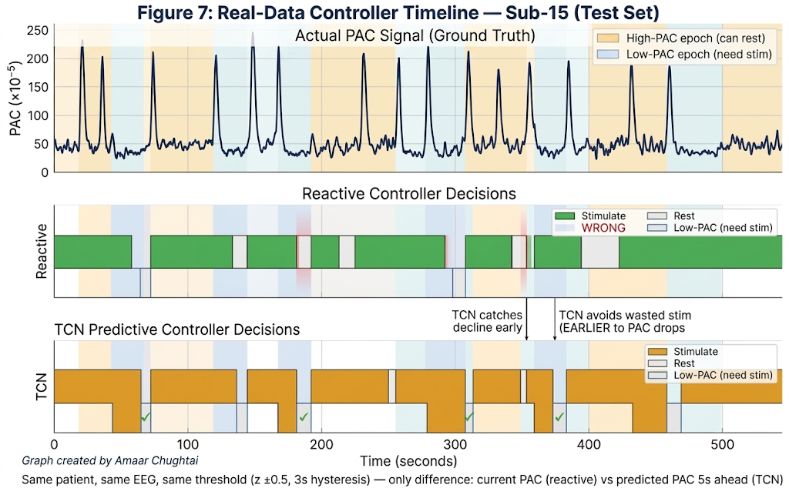
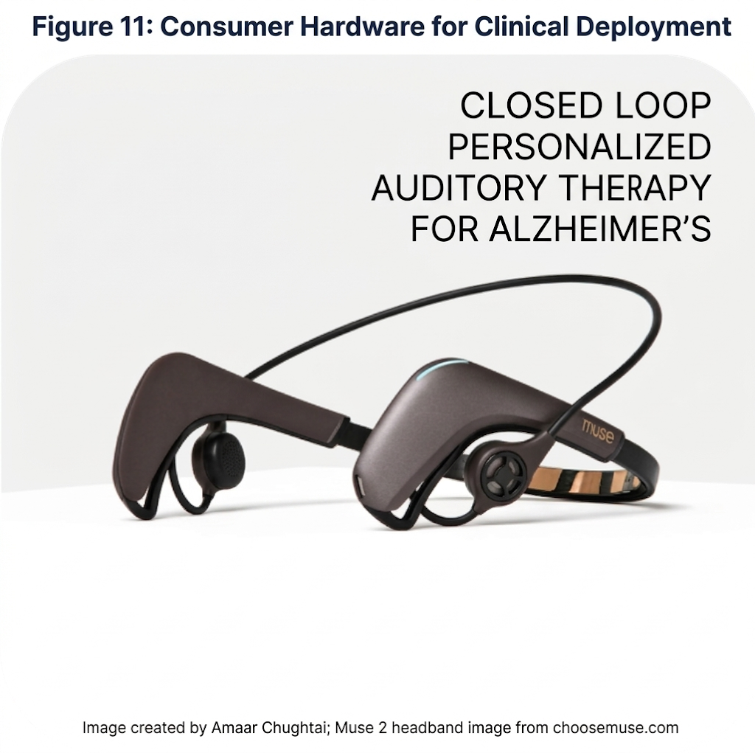
Personalized Deep Learning Model for Closed-Loop 40 Hz Entrainment to Optimize Theta-Gamma Coupling in Alzheimer's Disease
Amaar M. Chughtai
Introduction
System Architecture
Materials
Results / Findings
Alzheimer's disease affects over 55 million people worldwide with no cure. Recent research shows 40 Hz auditory stimulation synchronizes brain gamma oscillations, reducing amyloid-beta plaques and tau tangles in animal models (Iaccarino 2016) and showing cognitive benefits in human trials (Chan 2025).
Current protocols deliver stimulation on a fixed schedule — 40s ON / 20s OFF, cycling for one hour regardless of how the patient's brain responds. This ignores that some patients maintain strong theta-gamma coupling throughout a session while others lose it within seconds. Prolonged stimulation also causes neural habituation, where the brain "tunes out" the stimulus. The result: wasted stimulation during strong coupling and missed therapeutic windows during fading coupling.
Can we predict when a patient's brain will lose entrainment and stimulate proactively, before decline occurs?
To control stimulation proactively, the system needs to predict PAC 5-10 seconds into the future. The approach consists of two phases:
Estimate current PAC from raw EEG in real time (since live patients don't have ground-truth labels)
Predict future PAC from a history of past estimates — temporal forecasting
Stage 1: Architecture Decision for Static PAC Estimation
Dataset:
35 dementia patients, OpenNeuro ds005048 (Lahijanian 2024)
7 frontal EEG channels (Fp1, Fp2, F3, F4, F7, F8, Fz), 250 Hz
Alternating Stimulus (40 Hz AM auditory) and Rest epochs, 20-40s each
17,283 two-second windows; subject-level splits (24 train / 5 val / 6 test)
Compute: Python 3.13, PyTorch, Apple Silicon (MPS), no cloud GPU required
Result 1: TCN Predictive Controller Outperforms All Alternatives Controller performance replayed on all 35 subjects' real EEG:
Architecture | Params | Test R²
EEGNet (V4) | 1457 | 0.287
SpecRNN (V3) | 180K | 0.236
ViT-TCNet (V4) | ~2M | 0.222
Ridge Regression (V1) | 135 coefs | 0.287
ATCNet (V6) | 29K | 0.075
EEGNetLarge (input) | 141K | 0.287
EEGNet matches the best R² (0.287) with only 1,457 parameters. It's the lightest weight architecture tested, enabling real-time inference on embedded devices — provides the current PAC estimate that feeds into the temporal predictor.
Conclusion: R² = 0.287 is a data ceiling (epoch-level PAC labels on 2s windows).
Controller | Alignment | Low-PAC Targeting | PAC Gap (×10⁻⁶) | Stim %
Fixed Schedule | 45.0% | 61.4% | -6.6 (wrong direction) | 66.6%
Reactive | 64.5% | 51.7% | +21.1 | 36.7%
TCN Predictive | 72.1% | 82.6% | +30.5 | 59.7%
Oracle | 100.0% | 100.0% | +33.3 | 48.3%
Dropping 61 spectral features and keeping only 12 PAC-trajectory features raised test R² from -0.025 to 0.606 (5-seed mean ± 0.032). Spectral features encoded patient-specific anatomy that does not generalize across subjects. Feature selection mattered more than architecture.
TCN vs Reactive: Alignment g = +1.31, Low-PAC targeting g = +4.47, PAC gap g = +1.57 (all p < 0.001)
TCN PAC targeting gap reaches 91% of the theoretical oracle
TCN uses less stimulation than Fixed Schedule (59.7% vs 66.6%)
Reactive misses 48% of low-PAC windows that need treatment
Background
40 Hz gamma entrainment reduces amyloid load in Alzheimer's mouse models by activating microglia (Iaccarino 2016); multi-sensory stimulation reduces tau pathology and improves cognition (Martorell 2019); auditory entrainment enhances default mode network connectivity in human dementia patients (Lahijanian 2024)
Phase-Amplitude Coupling (PAC) quantifies entrainment success — how strongly gamma amplitude (38-42 Hz) locks to theta phase (4-8 Hz), measured via the Modulation Index (Tort 2010). High PAC = entrained; low PAC = lost synchronization.
Neural habituation causes repeated identical stimuli to produce progressively weaker neural responses (Thompson & Spencer 1966), making fixed schedules less effective over time
No existing system predicts future entrainment state for proactive control. Current approaches either use fixed schedules (no adaptation) or reactive thresholds (respond after PAC decline has already occurred).
Procedure
Training:
EEGNet: MSE loss, Adam optimizer, gradient clipping (max_norm=1.0), early stopping
Causal TCN: Huber loss (robust to PAC outliers), learning rate reduction on plateau, early stopping (patience=20)
All hyperparameters tuned on validation set (5 subjects); test set (6 subjects) used only for final evaluation
Validation (two independent protocols):
Primary (real data): Replayed TCN controller on all 35 subjects' actual EEG recordings — offline counterfactual decisions on real brain data. For validation, ground-truth PAC labels were used as TCN input, isolating the TCN's predictive contribution from EEGNet estimation error.
Secondary (simulation): Closed-loop simulation with neural fatigue modeling — 6 severity levels × 50 trials × 600 seconds per trial
Statistical validation:
Wilcoxon signed-rank tests (non-parametric, paired)
Bootstrap 95% confidence intervals
Hedges' g effect sizes
Compared against: Fixed Schedule, Reactive Threshold, PI Controller, Alignment Oracle (theoretical upper bound)
Stage 2: Temporal Prediction; Causal TCN
Since no single-window architecture could exceed R² = 0.287, I shifted the approach: instead of predicting PAC better from one snapshot, predict it further into the future from a sequence of snapshots. The Causal TCN ingests 20 seconds of history and forecasts PAC 5 seconds ahead.
12 TCN input features: 7 PAC-derived (current value from EEGNet, moving averages, trends) + 5 stimulation context (on/off state, duration, session phase)
Result 2: Every Patient Benefits
35/35 subjects (100%) show higher utility with TCN vs Reactive (binomial p < 0.001)
Advantage holds for 6 held-out test subjects never seen during training
Result 3: Advantage Increases with Fatigue
Simulation results across 6 fatigue severity levels (n=50 trials each):
 | EEGNet | Causal TCN
Purpose | Estimate current PAC (raw EEG) | Predict future PAC (5s horizon)
Parameters | 1,457 (7 ch x 500 windows) | 5,154
Input | Raw EEG (7 ch x 500 samples) | 12 features x 20 timesteps
Architecture | Temporal + depth-wise spatial conv. | Dilated causal conv (d=1,2,4,8)
Output | Current PAC Estimate | Future PAC (5s Horizon)
Key Feature | Real-time-inference | 11-step receptive field, causal (no future leakage)
Fatigue Level | Fixed Efficiency | Adaptive Efficiency | Improvement
None | 5.381 | 5.401 | +0.4%***
Mild | 5.294 | 5.361 | +1.3%***
Moderate | 5.101 | 5.231 | +2.6%***
High | 4.968 | 5.184 | +4.3%***
Severe | 4.819 | 5.092 | +5.7%***
***p < 0.001, Hedges' g = 1.7–2.4 (large to very large effects). Advantage grows as fatigue worsens; exactly when personalization matters most.
Result 4: Robust Across Fatigue Model Assumptions
Tested under 4 different mathematical models of neural fatigue (n = 50 trials each):
Fatigue Model | Fixed Efficiency | Adaptive | Hedges’ g
Exponential Decay | 5.381 | 5.401 | 2.01
Step Function | 4.947 | 5.361 | 1.21
Heterogeneous (50/50) | 5.101 | 5.231 | 1.71
Saturation (synaptic) | 4.819 | 5.092 | 3.66
Hypothesis
Data Analysis
Future Directions
A causal Temporal Convolutional Network trained on PAC trajectory features can forecast coupling dynamics 5-10 seconds ahead, a horizon where simpler baselines collapse, enabling a closed-loop controller that delivers stimulation proactively rather than reactively.
Goals:
Predict brain entrainment 5-10s into the future (the minimum lead time for proactive control)
Closed-loop controller — integrate predictions into a personalized stimulation controller
Validate on real patient EEG that predictive control outperforms fixed and reactive approaches
Each horizon trains a separate model. Persistence works at 1-2s; the TCN's advantage emerges at 3-10s, the lead time needed for proactive control.
Deploy with live EEG streaming for real-time crossover validation (adaptive vs fixed within-same session)
Record 30-60-minute sessions to capture the full habituation time course
Replace the heuristic controller with reinforcement learning for long-horizon optimization
Extend to multi-biomarker control (PAC + spectral power + connectivity)
System cost under $300/patient (consumer EEG + headphones)
Summary of Key Results
72.1% Alignment
vs. 64.5% reactive
g = 1.31
p < 0.001
82.6% Low-PAC Targeting
vs. 51.7% reactive
g = 4.47
p < 0.001
35/35 Subjects benefited
Via EEG Replay
Binomial p < 0.001
91% of oracle bound
References / Acknowledgements
Real EEG from a held-out test subject. The reactive controller stimulates after PAC drops; the TCN anticipates decline 5 seconds early.
Conclusions
[1] Iaccarino et al. Nature 540(7632), 230-235, 2016.
[2] Martorell et al. Cell 177(2), 256-271, 2019.
[3] Tort et al. J Neurophysiol 104(2), 1195-1210, 2010.
[4] Lawhern et al. J Neural Eng 15(5), 056013, 2018.
[5] Lahijanian et al. Sci Rep 14, 13153, 2024.
[6] Thompson & Spencer. Psychol Rev 73(1), 16-43, 1966.
[7] Chan et al. Alz & Dem 21(10), e70792, 2025.
[8] Fortunato et al. Front Neurosci 17, 2023.
AP Statistics teacher consulted on statistical test selection. All other work conducted independently. Computing: personal MacBook + RTX 3080. No institutional lab or mentor.
Data: OpenNeuro ds005048, open access license. All diagrams by the author. All experimental design, analysis, interpretation, and conclusions are the student's own work.
Towards Clinical Use
At 5-10s horizons, the TCN maintains R² = 0.37-0.67 while all baselines collapse below zero; a +0.5 R² margin at the operationally relevant range for proactive control
On real patient EEG: 72.1% alignment vs 64.5% reactive (p < 0.001), targeting 82.6% of low-PAC windows vs 51.7% — 60% improvement in therapeutic targeting
All 35 patients benefited, including 6 held-out test subjects — generalizes across individuals without retraining
Adaptive advantage increases with fatigue (+0.4% to +5.7%) and holds across four fatigue model assumptions
Limitation: Real-data validation uses offline replay on recorded EEG, not live closed-loop streaming. The system makes decisions on real brain data but cannot observe the brain's response to those decisions.
The full pipeline runs in real time on consumer hardware:
EEG capture: Muse 2 headband ($249); 4 dry electrodes, no gel or technician needed
Processing: Single laptop, <50ms end-to-end inference latency
Audio delivery: Standard headphones with 40 Hz amplitude-modulated audio
Total cost per patient: Under $300 (headband + headphones)

