Slide 1
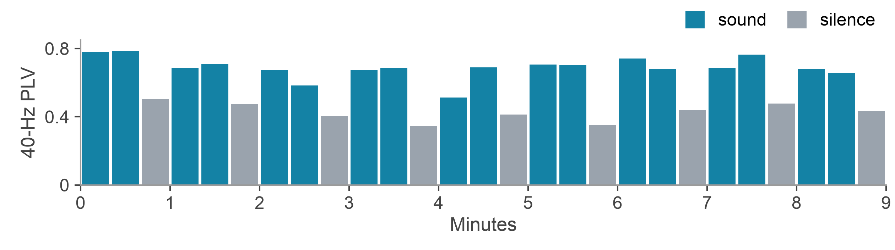
Early and Later EEG Synchronization During 40-Hz Auditory Stimulation
Amaar Chughtai
Valley Christian High School, San Jose, California
IEEE MIT URTC 2026
One participant's session (sub-32, stronger responder)
Notes:
Hi, I'm Amaar Chughtai, from Valley Christian High School. My grandmother had dementia, which is how I started reading about 40-hertz sound. The bars are one strong responder's session: red is sound, gray is silence.

Slide 2
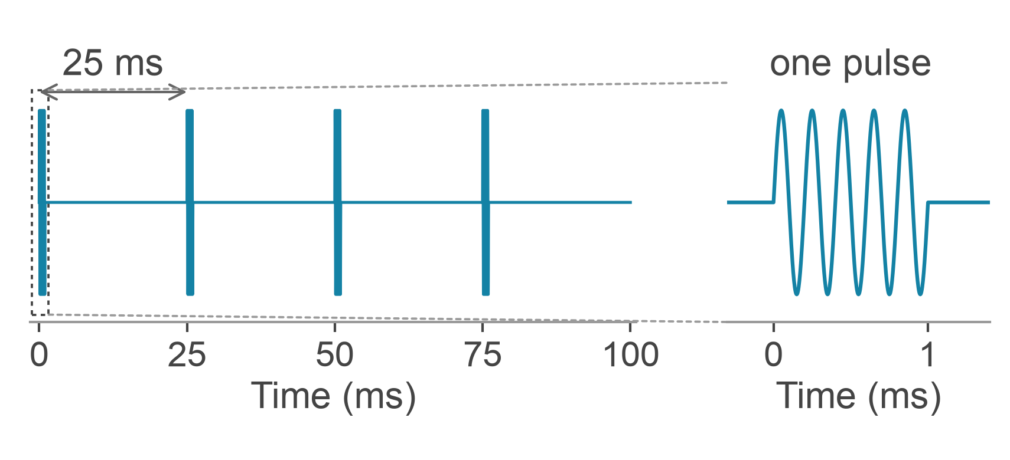
Does the EEG response in the first two minutes track the response a few minutes later?
In mice, 40-Hz light and sound reduced Alzheimer's-like pathology.^{1,2} Replication has been mixed,³ and benefit in patients hasn't been established.^{4,5}
Not every brain follows a fixed-schedule 40-Hz sound.⁶ To maximize auditory therapy, we must tailor stimulation by person, meaning we must decide when to stimulate while the session is still running. That only works if the early EEG responses contains information about later ones.
The stimulus: a 1-ms, 5-kHz tone pip every 25 ms, so 40 per second, played from two loudspeakers.⁶
¹Iaccarino et al., Nature 2016. ²Martorell et al., Cell 2019. ³Soula et al., Nat Neurosci 2023. ⁴Chan et al., PLOS ONE 2022. ⁵Hajós et al., Front Neurol 2024. ⁶Lahijanian et al., Sci Rep 2024.
Notes:
This is the stimulus: a one-millisecond beep, forty times a second. In mice, 40-hertz light and sound reduced Alzheimer's-like pathology. But replication has been mixed, and benefit in patients hasn't been established.
And some brains barely follow the sound. To tailor stimulation to a person, you'd have to decide while the session is still running.
So my question: within one session, does the response in the first two minutes track the response a few minutes later?

Slide 3
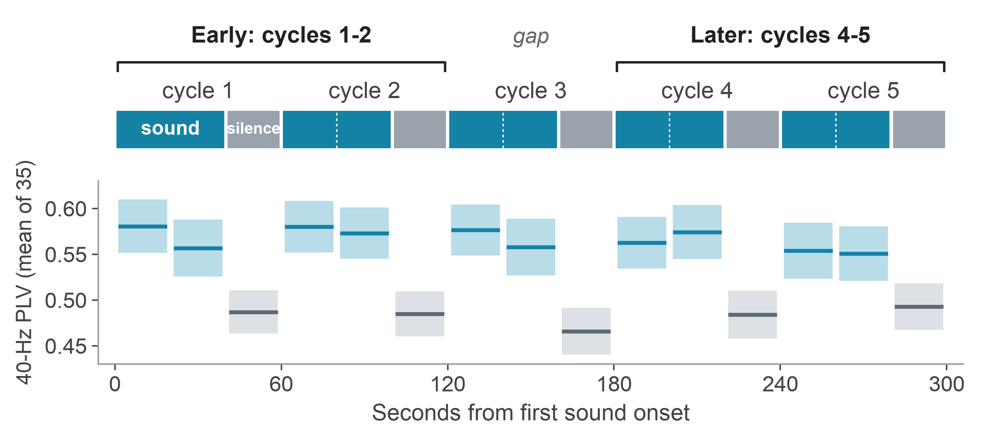
Dataset: 35 people, 40s of sound, 20s of silence
Public EEG from a memory clinic in Tehran (OpenNeuro ds005048). 10 people were cognitively normal, 6 had mild cognitive impairment, 17 had Alzheimer's disease, and 2 were unclassified.
In every cycle shown, the group's 40-Hz PLV was higher with sound than in the silence right after it.
Over the whole session, sound minus silence was +0.077 (95% CI 0.045 to 0.112), and it was higher with sound in 27 of 35 people.
Bands show ±1 standard error across people. Each 40-s sound block is split into two 20-s windows. Sessions had 5 (n = 8) or 9 (n = 27) complete cycles, because the last silence of each recording is cut short. 19-channel EEG at 250 Hz, cleaned by the dataset authors (Lahijanian, Aghajan & Vahabi, Sci Rep 2024).
Notes:
I used public EEG from 35 people referred to a memory clinic, about half with Alzheimer's. Each cycle is 40 seconds of sound, then 20 of silence. In every cycle shown, the group's synchronization is higher with sound than in the silence after.
Eight people had only five full cycles. So I compared cycles one and two, the first two minutes, with four and five, the latest pair everyone has, and left cycle three out so the two windows never touch.

Slide 4
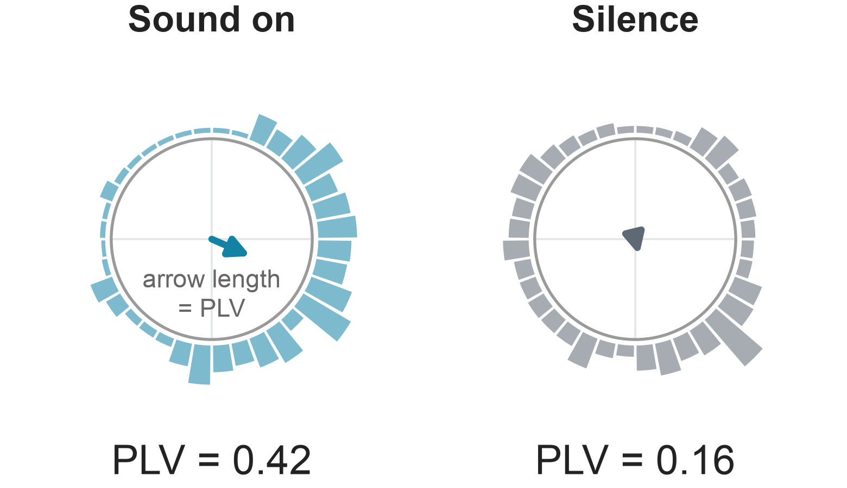
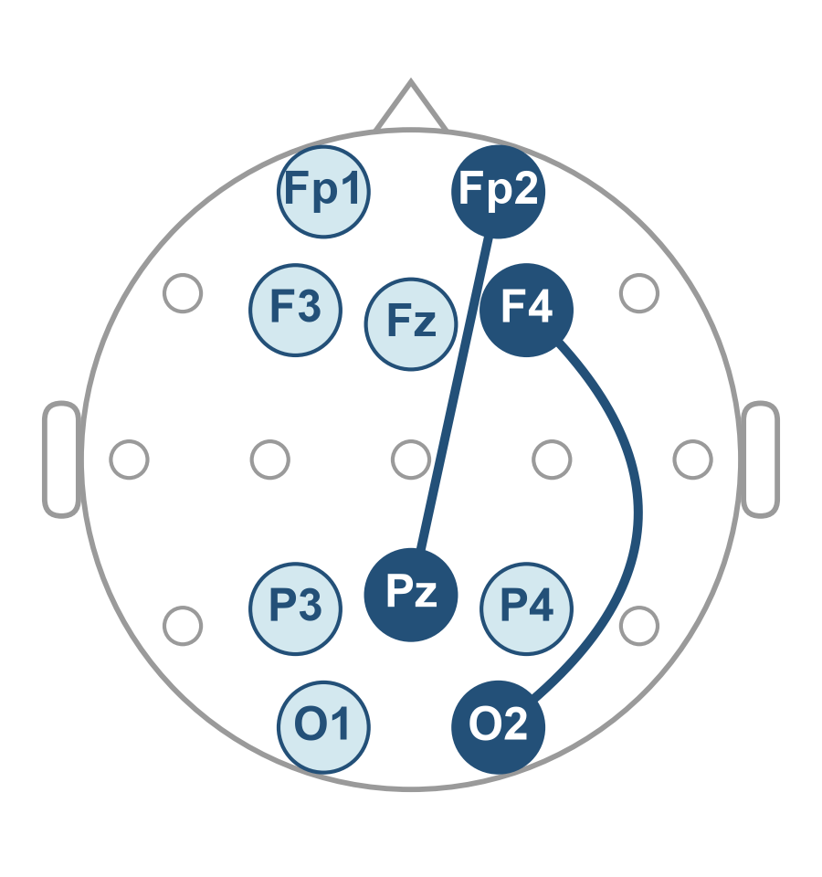
Synchronization quantification
Each signal is one frontal minus one posterior electrode. 25 signals make 200 pairs that share no electrode. The two lines are the example pair, Fp2‑Pz and F4‑O2.
One pair of signals from sub-01 (largest early contrast), cycle 1, the median of its 200 pairs. The bars show where the phase difference fell over the 20-s window.
For each cycle k, I subtract the silence right after:
$$C_{k}={\overline{PLV}}_{k}^{sound}−{PLV}_{k}^{silence}$$
$${PLV}_{ab}=\left|\frac{1}{N}\sum_{n=1}^{N}{e^{iΔφ_{ab}\left(n\right)}}\right|$$
$$C_{early}=\frac{1}{2}\left(C_{1}+C_{2}\right) \\ C_{later}=\frac{1}{2}\left(C_{4}+C_{5}\right)$$
Raw PLV alone mostly describes the person. Block 1 and the last three blocks correlate at r = 0.87 to 0.93, at every frequency.
N = 5000 samples per window. The reported PLV is the mean over all 200 pairs.
The bar marks the mean of the sound block's two 20-s windows. Each window is filtered on its own (Butterworth band-pass, 39.5 to 40.5 Hz, zero-phase), with phase from the Hilbert transform. Montage and filter follow Lahijanian et al. 2024. PLV: Lachaux et al. 1999; Mormann et al. 2000.
Notes:
Each signal is one frontal electrode minus one posterior electrode, like the two lines on this head. *(point at the head)* I filter both around 40 hertz and track their timing difference.
The bars show where that difference landed. With sound, it piles up on one side; in silence, it spreads around. Make each moment an arrow and average them: arrows that agree give a long average, near one; scattered arrows, near zero. That length is the phase-locking value: point four two versus point one six. I average it over 200 pairs that never share an electrode.
Then I subtract silence from sound, cycle by cycle. That's the contrast, C. Why subtract? Raw PLV correlates early to late at every frequency, even where the sound barely changes it, so it mostly describes the person. Subtracting their own silence removes most of that.

Slide 5
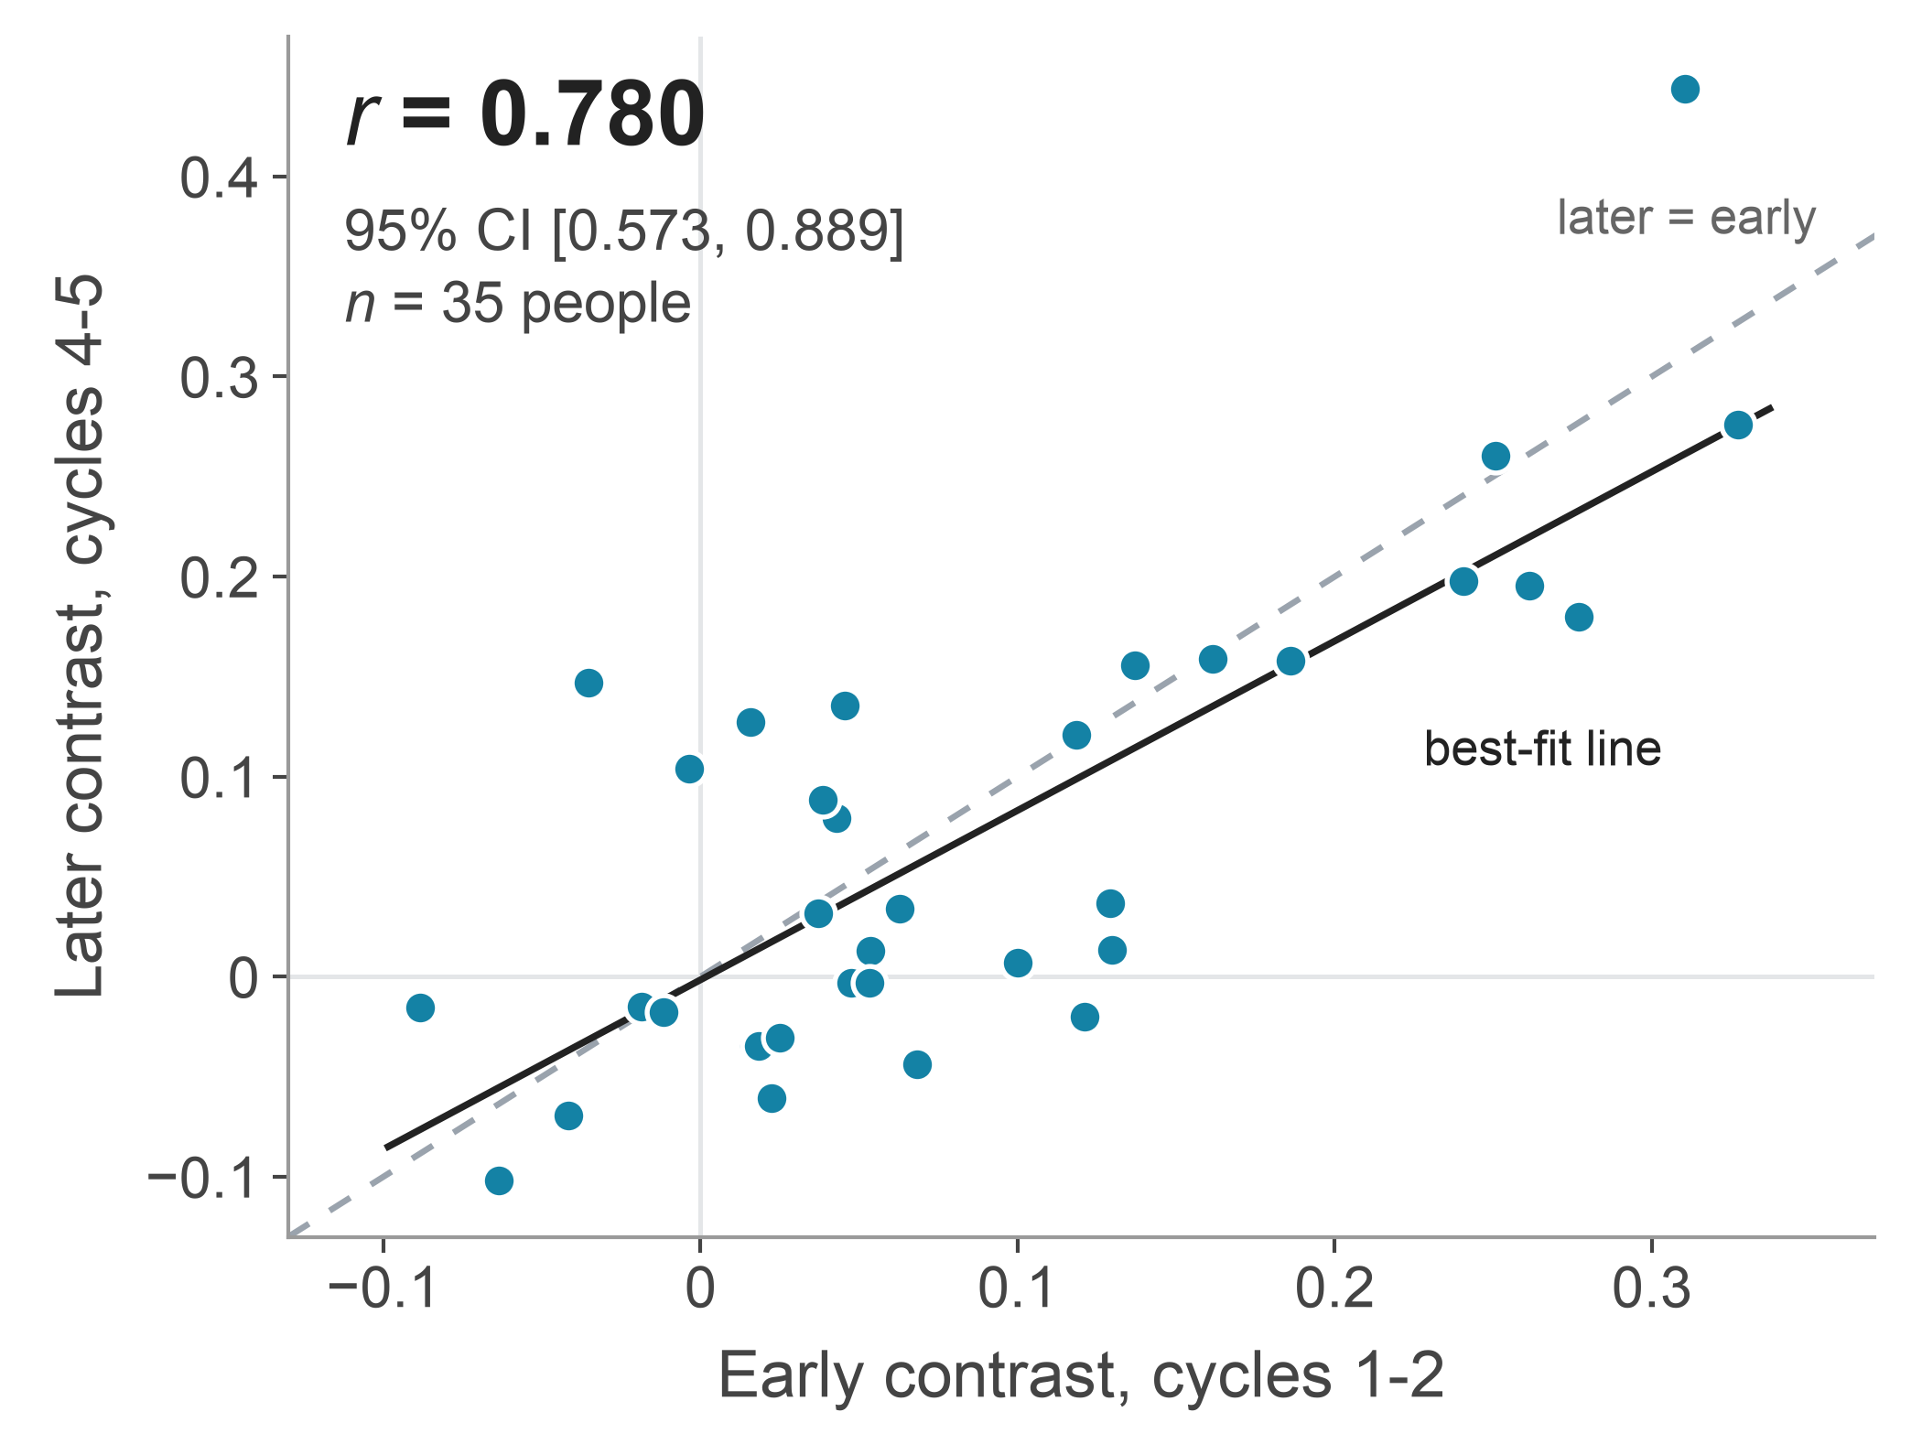
Larger early contrasts correlate with larger later contrasts
Each dot represents one individual.
The rank correlation agrees (Spearman ρ = 0.688).
Lin's concordance is 0.771, so the values agree, not just the order.
The group mean barely moved (-0.015, p = 0.25), but individuals did. 95% limits of agreement: -0.16 to +0.13.
Without the most influential person (top right), r = 0.747.
CI from 50,000 participant bootstrap resamples; p from a paired t-test. Early: cycles 1-2 (0-120 s after the first sound). Later: cycles 4-5 (180-300 s).
Notes:
Each dot is one person. People with a bigger early contrast had a bigger later contrast. The correlation is 0.78, *(pause)* with a 95 percent confidence interval of 0.57 to 0.89.
The dots sit around the dashed line, where later equals early, so it's agreement, not just the same ranking. Individuals still moved around. And no single person drives it: without the most influential point, *(point at the top-right dot)* up here, it's still 0.75.

Slide 6
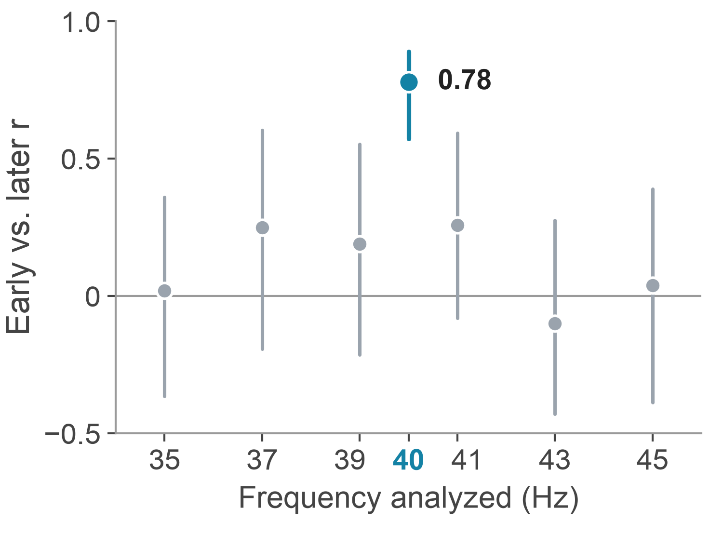
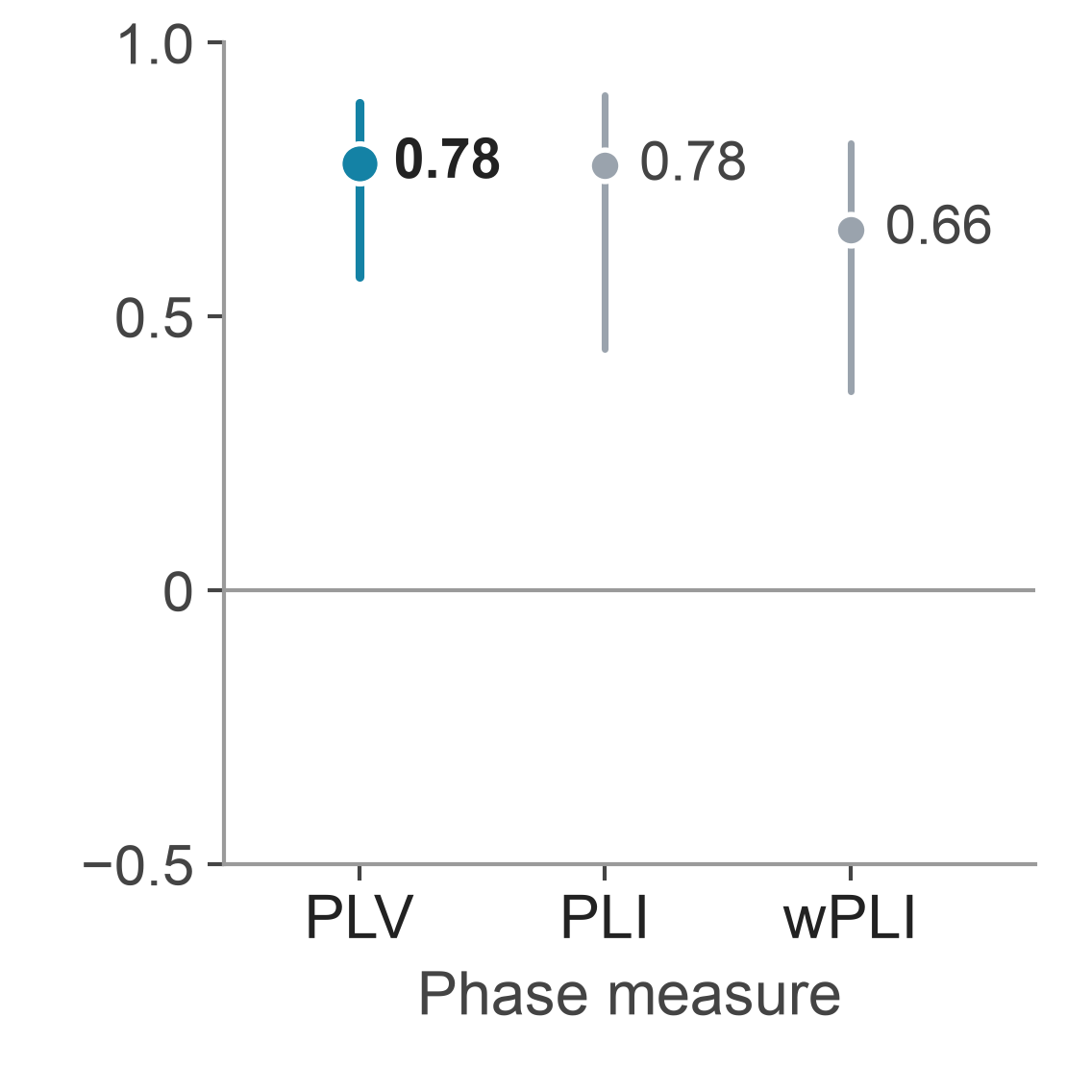
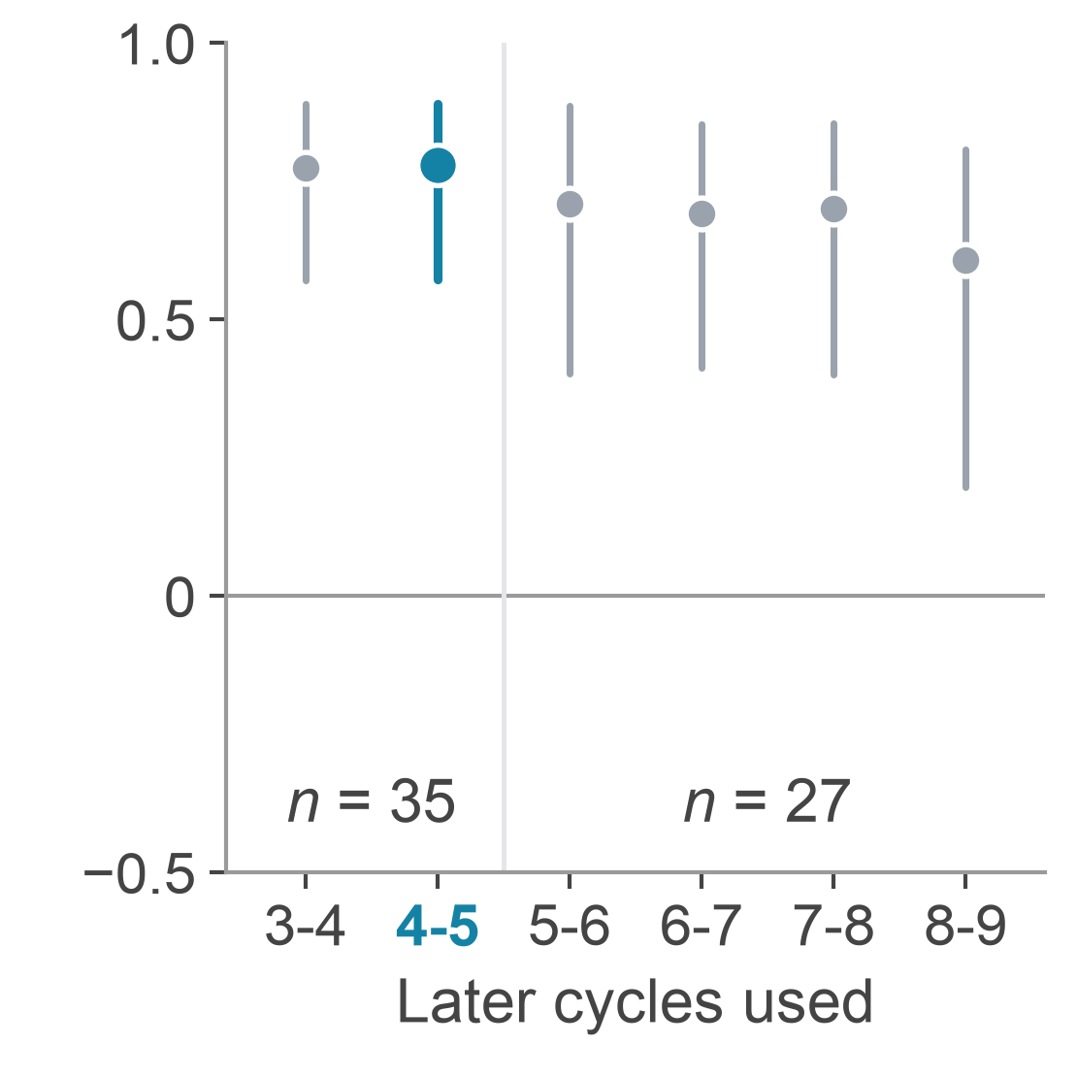
Resilience Testing
Other frequencies
Other phase measures
Other later windows
The six neighbors range from -0.10 to 0.26. The smallest gap from 40 Hz is 0.52 (95% CI 0.08 to 0.65).
PLI and wPLI ignore zero-lag coupling, which one source reaching both electrodes would produce.
Cycles 4-5 gave the highest r. The other five windows gave 0.61 to 0.77, all p < 0.05 after Bonferroni correction.
Dots are early vs. later r with 95% participant-bootstrap intervals; the early window is always cycles 1-2. Cycles 6-9 exist only in the 27 longer sessions. PLI: phase-lag index (Stam et al. 2007). wPLI: weighted PLI (Vinck et al. 2011).
Notes:
Then I tried to break it.
First: anything general about a person's recording would show up at neighboring frequencies too. They show much less: minus 0.1 to 0.26, against 0.78.
Second: PLV can be fooled when one source reaches both electrodes at once. The phase lag index and its weighted version discount that zero-lag part, and still give 0.78 and 0.66.
Third: I picked cycles four and five after looking, and they gave the highest r. The other windows gave 0.61 to 0.77, all significant after correction.

Slide 7
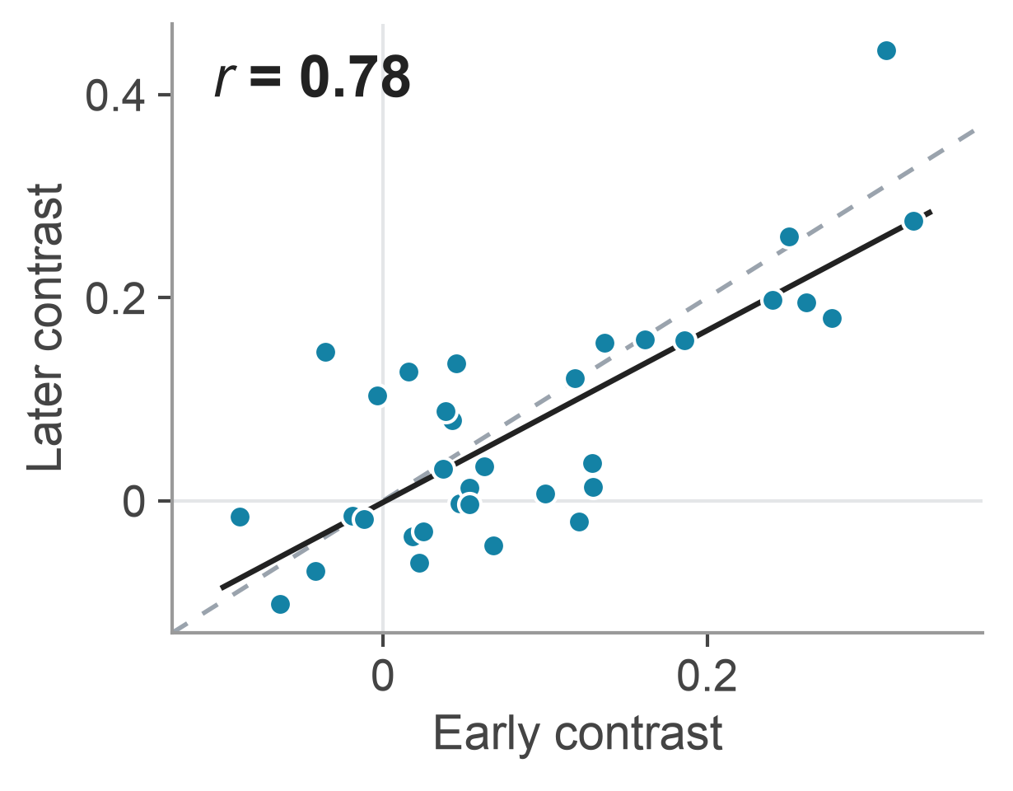
Limitations and further development
The contrast in the first two minutes tracked the contrast 3 to 5 minutes in (r = 0.78), most strongly at 40 Hz.
Limitations
I picked cycles 4-5 after looking at the data.
The EEG was cleaned offline, using whole recordings.
Silence always followed sound, and there was no sham.
Scalp EEG can't rule out a shared response or an artifact.
Next: a preregistered, real-time test with a sham or counterbalanced order.
Data: Lahijanian, Aghajan & Vahabi, OpenNeuro ds005048 (CC0). Thank you to the participants and the dataset authors.
Notes:
So, back to my question: here, the first two minutes did track three to five minutes in. That's enough to justify a prospective test, and no more. I picked the later window after looking, the data were cleaned offline, silence always followed sound with no sham control, and scalp EEG can't rule out a shared response or an artifact. Repeat sessions, guiding stimulation, and clinical benefit are all untested.
Next is a preregistered, real-time test with a sham or counterbalanced order. Thank you.

