Slide 1
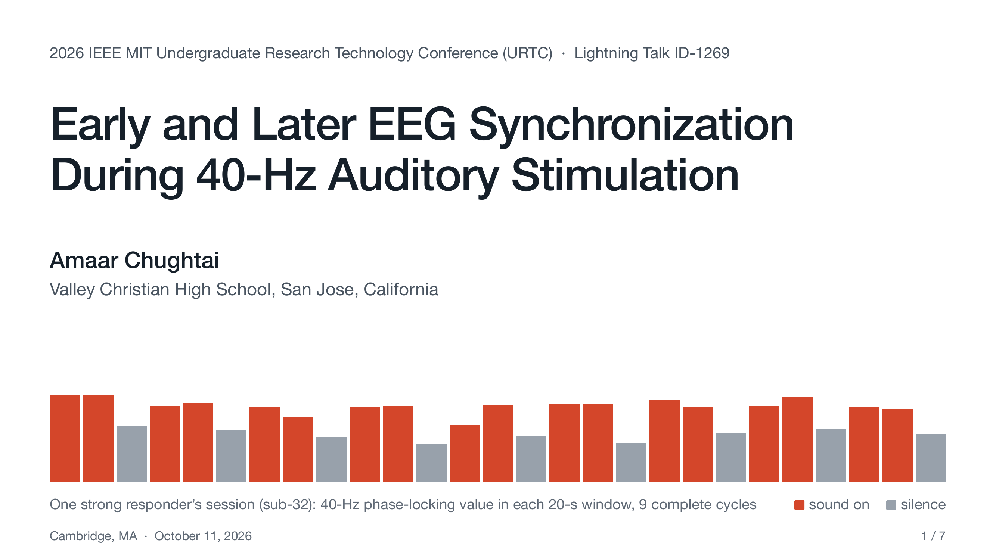
Notes:
Hi, I'm Amaar Chughtai, from Valley Christian High School. My grandmother had dementia, which is how I started reading about 40-hertz sound. The bars are one strong responder's session: red is sound, gray is silence.

Slide 2
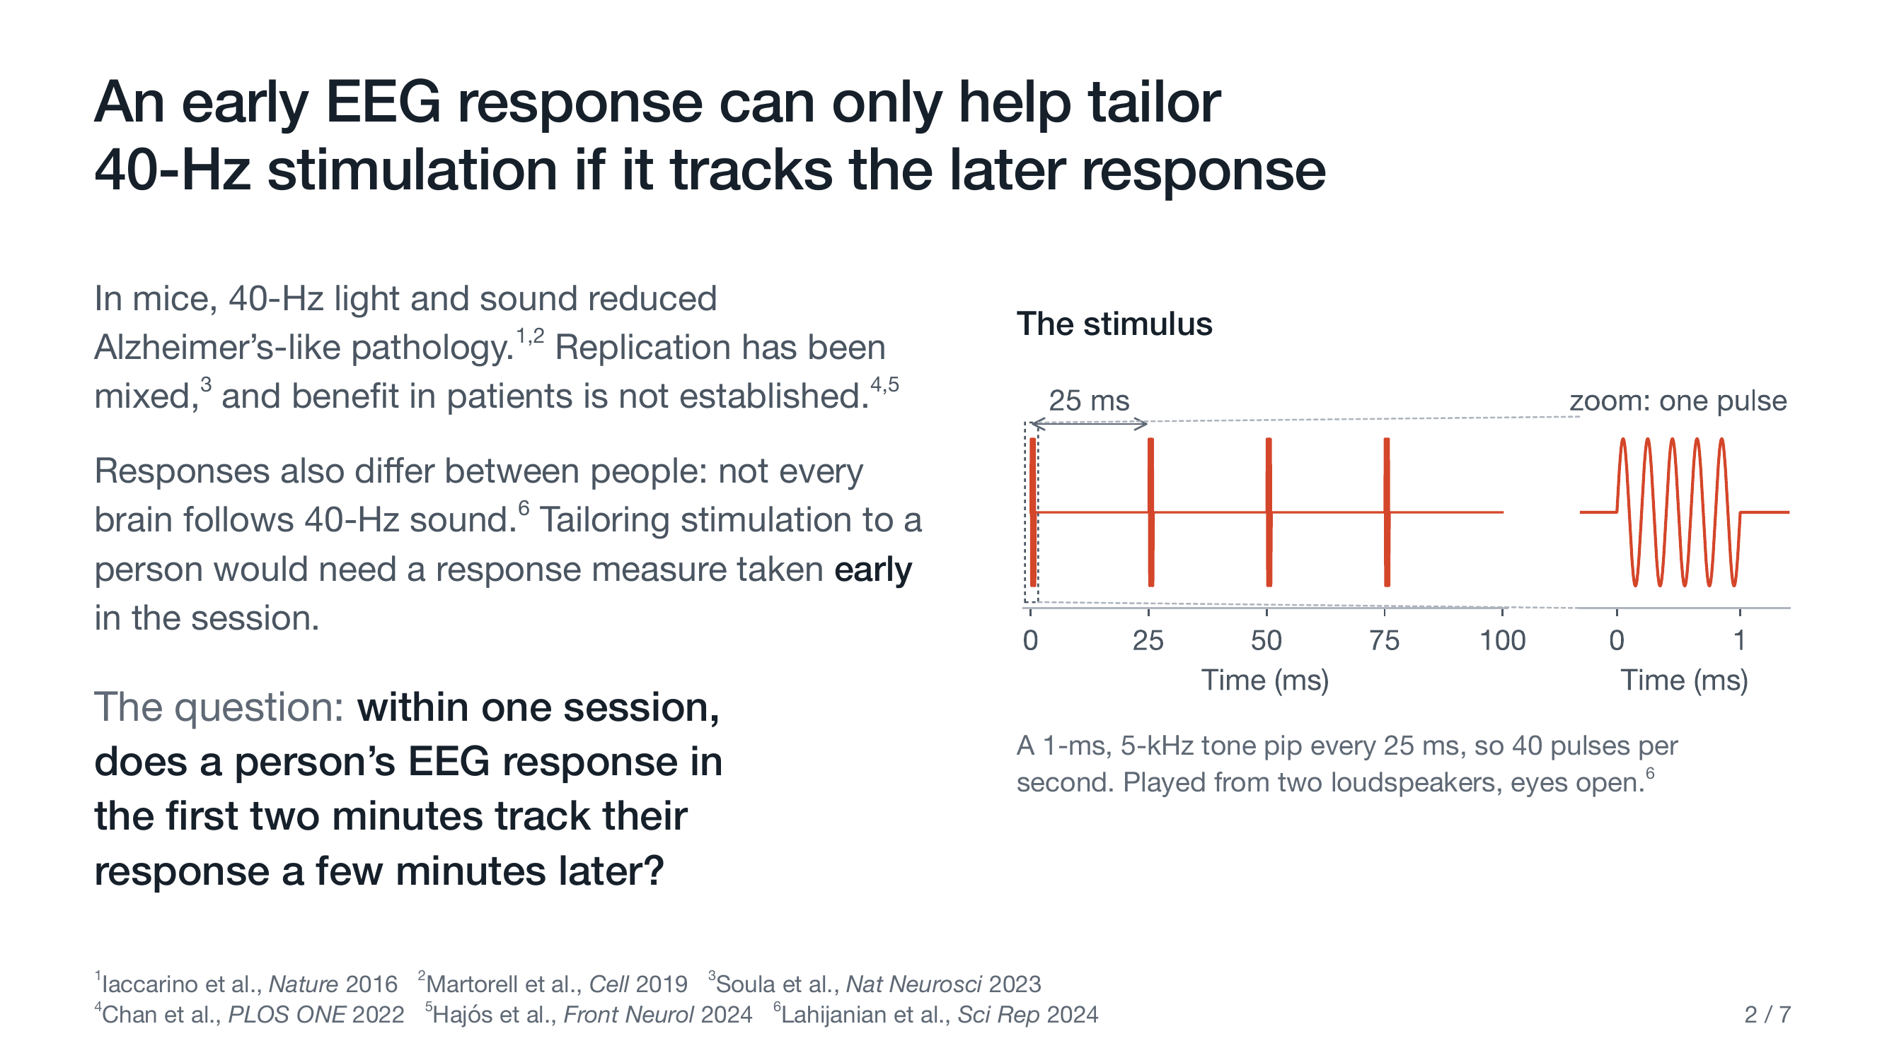
Notes:
This is the stimulus: a one-millisecond beep, forty times a second. In mice, 40-hertz light and sound reduced Alzheimer's-like pathology. But replication has been mixed, and benefit in patients hasn't been established.
And some brains barely follow the sound. To tailor stimulation to a person, you'd have to decide while the session is still running.
So my question: within one session, does the response in the first two minutes track the response a few minutes later?

Slide 3
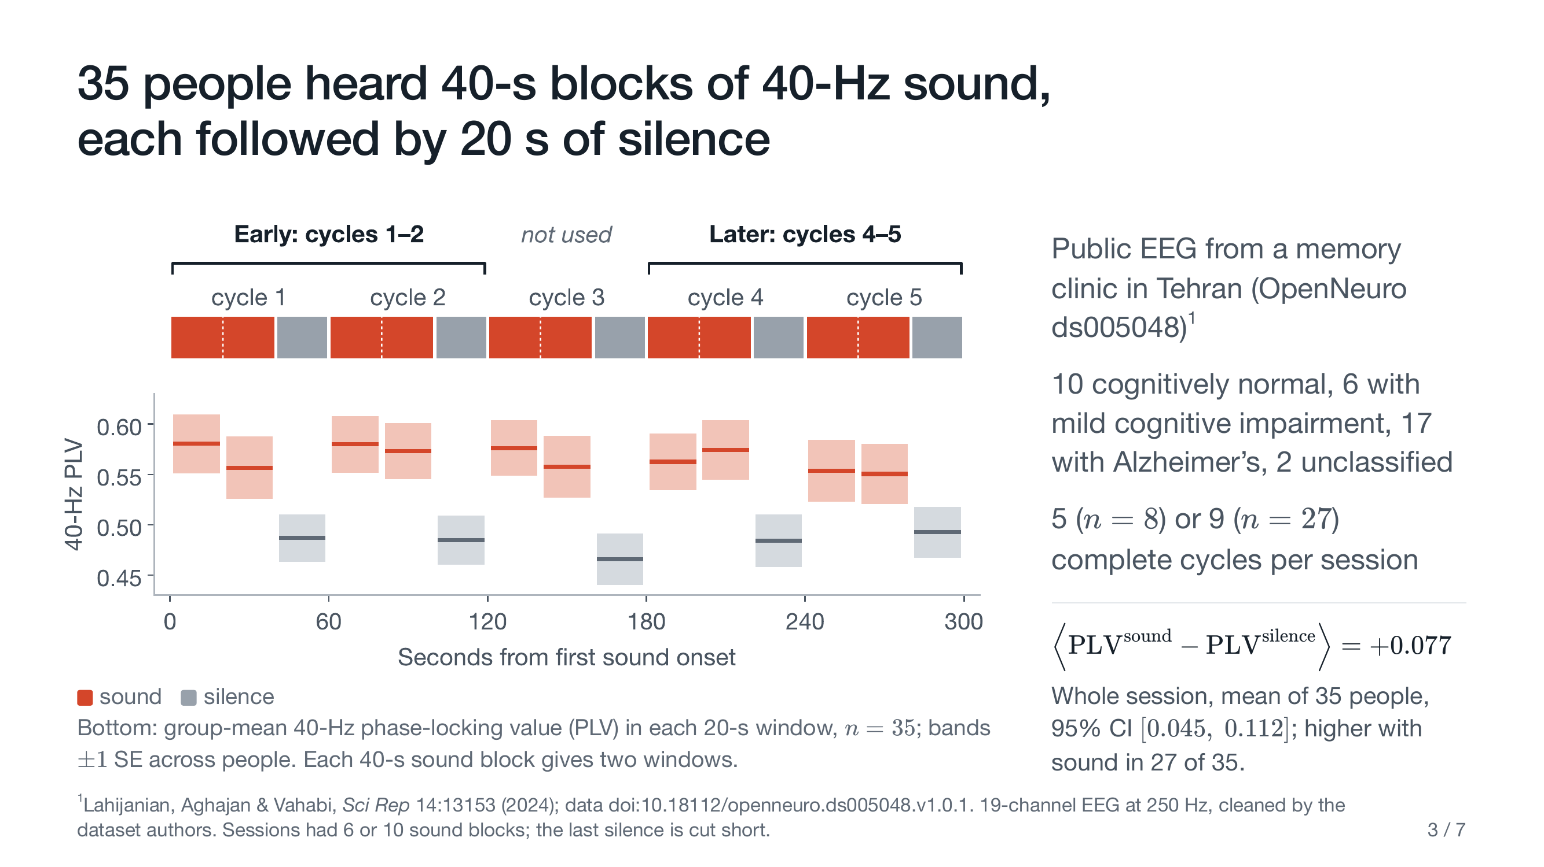
Notes:
I used public EEG from 35 people referred to a memory clinic, about half with Alzheimer's. Each cycle is 40 seconds of sound, then 20 of silence. In every cycle shown, the group's synchronization is higher with sound than in the silence after.
Eight people had only five full cycles. So I compared cycles one and two, the first two minutes, with four and five, the latest pair everyone has, and left cycle three out so the two windows never touch.

Slide 4
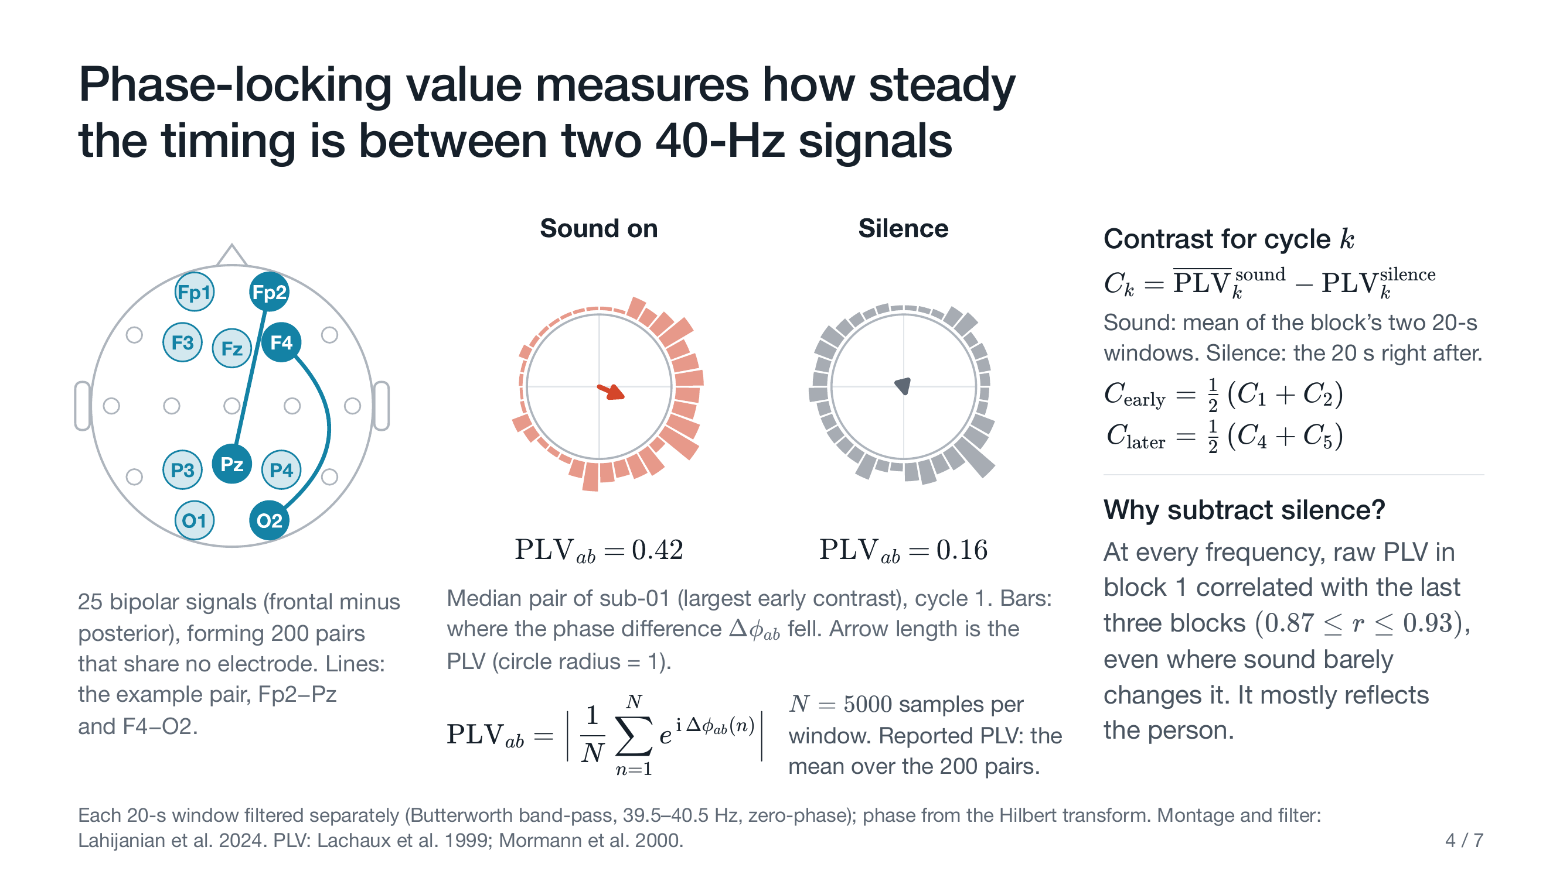
Notes:
Each signal is one frontal electrode minus one posterior electrode, like the two lines on this head. *(point at the head)* I filter both around 40 hertz and track their timing difference.
The bars show where that difference landed. With sound, it piles up on one side; in silence, it spreads around. Make each moment an arrow and average them: arrows that agree give a long average, near one; scattered arrows, near zero. That length is the phase-locking value: point four two versus point one six. I average it over 200 pairs that never share an electrode.
Then I subtract silence from sound, cycle by cycle. That's the contrast, C. Why subtract? Raw PLV correlates early to late at every frequency, even where the sound barely changes it, so it mostly describes the person. Subtracting their own silence removes most of that.

Slide 5
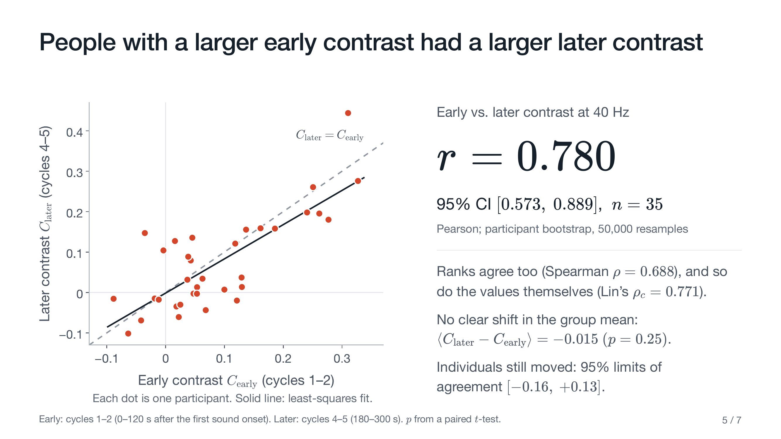
Notes:
Each dot is one person. People with a bigger early contrast had a bigger later contrast. The correlation is 0.78, *(pause)* with a 95 percent confidence interval of 0.57 to 0.89.
The dots sit around the dashed line, where later equals early, so it's agreement, not just the same ranking. Individuals still moved around. And no single person drives it: without the most influential point, *(point at the top-right dot)* up here, it's still 0.75.

Slide 6
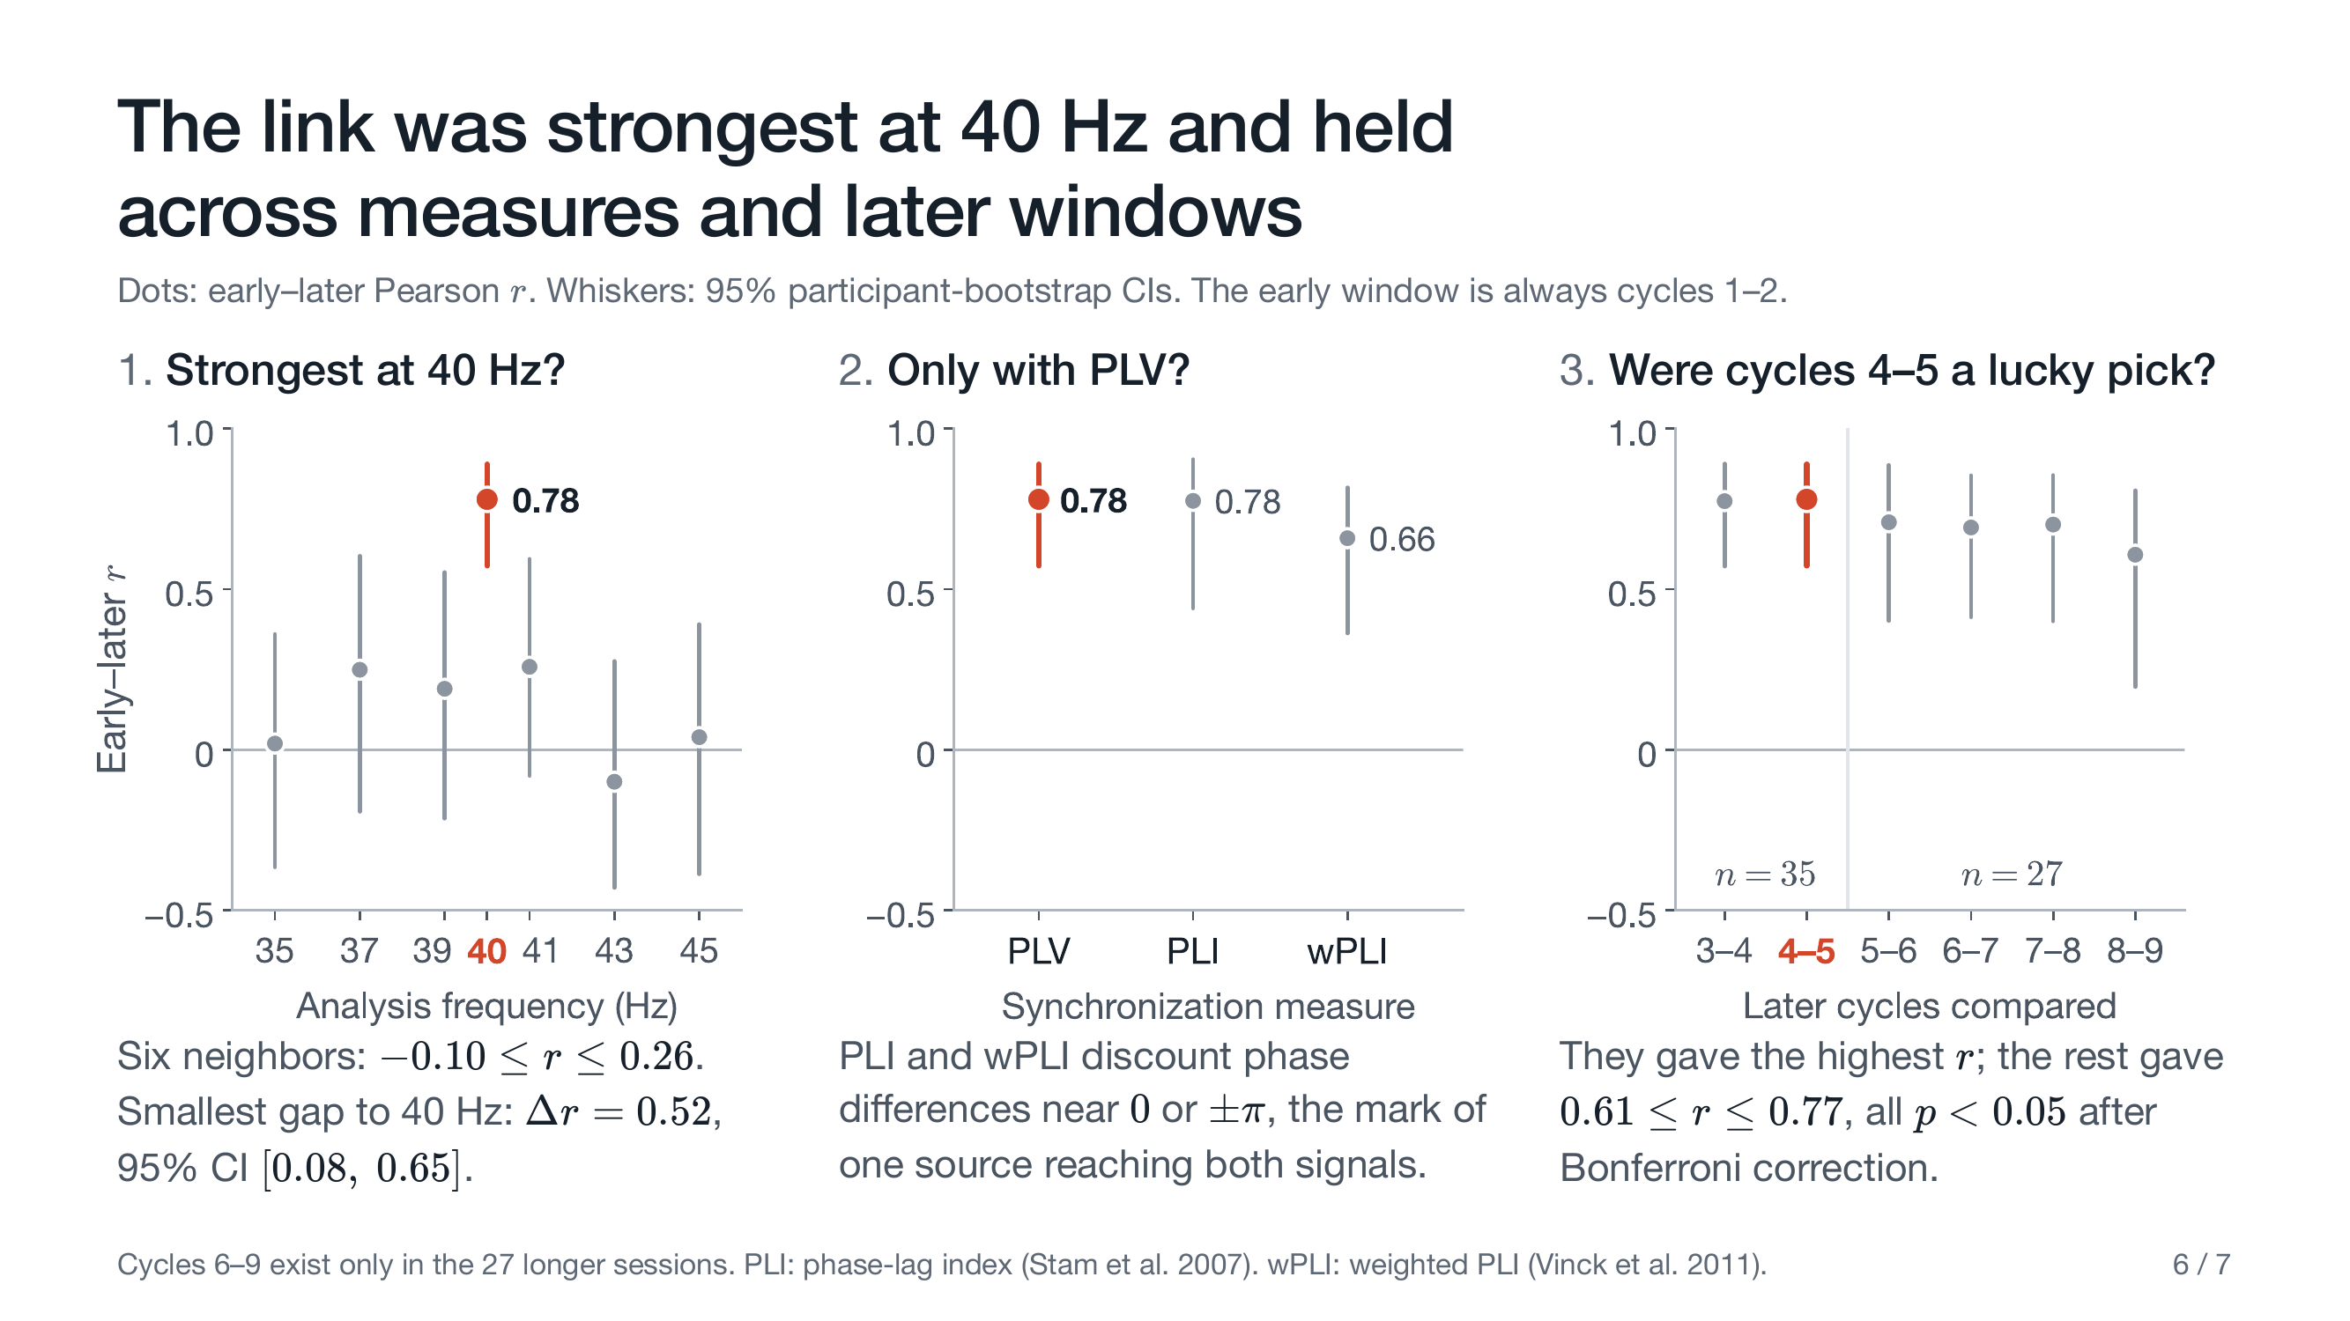
Notes:
Then I tried to break it.
First: anything general about a person's recording would show up at neighboring frequencies too. They show much less: minus 0.1 to 0.26, against 0.78.
Second: PLV can be fooled when one source reaches both electrodes at once. The phase lag index and its weighted version discount that zero-lag part, and still give 0.78 and 0.66.
Third: I picked cycles four and five after looking, and they gave the highest r. The other windows gave 0.61 to 0.77, all significant after correction.

Slide 7
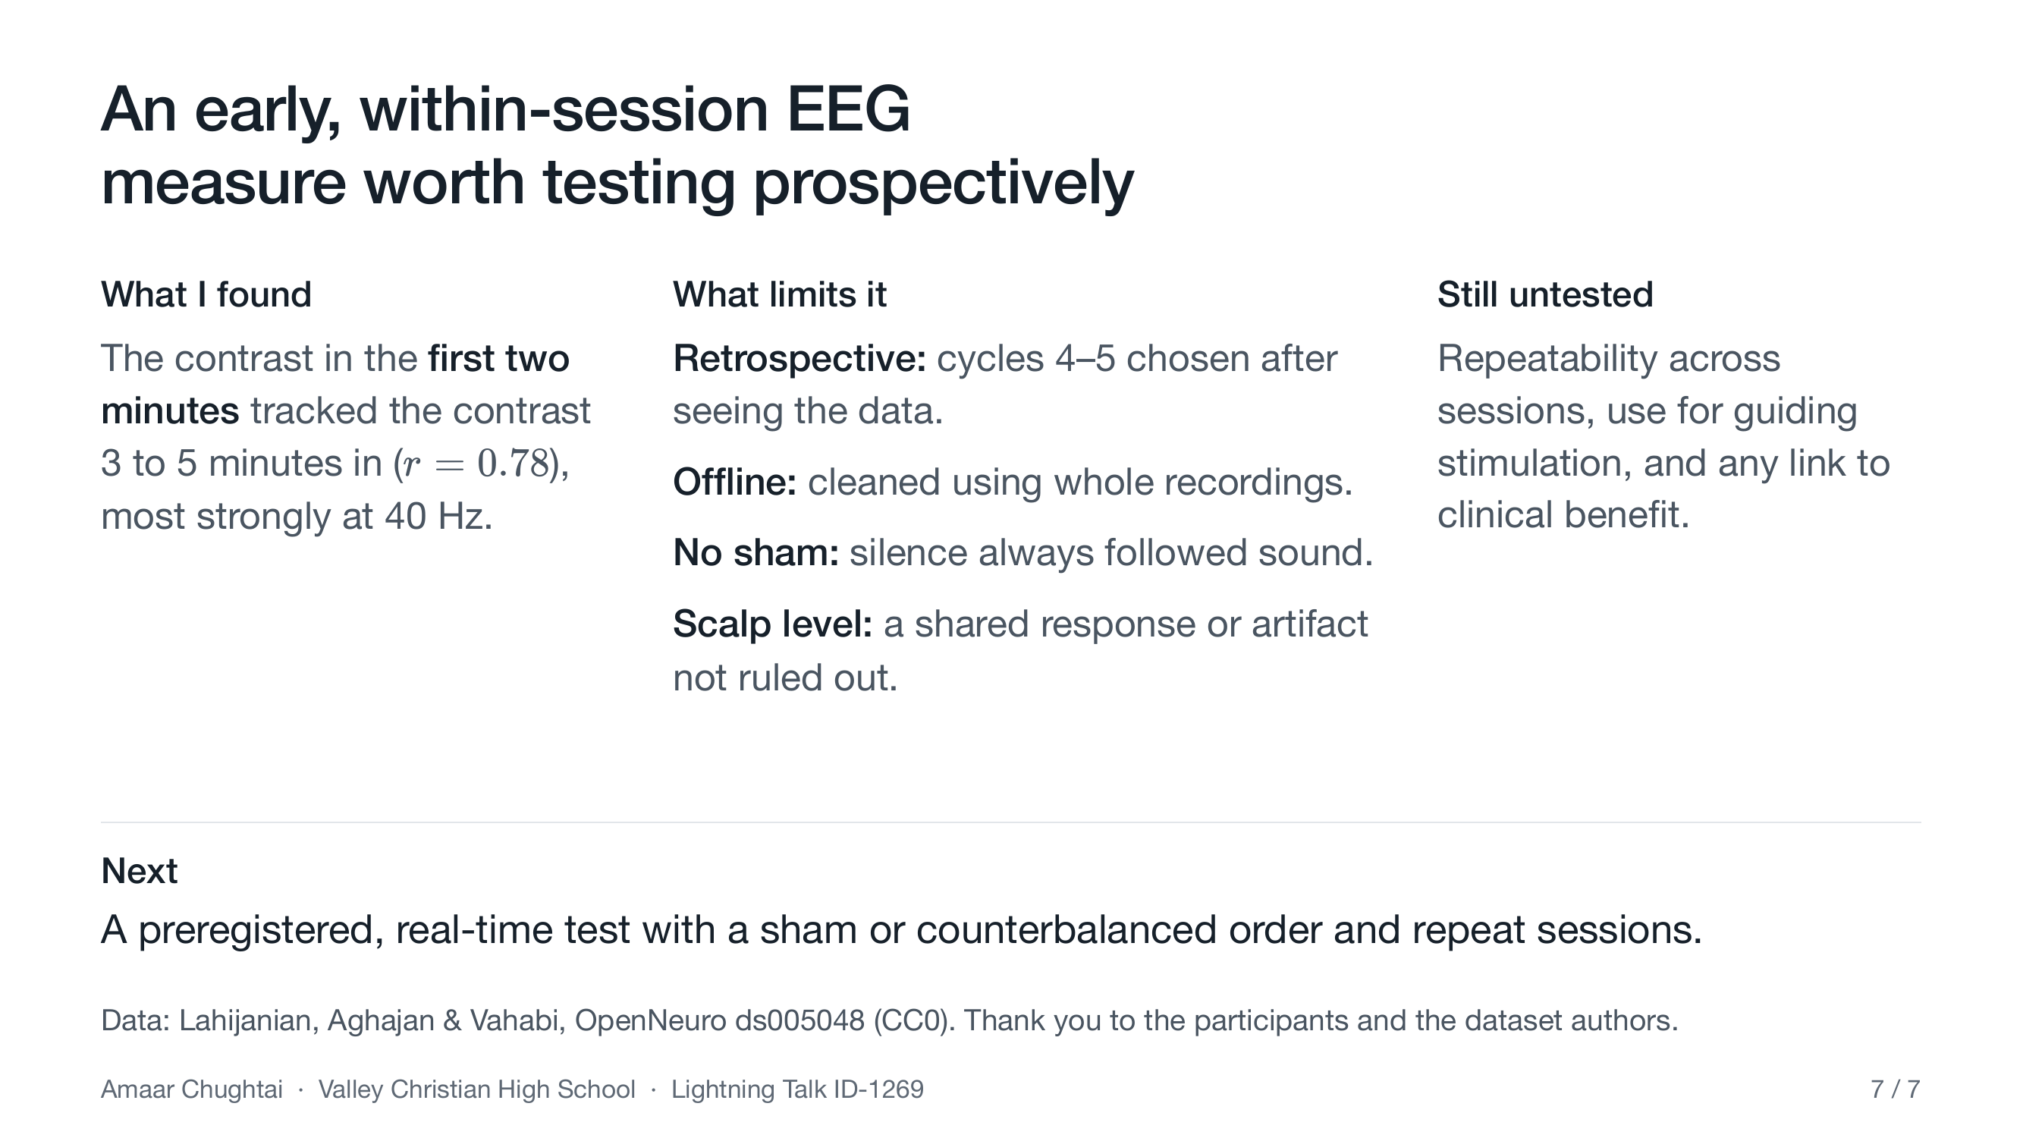
Notes:
So, back to my question: here, the first two minutes did track three to five minutes in. That's enough to justify a prospective test, and no more. I picked the later window after looking, the data were cleaned offline, silence always followed sound with no sham control, and scalp EEG can't rule out a shared response or an artifact. Repeat sessions, guiding stimulation, and clinical benefit are all untested.
Next is a preregistered, real-time test with a sham or counterbalanced order. Thank you.

