Slide 1
Restaurant order analysis
What two years of order data does — and doesn't — tell us
Order-level transaction study | Prepared for stakeholder review

Slide 2
THE BUSINESS
Two years of orders, at a glance
100
16,658
$332K
customers
orders placed
total revenue
Every one active and ordering throughout the full period
Jan 2022 - Dec 2023, across 5 menu categories
Averaging roughly $13,800 in revenue per month
This deck covers what's driving revenue today, and whether we can predict tomorrow's best customers.
2

Slide 3
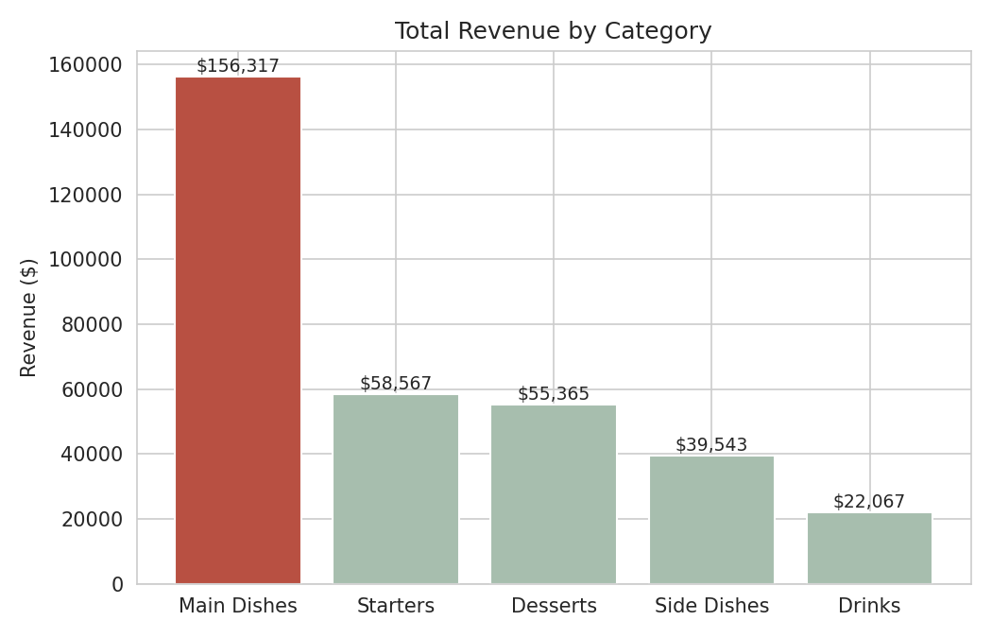
REVENUE MIX
Main Dishes carry the business
47%
of all revenue comes from Main Dishes — more than Starters, Desserts, and Side Dishes combined
Takeaway: menu, staffing, and inventory priorities should weight toward Main Dishes.
3

Slide 4
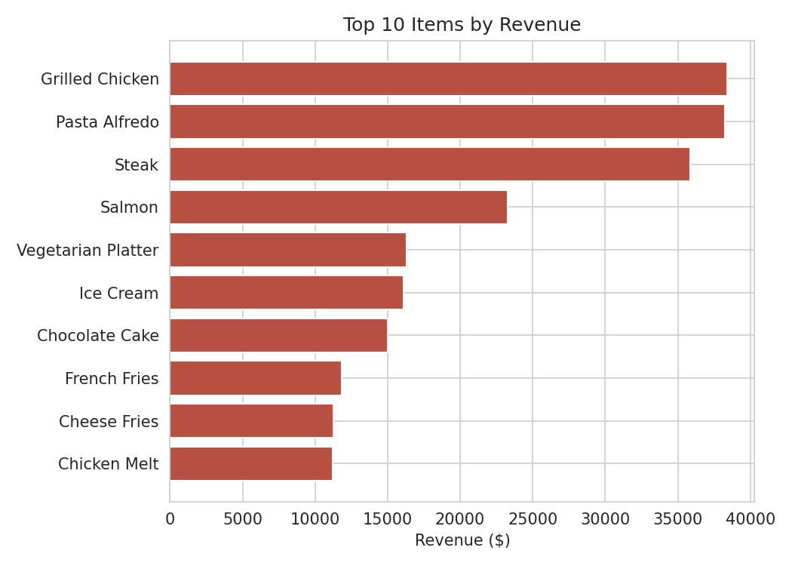
BEST SELLERS
Three dishes anchor the menu
$38,382
Grilled Chicken
$38,227
Pasta Alfredo
$35,849
Steak
These three items alone generated over $112,000 -- about a third of total revenue.
4

Slide 5
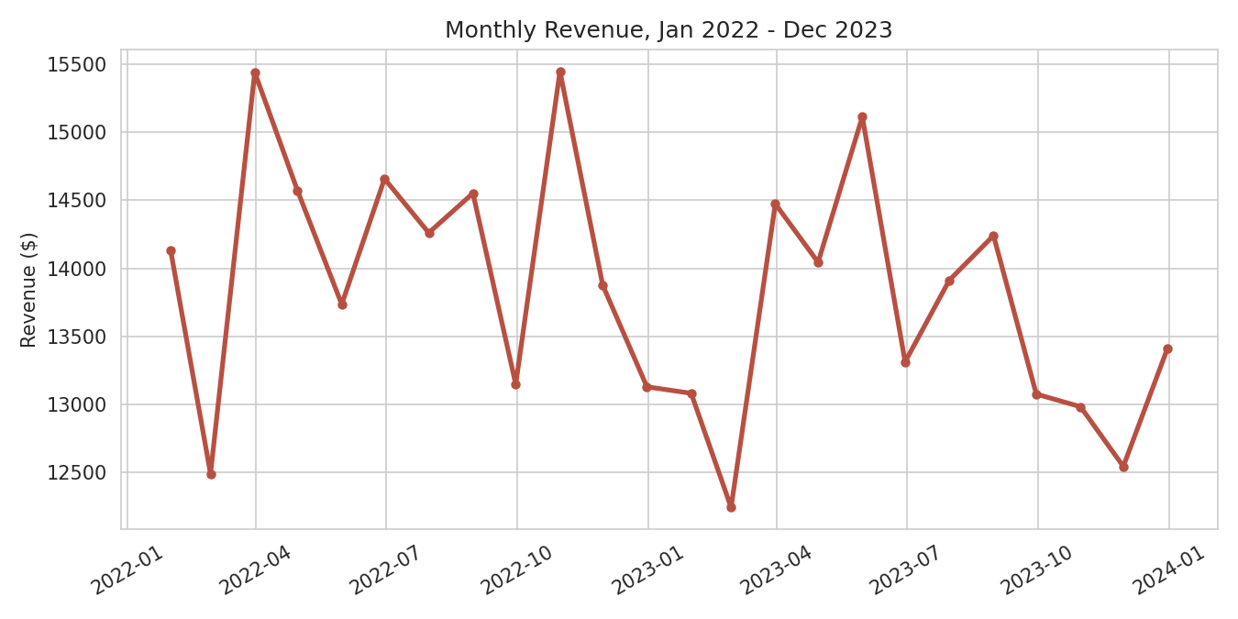
TREND
Revenue is stable, not growing
Monthly revenue has oscillated between roughly $12,200 and $15,400 for two straight years, with no sustained upward trend or clear seasonal pattern.
5

Slide 6
THE QUESTION WE TESTED
Can we spot next year's best customers, early?
Using each customer's first-year (2022) ordering behavior, we tried to predict who would land in the top 30% of spenders in year two (2023).
Note: a churn model didn't fit this data -- every customer ordered within the last 20 days of the dataset, so there's no inactive segment to detect. This was the right question for the data we actually have.

Slide 7
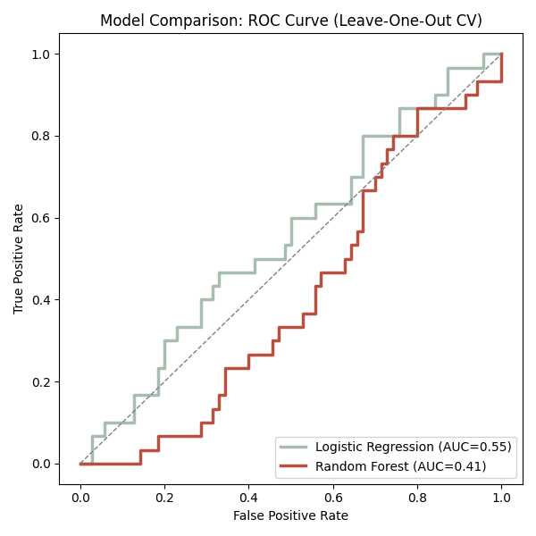
RESULT
The honest answer: not reliably
0.10
correlation between a customer's 2022 revenue and their 2023 revenue -- essentially none
0.55
best model's accuracy score (ROC-AUC) -- barely better than a coin flip (0.50)
Year-one spending does not reliably predict year-two spending in this customer base.
7

Slide 8
WHY IT MATTERS
A null result is still a useful result
Don't target a "future VIP" program on this data
The model isn't accurate enough to act on -- using it would misdirect loyalty spend toward the wrong customers.
Customer value looks close to random year-to-year
This itself is worth investigating -- it may mean spending is driven by factors this data doesn't capture.
The fix is better data, not a better model
Party size, promotions, feedback, and loyalty engagement would likely carry more signal than order history alone.
8

Slide 9
RECOMMENDATIONS
Where to go from here
1
Act on what's solid today
2
Investigate the flat revenue trend
Weight menu, staffing, and inventory decisions toward Main Dishes and the top 3 items.
Two years without growth is a marketing and demand question, independent of customer scoring.
3
Expand what you track per customer
4
Re-test the model once richer data exists
Add party size, promo exposure, and feedback data before attempting value prediction again.
The method (LOOCV, logistic regression) is sound -- it just needs more informative inputs.
9

Slide 10
Bottom line
The menu tells a clear story. The customers don't -- yet.
Main Dishes and three signature items drive the business today. Predicting tomorrow's best customers will take richer data than order history alone provides.
Analysis based on the uploaded order data (Clean_data.xlsx), Jan 2022 - Dec 2023.

