Slide 1

CERBERUS
IEEE HOST 2023 - SCS

Slide 2
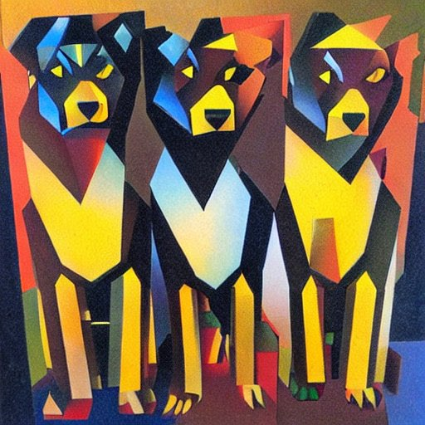
Approach
Convolutional Neural Network
Small training set -> short training length
Significant input image processing to maximize features

Slide 3
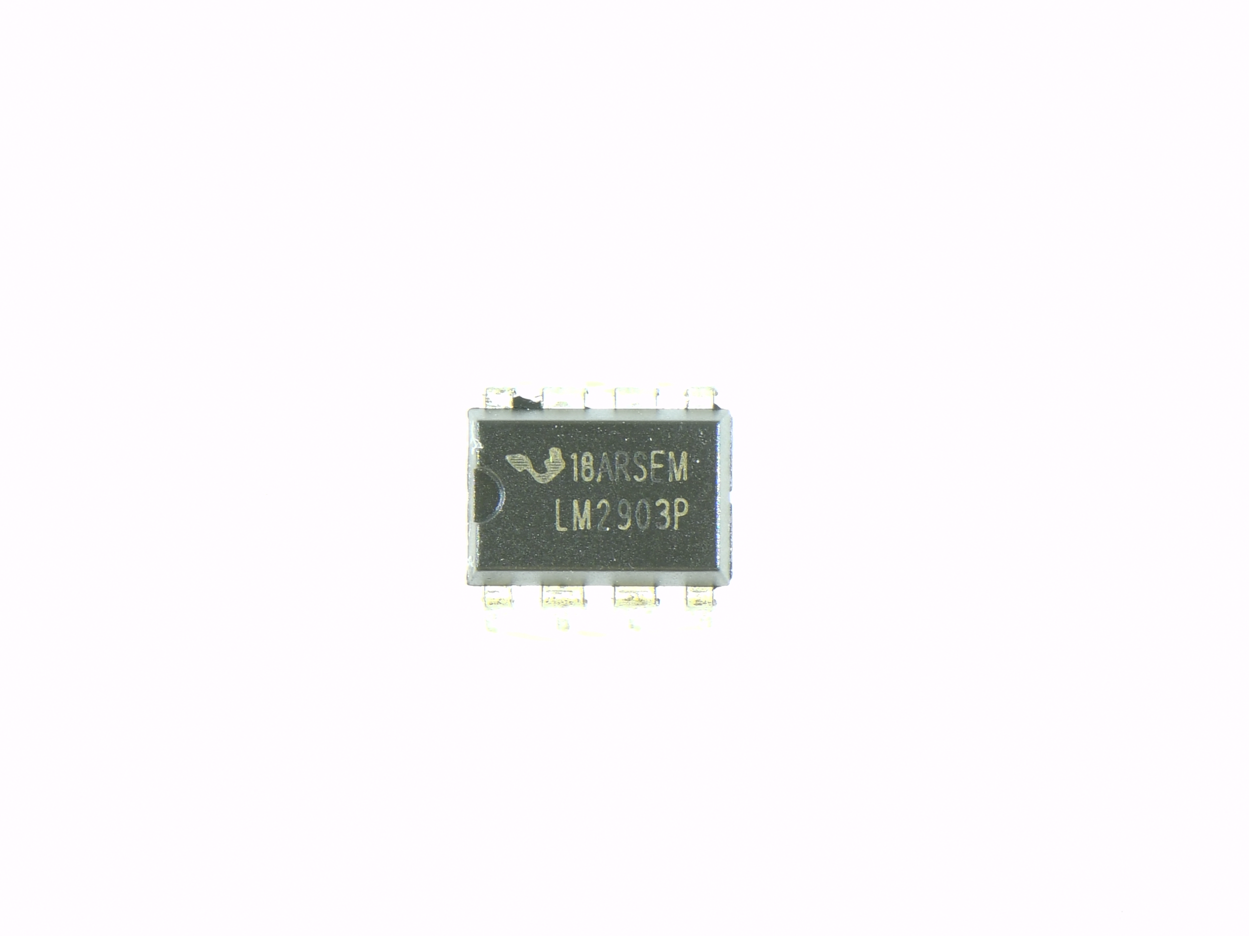
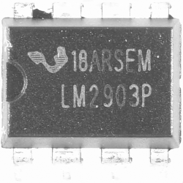
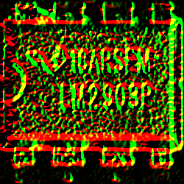
Methodology 1) Image processing
2. Output (feature extraction) – taken from Laplacian (blue), SobelX (green) and SobelY (red)
2. Whitespace Removal
and size reduction
1. Original Image

Slide 4
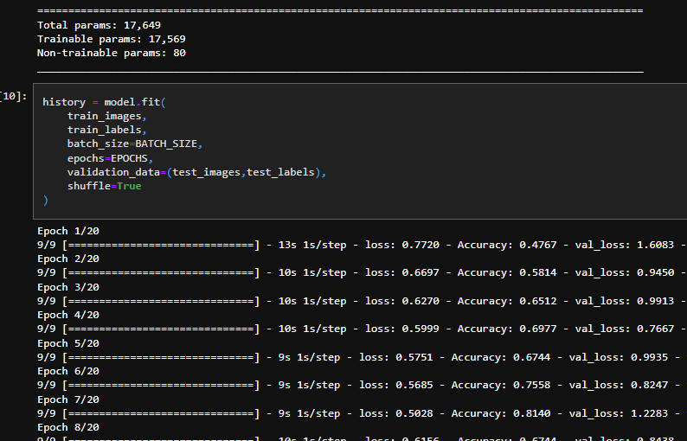
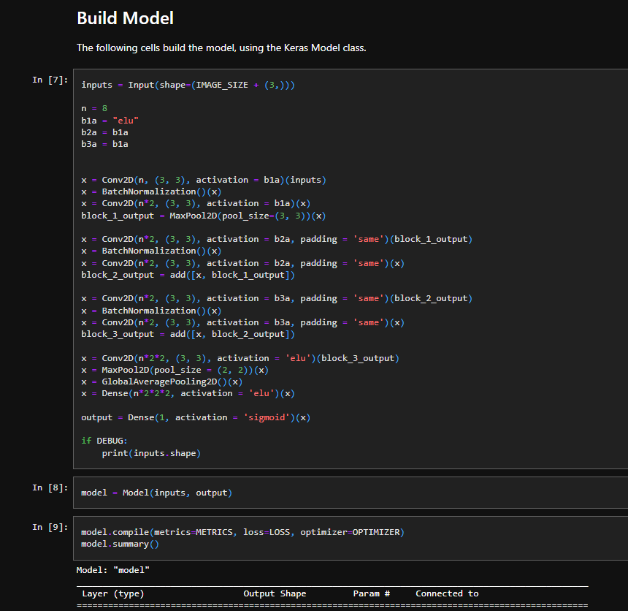
Methodology 2) Modeling
2. Training
We ran until we yielded a model with similar accuracy on both the training and validation sets with reasonable loss values. Our submitted model had accuracy in the 60-65% range for both sets.
1. Model definition

Slide 5
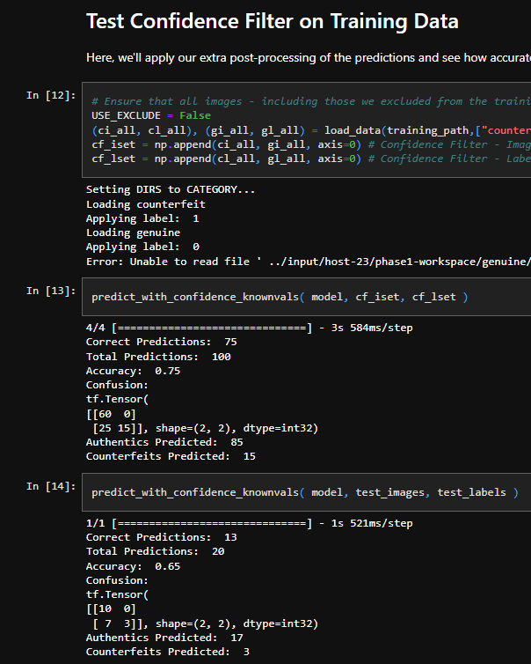
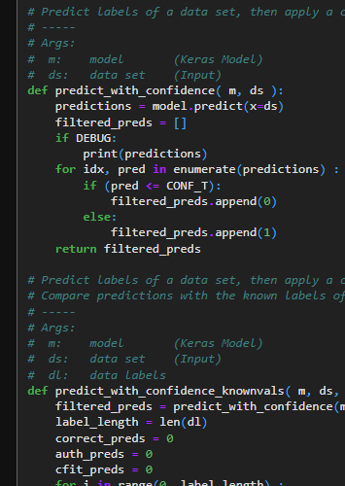
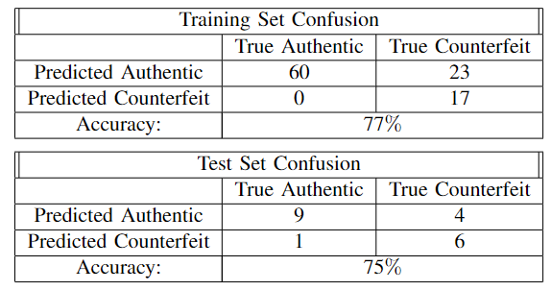
Results
The trained model is tested; accuracy is measured on its predictions for both the training and test (validation) sets.
Our final model predicts 92 of 120 labels correctly, achieving a total accuracy of ~76%
Note: this is not from the run that produced our final model

Slide 6
Discussion
Model produces more false-negatives than desired
Could be improved with:
More data
Better image preprocessing
More tinkering with the model
Creation of more specific models (e.g. front/back of chip)

