Slide 1
Sales in Stormy Weather
Zach Aldrich, Bonnie Daniel, Alec Grubbs, Nate Lurie, Suraj Tata Prasad, Francisco Sananez

Slide 2

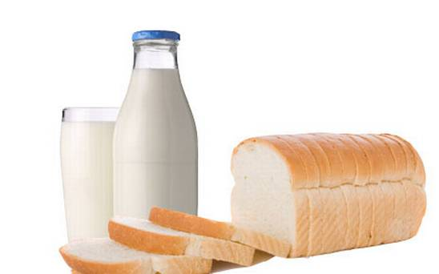
Research Objective
Primary Objective
Create a model that accurately predicts the sales of 111 products that have been designated as potentially weather-sensitive across 45 Walmart stores.
Products include:
Umbrellas
Bread
Milk
Etc.
Secondary Objective
Create a series of metrics that consolidate weather variables in order to simplify the representation of major weather events for the purpose of improving the final models predictive ability

Slide 3
Methodology
Data Preprocessing/ Feature Selection
SQL Database – combine all tables into single workable format
PCA & Lasso – determine key weather features important in predicting product sales
Weather Data Training
Develop metrics aimed to quantitatively represent major weather events
Needed to create lag variables to understand how a weather forecast for major weather events tomorrow effects sales of certain products today.
Combine selected features from PCA & Lasso with developed weather metrics into a new revised dataset
Use the new dataset to train a variety of supervised models and determine the single model with the greatest predictive ability via out of sample test set validation.

Slide 4
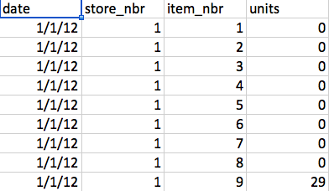
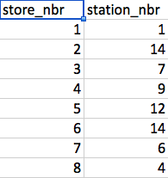
Datasets
Store Data
Date
Store Number
Actual store number masked
Product Item Number
Actual Products masked
Units sold
Store-Weather Link Data
Store Number
Actual store number masked
Weather Station Number

Slide 5

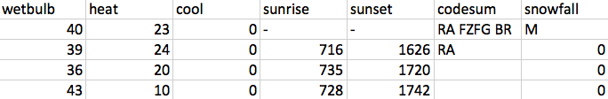

Datasets
Weather Data
Detailed weather data for a specific date at each weather station\
PDF to feature meaning and categorical value reference guide found HERE:

