Slide 1
Visualization of Animal Overcrowding in Austin
Created by: Addison Machann

Slide 2
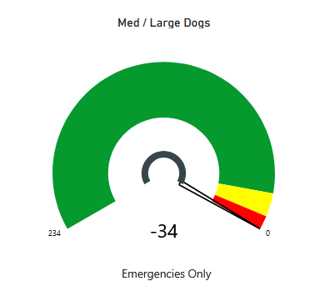
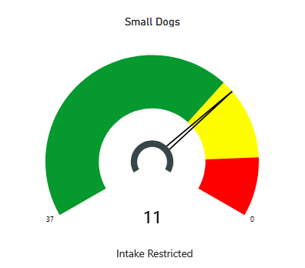
Problem Statement
Despite best efforts, shelters across the nation, including the municipal Austin Animal Center, are continuing to overflow because of animal overcrowding. This results in an increase in injured animals, people, and early behavioral or time/space euthanasia scenarios.
Current Capacity State
of Austin Animal Center
(as of 12/14/2024):

Slide 3
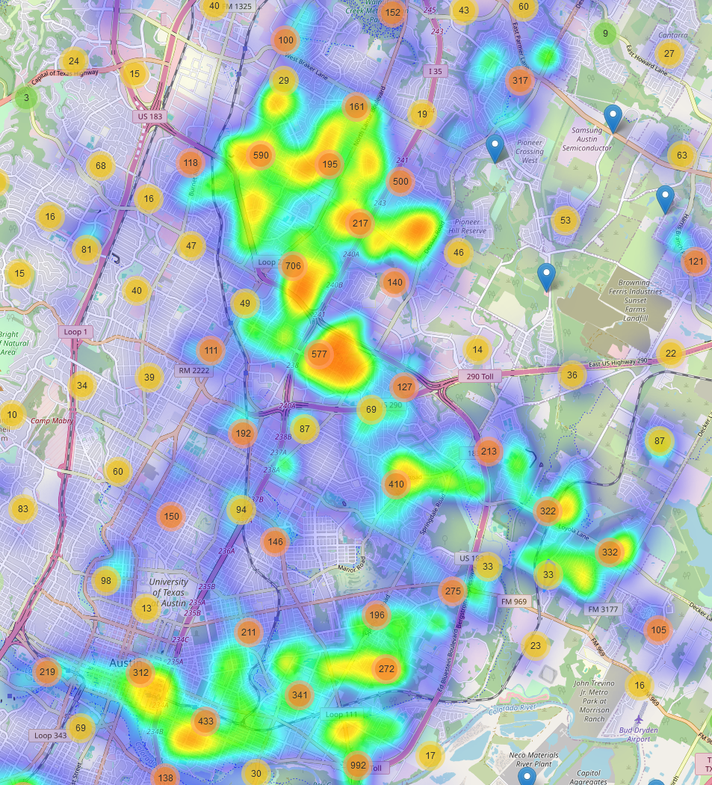
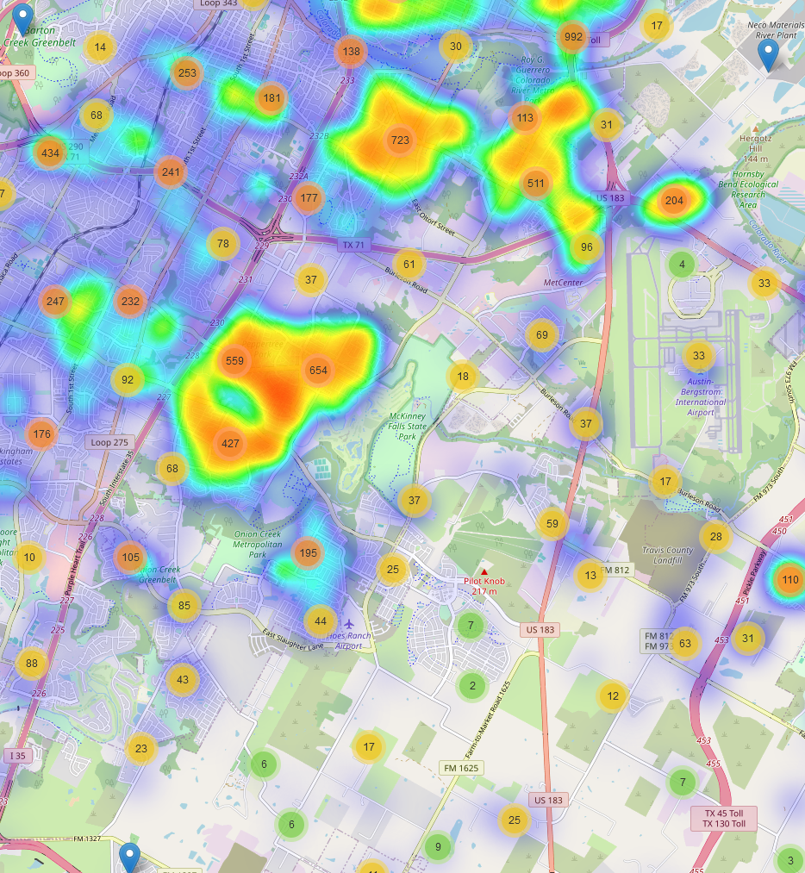
Mapping
Left Map:
Indicates a severe overcrowding of animal intakes surrounding downtown and North Central Austin.
Right Map:
Indicates equally extreme overcrowding of animals in South Central Austin and certain residential zones South of TX-71.

Slide 4
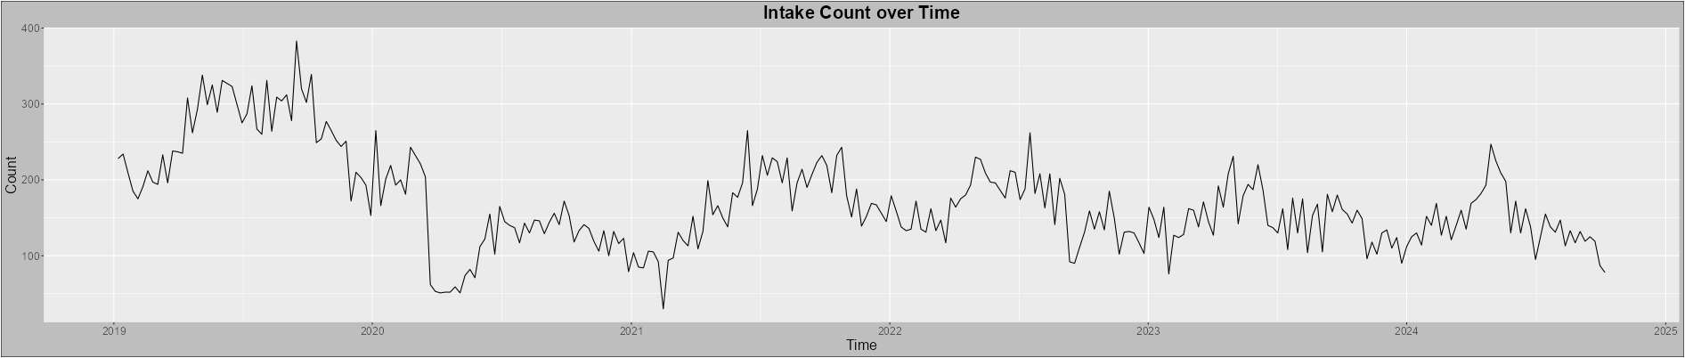
Intake Variation over Time
Trends and Observations:
Spikes in weekly intake count starting around April and May and typically ending by August.
Troughs in count starting around November and lasting until February or March.
Significant drop in intake count starting around March 2020:
Indicates a likely correlation with the start of the COVID-19 pandemic.
Intake counts have yet to return to the levels found prior to this incident.
Weekly intake count fluctuates constantly but has averaged ~150 in recent years.

Slide 5
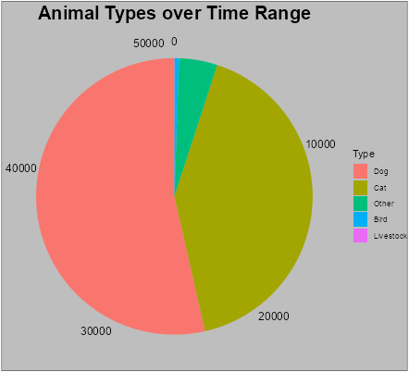
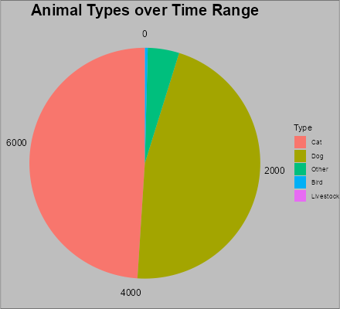
Animal Ratios
Observations:
Most intaken animals are dogs, but cats may lead in certain years.
Other animals like racoons and bats make up a small portion of the total intake.
Birds and livestock take up virtually no intake space.
Figure 1: Range = 01/01/2019-10/14/2024
Figure 2: Range = 01/01/2023-12/31/2023

Slide 6
Conclusion and Recommendations
Animal overcrowding is most certainly a geospatially influenced problem, as evidenced by the significant clustering of high intakes.
Overcrowding is also clearly influenced by the time of year and potentially by significant world events.
Education regarding proper animal welfare and adequate resources for animal care could significantly improve intake numbers.
Subsequently, these resources and education should be prioritized in distribution in high intake density zip codes and during certain times of the year, such as summertime.
An increased crackdown on puppy and kitten mills, as well as dog fighting rings is required to further reduce the number of animals that end up in a shelter like Austin Animal Center.

Slide 7
References
Austin Animal Center Shelter Capacity. (2024, December 14). https://www.austintexas.gov/page/shelter-capacity

