Slide 1


How To Boost Guest Satisfaction In Airbnb
Ashrith Madan
MSBA, University of Washington Tacoma

Slide 2

Agenda
Problem Statement
Data Evaluation
Visual Model
Uncertainty Scenarios
Decision Alternatives
Next Steps

Slide 3

Problem Statement
Travelers on Vacation want to release their everyday stress and look forward to finding a hassle-free environment while on vacation. And there are several essential needs that need to be attended in order to increase their vacation satisfaction. How can it be done?

Slide 4

Data Evaluation
Evaluation Methods:
Linear Programming – to predict customers need for a satisfactory stay
MaxiMax - Calculating cost of replenishing amenities for next customer
MaxiMin - Calculating cost of replenishing amenities for next customer

Slide 5
Data Evaluation
Evaluation Measures:
Amenities that can be provided
Pricing
Service Quality
Food
Experiences to offer

Slide 6
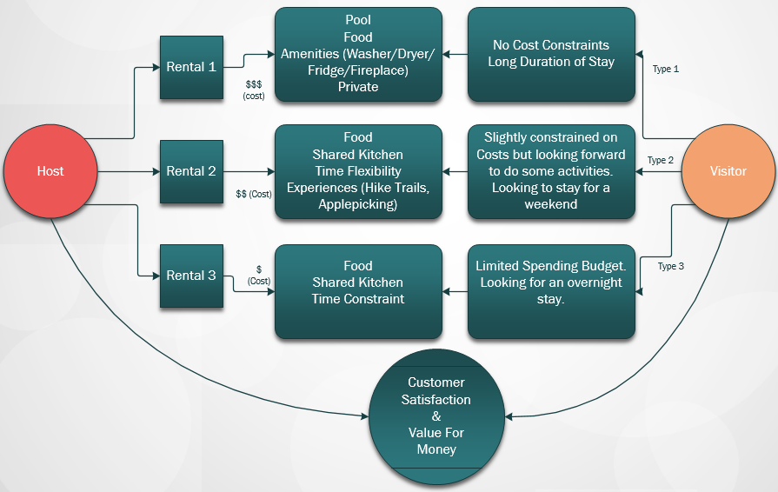
Visual Model

Slide 7
Uncertainty Scenarios
Price Surge
Availability/Missing Amenities
Weather Conditions
Political Environment

Slide 8
Decision Alternatives
Review Data of Other Hosts to make Improvements
Create a suitable place for your guests
Boost their Satisfaction by attending their needs
Get good reviews

Slide 9

Next Steps
Provide Discounts for Returning Visitors.
Finding Their Needs and Try to make it available when the visitor checks in.
Make them feel at home
Provide meaningful Experiences
Be a Super Host

Slide 10
Thank You

