Slide 1
Book2
File created on: 2/25/19 5:14:19 PM EST

Slide 2
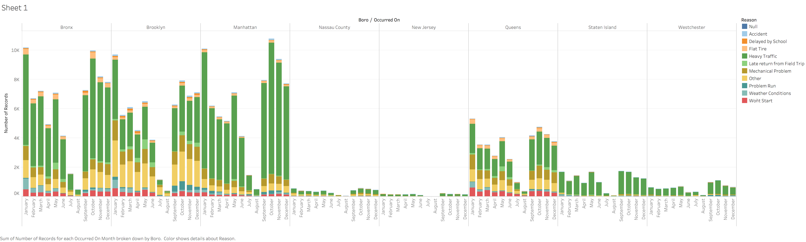

Slide 3
Description of Graph
Summarizes the different factors of delays by month for all bus companies aggregated
We observe that the primary reasoning for bus delays is heavy traffic
This heavy traffic ratio spikes around the winter seasons presumably due to other factors such as weather conditions
Highest traffic ratio also occurs in Manhattan
This makes sense as this is the area of highest breakdowns.

Slide 4
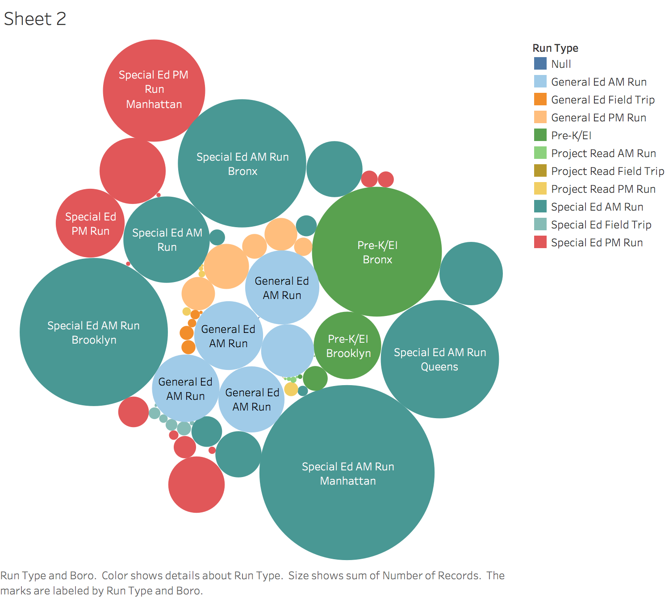

Slide 5
Description of Visual
Most common delays overwhelmingly seem to be involving the transportation of special education children.
With Manhattan again having the biggest bubble but Brooklyn isn’t far behind
Some bubbles are probably smaller just because of sample size. Probably smart to run percentages on these later*

Slide 6
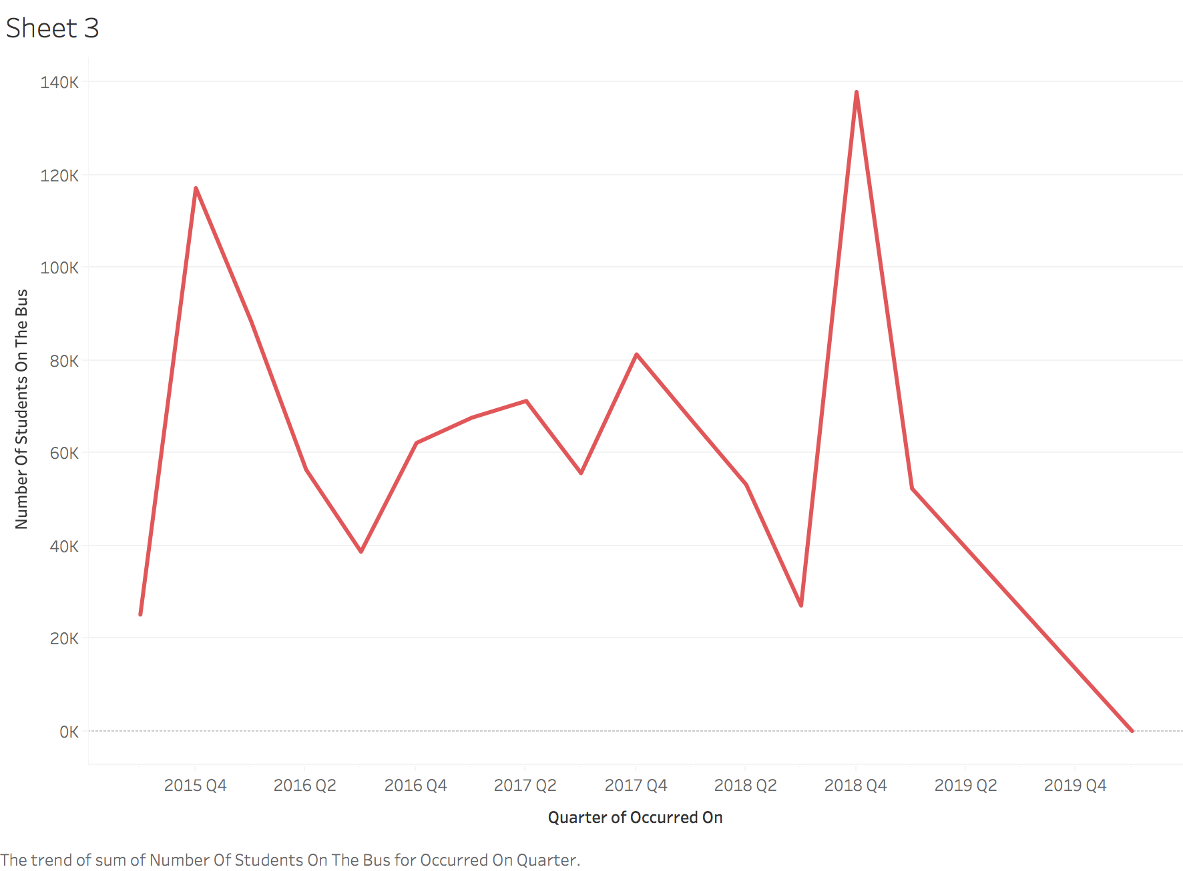

Slide 7
Description of Visual
Slow decrease from 2016 to 2018 which shows that perhaps improvements are being made, but not rapidly enough
* Remember to filter out data for 2019 Q2 and Q4 as the data hasn’t been updated yet

Slide 8
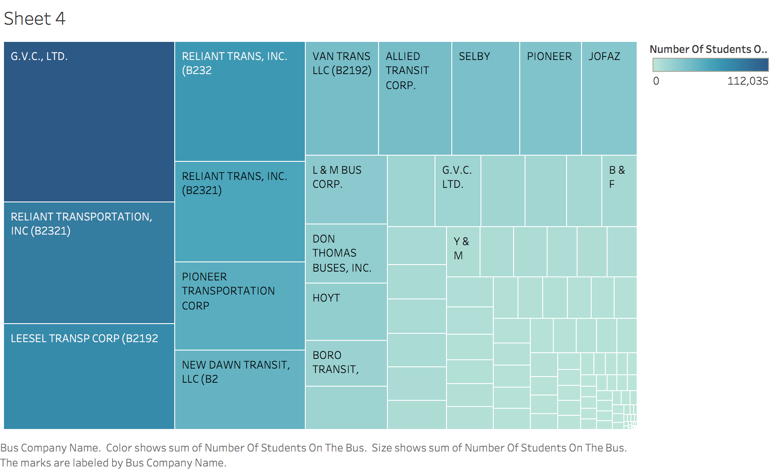

Slide 9
Description Of Visual
Just a simple showing of which bus companies are the most popular

Slide 10
