Slide 1
Java bytecode instrumentation for performance analysis
Nicola Amadio University of Milan Master of Science in Computer Science Supervisors: Alessandra Gorla, Antonio Carzaniga, Mattia Monga

Slide 2
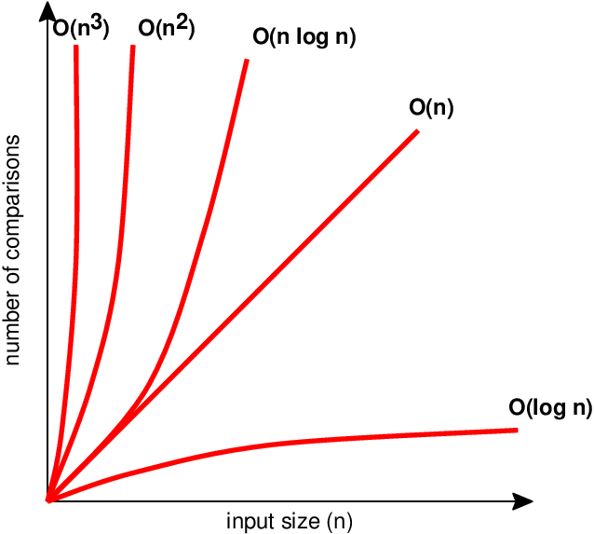
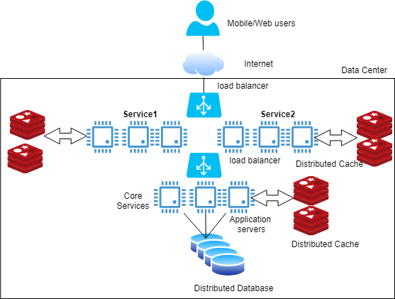
Performance analysis of complex systems.
https://medium.com/swlh/building-scalable-distributed-systems-part-2-distributed-system-architecture-blueprint-a-dbef1e1ae69e

Slide 3
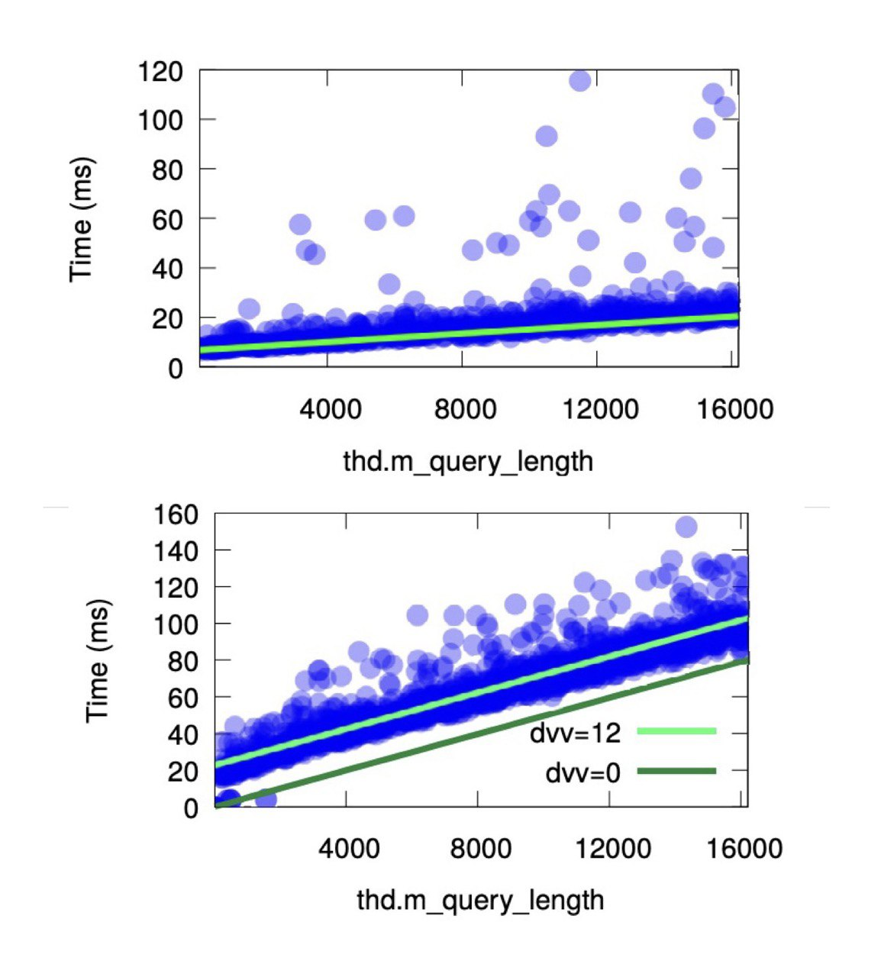
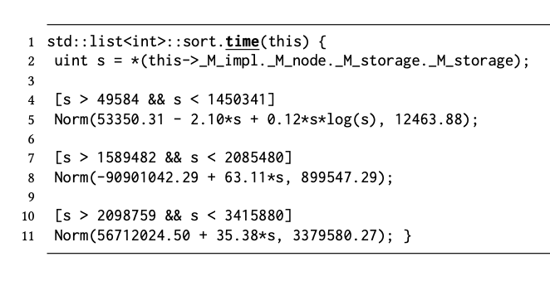
Rogora et al. - Freud, a tool to create Performance Annotations

Slide 4
Goal - Java instrumentation for Freud
Instrument Java methods to log their execution time.
Serialize performance data to allow compatibility with Freud.

Slide 5
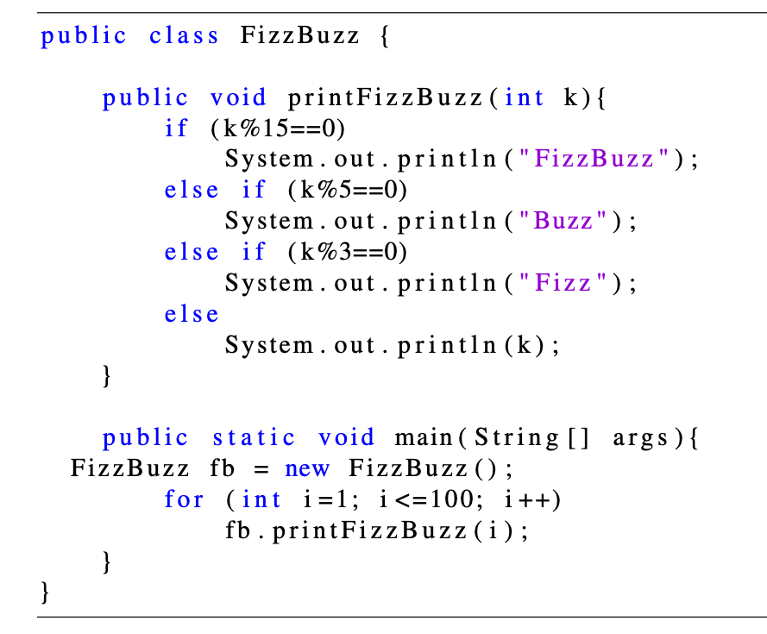
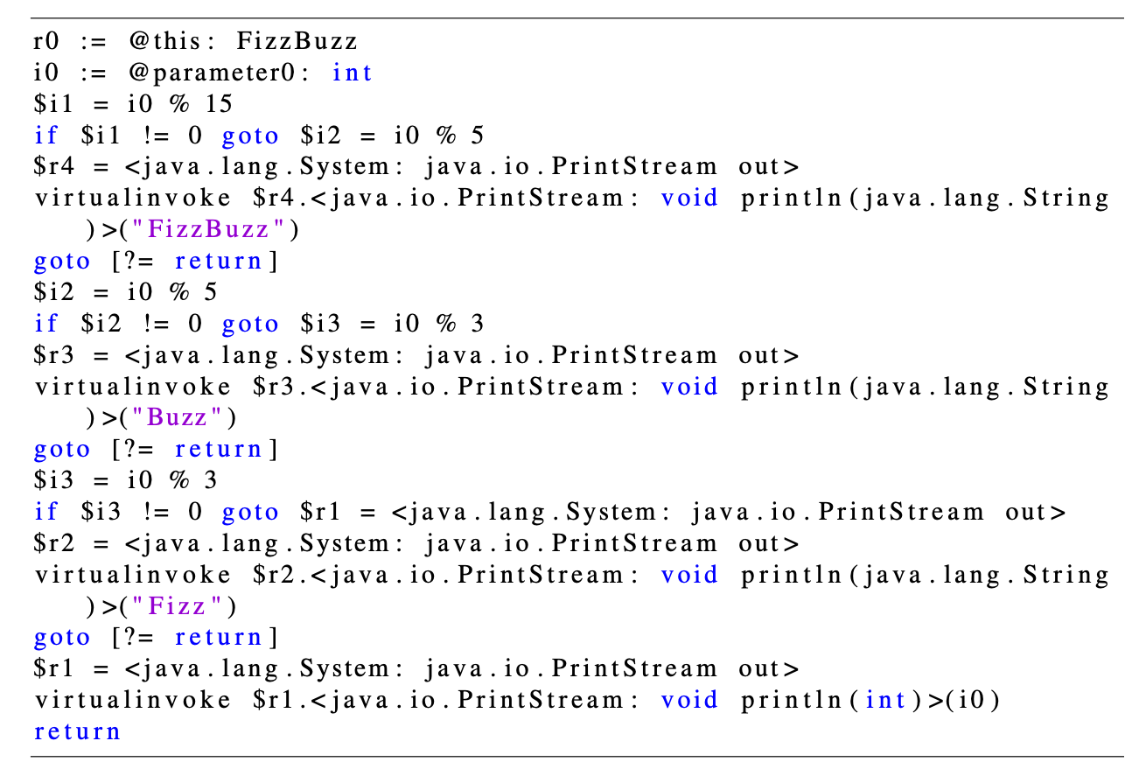
Soot, a Java optimization framework
Java
Jimple

Slide 6
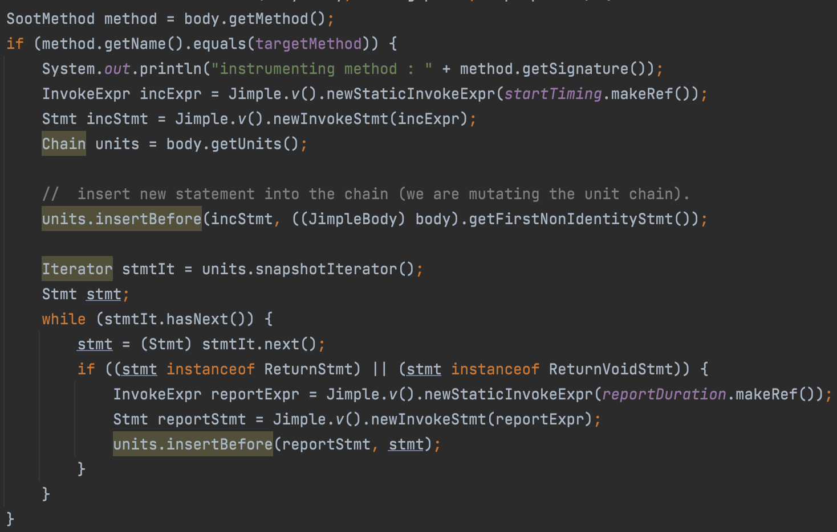
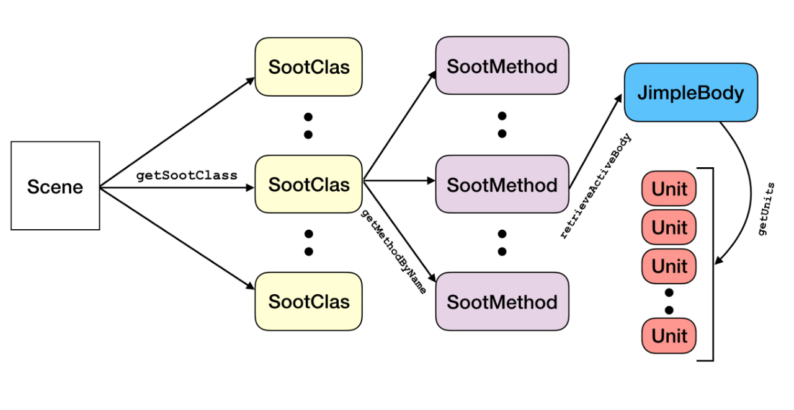
Using Soot to instrument a Java class

Slide 7
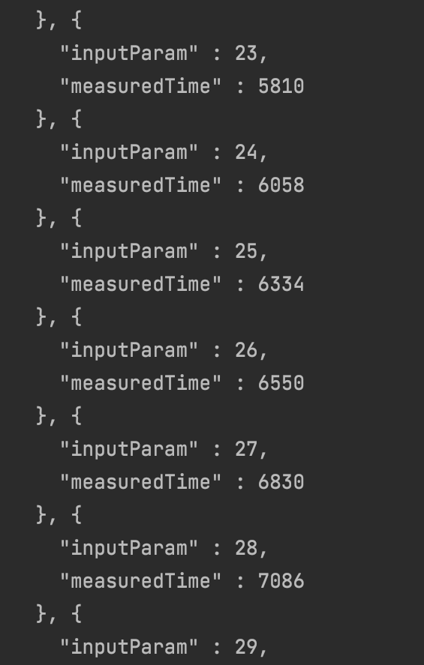
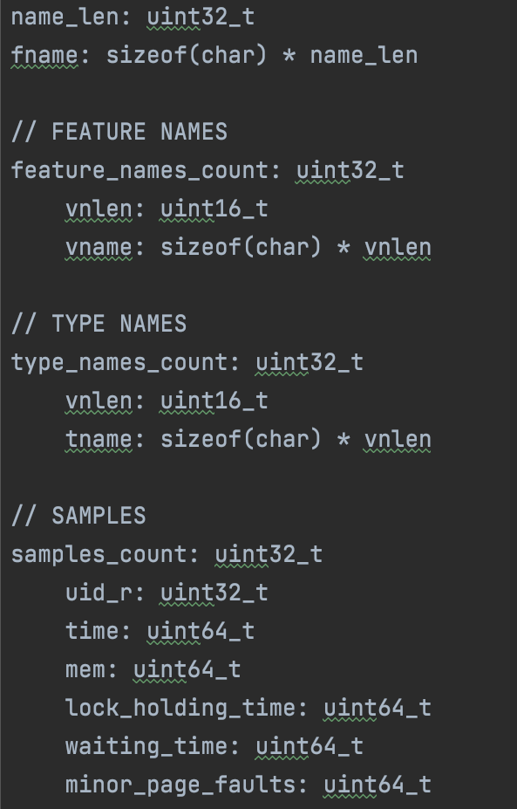
Serialization for Freud

Slide 8
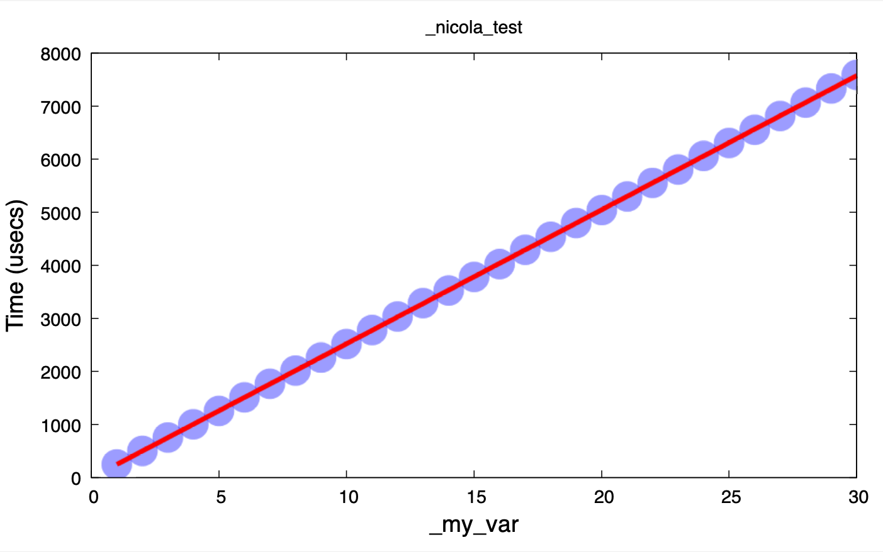
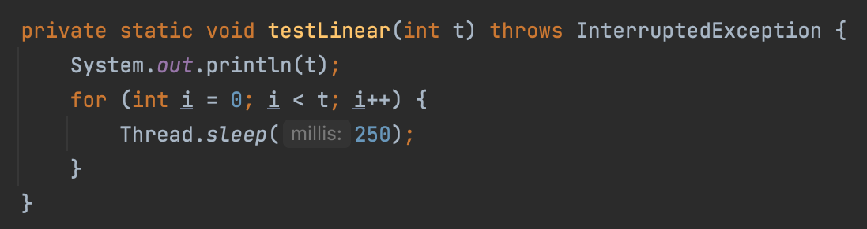
Test 1 – linear time complexity

Slide 9
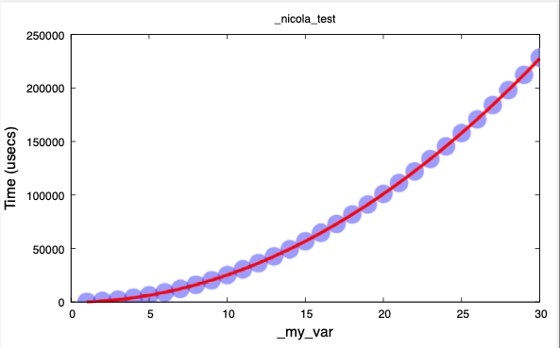
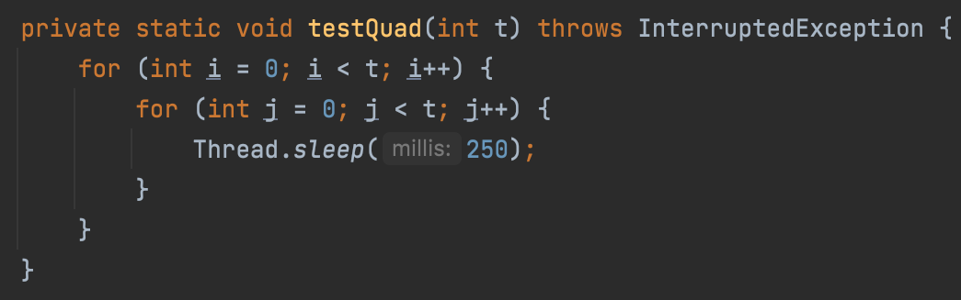
Test 2 – quadratic time complexity

Slide 10
Future work - Extending Instrumenter
Automatically log features, such as input parameters of methods.
Test instrumenter on real-world Java system (e.g. Hadoop).
Add instrumentation for other metrics (e.g. memory consumption, lock holding time, etc.).

Slide 11
Conclusion
Developed the core components of a Java instrumenter, to allow logging of methods' running time.
Created a custom serializer to transform performance logs into binary files compatible with Freud's statistical analysis API.
Paved the way for extending Freud's scope of application to Java systems.

Slide 12
References
Freud, a tool to generate performance annotations. https://github.com/usi-systems/freud.
D. Rogora, A. Carzaniga, A. Diwan, M. Hauswirth, R. Soulé. “Analyzing System Performance with Probabilistic Performance Annotations”. In: Proceedings of the Fifteenth European Conference on Computer Systems. EuroSys ’20. Heraklion, Greece: Association for Computing Machinery, 2020.
Soot, a Java optimization framework. http://soot-oss.github.io/soot.
Java instrumenter. https://github.com/amadionix/freud-java-instrumenter.
Freud's compatible serializer. https://github.com/amadionix/freud-java-serialization.

Slide 13
Q&A

Slide 14
Thank you!
Java bytecode instrumentation for performance analysis
Nicola Amadio University of Milan Master of Science in Computer Science Supervisors: Alessandra Gorla, Antonio Carzaniga, Mattia Monga

