Slide 1
Objectives
In this session, you will learn to:
Basic Elements Of Java
Data types, operators and statements
Notes:
Introduce the students to the course by asking them what they know about forensics. Next, ask the students what they know about system forensics and why is it required in organizations dependent on IT. This could be a brief discussion of about 5 minutes.
Lead the discussion to the objectives of this chapter.

Slide 2
Primitive data types
Primitive data types are basic data types.
Integer type: byte, short, int, long
Floating point types: float, double
Character data types : char
Boolean data type: boolean

Slide 3
Ranges of Primitive data types
Type | Size in Bytes | Min Range | Max Range
byte | 1 | -2⁷ | 2⁷-1
short | 2 | -2¹⁵ | 2¹⁵-1
int | 4 | -2³¹ | 2³¹-1
long | 8 | -2⁶³ | 2⁶³-1
char | 2 | 0 | 2¹⁶-1
float | 4
double | 8
boolean | JVM Specific (typically 1)
3
Notes:
Note that char is 16 bit Unicode character. Also, there no unsigned char in java.

Slide 4
Variables
Variable name must begin with
a letter (A-Z, a-z, or any other language letters supported by UFT 16)
An underscore (_)
A dollar ($)
after which it can be sequence of letters/digits.
Digits: 0-9 or any Unicode that represents digit.
Length of the variable name is unlimited
Java reserved words should not be used as variable names.
4

Slide 5
Variable Naming Convention
Must begin with lower case
Must always begin your variable names with a letter, not "$" or "_".
Avoid abbreviations, use meaningful names.
If a variable consists of two or more words, then the second and subsequent words should start with upper case.
For example, rowHeight.
5
Notes:
http://download.oracle.com/javase/tutorial/java/nutsandbolts/variables.html

Slide 6
Reading input from console
To read input from the console, JDK provides a friendly class called java.util.Scanner.
import java.util.Scanner;
class A{
public static void main(String[] args) {
Scanner sc = new Scanner(System.in);
int i = sc.nextInt();
System.out.println(i);
}
}
→Step 1
→Step 2
→Step 3
To read any primitive types, replace XXX in nextXXX() with the primitive type.
To read a string use next()
6
Notes:
Like System.out.print, Java provides System.in.read. But, it returns int. That is, it reads byte by byte. Since it is difficult for us to work with this, Java provides another friendly class called Scanner class. The full name for this class is java.util.Scanner.
The functions like java.util.Scanner.nextInt(), java.util.Scanner.nextByte(), java.util.Scanner.nextDouble(), java.util.Scanner.nextFloat(), java.util.Scanner.nextBoolean() is used to read respective datatypes.
The import statement above helps in reducing the typing effort of using full name of the class.
Reading using Scanner class involves 3 steps:
Step 1 (optional): include an import statement, so that we don’t have to type the full name of Scanner every time.
Step 2: Create a Scanner object
Step3: call functions to read() data from console.

Slide 7
Keywords/ Reserved words
abstract | continue | for | new | switch
assert | default | goto | package | synchronized
boolean | do | if | private | this
break | double | implements | protected | throw
byte | else | import | public | throws
case | enum | instanceof | return | transient
catch | extends | int | short | try
char | final | interface | static | void
class | finally | long | strictfp | volatile
const | float | native | super | while
Note that null, true and false are not keywords
7
Notes:
goto and const are unused keywords. They are reserved for future use. Java classes are not keywords.

Slide 8
Constants
final double PI=3.14;
Constant Naming Convention
All the rules that apply for a variable, applies to constants as well except for the one given below.
Convention for constants is that they must all be in UPPER CASE. In cases where you have more than one word making up constant, words must be separated by underscore.
8
Notes:
Value of a constant cannot be changed once a value is assigned. final keyword in front of the variable denotes constant.

Slide 9
Literals
Integer Literal
Integer literals are by default int (32 bits).
They can be decimal, octal, hexadecimal or long
10, -1, 010, 0xF, 4000000000l, 4000000000L
Floating Point Literal
Floating-Point literals are by default double (64 bits).
32.4, .24, 3E1, 3e-1, 32.4d , 3E1D, 3e-1, 32.1F
Character Literal
They can be characters inside single quote, unicode char or octal character or escape sequence (next slide).
'a‘, '\u0041‘, '\101’ , ‘\n’
Boolean Literal : true, false
String Literal : “Thank You”, "\u0041\u0069 “ (Ai), “Fly\n”
9
Notes:
Note that suffix l and L are same. Similar is the case for d and D, f and F, e and E.
Also following are incorrect for boolean literal assignments:
boolean b1=1;
boolean b2=10;
boolean b3=-1;

Slide 10
Variable Declarations
Local declarations
Class declarations
Instance declaration
Static declaration
More on this in classes session
10
Notes:
Local declarations
Declarations made inside a method
A local variable must always be initialized to a value before it can be used in calculations or display.
If a variable is used without initialization, compiler will flag an error.
Class declarations
Declarations made outside a method and inside class
A class variable is automatically assigned a default value if it is not initialized.
There are two types of class declarations
Instance declaration
Static declaration

Slide 11
Example: Variable Declarations
public class Student {
public String name;
public int rollno;
public void display(){
String title=“ABC” ;
System.out.print(title);
System.out.println(name);
title=“Roll No.:”;
System.out.print(title);
System.out.println(rollno);
}}}
Or String name=“ab”;
Class declarations
Local declaration
Must be initialized otherwise you get a compilation error !
11

Slide 12
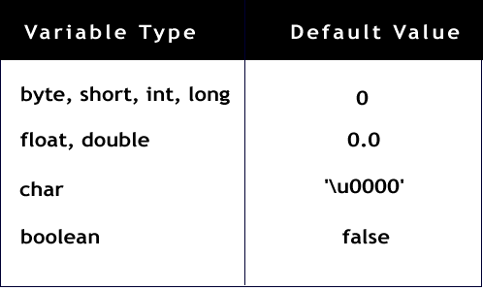
Default Values
String/
any other Object
null
12

Slide 13
Arithmetic Operators
Unary: + - ++ --
Examples: –5, +5
char ch=‘X’;
ch++; // (ch = ‘Y’)
Binary : + - * / %
Examples: int i= j+5;
13
Notes:
Example 1:
int k=10;
k++; //value becomes 11
char ch=‘X’;
ch++; // (ch = ‘Y’)
Example 2:
int a = 5;
int b = 2;
int c = a + b;
System.out.println(5%2); // output is 1

Slide 14
Relational Operators
< > >= <= == !=
Returns true or false
Example:
int i=10;
int j=20;
System.out.println( i>j );
// output is false
System.out.println(i==10);
// output is true
14

Slide 15
Exercise
Write a program to do the following,
Get two numbers as input from the user through console and swap the values of two numbers without using a temporary variable and display the same.
Determine whether the given year is leap year or not (Read the input through console ).
15

Slide 16

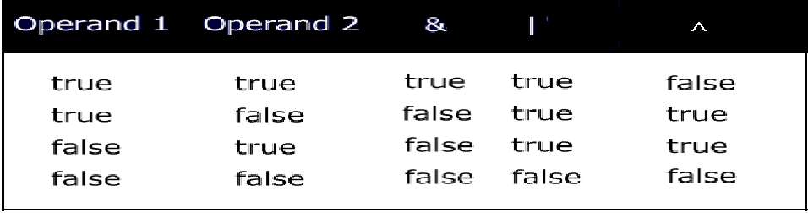
Logical Operators
& | ^
What will happen when you compile the following statement?
if(~(1>2))
System.out.println(“OK");
16

Slide 17
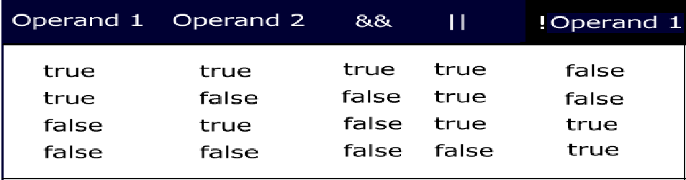
Conditional Logical Operators
&& || ! ?:
Logical operators are binary operators that require boolean values as operands.
&& and || are also called short circuit operators because they are optimized.
17
Notes:
How are the short circuit operators “optimized”?
&& checks if the first condition is false. If it is so, then it doesn't evaluate the second condition.
|| checks if the first condition is true. If it is so, then it doesn't evaluate the second condition.

Slide 18
Activity
Type this code and find out the difference between && and & operators?
public class Example{
public static void main(String args[]){
int i=0;
int j=2;
boolean b= (i>j) && (j++>i);
System.out.println(j);
b= (i>j) & (j++>i);
System.out.println(j);
}
}
18

Slide 19
Ternary operator
Syntax of ?:
<variable> = (boolean expression) ? <value to assign if true> : <value to assign if false>
Example :-
int i=10;
double j=10.1;
int k=(i>j)?10:20;
System.out.println(k); // outputs 20
Use case:
Int interestRate=12;
Int loanAmount = interestRate>10 ? 4000000:200000;
19

Slide 20
Compound Operators
+= -= *= /= %= &= |= ^=
Example:
int a = 10;
int b=2;
a+=b; // means a=(int)(a+b);
double d=45.3;
d/=1.2;
20
Notes:
Note that a=a+b; and a+=b; are not exact equivalents. The later involves a cast operator. We will look into this in greater detail after we have looked at cast.

Slide 21
Automatic or implicit conversion
The conversion in the direction indicated happens automatically.
byte→short→int→long→float→double
char
When an arithmetic operation happens between different numeric types, the result of the operation is always of the higher numeric data type.
When the integer literals are within the range of the specified integer data types, the conversion automatically happens. In case the literal is beyond range, the compiler flags an error. byte b=298;
If an arithmetic operation happens between any integer type except long, the result is an int.
Similarly when arithmetic operation happens between floating points, the result is double.
Compound assignment operator and pre/post increment/ decrement operator does the conversions required.
21

Slide 22
Loss of information
There could be loss of some information during conversion of the following:
int → float
long→float
long→ double
Example
int i=76543210;
float f= i; → 7.6543208E7
22

Slide 23
Assignment conversions- integers
int i=10;
int b=10;
int k=i+b; // ok
2. byte b1=20; // ok
short s=10; // ok
But byte b=39078; // error
3. int b=10;
byte b1=b; //error
But final int b=10;
byte b1=b; //ok
23
Notes:
Since adding 2 bytes or two integers of any type except long results in int, the value can be stored only in int or long. Java does not allow ints to be automatically truncated into lower integral types like byte or short. If we desire such conversion we must explicitly request for it through cast.

Slide 24
byte b1=20, b2=30;
int i=b1+b2; // ok
But byte b=b1+b2; // error
Same is the case with short
byte b=b+1; // error
But byte b+=1; // ok
byte c=10; // ok
byte c1=-c; // error
byte c2=c1+1; // Error : possible loss of precision
But byte c2=++c1; // ok

Slide 25
Assignment conversions- double
int f = 32;
float t=f; //ok
int k=t; //error
25
Notes:
Adding float results in double and so, only double variable can be used to store the result.

Slide 26
char conversions
char c=‘A’;
int i=c;
Assigns unicode value of A to int
2. char c=65;// ok
65 is within the range of char
char c=-65; // error
4. int ii=65;
char c=ii; //error
5. char c=‘A’;
short s=c ; // error

Slide 27
Explicit conversion or casting
Any conversion between primitives (excluding boolean) that is not possible implicitly can be done explicitly.
Conversions like (a) double to long, (b) char to byte etc.
This is done through what is called casting.
Example:
int k=10;
char b=k; // error
Casting makes the error disappear:
char b=(char)k;
27
Notes:
128 is 10000000. Since 8th bit for a byte represents a –ve number, 10000000 is –ve.
To get the value of – ve number find its 2’s complement (1’s complement+1)
1’s complement of 128 is 01111111
+1 is 10000000 which is 128.
Since the number is a –ve number the result is -128.

Slide 28
Flow control statements
Conditional Statements
if statement
switch statement
Loops
for statement
enhanced for statement
while statement
do-while statement
Loops can have break or continue.
All of these statements except (enhanced for statement) are same as that in C (in terms of the syntax and way they work).
But note that for Java conditions must always evaluate to boolean value.
The switch expression should be integer value (not long) or char and case expression must evaluate to a constant/final value
Coming up later
28
Notes:
if statement syntax:
if (condition) statement(s)
[else statement(s)] ;
if statement is same as that in C except that the condition must always evaluate to a boolean value.
Examples:
if(x==y) x++;
if (x>y) y++;
else x++;
if(true) { y++;
System.out.println(“OK”);
}
Switch statement:
Syntax:
switch (expression){
[case expression: statement(s)]
…
[default: statement(s)]
}
switch statement is also very similar to the one in C
switch expression must be either integer value (not long) or char. In Java SE and later, String can also be used in switch statement's expression
case expression must evaluate to a constant/final value.
break statement after every set of case statements will prevent fall-through.
for loop:
Syntax
for(initialization;condition;iteration) statement(s);
for statement (like in C) is used to iterate through a set of statements over a range of values specified and computed by the for loop itself.
The initialization expression is
used to initialize variable(s)
more than one variable initialization is separated by commas)
can also include initialization with declaration
executed only once when the loop begins.
The condition expression
Must evaluate to a boolean value
Loop iterates till the condition is true
Only one condition can be specified; multiple conditions can be combined using logical operators
is evaluated at the beginning of each loop
The iteration expression
is usually an increment or decrement expression of the variable initialized in the initialization expression
is evaluated at the beginning of each loop
while and do-while:
while(condition) statement(s);
do statement(s) while(condition);
Like in C, while and do-while statement are used to iterate through a set of statements till the condition remains true.
while evaluates the condition before at the beginning of each iteration whereas do-while evaluates condition only at the end of each iteration.
Therefore, do-while guarantees that the loop statements are executed at least once.
Condition expression must result in ___________
Can you think of a situation where you would prefer do-while instead of while?

Slide 29
Labeled continue/break statements
The normal break (without labels) is used to break out of the loop (used in switch statement also) and continue is used to skip the rest of the statements in the loop and start with a new iteration.
In cases where there are multiple loops, when we break out or continue the loop, the immediate loop breaks or continues.
break and continue statement can also be used with labels to indicate from which outer loops should it break out or continue.
The outer loop where the break or continue must happen is labeled.
Note that labeled break/ continue will work only if the labels are provided for the loops in which they are enclosed.
29

Slide 30
Labeled continue/break statements
Example:
first: for(int i=0;i<2;i++)
for(int j=1;j>0;j--)
if(i!=j)
continue first;
else
System.out.println(i+j);
//prints 2
When i=0 and j=1
30

