Slide 1
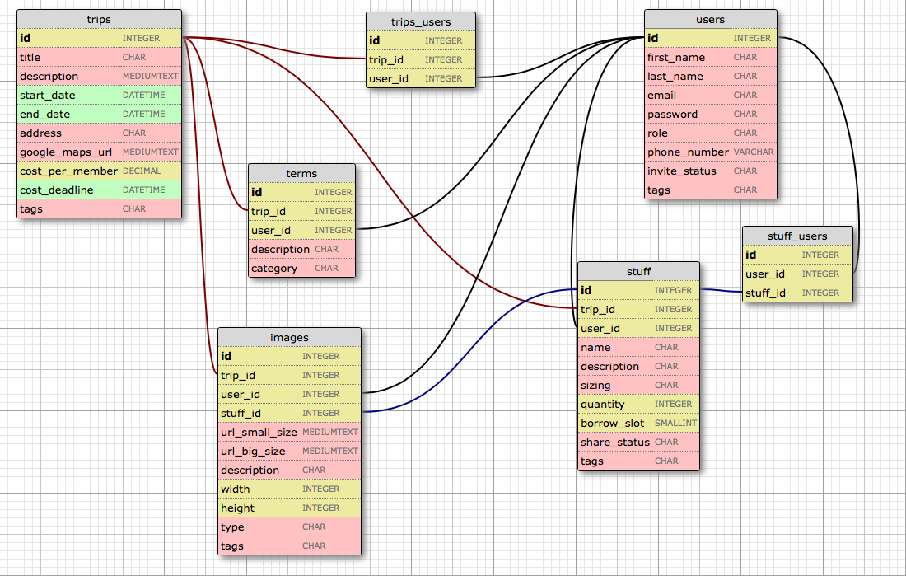
join table
join table
users role:
organizer
member
tripterms category:
(determined by user)
users invite_status:
accepted
rejected
invited
null (not invited)
stuff share_status:
have it
will buy it
request to borrow
request fulfilled
stuff borrow_slot:
-1 = owner
1 = available slot 1
2 = available slot 2
3 = available slot 3
...
n = available slot n
tags are strings separated by a pipe symbol “|”
purpose of tags is to categorize characteristics that can cross table categories, for example:
“required | cheap | vigorous | local”

