Slide 1
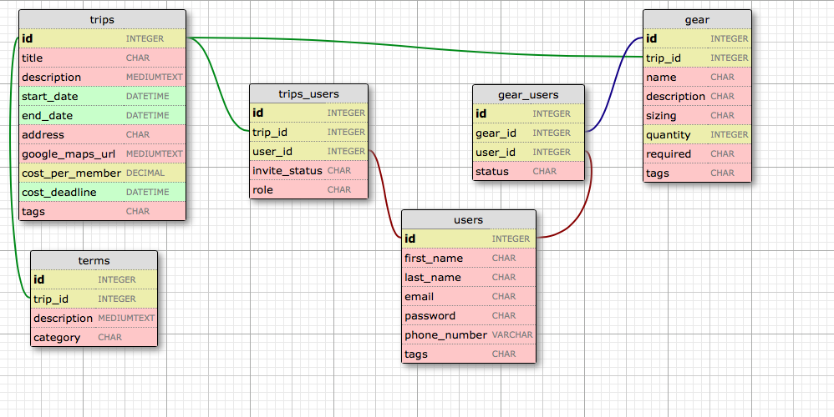
join table
join table
MariaDB Schema
join table
join table
gear required:
required
recommended
gear_users status:
i own it
i will buy it
trips_users role:
organizer
member
trips_users invite_status:
accepted
rejected
invited
null (not invited)
terms category:
(determined by user)
“required” table
this table contains required or
recommended trip items first set by
the organizer.
tags are strings separated by a pipe symbol “|”
purpose of tags is to categorize characteristics
that can cross table categories, for example:
“required | cheap | vigorous | local”

