Slide 1
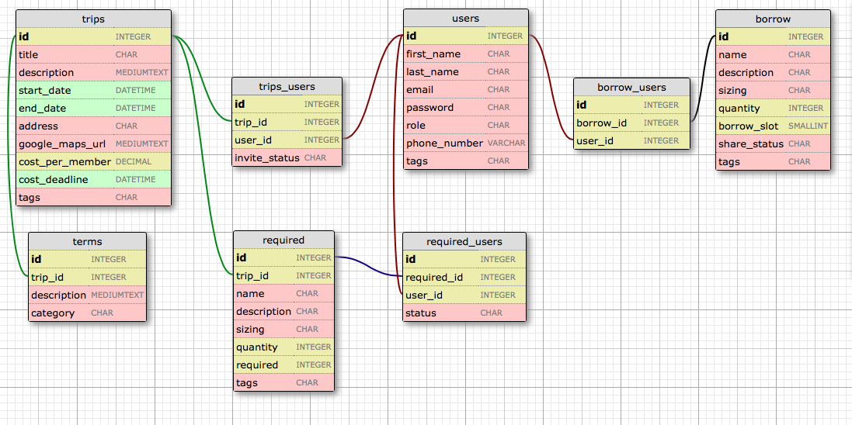
join table
join table
trips invite_status:
accepted
rejected
invited
null (not invited)
users role:
organizer
member
join table
join table
join table
borrow share_status:
being borrowed
not being borrowed
borrow borrow_slot:
-1 = owner
1 = available slot 1
2 = available slot 2
3 = available slot 3
...
n = available slot n
required_users status:
i own it
i will buy it
i need to borrow
being borrowed
“borrow” table
this table contains trip equipment, clothes, or food items that are owned by users or can be loaned and borrowed.
tripterms category:
(determined by user)
“required” table
this table contains required or
recommended trip items first set by
the organizer.
tags are strings separated by a pipe symbol “|”
purpose of tags is to categorize characteristics
that can cross table categories, for example:
“required | cheap | vigorous | local”

