Slide 1
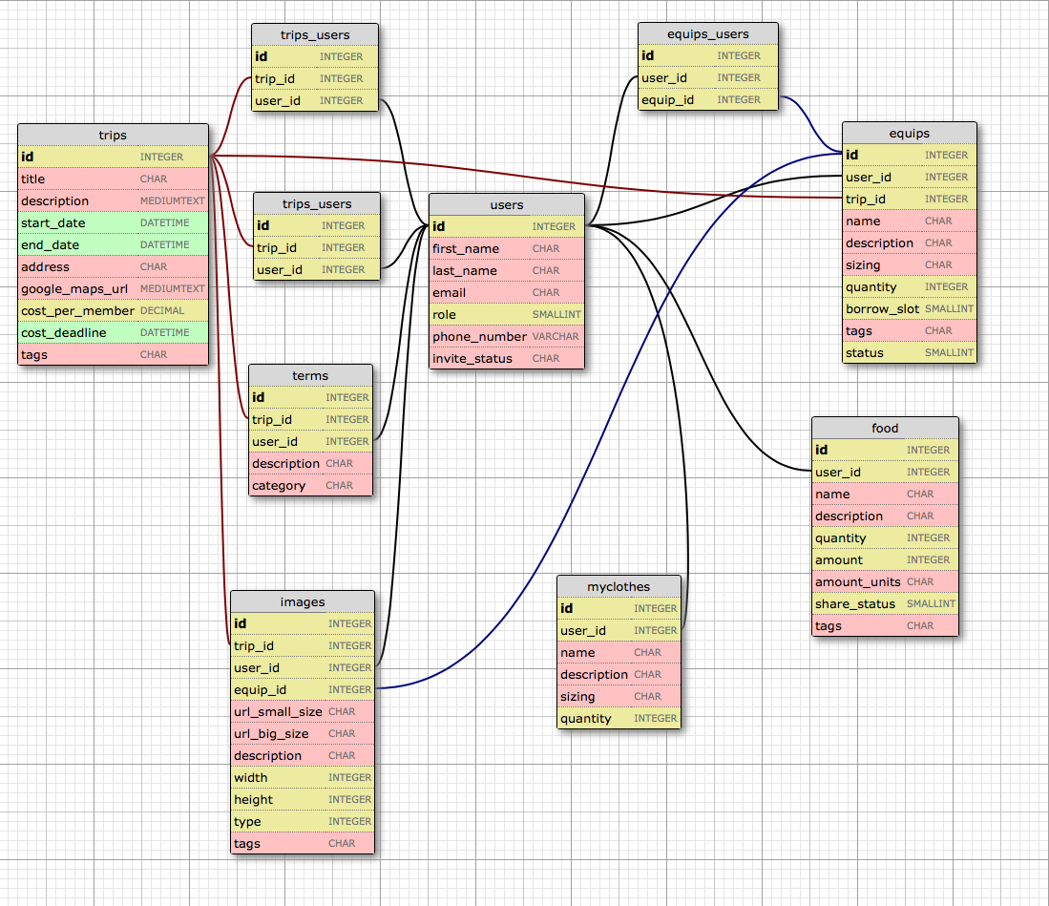
join table
join table
join table
equips borrow_slot:
1 = owner
1 = available slot 1
2 = available slot 2
3 = available slot 3
...
n = available slot n
join table
users invite_status:
accepted
rejected
invited
null (not invited)
tripterms category:
(determined by user)
join table

