Slide 1
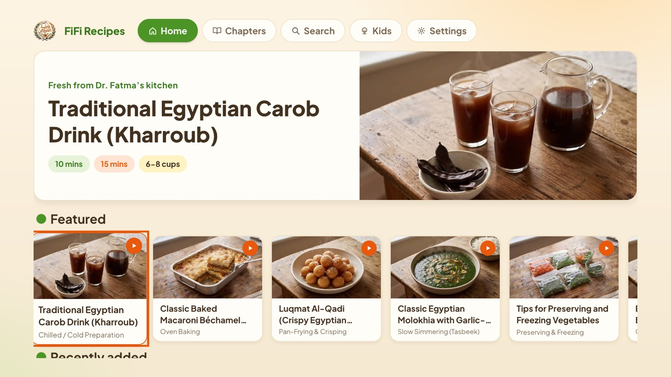
FiFi Recipes Description
CP: Dr. Fatma / FiFi
Tizen web application · version 1.0.2
App ID FiFiCookTV.FifiRecipes
No login · free · internet required
Fresh from Dr. Fatma’s kitchen

Slide 2
Revision History
Version | Date | Description | Author
1.0.2 | 2026.10.02 | First submission to TV Seller Office (supports 2020+ TVs, Tizen 5.5+) | Ahmed Abdel Aal

Slide 3
Contents
1
App overview
2
UI Structure
3
Usage Scenario
4
Menu & function description
5
Key policy
6
How to change languages
7
Notes for the tester

Slide 4
App overview
What it is
Supported TVs
Egyptian family recipe archive: 1,000+ recipes, chapters, search, and a Kids cooking mode.
2020 and newer (Tizen 5.5+). Tested on a 2020 QN65Q60T.
Log-in / activation
Payment & ads
None. No account, no activation, no test account needed.
Free. No in-app purchases, no advertising, no tracking.
Network
Languages
Required. Recipes load from fifi.cooking; videos play via a YouTube relay page.
25 languages, chosen in-app; Arabic, Urdu and others mirror right-to-left.

Slide 5
UI Structure
Launch
from Smart Hub
Language
first launch only
Home
top menu + rails
Recipe
ingredients & steps
Video
full-screen player
Chapters
browse by chapter
Search
on-screen keyboard
Kids
illustrated recipes
Settings
language · about
Top menu items are reachable from every screen with ↑. Return walks back along these arrows; Return on Home exits to Smart Hub.

Slide 6
Usage Scenario
Open Smart Hub › Apps and launch FiFi Recipes.
First launch: pick a language (e.g. English) with the arrows, press OK.
Home: move along the recipe rails, press OK on a card.
Recipe: press ↓ to read ingredients and steps.
Further down, press OK on a video card: it plays full screen.
Use Play/Pause and Stop; press Return to close the player.
Press ↑ to the top menu › Search; type “kofta” on the on-screen keyboard and open a result.
Top menu › Kids: open a recipe › “Get ready” › step cards (← →) › celebration.
Top menu › Settings › Language: choose Arabic; the layout mirrors right-to-left.
Press Return back to Home, then Return again: the app closes to Smart Hub.
No log-in, activation or payment exists in the app, so the scenario needs no account or test credentials.

Slide 7
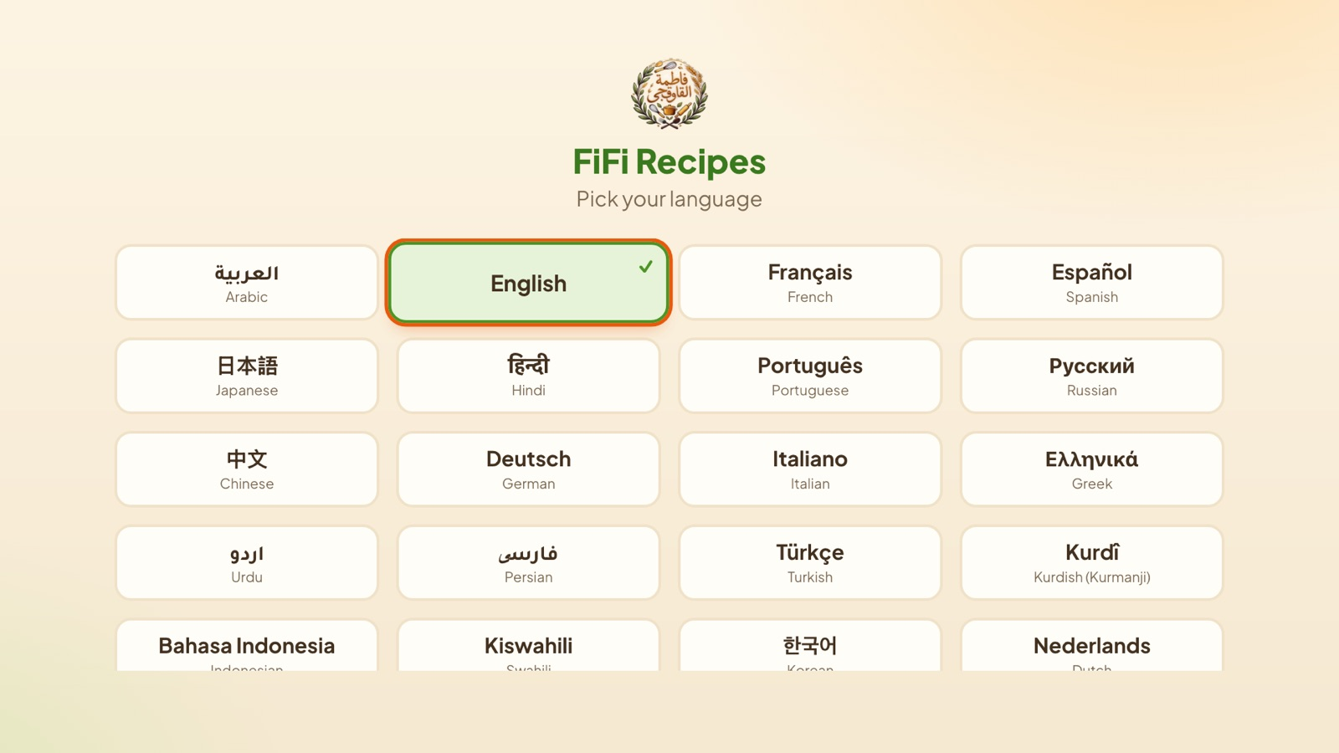
Menu & function · Language picker
Shown on first launch only.
Arrows move between languages; OK confirms and opens Home.
The choice is remembered; change it later in Settings.

Slide 8
Menu & function · Home
Top menu: Home, Chapters, Search, Kids, Settings.
Featured recipe banner, then rails of recipes: ← → scroll a rail, ↓ next rail.
OK on a card opens the recipe.
Return on Home closes the app (back to Smart Hub).

Slide 9
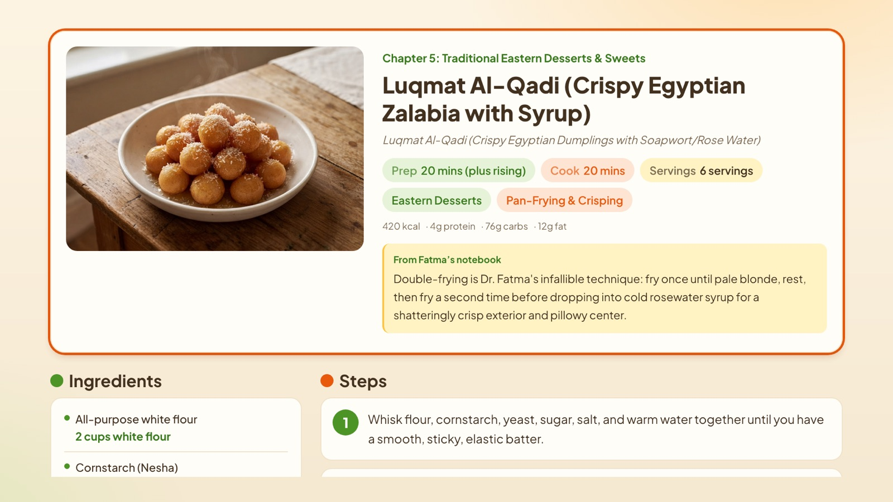
Menu & function · Recipe
Title, times, servings, nutrition and “From Fatma’s notebook”.
↓ scrolls to Ingredients and numbered Steps; the focused step is outlined.
Video cards further down; OK opens the player.
Return goes back to the previous screen.

Slide 10
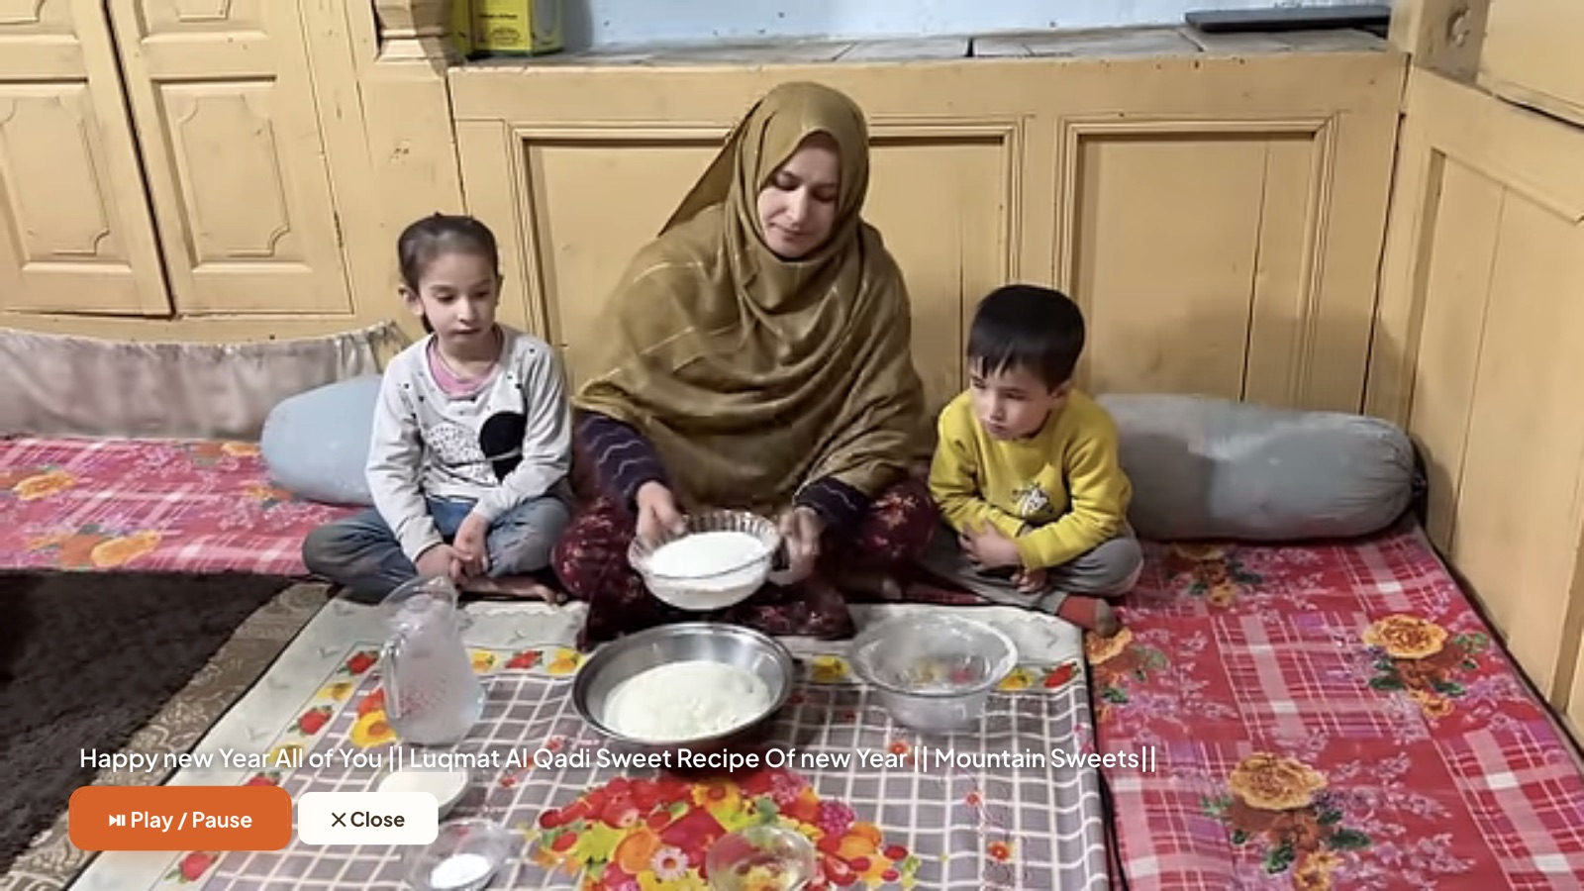
Menu & function · Video player
Plays the recipe video full screen (YouTube relay page).
Play/Pause, Play, Pause and Stop keys control playback; on-screen Play/Pause and Close buttons too.
Return or Stop closes the player.
Smart Hub / leaving the app pauses the video.

Slide 11
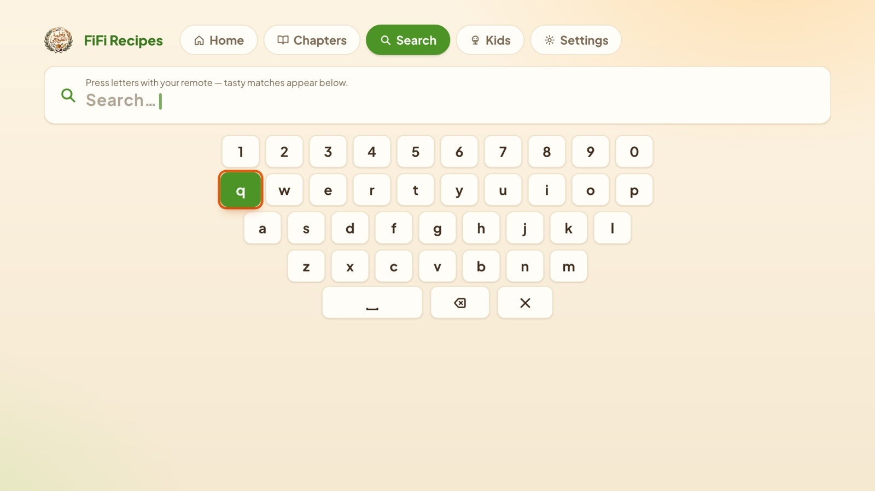
Menu & function · Search
On-screen keyboard: arrows to a letter, OK to type; space, delete and clear keys below.
Matching recipes appear under the keyboard as you type.
Unmatched words show a “no results” message.

Slide 12
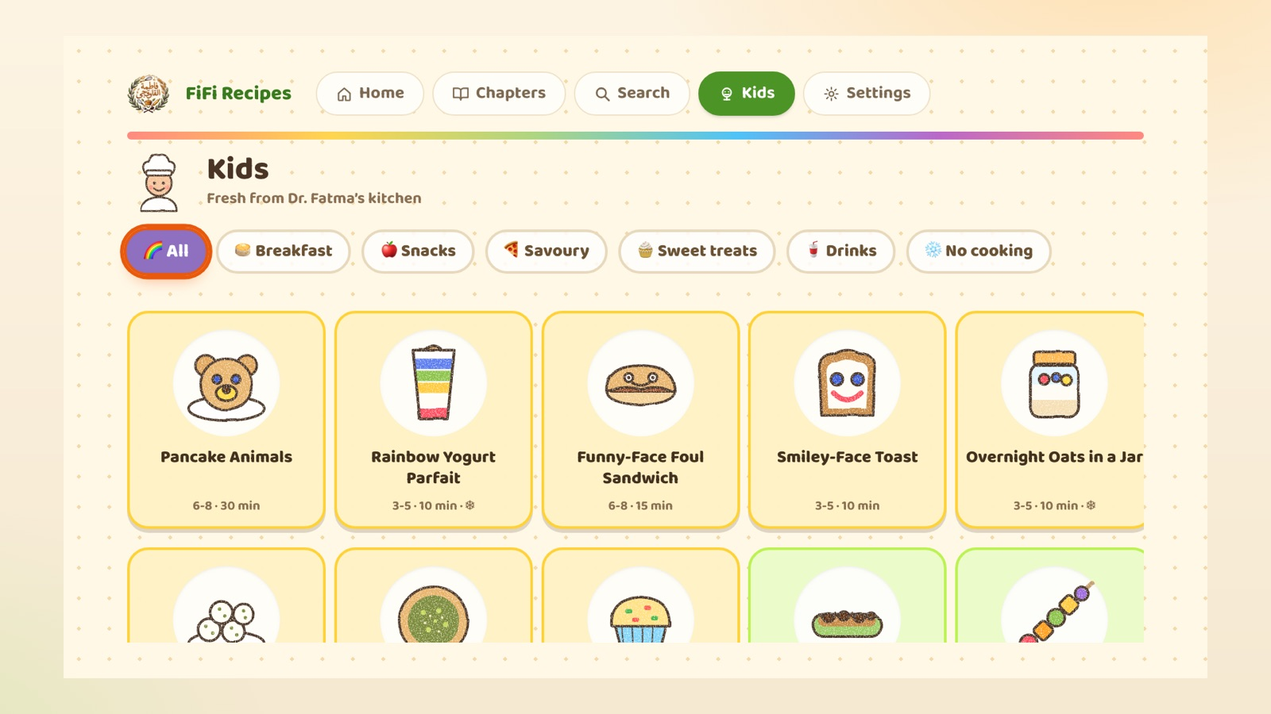
Menu & function · Kids
Filter chips: All, Breakfast, Snacks, Savoury, Sweet treats, Drinks, No cooking.
OK on a recipe opens the “Get ready” checklist with allergen and grown-up notes.
Step cards: ← → to move; a celebration screen at the end.

Slide 13
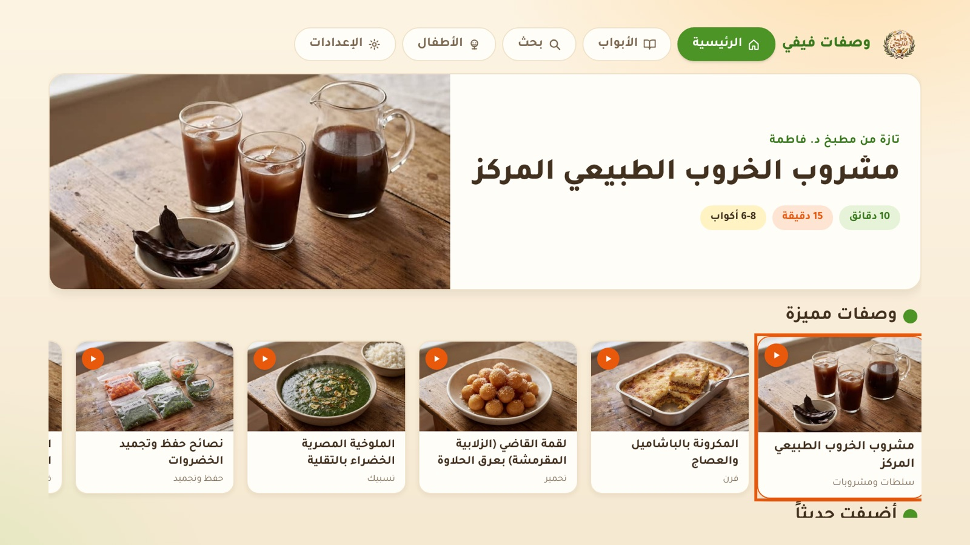
Menu & function · Settings
Settings: language, about, app version.
Choosing Arabic (shown) mirrors the entire interface; arrow keys follow the mirrored layout.

Slide 14
Key Policy
Button | Action | Remarks
UP / DOWN / LEFT / RIGHT | Move the highlight (focused item outlined in orange)
ENTER | Select the highlighted item (recipe, chapter, video, key, filter)
RETURN | Move to the previous page; on Home, close the app and return to Smart Hub | Samsung Mandatory
EXIT | Close the app immediately (handled by the system, no popup) | Samsung Mandatory
PLAY/PAUSE · PLAY · PAUSE | Control playback while the video player is open | N/R outside the player
STOP | Stop the video and close the player | N/R outside the player
FF / REW | Not used | N/R
CH. UP / DOWN | Not used | N/R
Number keys 0–9 | Not used | N/R
Colour keys (RED/GREEN/YELLOW/BLUE) | Not used | N/R

Slide 15
How to change languages
Items | Contents
How to change languages | The app language is chosen inside the app, independent of the TV country or OSD language. 1. First launch: the language picker appears; select a language and press OK. 2. Any time later: top menu › Settings › Language › select a language. The change applies immediately. 3. Right-to-left languages (Arabic, Urdu, Persian, Pashto, Hebrew, Kurdish) mirror the layout.
Supported languages | Arabic, English, French, Spanish, Japanese, Hindi, Portuguese, Russian, Chinese, German, Italian, Greek, Urdu, Persian, Turkish, Kurdish, Indonesian, Swahili, Korean, Dutch, Pashto, Hebrew, Polish, Swedish, Telugu

Slide 16
Notes for the tester
1
No account There is no login, activation or payment anywhere in the app.
2
Network loss A banner appears when the connection drops; the app recovers automatically when it returns.
3
Return / Exit Return on Home exits to Smart Hub. Exit always closes immediately (system key, not intercepted).
4
Background Media pauses when the app is hidden (Smart Hub / Home key) and can be resumed.
5
Rapid input Held or rapid arrow presses are throttled so focus never skips or breaks.
6
Privacy No personal data is collected or stored. Policy: samsungsmarttv.fifi.cooking/privacy.html
Support: samsungtv@fifi.cooking · samsungsmarttv.fifi.cooking/support.html

