Slide 1
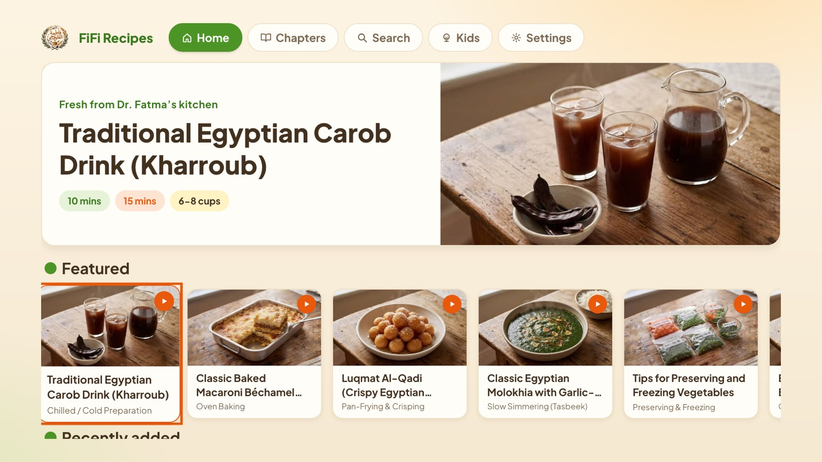
FiFi Recipes
App UI Description for Samsung TV certification
Tizen web application · version 1.0.2
App ID FiFiCookTV.FifiRecipes
No login · free · internet required
Fresh from Dr. Fatma’s kitchen

Slide 2
The app at a glance
What it is
Supported TVs
Egyptian family recipe archive: 1,000+ recipes, chapters, search, and a Kids cooking mode.
2020 and newer (Tizen 5.5+). Tested on a 2020 QN65Q60T.
Account
Purchases & ads
None. No login, no test account needed.
Free. No in-app purchases, no advertising, no tracking.
Network
Languages
Required. Recipes load from fifi.cooking; videos play via a YouTube relay page.
24 interface languages, chosen in-app; Arabic, Urdu and others mirror right-to-left.

Slide 3
Remote control keys
Key | What it does
Arrows ← ↑ → ↓ | Move the focus (focused item is outlined in orange and enlarged)
OK / Enter | Select: open a recipe, a chapter, a video, a keyboard letter, a filter
Return | Go back one screen. On Home, Return closes the app and returns to Smart Hub
Exit | Handled by the system: closes the app immediately, no confirmation popup
Play/Pause · Play · Pause | Control the recipe video while the player is open
Stop | Stop the video and close the player
Number and colour keys are not used. The pointer of smart remotes is disabled; the UI is fully focus-driven.

Slide 4
Screen flow
Launch
from Smart Hub
Language
first launch only
Home
top menu + rails
Recipe
ingredients & steps
Video
full-screen player
Chapters
browse by chapter
Search
on-screen keyboard
Kids
illustrated recipes
Settings
language · about
Top menu items are reachable from every screen with ↑. Return walks back along these arrows; Return on Home exits.

Slide 5
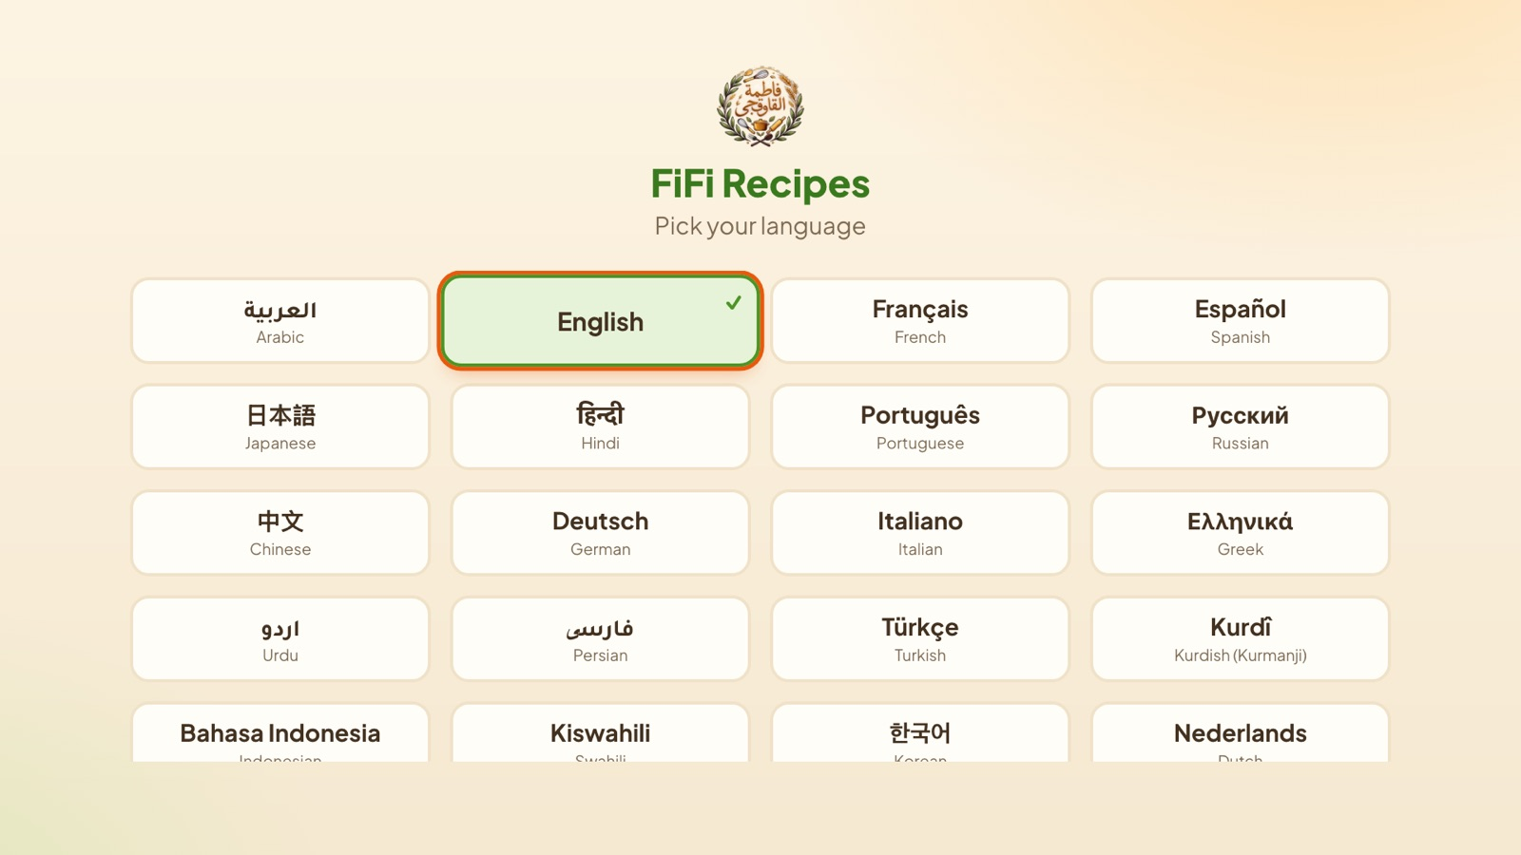
1 · Language picker
Shown on first launch only.
Arrows move between languages; OK confirms and opens Home.
The choice is remembered; change it later in Settings.
Arabic, Urdu, Persian, Pashto, Hebrew and Kurdish switch the whole layout to right-to-left.

Slide 6
2 · Home
Top menu: Home, Chapters, Search, Kids, Settings.
Featured recipe banner, then rails of recipes (← → to scroll a rail, ↓ for the next rail).
OK on a card opens the recipe.
Return on Home closes the app (back to Smart Hub).

Slide 7
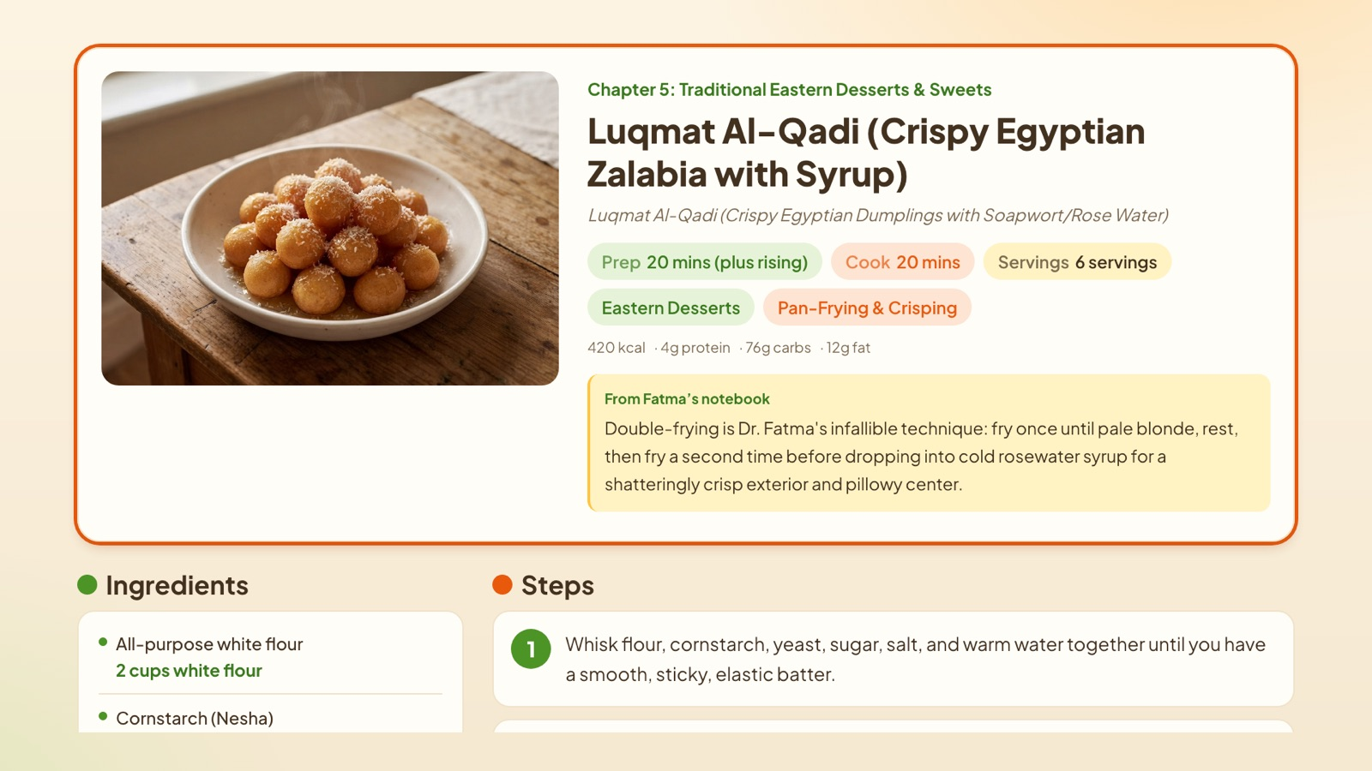
3 · Recipe
Title, times, servings, nutrition and “From Fatma’s notebook”.
↓ scrolls to Ingredients and numbered Steps; the focused step is outlined.
Video cards appear further down; OK opens the player.
Return goes back to the previous screen.

Slide 8
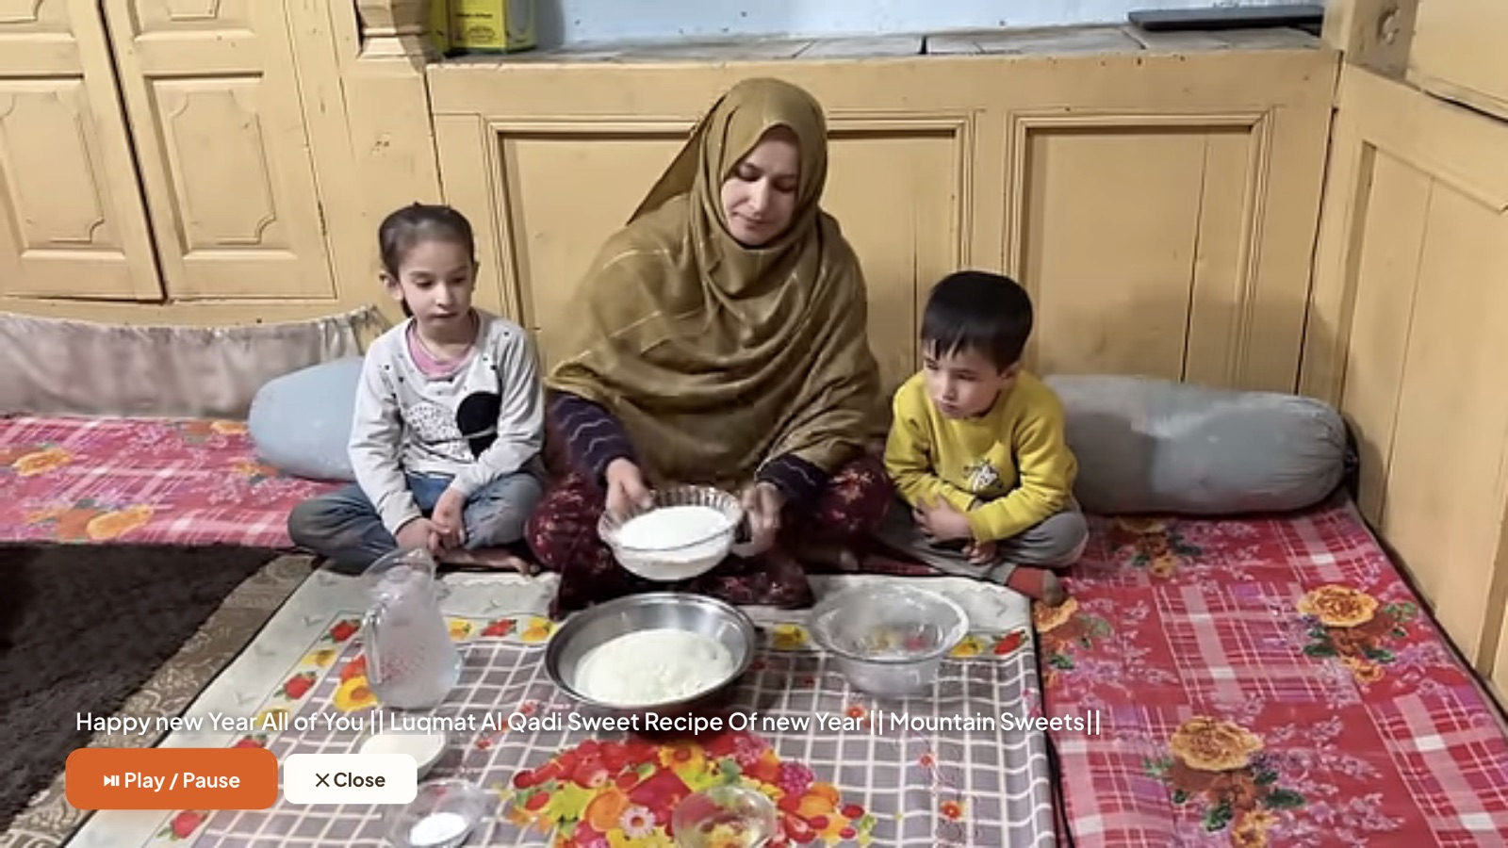
4 · Video player
Plays the recipe video full screen (YouTube relay page).
Play/Pause, Play, Pause and Stop keys control playback; on-screen Play/Pause and Close buttons too.
Return or Stop closes the player.
Opening Smart Hub or leaving the app pauses the video.

Slide 9
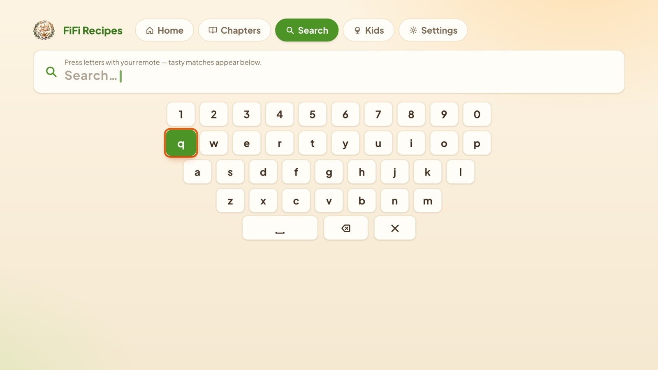
5 · Search
On-screen keyboard: arrows to a letter, OK to type; space, delete and clear keys below.
Matching recipes appear under the keyboard as you type.
Unmatched words show a friendly “no results” message.

Slide 10
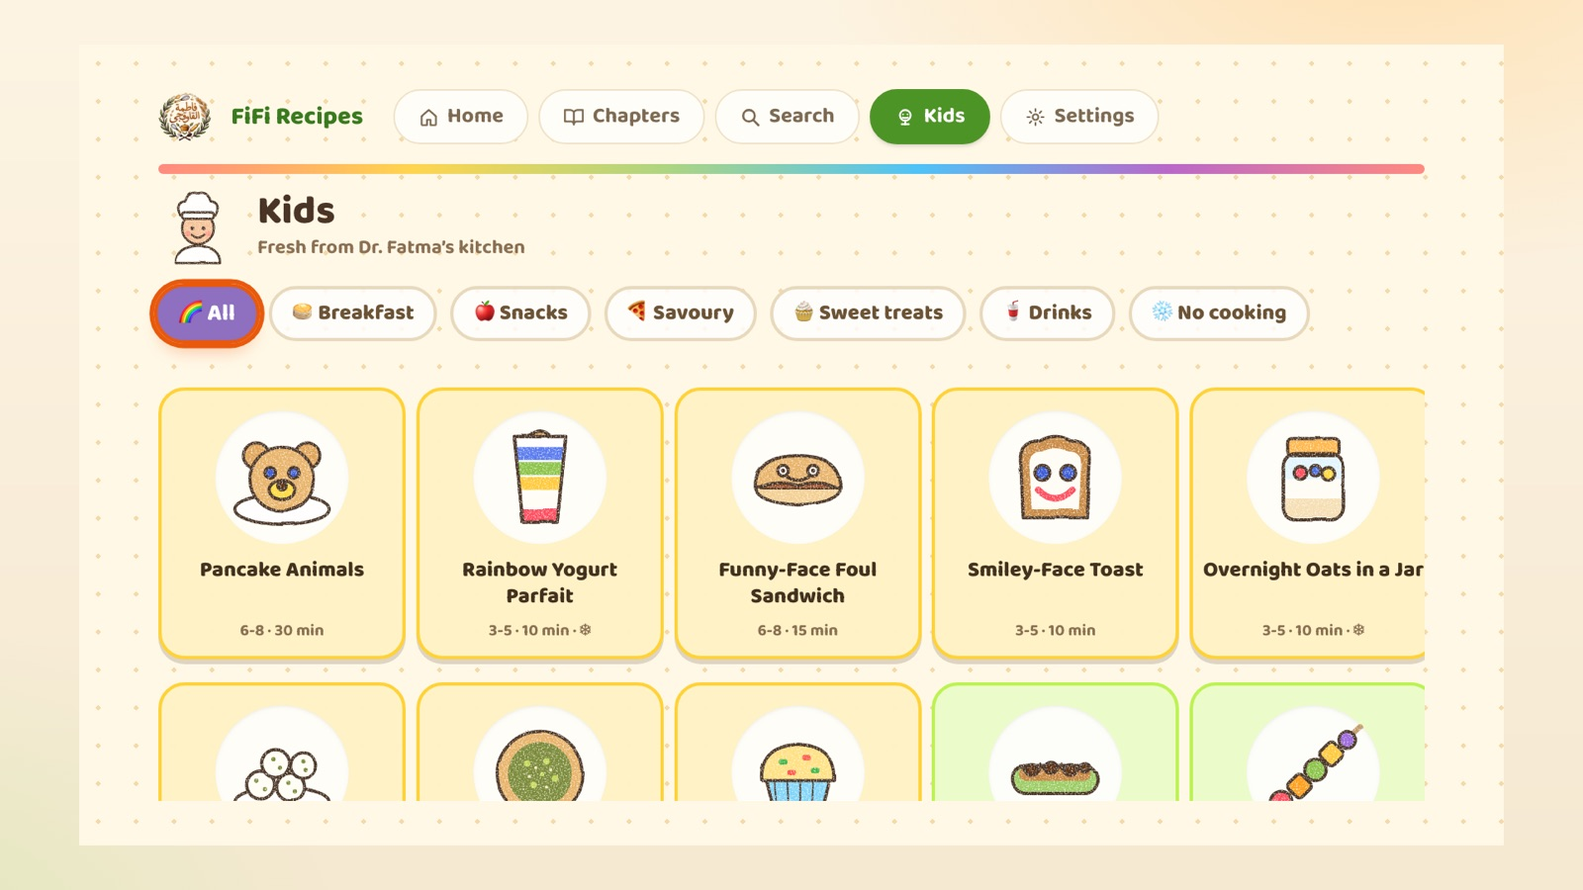
6 · Kids
Filter chips: All, Breakfast, Snacks, Savoury, Sweet treats, Drinks, No cooking.
OK on a recipe opens the “Get ready” checklist with allergen and grown-up notes.
Step cards: ← → to move; a celebration screen at the end.
Return goes back one screen at a time.

Slide 11
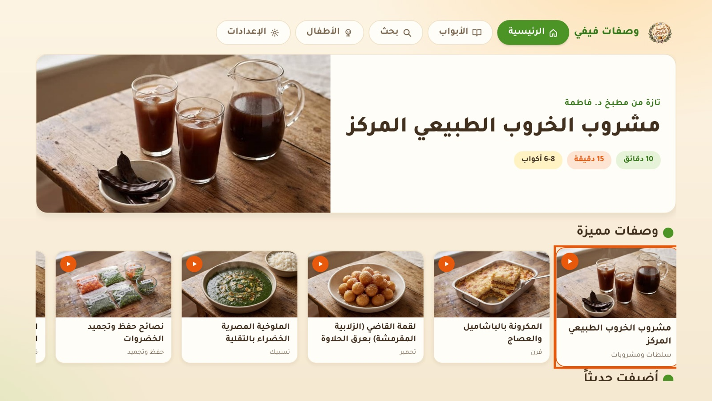
7 · Settings & right-to-left
Settings: change language, about, app version.
Choosing Arabic (shown) mirrors the entire interface; arrow keys follow the mirrored layout.

Slide 12
Notes for the certification tester
1
No account There is no login or sign-up anywhere in the app.
2
Network loss A banner appears when the connection drops; the app recovers automatically when it returns.
3
Return / Exit Return on Home exits to Smart Hub. Exit always closes immediately (system key, not intercepted).
4
Background Media pauses when the app is hidden (Smart Hub / Home key) and can be resumed.
5
Rapid input Held or rapid arrow presses are throttled so focus never skips or breaks.
6
Privacy No personal data is collected or stored. Policy: samsungsmarttv.fifi.cooking/privacy.html
Support: samsungtv@fifi.cooking · samsungsmarttv.fifi.cooking/support.html

