Slide 1
Lyric Database
Lyric Music
Lyric Music is an e-commerce company that provides web services to music artists. Among its services are offering mp3 and Real Audio files for download, selling CDs, and developing promotional materials for artists.
Lyric Music Data
A database can be described in more than one way. One technique is to simply list the rows and columns of each table. These are shown below.

Slide 2
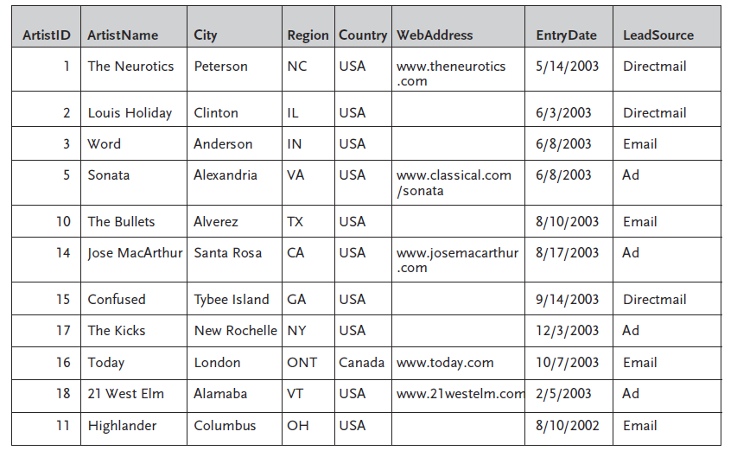
Artists
The Artists table holds information about each artist. An artist could be a band or group. It
could also be a solo artist.

Slide 3
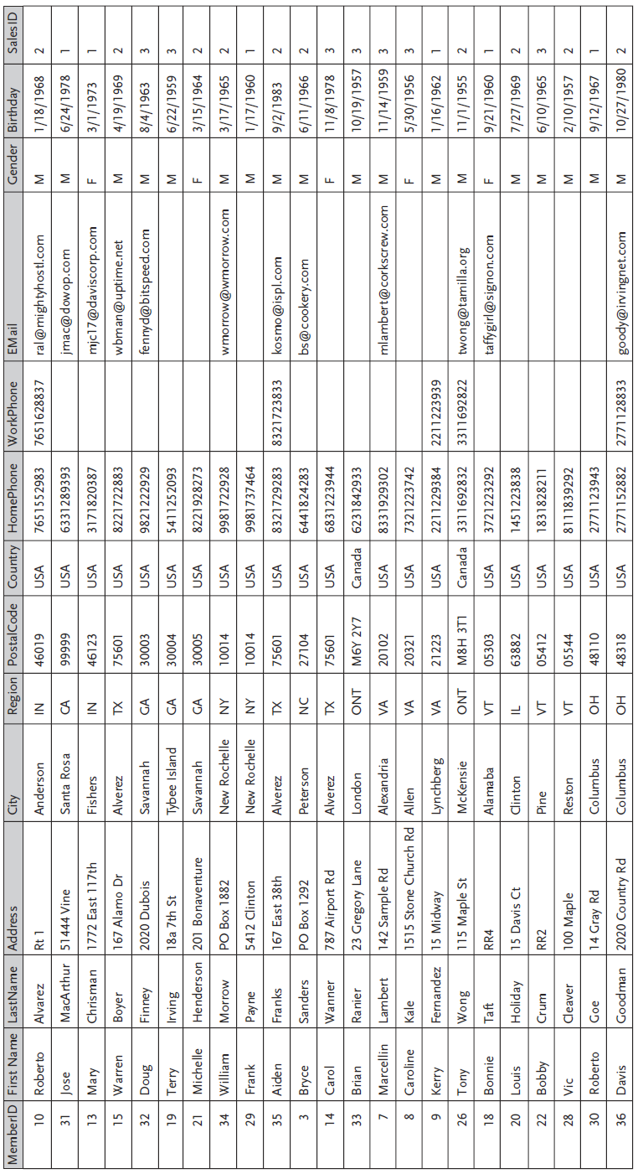
Members
The Members table holds information about the individuals who are members of each artist group.

Slide 4
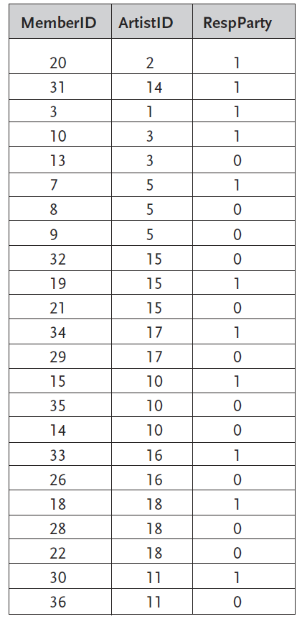
XrefArtistsMembers
An artist (band) may have several members. But also a member may be part of more than one
artist group. For instance Band X may have four members, one of whom also works as a solo
artist. A cross-reference (xref ) table is needed to maintain this complex relationship between
artists and members. XrefArtistsMembers is that table. Its primary key is a combination of
MemberID and ArtistID, so it can match any artist with any member and vice-versa. The
RespParty is a Yes/No field that identifies which of each artist’s members is the person responsible for paying bills and receiving official correspondence from Lyric Music.

Slide 5
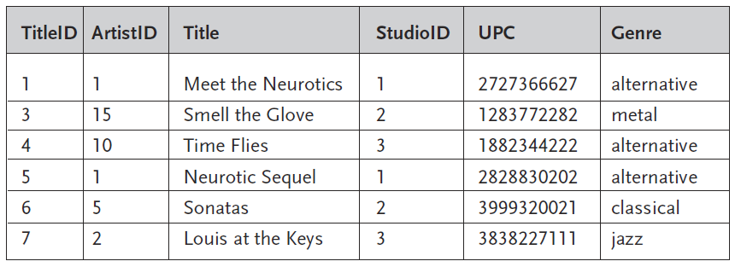
Titles
The Titles table tracks information on each CD title produced by each artist. ArtistID is a
foreign key that relates this table to Artists.

Slide 6
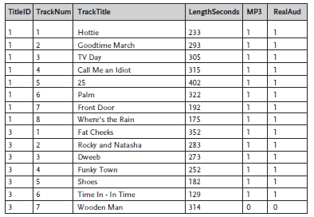
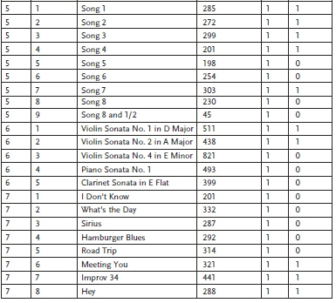
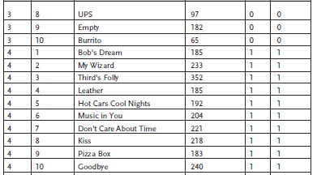
Tracks
Each CD title can have multiple tracks. The primary key of this table is the combination of
TitleID and TrackNum. The mp3 and RealAud fields are Yes/No fields that indicate whether that track is available in mp3 or Real Audio formats.

Slide 7
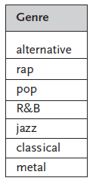
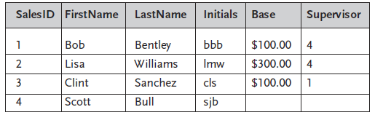
Genre and Salespeople
Genre:
Each title is classified according to its genre. The Genre table is a simple look-up table that lists the valid genres.
Salespeople
The Salespeople table tracks information on the salespeople who work with each member and studio.

Slide 8
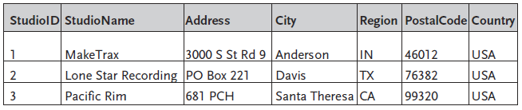
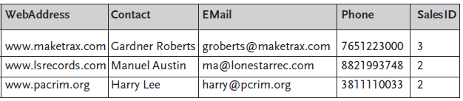
Studios
The Studios table holds information about the studios that produce each CD title.

Slide 9
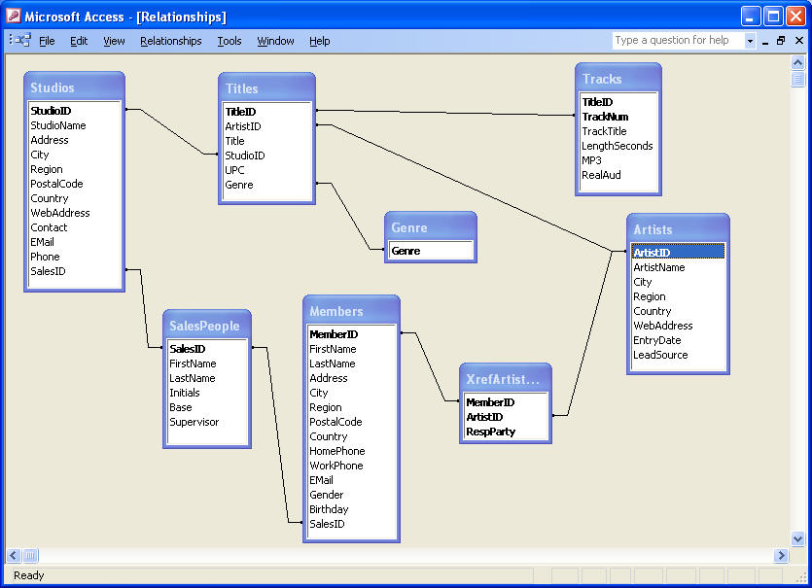
Lyric Music Database Relationships

Slide 10
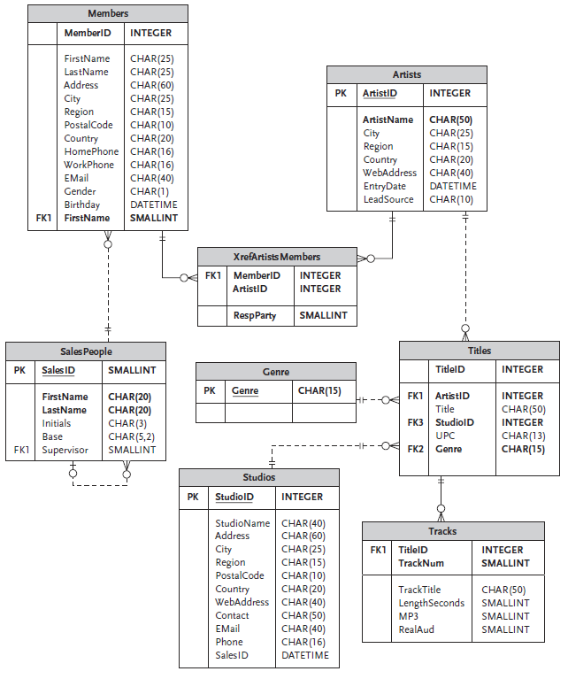
Lyric Music Database Design

