Slide 1
General theme to follow
Header: closest to 20
Font size: subheading 24, heading 60, title 96
Font type to use : quicksand
Home page
Bar at the top with options (everything under sub-bullets is optional)
Lists
Current list
Saved lists
List history
New Deals
Sorted by stores in dropdown
Your savings
Price (Added recently)
cart

Slide 2


Slide 3


Slide 4
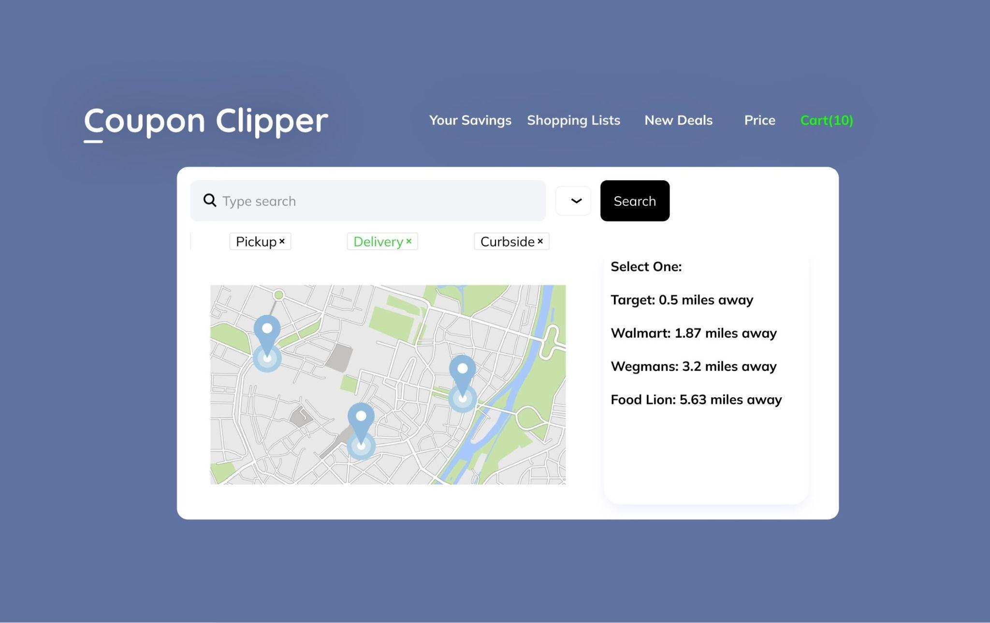

Slide 5
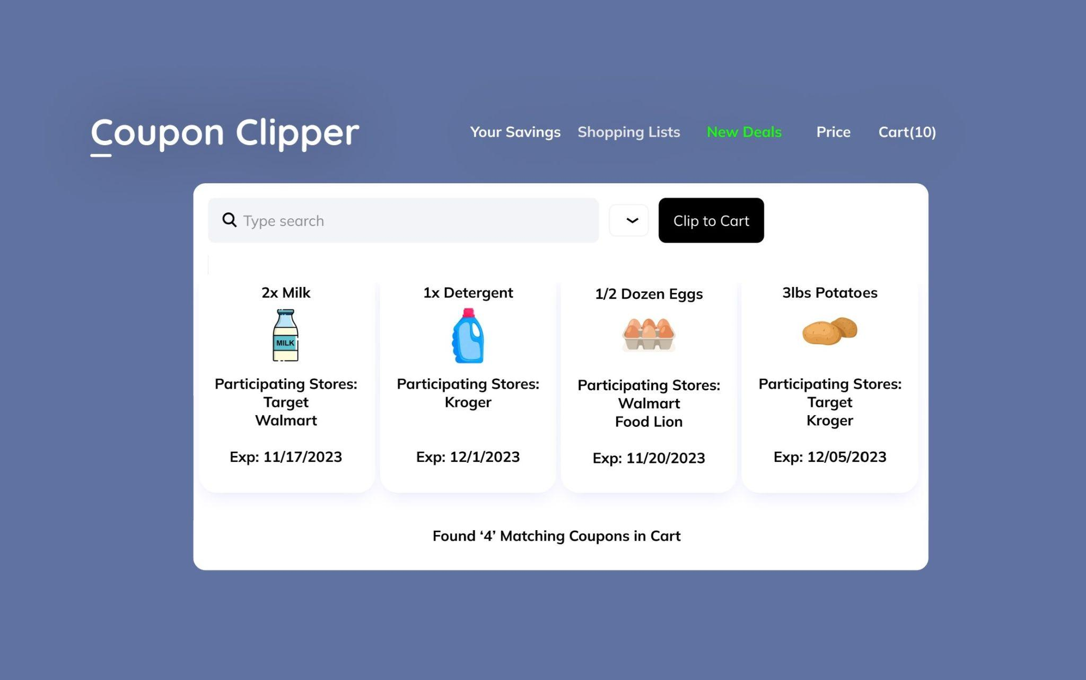

Slide 6
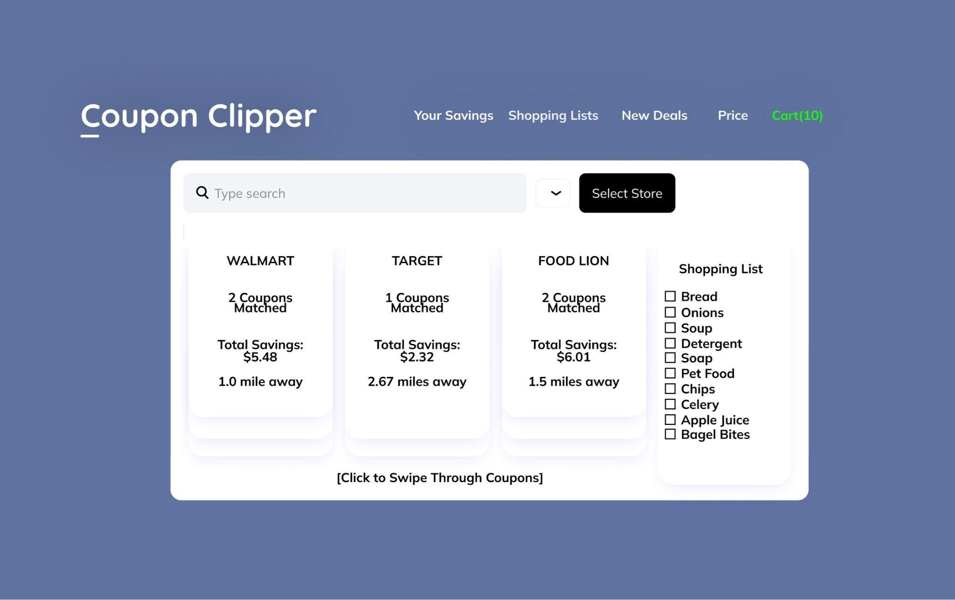

Slide 7
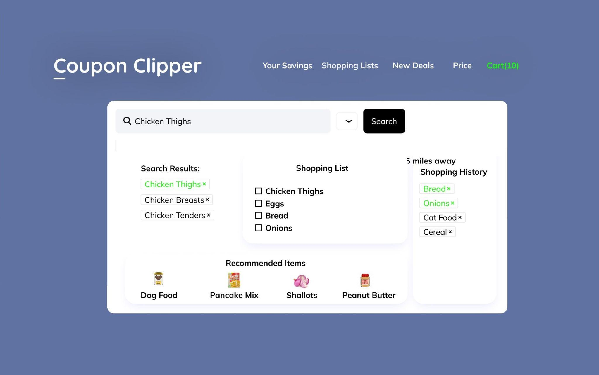

Slide 8
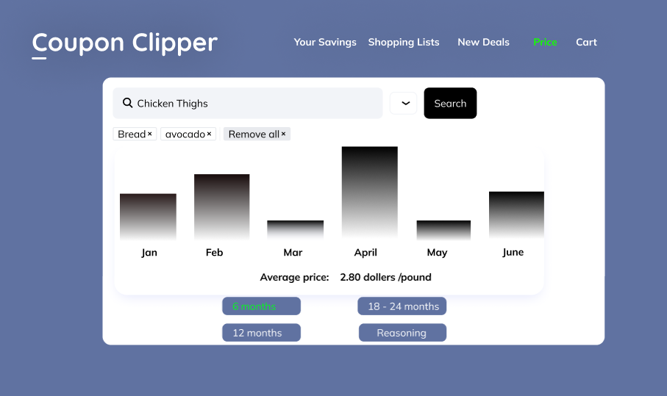

Slide 9
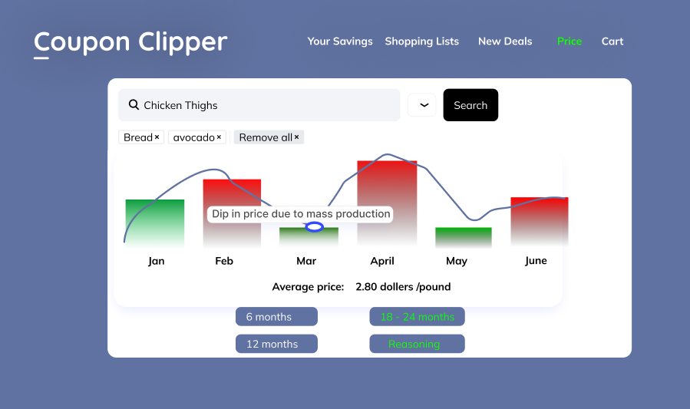

Slide 10
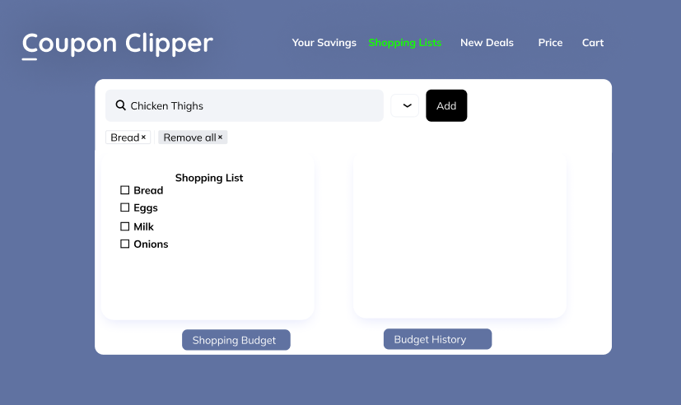

Slide 11
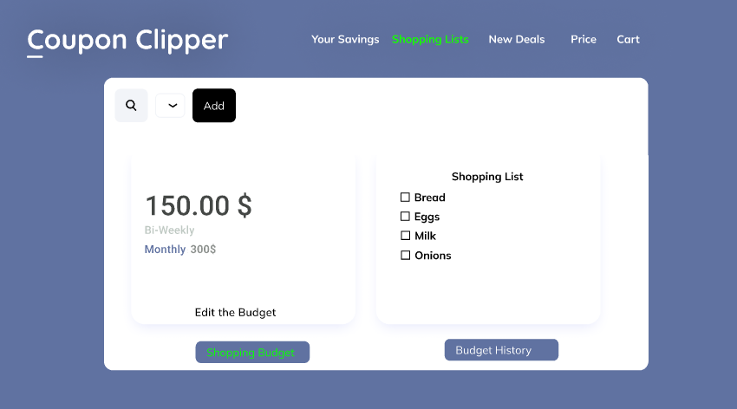

Slide 12
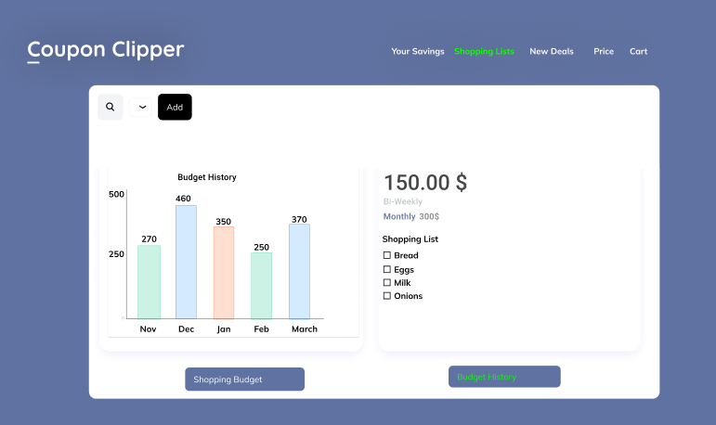

Slide 13
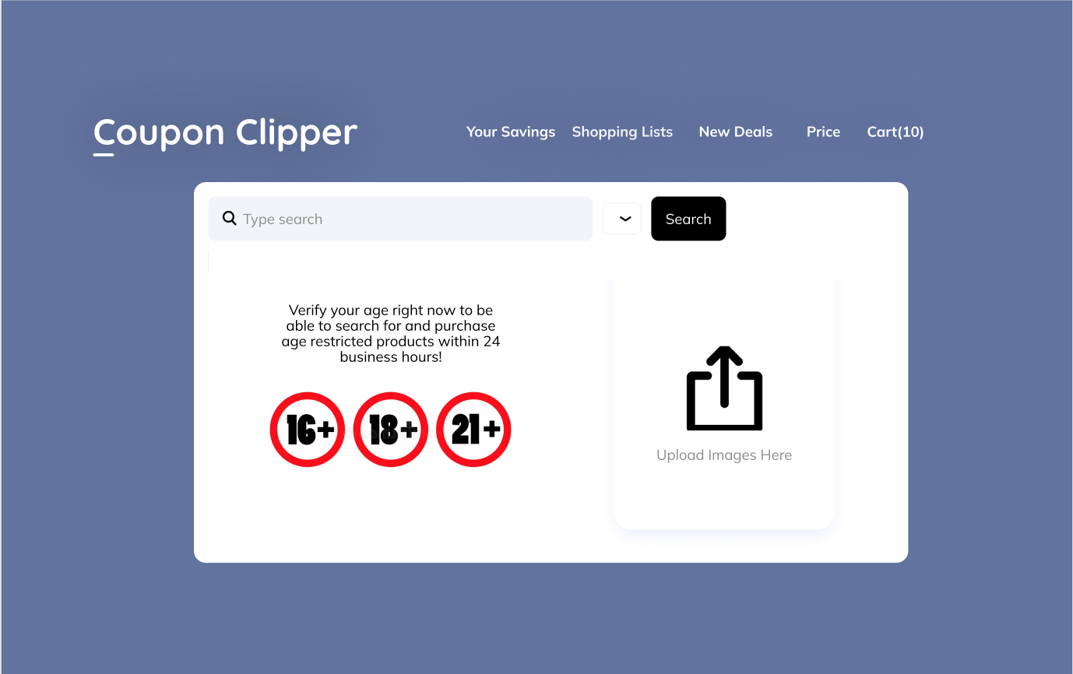

Slide 14
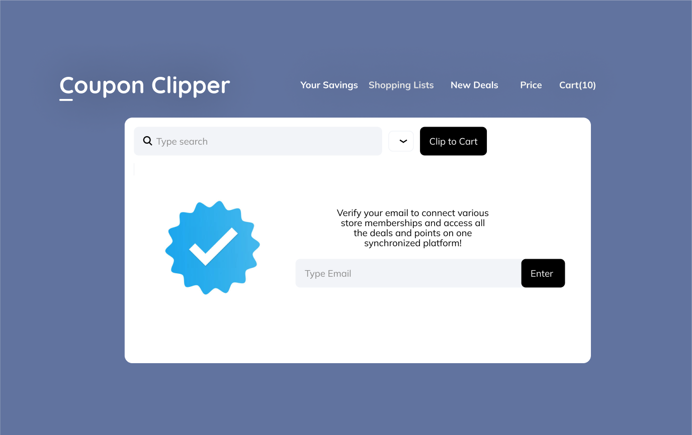

Slide 15
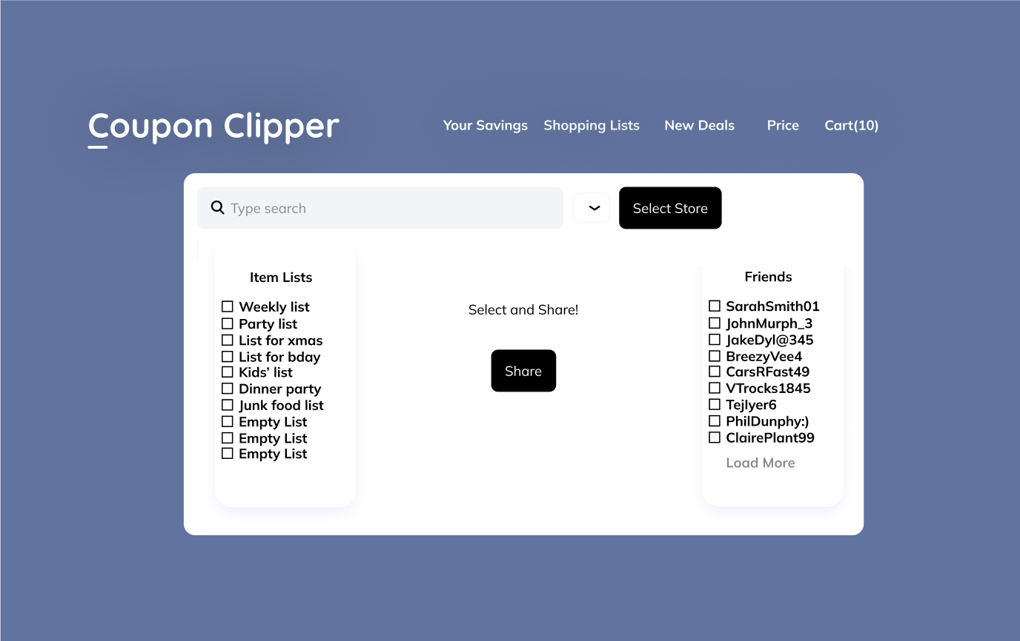

Slide 16


Slide 17
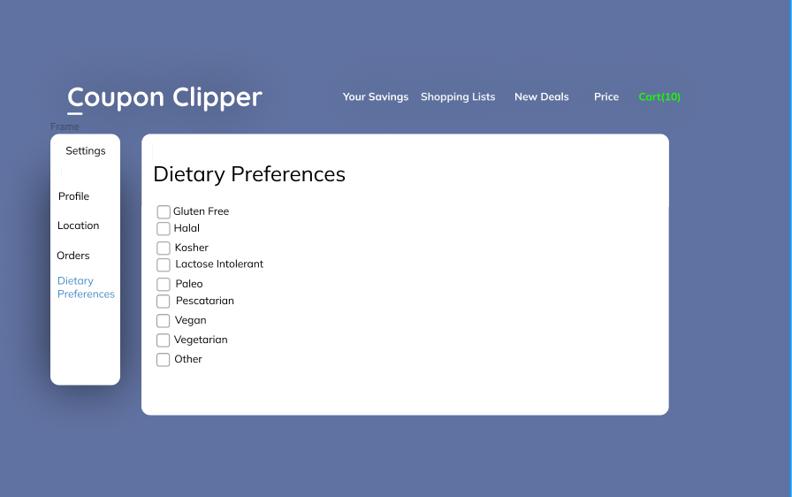

Slide 18
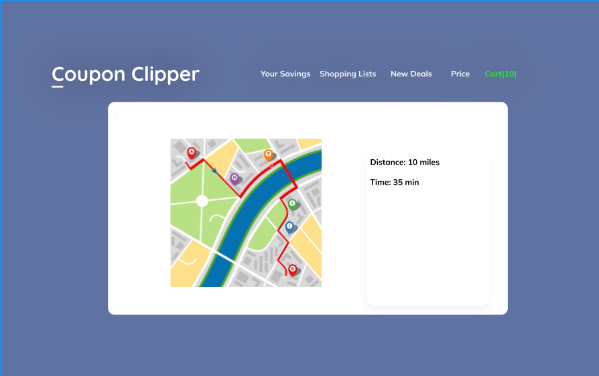

Slide 19
