Slide 1

Culture + Values
Amador Chavez

Slide 2
Have You Ever Been Frustrated?

Slide 3
I Have…
Here’s My Story

Slide 4
Amazing
Willingly Naked
Exact
Seriously Responsive
Original
Merry
Empathetic

Slide 5
“
We see things you don’t see. We’re actually doing what’s best for you.
”
— Nifty Leadership
Notes:
The Way of The Liberal

Slide 6
“
You’re too focused on certain values — and forgetting the other values that are more important.
”
— Nifty Leadership
Notes:
The Way of The Liberal

Slide 7

Life Is About Trade-Offs

Slide 8
We have strong feelings.
Should we be…
Willingly Naked
Empathetic
Should we share everything, even the ugly, hurtful stuff?
Should we censor ourselves to protect people?

Slide 9
The client wants a plan
Should we be…
Exact
Original
Should we be ‘by the book’ with everything we do?
Should we be open-ended and willing to experiment?

Slide 10
Someone’s cat died.
Should we be…
Merry
Empathetic
Be happy
Express Our Condolences

Slide 11
A project is due
Should we be…
Seriously
Responsive
Amazing
Deliver something average or mediocre on time?
Deliver something amazing that’s late?
Notes:
Give something with slightly lower quality now
Give something Amazing in 2-3 Extra Weeks

Slide 12
Withholding Information Out Of Love

Slide 13
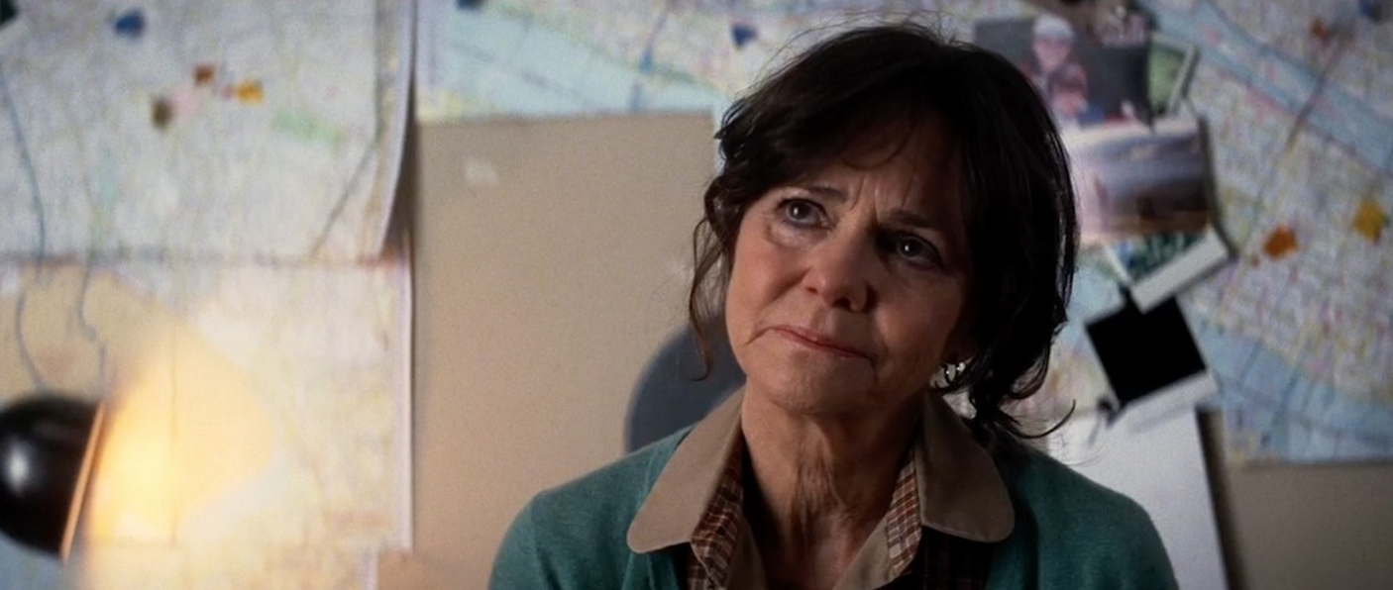
Notes:
ASM2: Aunt May hides information to protect Peter's feelings

Slide 14
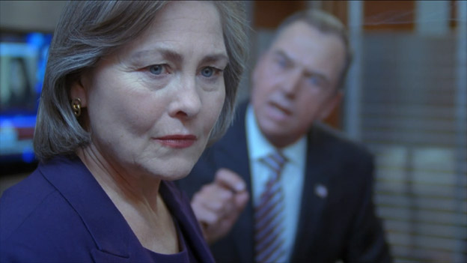
Notes:
President Taylor in 24 withholds information about Russion involvement to maintain the peace treaty.
lie to protect you

Slide 15
A Lot Of Hurtful Things Come From Love

Slide 16
Liberals Are Empathetic
They believe people shouldn’t make decisions for themselves, because can't be trusted to make good decisions, and so the smart people should make the decisions for them because they (the majority of people) don't know any better.
If the smart people can come up with a plan that will benefit everyone in the long run, then it's ok to withhold information or require seemingly unfair regulations.

Slide 17
Nifty Is Empathetic
Nifty withholds information and makes seemingly unfair decisions because they know what they're doing. They are looking at multiple variables. They are seeing things we don’t see because they are looking at the big picture.

Slide 18
Example 1: Healthcare
Empathy
Choice
Give everyone healthcare by mandating insurance.
Let People Make Their Own Decisions About Healthcare
Notes:
Duality of Values
Duel of the Values

Slide 19
Example 2: Gun Control
Empathy
Choice
Get Guns Away From Citizens Because Guns Lead to Death
Guns Are A Safeguard Against Government Corruption
Notes:
Duality of Values
Duel of the Values

Slide 20
Example 3: Unhealthy Foods
Empathy
Choice
Ban Trans Fats +
Tax Soda/Sugar
Let People Eat What They Want
Notes:
Duality of Values
Duel of the Values

Slide 21
Example 4: Salary
Empathy
Choice
To Protect Others You Can’t Know
Verify There Is No Unfairness
Notes:
Duality of Values
Duel of the Values

Slide 22
Example 5: Clarity
Empathy
Choice
Prevent Bitterness
Given The Information To Make Informed Decisions
Notes:
Duality of Values
Duel of the Values

Slide 23
The Nifty Way:
Empathy Trumps All

Slide 24
Is Empathy A
Good Cornerstone?
The Downsides of Empathy

Slide 25
Information Asymmetry Dangers
Humans Are Imperfect
Corruption Is A Real Danger
Unconscious Biases

Slide 26
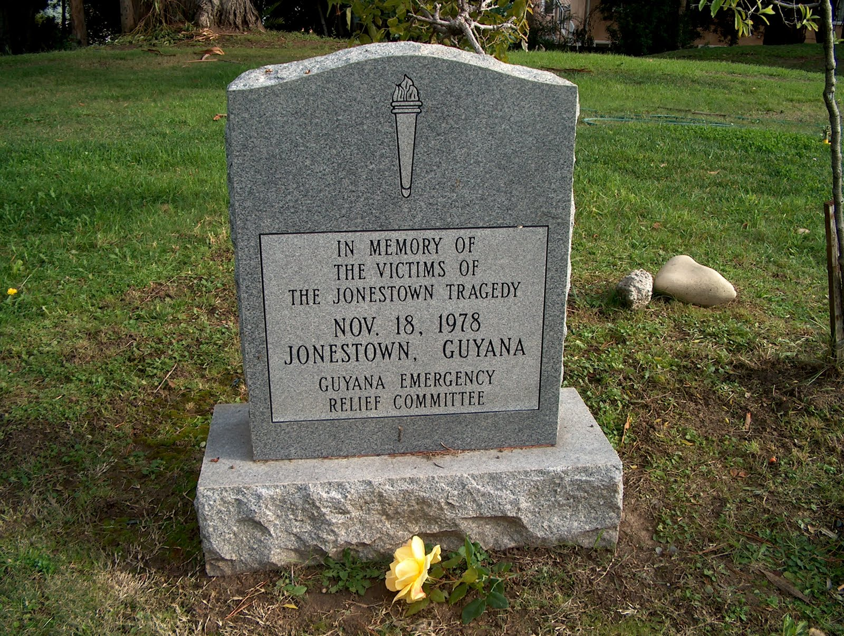
Blind Trust Isn’t Good

Slide 27
Do We Really
Have To Choose?
False Dichotomies & Balance
Notes:
False Dichotomies

Slide 28
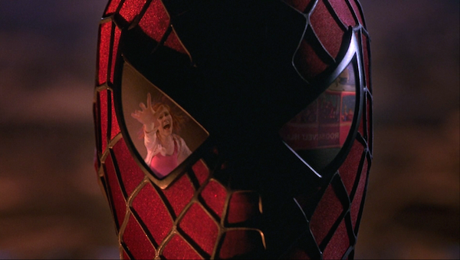
Notes:
<iframe width="560" height="315" src="https://www.youtube.com/embed/O7EZ-CBVgF8?start=72" frameborder="0" allow="autoplay; encrypted-media" allowfullscreen></iframe>

Slide 29
Example 3: Unhealthy Foods
Empathy
BALANCE
Freedom/ Fairness
Ban Trans Fats +
Tax Soda/Sugar
Educate People + Retain Choices
Let People Eat What They Want
Notes:
Maybe, we don’t need to choose one side or another. We can respect both Empathy & Choice. Maybe we don’t need to ban things, but we need to give people the power to make informed choices. Maybe labeling is the middle ground.

Slide 30
Is Empathy a Disguise?
There Are Three
Reasons For Everything
Notes:
There are Three Reasons For Everything

Slide 31
Abortion
YES
NO
Good Reason
Good Reason
Give Women Choice and Prevent Poverty
Save Human Life
Real Reason
Real Reason
Have Sex Without Consequence
Protect People
Fake Reason
Fake Reason
You Hate Women!
You Hate Babies!
Notes:
Duality of Values
Duel of the Values

Slide 32
Salary Transparency
NO
YES
Good Reason
Good Reason
We Care About Your Feelings
I’ve Been Giving X-Amount Of Value
Real Reason
Real Reason
I Don’t Want To Spend Money
I Want More Money
Fake Reason
Fake Reason
You Hate Employees!
Employees Are Acting Entitiled
Notes:
Duality of Values
Duel of the Values

Slide 33
Trust
A Better Cornerstone
Notes:
There are Three Reasons For Everything

Slide 34
The Key To
Ethical Retention of
the Right People is Trust
Notes:
There are Three Reasons For Everything

Slide 35
Trust Equation
Confidence in Competency × Confidence in Character
Notes:
There are Three Reasons For Everything

Slide 36
Why Don’t We Communicate?
Power Imbalance
Notes:
There are Three Reasons For Everything

Slide 37
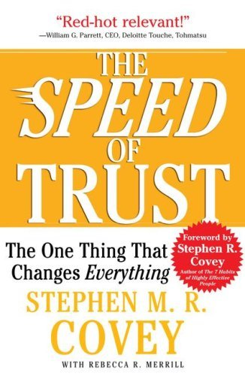


Slide 38
“
I totally wish I could bring up certain dissatisfactions, but I’m all but certain that in doing so, I would be marked as a malcontent, prior organizational reputation notwithstanding.
”
- Nick
Notes:
The Way of The Liberal

Slide 39
So What?
Conclusions
Notes:
There are Three Reasons For Everything

Slide 40
To Non-Management
Give The Benefit of The Doubt
Communicate Your Concerns

Slide 41
To Management
Give Greater Emphasis to Communication
Give Context to Decisions
Seek Feedback From Employees

