Slide 1
Se|| GROUP 1 MEMBERS
Amadu Abubakarr Bah (Group Leader)
Login management (admin,staff,student)
Overall summary (admin,staff,student)
Staff management (admin)
Abubakarr Turay
Student, course, subject, session management (admin)
Agustina Hawanatu Brima
Attendance management (admin,staff,student)
Result management (staff,student)
Charles Thomas
Leave management (admin,staff,student)
Feedback management (admin,staff,student)

Slide 2
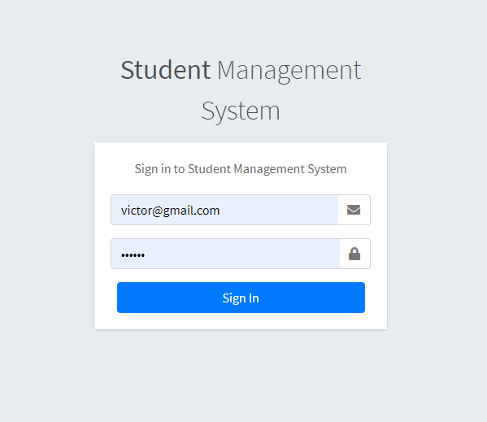
Home page (login authentication)

Slide 3
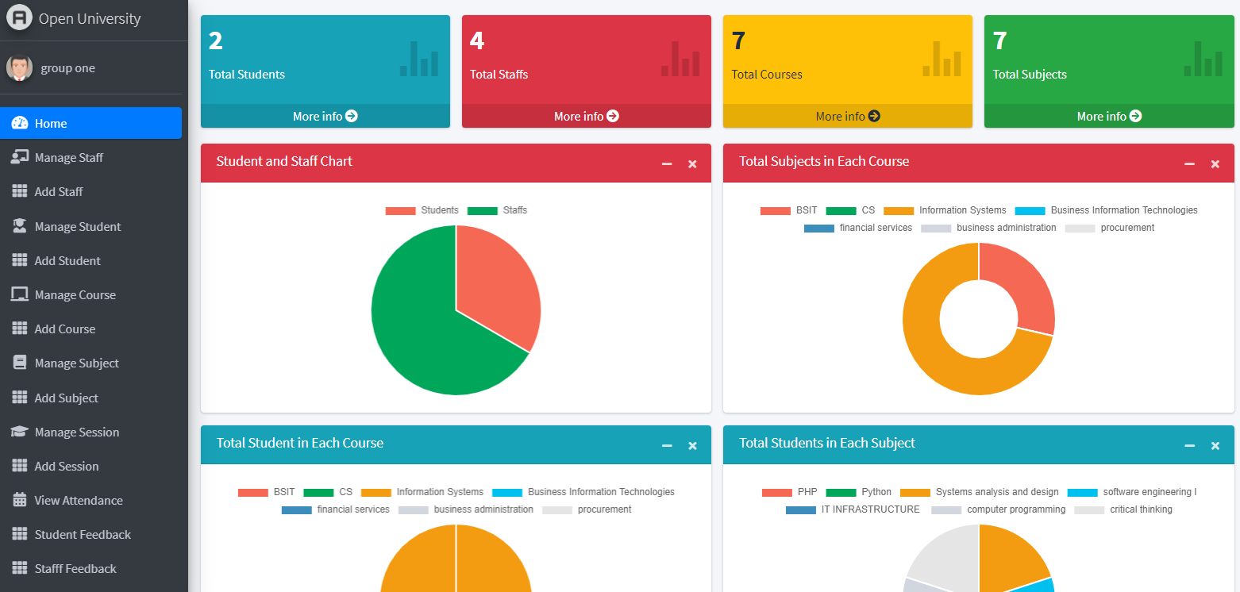
Admin dashboard

Slide 4
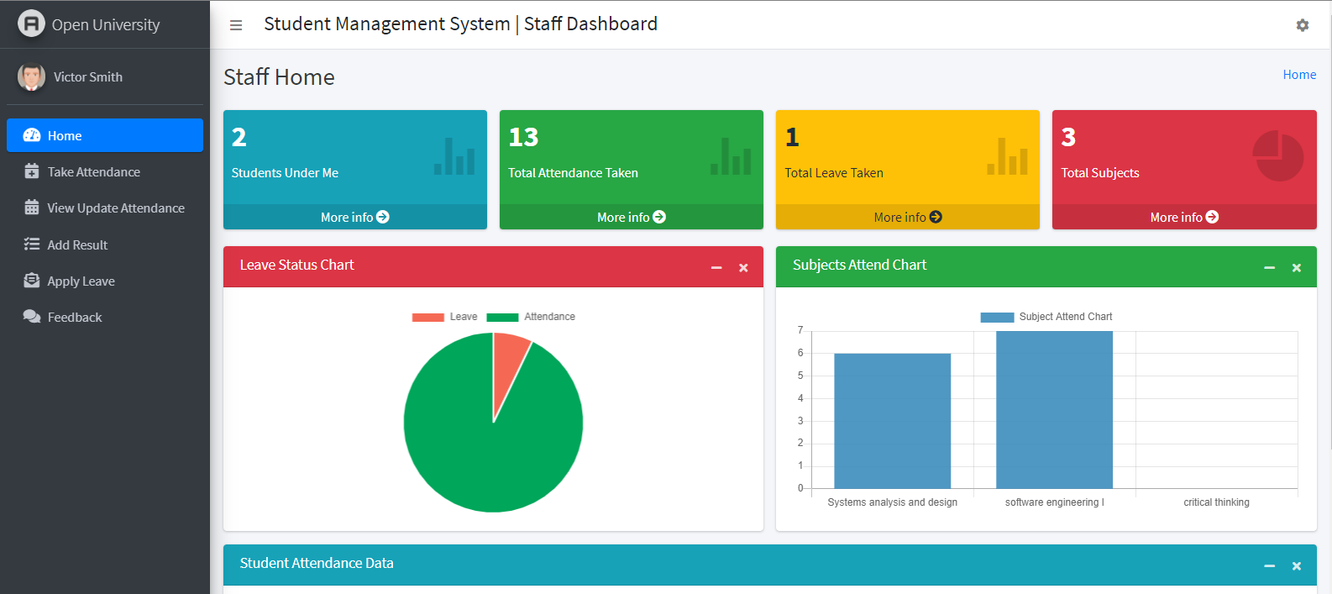
Staff dashboard

Slide 5
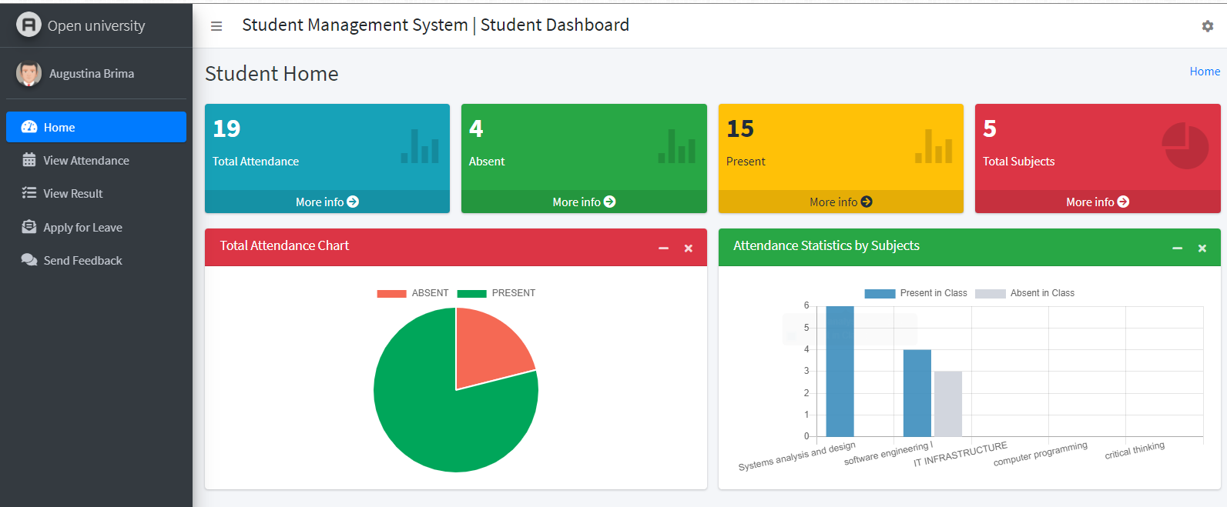
Student dashborad

