Slide 1


https://www.erlang.org/docs
http://erlangcentral.org/
http://learnyousomeerlang.com/
Introduction to Functional Programming

Slide 2
A functional programming language is one that supports and encourages programming without side-effects. In functional code, the output value of a function depends only on the arguments that are input to the function, so calling a function f twice with the same value for an argument x will produce the same result f(x) each time Eliminating side effects, i.e. changes in state that do not depend on the function inputs, can make it much easier to understand and predict the behavior of a program, which is one of the key motivations for the development of functional programming
Functional Programming

Slide 3
DISTRIBUTED
FAULT TOLERANT
SCALABILITY
HIGHLY AVAILABLE
HOT SWAPPING

Slide 4
“If somebody came to me and wanted to pay me a lot of money to build a large scale message handling system that really had to be up all the time, could never afford to go down for years at a time, I would unhesitatingly choose Erlang to build it in” Tim Bray, director of Web Technologies at Sun Microsystems, expressed in his keynote at OSCON in July 2008

Slide 5
Why & What
Why Erlang?
What is Erlang?
You want to write programs that run faster when you run them on a multicore computer.
You want to write fault-tolerant applications that can be modifie without taking them out of service.
You’ve heard about “functional programming” and you’re wondering whether the techniques really work.
You want to use a language that has been battle tested in real large-scale industrial products that has great libraries and an active user community.
You don’t want to wear your fingers out by typing lots of lines of code.
Erlang is a language where concurrency belongs to the programming language and not the operating system
Erlang makes parallel programming easy by modeling the world as sets of parallel processes that can interact only by exchanging messages.
there are parallel processes but no locks, no synchronized methods, and no possibility of shared memory corruption, since there is no shared memory
can run on a single processor, can run on a multicore processor, or can run on a network of processors

Slide 6
Topics
Basic Programming Constructs
Sequential Programming
Exceptions
Advanced Sequential Programming
Compiling and Running
Concurrent Programming
Errors in Concurrent Programming
Distributed Programming
Interfacing Techniques
Programming with files
Socket Programming
ETS & DETS
Mnesia

Slide 7
Installing Erlang
Debian Based systems
apt-get install erlang
Windows Installer
http://www.erlang.org/download.html
Build from source
http://www.erlang.org/download.html

Slide 8
Starting the Shell
$ erl
Erlang/OTP 18 [erts-7.2] [source] [64-bit] [async-threads:10] [hipe] [kernel-poll:false]
Eshell V7.2 (abort with ^G)
1>

Slide 9
Simple Arithmetic
1> 2 + 3 * 4.
14
2> (2 + 3) * 4.
20
3> 123456789 * 987654321 * 112233445566778899 * 998877665544332211.
13669560260321809985966198898925761696613427909935341
4> 16#cafe * 32#sugar.
1577682511434

Slide 10
Variables
1> X = 123456789.
123456789
2> X.
123456789
3> X*X*X*X.
232305722798259244150093798251441
4> X = 1234.
??????????

Slide 11
Variables
When X is UNBOUND = acts like an assignment operator
When X is BOUND ‘=‘ acts like an pattern matching operator
Scope of X is the lexical unit in which it is defined
Lhs = Rhs really means this:
evaluate the right side (Rhs), and then match the result against the pattern
on the left side (Lhs)
In Erlang, there is no mutable state, there is no shared memory,
and there are no locks. This makes it easy to parallelize our
programs.
1> X = 123456789.
123456789
2> X = 1234.
=ERROR REPORT==== 11-Sep-2006::20:32:49 ===
Error in process <0.31.0> with exit value:
{{badmatch,1234},[{erl_eval,expr,3}]}
** exited: {{badmatch,1234},[{erl_eval,expr,3}]} **
Lhs = Rhs really means this:
evaluate the right side (Rhs), and then match the result against the pattern
on the left side (Lhs)

Slide 12
Variables
1> 5/3.
1.66667
2> 4/2.
2.00000
“/” always returns a float
3> 5 div 3.
1
4> 5 rem 3.
2
Div & rem are used for integer division and remainer

Slide 13
Atoms Atoms are used to represent different non-numerical constant values. Similar to enumerated types in C or Java
#include "glob.h“
#define RET_SUCCESS 223
int ret;
ret = file_operation(OP_READ, buff);
if( ret == RET_SUCCESS ) { ... }
Ret = file_operation(op_read, Buff),
if
Ret == ret_success ->
...

Slide 14
Atoms
Atoms start with lowercase letters, followed by a sequence of alphanumeric
characters or the underscore (_) or at (@) sign.
red,december, cat, meters, yards, joe@somehost, and a_long_name
Atoms can also be quoted with a single quotation mark (’).
’Monday’, ’Tuesday’, ’+’, ’*’, ’an atom with spaces’
The value of an atom is just the atom

Slide 15
Tuples
You can create a tuple by enclosing the values you want to represent in curly brackets and separating them with commas
Tuples are similar to structs in C, with the difference that they are Anonymous
Can be Nested

Slide 16
Tuples
struct point {
int x;
int y;
}
P.x = 10; P.y = 45;
1> Point = {point, 10, 45}.
2> {point, X, Y} = Point.
{point,10,45}
3> X.
10
4> Y.
45
5> {point, C, C} = Point.
????

Slide 17
Tuples
5> {point, C, C} = Point.
=ERROR REPORT==== 28-Oct-2006::17:17:00 ===
Error in process <0.32.0> with exit value:
{{badmatch,{point,10,45}},[{erl_eval,expr,3}]}
C cannot be simultaneously 10 and 45

Slide 18
Tuples
1> Person={person,{name,{first,joe},{last,armstrong}},{footsize,42}}.
{person,{name,{first,joe},{last,armstrong}},{footsize,42}}
2> {_,{_,{_,Who},_},_} = Person.
{person,{name,{first,joe},{last,armstrong}},{footsize,42}}
The symbol _ is called an anonymous variable.
Indicates a placeholder for variables that we’re not interested in.
several occurrences of _ in the same pattern don’t have to bind to the same value
3> Who.
joe

Slide 19
Lists
We create a list by enclosing the list elements in square brackets and
separating them with commas
1> ThingsToBuy = [{apples,10},{pears,6},{milk,3}].
[{apples,10},{pears,6},{milk,3}]
The individual elements of a list can be of any type
2> [1+7,hello,2-2,{cost, apple, 30-20},3].

Slide 20
Lists
We call the first element of a list the head of the list, and what’s left is called the tail of the list
Eg: [1,2,3,4,5], 1 is Head, and [2,3,4,5] represents tail
If T is a list, then [H|T] is also a list with Head ‘H’ and Tail ‘T’
The vertical bar | separates the head of a list from its tail
[ ] is the empty list
We can add more than one element to the beginning of T by writing [E1,E2,..,En|T]

Slide 21
Lists
If we have the nonempty list L, then the expression [X|Y] = L, where X and Y are unbound variables, will extract the head of the list into X and the tail of the list into Y
4> [Buy1|ThingsToBuy2] = ThingsToBuy1.
[{oranges,4},{newspaper,1},{apples,10},{pears,6},{milk,3}]
Buy1 → {oranges,4}
ThingsToBuy2 → [{newspaper,1}, {apples,10}, {pears,6}, {milk,3}].
5> [Buy2,Buy3|ThingsToBuy3] = ThingsToBuy2.
Buy2 → {newspaper,1}
Buy3 → {apples,10}
ThingsToBuy3 → [{pears,6},{milk,3}]

Slide 22
Strings
Strictly speaking, there are no strings in Erlang
Strings are really just lists of integers
Strings are enclosed in double quotation marks (")
1> Name = "Hello".
"Hello"

Slide 23
Strings
2> [1,2,3].
[1,2,3]
3> [83,117,114,112,114,105,115,101].
"Surprise“
All the items in the list are printable characters, so the
list is printed as a string.
The characters in a string represent Latin-1 (ISO-8859-1) character
codes.

Slide 24
Strings
3> [83,117,114,112,114,105,115,101].
"Surprise“
4> [1,83,117,114,112,114,105,115,101].
[1,83,117,114,112,114,105,115,101].
the list starts with a 1, which is not a printable character. Because of this, the list is printed
without conversion

Slide 25
Strings
We don’t need to know which integer represents a particular character.
We can use the “dollar syntax” for this purpose
5> I = $s.
115
6> [I-32,$u,$r,$p,$r,$i,$s,$e].
"Surprise"

Slide 26
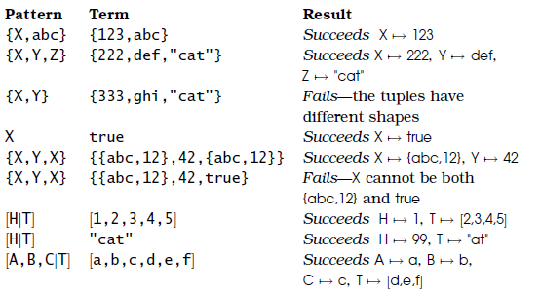
Pattern Matching

Slide 27
Git Path
git remote add origin git@github.com:amadupu/ErlangTraining.git
git init
git@github.com:amadupu/ErlangTraining.git
git remote add origin git@github.com:amadupu/ErlangTraining.git
git clone git@github.com:amadupu/ErlangTraining.git
git add <filename>
git commit -m "Commit message“
git push origin master
git pull google master
git checkout -b feature_x
git checkout master
git branch -d feature_x
git push origin <branch>
git pull
git merge <branch>
git diff <source_branch> <target_branch>
git tag 1.0.0 1b2e1d63ff

Slide 28
Sequential Programming
Moduels
Funcitons
Pattern Matching
Higher order Functions (funs)
Guards
Records
Case expressions
If expressions

Slide 29
Modules
Modules are the basic unit of code in Erlang
All the functions we write are stored in modules
Modules are stored in files with .erl extensions
Modules must be compiled before the code can be run.
A compiled module has the extension .beam
Beam is short for Bogdan’s Erlang Abstract Machine; Bogumil (Bogdan) Hausman wrote an Erlang compiler in 1993 and designed a new instruction set for Erlang

Slide 30

Modules
The function area consists of two clauses.
The clauses are separated
by a semicolon, and the final clause is terminated by dot-whitespace
Each clause has a head and a body
the head consists of a function name followed by a pattern (in parentheses)
the body consists of a
sequence of expressions which are evaluated if the pattern in the head is successfully matched against the calling arguments

Slide 31

Export & Imports
The function total must be exported from the module if we want to call it from outside the model
The functions map/2 & sum/1 are are imported from lists, we need not use full qualified method name
-export , -import is called annotations
-compile(export_all)
Exports all methods in the module

Slide 32
Clause
The function area consists of several different clauses. When we call the function, execution starts in the first clause that matches the call arguments
Our function does not handle the case where none of the patterns
match—our program will fail with a runtime error

Slide 33
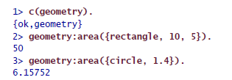
Clause
command c(geometry),
which compiles the code in the file geometry.erl
The compiler returns
{ok,geometry}, which means that the compilation succeeded and that the module geometry has been compiled and loaded
Note how we need to
include the module name together with the function name in order to identify exactly which function we want to call

Slide 34

Arity
The arity of a function is the number of arguments that the function
has.
In Erlang, two functions with the same name and different arity
in the same module represent entirely different functions

Slide 35

Funs
funs are “anonymous” functions
fun(X) ->
//expressions//
end.

Slide 36

Funs
Funs can have any number of arguments

Slide 37
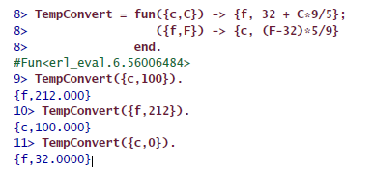
Funs
Funs can have several different clauses

Slide 38

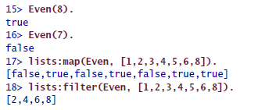
Funs
Functions that return funs, or functions that can accept funs as their
arguments, are called higher-order functions
Functions That Have Funs As Their Arguments
List-at-a-time operation

Slide 39



Funs
Functions that return funs, or functions that can accept funs as their
arguments, are called higher-order functions
Functions That return funs
Mult is a generalization of Double. Instead of computing a value, it returns a function, which when called will compute the required value.

Slide 40
List Comprehensions
List comprehensions are expressions that create lists without having to
use funs, maps, or filters
[X || Qualifier1, Qualifier2, ...]
X is an arbitrary expression, and each qualifier is either a generator or
a filter.
Generators are written as Pattern <- ListExpr where ListExpr must be
an expression that evaluates to a list of terms.
Filters are either predicates (functions that return true or false) or
boolean expressions.

Slide 41



List Comprehensions
The notation [ F(X) || X <- L] means “the list of F(X) where X is taken from
the list L.

Slide 42
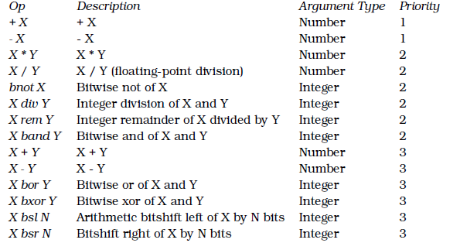
Arithmetic Expressions
Operators with equal
priorities are treated as left associative and are evaluated from left to
right.

Slide 43

Guards
Using guards, we can perform simple tests and comparisons
on the variables in a pattern
You can use guards in the heads of function definitions where they are
introduced by the when keyword, or you can use them at any place in
the language where an expression is allowed.
When they are used as expressions, they evaluate to one of the atoms true or false
If the guard evaluates to true, we say that the evaluation succeeded; otherwise, it fails

Slide 44
Guards
A guard sequence is either a single guard or a series of guards, separated
by semicolons (;)
G1; G2; ...; Gn
A guard is a series of guard expressions, separated by commas (,)
GuardExpr1, GuardExpr2, ..., GuardExprN

Slide 45


Guards

Slide 46


Guards
Short Circuit Boolean expressions

Slide 47
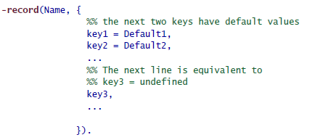
Records
Records provide a method for associating a name with a particular element in a tuple
Each field in a record can have a default value that is used if
no value for this particular field is specified when the record is created

Slide 48

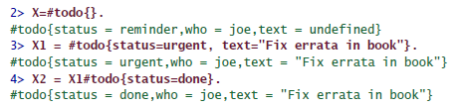
Records

Slide 49
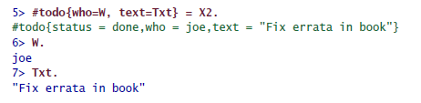

Records

Slide 50
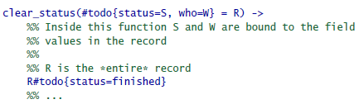

Records

Slide 51
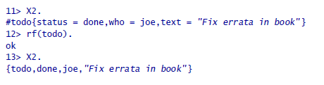
Records
Records are Tuples in disguise

Slide 52

Case Expressions
When writing separate function clauses is inconvenient, case expressions can be used
The result of evaluating the expression sequence is the value of the case expression
If none of the patterns match, then an exception is raised.

Slide 53

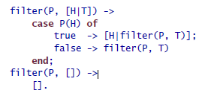
Case Expressions

Slide 54
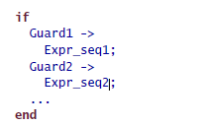
If Expressions

Slide 55


Building Lists
Always add elements to a list head.
2. Taking the elements from the head of an InputList and adding
them head first to an OutputList results in the OutputList having
the reverse order of the InputList.
3. If the order matters, then call lists:reverse/1, which is highly optimized.
4. Avoid going against these recommendations.
In-efficient way

Slide 56
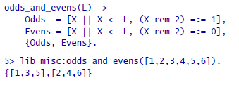
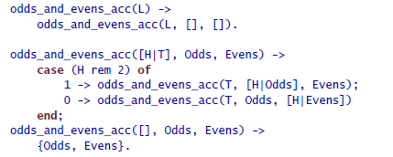
List Accumulators

Slide 57
Exception Types
exit(Why)
This is used when you really want to terminate the current process.
If this exception is not caught, the message {’EXIT’,Pid,Why}
will be broadcast to all processes that are linked to the current
process.
throw(Why)
This is used to throw an exception that a caller might want to
catch.
erlang:error(Why)
This is used for denoting “crashing errors.”
improve the quality of error messages

Slide 58
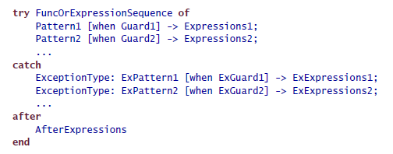
Try Catch Expressions
If Exception-Type is omitted, then the value defaults to throw
Internal errors that are detected by the Erlang runtime system
always have the tag error
The code following the after keyword is used for cleaning up after FuncOr-ExpressionSeq.
The code in the after section is run immediately after
any code in Expressions in the try or catch section of the expression
The return value of AfterExpressions is lost
try...catch Has a Value

Slide 59

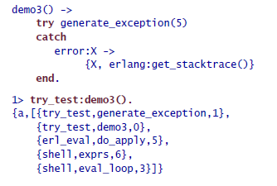
Try Catch Expressions

Slide 60
Catch Primitives
The other way to trap an exception is to use the primitive catch. When
you catch an exception, it is converted into a tuple that describes the
Error
Lose a lot of precision in analyzing the cause of the problem.

Slide 61
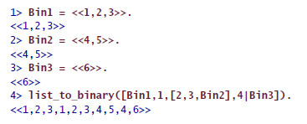
list_to_binary
list_to_binary returns a binary constructed from the integers and
binaries in IoList. Here IoList is a list, whose elements are integers in
0..255, binaries, or IoLists
@spec list_to_binary(IoList) -> binary()

Slide 62

Tuple_to_list
converts a tuple to a list

Slide 63

Binaries
Binaries are written and printed as sequences of integers or strings,
enclosed in double less-than and greater-than brackets
When you use integers in a binary, each must be in the range 0 to 255
As with strings, if the content of a binary is a printable string, then the
shell will print the binary as a string; otherwise, it will be printed as a
sequence of integers.

Slide 64

Split_binary
This splits the binary Bin into two parts at position Pos
@spec split_binary(Bin, Pos) -> {Bin1, Bin2}

Slide 65

term_to_binary
This converts any Erlang term into a binary
This is extremely useful for storing complex data structures in files or sending complex data structures to remote machines.
@spec term_to_binary(Term) -> Bin

Slide 66
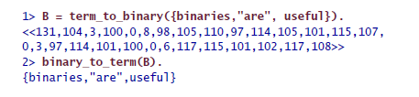
Binary_to_term
This is the inverse of term_to_binary

Slide 67

size
This returns the number of bytes in the binary.
@spec size(Bin) -> Int

Slide 68
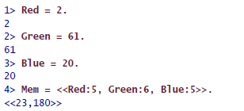
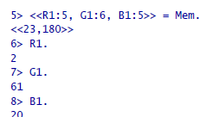
Bit Syntax
We can create a 16-bit memory area Mem containing a single RGB
triplet as follows

Slide 69


Bit Syntax Expressions
Bit syntax expressions are of the following form
Each element Ei specifies a single segment of the binary. Each element
Ei can have one of four possible forms:
Whatever form you use, the total number of bits in the binary must be
evenly divisible by 8.

Slide 70
Bit Syntax Expressions
Value
When you construct a binary, Value must be a bound variable, a literal
string, or an expression that evaluates to an integer, a float, or a binary.
When used in a pattern matching operation, Value can be a bound or
unbound variable, integer, literal string, float, or binary

Slide 71
Bit Syntax Expressions
Size
Size must be an expression that evaluates to an integer. In pattern
matching, Size must be an integer or a bound variable whose value is
an integer. Size cannot be an unbound variable.
The value of Size specifies the size of the segment in units
The default value depends on the type
For an integer it is 8, for a float it is 64, and for a binary it is the size of the
Binary
In pattern matching, this default value is valid only for the very
last element. All other binary elements in the matching must have a
size specification.

Slide 72
Bit Syntax Expressions
TypeSpecifierList
TypeSpecifierList is a hyphen-separated list of items of the form
End-Sign-Type-Unit.
Any of the previous items can be omitted, and the items can
occur in any order. If an item is omitted, then a default value for the
item is used

Slide 73

Bit Syntax Expressions
TypeSpecifierList
@type End = big | little | native
This specifies the endianess of the machine. native is determined
at runtime, depending upon the CPU of your machine.
The default is big. The only significance of this has to do with packing and
unpacking integers from binaries

Slide 74
Bit Syntax Expressions
TypeSpecifierList
@type Sign = signed | unsigned
This parameter is used only in pattern matching. The default is
unsigned

Slide 75
Bit Syntax Expressions
TypeSpecifierList
@type Type = integer | float | binary
The default is integer

Slide 76

Bit Syntax Expressions
TypeSpecifierList
@type Unit = 1 | 2 | ... 255
The total size of the segment is Size x Unit bits long. The total segment
size must be greater than or equal to zero and must be a
multiple of 8.
The default value of Unit depends upon Type and is 1 if Type is
integer or float and 8 if Type is a binary

Slide 77
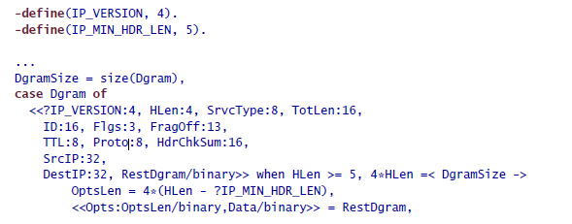
Bit Syntax Expressions

Slide 78
apply
apply(Mod, Func, [Arg1, Arg2, ..., ArgN])
Equivalent to Mod:Func(Arg1, Arg2, ..., ArgN)
Warning: The use of apply should be avoided if possible. When the number
of arguments to a function is known in advance, it is much better
to use a call of the form M:F(Arg1, Arg2, ... ArgN) than apply
many analysis tools cannot work out what is happening, and certain compiler optimizations cannot be made

Slide 79
Attributes
-module(modname).
The module declaration. modname must be an atom. This attribute
must be the first attribute in the file. Conventionally the code for
modname should be stored in a file called modname.erl. If you do
not do this, then automatic code loading will not work correctly

Slide 80
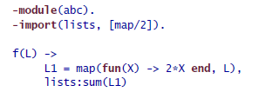
Attributes
-import(Mod, [Name1/Arity1, Name2/Arity2,...]).
Specify that the function Name1 with Arity1 arguments is to be
imported from the module Mod.
Once a function has been imported from a module, then calling
the function can be achieved without specifying the module name.

Slide 81
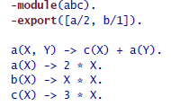

Attributes
-export([Name1/Arity1, Name2/Arity2, ...]).
Export the functions Name1/Arity1, Name2/Arity2, and so on, from
the current module. Note that only exported functions can be
called from outside a module

Slide 82
Attributes
-compile(Options).
Add Options to the list of compiler options. Options is a single compiler
option or a list of compiler options (these are described in the
manual page for the module compile).
Note: The compiler option -compile(export_all). is often used while
debugging programs. This exports all functions from the module
without having to explicitly use the -export annotation

Slide 83
Attributes
-vsn(Version).
Specify a module version. Version is any literal term. The value of
Version has no particular syntax or meaning, but it can be used by
analysis programs or for documentation purposes.

Slide 84
User Defined Attributes
-SomeTag(Value).
SomeTag must be an atom, and Value must be a literal term. The values
of the module attributes are compiled into the module and can be
extracted at runtime.
Use Mod:module_info/0 or Mod:module_info/1 or beam_lib:chunks/2 for viewing attributes
Mod:module_info vs beam_lib:chunks

Slide 85

Block Expressions
You can use block expressions to group a sequence of expressions,
similar to a clause body. The value of a begin ... end block is the value
of the last expression in the block
Block expressions are used when the syntax requires a single expression
but you want to have sequence of expressions at this point in the
code.

Slide 86
Booleans
There is no distinct boolean type in Erlang; instead, the atoms true and
false are given a special interpretation and are used to represent boolean
literals.
Force Binary Functions to Return Booleans

Slide 87
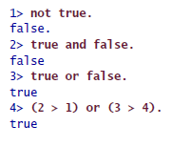
Boolean Expressions
There are four possible boolean expressions:
• not B1: Logical not
• B1 and B2: Logical and
• B1 or B2: Logical or
• B1 xor B2: Logical xor
In all of these, B1 and B2 must be boolean literals or expressions that
evaluate to booleans.

Slide 88
Character Set
Internally Erlang has no character data type. Strings don’t really exist
but instead are represented by lists of integers.

Slide 89

Comments
Comments in Erlang start with a percent character (%) and extend to
the end of line. There are no block comments
Note: You’ll often see double percent characters (%%) in code examples.
Double percent marks are recognized in the emacs erlang-mode and
enable automatic indentation of commented lines

Slide 90
epp
Before an Erlang module is compiled, it is automatically processed by
the Erlang preprocessor epp. The preprocessor expands any macros
that might be in the source file and inserts any necessary include files
compile:file(M, [’P’]).
This compiles any code in the file M.erl and produces
a listing in the file M.P where all macros have been expanded and any
necessary include files have been included

Slide 91
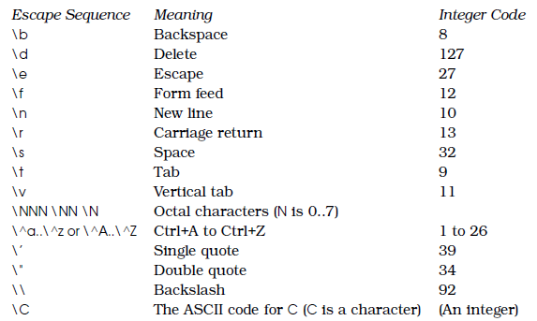
Escape Sequences
Within strings and quoted atoms, you can use escape sequences to
enter any nonprintable characters

Slide 92
Expressions
In Erlang, anything that can be evaluated to produce a value is called
an expression. This means things such as catch, if, and try...catch are
expressions. Things such as records and module attributes cannot be
evaluated, so they are not expressions.

Slide 93
Expressions Sequences
Expression sequences are sequences of expressions separated by commas.
These are found all over the place immediately following an ->
arrow.
The value of the expression sequence E1, E2, ..., En is defined to
be the value of the last expression in the sequence. This is computed
using any bindings created when computing the values of E1, E2, and
so on.

Slide 94
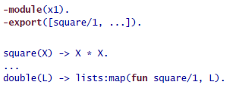

Function References
fun LocalFunc/Arity
This is used to refer to the local function called LocalFunc with Arity
arguments in the current module
fun Mod:RemoteFunc/Arity
This is used to refer to an external function called RemoteFunc with
Arity arguments in the module Mod

Slide 95
Include Files
Files can be included with the following syntax:
-include(Filename).
In Erlang, the convention is that include files have the extension .hrl.
The FileName should contain an absolute or relative path so that the
preprocessor can locate the appropriate file.
Library header files can be included with the following syntax:
-include_lib(Name).

Slide 96
List Operations ++ and --
++ and - - are infix operators for list addition and subtraction
A ++ B adds (that is, appends) A and B.
A - - B subtracts the list B from the list A.
f("begin" ++ T) The clause is expanded into [$b,$e,$g,$i,$n|T].

Slide 97


Macros
-define(Constant, Replacement).
-define(Func(Var1, Var2,.., Var), Replacement).
Macros are expanded by the Erlang preprocessor epp when an expression
of the form ?MacroName is encountered

Slide 98
Macros
In addition, a number of predefined macros provide information about
the current module. They are as follows:
• ?FILE expands to the current filename.
• ?MODULE expands to the current module name.
• ?LINE expands to the current line number

Slide 99
Macros
Control Flow
-undef(Macro).
Undefines the macro; after this you cannot call the macro
-ifdef(Macro).
Evaluates the following lines only if Macro has been defined.
-else.
Allowed after a ifdef or ifndef statement. If the condition was false,
the statements following else are evaluated
-endif.
Marks the end of an ifdef or ifndef statement

Slide 100

Macros
NOTE: c(m1, Options) provides a way of passing options to the compiler. {d,
debug} sets the debug flag to true so that it gets recognized in the -
ifdef(debug) section of the macro definition

Slide 101




Match Operators

Slide 102
Numbers
Integers
Integer arithmetic is exact, and the number of digits that can be represented
in an integer is limited only by available memory
Conventional syntax: 12, 12375, and -23427
Base K integers: Integers in a number base other than ten are
written with the syntax K#Digits
$ syntax: The syntax $C represents the integer code for the ASCII
character C. Thus, $a is short for 97, $1 is short for 49, and so on
Examples: 0 -65 2#010001110 -8#377 16#fe34 16#FE34 36#wow
(Their values are 0, -65, 142, -255, 65076, 65076, and 42368, respectively.)

Slide 103
Numbers
Floats
A floating-point number has five parts: an optional sign, a whole number
part, a decimal point, a fractional part, and an optional exponent
Par
After parsing, floating-point numbers are represented internally in
IEEE 754 64-bit format. Real numbers in the range −10323 to 10308 can
be represented by an Erlang float
Example: 1.0 3.14159 -2.3e+6 23.56E-27

Slide 104
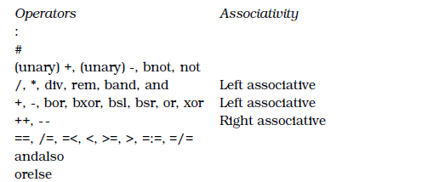
Operator Precedence
Operator precedence and associativity is used to determine the evaluation order in unparenthesized expressions.
As with all programming languages, it is better to use parentheses to denote scope than to rely upon the precedence rules.

Slide 105
Process Dictionary
Each process in Erlang has its own private data store called the process
Dictionary
The process dictionary is an associative array (in other languages
this might be called a map, hashmap, or hash table) composed
of a collection of keys and values
Each key has only one value
NOTE: use the process dictionary sparingly.

Slide 106
Process Dictionary
@spec put(Key, Value) -> OldValue
@spec get(Key) -> Value
@spec get() -> [{Key,Value}].
@spec get_keys(Value) -> [Key].
@spec erase(Key) -> Value.
@spec erase() -> [{Key,Value}].

Slide 107
References
erlang:make_ref()
References are globally unique Erlang terms. References are useful for creating unique tags that can be included in data and then at a later stage compared for equality

Slide 108
Process Dictionary
@spec put(Key, Value) -> OldValue
@spec get(Key) -> Value
@spec get() -> [{Key,Value}].
@spec get_keys(Value) -> [Key].
@spec erase(Key) -> Value.
@spec erase() -> [{Key,Value}].

Slide 109
Short Circuit Boolean Expr
Short-circuit boolean expressions are boolean expressions whose arguments
are evaluated only when necessary
Expr1 orelse Expr2
Expr1 andalso Expr2
Note: In the corresponding boolean expressions (A or B; A and B), both the
arguments are always evaluated, even if the truth value of the expression
can be determined by evaluating only the first expression

Slide 110
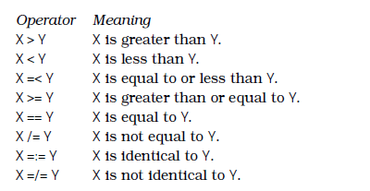
Term Comparisions
number < atom < reference < fun < port < pid < tuple < list < binary

Slide 111


Underscore Variables
The special syntax _Var is used for a normal variable, not an anonymous variable. (ie only underscore )
Suppress warning for unused variables
Since _Var is a normal variable, very subtle bugs can be caused by forgetting
this and using it as a “don’t care” pattern

Slide 112
Shutdown
erlang:halt()
immediately stops the system. The system may go for error recover after restart
Not the recommended way to stop the system

Slide 113
Shutdown
Init:stop()
This flushes all open files, stops the database (if running), and closes
all OTP applications in an ordered manner
q() is a shell alias.

Slide 114
Search Paths
The Erlang runtime system makes use of a code autoloading mechanism.
For this to work correctly, you must set a number of search
paths in order to find the correct version of your code
@spec code:add_patha(Dir) => true | {error, bad_directory}
@spec code:add_pathz(Dir) => true | {error, bad_directory}
@spec code:get_path() => [Paths]
Alternative way
> erl -pa Dir1 -pa Dir2 ... -pz DirK1 -pz DirK2

Slide 115
About .config
when you start Erlang, it first reads and evaluates all the commands in the .config file
The file is placed in home folder
If there is a file called .erlang in the current directory when Erlang is
started, then it will take precedence over the .erlang in your home directory.
NOTE: To find out where Erlang thinks your home directory run the following command:
init:get_argument(home)

Slide 116
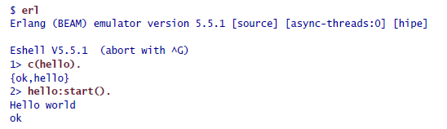
Running Program
Compile and run in erlang shell

Slide 117

Running Program
Compile and Run from the Command Prompt
-noshell
Start Erlang without an interactive shell
-s hello start
Run the function hello:start().
-s init stop
When apply(hello, start, [ ]) has finished, then the system evaluates
the function init:stop().
Note: When using the -s Mod ... option, the Mod must have been
compiled.

Slide 118

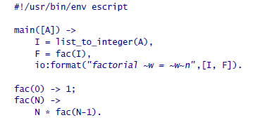


Escript
Using escript you can run your programs directly as scripts—there’s no
need to compile them first

Slide 119
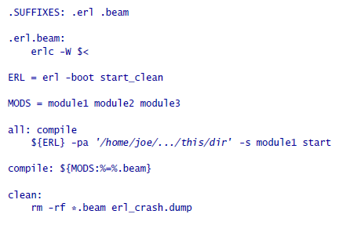
Makefile
Automates compiling and distribution of erlang code

Slide 120
Crash Dump
If Erlang crashes, then it leaves behind a file called erl_crash.dump in the current working directory. The contents of this file might give you a clue as to what has gone wrong.
Refer documentation for more details

Slide 121
Process
In Erlang, processes belong to the programming language and NOT the operating system
Creating and destroying processes is very fast
Sending messages between processes is very fast
Processes behave the same way on all operating systems
We can have very large numbers of processes
Processes share no memory and are completely independent
The only way for processes to interact is through message passing

Slide 122
Process
In Erlang, programming with processes is easy. It just needs
three new primitives: spawn, send, and receive

Slide 123
Process
Pid = spawn(Fun)
Creates a new concurrent process that evaluates Fun.
The new process runs in parallel with the caller.
spawn returns a Pid (shortfor process identifier).
You can use Pid to send messages to the process

Slide 124
Process
Pid ! Message
Sends Message to the process with identifier Pid.
Message sending is asynchronous. The sender does not wait but continues with what it was doing.
! is called the send operator
message sending primitive ! Returns the message itself
Pid1 ! Pid2 ! ... ! M means send the message M to all the processes Pid1, Pid2, and so on.

Slide 125
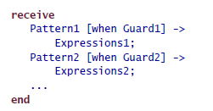
Process
receive ... End
Receives a message that has been sent to a process.
If none of the patterns matches, the message
is saved for later processing, and the process waits for the next message

Slide 126
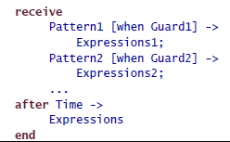
Process
Receive with timeout
maximum time that the process will wait to receive a message

Slide 127

Process
Receive with timeout
Sleep Method

Slide 128
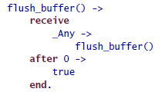
Process
Receive with timeout 0
flush_buffer

Slide 129
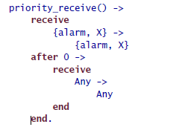
Process
Receive with timeout 0
Priority_receive

Slide 130
Process
Receive with timeout infinity
If the timeout value in a receive statement is the atom infinity, then the timeout will never trigger

Slide 131
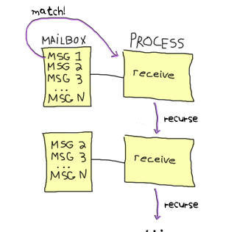
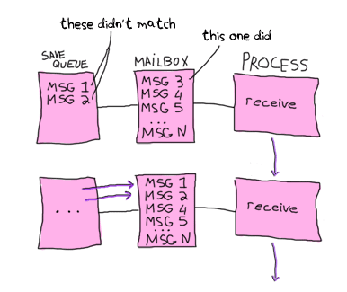
Process
Selective Receive

Slide 132
Process
Registered Process
Erlang has a method for publishing a process identifier so that any process
in the system can communicate with this process. Such a process
is called a registered process

Slide 133
Process
register(AnAtom, Pid)
Register the process Pid with the name AnAtom. The registration
fails if AnAtom has already been used to register a process.

Slide 134
Process
unregister(AnAtom)
Remove any registrations associated with AnAtom
Note: If a registered process dies it will be automatically unregistered.

Slide 135
Process
whereis(AnAtom) -> Pid | undefined
Find out whether AnAtom is registered.
Return the process identifier Pid, or return the atom undefined if no process is associated with AnAtom

Slide 136
Process
registered() -> [AnAtom::atom()]
Return a list of all registered processes in the system

Slide 137
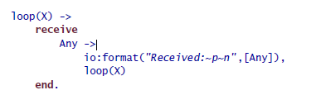
Process
Tail recursion
A tail-recursive function can be compiled so that the last function call in a sequence of statements can be replaced by a simple jump to the start of the function being called.
This means that a tail-recursive function can loop forever without consuming
stack space.

Slide 138
Process
spawn(Mod, FuncName, Args)
This creates a new process. Args is a list of arguments of the form
[Arg1, Args2, ..., ArgN]. The newly created process starts evaluating
Mod:FuncName(Arg1, Arg2, ..., ArgN).
Spawning a function with an explicit module, function name, and argument
list (called an MFA) is the proper way to ensure that our running
processes will be correctly updated with new versions of the module
code if it is compiled while it is being used.

Slide 139
Exercise
Implement a clock, which calls the callback function when the timer expires

Slide 140
Process
Links
A link is something that defines an error propagation path between
two processes.
If two processes are linked together and one of the
processes dies, then an exit signal will be sent to the other process.
The set of processes that are currently linked to a given process is
called the link set of that process.

Slide 141
Process
Exit signals
An exit signal is something generated by a process when the process
Dies, specifying a reason
This signal is broadcast to all processes that are in the
link set of the dying process
When a process has successfully evaluated the function it was
spawned with, it will die with the exit reason normal

Slide 142
Process
System Process
When a process receives a non-normal exit signal, it too will die
unless it is special kind of process called a system process
When a system process receives an exit signal Why from a process Pid,
then the exit signal is converted to the message {’EXIT’, Pid, Why}
and added to the mailbox of the system process.
Calling the BIF process_flag(trap_exit, true) turns a normal process
into a system process that can trap exits.

Slide 143
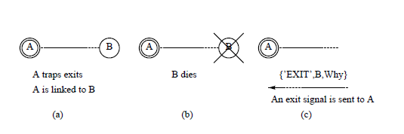
Process
Normal Process
System Process
Remote handling of errors

Slide 144
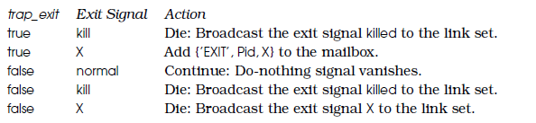
Process
Signal Handling
An untrappable exit signal will always kill the process it is sent to, even
if it is a system process

Slide 145
Process
Idiom 1: I Don’t Care If a Process I Create Crashes
Pid = spawn(fun() -> ... end)

Slide 146
Process
Idiom 2: I Want to Die If a Process I Create Crashes
Pid = spawn_link(fun() -> ... end)

Slide 147
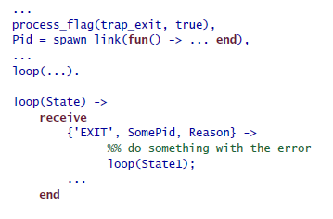
Process
Idiom 3: I Want to Handle Errors If a Process I Create Crashes

Slide 148
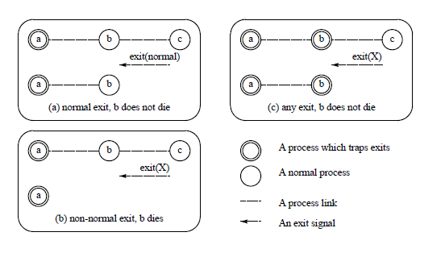
Process
Trapping Exits

Slide 149
Process
@spec spawn_link(Fun) -> Pid
This is exactly like spawn(Fun), but it also creates a link between
the parent and child processes.

Slide 150
Process
@spec process_flag(trap_exit, true)
This turns the current process into a system process. A system process is a process that can receive and process error signals

Slide 151
Process
@spec link(Pid) -> true
Create a link to the process Pid if there is not already a link.
Links are symmetric.

Slide 152
Process
@spec unlink(Pid) -> true
This removes any link between the current process and the process Pid.

Slide 153
Process
@spec exit(Why) -> none()
This causes the current process to terminate with reason Why.
If the clause that executes this statement is not within the scope of catch statement, then the current process will broadcast an exit signal, with argument Why to all processes to which it is currently linked

Slide 154
Process
@spec exit(Pid, Why) -> true
This sends an exit signal with reason Why to the process Pid.

Slide 155
Process
@spec erlang:monitor(process, Item) -> MonitorRef
A monitor is an asymmetric link
Item is a PID or a registered name of a process
If process A monitors process B and B dies, A will be sent an exit signal. But if A dies, B will not be sent a signal.

Slide 156
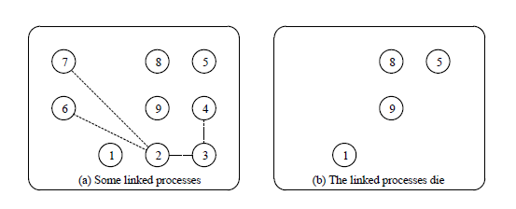
Process
Link set

Slide 157
Distributed Programming
Performance
Reliability
Scalability
Intrinsically distributed application

Slide 158
Distributed Programming
Model 1: Distributed Erlang
Provides a method for programming applications that run on a set of tightly coupled computers and trusted env
In distributed Erlang, programs are written to run on Erlang nodes.
We can spawn a process on any node, and all the message passing
and error handling primitives we talked about in previous chapters
work as in the single node case

Slide 159
Distributed Programming
Model 1: Distributed Erlang
Provides a method for programming applications that run on a set of tightly coupled computers and trusted env
In distributed Erlang, programs are written to run on Erlang nodes.
We can spawn a process on any node, and all the message passing
and error handling primitives we talked about in previous chapters
work as in the single node case

Slide 160
Distributed Erlang
“Writing a distributed Erlang program is easy; all we have to do is spawn our processes on the correct machines, and then everything works as before.”

Slide 161
Distributed Programming
Starting Node on same host
$ erl -sname user1
(user1@localhost) 1>
The argument -sname <name> means “start an Erlang node with name
<name> on the local host.”
Using -sname is also the method that will work if no DNS service is available.
NOTE –sname stands for short name

Slide 162
Distributed Programming
Starting Node on different host in same LAN
$ erl -name user1 -setcookie somerandomtoken
(user1@region1.example.com) 1>
$ erl -name user2 -setcookie somerandomtoken
(user2@region2.example.com) 1>
Use –name when on different networks. If in the same network use –sname
Ensure that both nodes have the same cookie
Make sure the fully qualified hostnames of the nodes concerned
are resolvable by DNS
Make sure that both systems have the same version of the code

Slide 163

Distributed Programming
Starting Node on different host in INTERNET
Same procedures as that of different host in LAN
Make sure that port 4369 is open for both TCP and UDP traffic.
This port is used by a program called epmd (short for the Erlang
Port Mapper Daemon).
Choose a port or range of ports to be used for distributed Erlang,
and make sure these ports are open

Slide 164
Distributed Programming
@spec spawn(Node, Fun) -> Pid
This works exactly like spawn(Fun), but the new process is spawned
on Node

Slide 165
Distributed Programming
@spec spawn(Node, Mod, Func, ArgList) -> Pid
This works exactly like spawn(Mod, Func, ArgList), but the new process
is spawned on Node

Slide 166
Distributed Programming
@spec spawn_link(Node, Fun) -> Pid
This works exactly like spawn_link(Fun), but the new process is
spawned on Node

Slide 167
Distributed Programming
@spec spawn_link(Node, Mod, Func, ArgList) -> Pid
This works like spawn(Node,Mod, Func, ArgList), but the new process
is linked to the current process

Slide 168
Distributed Programming
@spec disconnect_node(Node) -> bool() | ignored
This forcibly disconnects a node.

Slide 169
Distributed Programming
@spec monitor_node(Node, Flag) -> true
If Flag is true, monitoring is turned on; if Flag is false, monitoring
is turned off.
If monitoring has been turned on, then the process that evaluated this BIF will be sent {nodeup, Node} and {nodedown,Node} messages if Node joins or leaves the set of connected Erlang nodes.

Slide 170
Distributed Programming
@spec node() -> Node
This returns the name of the local node. nonode@nohost is returned
if the node is not distributed.

Slide 171
Distributed Programming
@spec node(Arg) -> Node
This returns the node where Arg is located. Arg can be a PID, a reference, or a port. If the local node is not distributed, nonode@nohost is returned.

Slide 172
Distributed Programming
@spec nodes() -> [Node]
This returns a list of all other nodes in the network to which we are connected

Slide 173
Distributed Programming
@spec is_alive() -> bool()
This returns true if the local node is alive and can be part of a distributed system. Otherwise, it returns false

Slide 174
Distributed Programming
{RegName, Node} ! Msg
Sends the message Msg to the registered process RegName on the node
Node

Slide 175
Distributed Programming
Libraries for Distributed Programming
rpc: Provides a number of remote procedure call services
call(Node, Mod, Function, Args) -> Result | {badrpc, Reason}
This evaluates apply(Mod, Function, Args) on Node and returns the
result Result or {badrpc, Reason} if the call fails
global: Has functions for the registration of names and locks in a
distributed system and for the maintenance of a fully connected
network.

Slide 176
Distributed Programming
Cookie Protection System
For two distributed Erlang nodes to communicate, they must have the
same magic cookie
cookies are never sent across the network in the clear
Cookies are used only for the initial authentication of a session
Distributed Erlang sessions are not encrypted but can be set
up to run over encrypted channels

Slide 177
Distributed Programming
Cookie Protection System
Method 1: Store the same cookie in the file $HOME/.erlang.cookie
This file contains a random string and is automatically created the
first time Erlang is run on your machine
Method2: When Erlang is started, we can use the command-line
argument -setcookie C to set the magic cookie to C. (not recommended)
$ erl -setcookie AFRTY12ESS3412735ASDF12378 ...
Method 3: The BIF erlang:set_cookie(node(), C) sets the cookie of the
local node to the atom C

Slide 178
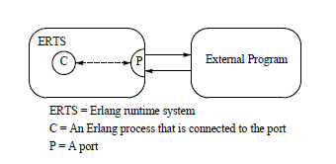
Interfacing Techniques
Running the external program in a separate operating system process outside the Erlang runtime system and communicate with this process through a byte-oriented communication channel.

Slide 179
Interfacing Techniques
Connected Process
The process that creates a port
is called the connected process for that port
all messages to the external program must be tagged with the PID of the connected process, and all messages from the external program are sent to the connected processes

Slide 180
Interfacing Techniques
Port
The Erlang side of the communication
is controlled by an Erlang port.
As far as the programmer is concerned, the port behaves just like an Erlang process

Slide 181
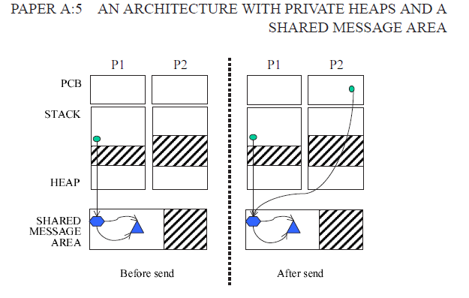
Memory Architecture
http://www.it.uu.se/research/publications/lic/2005-001/2005-001.pdf

Slide 182
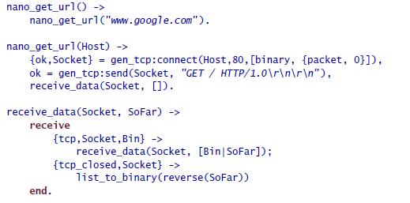
Socket Programming

Slide 183
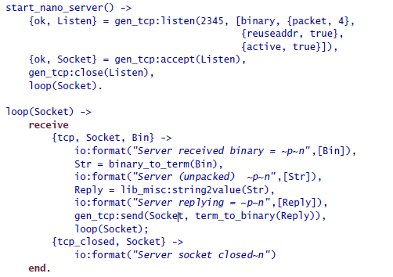
Socket Programming
Simple Server
{packet, 4} means that each application message will be preceded by a 4-byte length
header.
gen_tcp:listen(..) returns {ok, Socket} or {error, Why},

Slide 184
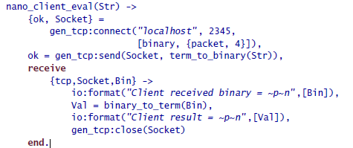
Socket Programming
Simple Client

Slide 185
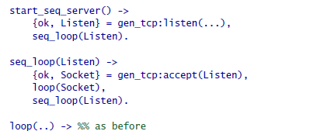
Socket Programming
Sequential Server

Slide 186
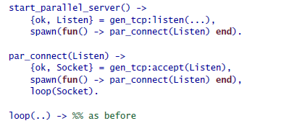
Socket Programming
Parallel Server

Slide 187
Socket Programming
The process that creates a socket (by calling gen_tcp:accept or
gen_tcp:connect) is said to be the controlling process for that socket.
All messages from the socket will be sent to the controlling process;
if the controlling process dies, then the socket will be closed.
The controlling process for a socket can be changed to NewPid by
calling gen_tcp:controlling_process(Socket, NewPid).

Slide 188

Socket Programming
After we have accepted a connection, it’s a good idea to explicitly
set the required socket options, like this:

Slide 189
Socket Programming
Message Reception
Active Reception (Non Blocking)
Passive Reception (Blocking)
Hybrid Reception (partial blocking)

Slide 190


Socket Programming
Active Message Reception (Non Blocking)
If the client produces data faster than the server can consume this data, then the system can be flooded with messages—the message buffers will fill up, and the system might crash or behave strangely

Slide 191

Socket Programming
Passive Message Reception (Blocking)
The code in the server loop calls gen_tcp:recv every time it wants to receive data. The client will block until the server has called recv

Slide 192

Socket Programming
Hybrid Message Reception (Partial Blocking)
In this mode, the socket is active but for only one message. After the controlling processes has been sent a message, it must explicitly call inet:setopts to reenable reception of the next message. The system will block until this happens

Slide 193

Socket Programming
Simple UDP Server

Slide 194

Socket Programming
Simple UDP Client

Slide 195
ETS & DETS
used for efficient storage of large numbers of Erlang terms
provide large key-value lookup tables
ETS is memory resident
DETS is disk resident
ETS is highly efficient—using ETS, you can store colossal amounts of data (if you have enough memory) and perform lookups in constant (or in some cases logarithmic) time.
DETS uses disk storage, it is far slower than ETS but will have a much smaller memory footprint when running
ETS and DETS tables can be shared by several processes, making interprocess access to common data highly efficient

Slide 196
ETS & DETS
Data stored in an ETS table is transient and will be deleted when the ETS table concerned is disposed of.
Data stored in DETS tables is persistent and should survive an entire system crash
When a DETS table is opened, it is checked for consistency. If it is found to be corrupt, then an attempt is made to repair the table (which can take a long time since all the data in the table is checked).

Slide 197
ETS & DETS
ETS Tables are implemented in the underlying runtime system and have different
performance characteristics than ordinary Erlang objects
ETS tables are not garbage collected. this means there are no garbage collection penalties involved in using extremely large ETS tables, though slight penalties are incurred when we create or access ETS objects

Slide 198


ETS & DETS
Type of Tables
Sets
Unique keys
Ordered sets
Unique keys , ordered using balanced binary trees
Bags
Duplicate keys with unique values
Duplicate bags
Duplicate keys with duplicate values

Slide 199
ETS & DETS
If you want a sorted table, then use an ordered set.
Bags are more expensive to use than duplicate bags
ETS tables are stored in a separate storage area that is not associated with normal process memory.
An ETS table is said to be owned by the process that created it.
ETS tables are not garbage collected

Slide 200
ETS & DETS
When a tuple is inserted into an ETS table, all the data structures representing the tuple are copied from the process stack and heap into the ETS table
When a lookup operation is performed on a table, the resultant tuples are copied from the ETS table to the stack and heap of the process.
Large binaries are stored in their own off-heap storage area which can be shared by several processes and ETS tables, and the individual binaries are managed with a reference-counting garbage collector that keeps track of how many different processes and ETS tables use the binary
When the use count for the number of processes and tables that use a particular binary goes down to zero, then the storage area for the binary can be reclaimed

Slide 201
ETS & DETS
Sending messages between processes that contain large binaries is very cheap, and inserting tuples into ETS tables that contain binaries is also very cheap.
A good rule is to use binaries as much as possible for representing strings and large blocks of untyped memory

Slide 202
ETS
@spec ets:new(Name, [Opt]) -> TableId
Name is an atom
[Opt] is a list of options, taken from the following
set | ordered_set | bag | duplicate_bag
private| protected | public
named_table
{keypos, K}
Note: Opening an ETS table with zero options is the same as opening it
with the options [set,protected,{keypos,1}].

Slide 203
ETS
@spec ets:delete(TableId) -> true
Delete the entire Table as identified by TableId

Slide 204
ETS
@spec ets:delete(TableId,Key) -> true
Delete all objects with the key from the Table identified by TableId

Slide 205
ETS
@spec ets:lookup (TableId,Key) -> [object]
Return list of Objects from the table as identified by TableId

Slide 206
ETS
@spec ets:insert (TableId,ObjorObjList) -> true
Insert obj or list of objects into table identified by tableId

Slide 207
DETS
DETS files have a maximum size of 2GB.
No ordered_set tables
DETS files must be opened before they can be used, and they should be properly closed when finished with
When an DETS table is opened, it must be given a global name.
If two or more local processes open a DETS table with the same name and options, then they will share the table. The table will remain open until all processes have closed the table (or crashed).
Refer documentation for more details

Slide 208
MNESIA
Mnesia is based on records and tables (ETS and DETS).
Supports DETS' persistence, ETS' performance, and possible distribution
Strong consistency guarantees if you expect the network to be reliable
Not meant to replace your standard SQL database
Not meant to handle terabytes of data across a large number of data centers as often claimed by the giants of the NoSQL world
Use Mnesia when you know it will run on a fixed number of nodes, have an idea of how much data it will require, and know that you will primarily need to access your data from Erlang in ways ETS and DETS would let you do it in usual circumstances

Slide 209


MNESIA
What to Store

Slide 210
MNESIA
How to Store
ram_copies:
This option makes it so all data is stored exclusively in ETS, so memory only. Memory should be limited to a theoretical 4GB (and practically around 3GB) for virtual machines compiled on 32 bits, but this limit is pushed further away on 64 bits virtual machines, assuming there is more than 4GB of memory available.
disc_only_copies:
This option means that the data is stored only in DETS. Disc only, and as such the storage is limited to DETS' 2GB limit.
disc_copies:
This option means that the data is stored both in ETS and on disk, so both memory and the hard disk.
disc_copies tables are not limited by DETS limits. Mnesia uses a complex system of transaction logs and checkpoints that allow to create a disk-based backup of the table in memory.

Slide 211
MNESIA
How to Store
Table Types
The options are set, bag, and ordered_set.
ordered_set specifically is not supported for disc_only_copies tables
Note: Tables of type duplicate_bag are not available for any of the storage types. There is no obvious explanation as to why that is

Slide 212

MNESIA
Schema
To know how to store tables on disk, how to load them, and what other nodes they should be synchronized with, Mnesia needs to have something called a schema, holding all that information
Mnesia depends on the schema, but Mnesia should also create the schema

Slide 213
MNESIA
Schema
Call the function mnesia:create_schema(ListOfNodes) before starting Mnesia.
It will create a bunch of files on each node, storing all the table information required.
You don't need to be connected to the other nodes when calling it, but they need to be running;
the function will set the connections up and get everything working for you.

Slide 214
MNESIA
Schema
By default, the schema will be created in the current working directory, wherever the Erlang node is running
Specifying working directory:
erl -name SomeName -mnesia dir where/to/store/the/db
application:set_env(mnesia, dir, "where/to/store/the/db").
Note: Schemas may fail to be created for the following reasons: one already exists, Mnesia is running on one of the nodes the schema should be on, you can't write to the directory Mnesia wants to write to, and so on.

Slide 215
MNESIA
Schema
Starting Mnesia for the first time creates a schema in memory, which is good for ram_copies. Other kinds of tables won't work with it.
If you create a schema manually before starting Mnesia (or after stopping it), you will be able to create tables that sit on disk.
Start Mnesia, and you can then start creating tables. Tables can't be created while Mnesia is not running

Slide 216
MNESIA
Create Table
mnesia:create_table(TableName,ArgList)
TableName is an atom
ArgList ->
{attributes, List}
This is a list of all the items in a table.
By default it takes the form [key, value], meaning you would need a record of the form -record(TableName, {key,val}). to work
Spl construct
{attributes, record_info (fields, < record_name > )}

Slide 217
MNESIA
Create Table
mnesia:create_table/2
ArgList ->
{disc_copies, NodeList},
{disc_only_copies, NodeList},
{ram_copies, NodeList}
I could define a table X to be stored on disk and RAM on my master node, only in RAM on all of the slaves, and only on disk on a dedicated backup node by using all three of the options
{index, ListOfIntegers}
This is useful in cases where you are planning to build searches on record fields other than the primary key
Eg: {index, [#mafiapp_friends.expertise]}.

Slide 218
MNESIA
Create Table
mnesia:create_table/2
ArgList ->
{record_name, Atom}
To have a table that has a different name than the one your record uses
{type, Type}
Type is either set, ordered_set or bag tables

Slide 219



MNESIA
NOTE: For distribution across nodes use rpc:multicall(Nodes, Module, Function, Args) instead mnesia:start()

Slide 220
MNESIA
Activity Access Context
All modifications or even reads to a database table need to be done in something called activity access context
transaction
sync_transacation
async_dirty
sync_dirty
ets

Slide 221
MNESIA
Activity Access Context
transaction
A Mnesia transaction allows to run a series of database operations as a single functional block
This type of activity context is partially asynchronous
It will be synchronous for operations on the local node, but it will only wait for the confirmation from other nodes that they will commit the transaction, not that they have done it

Slide 222
MNESIA
Activity Access Context
sync_transaction
This activity context is pretty much the same as transaction, but it is synchronous
Synchronous transactions will wait for the final confirmation for all other nodes before returning, making sure everything went fine 100% of the way.

Slide 223
MNESIA
Activity Access Context
async_dirty
Bypasses all the transaction protocols and locking activities (note that it will, however, wait for active transactions to finish before proceeding)
Tries to perform all actions locally, and then return, leaving other nodes' replication take place asynchronously

Slide 224
MNESIA
Activity Access Context
sync_dirty
This activity context is to async_dirty what sync_transaction was to transaction
It will wait for the confirmation that things went fine on remote nodes, but will still stay out of all locking or transaction contexts.
NOTE: Dirty contexts are generally faster than transactions, but absolutely riskier by design. Handle with care

Slide 225
MNESIA
Activity Access Context
ets
This is basically a way to bypass everything Mnesia does and do series of raw operations on the underlying ETS tables, if there are any
No replication will be done.

Slide 226
MNESIA
Table Modifying Routines
write
delete
read
match_object
select

Slide 227

MNESIA
Table Modifying Routines
mnesia:write(RecordName)
where the name of the record is the name of the table, we're able to insert Record in the table
If the write operation is successful, write/1 will return ok
Otherwise it throws an exception that will abort the transaction

Slide 228

MNESIA
Table Modifying Routines
mnesia:delete(TableName,Key)
The record(s) that share this key will be removed from the table.
It either returns ok or throws an exception, with semantics similar to mnesia:write/1.

Slide 229

MNESIA
Table Modifying Routines
mnesia:read({TableName,Key})
returns a list of records with their primary key matching Key
If no record matches, an empty list is returned.
Much like it is done for delete and write operations, in case of a failure, an exception is thrown.

Slide 230

MNESIA
Table Modifying Routines
Mnesia:match_object(TableName, Pattern)
It uses patterns to return entire records from the database table
We need to use _ = '_' to declare all undefined values as a match-all specification ('_').

Slide 231

MNESIA
Table Modifying Routines
mnesia:select(TableName, MatchSpec)
It works using match specifications or ets:fun2ms as a way to do queries
Returns a list of all items that fit the match specification.
And again, in case of failure, an exception will be thrown

Slide 232

MNESIA
Query List Comprehensions
Query List Comprehensions are basically a compiler trick using parse transforms that let you use list comprehensions for any data structure that can be searched and iterated through
They're implemented for Mnesia, DETS, and ETS
-include_lib("stdlib/include/qlc.hrl").
qlc:q, compiles the query (its parameter) into an internal form that is used to query the database
qlc:eval(…) evaluates the query and returns all answers to the query in a list.

Slide 233
OTP Introduction
Design Principles
The OTP Design Principles is a set of principles for how to structure Erlang code in terms of processes,
modules and directories

Slide 234

OTP Introduction
Supervision Trees
This is a process structuring model based on the idea of workers and supervisors.
Workers are processes which perform computations, that is, they do the actual work
Supervisors are processes which monitor the behaviour of workers. A supervisor can restart a worker if something goes wrong.
The supervision tree is a hierarchical arrangement of code into supervisors and workers, making it possible to design and program fault-tolerant software
In a supervision tree, many of the processes have similar structures, they follow similar patterns

Slide 235
OTP Introduction
Behaviors
Behaviours are formalizations of common patterns
The idea is to divide the code for a process in a generic part (a behaviour module) and a specific part (a callback module).
The behaviour module is part of Erlang/OTP
To implement a process such as a supervisor, the user only has to implement the callback module which should export a pre-defined set of functions, the callback functions.
Code written without making use of behaviours may be more efficient, but the increased efficiency will
be at the expense of generality
Using behaviours also makes it easier to read and understand code written by other programmers

Slide 236

OTP Introduction
Different Type of Behaviors
gen server
For implementing the server of a client-server relation.
gen fsm
For implementing finite state machines.
gen event
For implementing event handling functionality.
Supervisor
For implementing a supervisor in a supervision tree.

Slide 237
OTP Introduction
Applications
Erlang/OTP comes with a number of components, each implementing some specific functionality.
Components are with Erlang/OTP terminology called applications.
The application concept applies both to program structure (processes) and directory structure
(modules).
The simplest kind of application does not have any processes, but consists of a collection of functional
modules. Such an application is called a library application
An application with processes is easiest implemented as a supervision tree using the standard
behaviours.
Examples:
Mnesia
Debugger
Minimal System based on Erlang OTP contains
Kernel
STDLIB

Slide 238
OTP Introduction
Releases
A release is a complete system made out from a subset of the Erlang/OTP applications and a set of
user-specific applications

Slide 239
OTP Introduction
Release Handling
Release handling is upgrading and downgrading between different versions of a release, in a (possibly)
running system.

Slide 240


gen_server

Slide 241

gen_server
Starting Gen Server
The first argument {local, ch3} specifies the name. In this case, the gen server will be locally
registered as ch3
If the name is omitted, the gen server is not registered. Instead its pid must be used. The name
could also be given as {global, Name}
If name registration succeeds, the new gen server process calls the callback function ch3:init([]).
init is expected to return {ok, State}
gen server:start link is synchronous
gen server:start link must be used if the gen server is part of a supervision tree. There is another function gen server:start to start a stand-alone gen server

Slide 242


gen_server
Synchronous request call - call
When the request is received, the gen server calls handle_call(Request, From, State) which is expected to return a tuple {reply,Reply, State1}
In this case, the reply is the allocated channel Ch and the new state is the set of remaining available
channels Chs2

Slide 243


gen_server
Asynchronous request- cast
When the request is received, the gen server calls handle_cast(Request, State) which is expected to return a tuple {noreply, State1}. State1 is a new value for the state of the gen server.
In this case, the reply is the allocated channel Ch and the new state is the set of remaining available
channels Chs2

Slide 244


gen_server
Stopping In a supervision tree
If the gen server is part of a supervision tree, no stop function is needed
If it is necessary to clean up before termination, the shutdown strategy must be a timeout value and the
gen server must be set to trap exit signals in the init function
When ordered to shutdown, the gen server will then call the callback function terminate(shutdown, State)

Slide 245



gen_server
Stopping Standalone servers
If the gen server is not part of a supervision tree, a stop function may be useful
The callback function handling the stop request returns a tuple {stop, normal, State1}, where
normal specifies that it is a normal termination and State1 is a new value for the state of the gen server.
This will cause the gen server to call terminate(normal,State1) and then terminate gracefully

Slide 246

gen_server
Handling Other Messages
If the gen server should be able to receive other messages than requests, the callback function
handle info(Info, State) must be implemented to handle them.
Examples of other messages are exit messages, if the gen server is linked to other processes (than the supervisor) and trapping exit signals

Slide 247


gen_fsm
If we are in state S and the event E occurs, we should perform the actions A and make a
transition to the state S'

Slide 248

gen_fsm
gen fsm:start link/4
spawns and links to a new process, a gen fsm.
It does not return until the gen fsm has been initialized and is ready to receive notifications
If name registration succeeds, the new gen fsm process calls the callback function Module:init(Arg). This function is expected to return {ok, StateName, StateData}
gen fsm:start link must be used if the gen fsm is part of a supervision tree, i.e. is started by a supervisor.
There is another function gen fsm:start to start a stand-alone gen fsm, i.e. a gen fsm
which is not part of a supervision tree

Slide 249
gen_fsm
gen fsm:start link/4
The first argument {local, Name} specifies the name.
If the name is omitted, the gen fsm is not registered. Instead its pid must be used. The name could also be given as {global, Name}
The second argument, is the name of the callback module, that is the module where the callback functions are located
The third argument, is a term which is passed as-is to the callback function init
The fourth argument, [], is a list of options. See documentation for more details

Slide 250


gen_fsm
gen fsm:send event/2
Notifies Event
When the event is received, the gen fsm calls StateName(Event, StateData) which is expected to return a tuple {next state, StateName1, StateData1}.
StateName is the name of the current state and StateName1 is the name of the next state
to go to. StateData1 is a new value for the state data of the gen fsm.

Slide 251

gen_fsm
timeouts
30000 is a timeout value in milliseconds. After 30000 ms, i.e. 30 seconds, a timeout occurs. Then
StateName(timeout, StateData) is called

Slide 252

gen_fsm
All state events
Sometimes an event can arrive at any state of the gen fsm. Instead of sending the message with
gen fsm:send event/2 and writing one clause handling the event for each state function, the message can be sent with gen fsm:send all state event/2 and handled with Module:handle event/3

Slide 253

gen_fsm
Stopping in supervision tree
If the gen fsm is part of a supervision tree, no stop function is needed.
If it is necessary to clean up before termination, the shutdown strategy must be a timeout value and the gen fsm must be set to trap exit signals in the init function
When ordered to shutdown, the gen fsm will then call the callback function terminate(shutdown, StateName, StateData)

Slide 254

gen_fsm
Stopping in standalone servers
The callback function handling the stop event returns a tuple {stop,normal,StateData1}, where
normal specifies that it is a normal termination and StateData1 is a new value for the state data of the gen fsm. This will cause the gen fsm to call terminate(normal,StateName,StateData1) and then
terminate gracefully

Slide 255

gen_fsm
Handling Other Messages
If the gen fsm should be able to receive other messages than events, the callback function
handle info(Info, StateName, StateData) must be implemented to handle them

Slide 256
gen_event
Event Handling Principles
In OTP, an event manager is a named object to which events can be sent. An event could be, for
example, an error, an alarm or some information that should be logged
In the event manager, zero, one or several event handlers are installed.
When the event manager is notified about an event, the event will be processed by all the installed event handlers
An event manager is implemented as a process and each event handler is implemented as a callback module
The event manager essentially maintains a list of {Module, State} pairs, where each Module is an event handler, and State the internal state of that event handler

Slide 257

gen_event
Starting Event Manager
This function spawns and links to a new process, an event manager.
The argument, {local, error man} specifies the name. In this case, the event manager will be locally registered as error man.
If the name is omitted, the event manager is not registered. Instead its pid must be used. The name could also be given as {global, Name}, in which case the event manager is registered using
global:register name/2.
gen_event:start link must be used if the event manager is part of a supervision tree, i.e. is started by a supervisor.
There is another function gen_event:start to start a stand-alone event manager, i.e. an event manager which is not part of a supervision tree.

Slide 258



gen_event
Adding Event Handler
This function sends a message to the event manager registered as error_man, telling it to add the event handler terminal_logger.
The event manager will call the callback function
terminal_logger:init([]), where the argument [] is the third argument to add handler.
init is expected to return {ok, State}, where State is the internal state fo the event handler.

Slide 259


gen_event
Notifying Events
error_man is the name of the event manager and no reply is the event
The event is made into a message and sent to the event manager. When the event is received, the event manager calls handle event(Event, State) for each installed event handler, in the same order as they were added. The function is expected to return a tuple {ok, State1}, where State1 is a new value for the state of the event handler

Slide 260


gen_event
Deleting Event Handler
This function sends a message to the event manager registered as error man, telling it to delete the event handler terminal logger.
The event manager will call the callback function terminal logger:terminate([], State), where the argument [] is the third argument to delete handler.
terminate should be the opposite of init and do any necessary cleaning up. Its return value is ignored.

Slide 261

gen_event
Stopping
When an event manager is stopped, it will give each of the installed event handlers the chance to clean up by calling terminate/2, the same way as when deleting a handler
If the event manager is part of a supervision tree, no stop function is needed. The event manager will automatically be terminated by its supervisor.
In case of standalone event managers can also be stopped by calling

Slide 262
supervisor
Supervisor principles
A supervisor is responsible for starting, stopping and monitoring its child processes.
The basic idea of a supervisor is that it should keep its child processes alive by restarting them when necessary. (restart strategy)
Which child processes to start and monitor is specified by a list of child specifications.
The child processes are started in the order specified by this list, and terminated in the reversed order.

Slide 263

supervisor
Restart Strategy: one_for_one

Slide 264

supervisor
Restart Strategy: one_for_all

Slide 265
supervisor
Restart Strategy: rest_for_one
If a child process terminates, the ’rest’ of the child processes – i.e. the child processes after the
terminated process in start order – are terminated. Then the terminated child process and the rest of the child processes are restarted

Slide 266

supervisor
Maximum Restart Frequency
The supervisors have a built-in mechanism to limit the number of restarts which can occur in a given time interval.
This is determined by the values of the two parameters MaxR and MaxT in the start specification returned by the callback function init:
If more than MaxR number of restarts occur in the last MaxT seconds, then the supervisor terminates all the child processes and then itself.
When the supervisor terminates, then the next higher level supervisor takes some action.
It either restarts the terminated supervisor, or terminates itself.
The intention of the restart mechanism is to prevent a situation where a process repeatedly dies for the same reason, only to be restarted again.

Slide 267

supervisor
Child Specification
Id is a name that is used to identify the child specification internally by the supervisor
StartFunc defines the function call used to start the child process. It is a module-function-arguments tuple used as apply(M, F, A). It should be (or result in) a call to supervisor:start link, gen server:start link, gen fsm:start link or gen event:start link

Slide 268
supervisor
Child Specification
Restart defines when a terminated child process should be restarted.
– A permanent child process is always restarted.
– A temporary child process is never restarted.
– A transient child process is restarted only if it terminates abnormally, i.e. with another exit reason than normal.

Slide 269
supervisor
Child Specification
Shutdown defines how a child process should be terminated.
– brutal kill means the child process is unconditionally terminated using exit(Child, kill).
– An integer timeout value means that the supervisor tells the child process to terminate by calling exit(Child, shutdown) and then waits for an exit signal back. If no exit signal is
received within the specified time, the child process is unconditionally terminated using exit(Child, kill).
– If the child process is another supervisor, it should be set to infinity to give the subtree enough time to shutdown.

Slide 270
supervisor
Child Specification
Type specifies if the child process is a supervisor or a worker
Modules should be a list with one element [Module], where Module is the name of the callback
module, if the child process is a supervisor, gen server or gen fsm.
If the child process is a gen event, Modules should be dynamic.

Slide 271



supervisor
Child Specification
gen_server
Event manager
supervisor
.

Slide 272


supervisor
Starting Supervisor
ch_sup:start link calls the function supervisor:start link/2. This function spawns and links to a new process, a supervisor.
The first argument, ch sup, is the name of the callback module, that is the module where the init callback function is located.
The second argument, [], is a term which is passed as-is to the callback function init. Here, init does not need any in-data and ignores the argument.
In this case, the supervisor is not registered. Instead its pid must be used. A name can be specified by calling supervisor:start link({local, Name}, Module, Args) or
supervisor:start link({global, Name}, Module, Args)
The new supervisor process calls the callback function ch sup:init([]). init is expected to return {ok, StartSpec}

Slide 273
supervisor
Adding Child Process
In addition to the static supervision tree, we can also add dynamic child processes to an existing
supervisor with the following call
Sup is the pid, or name, of the supervisor.
ChildSpec is a child specification.
Child processes added using start child/2 behave in the same manner as the other child processes
with the following important exception: If a supervisor dies and is re-created, then all child processes which were dynamically added to the supervisor will be lost.

Slide 274
supervisor
Stopping Child Process
Any child process, static or dynamic, can be stopped in accordance with the shutdown specification
The child specification for a stopped child process is deleted with the following call:
Sup is the pid, or name, of the supervisor.
Id is the id specified in the child specification.
As with dynamically added child processes, the effects of deleting a static child process is lost if the supervisor itself restarts.

Slide 275


supervisor
Simple-one-for-one supervisor
A supervisor with restart strategy simple_one_for_one is a simplified one_for_one supervisor, where all child processes are dynamically added instances of the same process
When started, the supervisor will not start any child processes. Instead, all child processes are added dynamically by calling
Sup is the pid, or name, of the supervisor. List is an arbitrary list of terms which will be added to the
list of arguments specified in the child specification. If the start function is specified as {M, F, A}, then the child process is started by calling apply(M, F, A++List)

Slide 276
supervisor
Stopping
Since the supervisor is part of a supervision tree, it will automatically be terminated by its supervisor.
When asked to shutdown, it will terminate all child processes in reversed start order according to the respective shutdown specifications, and then terminate itself

Slide 277
Applications
Concept
When we have written code implementing some specific functionality, we might want to make the code into an application, that is a component that can be started and stopped as a unit, and which can be re-used in other systems as well
To do this, we create an application callback module where we describe how the application
should be started and stopped
Then, an application specification is needed, which is put in an application resource file.
Among other things, we specify which modules the application consists of and the name of the callback module

Slide 278

Applications
Application callback Module
start is called when starting the application and should create the supervision tree by starting the top supervisor
It is expected to return the pid of the top supervisor and an optional term State, which
defaults to []. This term is passed as-is to stop
StartType is usually the atom normal. It has other values only in the case of a takeover or failover
StartArgs is defined by the key mod in the application resource file
stop/1 is called after the application has been stopped and should do any necessary cleaning up.
Note that the actual stopping of the application, that is the shutdown of the supervision tree, is handled automatically as described in Starting and Stopping Applications
A library application, which can not be started or stopped, does not need any application callback module

Slide 279
Applications
Application Resource File
To define an application, we create an application specification which is put in an application resource file, or in short .app file:
Application, an atom, is the name of the application
The file must be named Application.app
Each Opt is a tuple {Key, Value} which define a certain property of the application
All keys are optional. Default values are used for any omitted keys

Slide 280


Applications
Application Resource File
The contents of a minimal .app file for a library application libapp looks like this
The contents of a minimal .app file ch app.app for a supervision tree application like ch app looks like this:
The key mod defines the callback module and start argument of the application, in this case ch app and [], respectively. This means that

Slide 281


Applications
Application Resource File
When using systools, the Erlang/OTP tools for packaging code, the keys description, vsn, modules, registered and applications should also be specified:

Slide 282


Applications
Directory Structure
When packaging code using systools, the code for each application is placed in a separate directory lib/Application-Vsn, where Vsn is the version number
This may be useful to know, even if systools is not used, since Erlang/OTP itself is packaged according to the OTP principles and thus comes with this directory structure.
The code server will automatically use code from the directory with the highest version number, if there are more than one version of an application present
The application directory structure can of course be used in the development environment as well. The version number may then be omitted from the name

Slide 283
Applications
Application Controller
When an Erlang runtime system is started, a number of processes are started as part of the Kernel application. One of these processes is the application controller process, registered as application_controller
All operations on applications are coordinated by the application controller
It is interfaced through the functions in the module application
In particular, applications can be loaded, unloaded, started and stopped

Slide 284


Applications
Loading and Unloading Applications
Before an application can be started, it must be loaded
The application controller reads and stores the information from the .app file
An application that has been stopped, or has never been started, can be unloaded. The information about the application is erased from the internal database of the application controller.
Loading/unloading an application does not load/unload the code used by the application. Code loading is done the usual way.

Slide 285

Applications
Starting Application
An application is started by calling.
If the application is not already loaded, the application controller will first load it using application:load/1.
It will check the value of the applications key, to ensure that all applications that should be started before this application are running
The application controller then creates an application master for the application. The application master
is the group leader of all the processes in the application
The application master starts the application by calling the application callback function start/2 in the module, and with the start argument, defined by the mod key in the .app file.

Slide 286

Applications
Stopping Application
An application is stopped, but not unloaded, by calling:
The application master stops the application by telling the top supervisor to shutdown.
The top supervisor tells all its child processes to shutdown etc. and the entire tree is terminated in reversed start
order.
The application master then calls the application callback function stop/1 in the module defined
by the mod key

Slide 287


Applications
Configuring Application
An application can be configured using configuration parameters.
These are a list of {Par, Val} tuples specified by a key env in the .app file
Par should be an atom, Val is any term.
The application can retrieve the value of a configuration parameter by calling application:get env(App, Par) or a number of similar functions

Slide 288



Applications
Configuring Application
The values in the .app file can be overridden by values in a system configuration file. This is a file which
contains configuration parameters for relevant applications
The system configuration should be called Name.config and Erlang should be started with the
command line argument -config Name
If release handling is used, exactly one system configuration file should be used and that file
should be called sys.config
The value of file will override the value of file as defined in the .app file

Slide 289


Applications
Configuring Application
The values in the .app file, as well as the values in a system configuration file, can be overridden directly
from the command line:

Slide 290

Applications
Application Start Types
A start type is defined when starting the application:
If a permanent application terminates, all other applications and the runtime system are also
terminated.
If a transient application terminates with reason normal, this is reported but no other applications
are terminated. If a transient application terminates abnormally, that is with any other reason than
normal, all other applications and the runtime system are also terminated
If a temporary application terminates, this is reported but no other applications are terminated
It is always possible to stop an application explicitly by calling application:stop/1. Regardless of the
mode, no other applications will be affected
Note that transient mode is of little practical use, since when a supervision tree terminates, the reason is
set to shutdown, not normal.

Slide 291

Applications
Included Applications
An application can include other applications. An included application has its own application directory
and .app file, but it is started as part of the supervisor tree of another application
An application can only be included by one other application.
An included application can include other applications
An application which is not included by any other application is called a primary application
The application controller will automatically load any included applications when loading a primary
application, but not start them. Instead, the top supervisor of the included application must be started
by a supervisor in the including application.
This means that when running, an included application is in fact part of the primary application and a
process in an included application will consider itself belonging to the primary application

Slide 292

Applications
Specifying Included Applications
Which applications to include is defined by the included applications key in the .app file

Slide 293
Applications
Synchronizing Processes During startup
The supervisor tree of an included application is started as part of the supervisor tree of the including
application. If there is a need for synchronization between processes in the including and included
applications, this can be achieved by using start phases
Start phases are defined by the start phases key in the .app file as a list of tuples
{Phase,PhaseArgs}, where Phase is an atom and PhaseArgs is a term
Also, the value of the mod key of the including application must be set to {application starter,[Module,StartArgs]}, where Module as usual is the application callback module and StartArgs a term provided as argument to the
callback function Module:start/2.

Slide 294

Applications
Synchronizing Processes During startup
When starting a primary application with included applications, the primary application is started the
normal way:
The application controller creates an application master for the application, and the application master calls Module:start(normal, StartArgs) to start the top supervisor
Then, for the primary application and each included application in top-down, left-to-right order, the application master calls Module:start phase(Phase, Type, PhaseArgs) for each phase defined for for the primary application, in that order.
Note that if a phase is not defined for an included application, the function is not called for this phase and application

Slide 295
Applications
Synchronizing Processes During startup
The following requirements apply to the .app file for an included application
The {mod, {Module,StartArgs}} option must be included. This option is used to find the callback module Module of the application. StartArgs is ignored, as Module:start/2 is called only for the primary application
If the included application itself contains included applications, instead the option {mod, {application starter, [Module,StartArgs]}} must be included.
The {start phases, [{Phase,PhaseArgs}]} option must be included, and the set of specified
phases must be a subset of the set of phases specified for the primary application

Slide 296

Applications
Synchronizing Processes During startup
When starting prim app as defined above, the application controller will call the following callback functions, before application:start(prim app) returns a value

Slide 297
Distributed Applications
Definition
In a distributed system with several Erlang nodes, there may be a need to control applications in a
distributed manner. If the node, where a certain application is running, goes down, the application
should be restarted at another node

Slide 298

Distributed Applications
Specifying Distributed Application
Distributed applications are controlled by both the application controller and a distributed application
controller process, dist ac
Both these processes are part of the kernel application
Therefore, distributed applications are specified by configuring the kernel application, using the following
configuration parameter

Slide 299

Distributed Applications
Specifying Distributed Application
For distribution of application control to work properly, the nodes where a distributed application may
run must contact each other and negotiate where to start the application. This is done using the
following kernel configuration parameters

Slide 300
Distributed Applications
Specifying Distributed Application
When started, the node will wait for all nodes specified by sync nodes mandatory and
sync nodes optional to come up
When all nodes have come up, or when all mandatory nodes have come up and the time specified by sync nodes timeout has elapsed, all applications will be started.
If not all mandatory nodes have come up, the node will terminate
NOTE: All involved nodes must have the same value for distributed and sync nodes timeout, or the
behaviour of the system is undefined

Slide 301

Distributed Applications
Specifying Distributed Application

Slide 302

Distributed Applications
Starting Distributed Application
When all involved (mandatory) nodes have been started, the distributed application can be started by
calling application:start(Application) at all of these nodes
The application will be started at the first node, specified by the distributed configuration parameter,
which is up and running. The application is started as usual. That is, an application master is created
and calls the application callback function

Slide 303


Distributed Applications
Starting Distributed Application
Example the three nodes are started, specifying the system configuration file
When all nodes are up and running, myapp can be started. This is achieved by calling
application:start(myapp) at all three nodes. It is then started at cp1, as shown in the figure below.

Slide 304
Distributed Applications
Failover
If the node where the application is running goes down, the application is restarted (after the specified
timeout) at the first node, specified by the distributed configuration parameter, which is up and
running. This is called a failover
The application is started the normal way at the new node, that is, by the application master calling
Exception: If the application has the start phases key defined (see Included Applications [page 39]),
then the application is instead started by calling
where Node is the terminated node

Slide 305

Distributed Applications
Failover
Example: If cp1 goes down, the system checks which one of the other nodes, cp2 or cp3, has the least
number of running applications, but waits for 5 seconds for cp1 to restart. If cp1 does not restart and
cp2 runs fewer applications than cp3, then myapp is restarted on cp2

Slide 306

Distributed Applications
Failover
Example: Suppose now that cp2 goes down as well and does not restart within 5 seconds. myapp is now restarted on cp3

Slide 307
Distributed Applications
Takeover
If a node is started, which has higher priority according to distributed, than the node where a
distributed application is currently running, the application will be restarted at the new node and
stopped at the old node. This is called a takeover
The application is started by the application master calling
where Node is the old node

Slide 308
Distributed Applications
Takeover
If a node is started, which has higher priority according to distributed, than the node where a
distributed application is currently running, the application will be restarted at the new node and
stopped at the old node. This is called a takeover
The application is started by the application master calling
where Node is the old node

Slide 309

Distributed Applications
Takeover
Example: If myapp is running at cp3, and if cp2 now restarts, it will not restart myapp, because the order
between nodes cp2 and cp3 is undefined

Slide 310

Distributed Applications
Takeover
However, if cp1 restarts as well, the function application:takeover/2 moves myapp to cp1, because
cp1 has a higher priority than cp3 for this application. In this case, Module:start({takeover,
cp3@cave}, StartArgs) is executed at cp1 to start the application.

