Slide 1
Dive into web functional programming with Elm
Pragmatic web functional development

Slide 2

Adrian Magdas
Co-Founder & Lead Developer @ Crafting Software
adrian@craftingsoftware.com
@zenCrafter

Slide 3
Agenda
Why Functional Programming
Introduction to Elm language
Elm runtime system
Elm Application Architecture (TEA)
Take-aways

Slide 4
Why Functional Programming
Handling concurrency in imperative languages with shared mutable state is hard to get right, a lot of well known issues: race conditions, deadlocks, state management
FP avoids the problems associated with shared mutable state by forcing immutability and separation of data and data transformations
Usual properties for a functional language: functions as first class citizens, referential transparency, immutability, persistent data structures, pattern matching, pure functions, data separated from transformations

Slide 5
Why Elm?
No runtime errors in practice. No null. No undefined is not a function.
Friendly error messages that help you add features more quickly.
Well-architected code that stays well-architected as your app grows.
Automatically enforced semantic versioning for all Elm packages.

Slide 6
Short introduction to Elm
Values
Functions
Lists
Tuples
Records
Types

Slide 7
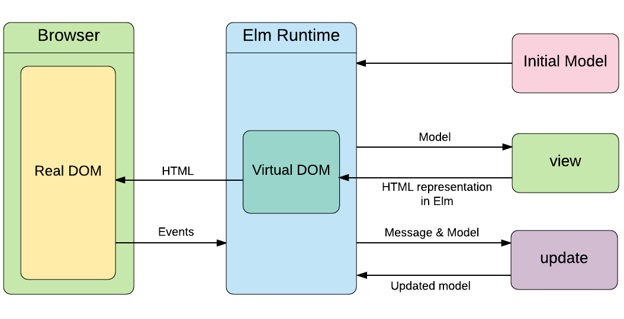
Elm System

Slide 8
Elm system
provides the runtime for Elm apps
acts as a side effect manager so there is a clear barrier between JS and Elm, any communication with JS has to be done via ports
ports
Subscriptions
Tasks

Slide 9
Elm Application Architecture
provides a simple way to structure any web application
Triplet: Init, Update, View
clear separation between state and state changing operations
influence for well known libraries like Redux

Slide 10
Take-aways
Functional programming: functions as first class citizens, referential transparency, immutability, persistent data structures, pattern matching, pure functions, data separated from transformations
State management: managing state is much more simple when we have a clear separation between state and operations on state
Elm: offers a pragmatic way to manage application state
There are no silver bullets but some bullets are better than others :)

Slide 11
Thank you
Develop with passion!

Slide 12
Resources
https://dev.to/rtfeldman/tour-of-an-open-source-elm-spa
http://rundis.github.io/blog/2017/elm_bootstrap_launch.html
https://discourse.elm-lang.org
https://guide.elm-lang.org/
http://package.elm-lang.org/packages/elm-lang/core/latest

