Slide 1
Dive into Elixir
When programming is fun again

Slide 2

By Adrian Magdas
Co-Founder & Lead Developer @ Crafting Software
adrian@craftingsoftware.com
@zenCrafter
linkedin.com/in/adrianmagdas

Slide 3
Agenda
Functional programming principles
Why Elixir & Erlang
Elixir language basics
Anatomy of an Elixir application

Slide 4
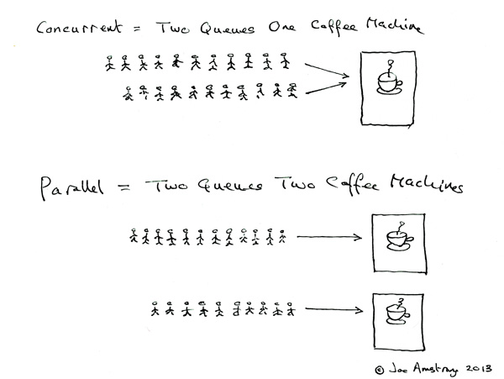
Concurrency vs. parallelism

Slide 5
Functional programming principles
Pure functions and higher order functions
Immutability and persistent data types
Support for recursion or CSP
Pattern matching
Focus on data transformation, pipe is king
= is a match operator, if the match succeeds, it binds a value to some name(s)

Slide 6
Why Erlang
Philosophy of Erlang: we assume that errors will occur, processes will crash and machines WILL FAIL
Focus on cure instead of prevention
Error handling: remote detection and handling of errors
Erlang and Elixir are impure, dynamically typed functional languages
Both run on the BEAM (Erlang VM) which has built-in concurrency, distribution and scalability, actors are part of the language itself

Slide 7
Why Erlang
Preemptive scheduling & share nothing
SMP support since 2006
Built-in fault tolerance: 99.99999% uptime
Battle tested: ~50% of all mobile comms go through Erlang boxes
Happy coincidence: the solution to telecom problems for reliability and scalability are a perfect match for the same problems the web and IOT are facing
2 million web servers vs. 1 server with 2 million connections

Slide 8
Why Elixir
Modern language with solid additions to Erlang: protocols, macros, sigils, pipe operator, great tooling
Beauty and expressiveness of Python & Ruby, power and awesomeness of Erlang
Compatible with existing Erlang infrastructure and libraries

Slide 9
Elixir agents
Agents in Elixir are regular light weight processes
In Elixir, all code runs inside processes. Processes are isolated from each other, run concurrent to one another and communicate via message passing.
Messages are sent asynchronously and stored in mailboxes
Used for keeping state or running asynchronous code
Better model for managing state than objects

Slide 10
Elixir tools
mix
Iex
observer
credo
dialyzer

Slide 11
Take-aways
Actor based concurrency: light weight processes, no shared state between actors, process linking and monitoring, all the communication happens by sending messages
OTP: patterns for handling process creation, supervision strategies and fault-tolerance support
Elixir&Erlang: suited for software systems, long lived and complex
There are no silver bullets :)

Slide 12
Thank you
Develop with passion!

Slide 13
Resources
https://pragprog.com/book/elixir/programming-elixir
http://elixir-lang.org/
http://elixirschool.com/
http://learnyousomeerlang.com/what-is-otp
http://learnyousomeerlang.com/the-hitchhikers-guide-to-concurrency
https://joearms.github.io/2013/04/05/concurrent-and-parallel-programming.html

