Slide 1

Generative AI for Software Engineers
Unlocking new levels of productivity and innovation.

Slide 2
Chapter 1
Introduction to Generative AI
Generative AI Defined
AI, ML, DL: The Landscape
Core Idea
Generative AI creates new content (code, text, images). This contrasts with Traditional AI, which focuses on predefined tasks like classification, or Descriptive AI, which summarises data.
Artificial Intelligence (AI) is the broad concept of machines mimicking human intelligence. Machine Learning (ML) is a subset of AI that enables systems to learn from data. Deep Learning (DL) is a subset of ML using neural networks.
At its heart, Generative AI goes beyond analysis; it produces original, contextually relevant outputs, revolutionising content creation and problem-solving.

Slide 3
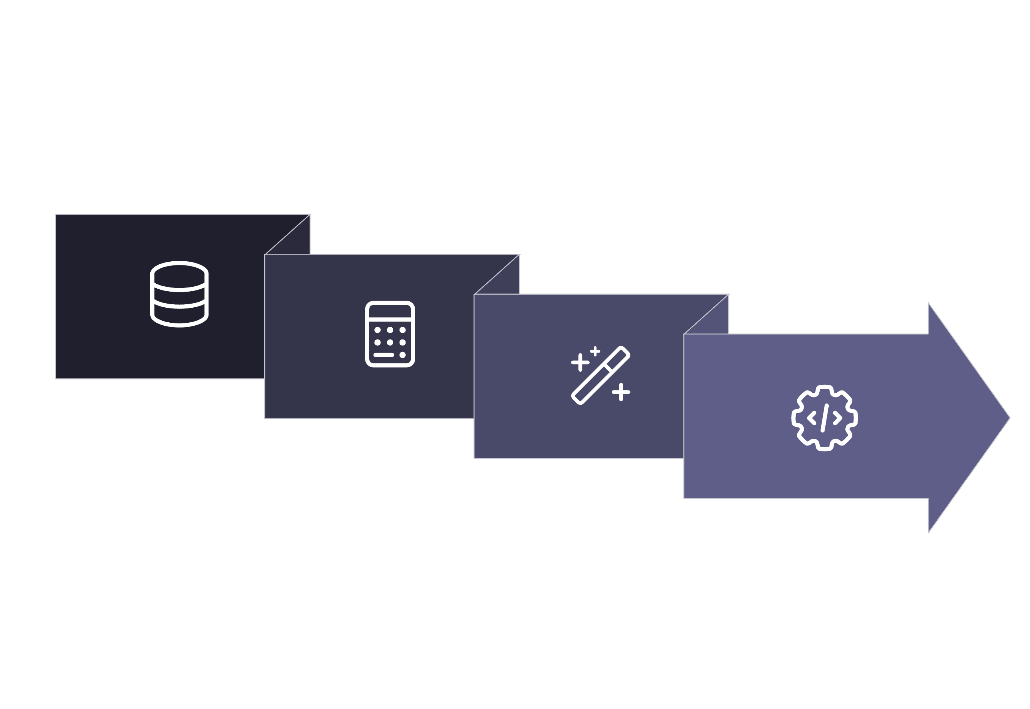




How Generative AI Works
Probabilistic Models
Transformers
Learn Data
Generate Content
Generative AI models learn intricate patterns from vast datasets, enabling them to generate novel content. These models often leverage transformer architectures, processing data sequentially to understand context and relationships. This probabilistic modelling allows them to predict and create outputs, from human-like text to photorealistic images.

Slide 4

Chapter 2
Why Generative AI Matters for Software Engineers
Boost productivity: Automates repetitive tasks and boilerplate code.
Infrastructure as code generation: Automates the creation of configuration files.
Faster prototyping: Quickly generates initial code structures and ideas.
Seamless documentation: Automatically generates and updates project documentation.
Code explanation and debugging: Helps understand complex code sections and suggests fixes.

Slide 5




Where to Use Generative AI in Software Development
Generative AI isn't just for code generation; its applications span numerous development stages, enhancing efficiency and accuracy across the board.
Coding Assistants
Test Case Generation
Tools like Copilot and CodeWhisperer provide real-time code suggestions and auto-completion, speeding up development.
AI can create comprehensive test cases, reducing manual effort and improving code coverage.
DevOps Automation
Code Review & Summarisation
Automates the creation of YAMLs, Dockerfiles, and Terraform scripts for infrastructure setup.
AI assists in reviewing code for best practices and summarising complex sections for quick understanding.

Slide 6




Chapter 3
Prompt Engineering Basics
Prompt engineering is the art of crafting effective inputs to guide Generative AI models towards desired outputs.
The Anatomy of a Prompt
Context, Tone & Formatting
A prompt includes instructions, context, input data, and desired output format. Clear, concise prompts yield better results.
Providing relevant context (e.g., code snippets), specifying the tone (e.g., formal, conversational), and enforcing formatting (e.g., JSON, markdown) significantly improves output quality.
Few-shot vs. Zero-shot
Iterative Refinement
Zero-shot prompting provides no examples. Few-shot includes examples in the prompt, guiding the model with demonstrations.
Prompt engineering is iterative: test, analyse output, refine prompt. Tools like ChatGPT and PromptHero aid this process.

Slide 7
Popular Generative AI Tools for Software Engineers
GitHub Copilot
Code completion, test generation
Best for day-to-day coding
ChatGPT (GPT-4)
Documentation, debugging, ChatOps
Flexible, integrates with workflows
TabNine
Lightweight code suggestions
Good for offline/local use
Amazon CodeWhisperer
AWS-focused coding help
Great with cloud SDKs
Cody (Sourcegraph)
Code context-aware assistance
Reads large codebases

Slide 8





Generative AI Across the SDLC
Requirements
AI assists in capturing clear needs quickly.
Design
Generative AI proposes optimal architecture models.
Development
AI generates and reviews code efficiently.
Testing & Monitoring
AI automates tests and tracks performance.

Slide 9
Chapter 4
Things to Keep in Mind
Validate AI-generated code
Always review and test AI-generated code. It may contain errors, inefficiencies, or security flaws.
Security vulnerabilities
AI models can sometimes introduce subtle vulnerabilities or propagate insecure patterns if not carefully managed.
Data privacy concerns
Be mindful of sensitive data in prompts, especially with cloud-based tools that might use your input for training.
Avoid dependency without understanding
Do not blindly accept AI suggestions. Understand the underlying logic and implications before integrating.
Human-in-the-loop
Maintain human oversight and control at all stages. AI is a tool to assist, not replace, human intelligence.

Slide 10

Precautions & Ethical Considerations
Data Leaks: Never input sensitive code, proprietary algorithms, or confidential data into public AI models.
Licensing: Be aware of the licensing implications for AI-generated code. Some tools may generate code based on open-source licenses.
Code Quality: Do not compromise on code quality. AI suggestions can be suboptimal or verbose; refactor and optimise as needed.
Team Policies: Adhere to your organisation's policies on AI tool usage, data handling, and intellectual property.

