Slide 1
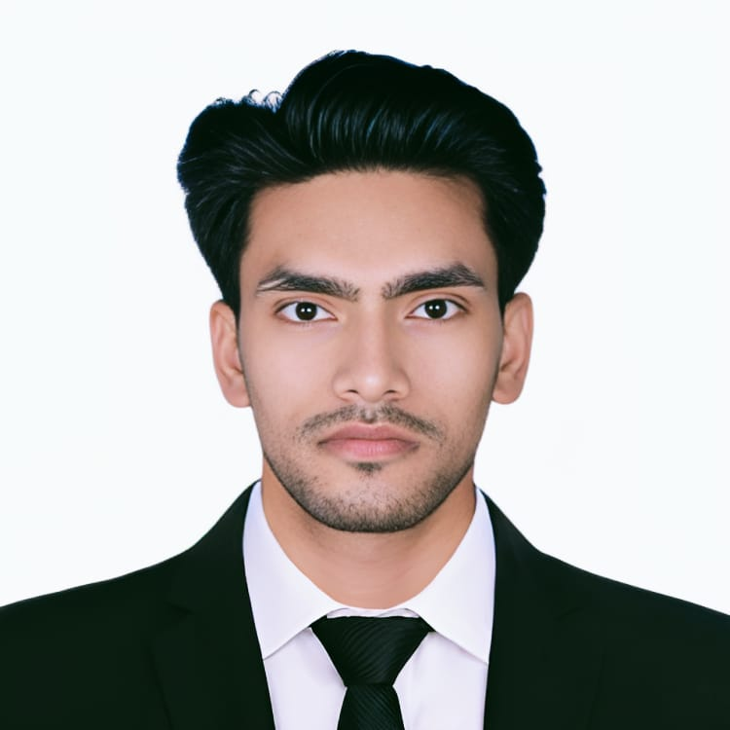


AMANDEEP
Master of Computer Applications
2023 - 2025
Analyst/Software Engineer
Skills
Hyderabad
Programming | Python, Java (Core, OOPs, Java 8, Maven integration)
Version Control | Git & GitHub
Shell Scripting | Linux CLI, Shell Scripting
CI/CD | Jenkins (Freestyle & Declarative Pipelines, GitHub Integration, Webhooks)
Containerization | Docker (Images, Containers, Dockerfile, Volumes, Networking, Docker Compose)
Container Orchestration | Kubernetes (Pods, Deployments, Services, ConfigMaps, Secrets, Namespaces, Ingress, Persistent Volumes, YAML writings), Docker Swarm
Infrastructure as Code (IaC) | YAML (K8s Manifests, Docker Compose), Ansible (Playbooks, Inventory, Roles, Modules)
Cloud Platforms | AWS EC2 (Ubuntu Setup, SSH, Key Pairs, Security Groups, IAM), Basic Cloud CLI usage
Build Tools | Maven (Build lifestyle, Dependency Management, Plugin usage)
GenAI Tools | ChatGPT, GitHub Copilot (Prompt writing, code generation, debugging assistance)
Tools | Git, GitHub, Jenkins, Docker, Kubernetes, Docker Swarm, Ansible,
Add On skills | Communication, Team collaboration, Fast Learner
amandeep.e.amandeep@capgemini.com
+91 6201799190
A4
Gained hands-on experience in key Devops tools and workflows, working on real-time pipelines, containerization, orchestration, and cloud infrastructure setups using Jenkins, Docker, Kubernetes, Ansible, and AWS EC2
Configured and managed Jenkins pipeline (freestyle & declarative), integrated with GitHub using webhooks for automated CI/CD
Built and deployed Docker containers using custom Dockerfiles, managed multi-container environments via Docker Compose, and handled volume mounting and networking
Orchestrated Kubernetes clusters using Minikube and kubectl; authored YAML manifests for Pods, Deployments, Services, Ingress, ConfigMaps, and PersistentVolumes
Provisioned, secured, and managed AWS EC2 instances, configured SSH access, IAM roles, and cloud CLI for seamless DevOps operations
Leveraged GenAI tools like ChatGPT and GitHub Copilot to accelerate code generation, YAML scripting, and CI/CD debugging in live environments.
Cloud-Native Java App Deployment with CI/CD Automation
Built and deployed a Java web app using a complete DevOps toolchain.
Automated CI/CD pipeline with Jenkins, Maven, and GitHub.
Containerized app using Docker and hosted on Apache Tomcat.
Managed deployments with Kubernetes on AWS.
Used Ansible for configuration and environment setup.
Achieved full automation from code commit to production rollout.
Deployed a full-stack chat application on Kubernetes using Minikube — containerized frontend/backend with Docker, pushed images to DockerHub, applied Kubernetes manifests (deployments, services, volumes, secrets), configured persistent storage for MongoDB, secured backend with secrets, and hosted locally via custom domain routing
Student Placement Committee Member
Lovely Professional University (MCA Dept.)
Collaborated with faculty and placement officers on recruitment planning.
Coordinated with students to gather job preferences and promote upskilling.
Contributed to company outreach and alumni engagement initiatives.
Check out my work on GitHub & Video Profile

