Slide 1
Getting Started with Kubernetes
A Comprehensive Overview

Slide 2
Agenda
Introduction to Kubernetes
What it is and why it matters
A Brief History
From Google’s Borg to CNCF
Key Features
Automation, scalability, and resilience
Kubernetes Architecture
Master and worker nodes explained
Control Plane vs. Data Plane
Understanding the core components
Deployments in Kubernetes
Managing applications the Kubernetes
Use Cases
Real-world applications and success stories

Slide 3
What is Kubernetes?
Kubernetes is an open-source container orchestration platform that automates the deployment, scaling, and management of containerized applications.

Slide 4
History of Kubernetes
Kubernetes was originally developed by Google and is now maintained by the Cloud Native Computing Foundation (CNCF). It was first released in 2014.

Slide 5
Key Features
1. Automated rollouts and rollbacks
2. Service discovery and load balancing
3. Storage orchestration
4. Self-healing
5. Secret and configuration management

Slide 6
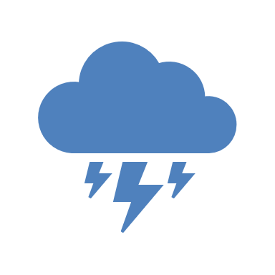
Brain Storm!! Why Kubernetes when already had other Orchestration Platforms?

Slide 7
Kubernetes Architecture
Kubernetes follows a master-worker architecture.
The master node controls and manages a set of worker nodes, where the containers are deployed.

Slide 8
Master Components
1. API Server
2. etcd
3. Scheduler
4. Controller Manager
5. Cloud Controller Manager

Slide 9
Node Components
1. Kubelet
2. Kube-proxy
3. Container runtime

Slide 10
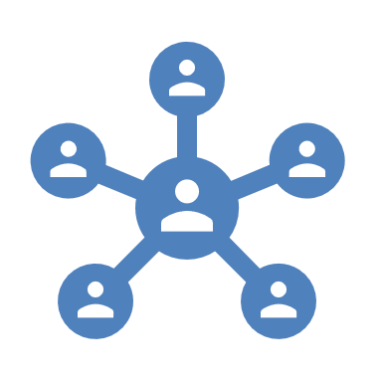
Pods and Services
The Smallest Deployable Unit.
Pods can host one or more Containers that share:
a. Same network namespaces
b. Same storage
Kubernetes networking model allows pods to communicate with each other and with services, without the need to configure network policies.
Exposing a pod:
a. Services
b. Ingress

Slide 11

Binge Netflix
How Netflix Manages there Microservices?? Problems: Demand Spikes Downtime Glitches

Slide 12
Advanced Features of Kubernetes
ConfigMaps
Secrets
Persistent Volumes
Horizontal Pod Autoscaler
Rolling updates
Self-healing

Slide 13
Use Cases
1. Microservices architecture
2. Continuous integration and continuous deployment (CI/CD)
3. Hybrid cloud and multi-cloud deployments
4. Batch processing and big data workloads

Slide 14
Conclusion
Kubernetes is the Invisible brain behind scalable, resilient and automated cloud deployments.
Enables: Managing complexity
Ensuring high availability
Automating operations
Real-time scaling

