Slide 1
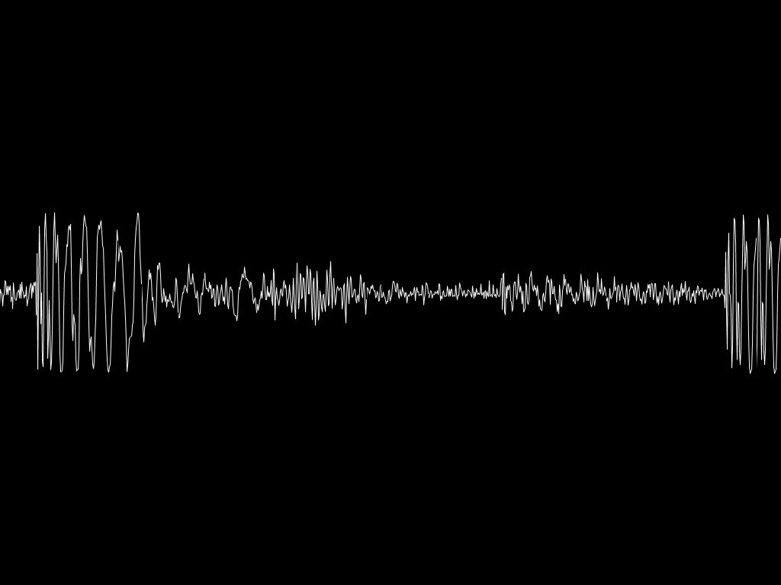
ADVANCED AUDIO CODING [AAC]
Presented By
Sirhan Shafahath
00606002
S7 EC

Slide 2
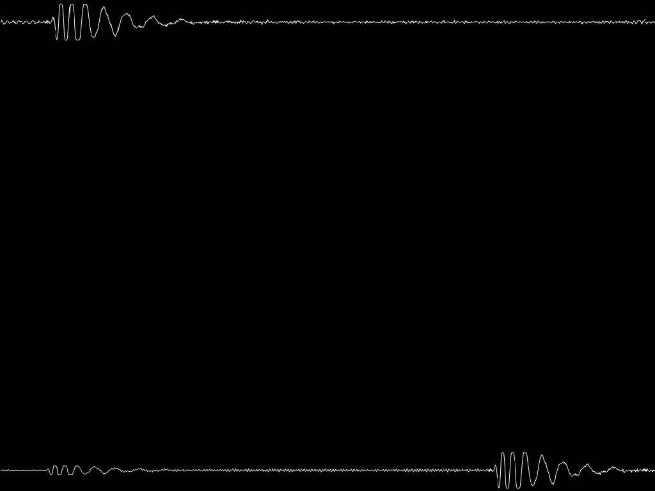
INTRODUCTION
Advanced Audio Coding (AAC) is a standardized, lossy compression and encoding scheme for digital audio
Its standardized (defined) in :
ISO/IEC 13818-7 [MPEG-2]
ISO/IEC 14496-3 [MPEG-4]
Developed with the cooperation and contribution of companies including Fraunhofer IIS, AT&T Bell Laboratories, Dolby, Sony Co. and Nokia
Designed to be the successor of the well-known audio compression format MP3
Filename extension : .m4a, .m4b, .m4p, .m4v, .m4r, .3gp, .mp4, .aac
It is currently the most powerful multichannel audio coding algorithm in MPEG family

Slide 3
INTRODUCTION TO DIGITAL AUDIO
Before the introduction of digital audio, audio signals have been represented in analog form
Main disadvantages of analog audio :
Compression, Rendering, Quality Enhancement
Representing audio signals in digital form allows us to achieve the above goals more easily
The idea behind digital audio is to use numbers to represent the physical sound via an analog-to-digital (A/D) conversion process
The A/D conversion process involves sampling and quantization

Slide 4
Continue…
Sampling : Each sample’s amplitude as a function of a discrete index. the rate at which each sample is extracted the sampling frequency or the sampling rate, which is described in terms of number of samples per second, or Hertz (Hz)
Quantization : Sample resolution or bit depth determines how precisely the sample’s amplitude is recorded or stored. An n-bit sample resolution allows 2^n different possible amplitude values

Slide 5
Continue…
Encoding : The sampled and quantized signals are encoded using some error correction codes and are stored in a media
CD AUDIO : It’s the most commonly used media for storing and transporting of digital audio.
Sampling Rate : 44100Hz (Nyquist Criteria satisfied for 20KHz)
Sample Resolution : 16-bit (ADC)
Size (1min,Stereo): 60 x 2 x 44100 x 16 = 10.584 MB/min
Filename : .cda, .cdda
Generally they are uncompressed PCM data
The large amount of data makes them not suitable for internet streaming and digital broadcasting because of large bandwidth
HERE ARISE THE NEED FOR COMPRESSION

Slide 6
Compression Techniques
Any compression technique belongs to either lossy compression or lossless compression
Lossless Compression :
  If data is losslessly compressed, the original data can be recovered exactly from the compressed data
  As name implies, involve no loss of information
Lossy compression :
  Involves some loss of information
  Data that have been lossy compressed generally cannot be recovered exactly
  By accepting the above, we can achieve higher compression ratios than lossless compression

Slide 7
Perceptual Audio Coding
One of the key elements in the development of reduced bit rate audio is the understanding and application of psychoacoustics
All of the current perceptual audio coders achieve high compression rates by exploiting the fact that signal information that cannot be detected by even a well-trained listener can be discarded
Human hearing is insensitive to quiet frequency components to sound accompanying other stronger frequency components
Stereo audio streams contain largely redundant information
Irrelevant signal information is identified during signal analysis by incorporating into the coder several psychoacoustic principles

Slide 8
Principles of Psychoacoustics
1. Absolute Threshold of Hearing :
The absolute threshold of hearing characterizes the amount of energy needed in a pure tone such that it can be detected by a listener in a noiseless environment
It can be expressed with a non-linear function,
T_{q}(f) = 3.64(f/1000)^{-0.8} - 6.5e^{-0.6(f/1000-3.3)2} + 10⁻³(f/1000)⁴ (dB SPL)

Slide 9
Equal loudness contours for pure tones

Slide 10
Continue…
When applied to signal compression, it could be interpreted as a maximum allowable energy level for coding distortions introduced in the frequency domain
So using this information the noise levels during quantization are tried to fit below this threshold
Due to this quantization noise does not become audible

Slide 11
2. Critical Band
Human ear can be viewed as a discrete set of band pass filters, which covers the entire 20kHz frequency range
The inner ear called as ”Cochlea” contains frequency sensitive positions. Whenever any tone enters the cochlea it moves until it reaches the position where it resonates
The “critical bandwidth” is a function of frequency that quantifies the cochlear filter pass bands. (unit – Bark)
As the center frequency goes on increasing, the bark-width also goes on increasing.
Spectral analysis of audio content is performed using critical bands.
Bark-width with center frequency ‘f’ is gives as …
BW_{c}(f) = 25 + 75(1 + 1.4(f/100)²)^{0.69} Hz

Slide 12
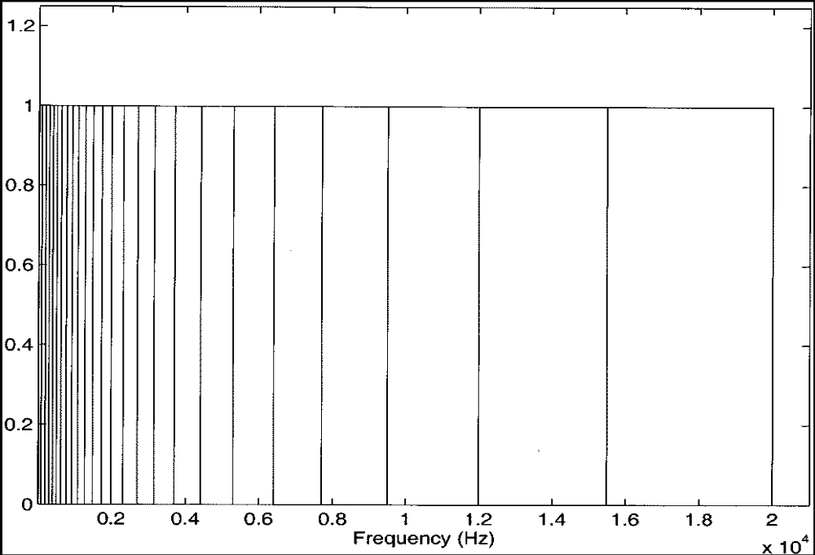
Idealized critical band filter bank

Slide 13
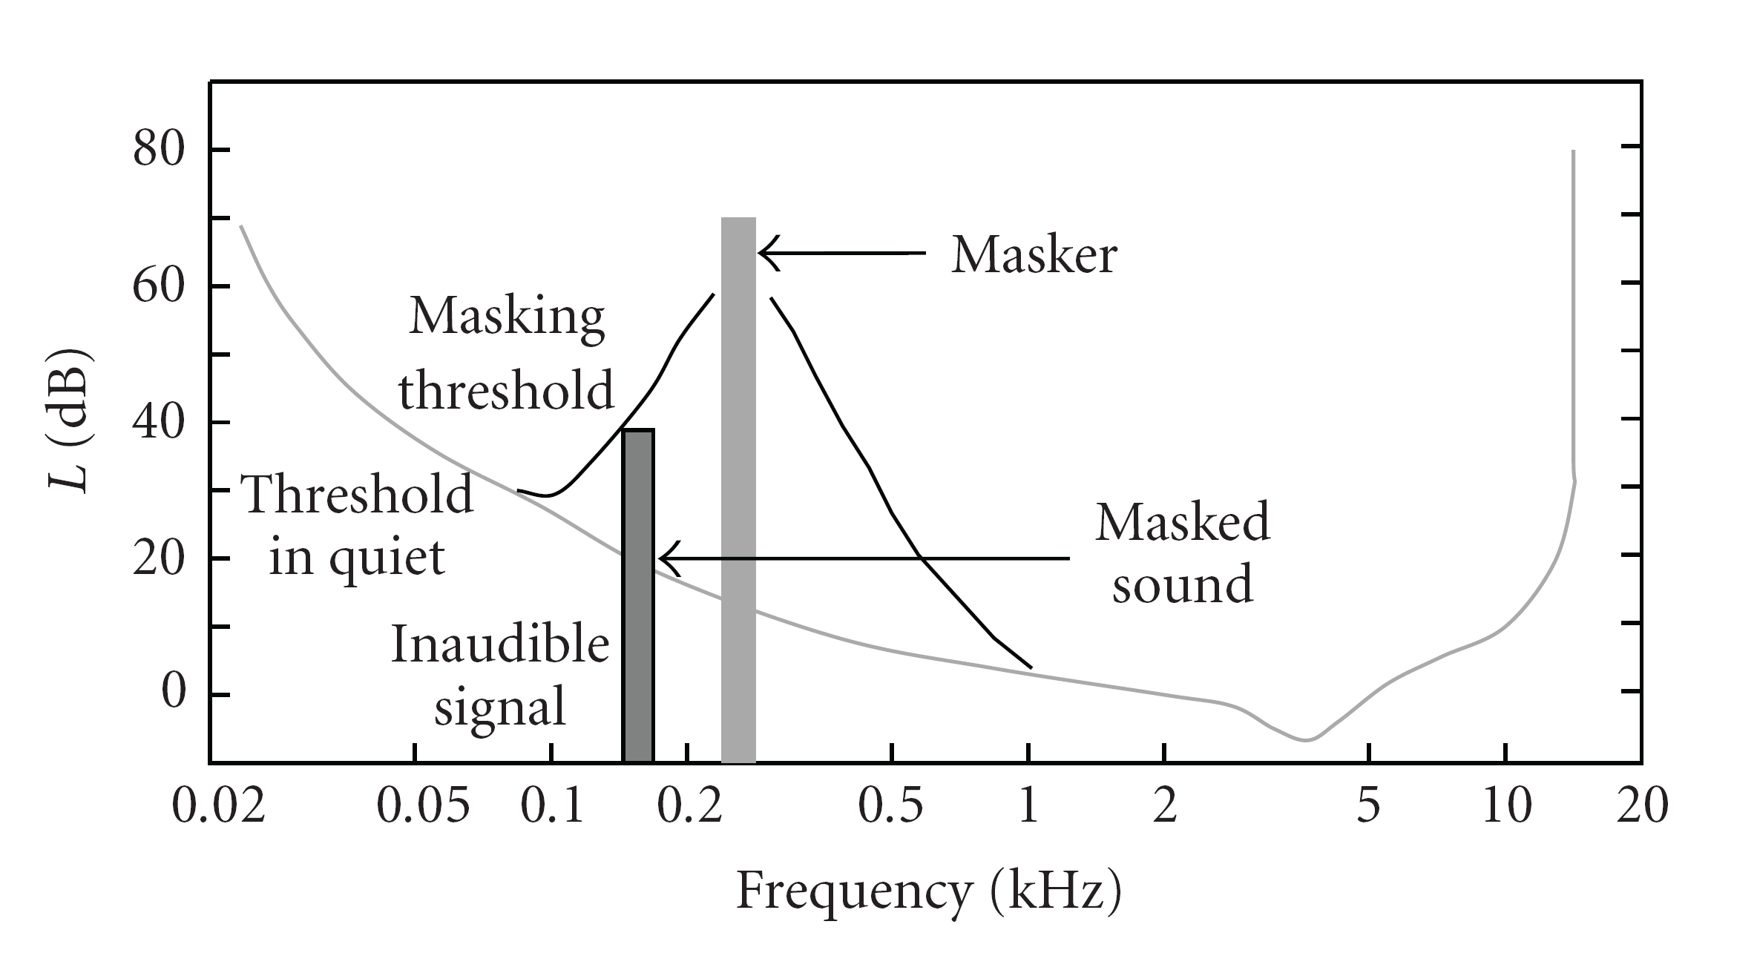
3. Masking
Masking refers to a process where one sound is rendered inaudible because of the presence of another sound

Slide 14
Advanced Audio Coding
Modular encoding
AAC takes a modular approach to encoding. Depending on the complexity of the bitstream to be encoded, the desired performance and the acceptable output, implementers may create profiles to define which of a specific set of tools they want use for a particular application. The standard offers four default profiles:
Low Complexity (LC) - the simplest and most widely used and supported
Main Profile (MAIN) - like the LC profile, with the addition of backwards prediction
Sample-Rate Scalable (SRS) - a.k.a. Scalable Sample Rate (MPEG-4 AAC-SSR)
Long Term Prediction (LTP) - added in the MPEG-4 standard - an improvement of the MAIN profile using a forward predictor with lower computational complexity

Slide 15
MPEG-2 AAC BLOCK DIAGRAMS

Slide 16
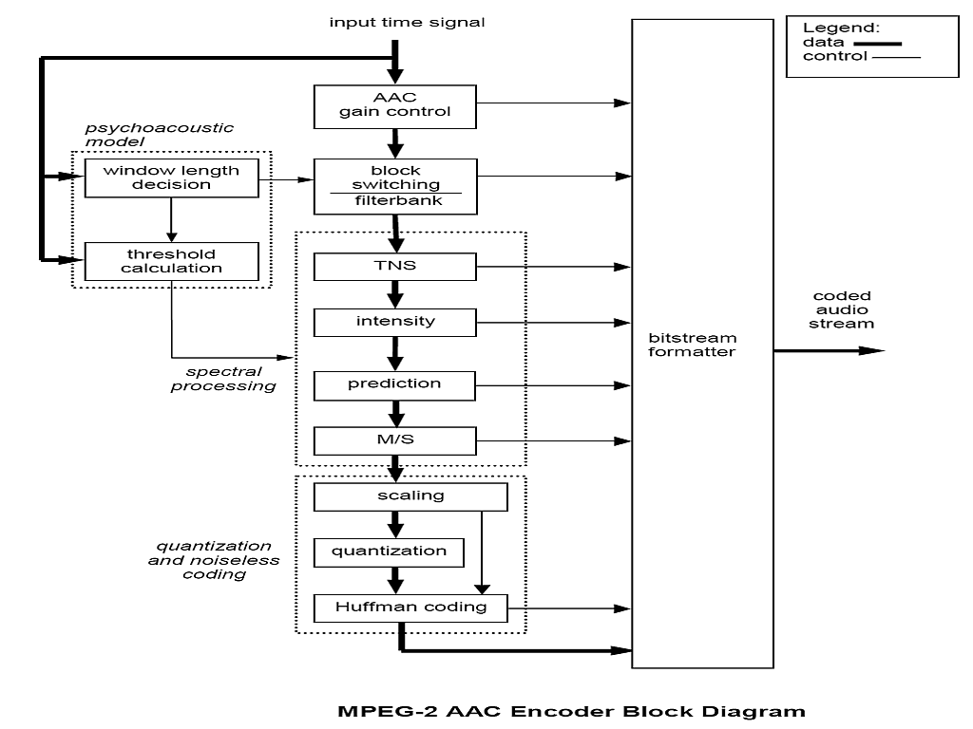

Slide 17
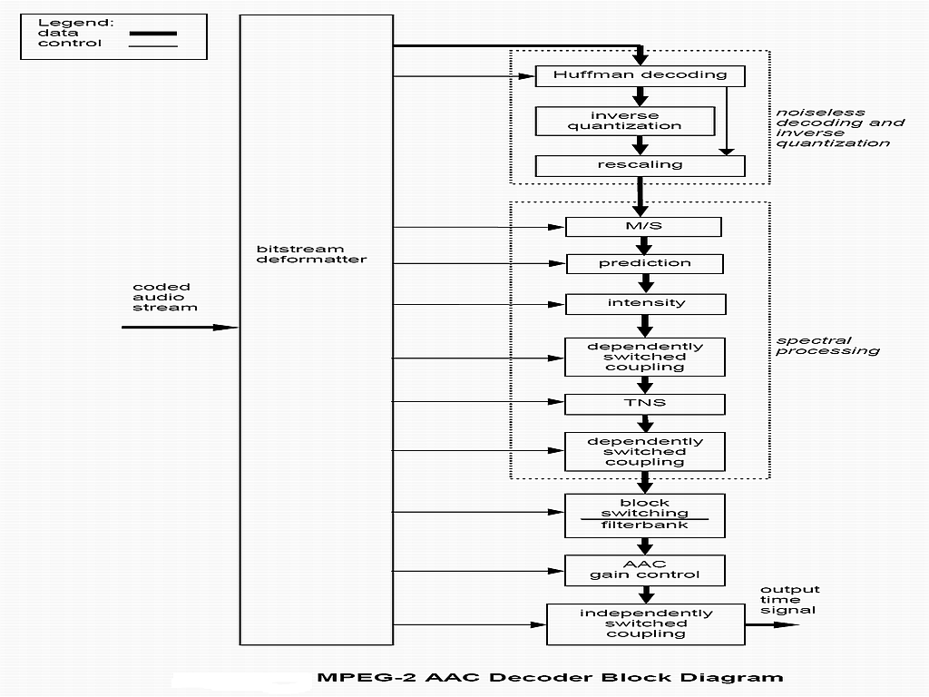

Slide 18
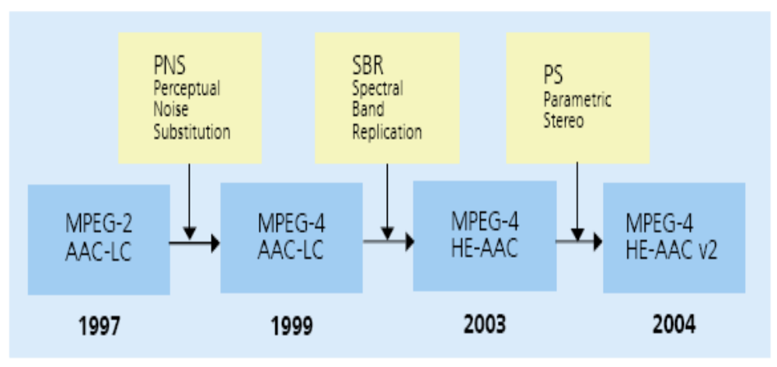
MPEG AAC FAMILY

Slide 19
MPEG-4 AAC LC
Perceptual Noise Substitution [PNS ]
Instead of trying to reproduce a waveform that is similar as input
signals, the model-based coding tries to generate a perceptually similar sound as output
The encoding of PNS includes two steps
(1) Noise detection : For input signals in each frame, the encoder performs some analysis and determines if the spectral data in a scale-factor band belongs to noise component
(2) Noise compression : All spectral samples in the noise-like scale-factor bands are excluded from the following quantization and entropy coding module. Instead, only a PNS flag and the energy of these samples are included in the bitstream

Slide 20
MPEG-4 HE-AAC
Spectral Band Replication [ SBR ]
Developed by a German based company “Coding Technologies”
SBR is a bandwidth extension tool
The main effect used is the high correlation between the low- and high-frequency content in an audio signal
In an SBR-based coding system, waveform audio coding is only used to code the lower frequencies of an audio signal. This low frequency content is used to recreate the high frequency content at the decoding side
This is done by state-of-the-art transposition method

Slide 21
Continue…
The reconstruction of the high band is conducted by transmitting guiding information such as the spectral envelope of the original input signal or additional information to compensate for potentially missing high-frequency components
This guiding information is referred to as SBR data
The recreated high-frequency content undergoes some frequency and time domain adjustment before it is combined with the low-frequency part of the audio signal
HE-AAC a.k.a aacPlus v1

Slide 22
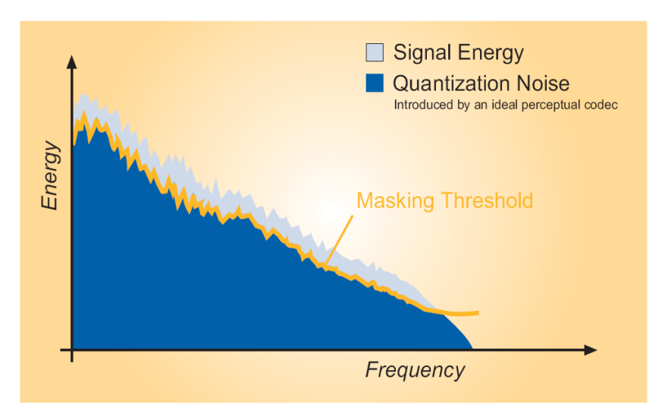
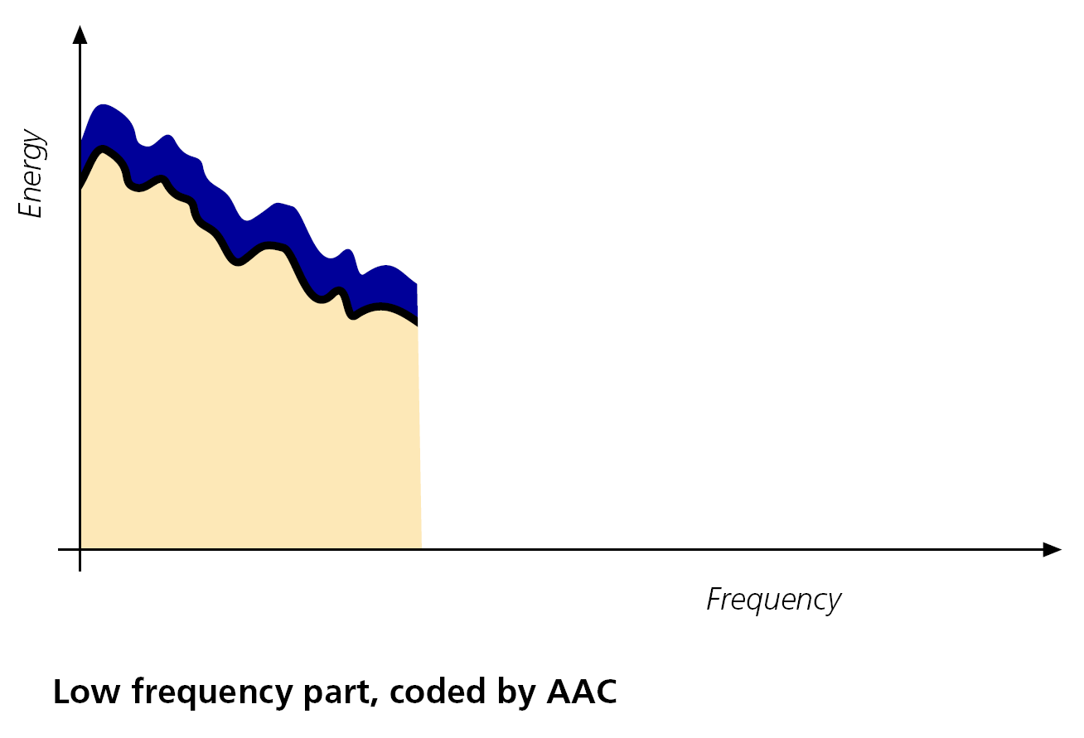
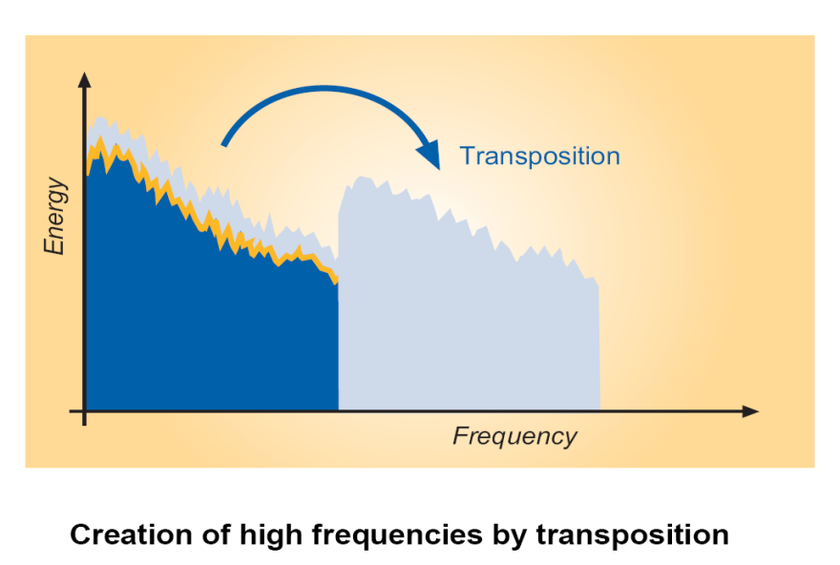
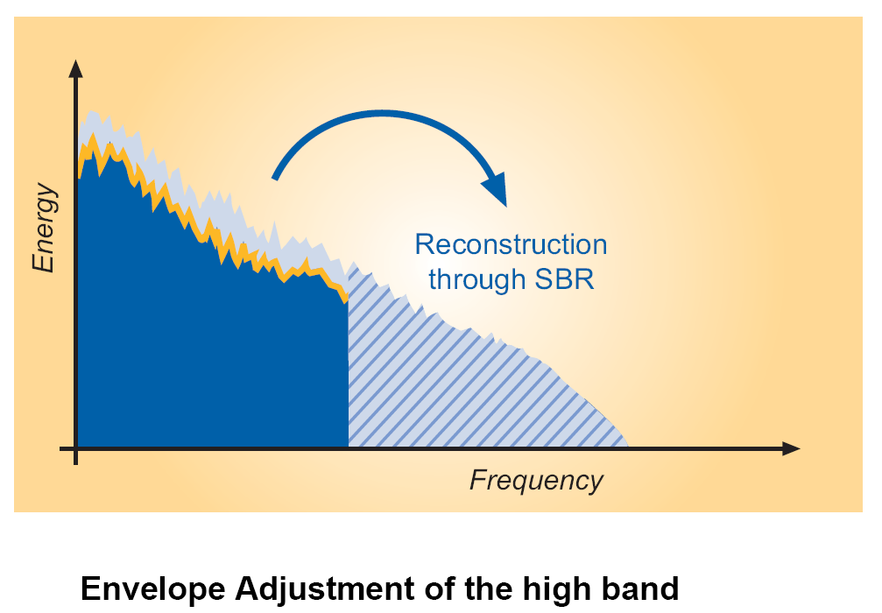
Continue…

Slide 23
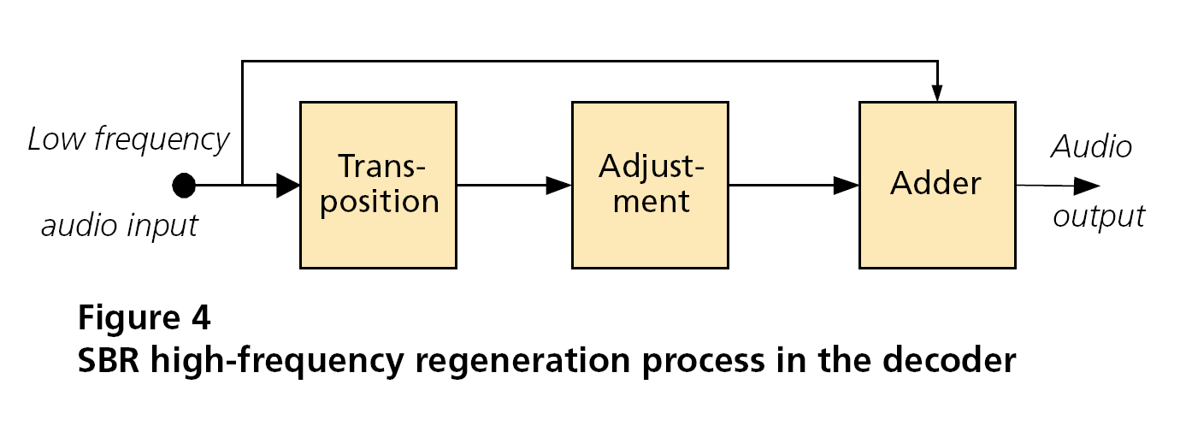
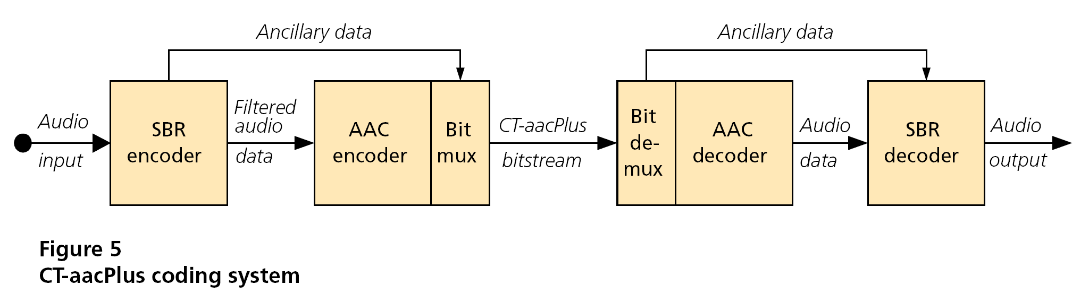
Continue…

Slide 24
MPEG-4 HE-AAC v2
Parametric Stereo
Its also a contribution from “Coding Technologies”
In the encoder, only a monaural downmix of the original stereo signal is coded after extraction of the Parametric Stereo data
Just like SBR data, these parameters are then embedded as PS side information in the ancillary part of the bit-stream
In the decoder, the monaural signal is decoded first. After that, the stereo signal is reconstructed, based on the stereo parameters embedded by the encoder

Slide 25
Continue…
Three types of parameters can be employed in a Parametric Stereo system to describe the stereo image.
􀂁
Inter-channel Intensity Difference (IID) : describing the intensity difference between the channels.
Inter-channel Cross-Correlation (ICC) : describing the cross correlation or coherence between the channels. The coherence is measured as the maximum of the cross-correlation as a function of time or phase.
Inter-channel Phase Difference (IPD) : describing the phase difference between the channels.
HE-AACv2 a.k.a aacPlus v2

Slide 26
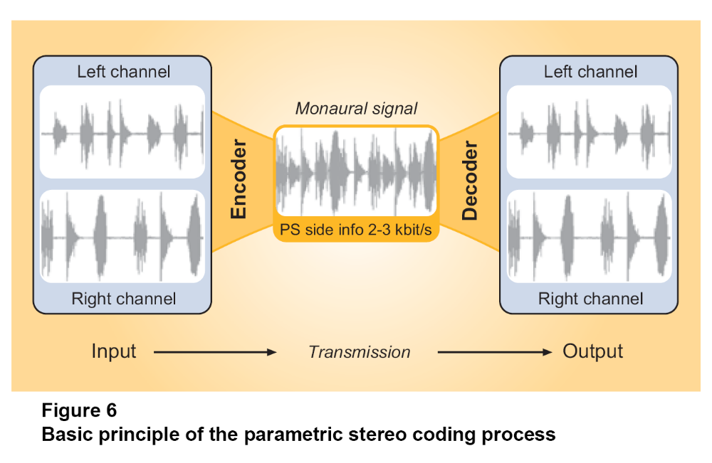
Continue…

Slide 27
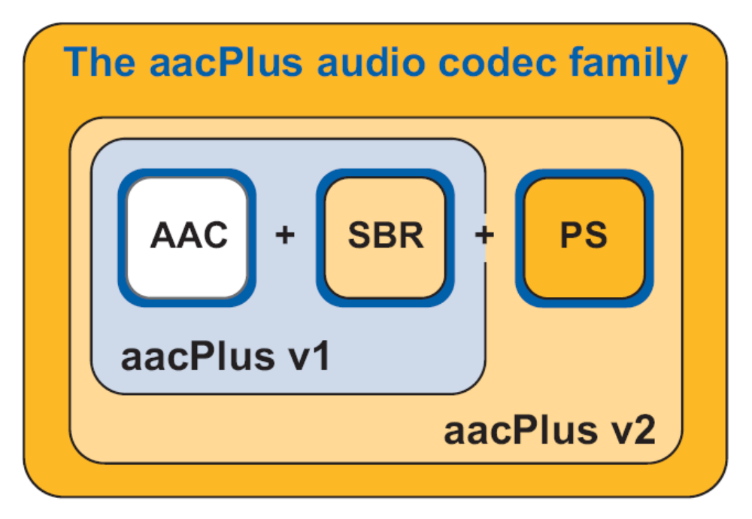

Slide 28
Advantages Over MP3
AAC
Multi Channel Audio – up to 48 audio channels
Sample frequencies from 8KHz ~ 96KHz
Simpler filter bank (pure MDCT used)
Better stationary and transient response due to block sizes of 1024 and 128 samples
Excellent handling of high frequency signals
CD quality audio at 64Kbits/sec
Much better quality of audio at lower bit rates (down to 32Kbps)
MP3
Stereo signal – maximum of only 2 channels
Sampling frequencies from 16KHz ~ 48KHz
Hybrid filter bank ( more computational power)
Poorer stationary and transient response due to block sizes of 576 and 192 samples
Signal handling up to 15.5/15.8 KHz
CD quality audio at 128Kbits/sec
Audio quality is poorer at low bit rates and may present coding artifacts

Slide 29
Disadvantages
Transparency is lost at very low bit rates when SBR is used
Small loss of stereo image when PS is used

Slide 30
APPLICATIONS
HE-AAC was chosen as the coding used in DAB (Digital Audio Broadcasting)
HE-AAC is the coding used in DRM (Digital Radio Mondiale)
It’s the default format in Apples i-POD
Used in mobile phone to store songs
It’s the audio coding used in .3gp and .3gpp format
It’s the audio coding used in DTH services [MPEG-4]
For Internet Streaming
Audio format in Bluetooth Stereo/Mono headsets [ A2DP – Advanced Audio Distribution profile ] (Optional)

Slide 31
Conclusion
AAC – The perceptual audio coding the world is going to adapt completely

Slide 32
References
Sites
www.wikipedia.org
www.hydrogenaudio.org
www.codingtechnologies.com
www.mp3-tech.org/aac.html
Books
High-Fidelity Multichannel Audio Coding - Dai Tracy Yang, Chris Kyriakakis, and C.-C. Jay Kuo
Introduction To Data Compression - Khalid Sayood
Papers
ISO/IEC Standards [13818-7, 14496-3]
MP3 and AAC Explained, Karlheinz Brandenburg [Father of MP3]
CT-aacPlus - a state-of-the-art audio coding scheme, Martin Dietz and Stefan Meltzer
MPEG-4 HE-AAC v2 - audio coding for today’s media world, Stefan Meltzer and Gerald Moser
………

Slide 33
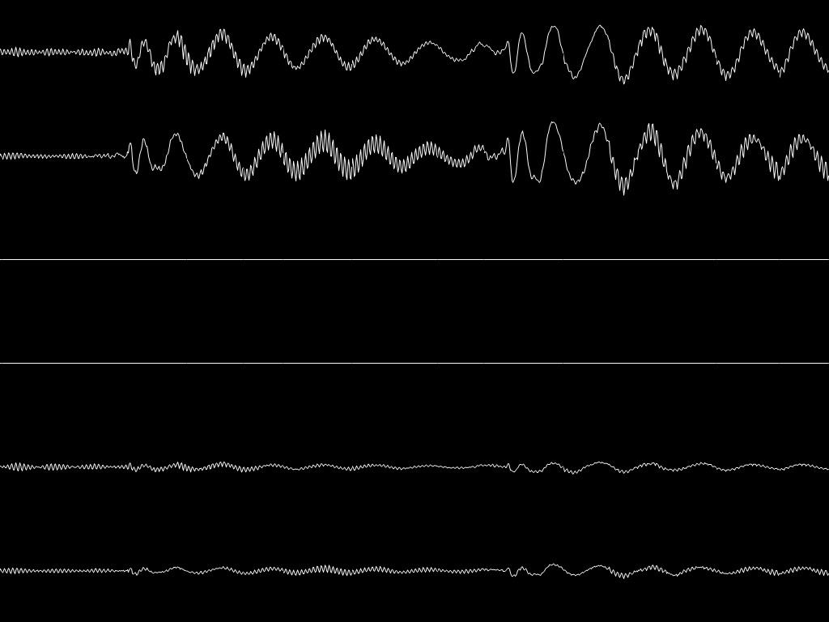
THANK YOU

