Slide 1
What should we grow today to make money tomorrow?
By: Anubha, Shreya, Ethan, Daniel
Mentor: Aviva Prins
Notes:
font small. make it big
presentation feedback:
and now anubha takes over
shreya. 2: more efficient than what?
3. our overall goal is to crop planning dss. tomato is multi harvest crop. harvesting means going to market, no storage capacity
4. transitions
5. problem; other more resources, time complexity, real humans, real needs,
details about
6. presenting the methods in a certain order. implemented concurrently. more info abt policies and include stuff while introducing
7. pseudocode visualization
8. results: mention how many agents, states, actions,
interpretation. why is it better

Slide 2
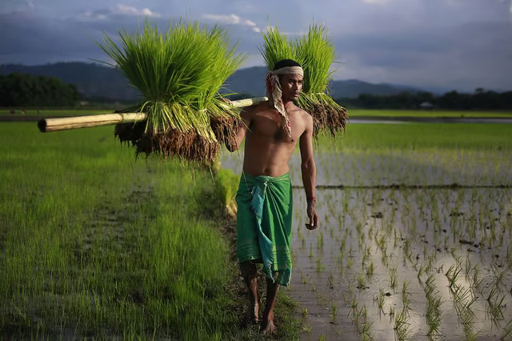
Introduction
Over half of agricultural households were in debt in India (2021)
Farmer debt at around 170 million rupees (2 million USD)
Nearly 30 farmers die by suicide daily
Most debt due to crop failures

Slide 3
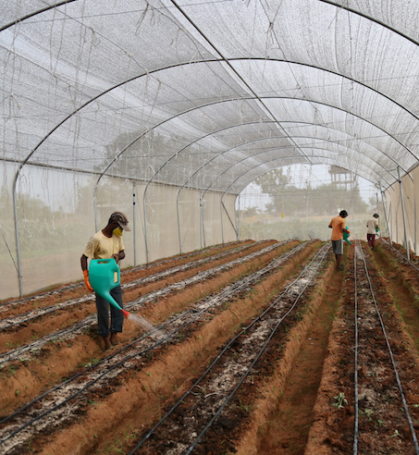
Introduction
Collaboration with Kheyti
Kheyti is an Indian non-profit organization with a greenhouse approach
More efficient compared to open fields: 90% less water, 7x more food per acre of land
Help low-resource farmers
Notes:
Remove 2 point?
Why is our work important?

Slide 4
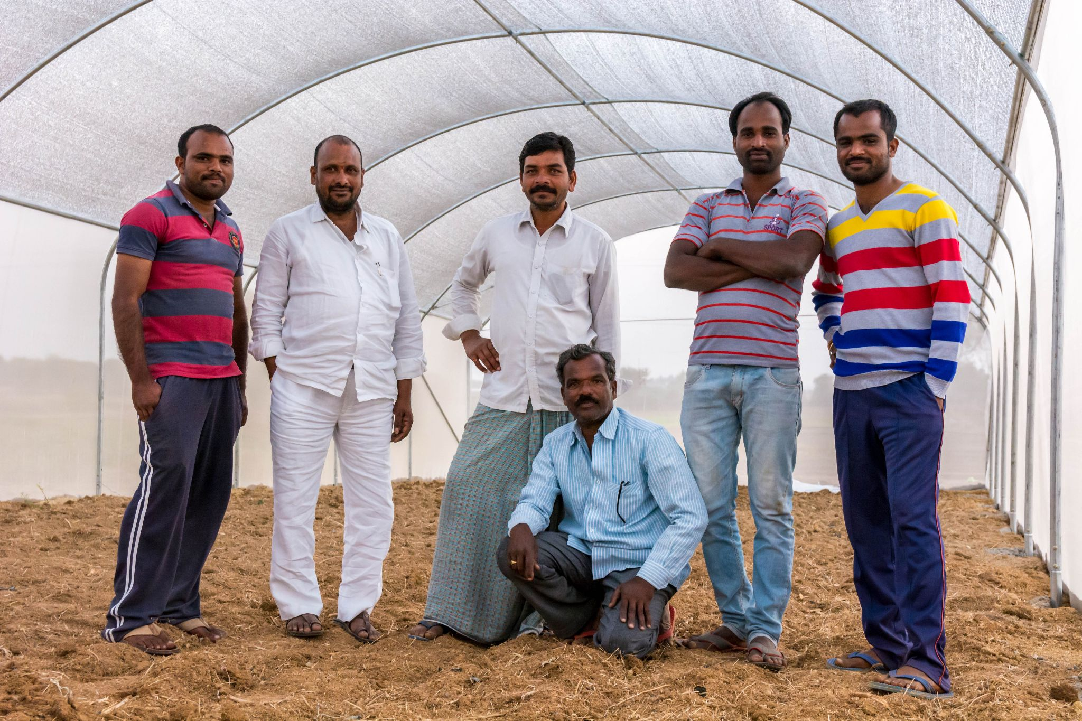
Problem Statement
Learn policies for multiple farmers to maximize total reward
Notes:
Challenges in current MARL literatures; rarely applicable to a farmer setting

Slide 5
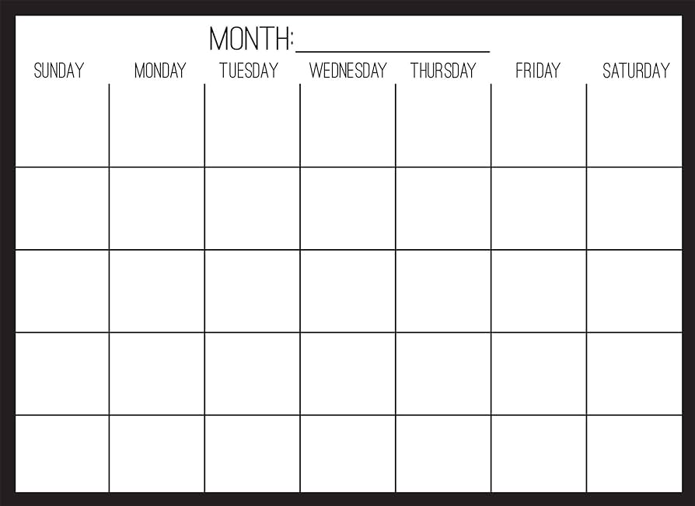
Crop Planning Decision Support System
October
March
Plant 🍅
Plant🥔
Harvest🥔
Plant 🌽
Harvest 🍅
Harvest 🍅
Plant 🌽
Notes:
bold, big
Crop planning
multi-harvest

Slide 6
current state
(crop, maturity, expiry)
action
next state
…
next state
(crop, maturity, expiry)
action
next state
(🔳, 0, 0)
❌
🍅
(🍅, 5%, 8)
(🔳, 0, 0)
🚜
🥔
(🥔, 100%, 7)
(🔳, 0, 0)
(🥔, 1%, 10)
Farmer 1
Let’s harvest.
Tomorrow we will plant something new.
(🔳, 0, 0)
❌
🍅
(🍅, 2%, 8)
(🔳, 0, 0)
🚜
🥔
(🍅, 100%, 5)
(🔳, 0, 0)
…
(🥔, 8%, 10)
Farmer 2
joint reward
0
₹ (3000, 2000)
0
₹ (0,0)
₹ (0, 0)
Notes:
make arrow black
We have to be careful that the number of combinations is not too complicated to compute. Even though there are a lot of possible situations, the way these situations change is often straightforward and predictable.
_____________
Problem: combinatorial states (possibly combined with the previous slide?)
CH~ we can note many possible items in the cross product are not actually reachable since we can’t go backwards in time, have constraints on crop sequences, etc.
Create an optimization-based decision support tool that provides crop planning advice to farmers based on market price data, factoring in long-term soil fertility and farmers’ skill levels, and other application-specific constraints.

Slide 7
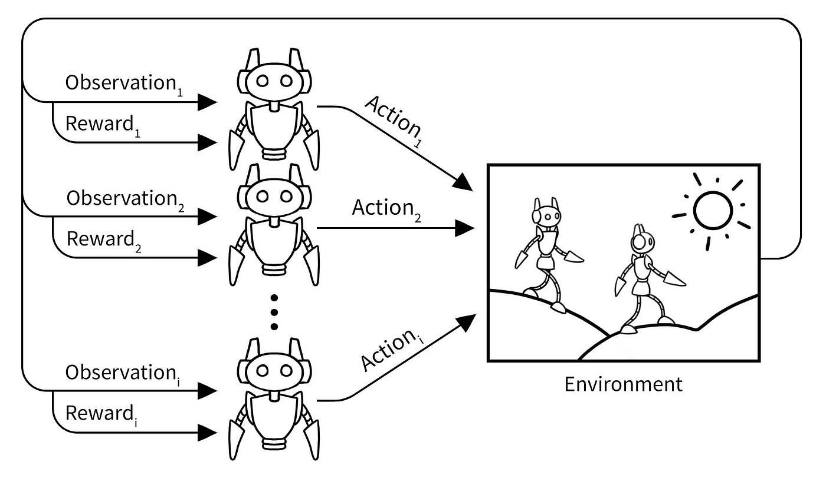
Multi-Agent Reinforcement Learning (MARL)
MARL is a branch of reinforcement learning where multiple agents interact within an environment.
Multi-Agent Markov Decision Process

Slide 8
Methods
Independent Q Learning
Multiagent Rollout
Agent by Agent Gradient

Slide 9
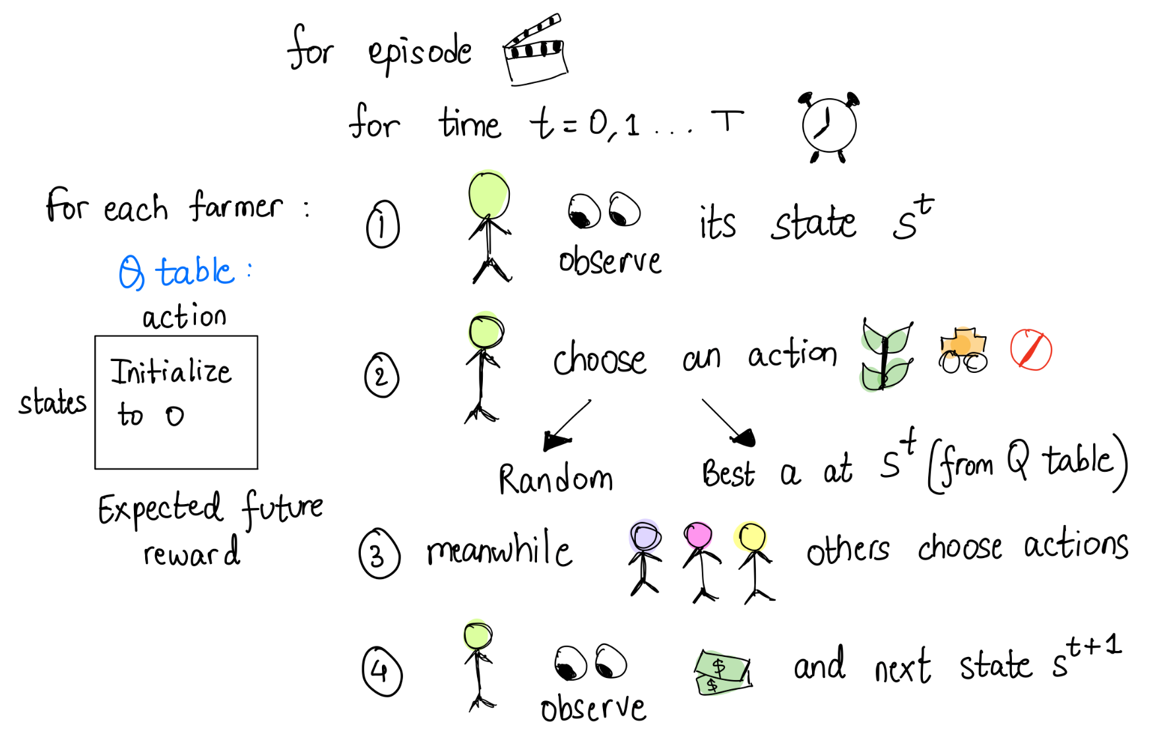
Independent Q-Learning (IQL)
^{[Albrecht et al. 2024]}

Slide 10
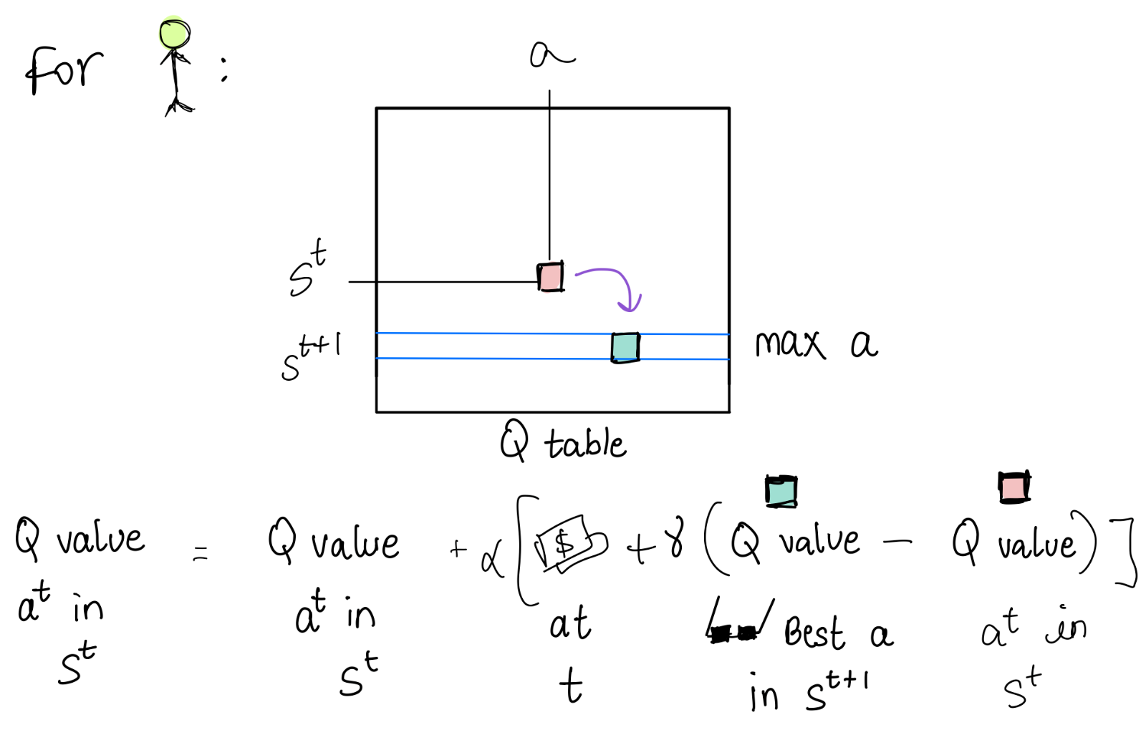
Independent Q-Learning (IQL)

Slide 11
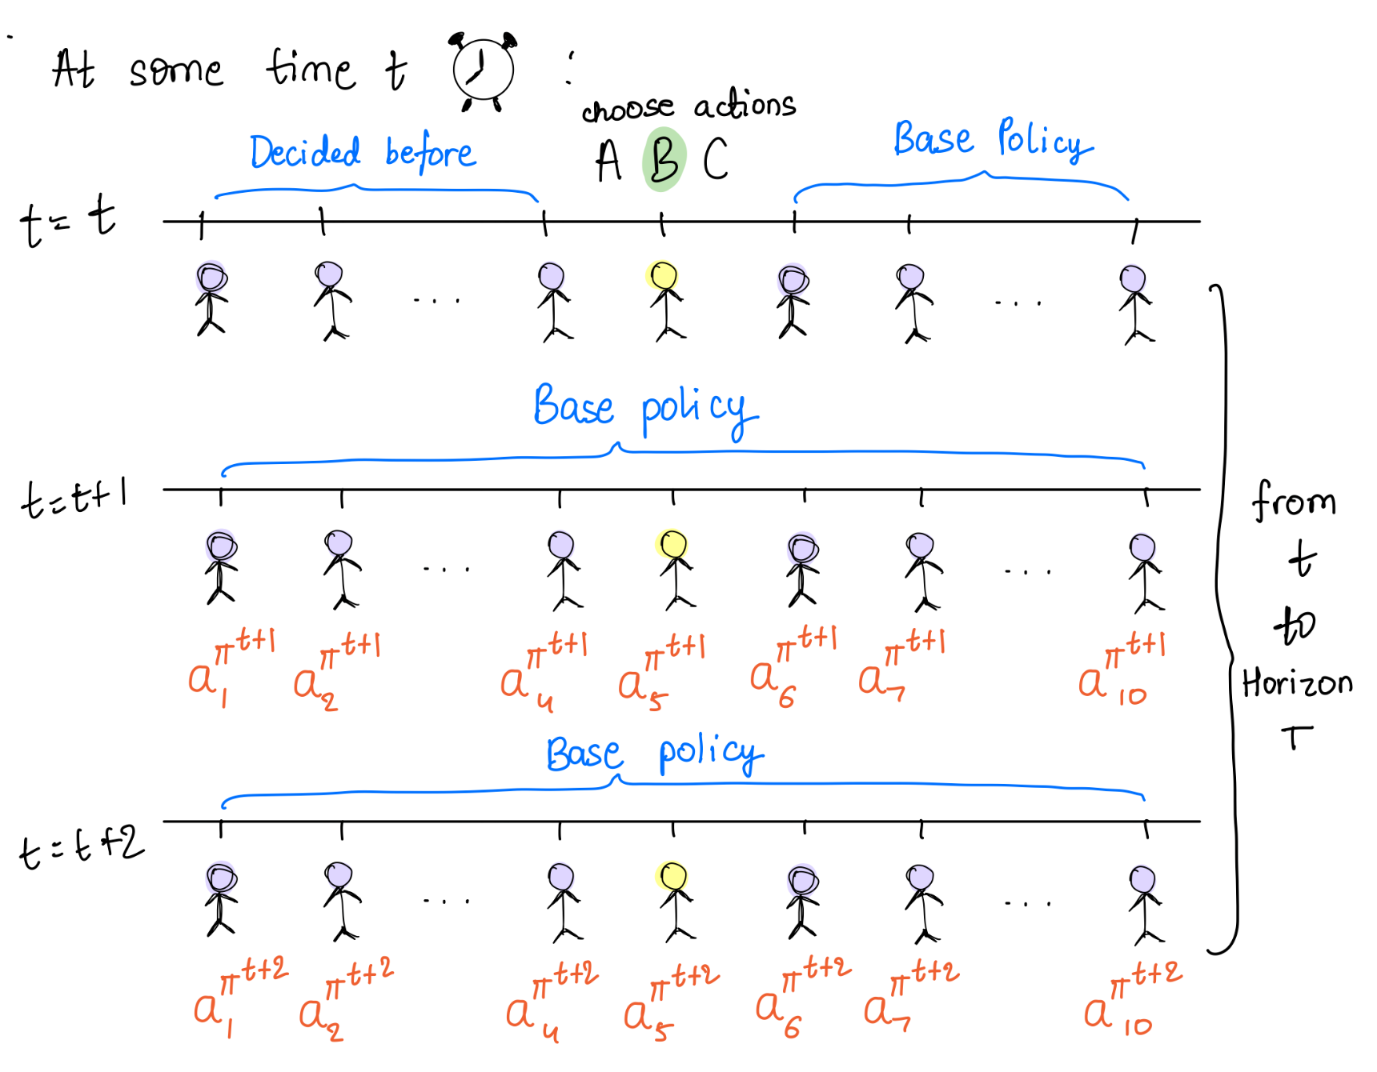
Multiagent Rollout
Rollout Policy
Each iteration serves as the base policy for the next
One-Step Lookahead
Simulate future trajectory agent by agent to get optimal action
Policy Iteration
Generates an improved policy
^{[Bertsekas 2021]}

Slide 12
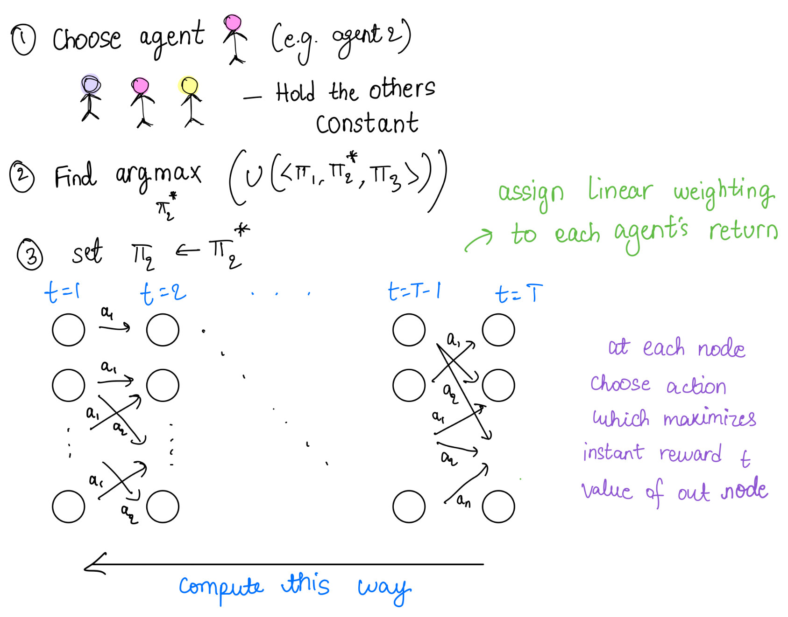
Agent by Agent Gradient (ABA)
Notes:
choose color

Slide 13
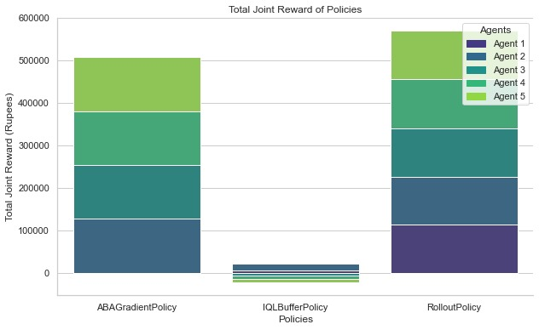
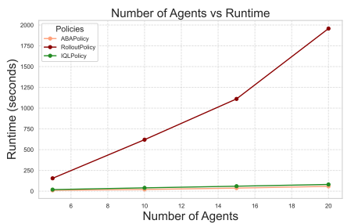
How do the policies compare?

Slide 14
Conclusion
IQL: Performs poorly on total joint reward, but really well on runtime. Increases linearly with number of agents.
Rollout: Performs poorly on runtime. Increases exponentially with number of agents.
ABA: Performs better than baseline on joint reward and runtime, worse on fairness.

Slide 15
Citations
Albrecht, S. V., Christianos, F., & Schäfer, L. (2024). Multi-agent reinforcement learning: Foundations and modern approaches. The MIT Press.
D. Bertsekas, "Multiagent Reinforcement Learning: Rollout and Policy Iteration," in IEEE/CAA Journal of Automatica Sinica, vol. 8, no. 2, pp. 249-272, February 2021, doi: 10.1109/JAS.2021.1003814.

