Slide 1

Ahmed Ali
Nawaz Quraishi

Slide 2

Motivation for the project
Compare traditional jobs with Data Scientist roles
Get insight from data to see if it is in sync with what what we know already
Understand the demand for Data Scientist jobs across Canada

Slide 3
Company Overview
Established in 2008
Global leader on insights about jobs and companies
Mission is to help people everywhere find a job and company they love
Some key stats:
62m
unique monthly visitors
114m
reviews, salaries & insights
65%
search and/or apply to jobs
2.2m
employers

Slide 4
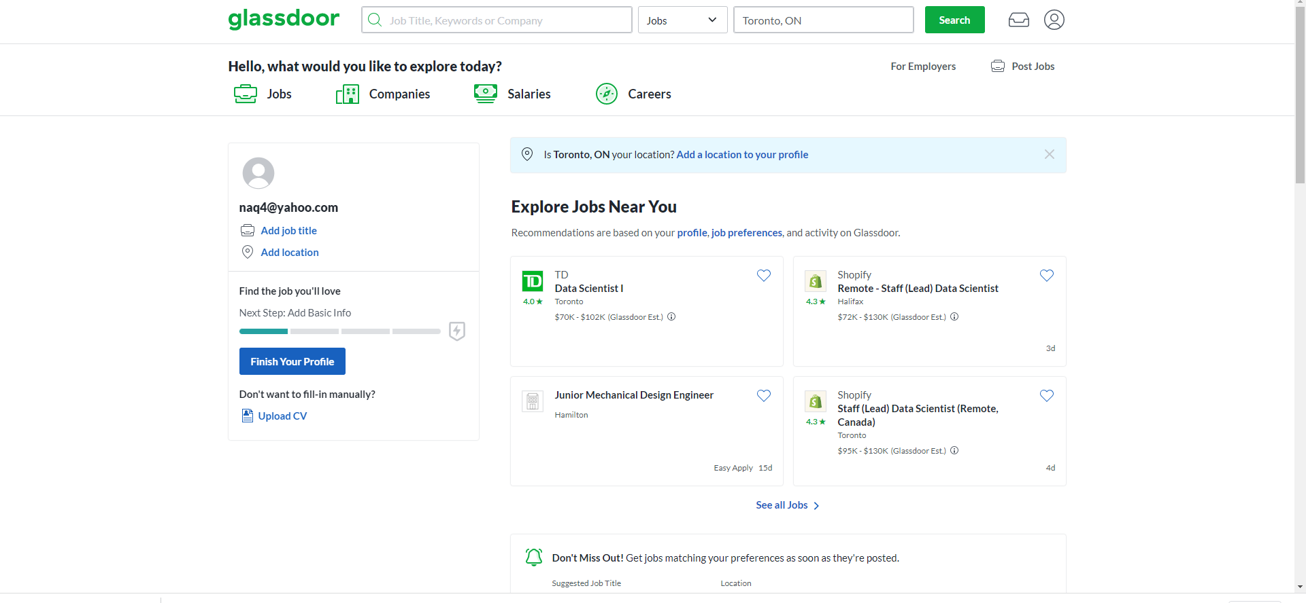
Website

Slide 5
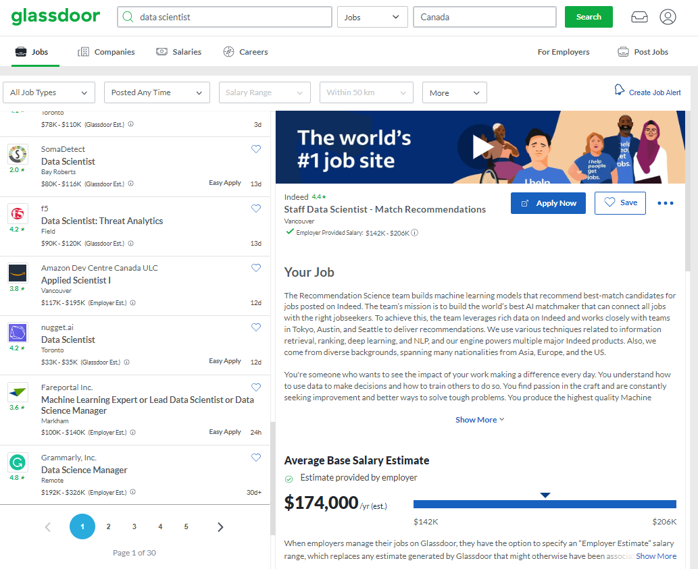
Navigating the website

Slide 6
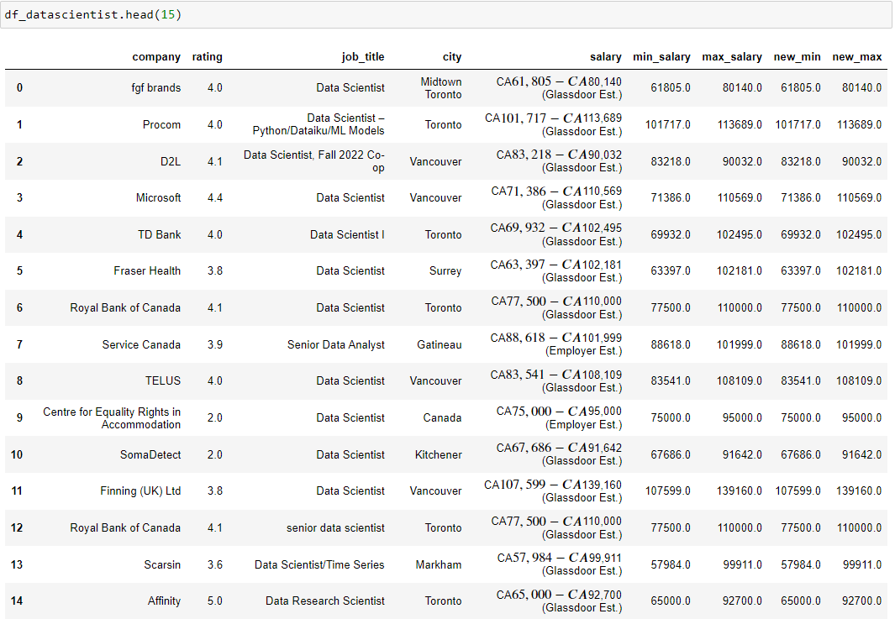
Data

Slide 7
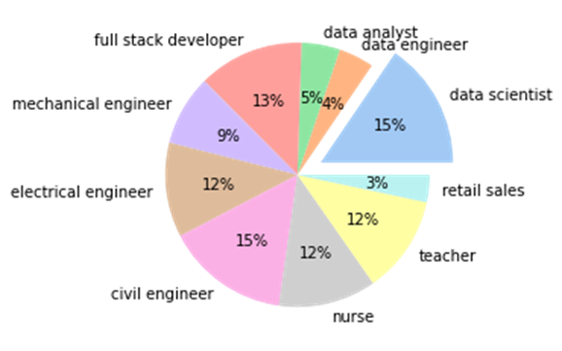
Analysis
The pie chart shows the proportion of each Job in relation to the jobs included in the study
Jobs selected are jobs that are traditionally sought after

Slide 8
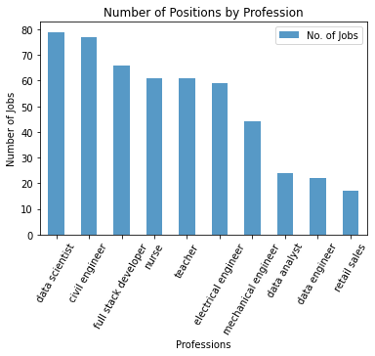
Analysis
The bar chart shows a current time snapshot of the number of available jobs
‘Data Science’ jobs exceed in number to the rest of jobs that are in comparison
With the exception of ‘Civil Engineering’, other Engineering specialization jobs are lesser in number than “Data Science’

Slide 9
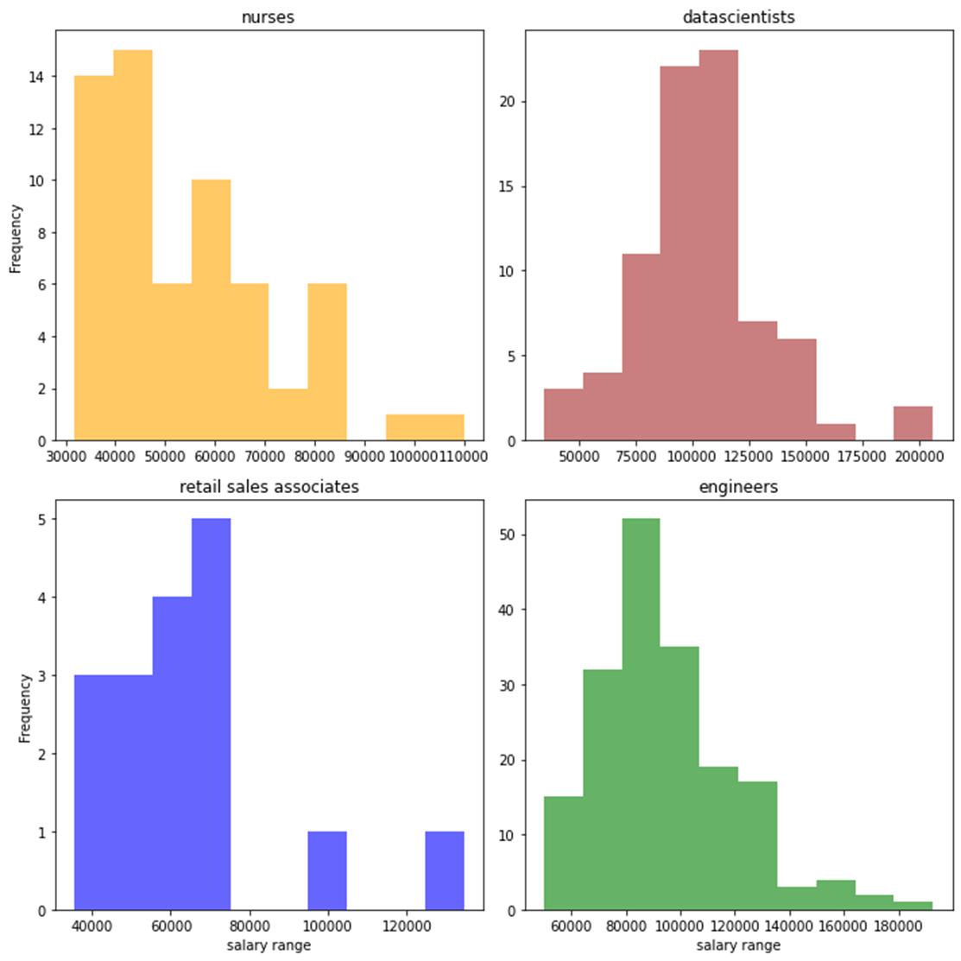
Analysis
Range of Data Scientists’ salary is higher than that of Nurses & Retail Sales Associates
Bell curve suggests Data Scientists’ salaries are centered around higher salary than that of Engineering

Slide 10
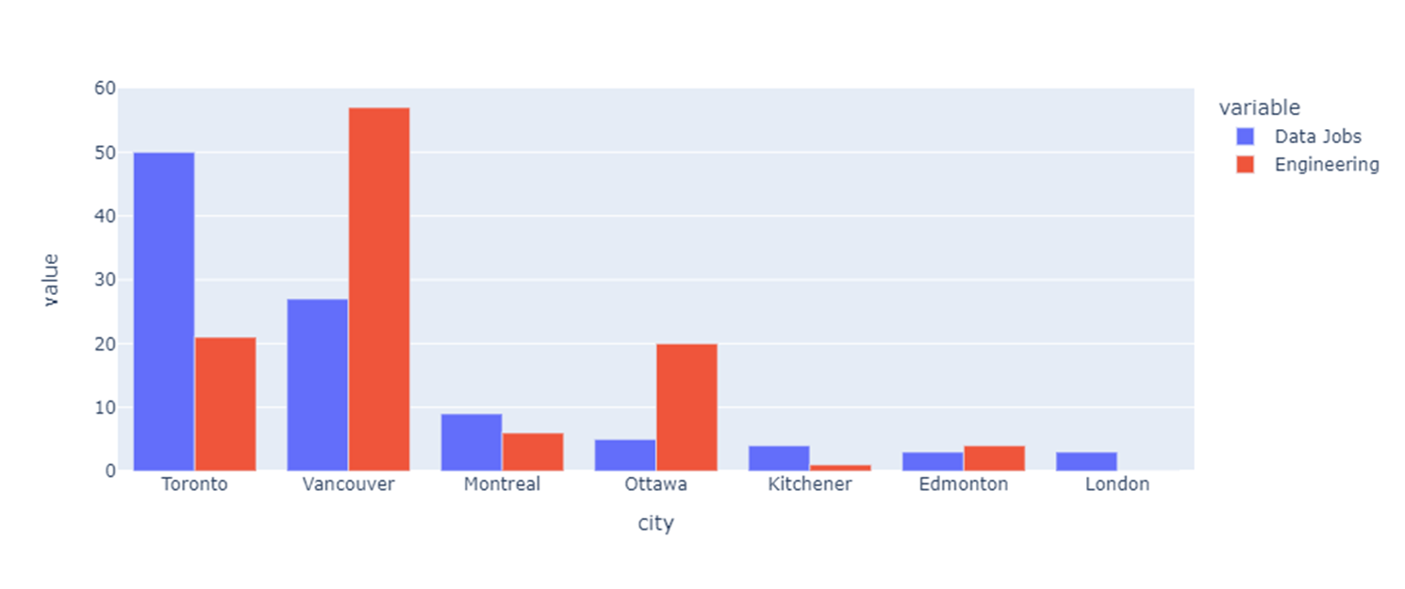
Analysis

Slide 11
Findings
Higher number of jobs for are Data Scientists than rest of the professions
Higher percent of Data Scientists jobs is on the higher end of its salary range
More Data Scientists jobs are in Toronto
More Engineering jobs are in Vancouver

Slide 12
Challenges
Moving to next page of job listings was not possible using BeautifulSoup as the url changes using a Java Script code
The jobs were heavily repeated on the website
The pattern of moving between pages differs when the number of pages is 5 or less than when it is more

Slide 13
Improvements
Scrape career websites to get more data
Job satisfaction as a criteria (rating of companies)
Job seniority as a criteria (years of experience and salary)
By passing the sign-in

