Slide 1
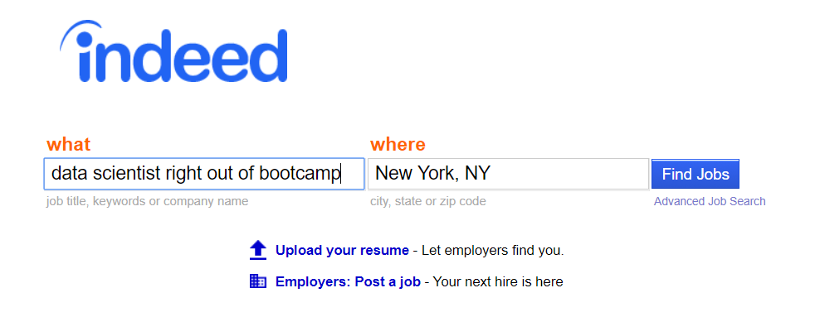
Company Reviews on Indeed.com
Exploratory data analysis, word clouds, and recent trends

Slide 2
Scraping and Exploring Company Reviews on Indeed
1. Website and data scraped
2. Initial EDA
3. Comparison Clouds
4. Some comparisons and recent trends
By industry
Top companies
Bottom companies
2017 spike in ratings with decrease in mean rating

Slide 3
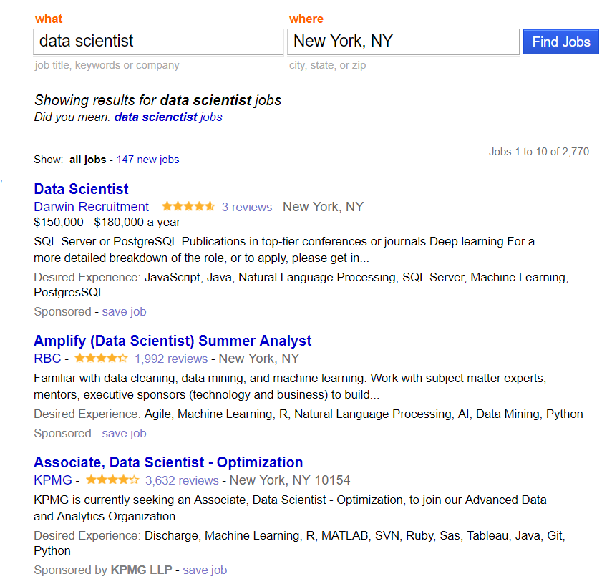
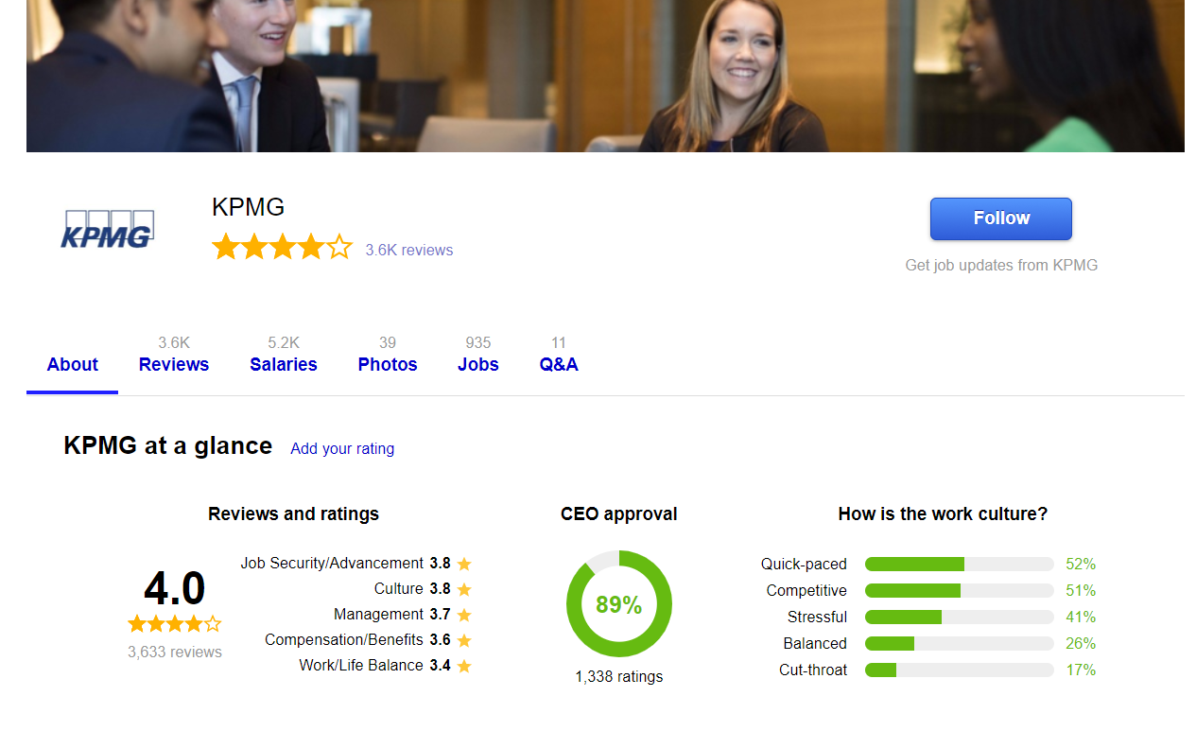
Company Reviews on Indeed.com
https://www.indeed.com/jobs?q=data+scientist&l=New+York%2C+NY
https://www.indeed.com/cmp/Kpmg

Slide 4
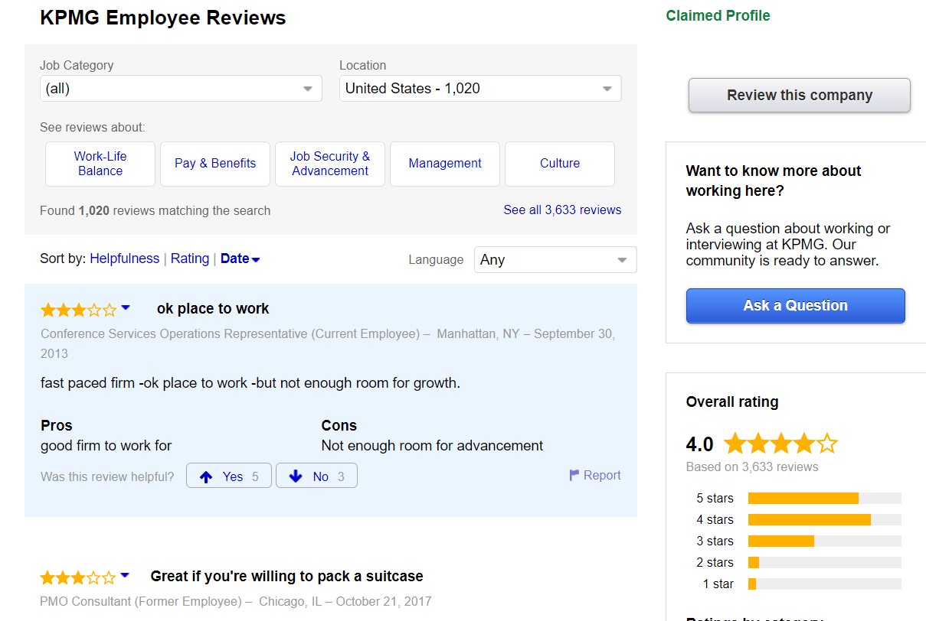
Company Reviews on Indeed.com (cont’d)
https://www.indeed.com/cmp/Kpmg/reviews[?start=review_num]
Review Information
1. Overall Rating + Sub-Ratings:
Job Work/Life Balance
Compensation/Benefits
Job Security/Advancement
Management
Job Culture
2. Review Title
3. Reviewer Info:
Title
Location
Date
4. Main text of review
5. Pros and cons of working at company
6. Helpful upvotes/downvotes
And company-wide data from Company page
1
2
3
4
5
6

Slide 5
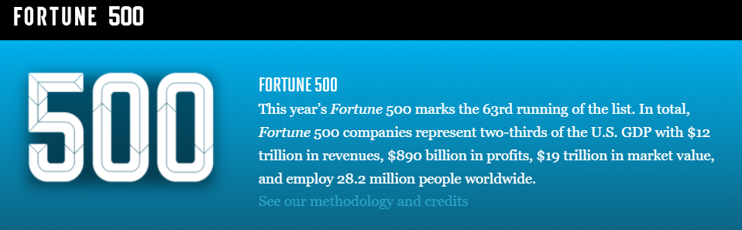
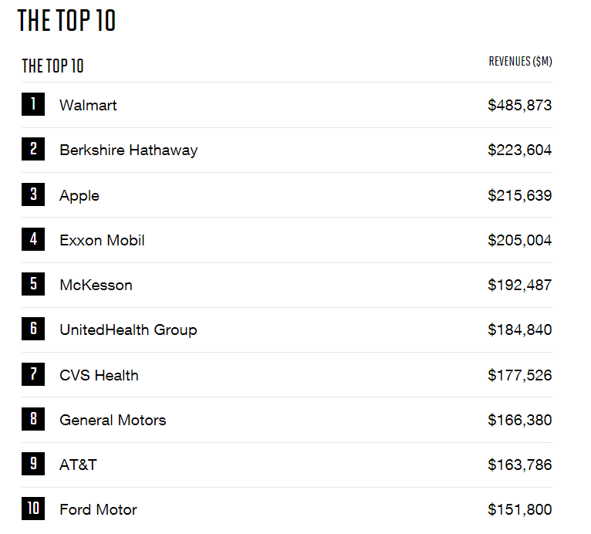
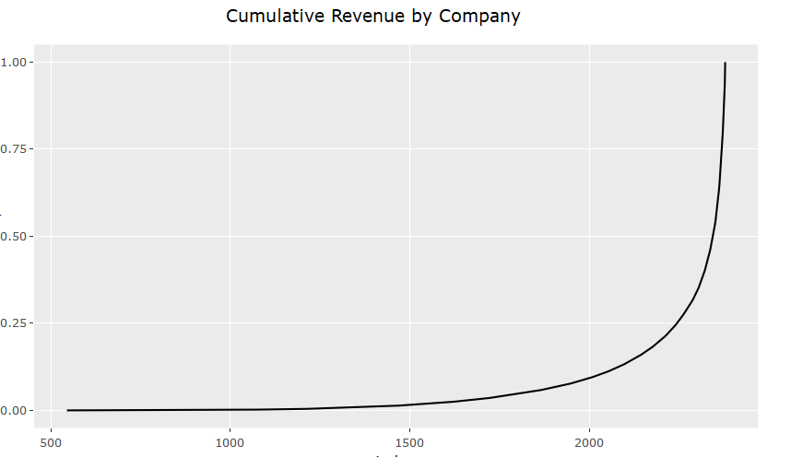
Company Reviews on Indeed.com (cont’d)
Top 50 represent ~70% of revenue
Top 500 represent 95% of revenue

Slide 6
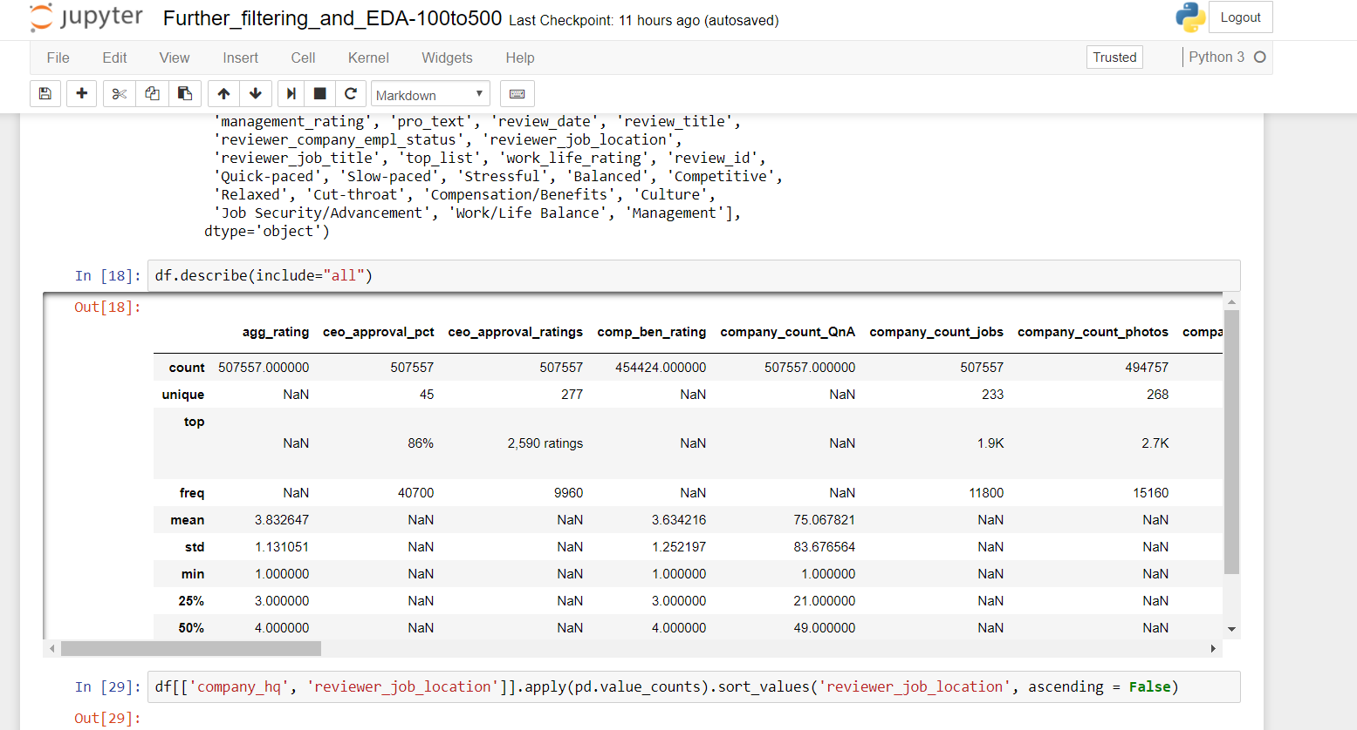
Data cleaning:

Slide 7
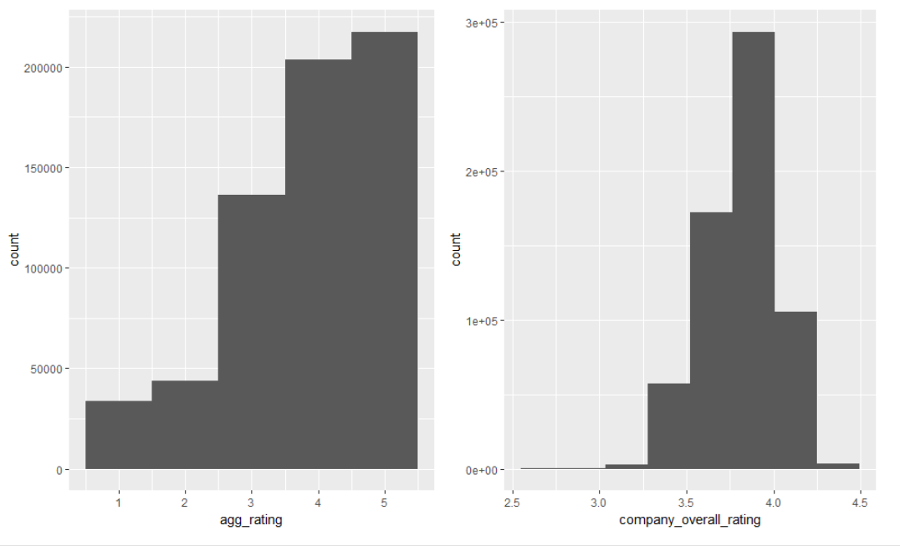
Initial EDA: Count by Review Reviewer rating skews to 5, Company Overall around 3.75

Slide 8
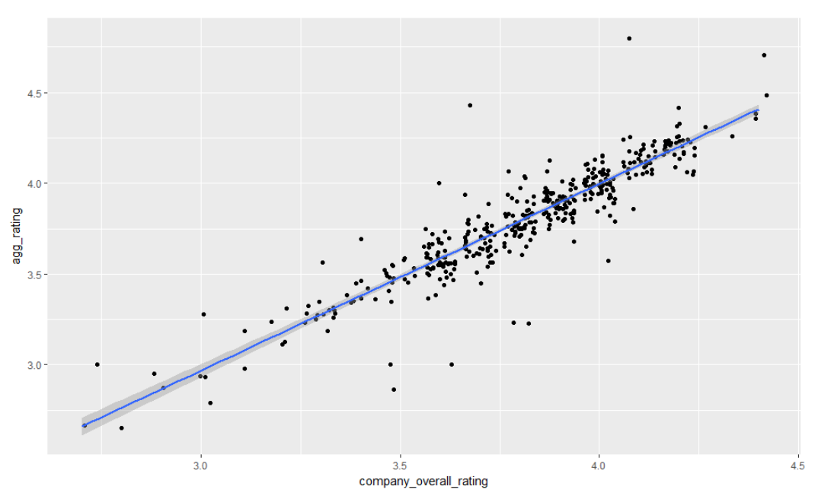
Mean reviewer rating (2016-17) and Company Overall per Company Overview Mostly reasonable, some outliers

Slide 9
Histogram by Stat

Slide 10
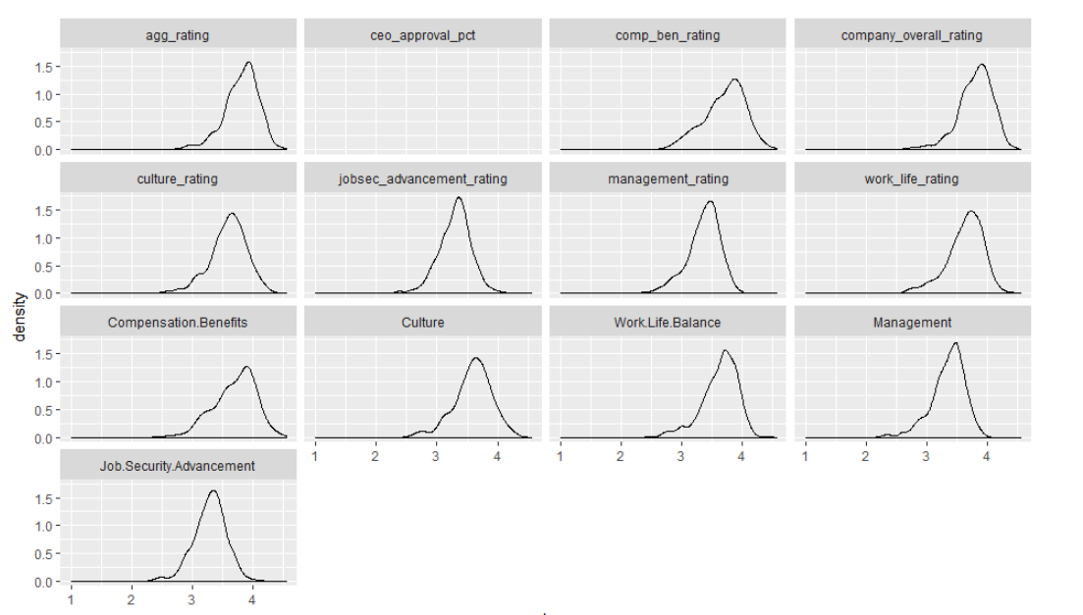
Mean Rating by Company

Slide 11
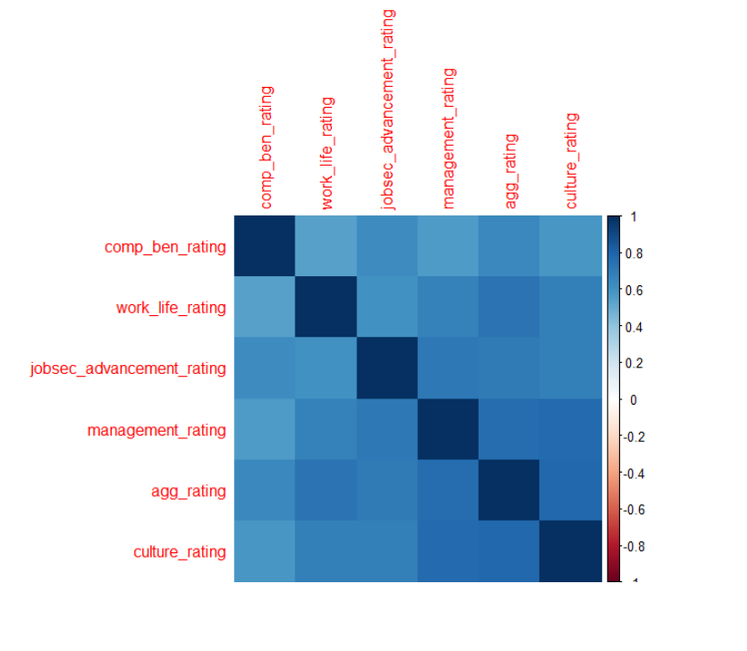
Review score Correlation Plot
- Overall rating (agg_rating) is significantly correlated to work-life balance, management, and culture
- Management, culture and overall rating all correlated

Slide 12
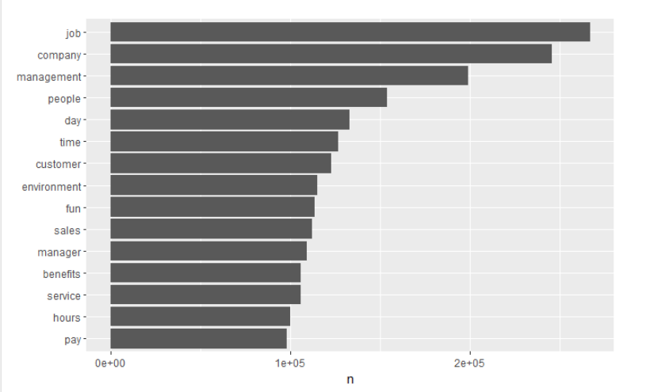
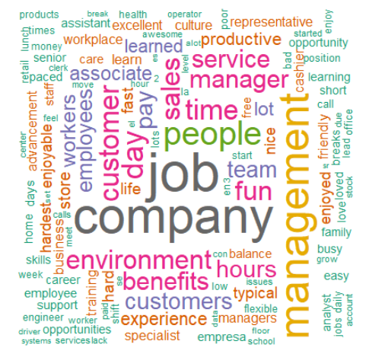
Review Content: Review text = typical workplace jargon

Slide 13
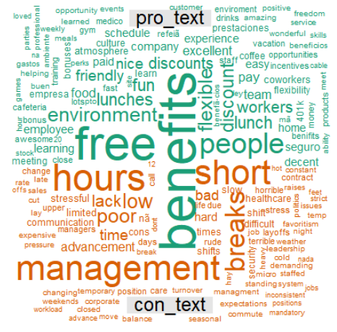
Review Content: Pros and Cons – what matters?

Slide 14
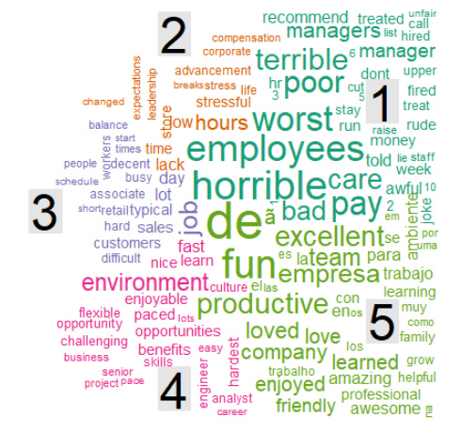
Review Content: Ratings
Los hispanohablantes les gusta su compañía?!

Slide 15
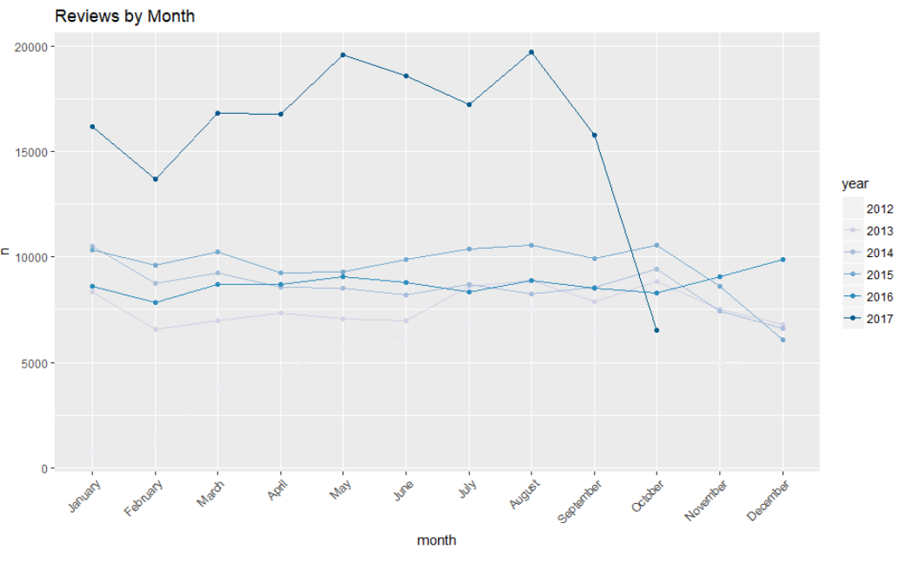
Trends over Time: 2017 reviews outpacing prior years by a wide margin

Slide 16
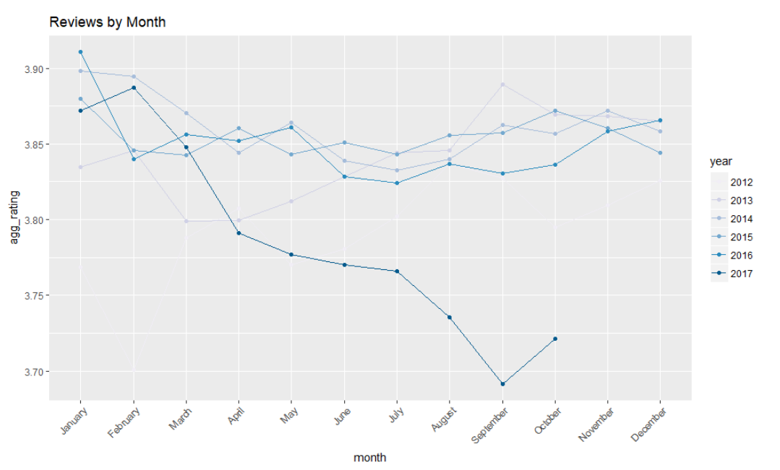
Trends over Time: ..and more negative mean review

Slide 17
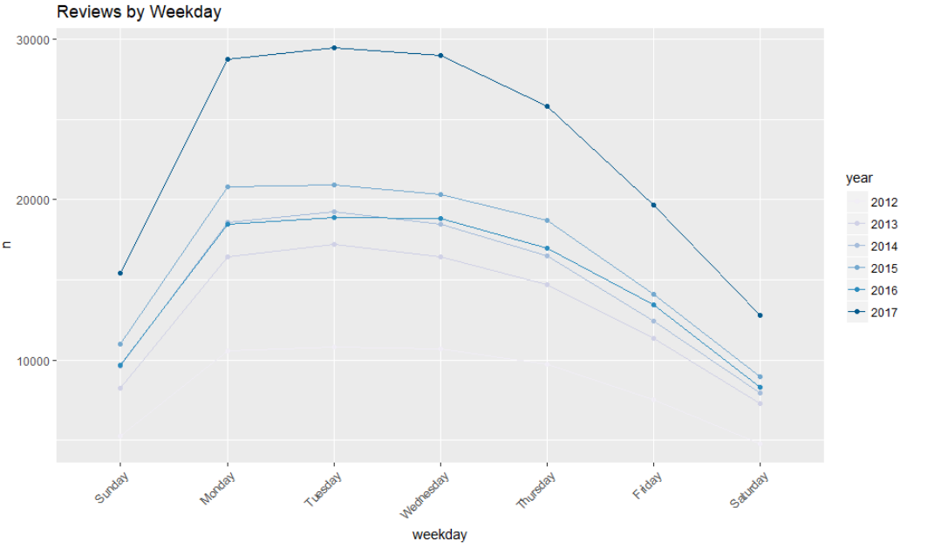
Trends over Time: Lots of reviews Monday to Thursday

Slide 18
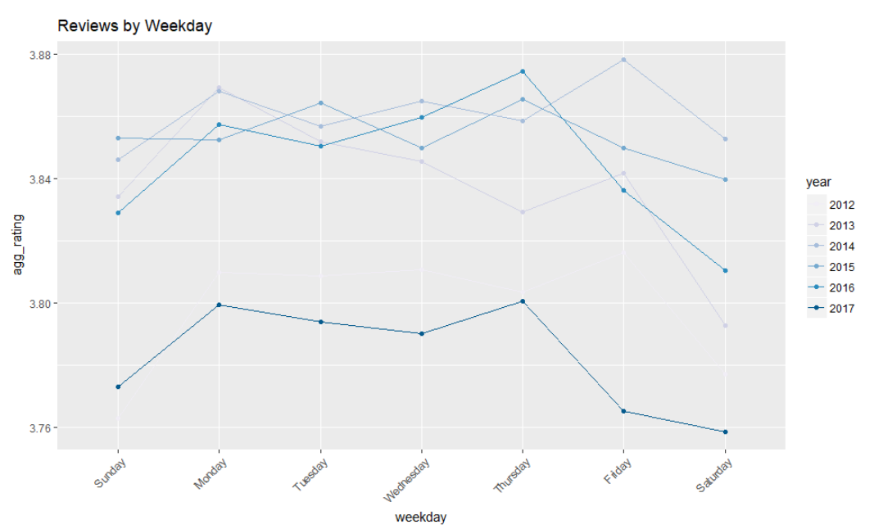
Trends over Time: And fairly happy until the weekend

Slide 19
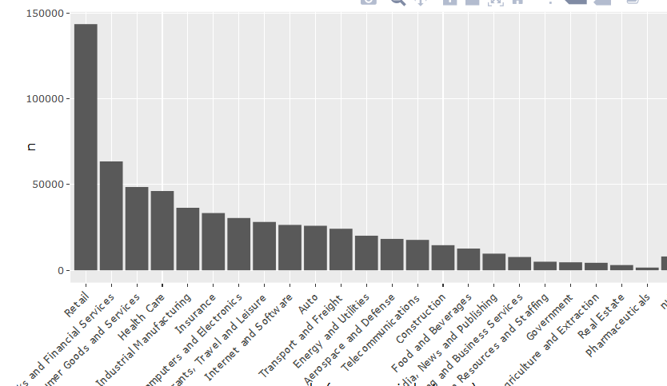
Follow ups:

Slide 20
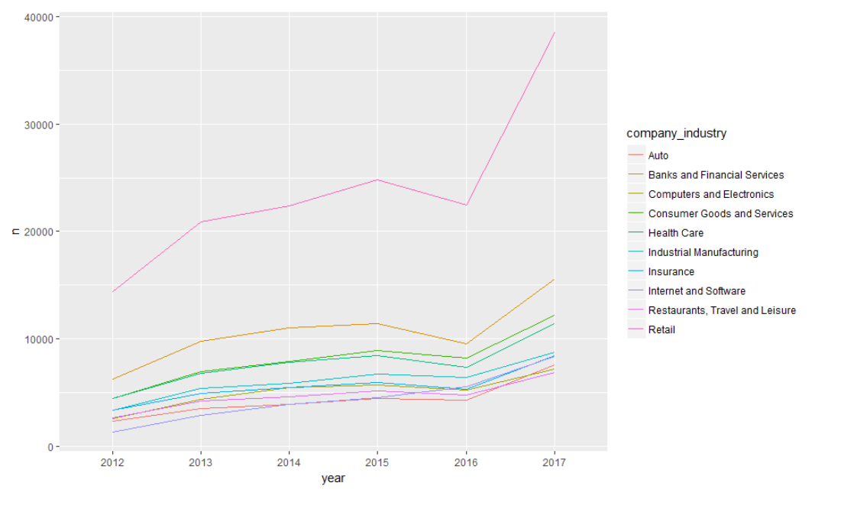
Top 10 Industries: Count of Reviews

Slide 21
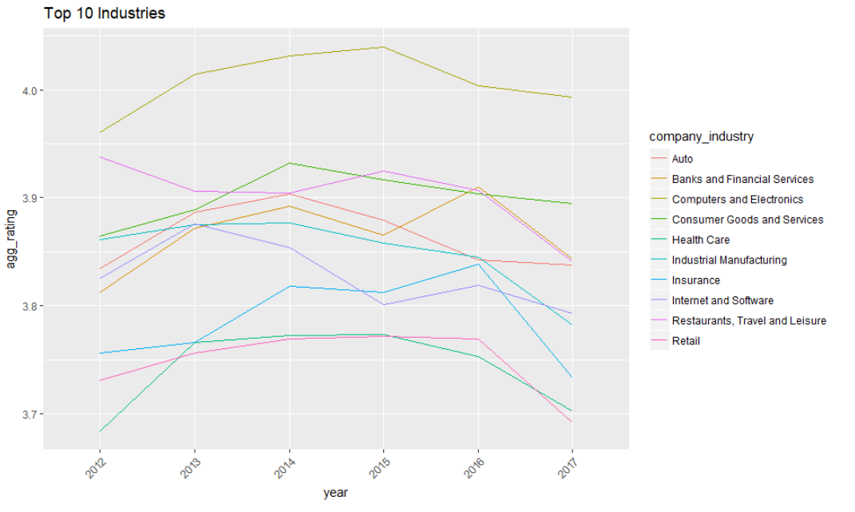
Top 10 Industries: Mean Rating

Slide 22
Follow-ups
- Tie company ratings to other data like stock price
- Drill down into recent trends
- Develop analysis for specific companies
- Further text analysis including sentiment, topic modeling, and other

Slide 23
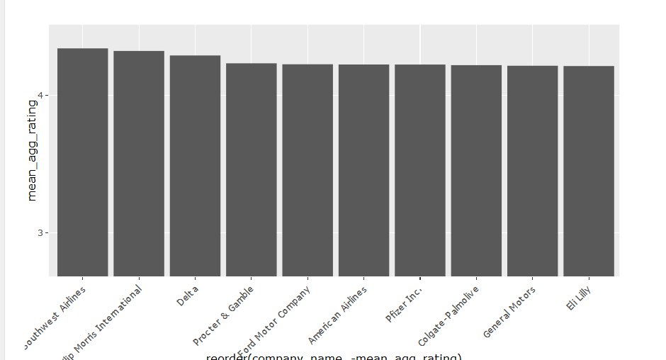
Top 10 Companies: Mean Rating

Slide 24
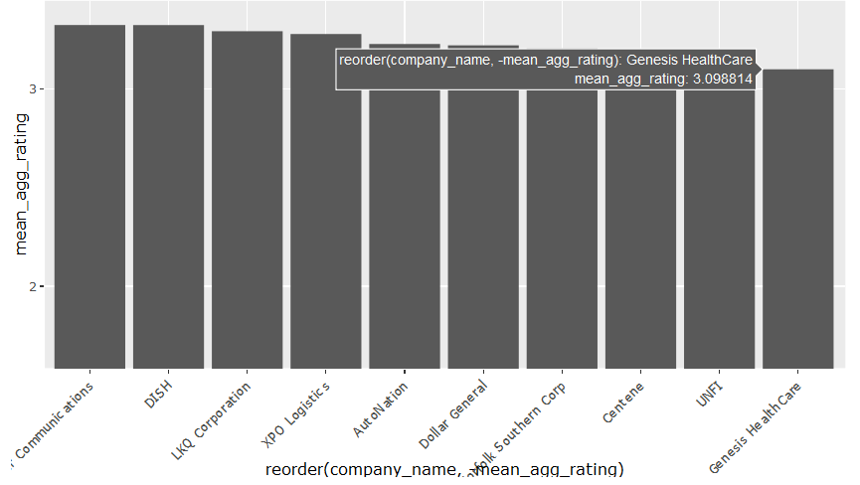
Bottom 10 Companies: Mean Rating

Slide 25
