Slide 1
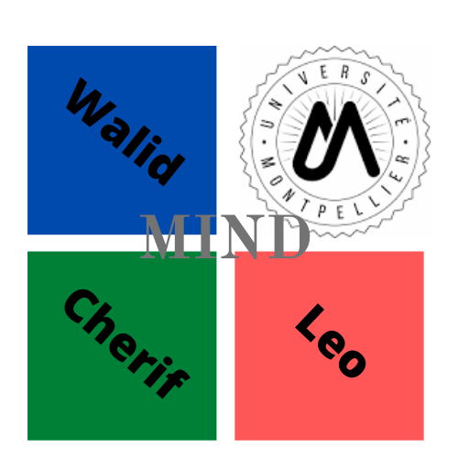
1
Package Billiard
Software development
University of Montpellier
AMAHJOUR Walid
CHAROY-GERARD Léo
AMGHAR Cherif
Directors:
Joseph Salmon
Benjamin Charlier
May 17, 2020

Slide 2
2
Table of contents
Square Case Billiard
Flat Torus Billiard
Elliptic Billiard

Slide 3
3
Our goal is to produce videos and widget representing a ball in a billiard with a simple shape and showing its trajectory.

Slide 4
4
Square case
Hypothesis:
The simple case would be a square billiard, with no friction and satisfying the Descartes rules.

Slide 5

5
Create and opening a window with tkinter
Importation of tkinter
We give a name for our window Billard simulation and
we choose the size 800*600

Slide 6
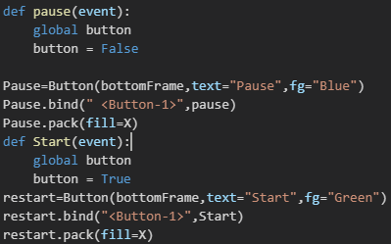
6
Create a button of the window

Slide 7
7
Create a ball

Slide 8
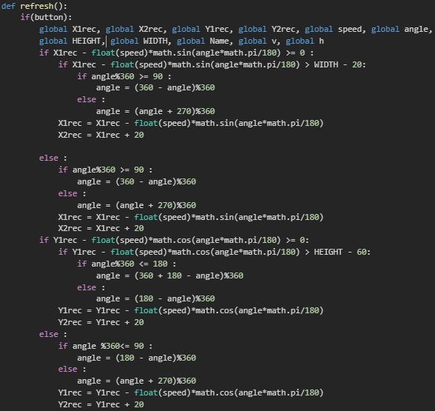
Condition movement
8

Slide 9

9
Now we present and explain the different step in this video

Slide 10
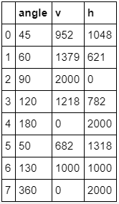
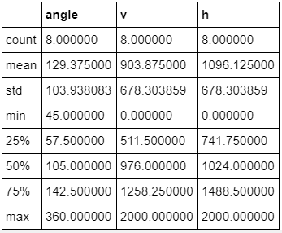
10
Statistic test
Descriptive Statistic

Slide 11
11
Flat Torus Billard
Torus:
In geometry, a torus is a surface of revolution generated by revolving a circle in three-dimensional space about an axis that is coplanar with the circle.

Slide 12
11
Flat Torus Billard
What is a flat torus?
This is a square whose sides are pair wise identified.
As a consequence, an imaginary being living in this square would exit the upper side each time it enters the lower side and similarly for the left and right sides.

Slide 13
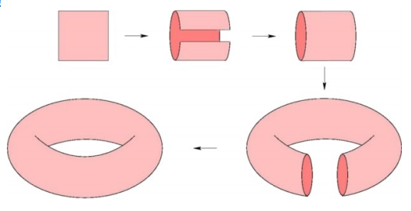
12
What does it mean to visualize a flat torus in three dimensional space?
In order to get a
concrete idea of the square world, let us imagine that the square is made of some soft
deformable material. We can now bend the square in the third dimension so as the upper
and lower sides coincide. We obtain this way a cylinder. We can further bend the cylinder
until its two boundaries are made face to face and can be stitched together. The resulting
object looks like a bicycle inner tube: the square world, although abstract, is nothing more
than a ring buoy!

Slide 14
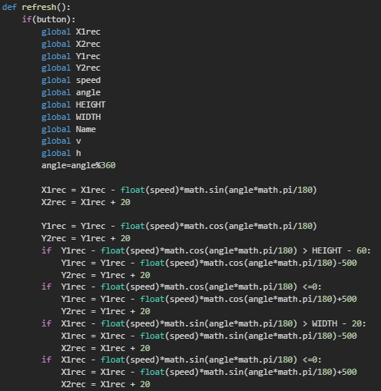
13
Condition movement of a flat torus square

Slide 15
14
Now we present and explain the different step in this video:

Slide 16
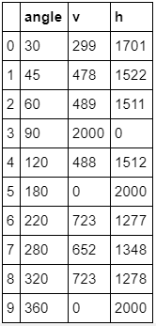
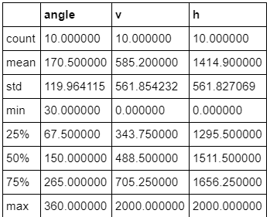
15
Descriptive statistic

Slide 17

16
Elliptic Billiard
Once again, a ball is set free in a stadium, this time of an elliptic shape. No friction will be taken into account. The analytic equation of such curve, surrounding two focal points,
Is ,with a et b being the width and height.
The billiard variables are the initial ball placement, as well as the angle of the first projection. By resolving some quadratic equations detailed in the github, it is possible to predict, given the initial conditions, every future bounce with the curve

Slide 18
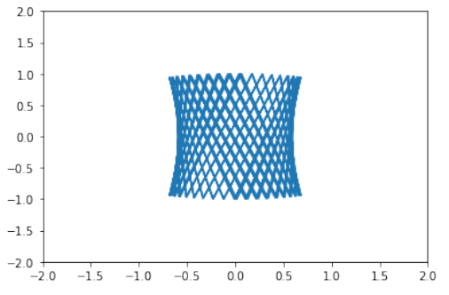
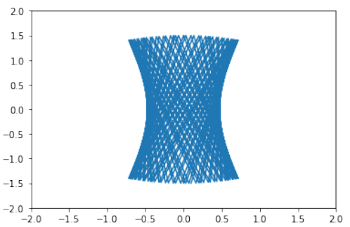
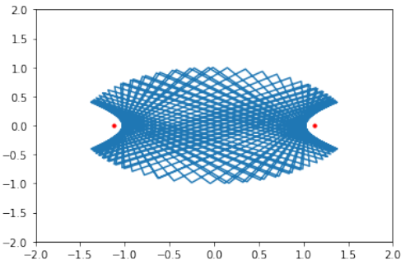
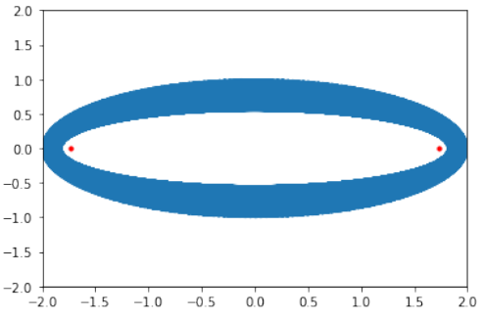
17
The different step to realize an elliptic billiard
On the other hand, considering the vertices of the ellipse, meaning the endpoints of the axis, it is also clear that if the ball first rolls between one focal and one of these vertices, the trajectory will be bound in an annular region bounded by another, smaller ellipse :

Slide 19
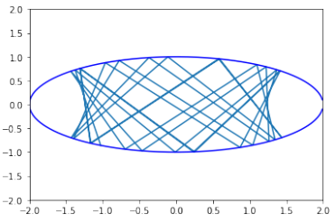
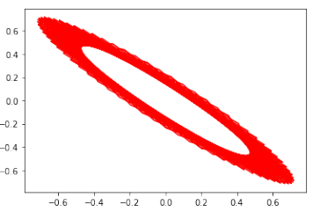
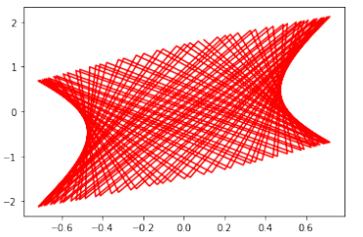
18
By modifying the entry point, these trajectories can occur :

Slide 20
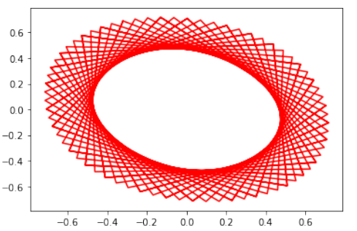
19
One can find multiple interesting shapes by modifying a, b or the initial conditions. Also, observing coordinates relations leads to interesting patterns. For instance, with the same parameters (except 10 times more iterations) as the first figure, plotting following x coordinates brings :

Slide 21
20
A demonstration video with different angle:

Slide 22
21
Obviously, our trajectory is coded by a sequence of values at every bounce, which creates a dynamical and deterministic system. Even if, depending of the ellipse’s shape, the path may be sensible to initial conditions, it remains on a particular curve, and the system can’t be called chaotic. Researches are regularly being made on the periodicity of such systems, given a N number of bounces. We’ll briefly talk about the apparition of chaos, when the initial shape becomes more and more deformed in the presentation.

Slide 23
22
Conclusion
This project allowed us to take a interesting look into the world of dynamical billiards. Using different systems and libraries to code and animate them, we are now equipped to deal with dynamical systems as a whole much more confidently. These systems being linked to many areas of research and applications (chaos, logistic maps), it has clearly been an very useful take and study.
Fore more details: https://github.com/amahjourwalid/projet_billard

Slide 24
23
Sources
Repo for the course HMMA238 'Software Development‘
Tkinter documentation
Matplotlib documentation
Seaborn documentation
https://scipython.com/book/chapter-7-matplotlib/examples/a-torus/

Slide 25
24
Thank you for your attention

