Slide 1
Home automation Documentation

Slide 2
Software
Home Assistant (https://home-assistant.io)
01
Pilight (https://pilight.org)
02
Python 3
03

Slide 3
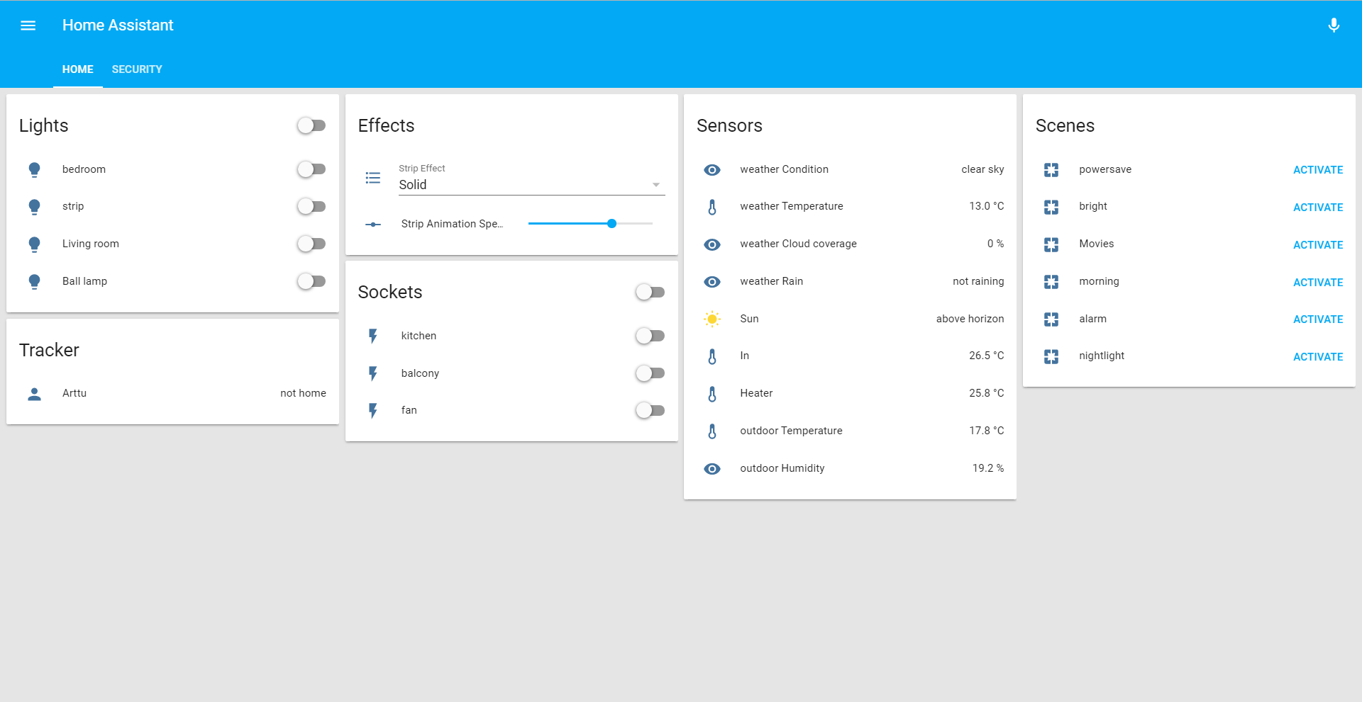
Web Interface

Slide 4
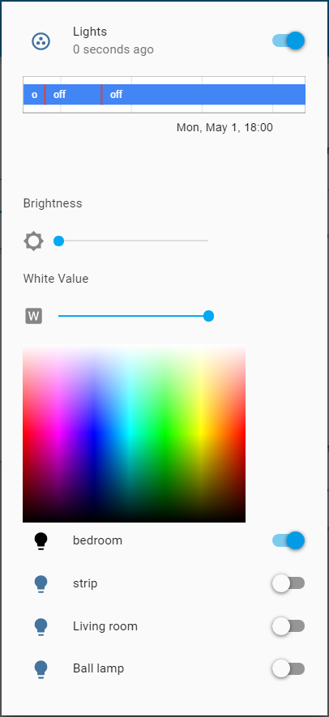
Light control panel
Allows control off all lights in a same group
Synchronizes Color and brightness settings of the lamps
Allows for synchronized effects and fades

Slide 5
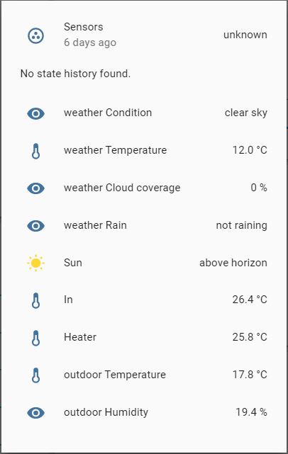
Sensor panel
Shows readings of grouped sensors in a simple, easy read panel
Supports multiple types of sensors

Slide 6
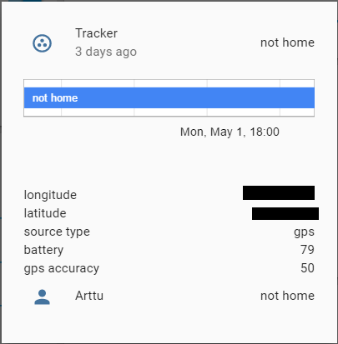
Device Tracker panel
Shows the last known status of a tracked device
Device tracker can be used to trigger automations
Supports multiple devices

Slide 7
Hardware
Raspberry Pi 2 B+
Generic 433 Mhz Transmitter and receiver
DHT22 Temperature and Humidity sensor
USB Bluetooth dongle with LE Support
DS18B20 Temperature sensors
IR-Leds
Wifi Dongle

Slide 8
Controlled devices
Sonoff wireless relays X2 – 5€ (Wi-Fi)
433 Mhz remote controlled outlets x3 – 10€
Digital led strip with Arduino Yün (Wi-Fi)
Mipow smart bulb – 12€ (BTLE)
Wireless Camera (Wi-Fi)
Chromecast – 30€
Possible to control televisions and other devices using IR

Slide 9
Mipow Smart bulb control component
There was no pre-existing component to control any Bluetooth LE lamps on home assistant when I first started using it
So, why not make one for the lamp that I have
With the help of the Open source community of home assistant, I started making the component using python 3
After a while, I ended up making a python module published in Python Package Index (https://pypi.python.org/pypi/mipow) And a separate component for home assistant using the module
Source code for the module is available at https://github.com/amahlaka/python-mipow

Slide 10
Digital LED strip with Arduino Yün
5 meter long strip of ws2812b addressable LED’s
Each led is its own “unit” that can change its color independently of other units, allowing for 1-Dimensional “animations” and effects to be created
Controlling the strip happens using only 1 wire, saving I/O Pins on microcontrollers like Arduino Yün
I chose to use Arduino Yün for the control, because it has built in Wi-Fi connectivity support
Communication between Home assistant and Yün happens using MQTT protocol
The strip takes in 12 Volts and Arduino Yün takes 5 Volts, so I had to add a step-down converter to the circuit
There is 5 Volt versions of the strip available, but their brightness is noticeably lower

Slide 11
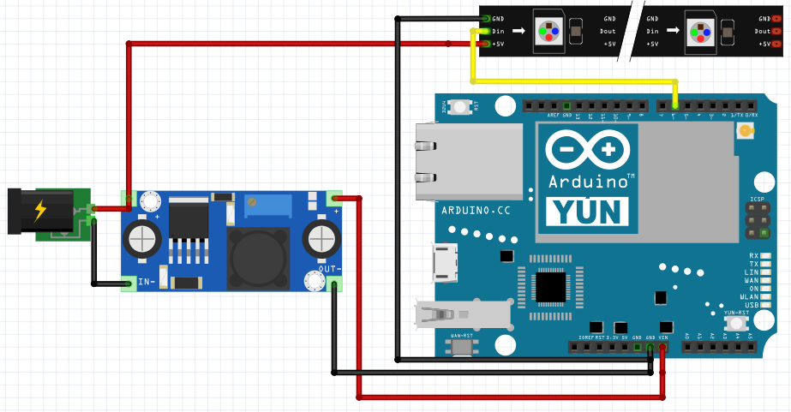
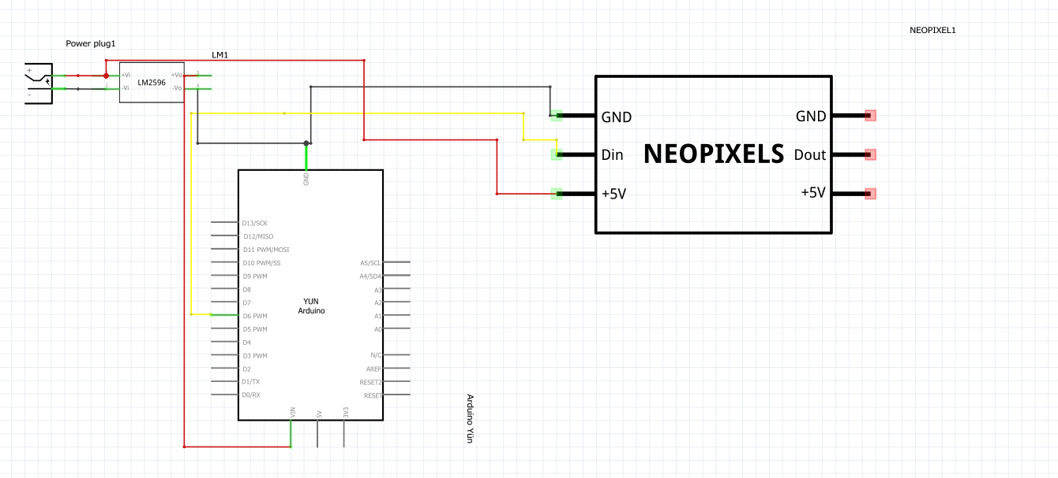
Digital LED strip with Arduino Yün – Schematics

