Slide 1
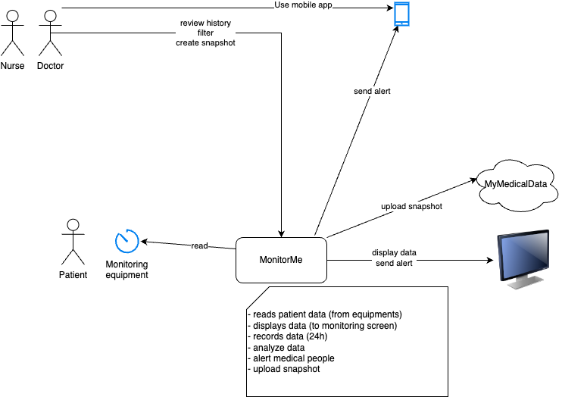

Slide 2

personel
doctor
MyMedicalData
MonitorMe Dashboard
MonitorMe App
snapshot creator
Patient DB
Notification creator
Signal DB
displays
patient
sign analyzer
(per type but using all signals)
MonitorThem
store
vital sign input device
vital sign
collector
(per patient and type)
send signal

Slide 4
